Slide 1
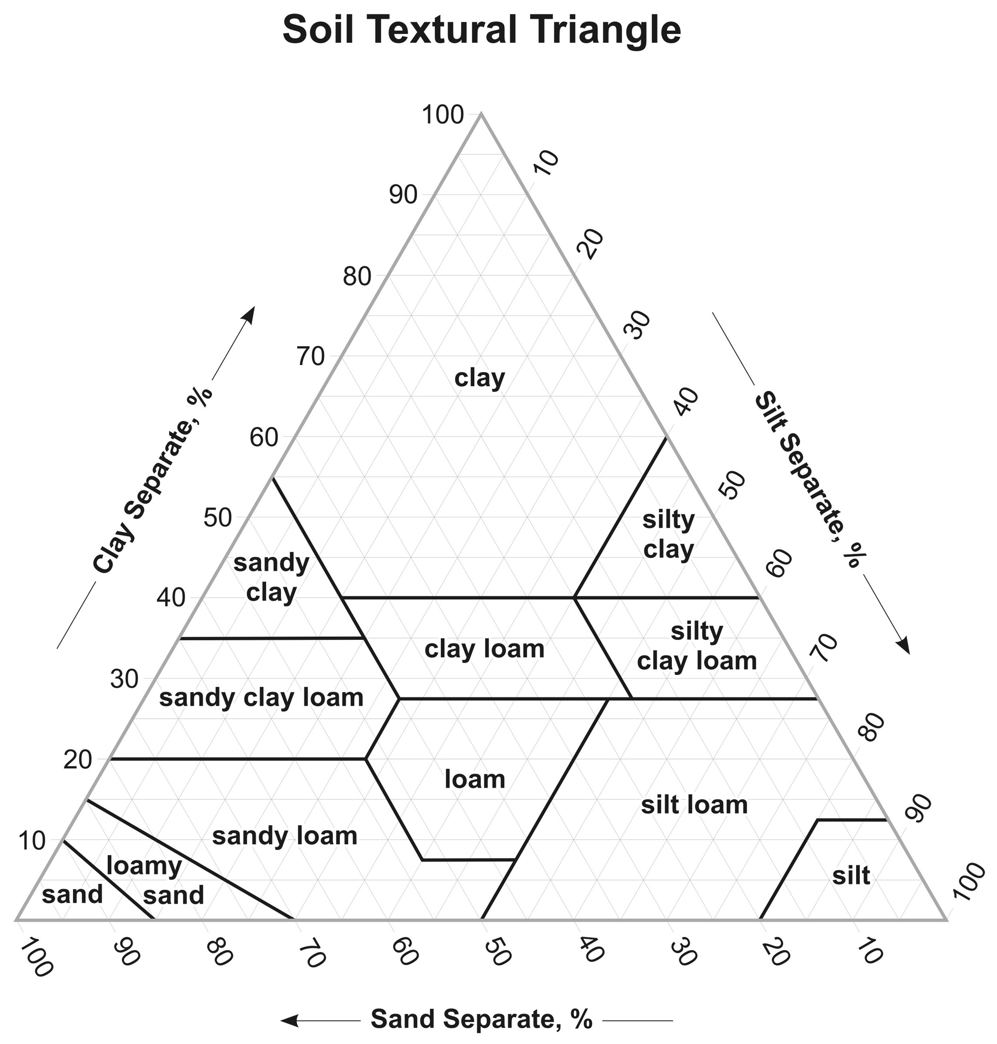

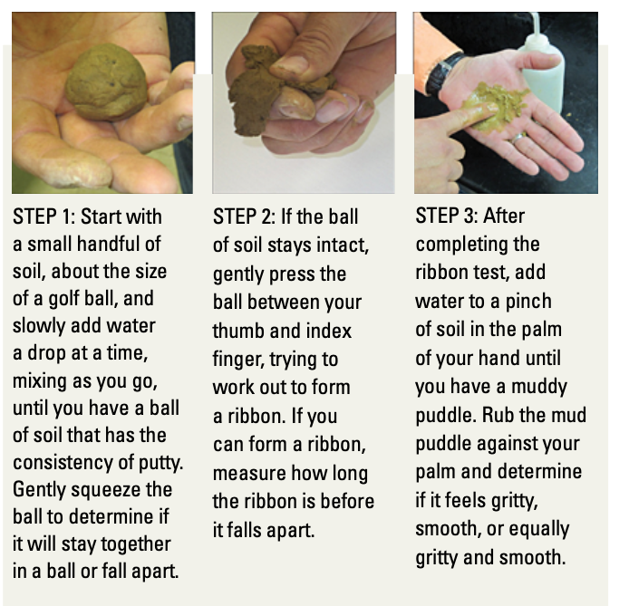

Three Sisters Project: Quick Soil Guide for Home Garden Health
In order to help mange a home garden, its best to know what soil conditions you are starting with. Soil texture can help determine where to begin. Texture can influence aeration, available water content, and nutrient availability.
Its important to remember that texture can’t be changed, but structure is a dynamic property that can be altered with management. However, texture influences how we can manage the soil, these changes won’t occur over night or even one growing season. It’s best to be consistent and mindful of how your garden soil is doing.
Let’s start by collecting a representative soil sample from your garden. Scan the code below for a tutorial video on collecting a soil sample. Once you have your sample collected, start with step one below, and continue with the flow chart on the back. Continue with steps two and three.
Prepared by the Iowa State Three Sisters Team
Scan to get started!
Source: Ritchey et al., 2015
Table 1. | Sand | Silt | Clay
Water holding capacity | Low | High | High
Feel when moist | Coarse/gritty | Floury/soft | Sticky
Desirable properties for plants | Aeration | Available water | Nutrient holding capacity
Source: Anderson et al., 2021

Slide 2
