Slide 1
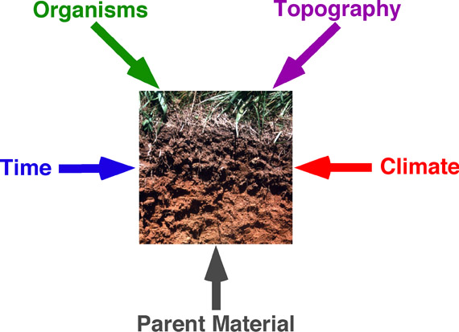
5 Soil Forming Factors − ClORPT
Cl = Climate
O = Organisms
R = Relief (or Topography)
P = Parent Material
T = Time
H = Humans ???

Slide 2
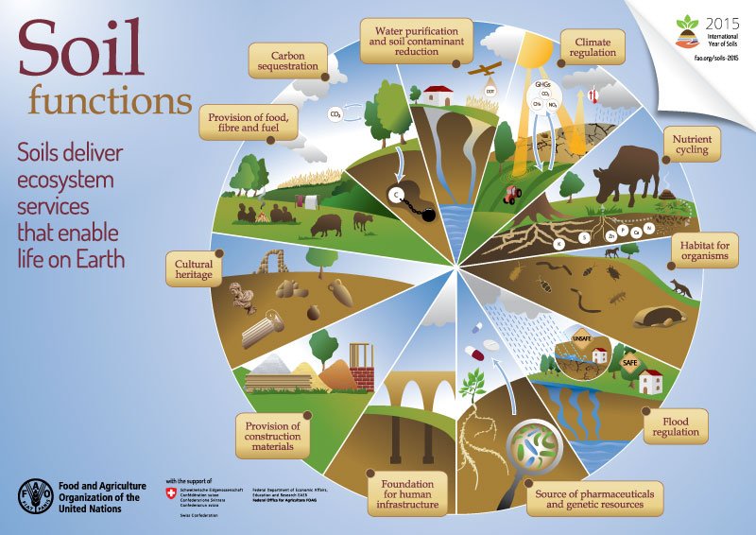

Slide 3
Human Health
Soil Health
“Health is the level of functional and metabolic efficiency of a living organism. In humans it is the ability of individuals or communities to adapt and self-manage when facing physical, mental, psychological and social changes with environment”
- Wikipedia
“Soil health, also referred to as soil quality, is defined as the continued capacity of soil to function as a vital living ecosystem that sustains plants, animals, and humans.”
- Natural Resource Conservation Service (NRCS)
Only living things
can be “healthy”
Soil Tilth → Soil Quality → Soil Health

Slide 4
How can we increase soil health?
Control traffic on soil
Minimum tillage
Manure use
Cover crops
Increase residue cover
Crop rotations – increase crop variety (i.e. diversity)
Rule of Thumb – Anything that increases soil biological activity!

Slide 5
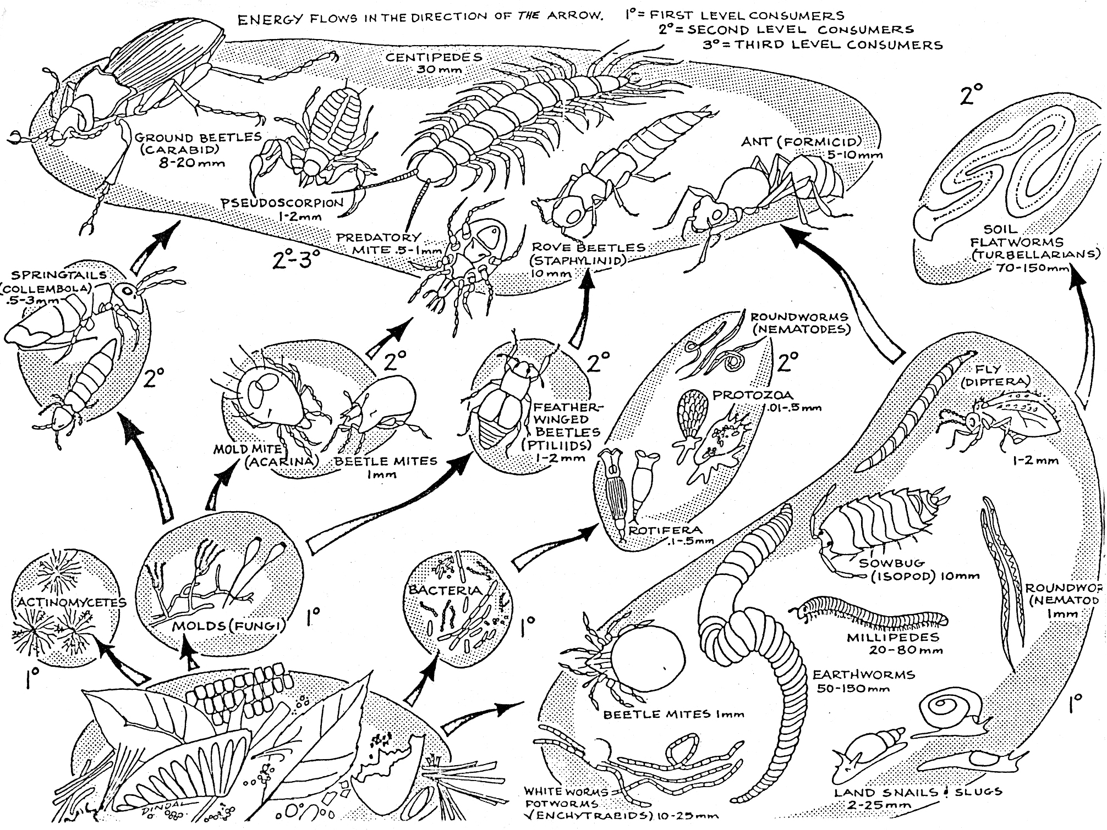
The “living” SOM

Slide 6

Who’s in our soil?
* 8,000 lb. elephant
Soil Flora or Fauna | Size (mm) | Numbers (per g of soil) | Biomass (lbs. / ac) | Elephants* (per acre)
Viruses | 0.0002 | 10¹⁰ – 10¹¹ | ???
Bacteria & Archaea | 0.001 | 10⁹ – 10¹⁰ | 400 – 4,500 | 0.30
Actinomycetes | 0.001 | 10⁷ – 10⁸ | 500 – 4,500 | 0.30
Fungi | 0.008 | 10 – 10³ m | 800 – 13,000 | 0.89
Algae | 0.013 | 10⁴ – 10⁵ | 10 – 500 | 0.03
Protista | 0.050 | 10² – 10⁶ | 20 – 300 | 0.02
Nematodes | 1 | 10¹ – 10² | 10 – 300 | 0.02
Mites | 0.5 | 1 – 10 | 1 – 500 | 0.03
Collembola | 1 | 1 – 10 | 1 – 500 | 0.03
Earthworms | 100 | NA | 50 – 3,500 | 0.23
TOTAL = |  |  | 1,800 – 27,600 | 1.86
From Nature & Property of Soils (Brady & Weil), and other sources

