Slide 1
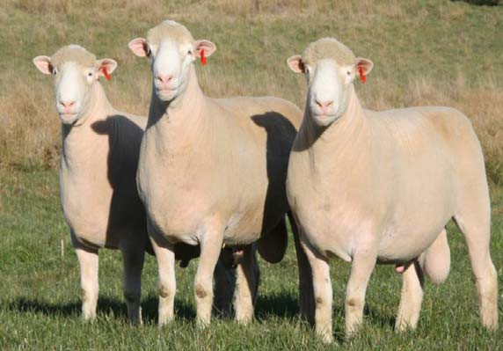




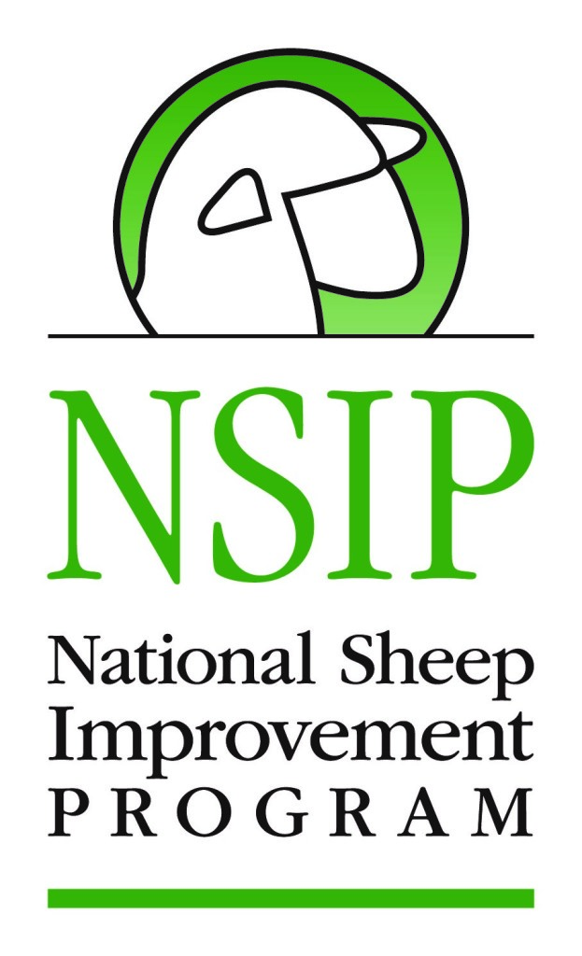



Attention: Sheep & Meat Goat Seedstock Producers
National Sheep Improvement Program (NSIP) Workshops
March 1-11, 2017 in VA, WV, PA, MD
Getting Your Genetics Right: Converting Performance Records into Relevant Decision-Making Tools
Workshop Topics
Defining and ranking of traits
How genetic information, estimated breeding values (EBV), can assist in improving performance traits
Selection for parasite resistance in pasture raised sheep and goats
Development of breeding objectives and approaches to selection of breeding animals
Fecal egg count and live ultrasound demo
What is an EBV worth?
Enrolling and using the NSIP System
Speakers:
Russell “Rusty” Burgett, NSIP Program Director
Dr. Anne Zajac, Parasitologist, Virginia Tech
Dr. Katherine Petersson, Univ. of Rhode Island
Melanie Barkley, Penn State Ext & NSIP member
March 3 – 10:00-4:30, Wardensville, WV. West Virginia Univ. Reymann Memorial Farm. 1695 State Rd, 259N. Contact: Dr. Marlon Knights, marlon.knights@mail.wvu.edu, 304-293-1946
March 4 – 9:00-3:30, Kearneysville, WV. West Virginia Univ. Jefferson County Ext Office. 1948 Wiltshire Rd. Contact: Emily Wells, emily.wells@mail.wvu.edu, 304-728-7413
FREE REGISTRATION (LUNCH PROVIDED), PLEASE CONTACT INDIVIDUAL LISTED ABOVE FOR EACH LOCATION
These workshops are being conducted as part of a Northeast SARE project (LNE15-342) entitled, New Approaches for Improving Integrated Parasite Control Strategies for Small Ruminants in the Northeast. http://web.uri.edu/sheepngoat/.
This work is supported by the USDA National Institute of Food and Agriculture (NIFA) Northeast Sustainable Agriculture Research and Education Program Project LNE15-342 and USDA NIFA Hatch Project 1007290. The University of Rhode Island provides equal program opportunity.

