Slide 1
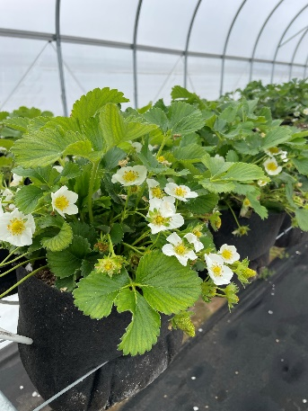
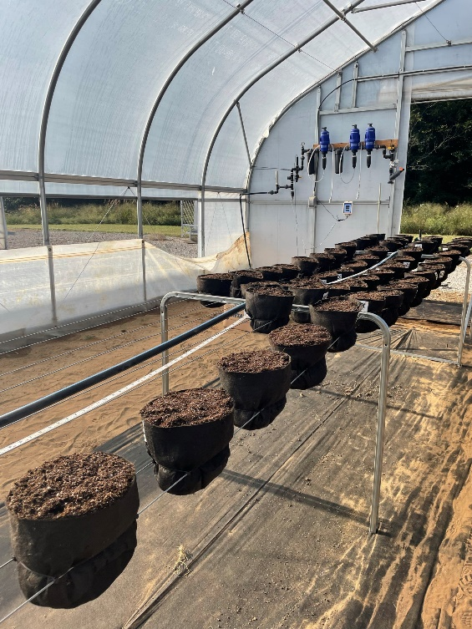
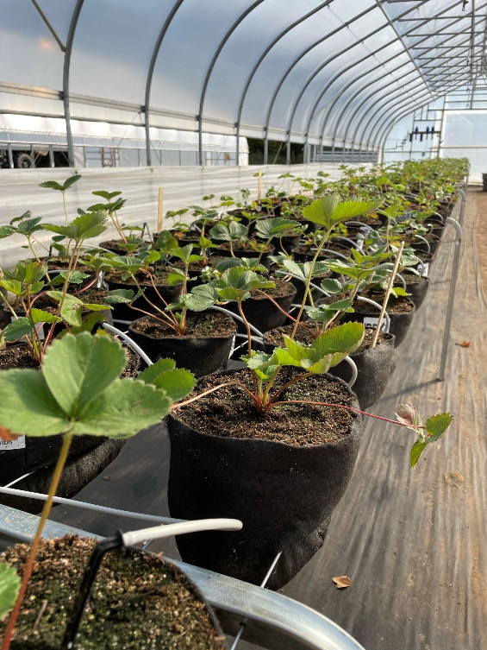
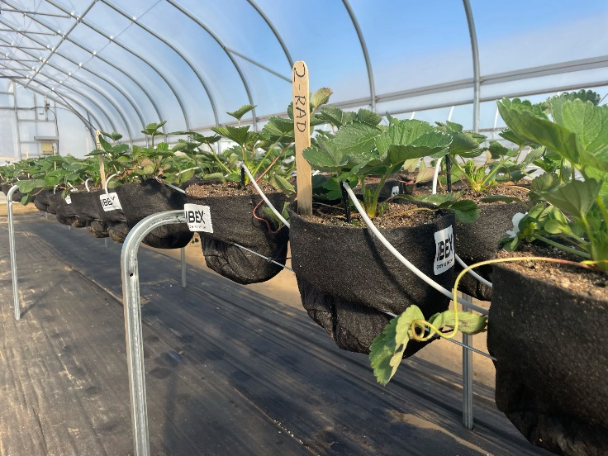
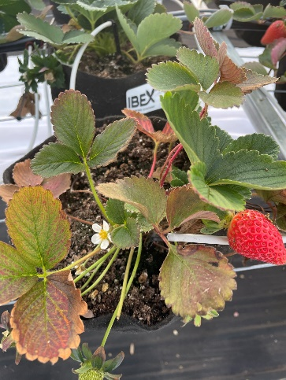
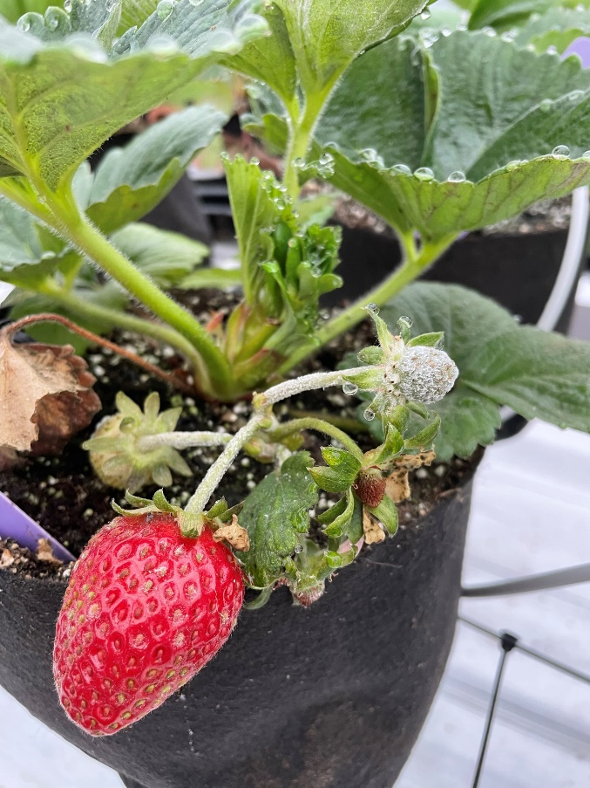
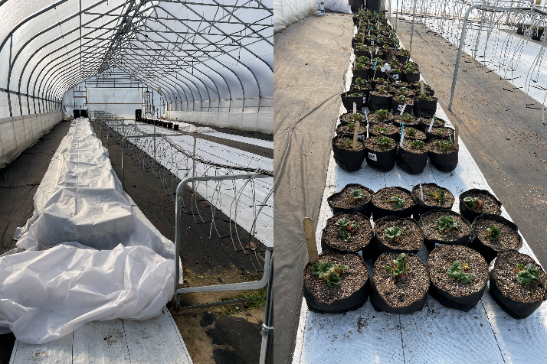
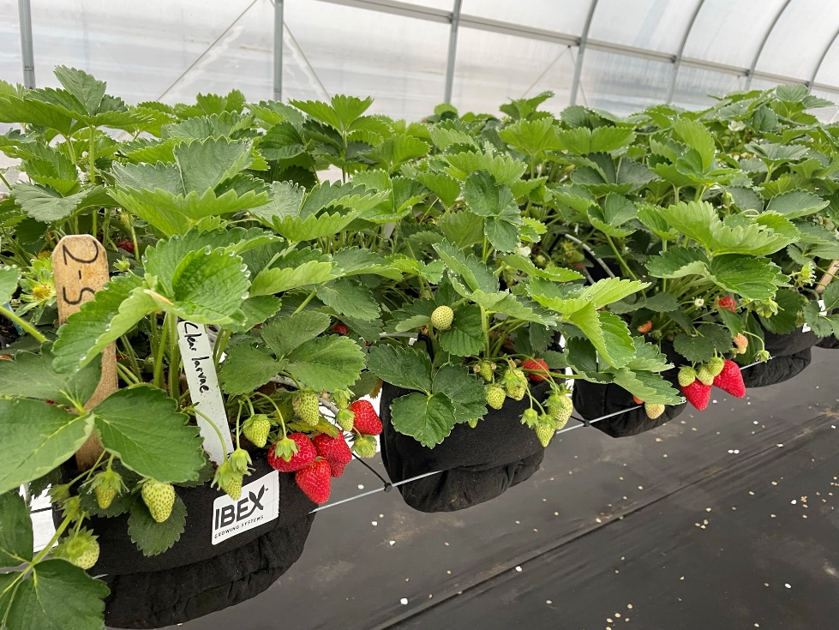
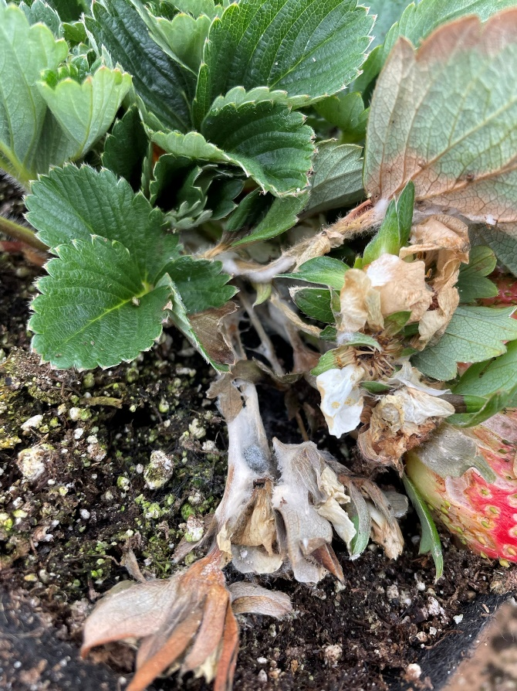
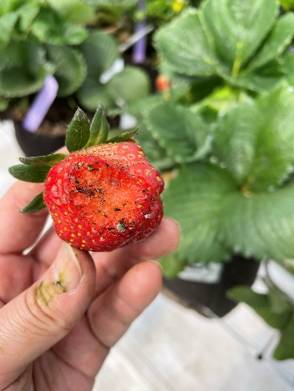
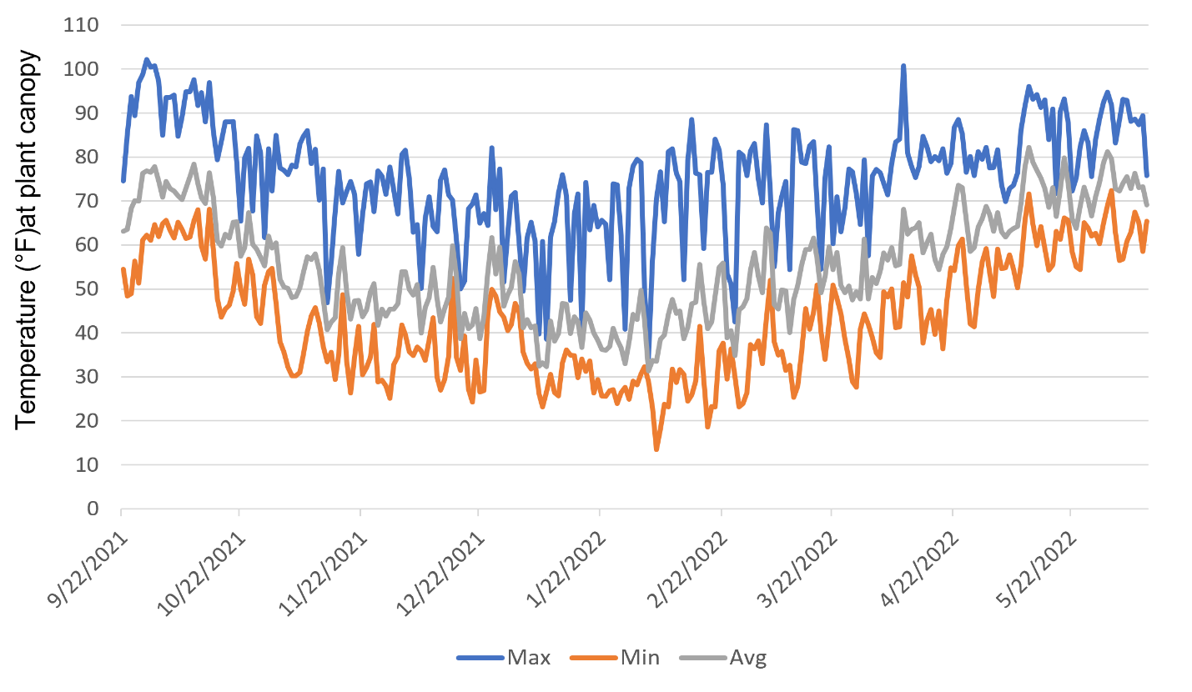
A Case Study of Strawberry Production in an Elevated Bench Growing System Inside a High Tunnel in Southern Indiana
Wenjing Guan¹ (guan40@purdue.edu), Dean Haseman¹, Laura Ingwell², Samantha Anne Willden², Dan Egel³
^{1.} Department of Horticulture and Landscape Architecture. Purdue University, 4369 North Purdue Rd, Vincennes, IN 47591.
^{2.} Department of Entomology, Purdue University, 901 W State Street, West Lafayette, IN 47907
^{3.} Department of Botany and Plant Pathology. Purdue University, 4369 North Purdue Rd, Vincennes, IN 47591.
Introduction
Yield. Marketable yield of evaluated cultivars ranged from 0.6 to 1.15 lb/plant. Cultivars Monterey had ripened fruit the earliest. Day-neutral cultivars and low-chilling short-day cultivars had ripened fruit in the fall. The fall yields, however, were less than 10% of the spring yields except for ‘Monterey’.
‘Sweet Charlie’ and ‘Florida Radiance’ started to produce fruit the earliest in the spring, around the middle of April.
The top yielding cultivars were ‘Florida Radiance’, followed by ‘San Andreas’ and ‘Florida Sensation’
Table 1. Fall and whole-season yields
Cultivar | Fall Yield |  |  |  | Whole-season Yield
 | Weight (lb/plant) |  | Fruit No. per plant |  | Weight (lb/plant) |  | Fruit No. per plant
Florida Radiance | 0.03 | c | 0.61 | cd | 1.15 | a | 40.3 | ab
San Andreas | 0.06 | abc | 1.8 | b | 1.09 | ab | 37.4 | bc
Florida Sensation | 0.08 | a | 1.5 | bc | 0.94 | abc | 28.5 | de
Monterey | 0.09 | a | 3.36 | a | 0.91 | bcd | 27.5 | e
Chandler | 0 | d | 0 | d | 0.82 | cd | 45.5 | a
Sweet Charlie | 0 | d | 0 | d | 0.77 | cde | 33.4 | de
Florida Brilliance | 0.07 | ab | 1.5 | bc | 0.71 | de | 26.2 | e
Albion | 0.05 | bc | 1.34 | bc | 0.60 | e | 18.7 | e
Locally produced strawberries have excellent market potential. Farmers are exploring different systems for growing strawberries in Indiana. Compared to open-field production, protected culture extends the production season and reduces the risk of unpredictable and deteriorating weather. Greenhouse production is attractive, but the high initial cost of building greenhouses with advanced environmental control is prohibitive to most small-scale farmers. High tunnels are a low-cost, plastic-covered structure that provides an intermediate level of environmental protection and control. Growing strawberries in-ground inside a high tunnel can extend the early-season harvest, increase yield, and reduce production risks compared to open-field production in the region. However, in-ground production is limited by poor soil quality and the potential build-up of soilborne diseases. Soils inside high tunnels, especially those in tomato production for multiple years, tend to build up salt and have high pH, which is unsuitable for strawberry production. Substrate production overcomes these soil challenges. Additionally, it makes growing strawberries on an elevated system possible, which improves harvesting efficiency and reduces physical strain on farm workers.
Objective of this study is to evaluate the performance of eight strawberry cultivars grown in an elevated bench system. Yield and quality parameters were measured. This report also includes a discussion on production challenges and economic considerations of this production system.
Fruit Quality. ‘Chandler’ and ‘Monterey’ had the highest total soluble solids, while ‘Florida Radiance’ and ‘Florida Sensation’ had the lowest soluble solids
Materials and Methods
Plant Health. Interveinal chlorosis (Fig.4) was observed toward the end of Mar. The symptom was most pronounced in ‘Chandler’. Analyzing individual nutrient contents of leaf samples revealed Copper, Ion, and Zinc levels were the lowest on ‘Chandler’. The nutrient disorder was likely caused by elevated growing medium pH that increased from 6.9 to 7.8 by the end of Mar. The nutrient disorder may have negatively affected strawberry yield, particularly for ‘Chandler’.
‘Chandler’ plant leaves showed interveinal chlorosis symptom as growing medium pH increased in the season.
- A commercial strawberry growing system (IBEX Growing Systems, Fort Wayne, IN) was used in the study. The system was built inside a high tunnel at Southwest Purdue Agricultural Center in Vincennes, IN in fall 2021
- The bags were filled with peat-based growing medium (Pro Mix HP Soilless Potting Mix).
Diseases and Insect Pests. - Cultivar Florida Brilliance started to show a decline in Nov. Neopestalotiopsis sp. was isolated from the declined plants.
- Powdery mildew (Podosphaera aphanis) occurred in fall of 2022. The symptoms were observed on leaves, runners and fruit. ‘Monterey’ had the highest disease rating.
- White mold (Sclerotinia spp.) was observed in the winter. The damaged tissues were cleaned before plant regrowth in the spring. No additional damage was observed in the spring.
- Gray mold (Botrytis cinerea) affected a few fruits lying on the growing medium. Gray mold pressure in general was low in the trial.
- Fungus gnats caused damage on ripening strawberry fruit when the fruits directly contacted the growing medium
- Aphids and twospotted spider mites (TSSM) were major pest problems in the spring. Predatory mites (Phytoseiulus persimilis PLUS, Arbico organics, Oro Valley, AZ) was applied in early May aimed to suppress twospotted spider mites (TSSM).
- Eight strawberry cultivars (McNitt Growers, Carbondale, IL) were evaluated, including: Albion, San Andreas, Monterey, Florida Radiance, Florida Sensation, Florida Brilliance, Chandler and Sweet Charlie
- Strawberry plugs were planted on 20 Sep. 2021,
- Bags were placed on the ground inside of the high tunnel and covered with a 1.5-oz thickness floating row cover in the winter
-Harvest was conducted once a week from 15 Oct. to end of Nov. 2021, and then every two weeks until 3 Jan. 2022. Spring harvest began on 14 Apr and lasted until 10 June.
Plant decline caused by Neopestalotiopsis sp
Powdery mildew
Results
White mold
Damage caused by fungus gnats
Conclusion
Temperature. Average temperatures were between 60 to 80 °F in the first month after transplanting and stayed between 40 to 60 °F afterward before plants were placed on the ground. During the period when plants were covered with floating row covers on the ground, the average temperatures at the plant canopy were between 30 to 50 °F. The lowest recorded temperature at plant canopy was 14 °F on 5 Feb. The average canopy temperature was around 50 °F when plants were placed back onto the bench system and increased to above 70 °F around the middle of May.
- Economic feasibility is the main barrier to adapting the system.
- Strawberry yield ranged from 0.6 to 1.15 lb/plant. Better management of root zone pH and disease and insect pests might achieve a higher yield.
- The primary production season in this study was between the middle of April and early June. The system is more likely to work economically if yields in the fall season can be improved.
- The Harvest in this study ended on 10 June 2022 because of high temperatures inside the high tunnel. Harvest may continue if shade cloth is used for the high tunnel. It is also possible to continue the harvest of day-neutral cultivars into the 2022 fall season.
Table 2. Partial variable costs of a 100’ bench system (400 plants total)
Item | Quantity | $/Unit | Total ($)
Assembled drip stakes | 400 | 1.85 | 740
One- gallon fabric grow bag | 400 | 1.58 | 632
Pro Mix HP Soilless potting mix 38 cu. ft. | 8 | 37 | 296
Jack’s 25-9-17 Berry Special fertilizer (25lb) | 0.5 | 70 | 35
Strawberry Plugs | 400 | 0.35 | 140
Total |  |  | 1843
Additional information of this research can be found in the Midwest Vegetable Trial Report https://docs.lib.purdue.edu/mwvtr/246/
This material is based upon work supported by the USDA National Institute of Food and Agriculture under award number 2021-38640-34714 through the North Central Region SARE program under project number LNC21-454. This work is also supported in part by the Specialty Crop Research Initiative (SCRI) [grant no. 2021-51181-35858/project accession no. 1027430] from the USDA National Institute of Food and Agriculture.

