Slide 1
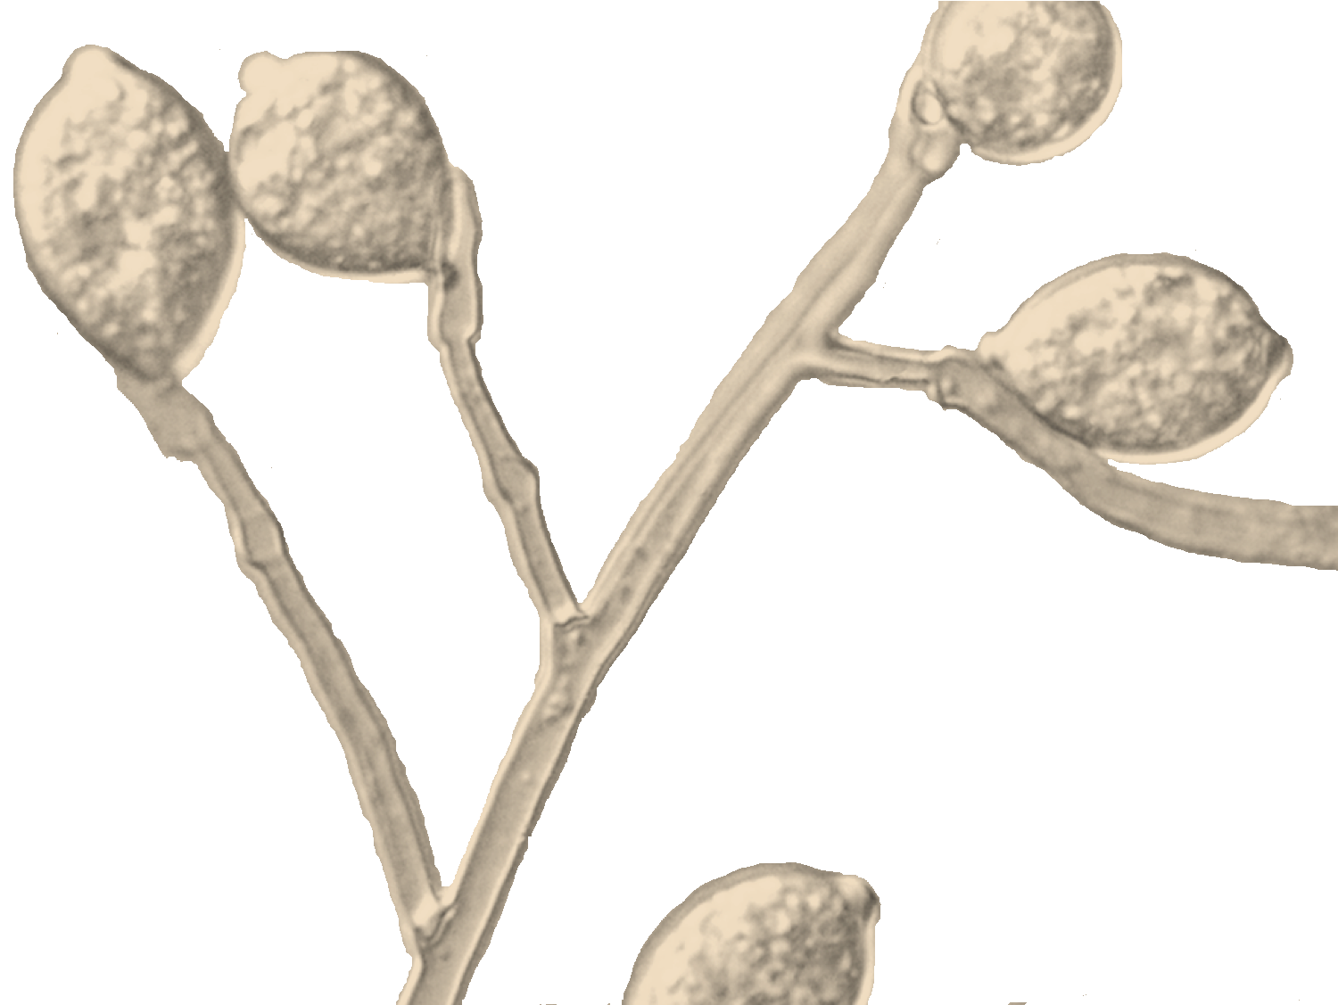
Genetic architecture of complex traits of Phytophthora infestans through genome-wide association mapping
Danies, G., Romero-Navarro, J.A., Gonzalez-Garcia, L.N., Myers, K., Bevels, E., Bond, M., Wu, Y., Restrepo, S. and Fry, W.E.
APS Annual Meeting
Pasadena, California, U.S.A.
August 3, 2015

Slide 2
Genotypes of P. infestans in USA from
1997 to 2014 (potato and tomato)
Lineages
(371)
(59)
(68)
(198)
(284)
(174)
(160)
Phytophthora infestans isolates collected in USA
*
Year
*Fry lab; Hu et al., 2012 Plant Disease; and Wangsomboondee et al., 2002 Ecology and Population Biology
Notes:
Is there information prior to 2009?

Slide 3
Genotypes of P. infestans in USA from
1997 to 2014 (potato and tomato)
Lineages
(371)
(59)
(68)
(198)
(284)
(174)
(160)
Phytophthora infestans isolates collected in USA
*
Year
*Fry lab; Hu et al., 2012 Plant Disease; and Wangsomboondee et al., 2002 Ecology and Population Biology
Notes:
Is there information prior to 2009?

Slide 4
Genotypes of P. infestans in USA from
1997 to 2014 (potato and tomato)
Lineages
(371)
(59)
(68)
(198)
(284)
(174)
(160)
Phytophthora infestans isolates collected in USA
*
Year
*Fry lab; Hu et al., 2012 Plant Disease; and Wangsomboondee et al., 2002 Ecology and Population Biology
Notes:
Is there information prior to 2009?

Slide 5
Genotypes of P. infestans in USA from
1997 to 2014 (potato and tomato)
Lineages
(371)
(59)
(68)
(198)
(284)
(174)
(160)
Phytophthora infestans isolates collected in USA
*
Year
*Fry lab; Hu et al., 2012 Plant Disease; and Wangsomboondee et al., 2002 Ecology and Population Biology
Notes:
Is there information prior to 2009?

Slide 6
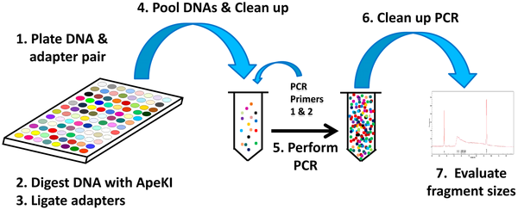

Genotyping by Sequencing
Elshire RJ, Glaubitz JC, Sun Q, Poland JA, et al. (2011) A Robust, Simple Genotyping-by-Sequencing (GBS) Approach for High Diversity Species. PLoS ONE 6(5): e19379. doi:10.1371/journal.pone.0019379
http://www.plosone.org/article/info:doi/10.1371/journal.pone.0019379

Slide 7
Danies et al., in preparation

Slide 8
Lineages differ in their host preference
Sporulation (sporangia per ml)
Lineage

Slide 9
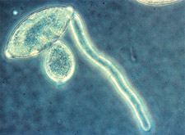
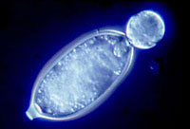
Temperature affects germination
Type of germination
Direct germination
H.D. Thurston
Indirect germination
W. E. Fry
(Danies et al, 2013. Plant Disease)

Slide 10
Rate of zoospore release differs between genotypes
4°C
Indirect germination (%)
W. E. Fry
Time (minutes)

Slide 11
Temperature has an effect on mycelial mass

Slide 12
Isolates differ in their sensitivity to mefenoxam
Growth as a proportion of control (0 µg per ml)
Concentration
Lineage

Slide 13
Genotyping by Sequencing Results
66 P. infestans isolates
Most isolates were sent in triplicates others in duplicate
570,192 SNPs after merging
Proportion of missing data < 0.2
Minor allele frequency > 0.1
98,013 SNPs after filtering
Notes:
It is crucial to constantly monitor populations of P. infestans to be able to better manage the disease.
Finding markers associated with important phenotypic traits, would allow us to design rapid DNA based approaches for diagnosis.

Slide 14
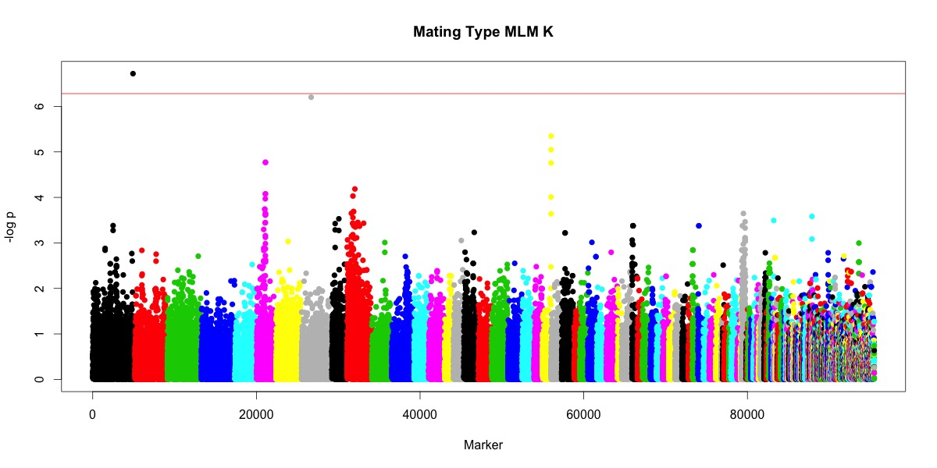
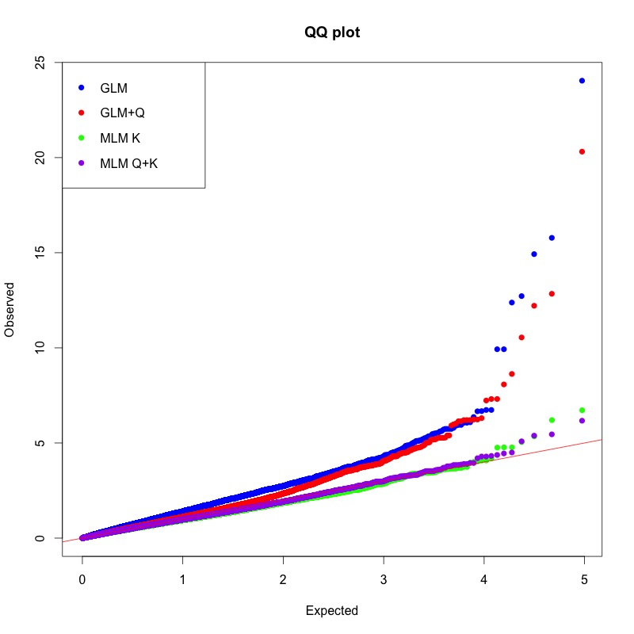
Genotyping by Sequencing Results
Notes:
It is crucial to constantly monitor populations of P. infestans to be able to better manage the disease.
Finding markers associated with important phenotypic traits, would allow us to design rapid DNA based approaches for diagnosis.

Slide 15
Table 1 Eleven lowest P-value association hits for mating type in P. infestans. Genes that are found within 1000 kb flanking region upstream and downstream of each significant SNP are shown.
ª Distance from SNP marker. Distance equal to 0 means that the SNP of interest is included within the gene.
NA: Information not available.

Slide 16
Concluding remarks
Phenotypic analyses take time but are fundamental for the improvement of disease management.
We need to look for genetic determinants of phenotypic traits of interest to be able to make isolate specific recommendations.
We need to work on improving P. infestans’ genome assembly.
Notes:
It is crucial to constantly monitor populations of P. infestans to be able to better manage the disease.
Finding markers associated with important phenotypic traits, would allow us to design rapid DNA based approaches for diagnosis.

Slide 17



Acknowledgements

