Slide 1
Northeast Garlic Post Harvest Trial Results 2015 Mid-Atlantic Fruit and Vegetable Program
Crystal Stewart
Eastern NY Commercial Horticulture Program
Cornell University Cooperative Extension

Slide 2
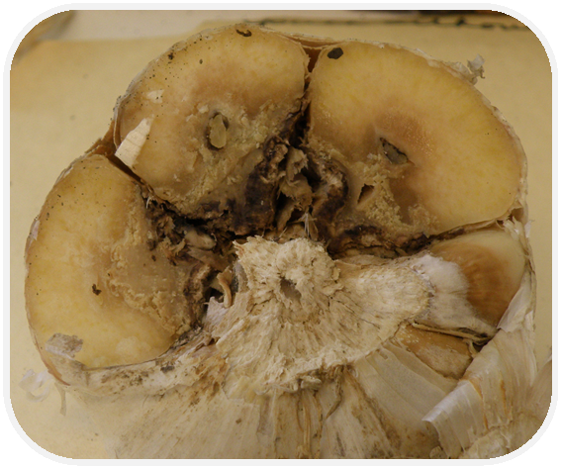
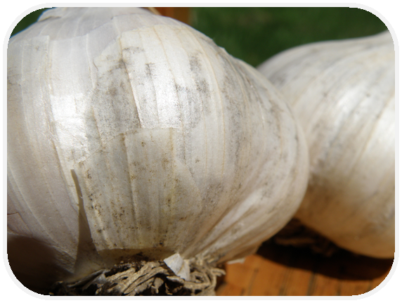
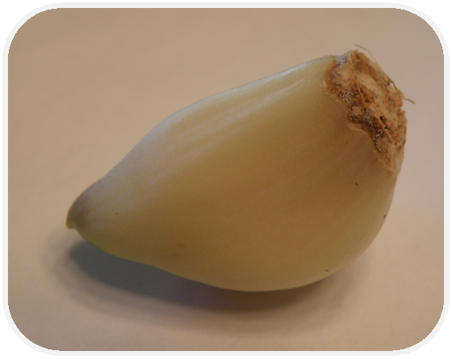

Slide 3
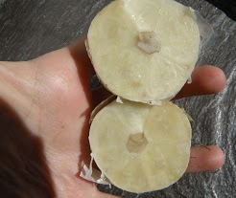
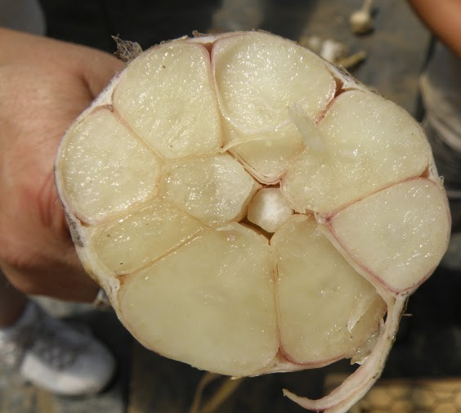
Harvest at the right time Undercut garlic before pulling Handle well at harvest
Prepare for Post-Harvest Success

Slide 4
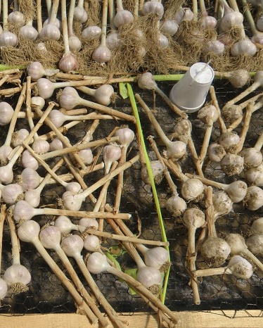
Post-Harvest Trial
Six farms over two years
Treatments included:
-Cutting tops
-Cutting roots
-Washing garlic
-Drying in high tunnels
-Drying in barns/sheds
-Leaving garlic intact
Combinations of the above

Slide 5
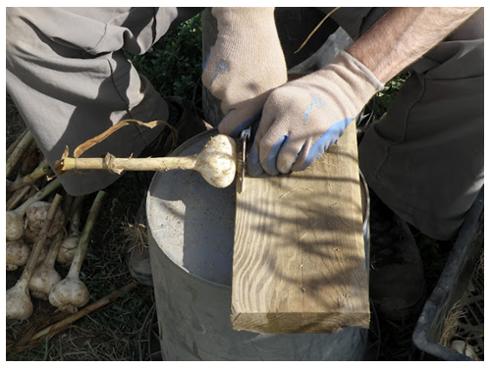
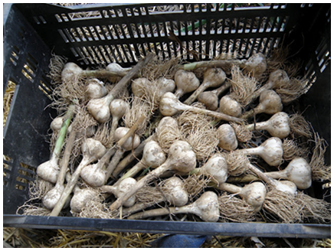
Root Pruning. Roots were cut while garlic was still moist using a knife or pruning shears. Care was taken not to damage the basal plate.
Top cutting. Tops were cut to a height of six inches while garlic was green. The mechanical cutting showed some variation of height.
Notes:
In two locations garlic roots were cut with a Sears anvil pruner (kind with razor blade for cutter). Other we used a knife. In one location a sickle-bar mower was used to cut the tops (it bounced, which made cutting height vary). In other two locations tops were cut with a pruning shears.

Slide 6
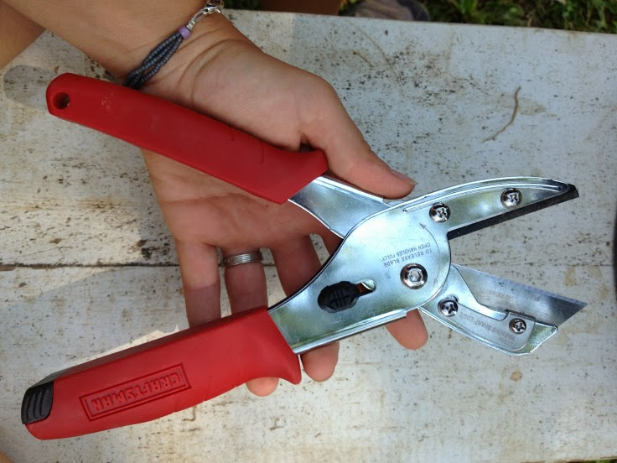
It’s the little things…

Slide 7
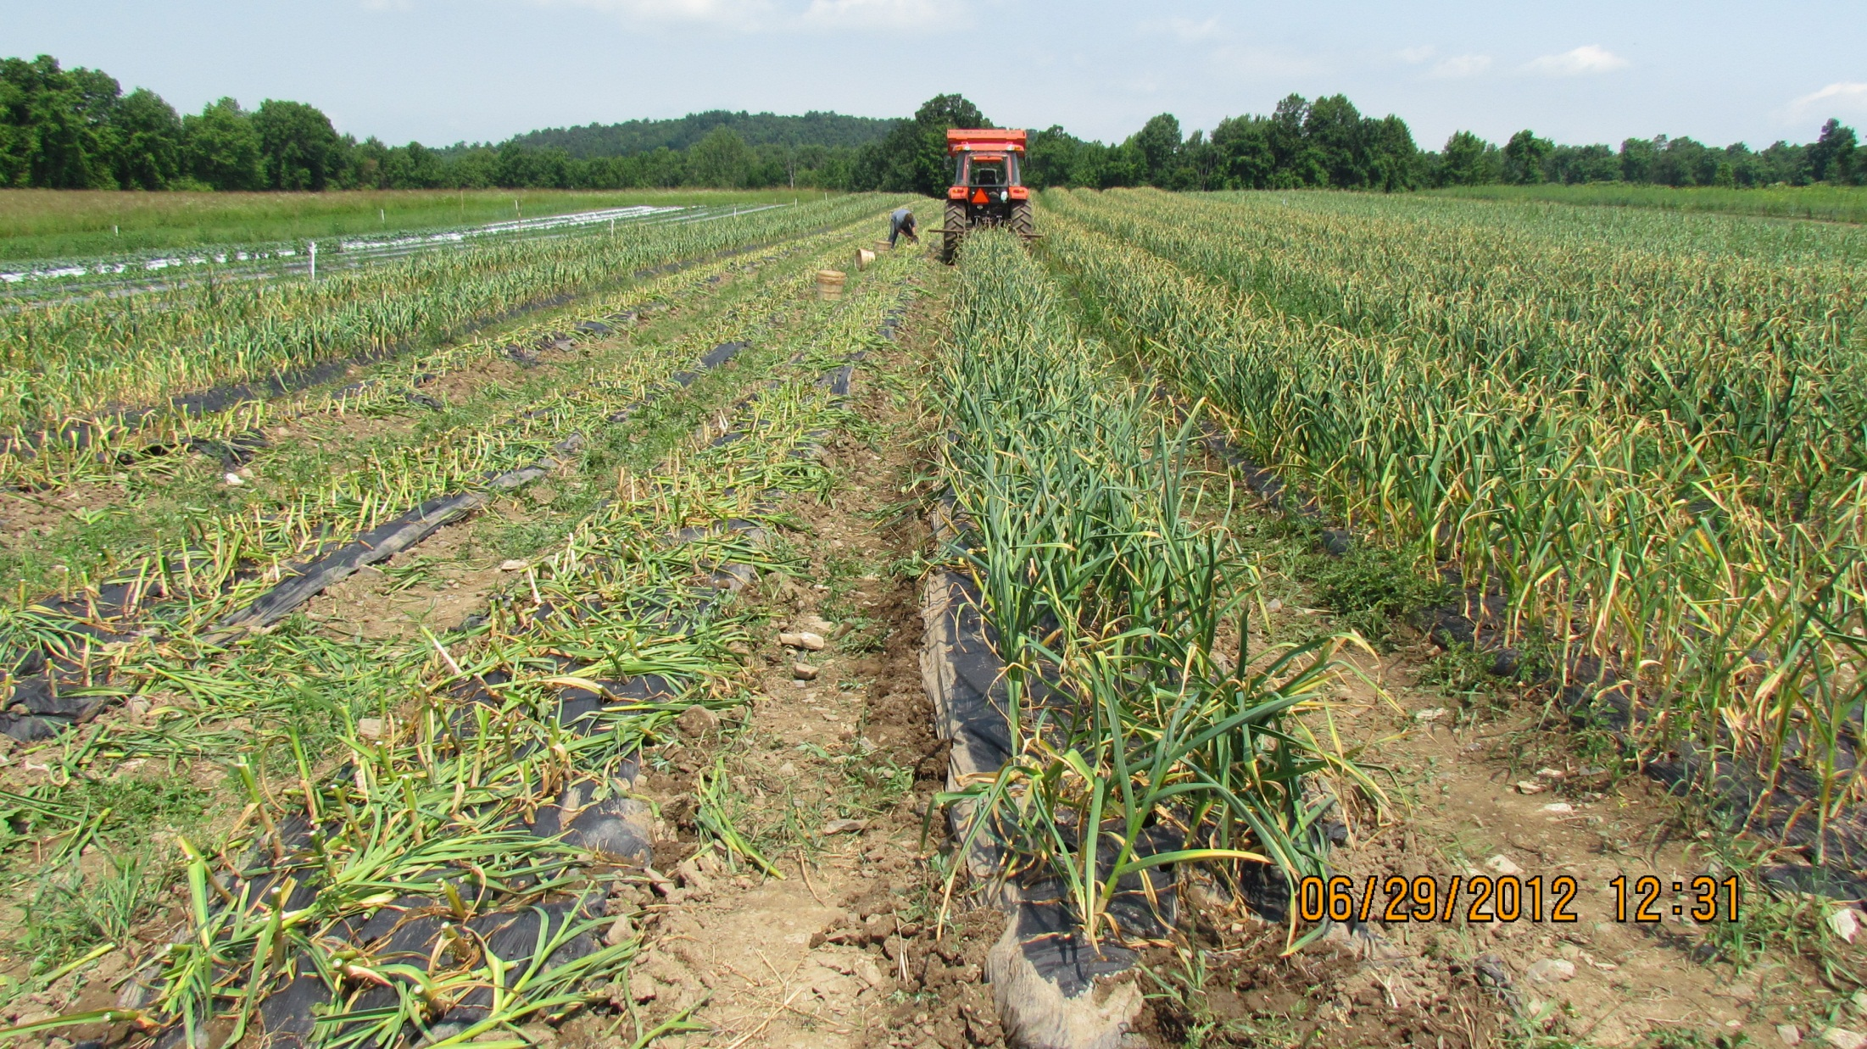
And the bigger things…
Tops cut 6” tall with sickle-bar mower. Greens left in field. Garlic was undercut to harvest.
Notes:
Animation on this slide. The arrow and Text box will disappear if you hit space bar once.

Slide 8
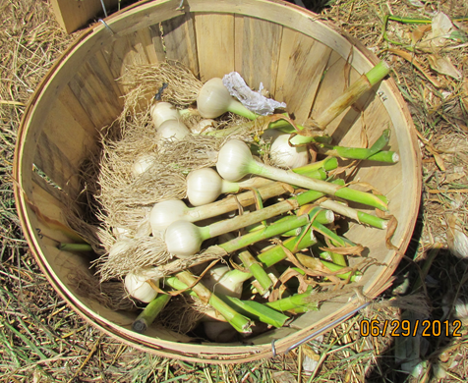
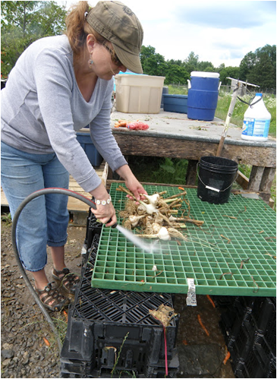
Washing was completed using a garden hose and a nozzle. Power washers were not used. After washing, garlic was air dried before being placed in the curing area. Garlic was washed until dirt was removed from the bulb.

Slide 9
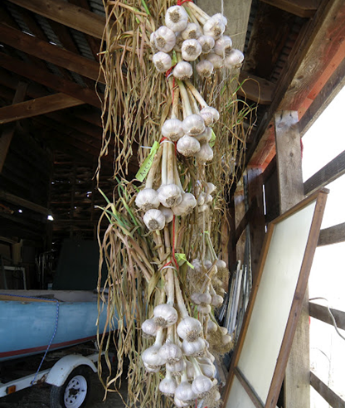
Drying in high tunnels: Garlic was moved to high tunnels immediately after other treatments were completed. All high tunnels had a shade cloth and were ventilated with fans, preventing temperatures from exceeding 110ºF.
Open-Air Drying: These treatments were placed in solid but well-ventilated buildings such as barns and sheds to dry without supplemental heat from the sun.

Slide 10
Roots and tops uncut: Garlic was left completely uncut in this treatment. It was spread out on drying racks to leave space for the bulbs to be one layer deep or it was tied into bundles of 6-10 and hung.

Slide 11
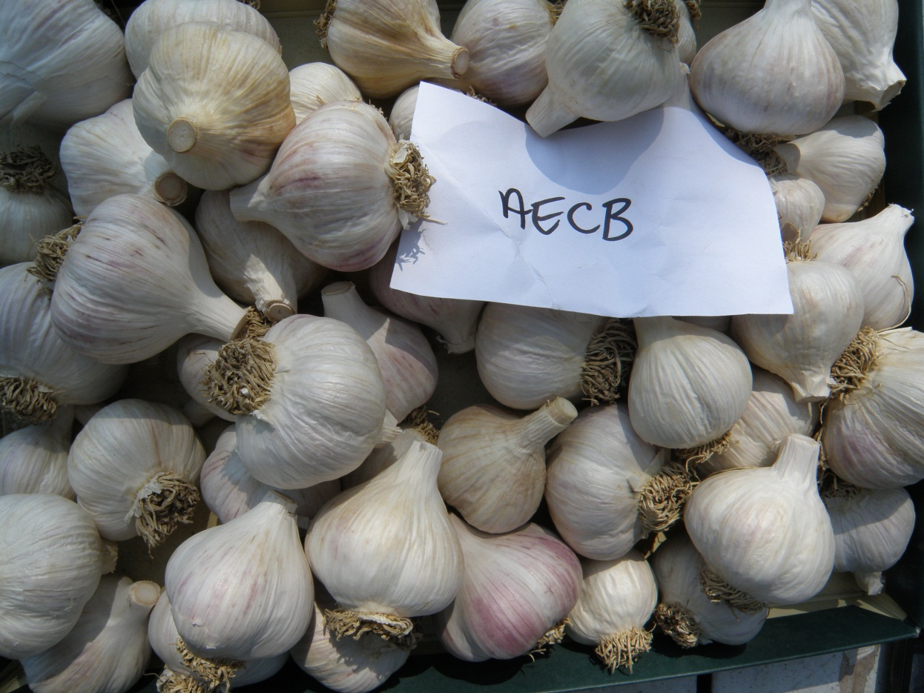
Results: Root Trimming
Trimmed vs. untrimmed: No significant differences were observed between these treatments in regards to bulb quality, weight, or disease incidence.
Treatment: Roots trimmed, tops trimmed, washed, open-air dried
Notes:
Shows how close we cut the roots. Not right up to basal plate. As close as you can get with shears. Cut or uncut, either way seemed to be fine.

Slide 12
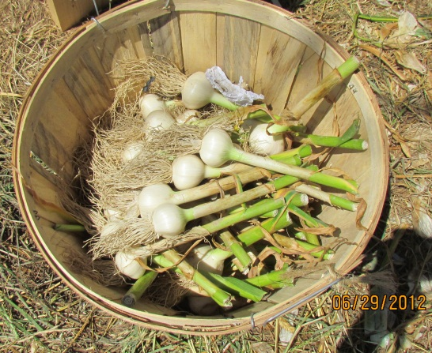
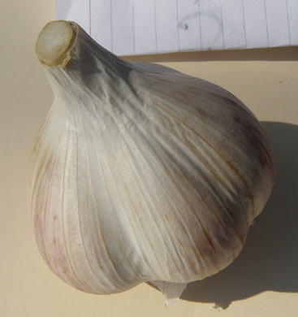
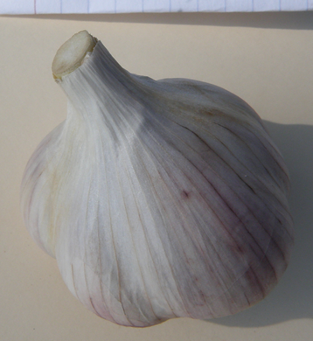
Results: Washing bulbs
Disease incidence, particularly Aspergillus and Embellisia, was slightly higher in washed garlic.
R to L: Immediately after washing, after curing, 1 leaf removed, two leaves removed
Notes:
Might have been able to make sure garlic was more completely dry before moving it into the HT. Harvested garlic very dry—little soil moisture.

Slide 13
Results: Trimming Tops
Weight

Slide 14
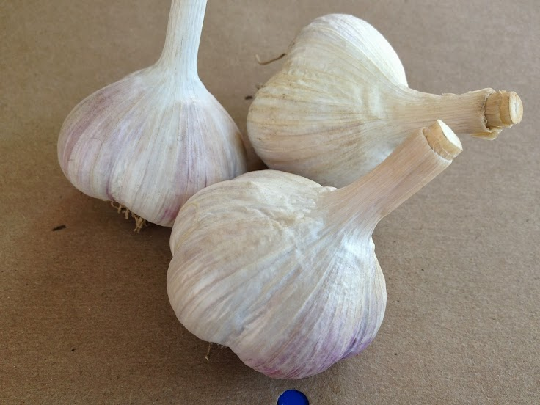

Slide 15
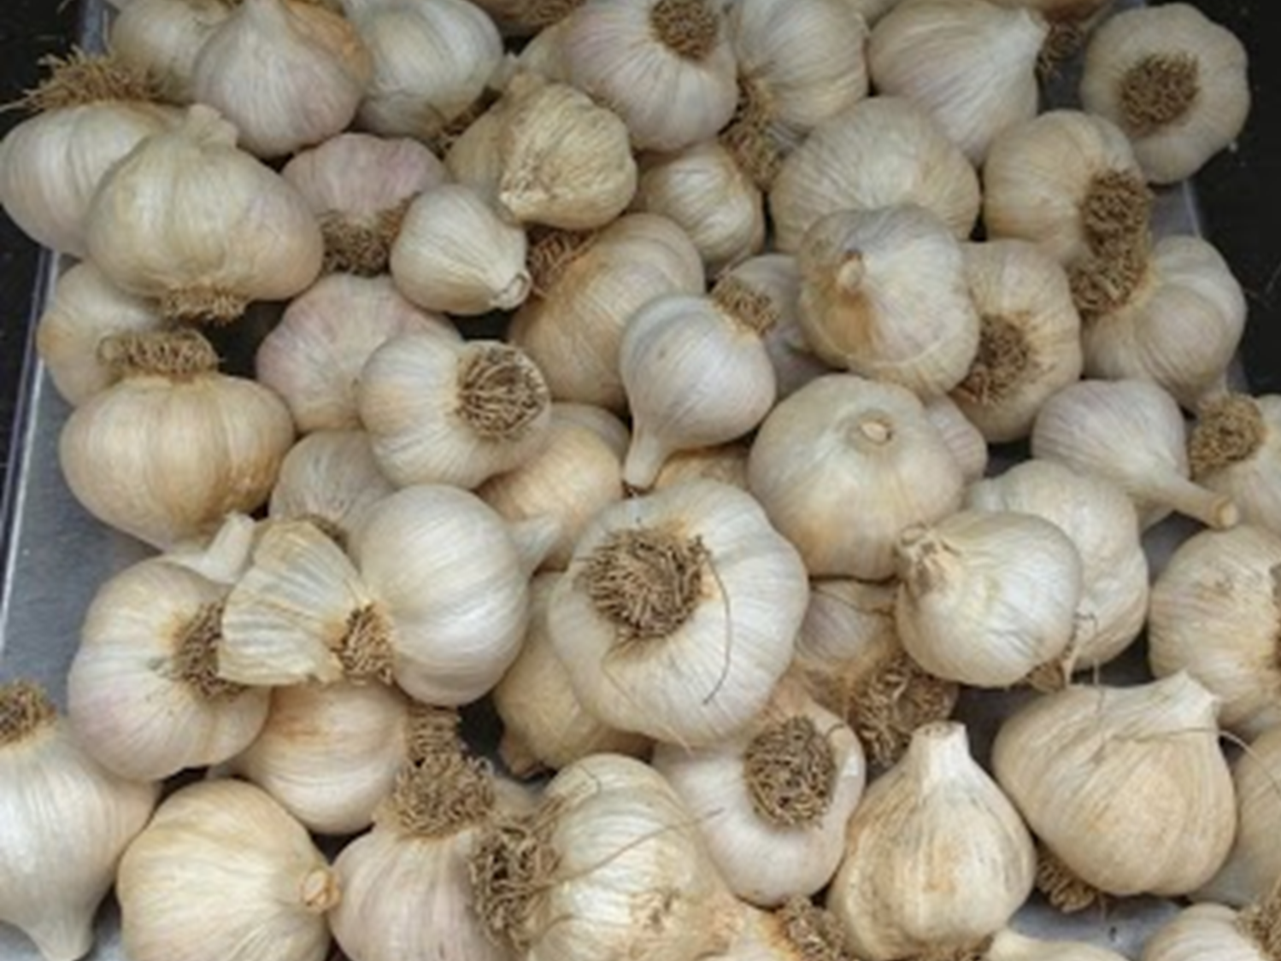
Results: High Tunnel Drying
Garlic in high tunnels dried an average of three days faster in high tunnels than in open air structures
Garlic dried in high tunnels had slightly better wrapper quality (tighter, less discoloration) at one site each year
Garlic dried in tunnels also had slightly lower disease incidence (Aspergillus and Embellisia) in two of the three sites in year one, though disease was not severe in any site or treatment
No garlic treatments showed damage from being dried in the high tunnel.

Slide 16
Conclusions
Drying garlic in HT did not cause post-harvest breakdown or increase disease incidence
Cutting the tops did not increase post-harvest breakdown or increase disease incidence. It also did not reduce weight in one of the two years of the trial.
Washing garlic immediately improved appearance but had minor effect on long-term appearance and disease incidence

Slide 17
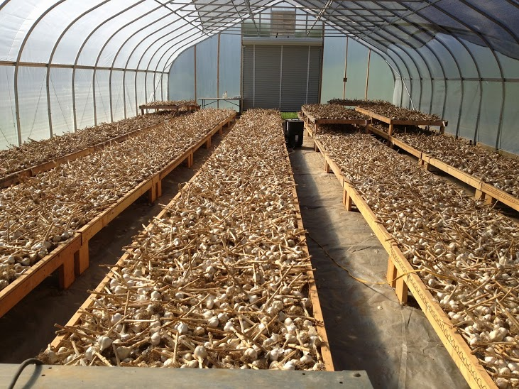

Slide 18
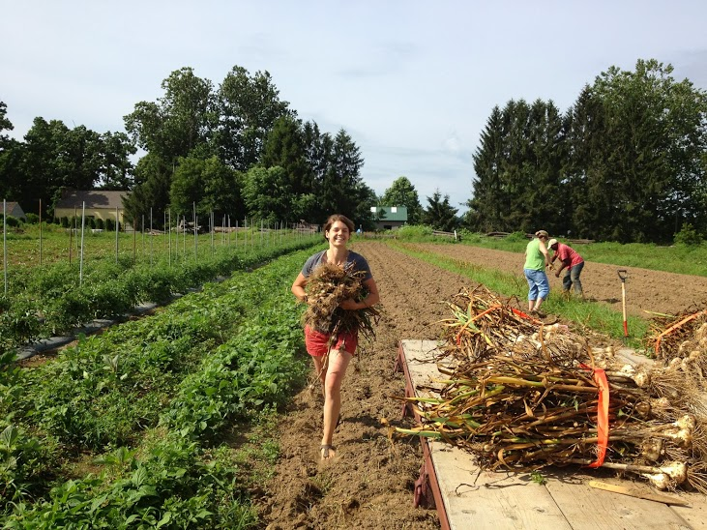
Questions?

