Slide 1
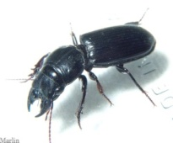
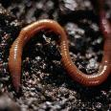
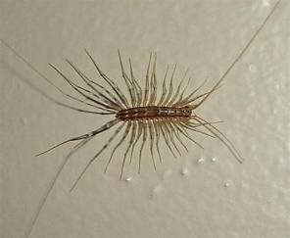
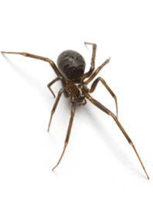
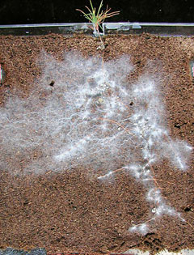
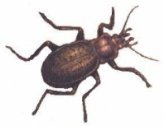
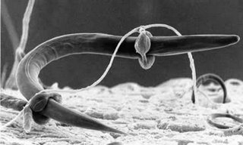
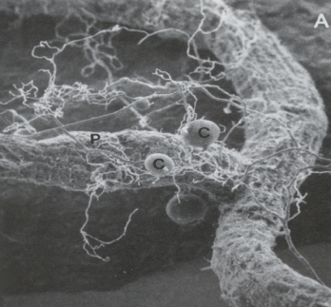
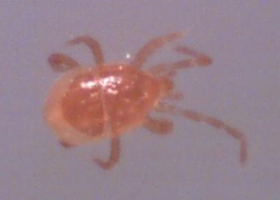
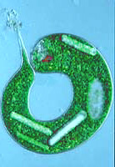
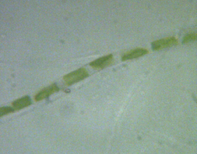
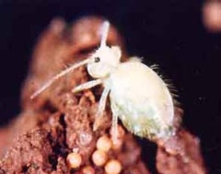
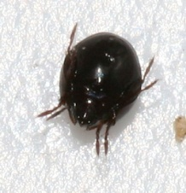
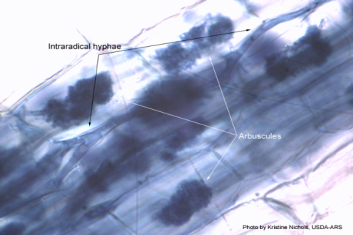
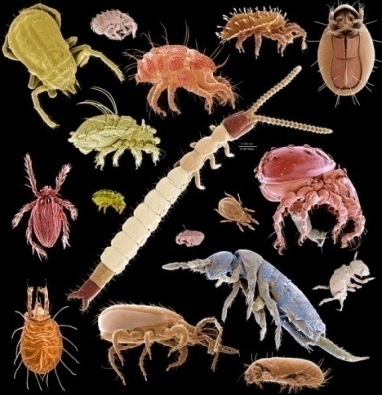
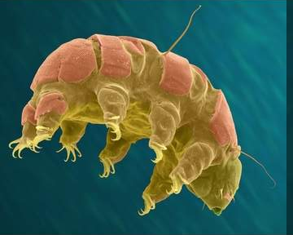
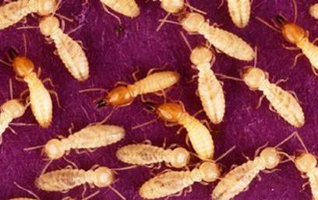
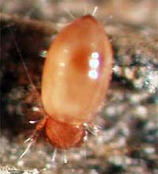
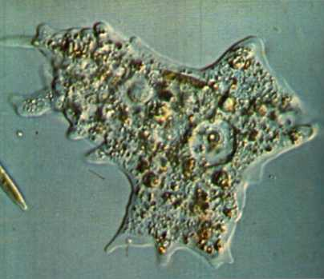
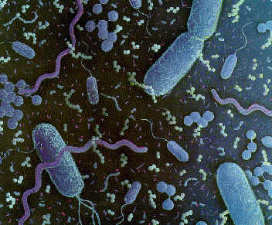
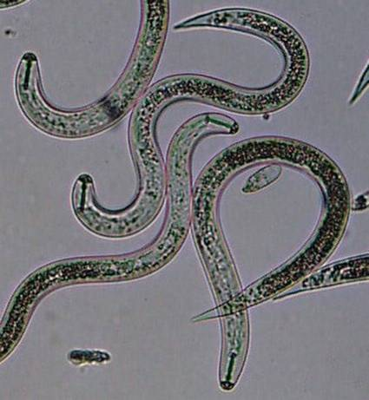
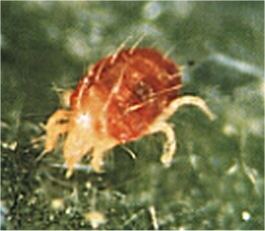
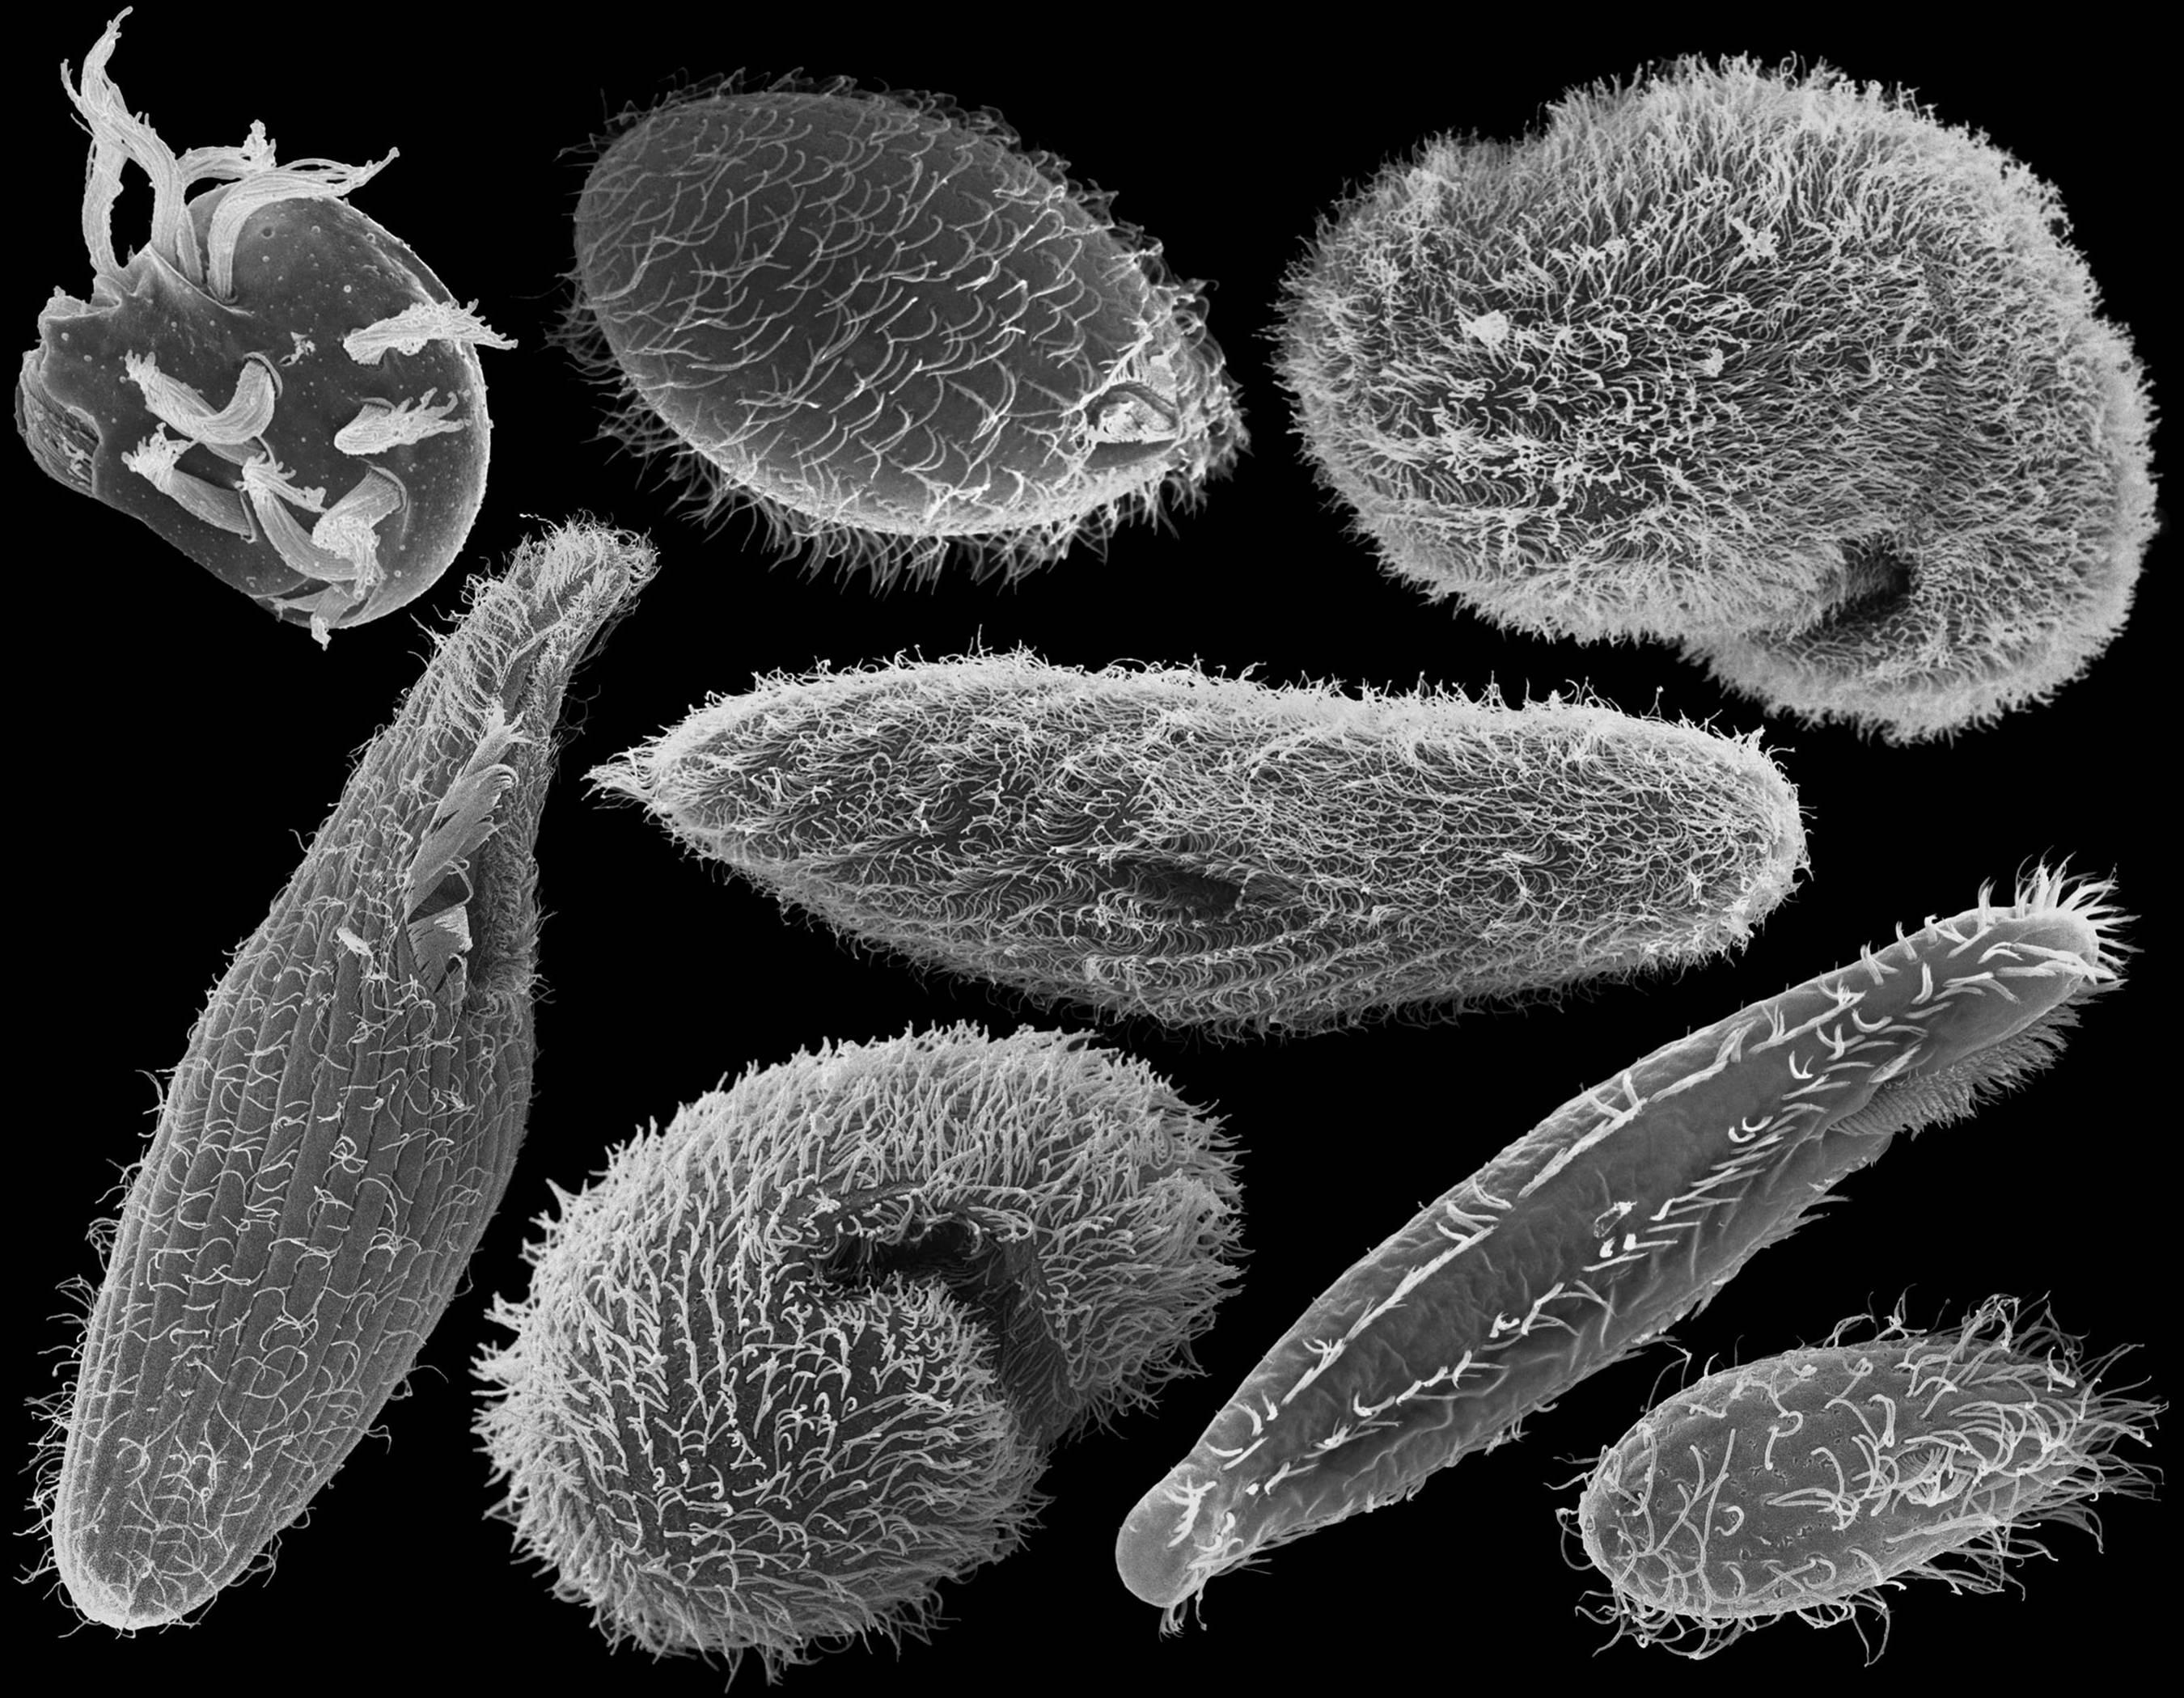
The Science Behind Soil Critters

Slide 2
But first, a bit about Soil Health…
Soil Health… the capacity of the soil to function.
What functions do you expect soil to perform?
The most important agricultural functions of the soil are biological.

Slide 3
The Biology of the Soil
Soil is organic (i.e. living)
Billions of different organisms from millions of species
Total weight of living organisms in the top six inches of an acre of soil can range from 5,000 pounds to as much as 20,000 pounds.
Soil from one spot may house a very different community from soil just a meter away, because of variations in the availability of water or nutrients or soil physical properties.

Slide 4
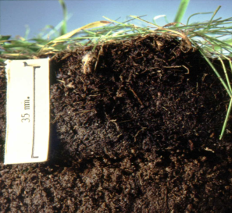
Ecosystems are not green; they are black and brown; fed by green that is powered by the Sun.
Soil organic matter (SOM) is <6% of soil by weight but controls >90% of the function.
Microbes process 90% of the energy in the soil.
33% of nitrogen from fertilizer ends up in corn …the rest comes from organic matter.
50% to 75% of Phosphorous occurs in soil organic matter.
Most SOM is present in the top 4” of soil.
Mineral soil is 5x as dense as soil OM.
As soil organic matter increases from 1% to 3%, the available water holding capacity of the soil doubles (Hudson, 1994).
Soils stockpile 1500 gigatons of carbon in SOM, more than Earth's atmosphere and all the plants combined (Dance, 2008).
Bill Kuenstler
Jerry Lemunyon
USDA NRCS
Fort Worth, Texas

Slide 5
"Land, then, is not merely soil; it is a fountain of energy flowing through a circuit of soils, plants, and animals."
- Aldo Leopold, A Sand County Almanac, 1949

Slide 6
Soil Organic Matter Composition
Soil microbial biomass
3-9% of total SOM mass
Soil organic matter
1-6% of total soil mass
Soil
Animals
10%
Readily
decomposable
7-21%
Bacteria &
actinomycetes
30%
Yeast,
algea,
protozoa,
nematodes
10%
Mineral particles
Stable (humus)
70-90%
Fungi
50%
- Modified from Building Soils for Better Crops, Magdoff and van Es, 2000

Slide 7
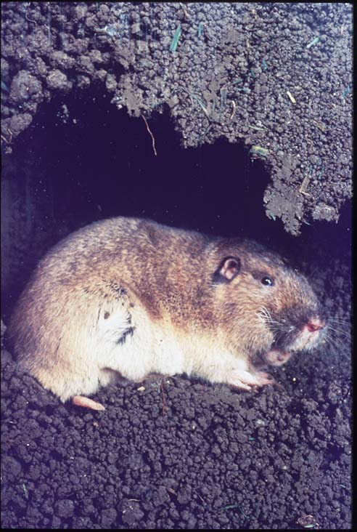
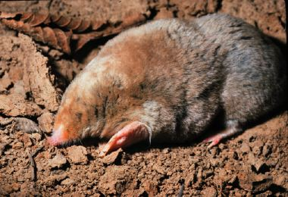
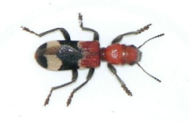
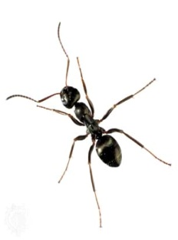
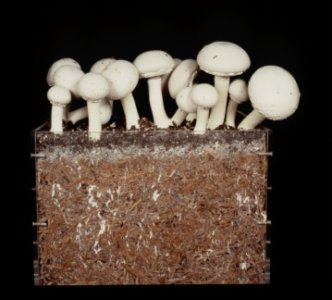
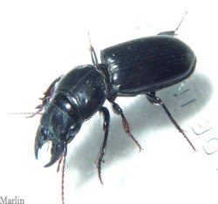
The Soil Food Web is a complex and diverse mix of species that represents the greatest concentration of biomass of anywhere on the planet Earth.

Slide 8
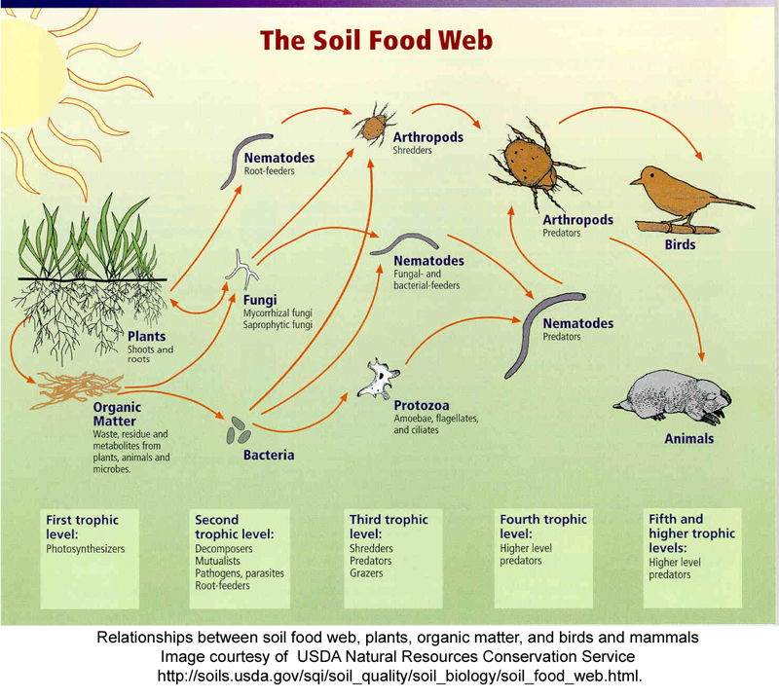

Slide 9
Microbial Biomass
Definition
Total weight of living micro-organisms (bacteria and fungi) in the soil.
Why is it important?
Nutrient Cycling
Formation & Maintenance of Soil Aggregates
Decomposition of Plant and Animal Residues
Labile pool of nutrients
Degradation of agrochemicals and pollutants applied to the soil
Contributes to water holding capacity
Plant health
Notes:
A single teaspoon of soil may contain as many as 9 billion soil microbes.
Others:
Contribute to organic matter
Degradation of agrochemicals and pollutants applied to the soil
Microbial respiration gives off carbon dioxide from the soil.
Contributes to water holding capacity
Symbiotic relationships between plants and other members of soil food web.
Plant health
Biomass is a better measure of the active C pool that a surrogate for microbial activity. This measures how many are there not what they are doing. If you want to know what they are doing- measure respiration or enzymes.

Slide 10
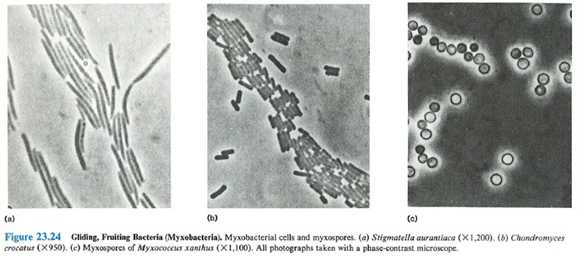
Bacteria
feed on organic matter that is easy to break down (simple sugars)
store and cycle nitrogen
contribute to soil stability
decompose pesticides
Staphylococcus aureus (a) X1,500, (b) x34,000
- Prescott, Harley, and Klein 1993
Prescott, Harley, and Klein 1993
Notes:
There are up to 11,000 different species in 1 gram of soil.

Slide 11
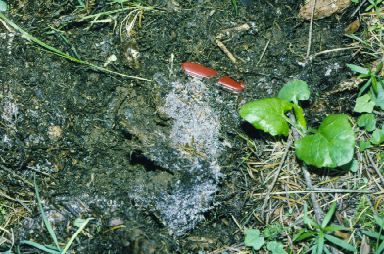
Fungi
Two main types: saprophytes and mutualists
Saprophytes feed on organic matter that is difficult to breakdown (high C:N)
Plant mutualists trade nutrients, primarily P, for plant C
Store nitrogen
Contribute to soil stability
Harmed by physical disturbance
Notes:
There tends to be higher amounts of fungi in no-till systems.
There are up to 3,000 species in a cultivated soil; more in a forest soil.
Saprophytic fungi are detritovores. They decompose OM.
(Symbiotic is a general term that can mean beneficial or deletrious relations) Mutualistic is a win-win symbiotic relationship.
Mutualistic fungi (the mycorrhizae) exchange C exuded from plant roots for soil P that soil roots alone can’t reach.

Slide 12
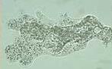
Protozoa
Protozoa include: Amoebae, ciliates, flagellates
Are an important part of the nitrogen cycle
Consume bacteria
Notes:
Too many protozoa can liberate excess nitrogen.
Excessive tillage introduces oxygen that can cause an increase in the population of bacteria that are the food source for protozoa.
Protozoa are sloppy feeders, cell contents spill, becoming available for plant use.

Slide 13
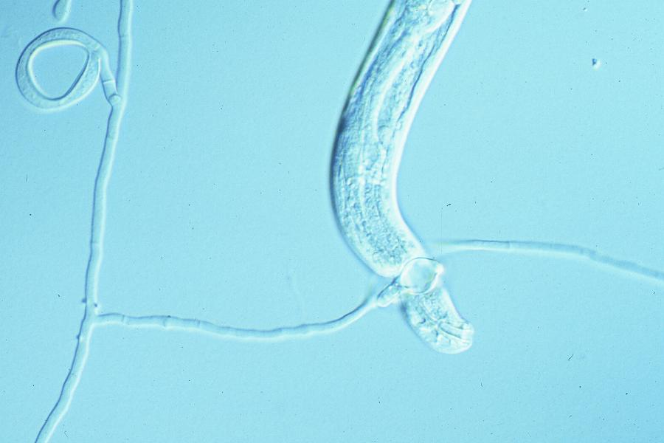
Nematodes
Fungal feeders, bacteria feeders, root feeders, predators and omnivores
An important part of the nitrogen cycle
About 10-20 individuals/gram of soil
Affected by management: pesticides, soil organic matter, tillage
Notes:
There are beneficial species of nematodes in the soil. Bongers 1990 Maturity Index is a measure of soil disturbance based on the diversity of nematodes in these different functional groups- ‘todes IDed to functional group not spp., making it easier to do.

Slide 14
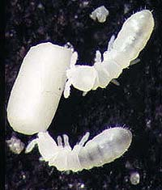
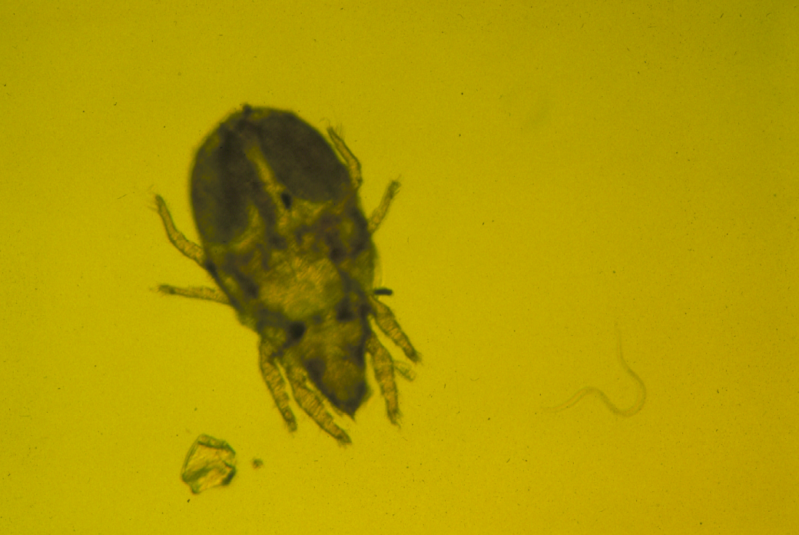
Microarthropods
Mites, collembola (or springtails)
Decompose & shred organic matter
An important part of the nitrogen cycle
Tillage and pesticides are harmful
Mite
Nematode
Sand particle
Notes:
Populations higher in undisturbed soils. Similar to nematodes, mites and collembola can be separated into functional groups by life history strategies (some grow fast, tolerate disturbance, some grow slow are relatively large and are very sensitive to disturbance) to get a relative index of soil disturbance.

Slide 15
Earthworms
Good for nutrient cycling and stability functions
Create pores that serve as lungs of the soil.
Notes:
Could be considered invasive exotic spp.
Displacement =local extinction

Slide 16
Soil Food Web Analysis
Soil Food Web testing by Earthfort www.earthfort.com
High in bacteria
Low in fungi, protozoa and nematodes
Greater diversity of soil food web = greater crop nutrient cycling.

Slide 17
Manage to improve soil health
Less soil disturbance
More plant diversity
Living roots as much time as possible
Keep the soil covered

Slide 18
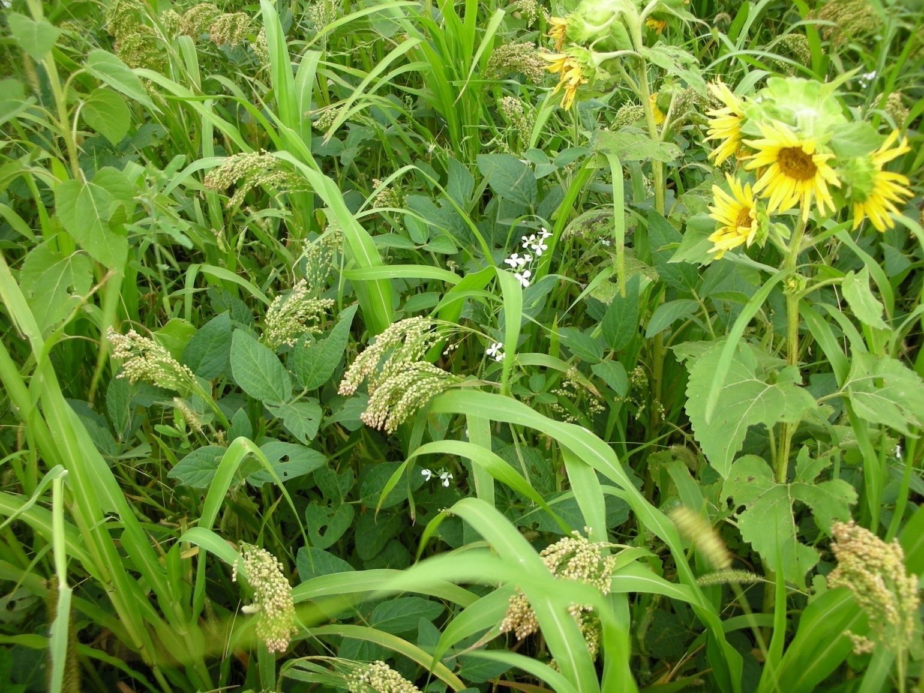
Manage your soil to be good Soil Food Web habitat!

