Slide 1
Economics of Cover Crop Alternatives, SARE Producer Grant
Josh Roe

Slide 2
Background
Many benefits of cover crops are well established.
Little data on economic return.
Received a SARE producer grant, (October 1, 2013 start date) to study the economics of grazing, haying and “leaving” cover crops.

Slide 3
Background
Chose a location on the farm with good access to water and pens for grazing.
Field has been in continuous no-till for approximately 15 years, alfalfa, corn, soybeans, and wheat.
Slight variation in the field, more sandy soil to the east.

Slide 4
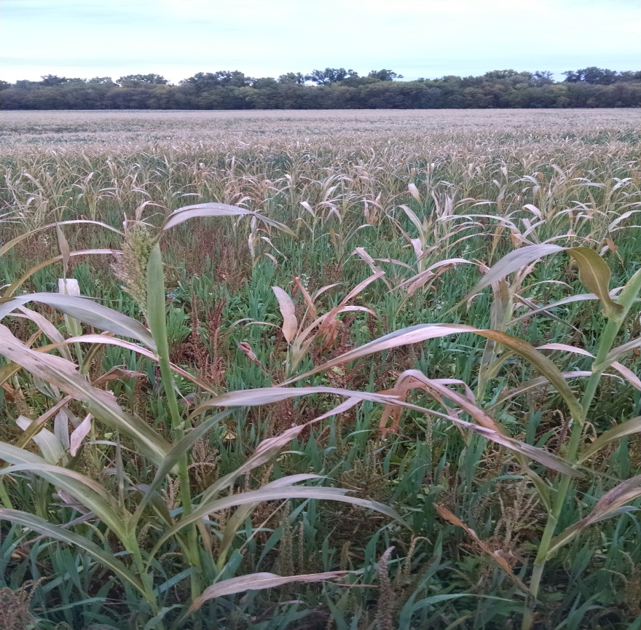
Design
61 acres planted in three plots: A plot each: for:
Grazing
Haying
Leaving

Slide 5
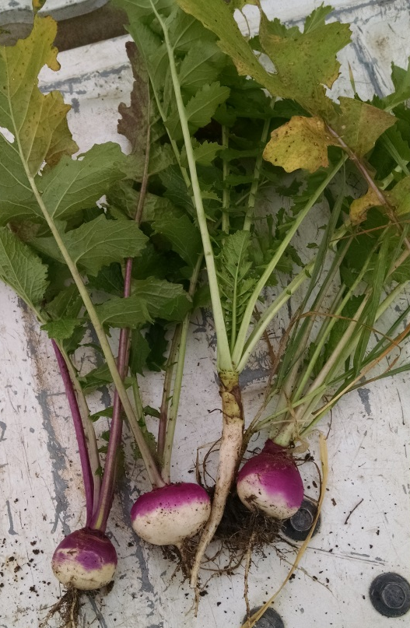
Design Continued
In the plots for leaving alone and grazing the mix is (pounds/acre):
Oats (30 pounds)
Spring Field Peas (20 pounds)
Radish, (3 pounds)
Turnips, (2 pounds)
Sorghum, (1 pound)

Slide 6
Design Continued
Same mix minus the radish and turnips in hayed plot.
Planted into wheat stubble on August 6.
Received 8 inches of rain within two weeks.

Slide 7
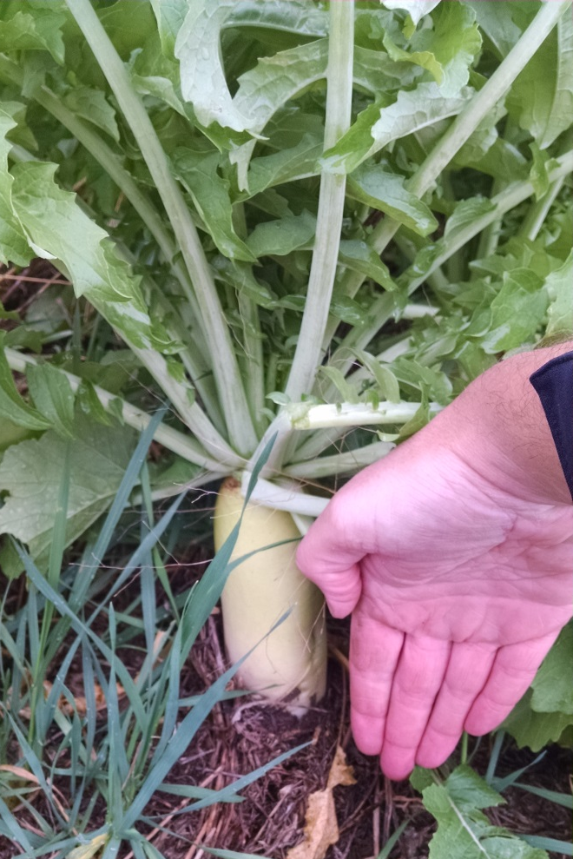
Leaving Alone
Cover Crop Establishment Costs
 | Per Acre | Total
Additional Chemical Application (glyphosate) | $15.59 | $951.00
Drilling | $17.48 | $1,066.00
Seed | $33.79 | $2,061.00
Total | $66.85 | $4,078.00

Slide 8
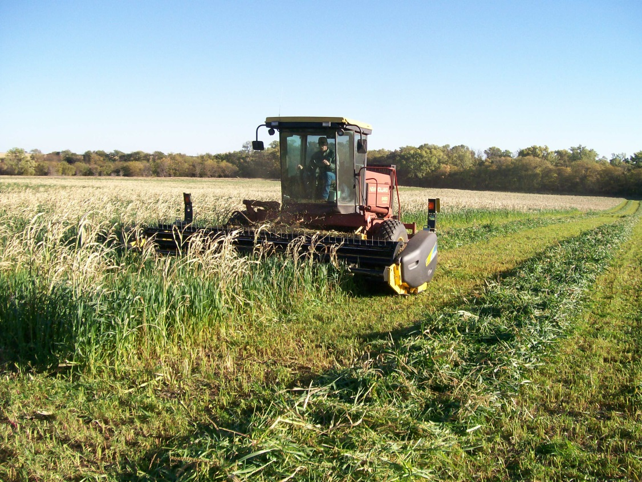
Hayed Portion
Swathed October 14th
38 bales averaging 1,750 pounds

Slide 9
Hayed Treatment Summary
Yield (Tons/Acre) | 1.59
"Income" Per Ton | $90.00
Cost Per Ton | $73.40
Net Income/Ton | $16.66

Slide 10
Net Income/Acre Given Price
Price/Ton | Net Income/Acre
$100 | $42.79
$90 | $26.89
$80 | $10.99
$73.09 | $0.00
$70 | -$4.91
$60 | -$20.81
$50 | -$36.71
19% Decrease in Price

Slide 11
Net Income/ Acre Given Yield
Tons/Acre | Net Income/Acre
1.70 | $36.79
1.59 | $26.89
1.50 | $18.79
1.40 | $9.79
1.30 | $0.79
1.29 | $0.00
1.20 | -$8.21
1.10 | -$17.21
1.00 | -$26.21
19% Decrease in Yield

Slide 12
Grazing Portion
Start grazing on October 19th
Package one: 58 head of 858 pound steers for 26 days
Package two: 58 head of 780 pound steers for 60 days
Grazing terminated January 17th
Supplemented with 7 pounds corn gluten pellets per day, forage (during wet conditions), and mineral

Slide 13
Grazing Summary
Head | 58
Days of Grazing | 86
Average Daily Gain | 2.13
Pounds of Gain Per Head | 183.18

Slide 14
Gain Results
Total Cost | $7,190.56
Cost Per Head | $123.98
Cost Per Pound of Gain | $0.68

Slide 15
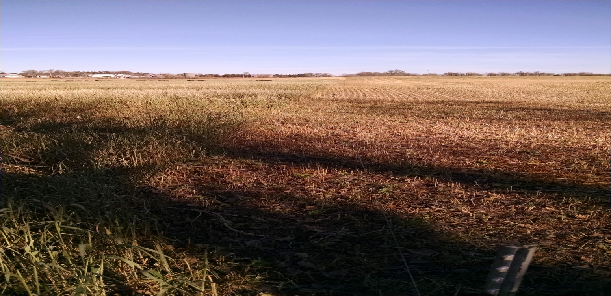
Caution!
“Optimal” rainfall (for NC Kansas).
High cattle prices.

Slide 16
Lessons Learned
Received 9” rain on May 5, 2015, significant gully erosion, but what would have happened without cover crops?
Surprisingly little regrowth after haying.
No corn yield impact, but again, adequate rainfall in 2015.
Lots of “activity” compared to farm across the road!

