Slide 1
Thank You! Sponsors, Supporters, and Collaborators

Slide 2
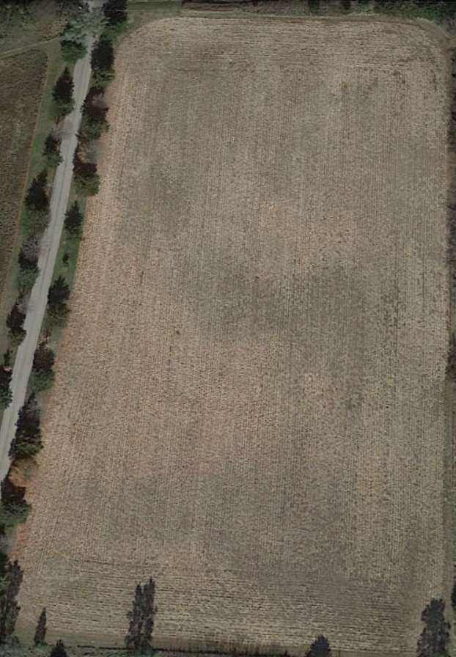
Plot 111011 (Graham Thompson) Plot Layout
60 ft Clear Headland
680ft
Tractor-Planter Setup 16 Rows-40 ft
Tractor-Planter Setup
1 Baseline-3 Configurations 40 ft wide
1 Baseline-3 * Configurations 40 ft wide
340 ft (EQIP)
2 10-80” Max Soil health Mix 30 ft
2 5-5-80” Triple Row
3 10-80” Max Soil health Mix 30 ft
3 10-80” Horse Hay
4 Baseline-3 Configurations 40 ft wide
4 MONOCROP Beans & Peas
Alfalfa/Grass Mix
Alfalfa/Grass Mix
375ft
Version: 26 Apr 2021
NOT Actual as Planted
5 10-80” Max Soil health Mix 30 ft
5 10-80” Peas & B. Beans
9 120” Triple Row Wildflower Mix
6 Baseline-3 Configurations 40 ft wide
6 Baseline w/ Horse Hay
415ft
7 Baseline-3 Configurations 40 ft wide
7 Baseline with Tall Prairie Flower & Grass
60 ft
60’ Horse Hay Mix
8 10-80” Max Soil health Mix 30 ft
8 10-80” Bee Feed, Butterfly Garden Mix
150 ft (SARE)
9 120” Quad Row Bee Feed, Monach Butterfly
* May include special test plots
665ft
10 10-80” Milpa Garden
Alfalfa/Grass Mix
60 ft Clear Headland

Slide 3
Example of Plot Layout with Replications: EQIP Plots
B Treatment
(Baseline)
A Treatment
(Max Soil Building Mix)
30”
No Cover Crop
30” Cover Crop 101
60” Narrow & Wide
Twin Soil Max Cover Crop
Pairs of 90” Twin Row Corn
40 Ft Wide Strip
30 Ft Wide Strip
70 ft width for each of 4 Replications
Repeated for
4 Randomized
Replications
Overall Plot Treatments per each of 4 Replications
“A” 90” Twin Rows with Max Soil Building Cover Crop
“B” 30” & 60” Baseline: 4 Row No CC, 4 row w/CC, 4 Wide Rows

Slide 6
Plot Stations
1: Cover Crop in Variable Row Widths
1A-30” Corn, No Cover Crop
1B-30” with Traditional Cover Crop
1C-60” Twin Max Soil Building
1D-90” Twin Max Soil Building
2: Bell Curve (Normal Distribution)
2A: Poor Corn
2B: Better Corn
3: Sheep Jeep/Chicken Tractor
4: Second Cash Crop
4A: Peas
4B: Beans
5: “Luberland”
(Future Biology Intensive Demo Plot)
6: Vegetable farming & Other Plot Sites
Mike Cook
Loran Steinlage
Shaffer Ridgeway
1
2
3
4
7
Wrap-up & Lunch at Shed
6
5

Slide 7
Traditional Cover Crop Mix Configuration 6 Species

Slide 8
Max Soil Builder Cover Crop Mix 12 Species

Slide 9
Milpa Garden Mix Configuration

