Slide 1
Agricultural and Resource Economics In-service Training
Fall 2022
Knoxville, Murfreesboro & Jackson, TN

Slide 2
12
Research/Education Grants
$1,622,395
16
Graduate Student Grants
$184,557
66
Total Grants Awarded
$2,604,919
State Contacts
Rob Holland
Director, SARE State Coordinator, University of Tennessee, Director, Center for Profitable Agriculture
Dr. Jason De Koff
SARE State Coordinator, Tennessee State University, Extension Program Leader
Troy Dugger
SARE Program Assistant, University of Tennessee, Program Coordinator, Center for Profitable Agriculture
25
Farmer/Rancher Grants
$253,377
6
Professional
Development Program Grants
$429,818
7
On-Farm Research Grants
$114,772

Slide 3
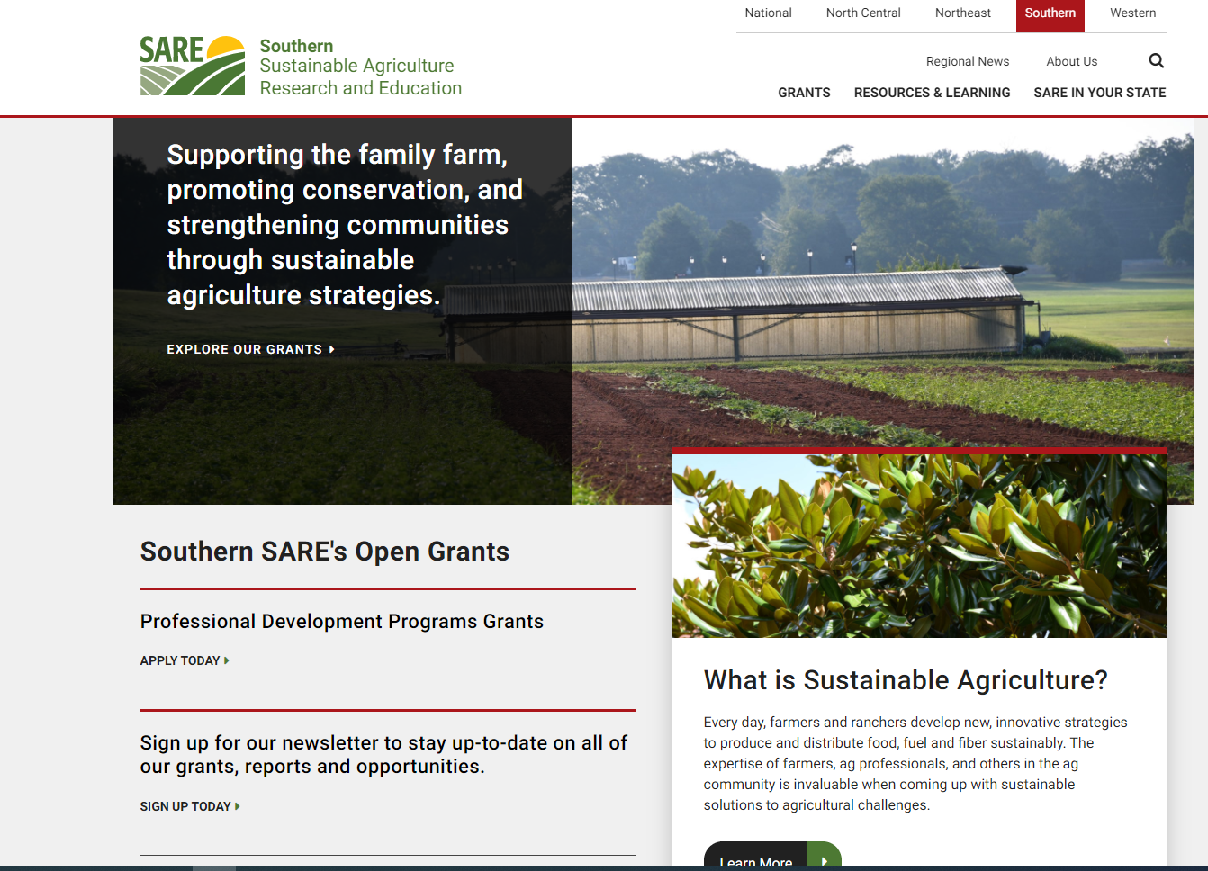
Southern SARE Website
https://southern.sare.org/

Slide 4
Research and Education Grants
First grants offered by SARE
“Big Grant” Programs
Research Grants, $400,000 for up to a 3-year period; researched-based with an educational outreach component – team of researchers – 3 farmers involved also
Education Grants, $50,000 maximum, up to two years of educational activities – urban ag systems, local/regional certification/ branding. No research involved in these grants
Should have educational/outreach efforts in proposal
Pre-proposals due in June; Selected pre-proposals are notified in August; Full Proposals due November, awarded in February

Slide 5
Professional Development Program Grants
Began in 1994
Agricultural professionals can apply; “Train-the Trainer”
Priority will be given to those projects under $80,000; can be one or two years
Fund seminars, workshops, farm tours, development, marketing and distribution of training materials, on-farm demonstrations
Producer involvement in planning, evaluation and delivery; include UT and TSU in proposal
Pre-Proposals due August; selected pre-proposals due as full proposals in November, funding announced in February

Slide 6
On-Farm Research Grants
“Small Grants” program – 2-year project, maximum grant $30,000
Extension Specialists, University Researchers, Government Personnel (NRCS), who work with farmers and conduct on-farm research with at least one cooperator
Must include one farmer and the project must be conducted on that cooperator’s farm or on a research farm with the cooperator’s involvement; A farmer/rancher cannot apply for this grant
Projects should be innovative and generate results that many farmers can use (Education Outreach)
Proposals due December 2, Noon Eastern Time; funding announced in March

Slide 7
Producer Grants
Began in 1994 – Farmers to conduct their own research projects
Individual Farmer ($15,000) or Farmer Group ($20,000) can apply, 2 years of research
Strive to solve a problem they face and relay that to other producers that can benefit from the results of the research. Must have one other cooperator – another farmer, Extension Agent, or USDA Personnel and an outreach component
Proposals due November 11, Noon, Eastern Time

Slide 8
Graduate Student Grants
Began in 2000 to give Master’s and PhD students the opportunity for research projects.
Recently increased to $16,500, two years
Can be used for supplies, equipment, labor, farm equipment rental or operating charges, travel expenses related to the project, student travel to one conference to present findings ($1000)
Proposals due May; funding announced September

Slide 9
Farmer Veteran Coalition of Tennessee
Small Grant Program
Direct assistance to veterans in their beginning years of farming.
Funds provided to a third-party vendor for items the farmer has identified that would be helpful.
Awards range from $1000 - $5000
Application opens in 2023 (Mid-January; awarded in May)
https://farmvetco.org/fvfellowship/
Short Answer & Essay Questions
Military Service
Educational Background
Prior Farming Experience
Business/Financial Planning
Short/Long Term Goals
Business Plan
Proof of Military Service
Member of Farmer Veteran Coalition

Slide 11
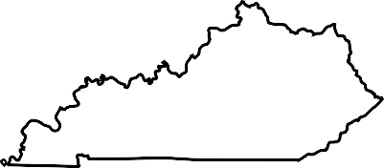
Programs Forages
Forage/Fencing Training Kits
4 Kits –
Value of each kit is approximately $1100
7 Producer Trainings Conducted
with 256 in attendance
1 Agent Training
with 17 Agents in attendance
Southern SARE Forage Training for Agents/ Producers
Columbian, AL
7 Agents,
1 Specialist
Southern Cover Crop Conference
Auburn University
Eden Shale Winter Feeding Field Day
Mercer and Owen County KY
2 Agents;
1 Area Specialist attended
6 Agents,
1 Extension Specialist

Slide 12
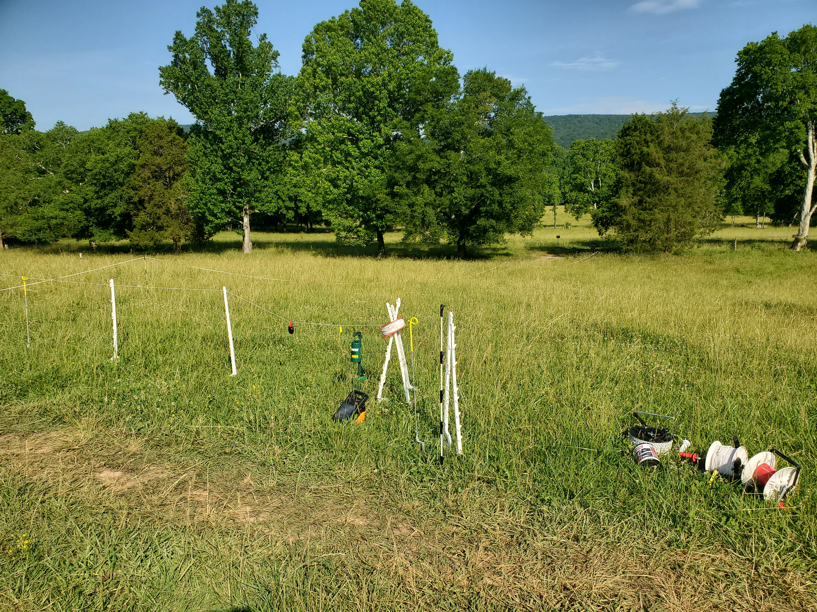
Temporary Fencing Kits
Funded by SARE in 2021
Debuted at an In-Service Training in June 2021
Contain various step in posts, reels,
polywire, fence chargers, etc.
One kit for each region, plus Dr. Mason
Can be “checked out” by agents for
use at local programs

Slide 13
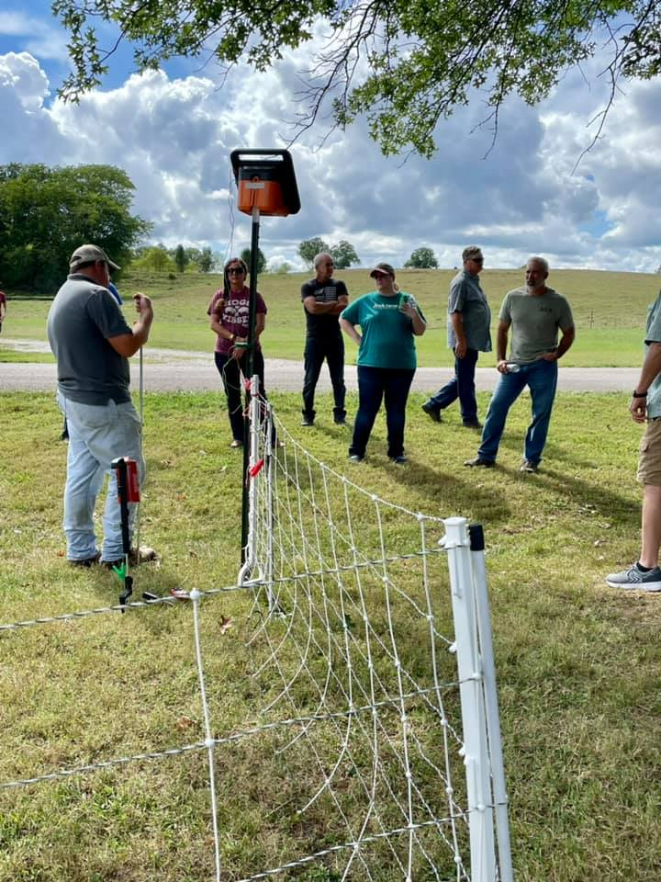
Temporary Fencing Kits

Slide 14
Impact of Temporary Fencing Kits
At various programs over the past year, over 600 people have learned about the benefits of temporary fencing and rotational grazing
Agent feedback regarding use of the kits:
“Producers really enjoyed having different fencing supplies to look at! The kits were very useful and easy to set up!”
“Having a couple of more kits available would be nice. I plan to also use the kit with my master beef class in the coming years.”
“Participants enjoyed the demonstration. I used for a master small ruminant class.”

Slide 15
Impact of Temporary Fencing Kits
At various programs over the past year, over 600 people have learned about the benefits of temporary fencing and rotational grazing
Agent feedback regarding use of the kits:
“Producers really enjoyed having different fencing supplies to look at! The kits were very useful and easy to set up!”
“Having a couple of more kits available would be nice. I plan to also use the kit with my master beef class in the coming years.”
“Participants enjoyed the demonstration. I used for a master small ruminant class.”

Slide 16
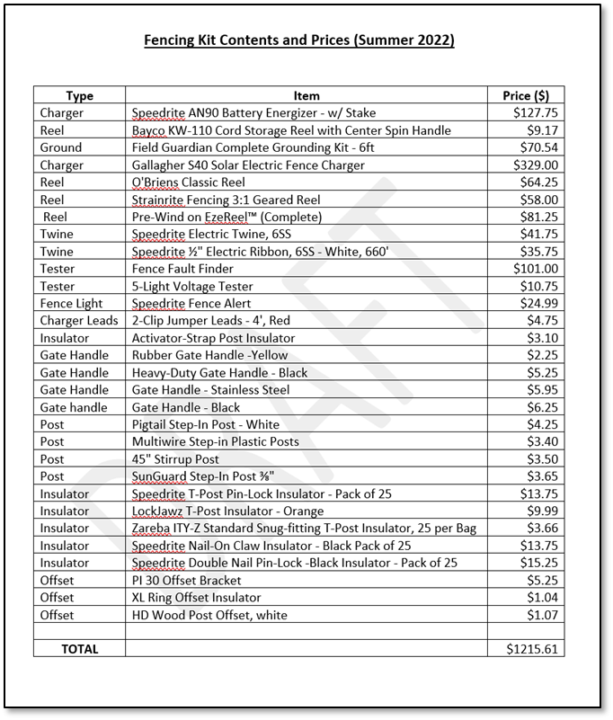
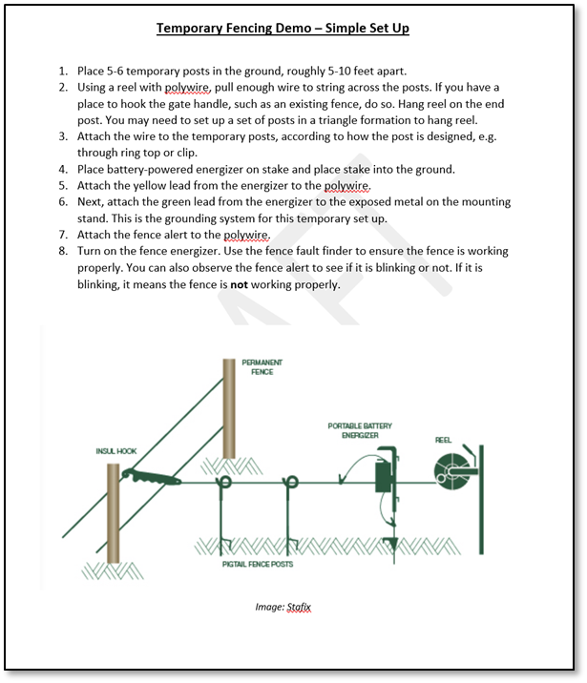
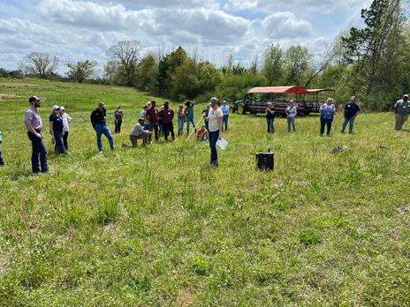
Temporary Fencing Kits

Slide 19
Future Thoughts:
Specialists submitted proposals for our State Model Program this year
Dr. Dilip Nandwani l TSU,
Organics
Dr. Katie Mason l UT, Training agents in forages/pastures
Dr. Lori Duncan l UT, Engineering Elements Trainings and an in- person training on regenerative agriculture
Involve more agencies in programs, such as NRCS in particular
Continue to promote, encourage application of and be successful in obtaining grant funds with producers, Extension, Research, and Graduate Students in the 5 grant programs of S-SARE
Involvement with the Tennessee Farm Bureau’s Young Farmer & Ranchers Environmental Stewardship Award
Continue efforts in Train-the- Trainer Programs with Extension and other groups

Slide 20
Troy Dugger, Program Assistant, TN SARE Program
Center for Profitable Agriculture
850 Lion Parkway, Columbia, TN 38401
pdugger2@utk.edu

