Slide 1


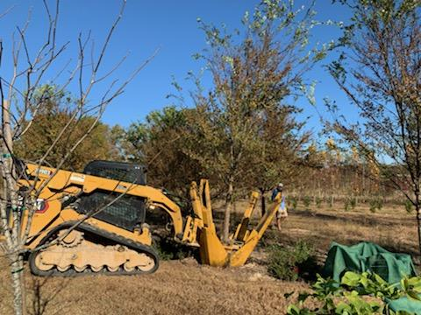
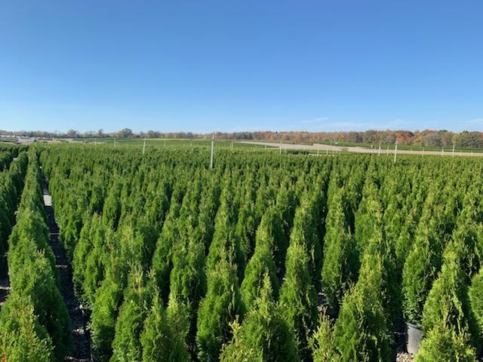
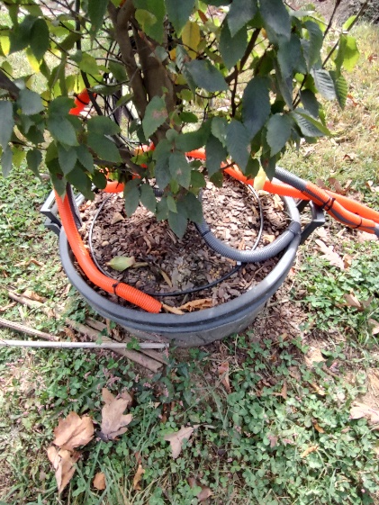

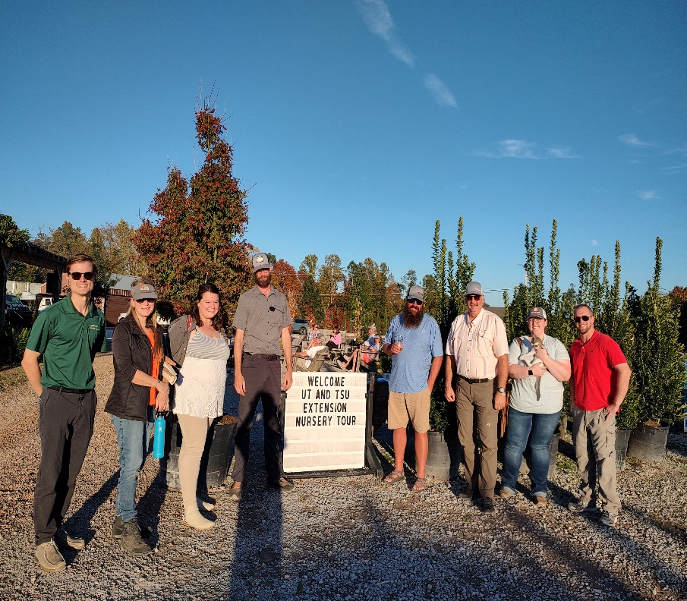
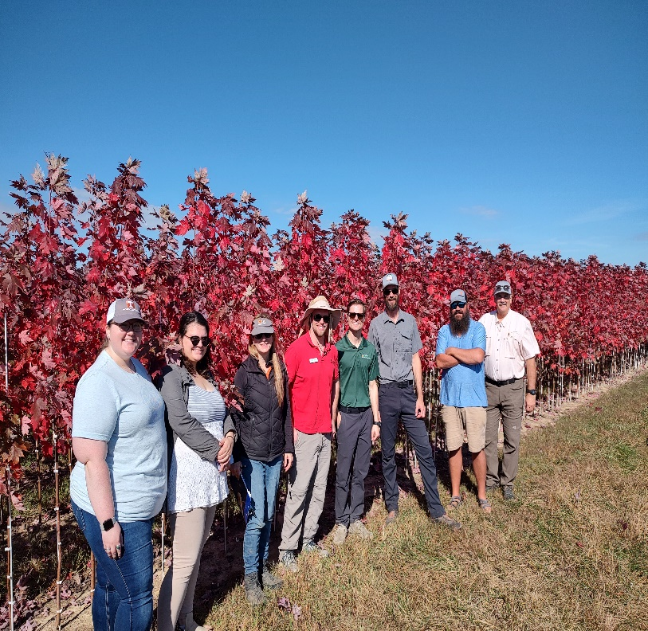
2023 Eastern Region
Nursery, Greenhouse, and
Landscaping Tour
(Central Tennessee)

Slide 2

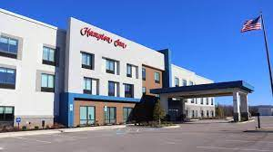
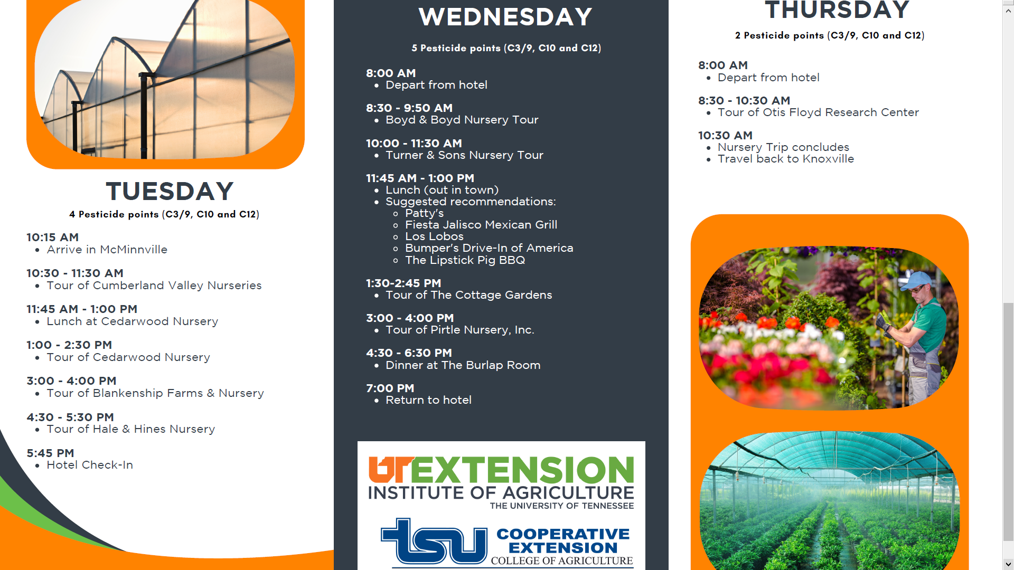

Awarded 11 Points
Categories 3, 10, and 12

Slide 3

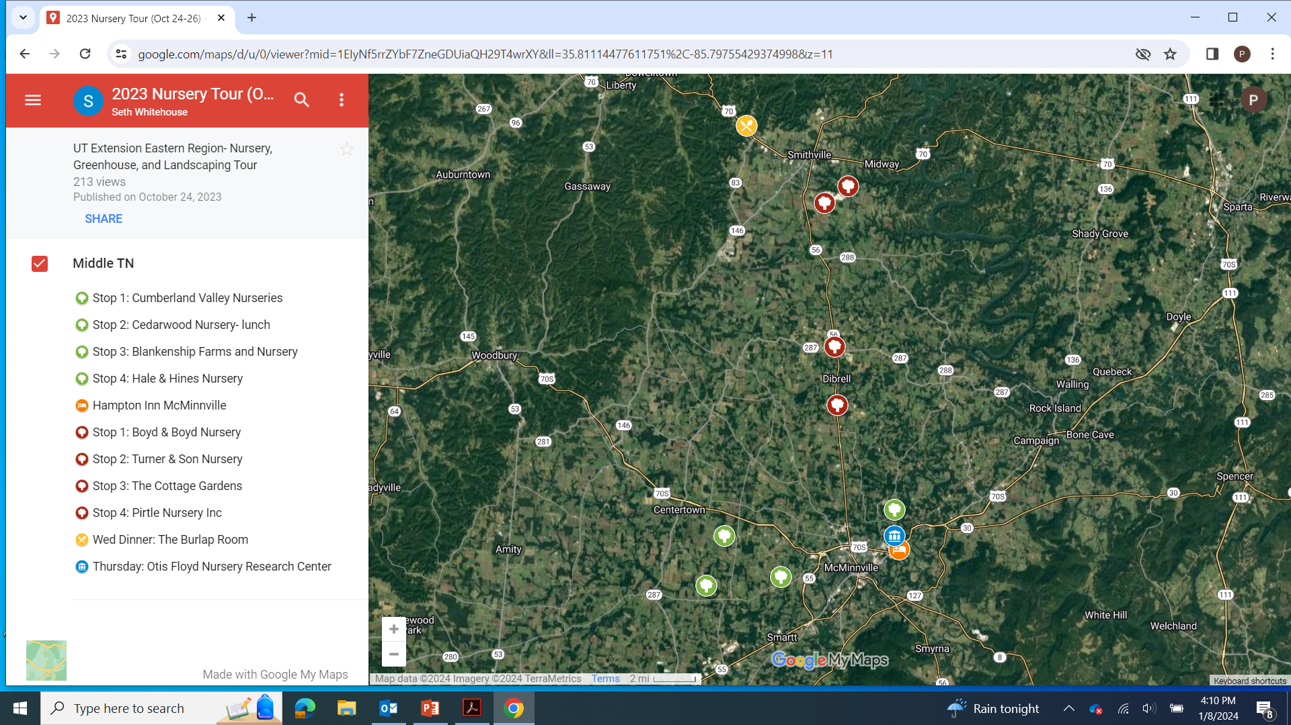
Scheduling our tour stops

Slide 4


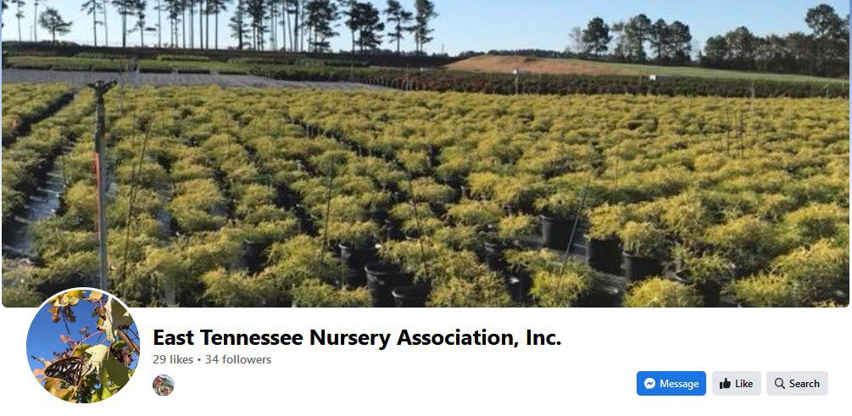
Others that were implemental
Focus Areas:
- Water use
- Reduced pesticide use
- Disease resistant varieties
- Effective management of nutrient inputs
- Embracing crop diversity
- Adoption of BMPs
- Implementing creative marketing strategies
Training for Extension Educators for Sustainable Agriculture Practices

Slide 5
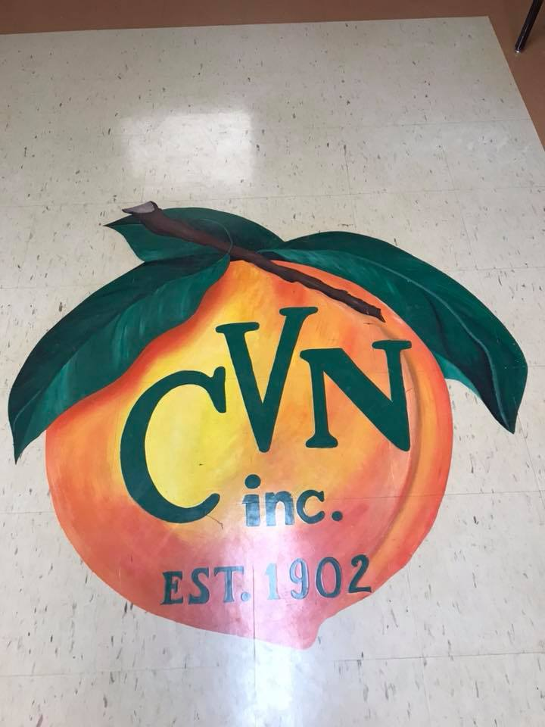
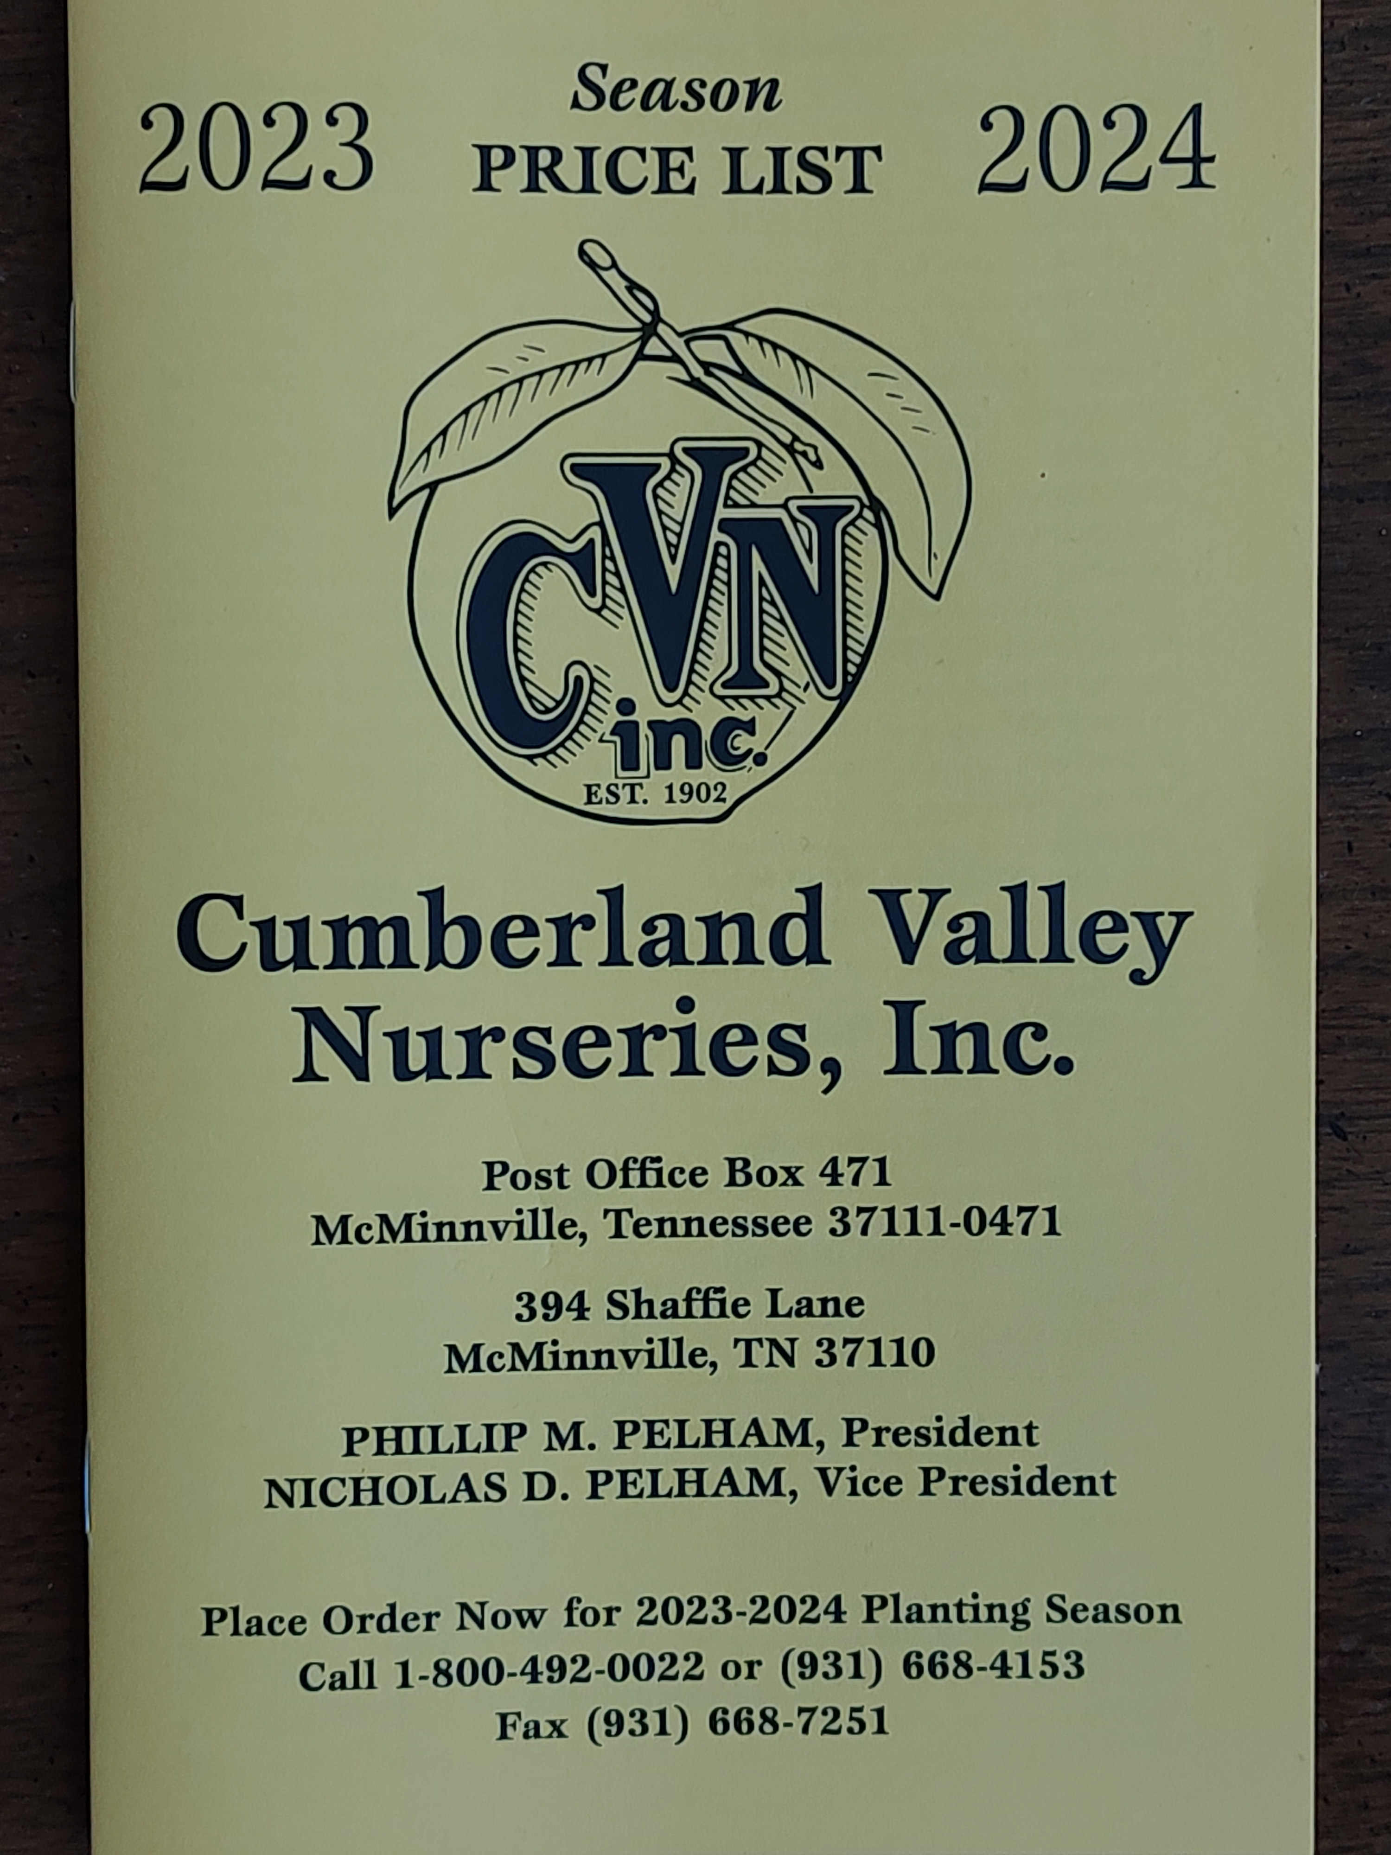
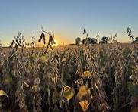

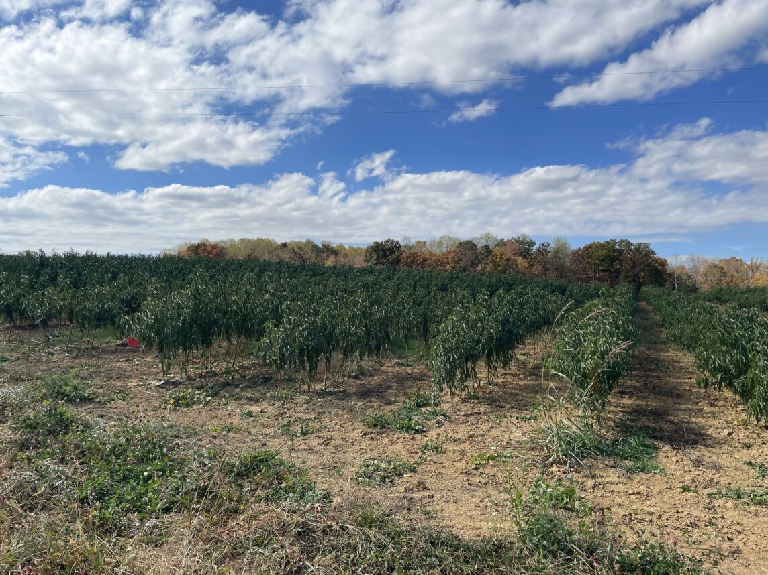

Family owned and operated
Phillip and Nick
Wholesale production
Rotate soybeans
Specialize in peaches
Apple, Pear Nectarine, Persimmon

Slide 6
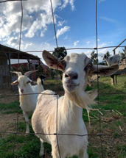
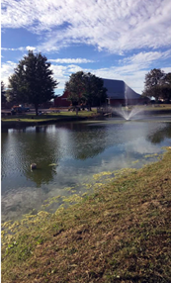
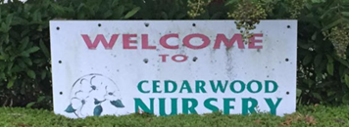
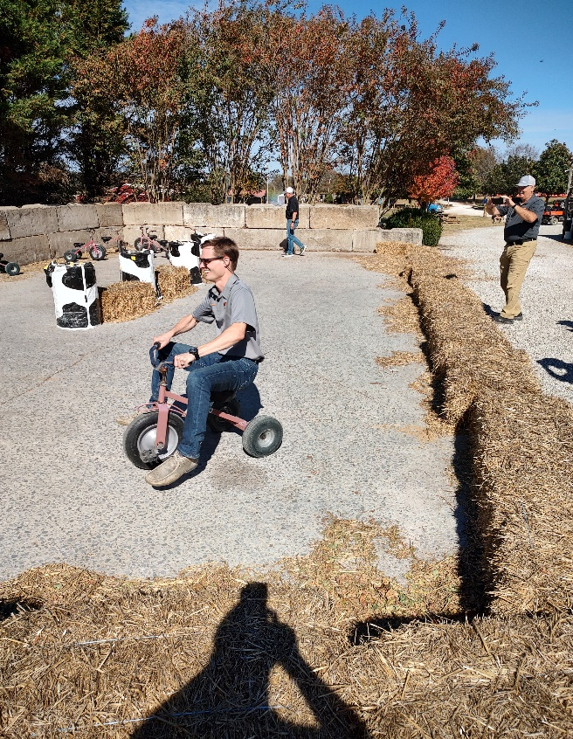

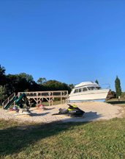
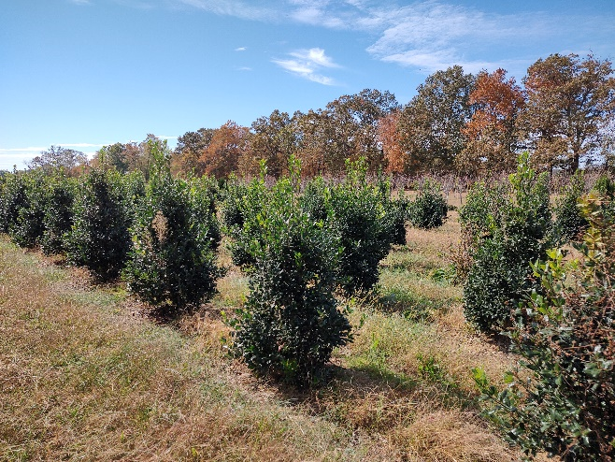
Luke Patterson
Wholesale and Retail 35 years
Containers and B&B trees and shrubs
Evergreens
Pumpkin Patch

Slide 7

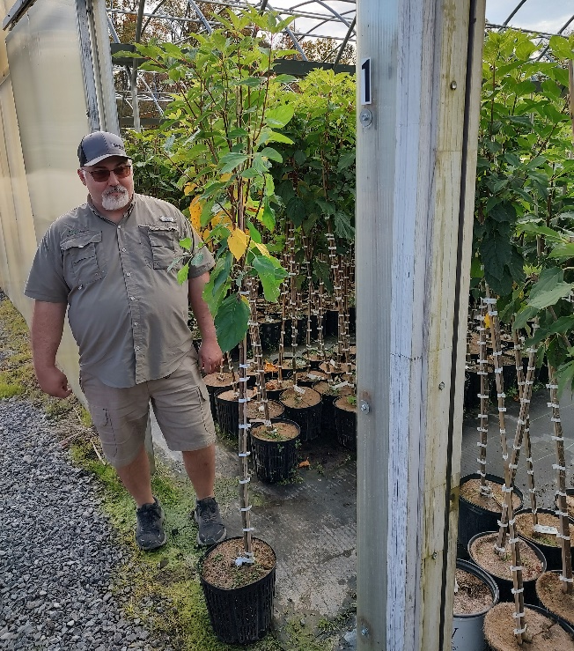

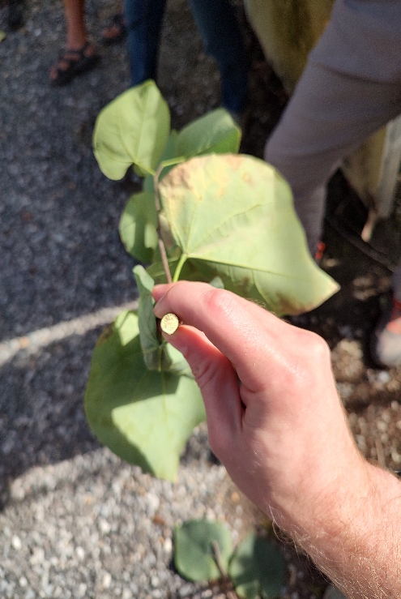
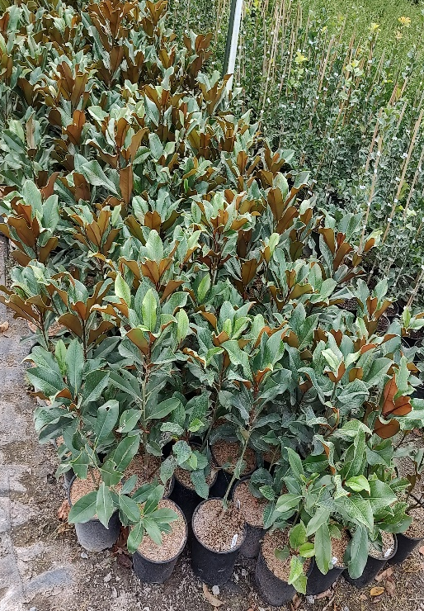

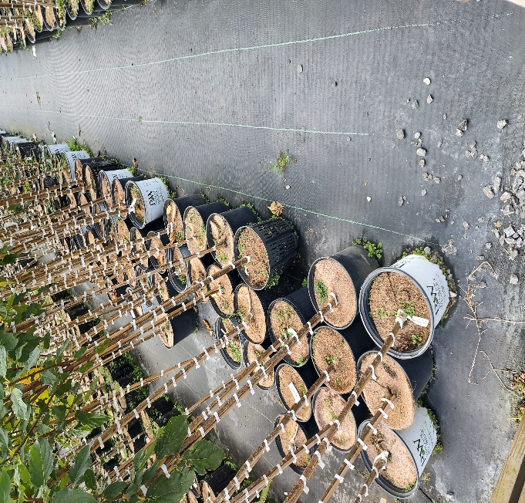
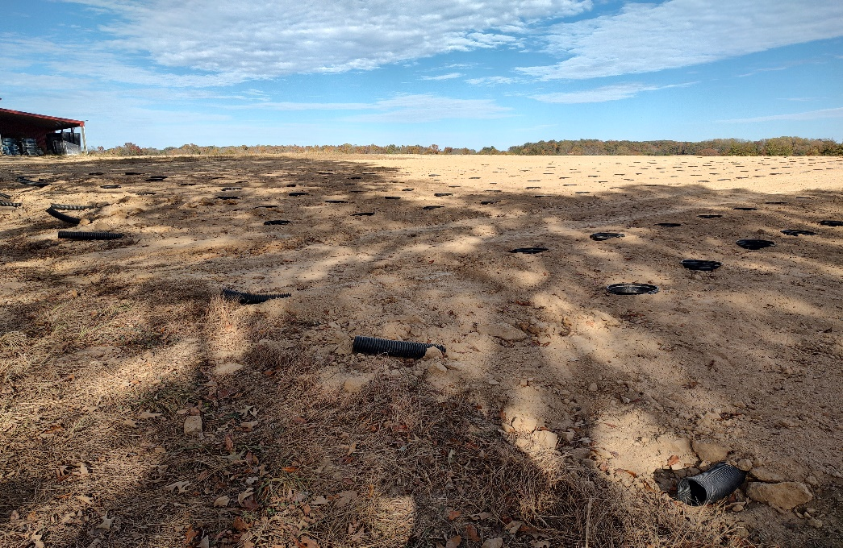
Jerry and Beth
B&B sourced from container liners
Air pruning pots
Sanitizing pruning and timing
New pot in pot production

Slide 8

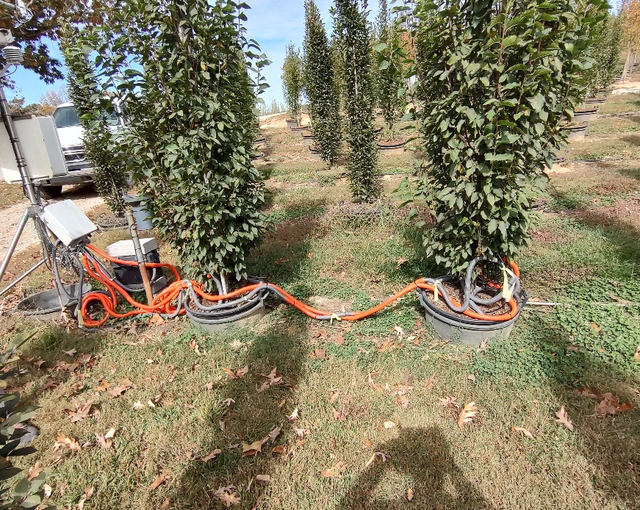

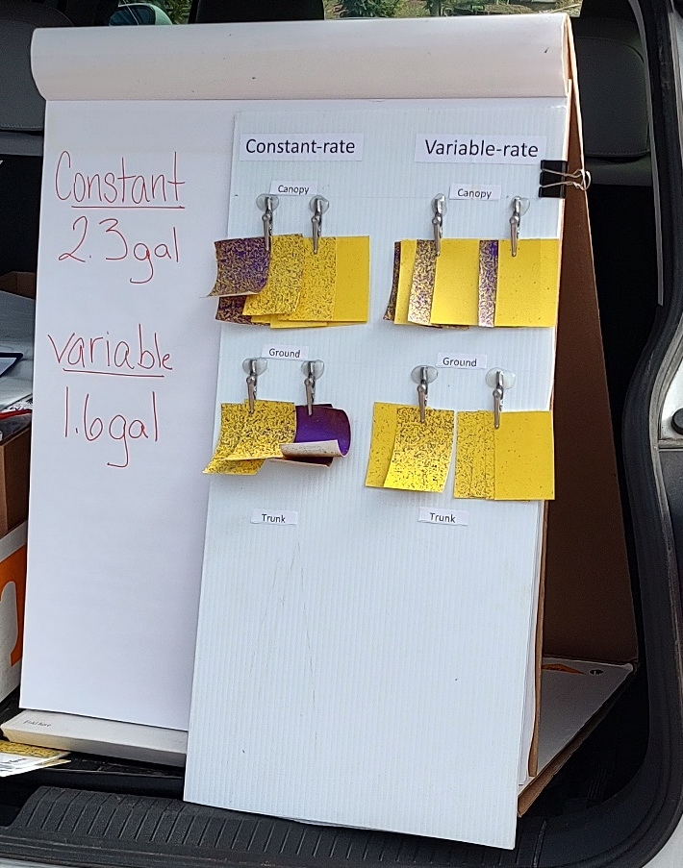
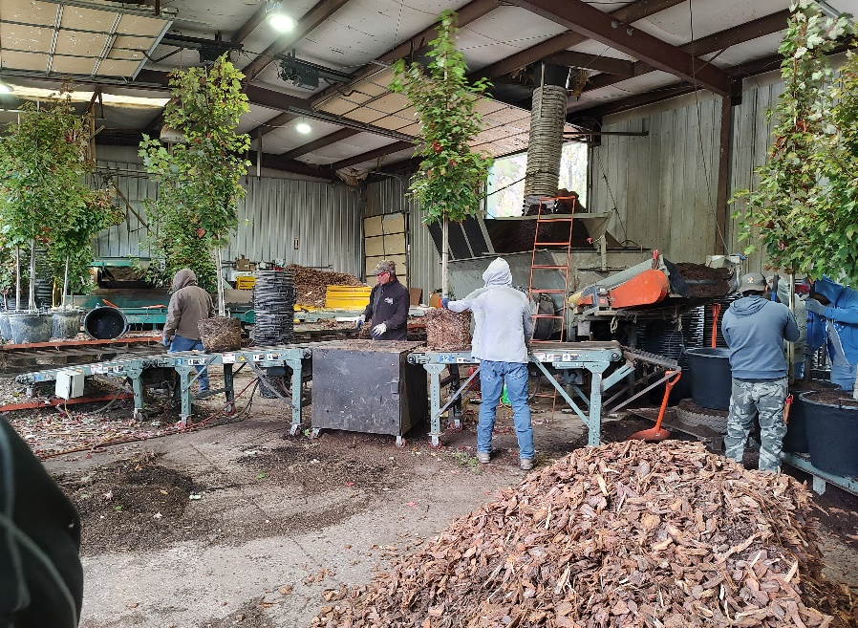
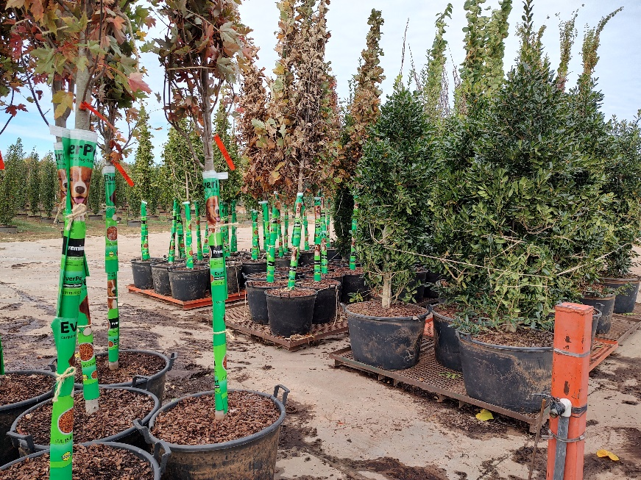
Terry Hines
200 Acres
Specialize in large container produce of shade and flowering trees
400 in containers and 60 field grown

Slide 9
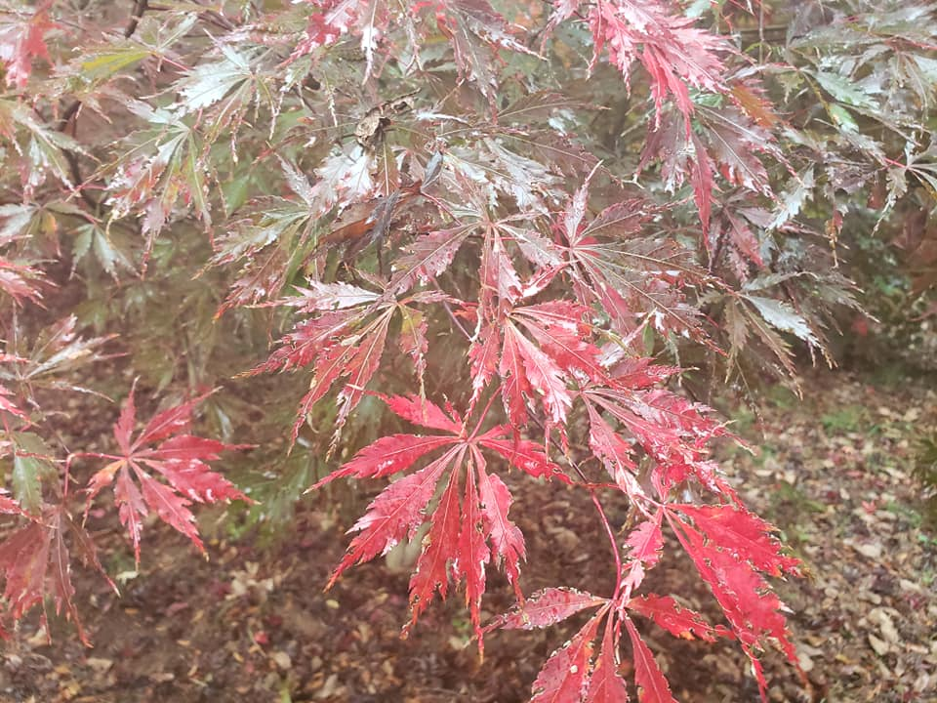

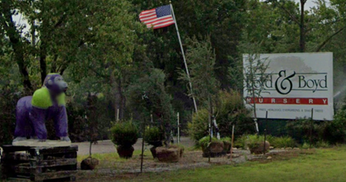
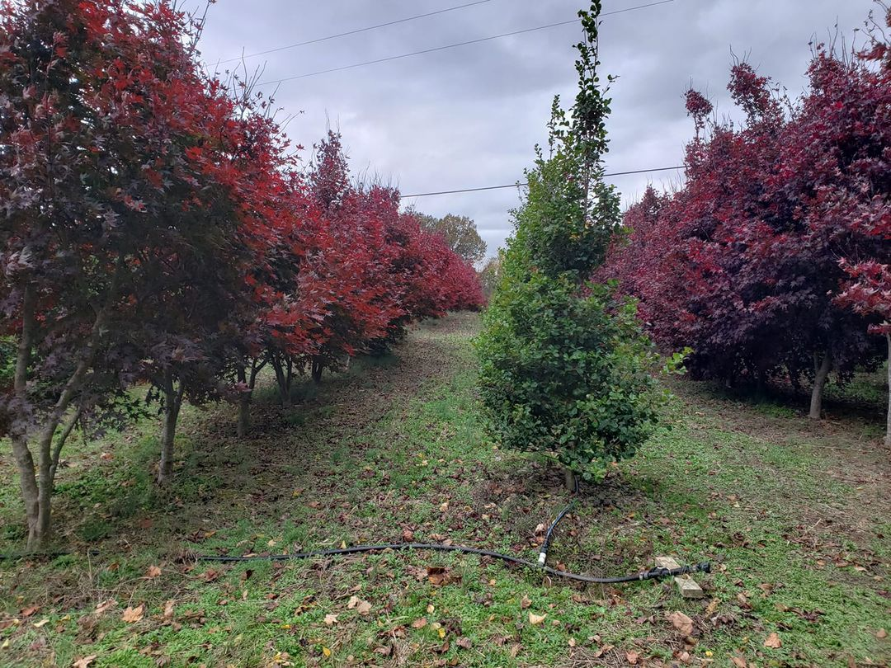
Tommy Boyd owner
Family owned since 1887
Specialize in broadleaf evergreens
Wholesale and retail
Irrigate using county water

Slide 10

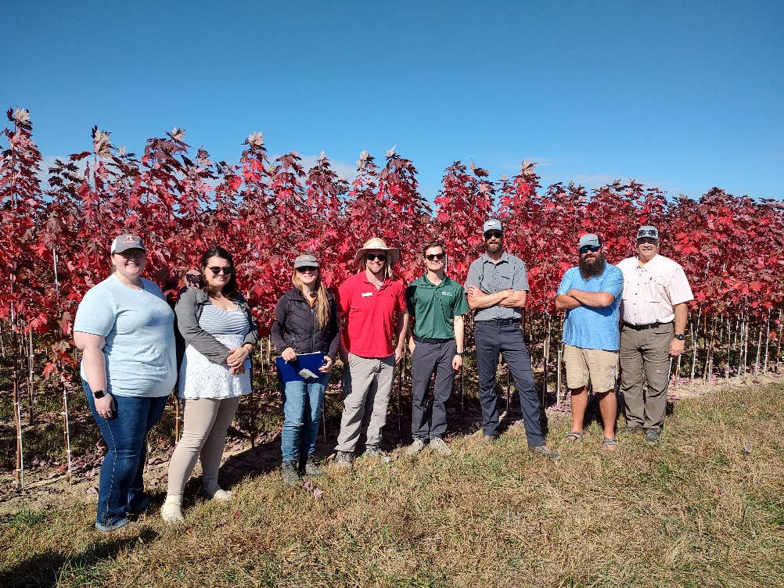
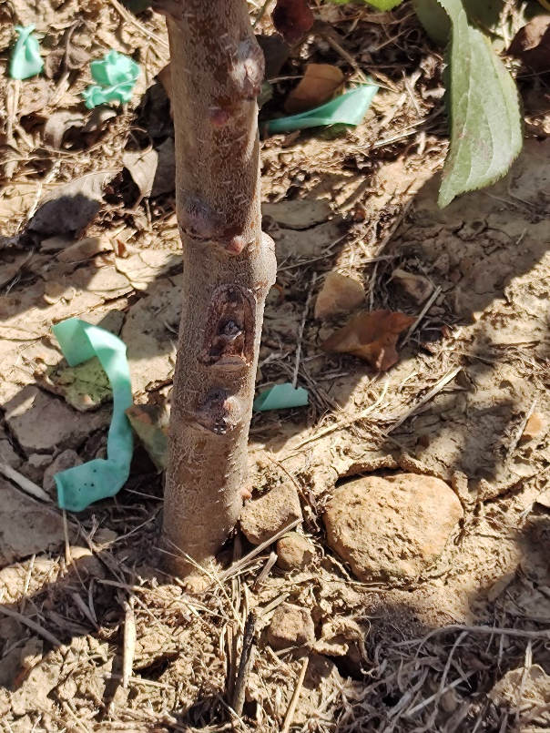
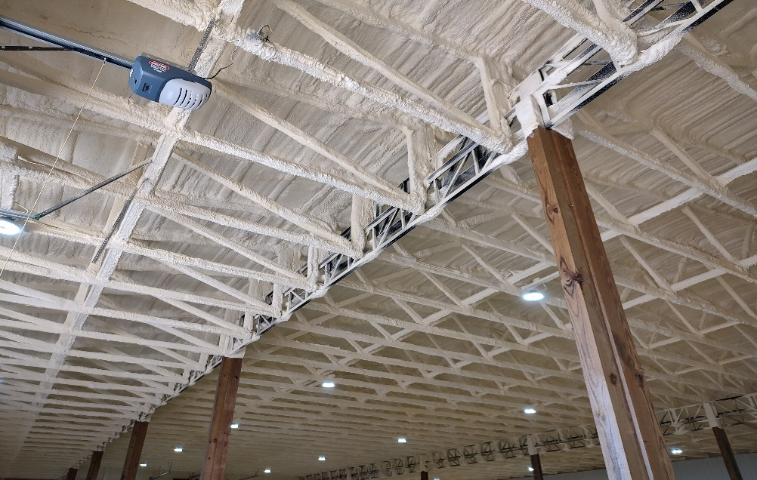
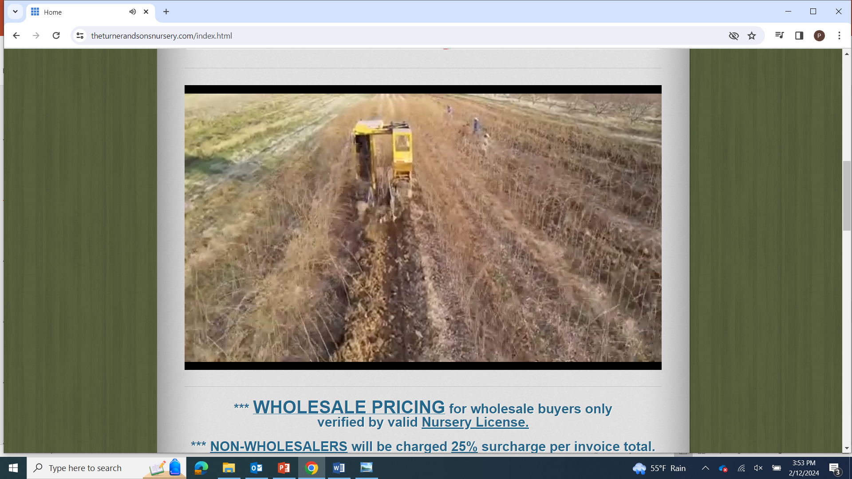
Jon Turner third generation
Over 150 acres
1995 container stock
Wholesale mainly
17 acre container sales yard
Specialize in fruit trees mainly apples and pears

Slide 11
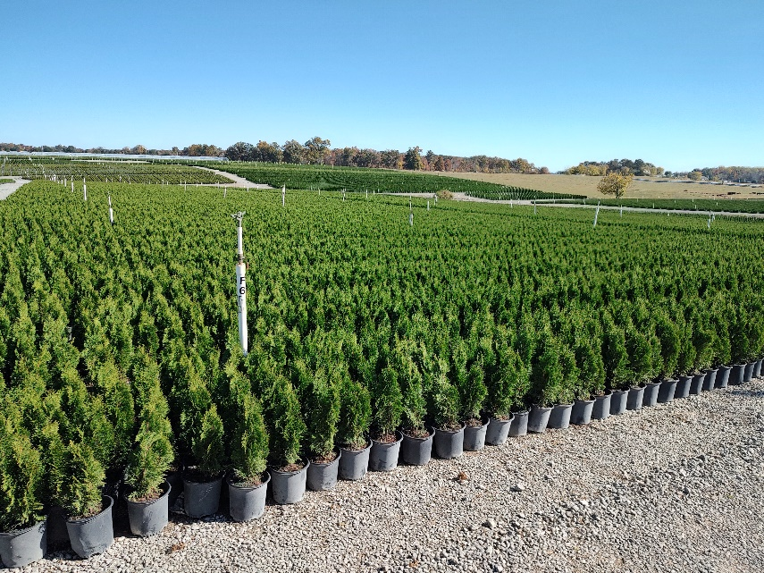
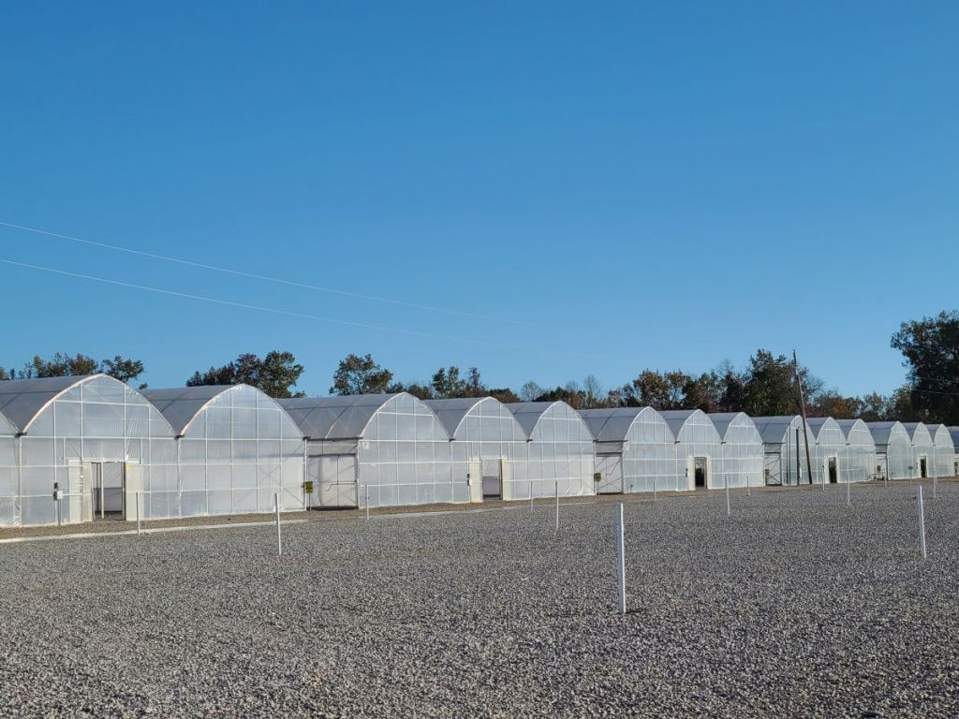
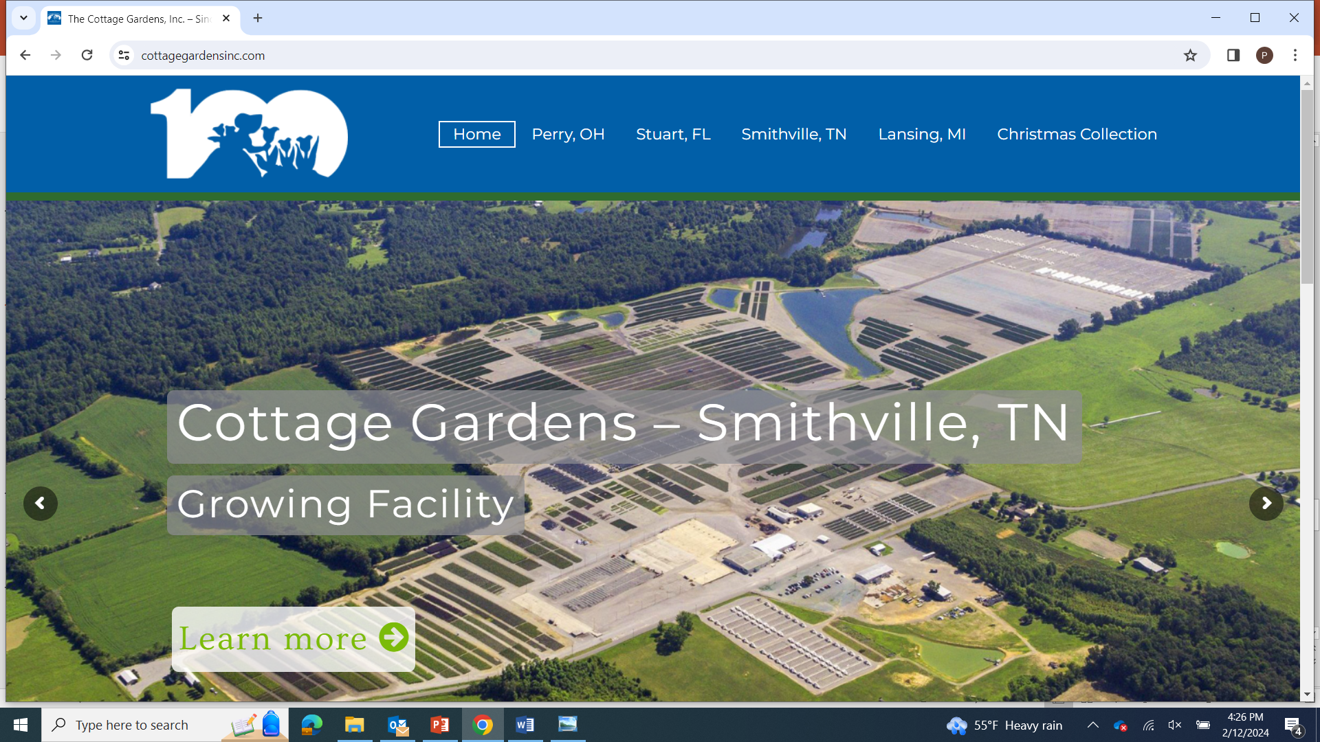
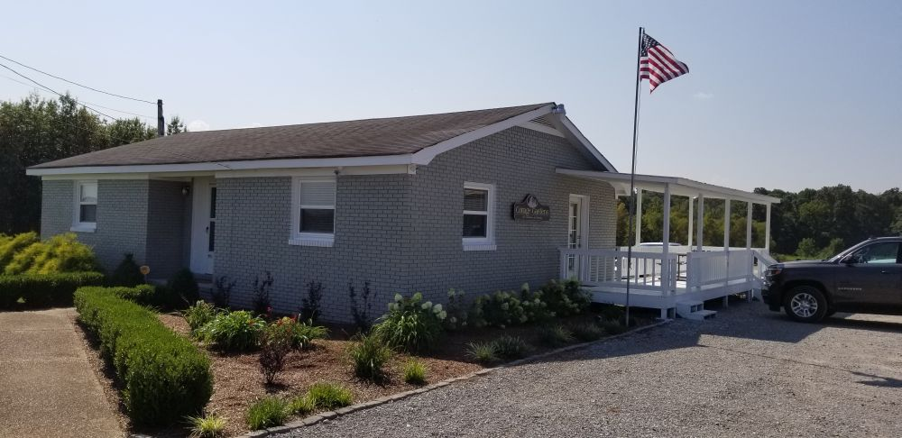
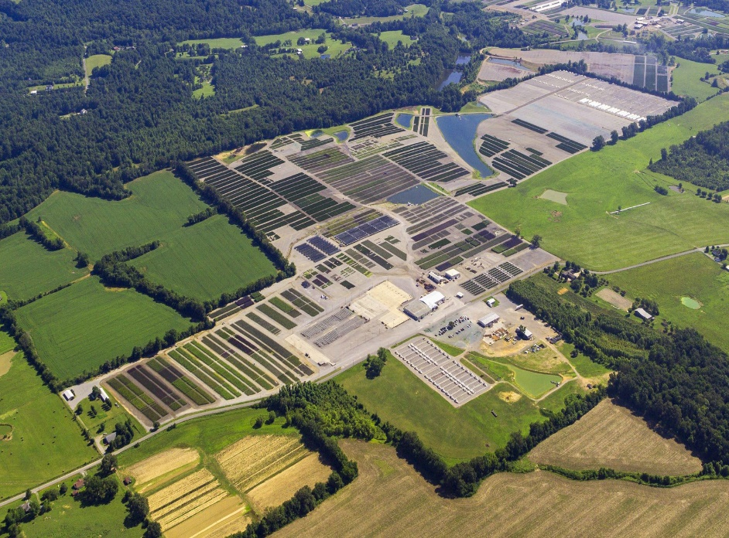
Founded in 1923
Perry, OH , Stuart, FL , Lansing, MI
500 plant varieties
Josh General Manager
300 acres
Container grown fruit, flowering, shade trees
Small fruits – raspberries, blueberries, and blackberries – and assorted shrubs.

Slide 12
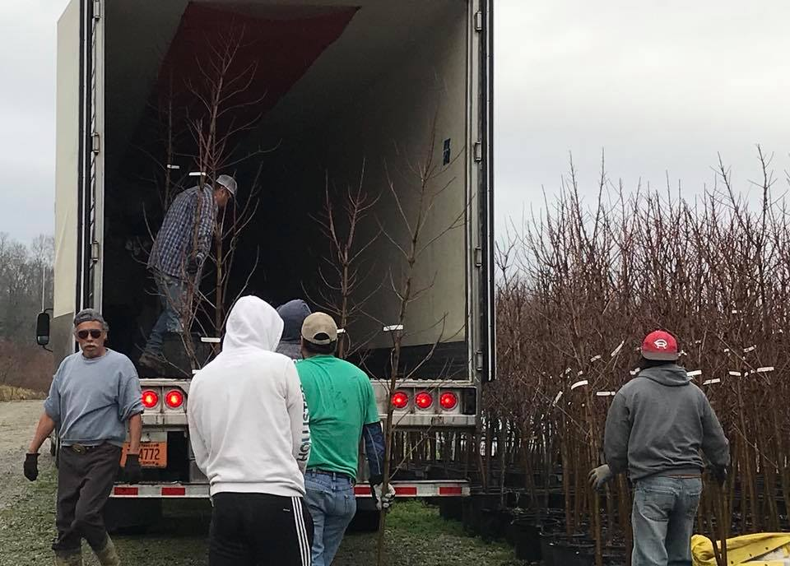

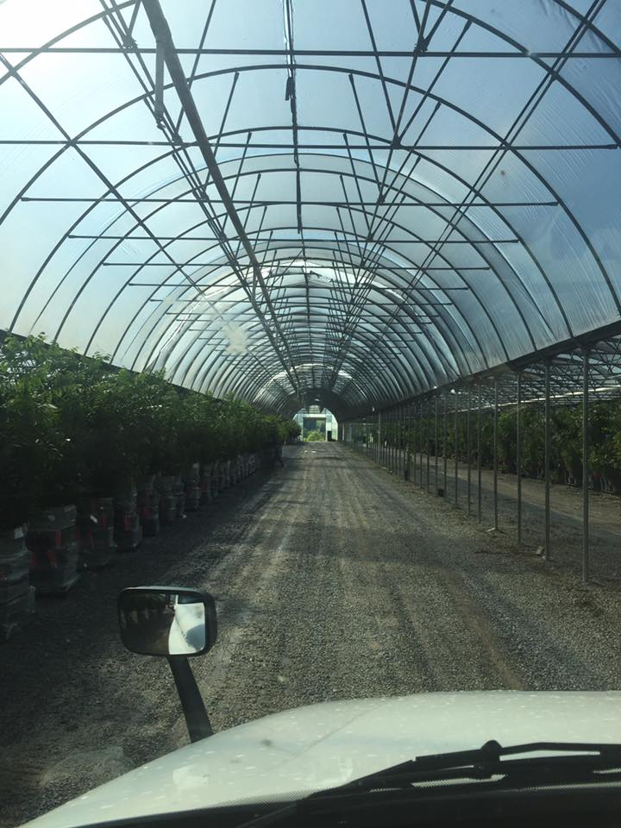
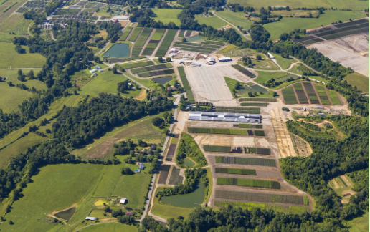
Family owned and operated since 1912
400 acres
Wholesale only
Fruit, shade, flowering and ornamental trees
Berries, nuts, shrubs and evergreens
Hundreds of varieties and sizes in 3, 5, 7 and 15 gallon containers

Slide 13
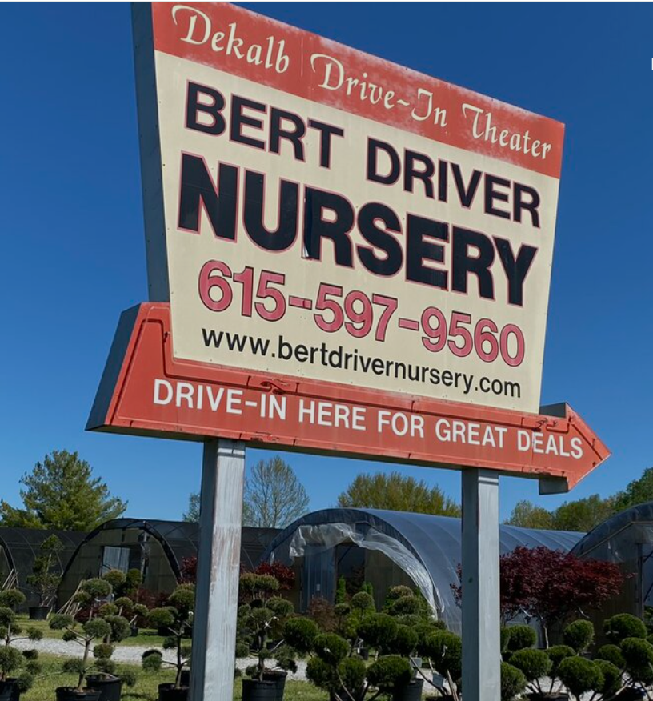
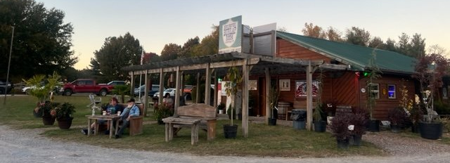
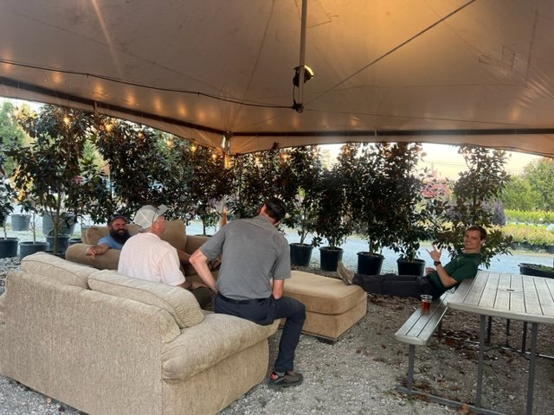
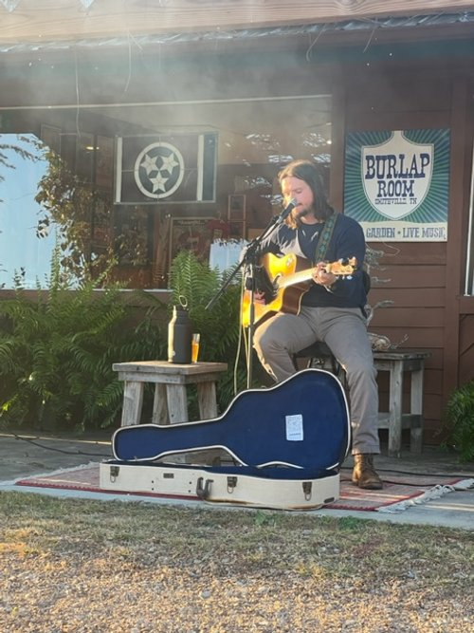
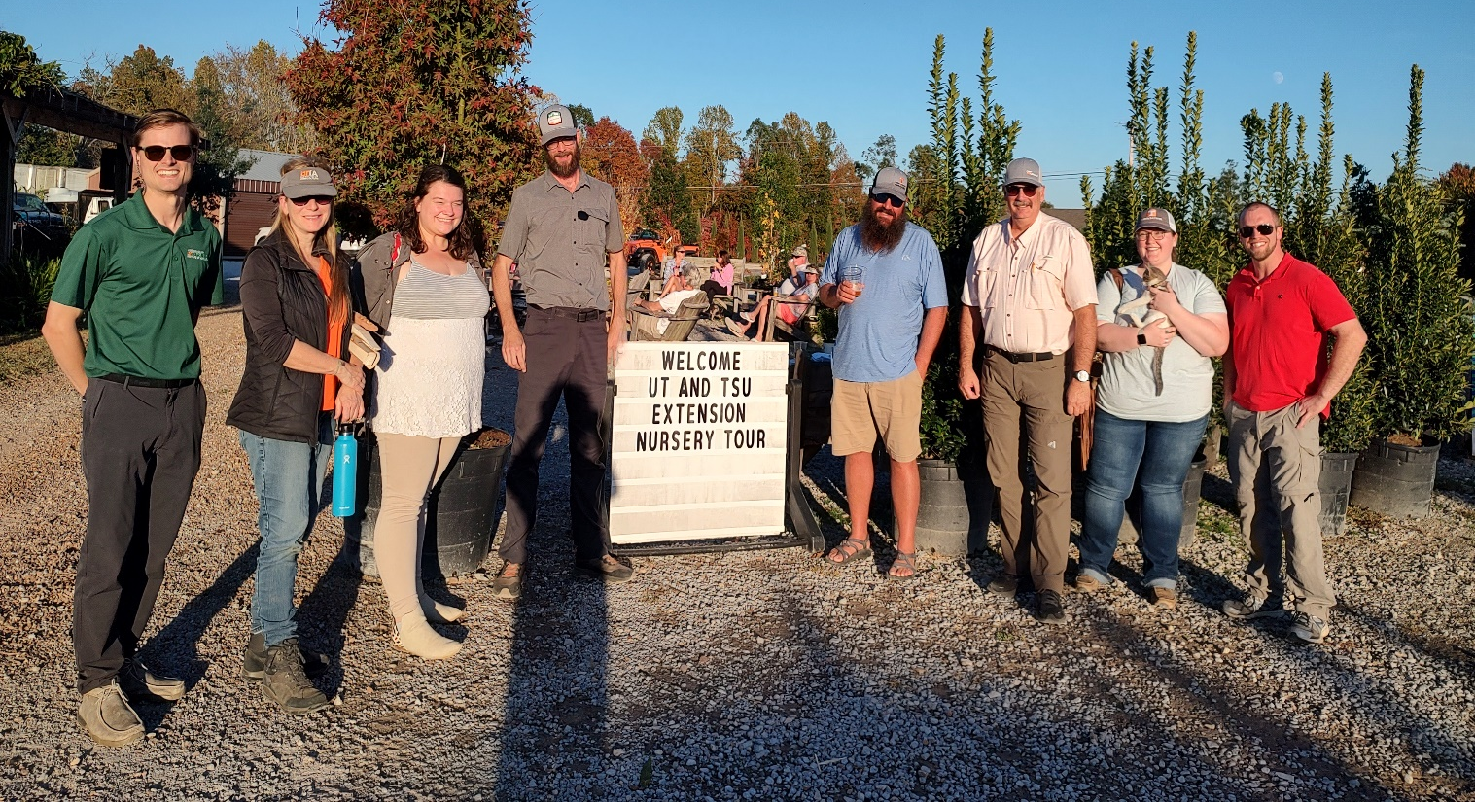
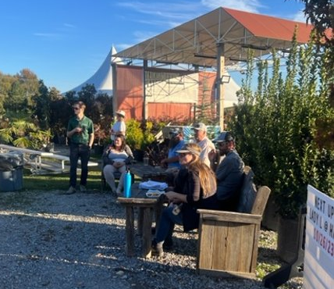

Slide 14
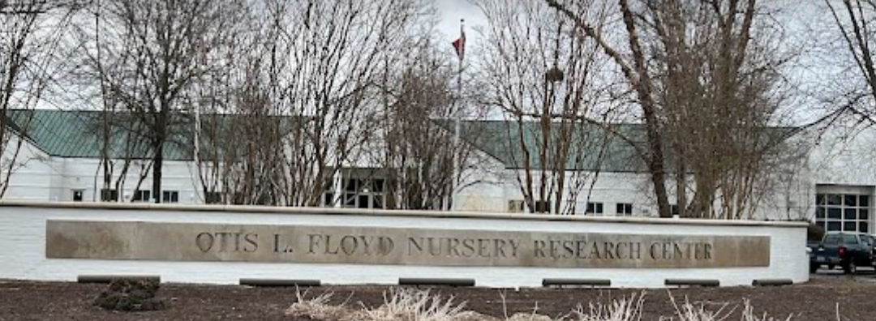


Research and extension programs in entomology, genetics, horticulture, pathology, chemical ecology, sustainability, nursery extension
Produce nursery Extension publications on nursery production, insect control, disease control, and weed control
Dr. Jason Oliver IPM, Bio Control, Semiochemicals/Trap Development
Insect focus groups: Japanese Beetle, Imported Fire Ants, and Wood-Boring Beetles
Dr. Anthony Witcher Sustainable nursery crop production with an emphasis on weed management, crop nutrition, and alternative soil/substrate amendments
Fulya Baysal-Gurel pathology vascular streak disease

Slide 15


2023 Nursery Tour Evaluations
Number of nursery growers | 1
Number of UT Extension Agents/Specialists | 7
Number of TSU Extension Agents/Specialists | 3
Total # of participants | 11
Total # of evaluation form submitted | 8
 | Reported Benefit | Total Possible Benefit | %
This tour helped develop networking relationships with Extension Agents and/or other nursery growers. | 10.0 | 10.0 | 100%
I learned new sustainable agriculture practices. | 9.6 | 10.0 | 96%
Acquired knowledge of research-based practices that reduce pesticide use. | 9.3 | 10.0 | 93%
Acquired knowledge of research-based practices that reduce fertilizer usage. | 9.2 | 10.0 | 92%
Acquired knowledge of research-based practices that reduce irrigation water use. | 9.6 | 10.0 | 96%
I learned about new labor saving-strategies. | 9.2 | 10.0 | 92%
I plan to utilize sustainable agriculture practices in my nursery or include them in my educational programs | 10.0 | 10.0 | 100%
 | $0 - $2,500 | $2,500 - $10,000 | $10,000 - $20,000 | over $20,000 | N/A
What is the economic benefit to you based on knowledge gained and contacts made on the Tour? | 2 | 3 | 1 | 2 | 0

