Slide 1
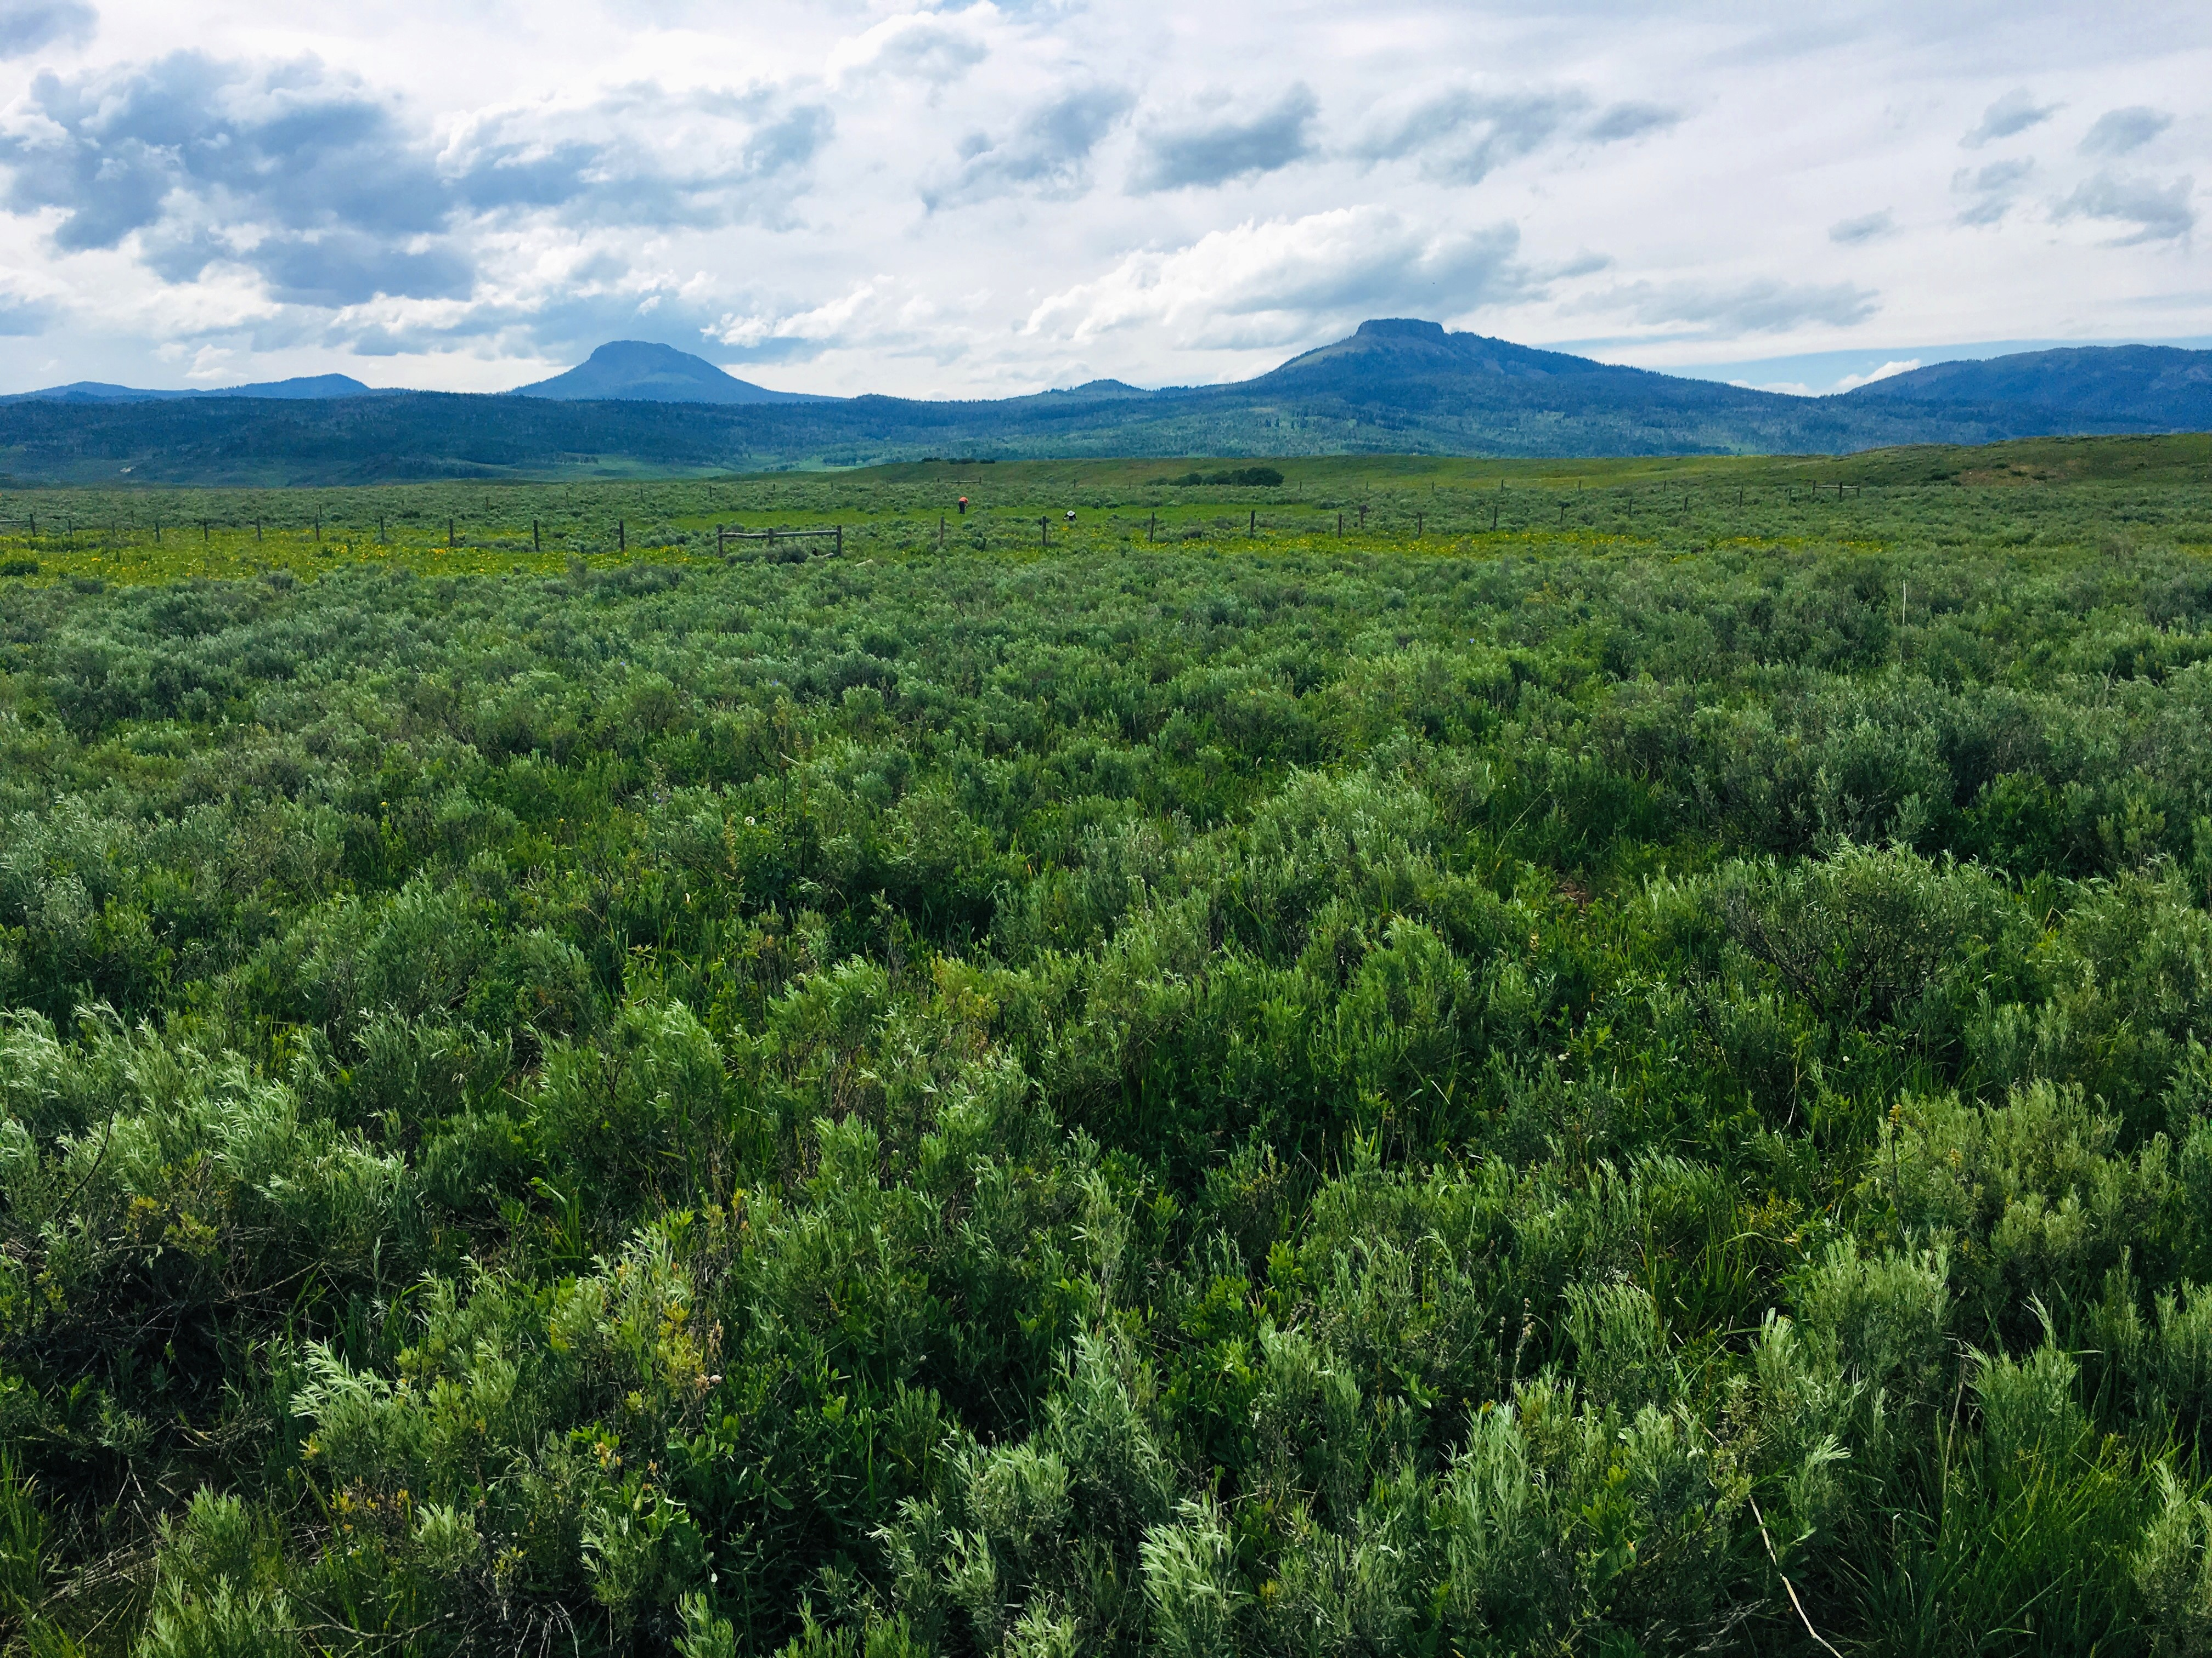


2023 Compost Update
December 14, 2023
Presented By:
Retta Bruegger &
Megan Machmuller
970-988-0043
retta.bruegger@colostate.edu
Notes:
Retta

Slide 2
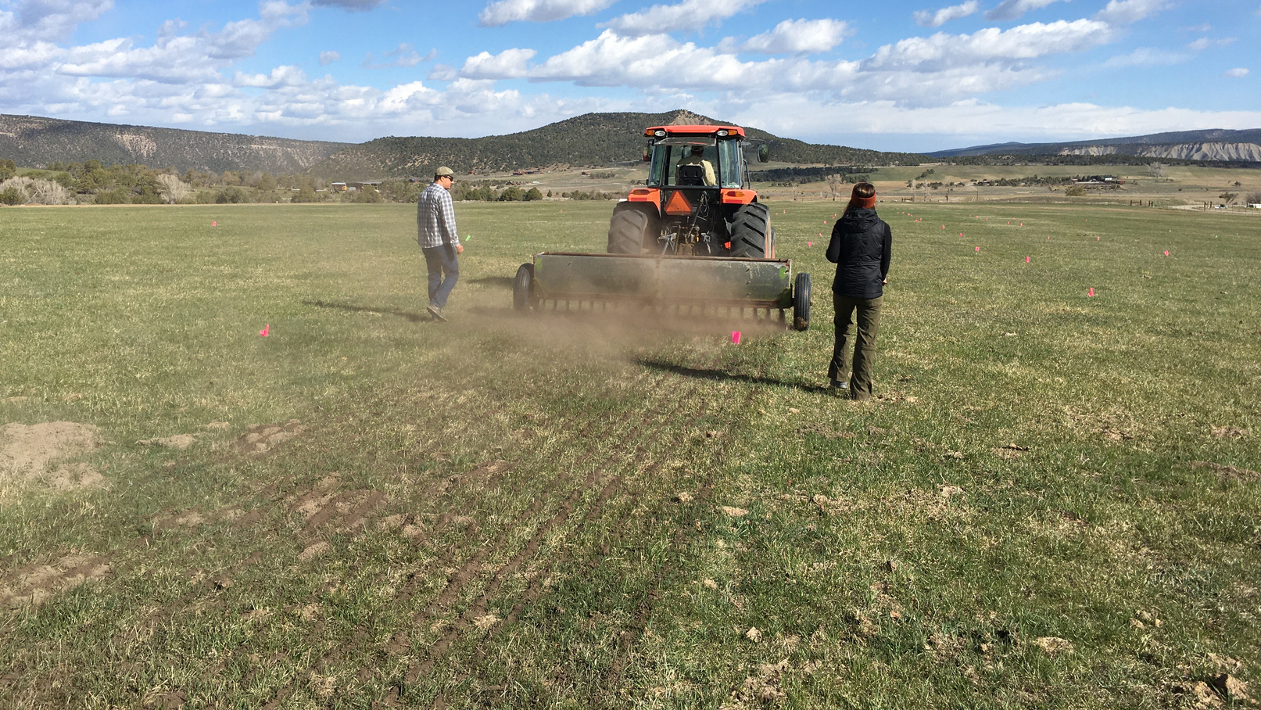

How did we get here?
Notes:
Retta – let's revisit why we did this experiment

Slide 3


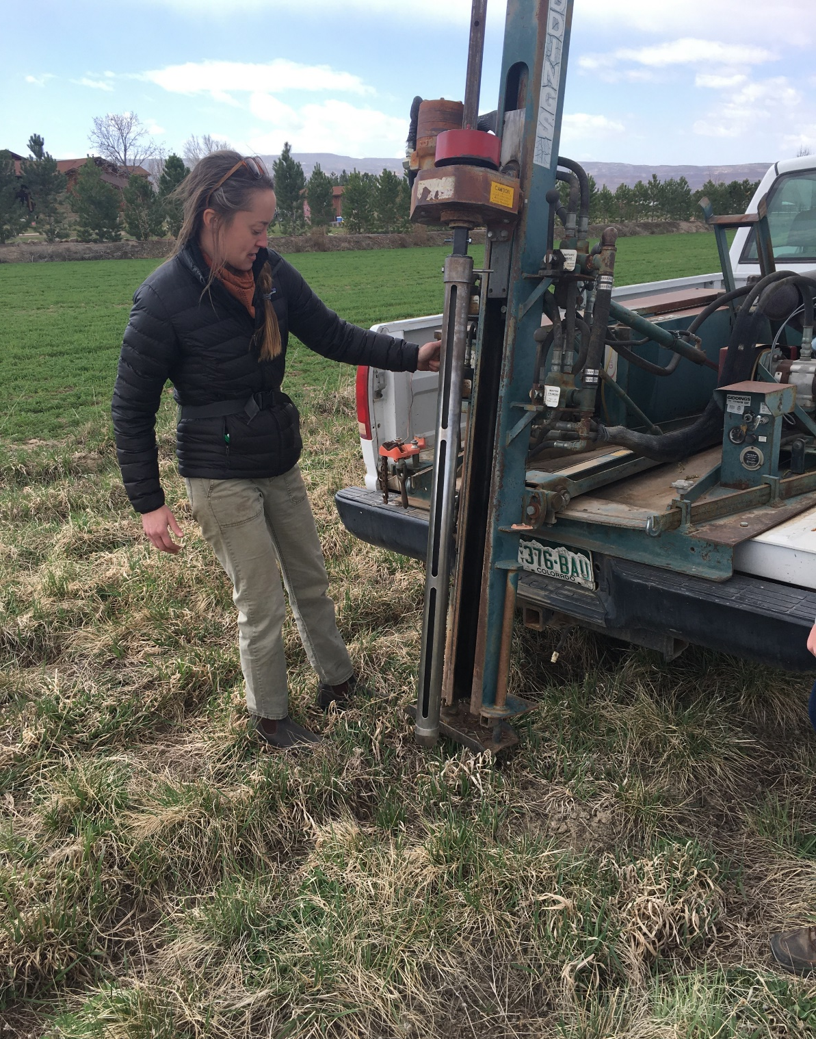
How effective is a 1-time application of compost to
increase soil organic matter and enhance plant growth compared to fertilizer? How appropriate is it for our region?
Project Questions
If effective, we would see an increase in above ground production and below ground soil organic matter and soil C in compost plots
If effective, we would see no adverse impacts from compost compared to fertilizer or doing nothing.
Notes:
Retta

Slide 4
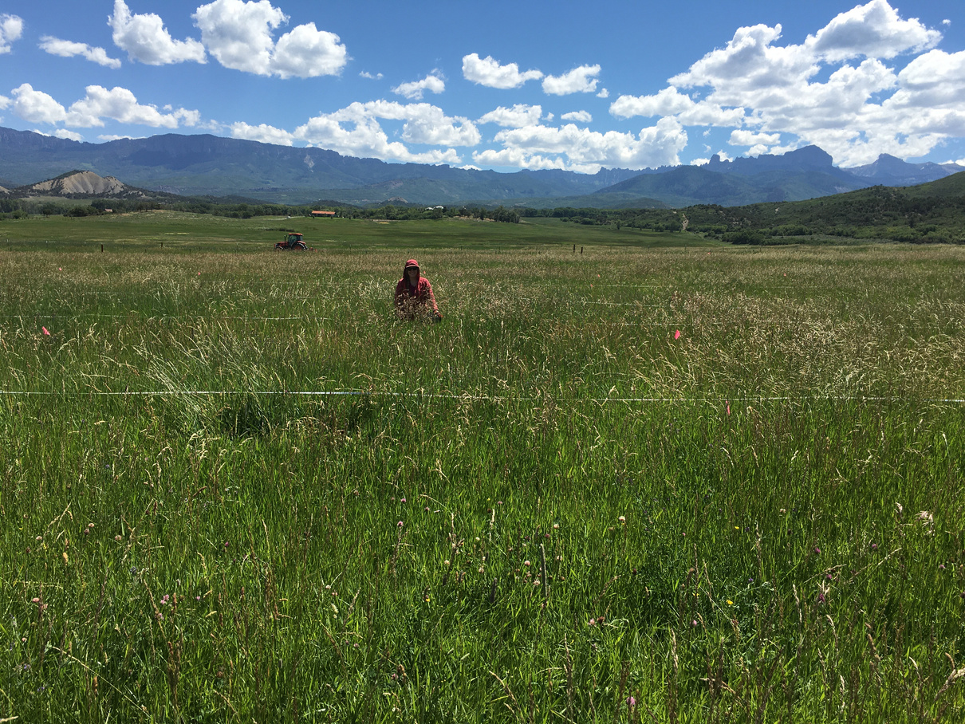
Test the efficacy of a 1-time compost application to..
Project Goals
Increase grass productivity.
01
Collected 2021, 2022, 2023
To sequester carbon and increase soil organic matter.
02
Collected 2022 & 2023
03
To alter species composition.
Collected 2021 & 2023
Notes:
Retta

Slide 5
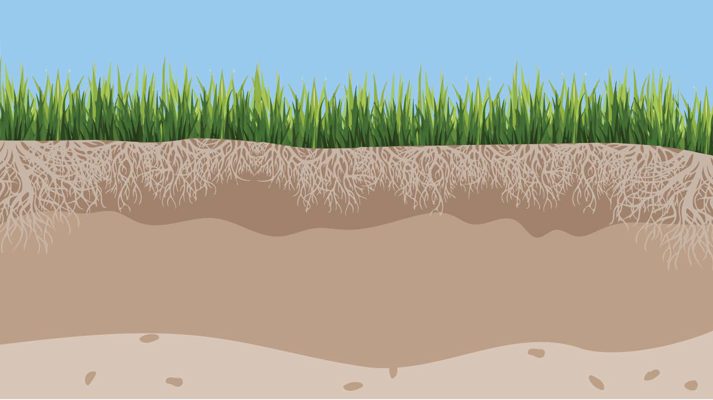



The simple biophysics of soil carbon sequestration
CO₂
CO₂
1. Increase Inputs
2. Decrease outputs
Cover crops & legumes
Manure/compost
Continues rotations
Biochar/Compost
Perennialization
Crop breeding for higher roots
Livestock integration
Agroforestry
No/minimum tillage
Reduce erosion
Avoided drainage
Maintain cover
…..
3. Increase efficiency of soil organic carbon
conversion
? Improved plant-microbiome relationships
? Improved N management
? Improved microbial C use efficiency
Notes:
plant C inputs to soils need to increase and soil C outputs via microbial C mineralization need to decrease, and/or the efficiency of microbial SOC transformations need to increase. Individually or in combo these mechanisms can lead to SOC accrual

Slide 6





You are here
2020
2021
2022
2023
Tested compost sources; picked a source; sampled soils for application rates
Applied compost & treatments; collected biomass & species data; tested soils for end-of-season N
Split plot design; collected soils data; will collect production data
Collect soils data; analyze results; develop recommendations
Timeline
Notes:
Retta

Slide 7
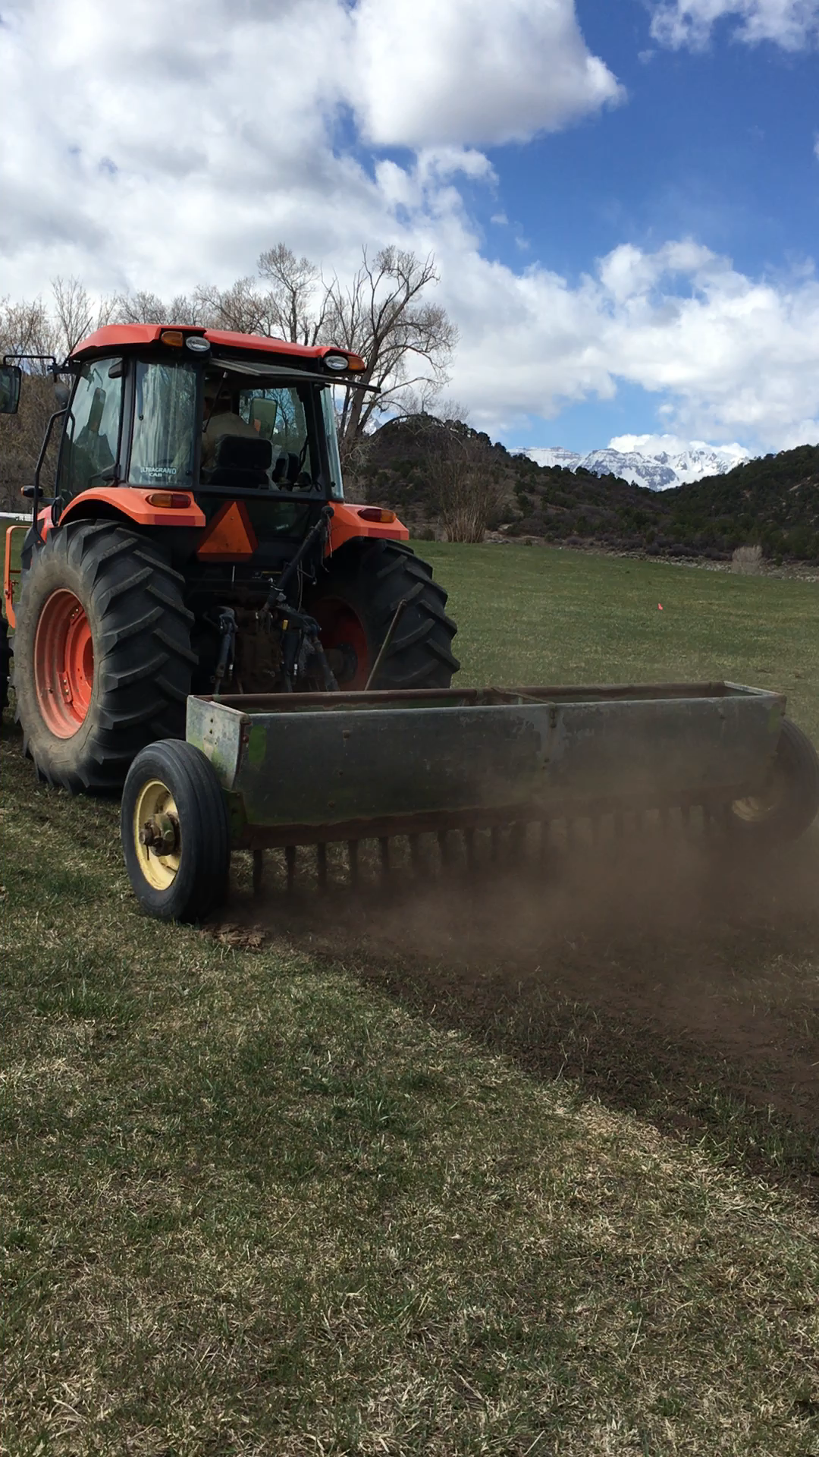
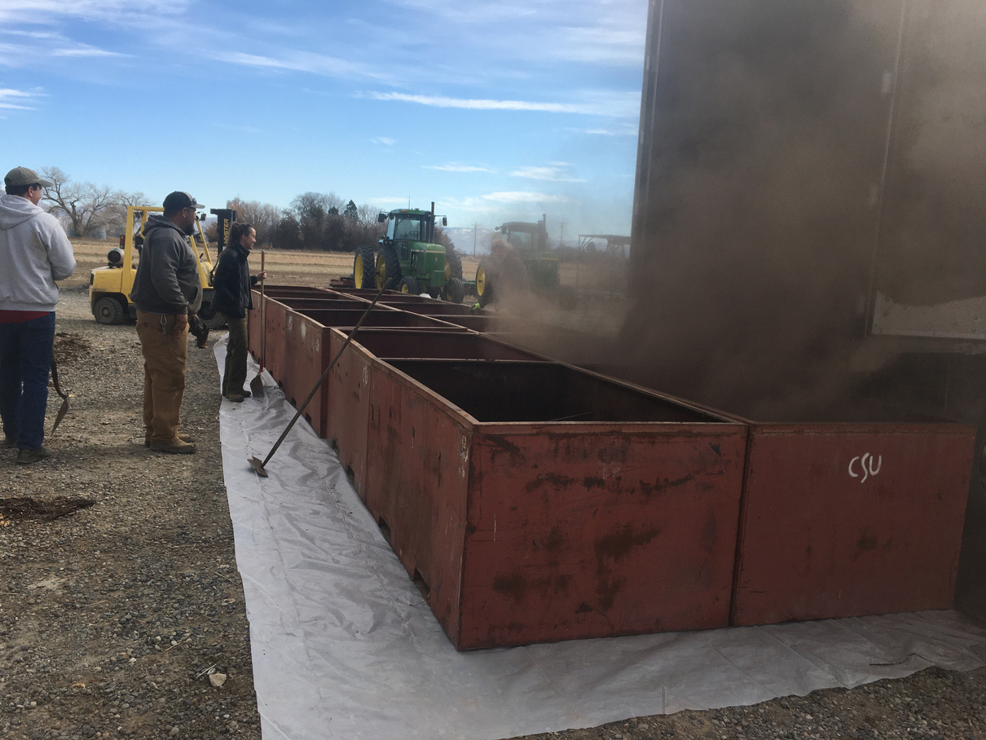

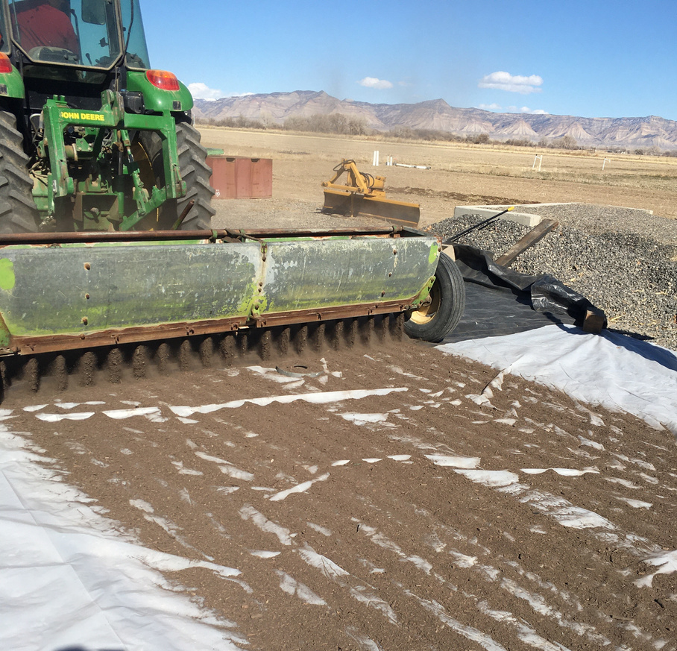
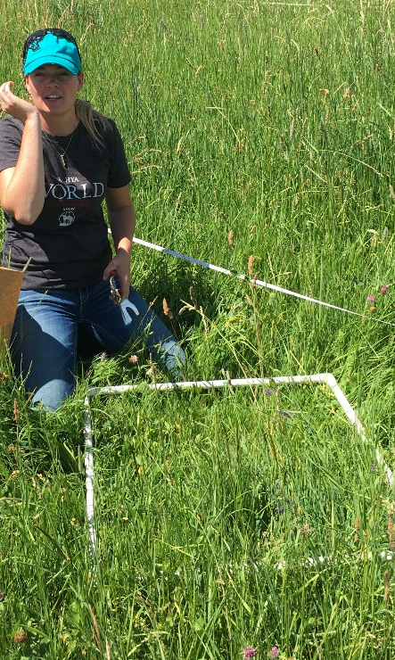
Growing season: Clip biomass plots and collect spp. composition before each cutting
Feb '21 Calculate and calibrate amounts
A trip down memory lane
2021
Fall/Winter '20/21
Test & Acquire Compost
March/ April '21 Spread compost & fertilizer
Fall / Winter ‘20-’21 Feb ’21 March/ April ’21 June/July/Sept. ‘21
Notes:
Retta

Slide 8

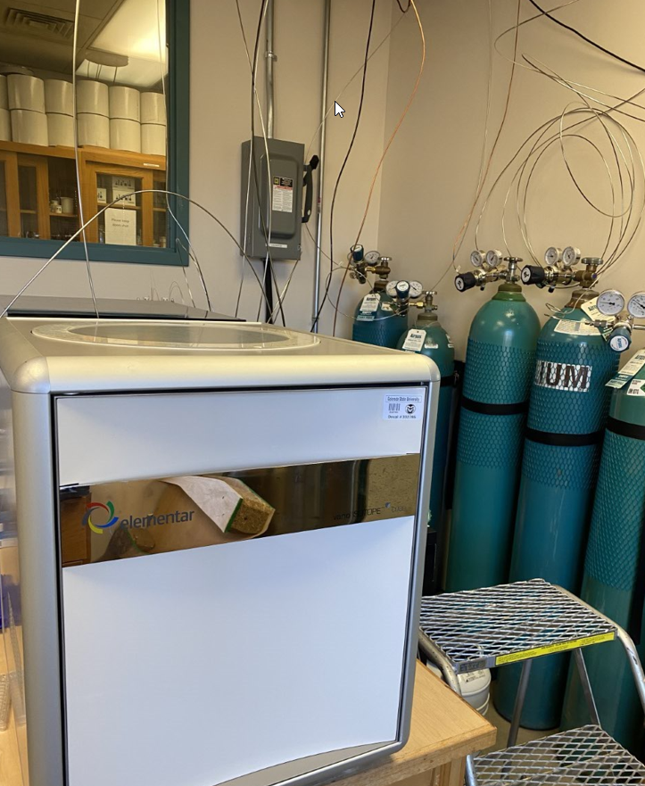
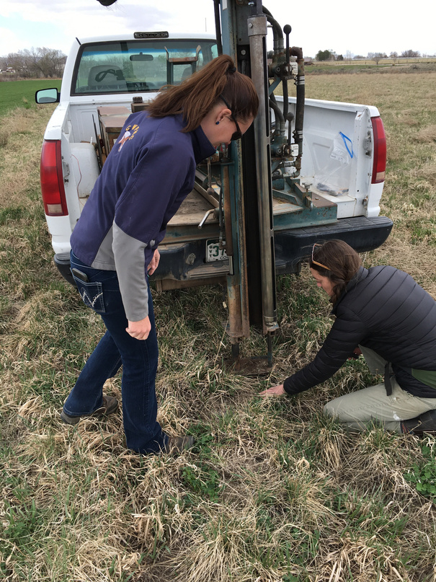
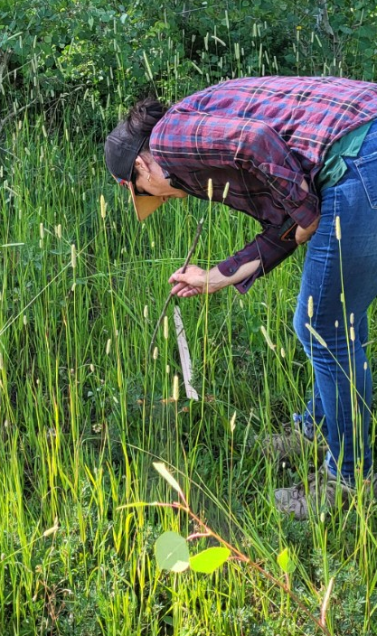
Collection Spp. Composition data
A trip down memory lane
Collect soils data
2022 - 2023
Analyze data
Analyze Soils in Lab
March/April ’22 & ’23 ‘22-’23 June/July ‘21 & ‘23 Fall 2023
Notes:
Retta

Slide 9
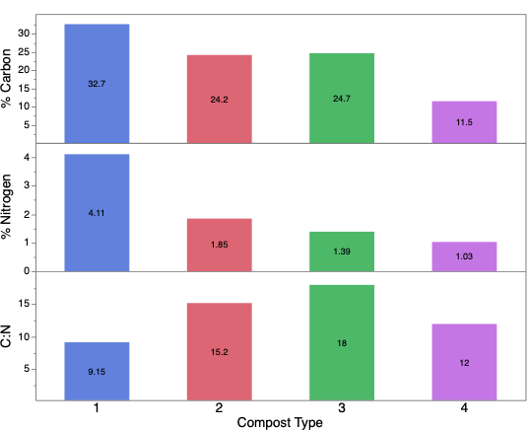

Choosing the Compost...
Moderate C:N Ratio
ØC:N > 20 , woody composts, can increase N fertilizer requirement
ØC:N 10 – 20, less plant available N short-term, but could supply longer-term(slow-release)
ØC:N < 10, more plant N supply in short-term
ØC:N 25-40, average range of manure composts
Notes:
Megan hopes to spend only 30 sec max on each slide for choosing compost...
Compost had moderate C:N ratio, less N available short-term, less leaching and contributes N supply longer-term (slow release) assuming active microbial decomposer activity

Slide 10
Low Soluble Salts
  Calcium (Ca), Potassium (K), Magnesium (Mg), Sodium (Na)
  Indirectly Measured by Electrical Conductivity
  Average (& range)for composts (lbs/ton)
    Salts, 29 (0-134)
Notes:
Megan
Compost had lowest soluble salts~salinity

Slide 11
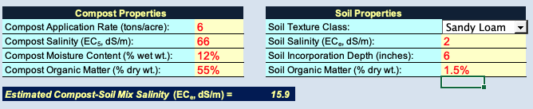


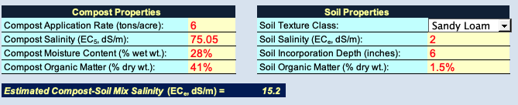
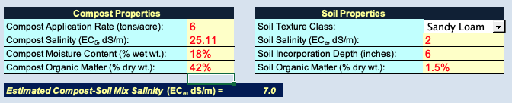
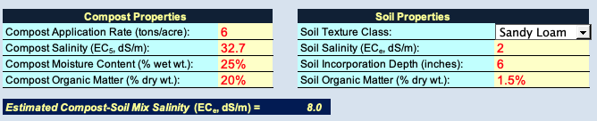
Less Salts = Lower Probability for Salinity Stress
CE
JG
Saline soils EC≥4.0 mmhos/cm
EC ≥ 12 will support a few forage species (tall wheatgrass, pubescent wheatgrass, alkali sacaton, Russian wildrye
EC ≥ 30 will not grow forage
3XM
TK
Estimation of Compost-Soil Mixture Salinity
Notes:
Megan
Compost had lowest salinity

Slide 12
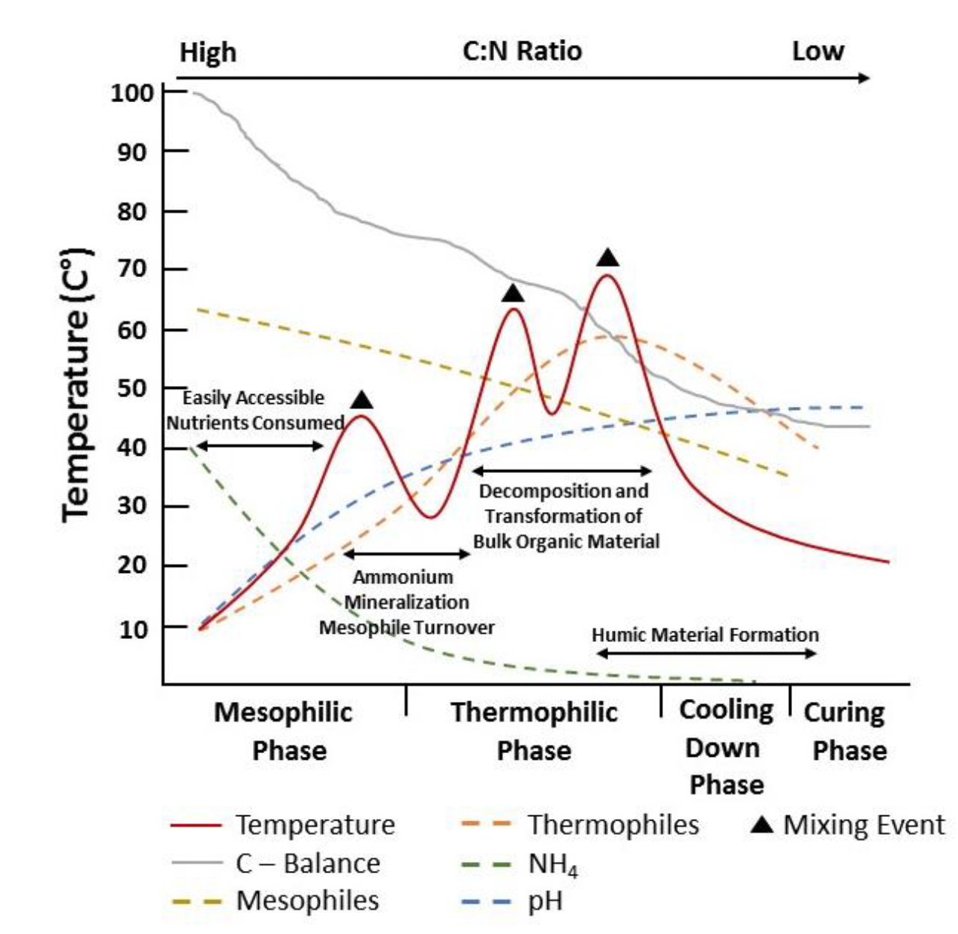
Highest Fungal:Bacterial Ratio
Phases of Composting
Compost Type
DNA copies / kg soil | 1 | 2 | 3 | 4
Total Microbial Biomass *10⁷ | 0.7 | 1.1 | 0.03 | 0.01
Fungi | 1.7 | 9.8 | 59.4 | 22.8
Microbial Biomass
  Highest → Lowest
  2 > 1 > 3 > 4
Fungal : Bacteria Ratio
Highest → Lowest
3 > 4 > 2 > 1
Image Adapted from Fischer 2012 (From Ward Guide)
Notes:
Megan
Compopst had highest F:B ratio

Slide 13
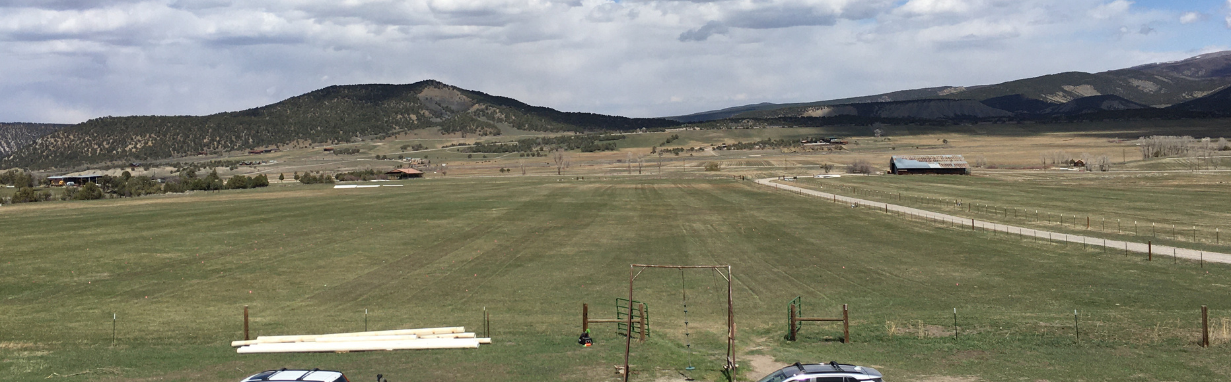
Experimental Design
Compost Only x 6
Compost + Fertilizer x 6
Fertilizer Only x 6
Control x 6
Sites x 2
Compost Only
Notes:
Retta

Slide 14
Experimental Design
Compost Only x 6
Compost + Fertilizer x 6
Fertilizer Only x 6
Control x 6
Sites x 2
Compost + Fertilizer

Slide 15
Experimental Design
Compost Only x 6
Compost + Fertilizer x 6
Fertilizer Only x 6
Control x 6
Sites x 2
Fertilizer Only

Slide 16
Experimental Design
Compost Only x 6
Compost + Fertilizer x 6
Fertilizer Only x 6
Control x 6
Sites x 2
Controls

Slide 17
Plot Layout – Original in 2021
*10 ft buffers between each treatment (not shown)
101
10 ft
102
Block 1
104
103
Control
202
240 ft (73 m)
Compost
204
Fertilization
Block 2
Irrigation Pipe
201
Compost + Fertilization
203
302
304
Block 3
303
301
50 ft
360 ft (110 m)
Notes:
Note: Megan addresses C and NPK amt on slides 19-20
Fruita Fertilizer Treatment: 50-40-40 NPK obtained from muriate of potash/KCl (0-0-60), MAP (11-52-0), and urea (46-0-0).
Ridgway Fertilizer Treatment: 90-50-0 NPK needed. Obtained from MAP (11-52-0), and urea (46-0-0).
Fruita Fertilizer+Compost Treatment: Compost applied at 6 tons/acre. 28.8 lbs N and all other nutrients supplied with 6 tons compost/acre. Additional 21.2 lbs N/acre supplied with urea (for total N of 50 lbs/acre)
Fruita Compost Treatment: Compost applied at 10.4 tons/acre; Total N = 50 lbs/acre in the first year, 46.9 Organic N, and 3.1 Inorganic N (from Application Calcs.xls)
Ridgway Compost Treatment: Compost applied at 18.8 tons/acre; Total N = 90 lbs/acre in the first year, 84.4 Organic N, and 3.1 Inorganic N (from Application Calcs.xls)
Plot IDs: [Block #, 0, Treatment #], Control=1, Compost Only=2, Fert Only=3, Compost+Fert=4

Slide 18
Plot Layout – Modifications in 2022
*10 ft buffers between each treatment (not shown)
101
101B
10 ft
102
102B
Block 1
104
104B
103
103B
Control
202
202B
240 ft (73 m)
Compost
204
204B
Fertilization
Block 2
Irrigation Pipe
201
201B
Compost + Fertilization
203
203B
302
302B
Control
304
304B
Compost ‘21 + Fertilization ‘22
Block 3
303
303B
Fertilization ‘21 + Fertilization ‘22
301
301B
Compost ‘21 & Fertilization‘21 + Fertilization ’22
50 ft
360 ft (110 m)
Notes:
Retta starts; Megan fill in
Megan addresses C and NPK amt on slides 19-20
Fruita Fertilizer Treatment: 50-40-40 NPK obtained from muriate of potash/KCl (0-0-60), MAP (11-52-0), and urea (46-0-0).
Ridgway Fertilizer Treatment: 90-50-0 NPK needed. Obtained from MAP (11-52-0), and urea (46-0-0).
Fruita Fertilizer+Compost Treatment: Compost applied at 6 tons/acre. 28.8 lbs N and all other nutrients supplied with 6 tons compost/acre. Additional 21.2 lbs N/acre supplied with urea (for total N of 50 lbs/acre)
Fruita Compost Treatment: Compost applied at 10.4 tons/acre; Total N = 50 lbs/acre in the first year, 46.9 Organic N, and 3.1 Inorganic N (from Application Calcs.xls)
Ridgway Compost Treatment: Compost applied at 18.8 tons/acre; Total N = 90 lbs/acre in the first year, 84.4 Organic N, and 3.1 Inorganic N (from Application Calcs.xls)
Plot IDs: [Block #, 0, Treatment #], Control=1, Compost Only=2, Fert Only=3, Compost+Fert=4

Slide 19
NPK Ratio
1-1-1
1-4-2
1-1-2
1-1-2
Application Rates
Rate of application determined by...
NPK concentrations in compost
Forage NPK needs
Soil NPK concentrations
Notes:
Megan
Compost additions based on N needs (forage needs minus N content of soil), With the NPK content of the compost, soil, we can determine how much to add based on forage productivity NPK needs. We optimized amendments based on N first...NEXT SLIDE
Fruita Fertilizer Treatment: 50-40-40 NPK obtained from muriate of potash/KCl (0-0-60), MAP (11-52-0), and urea (46-0-0).
Ridgway Fertilizer Treatment: 90-50-0 NPK needed. Obtained from MAP (11-52-0), and urea (46-0-0).

Slide 20
Treatment Amendments - NPK
Site | Treatment | Compost Mass (tons/acre) | Compost-C (tons/acre) | Compost-N (lbs/acre) | Fert-N (lbs/acre) | P (lbs/acre) | K (lbs/acre)
Ridgeway | Compost | 18.8 | 4.69 | 90 | --- | 347 | 628
Fruita | Compost | 10.4 | 2.60 | 50 | --- | 193 | 349
Ridgeway | Fert+Compost | 6 | 1.50 | 28.8 | 61.2 | 111 | 201
Fruita | Fert+Compost | 6 | 1.50 | 28.8 | 21.2 | 111 | 201
Ridgeway | Fert | 0 | --- | --- | 90 | 50 | ---
Fruita | Fert | 0 | --- | --- | 50 | 40 | 40
Compost Amendments first optimized for forage N requirements (accounted for existing soil N)
Compost P & K concentrations exceeded forage requirement
Notes:
Megan
Not sure if we also want to present the P and K additions, but might as well leave in?
Ridgway NPK needs = 90-50-0 NPK, Fruita NPK needs = 50-40-40
Compost additions based on N needs (forage needs minus N content of soil), compost amt required to meet N requirements included greater P and K than required, so did not add any additional in any compost treatment (compost only, or fert+compost)

Slide 21
Test the efficacy of a 1-time compost application to..
Project Goals
Increase grass productivity.
01
Collected 2021, 2022, 2023
To sequester carbon and increase soil organic matter.
02
Collected 2022 & 2023
03
To alter species composition.
Collected 2021 & 2023
Notes:
Retta

Slide 22
Test the efficacy of a 1-time compost application to..
Project Goals
Increase grass productivity.
01
Collected 2021, 2022, 2023
To sequester carbon and increase soil organic matter.
02
Collected 2022 & 2023
03
To alter species composition.
Collected 2021 & 2023
Notes:
Retta

Slide 23
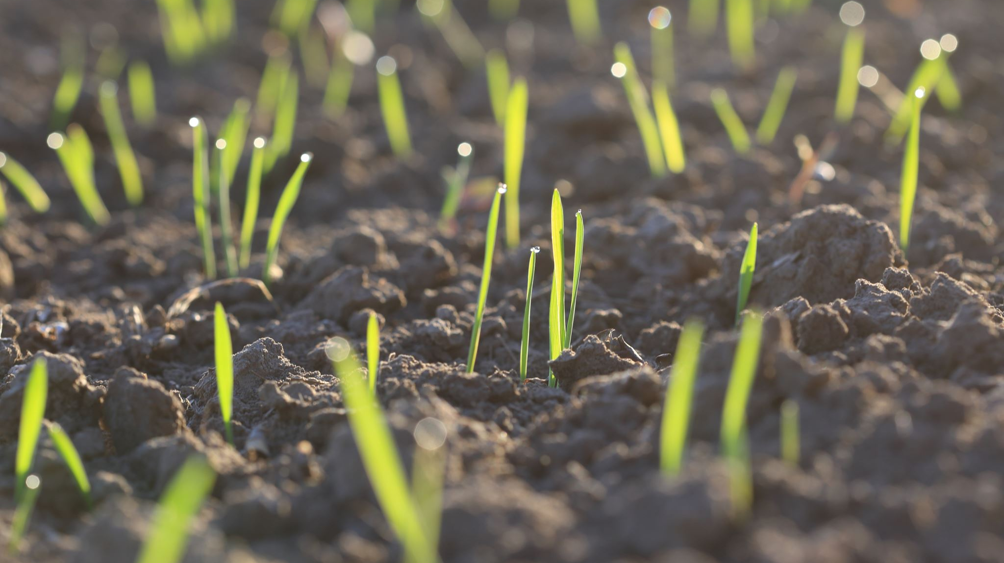
H1: Compost will lead to equal or increased production compared to commercial fertilizer.
Notes:
Studies in CA evaluated it on range – where it did in general, increase productivity. However, in a pasture situation, one would be fertilizing anyway. So, the goal in ours was to see if compost could perform similarly to fertilizer.

Slide 24
Compost plots were less productive (p = 0.008) compared to fertilized plots and were not different than controls (i.e., untreated).
Notes:
Fertilizer significantly higher than compost
Years sig different but we don’t really care.
Issues with controls in Fruita
Lag in growth in compost plots doesn’t translate into year 2 lags
Compost requires microbial breakdown - how long does it take
Prod2$Tx <- factor(Prod2$Tx, levels = c ('Control', 'Compost', 'Fertilizer', 'Fert+Compost’))
ggplot(data = Prod2, aes(x = interaction(Year, Site), y = YieldLbs, fill = Tx)) + stat_boxplot(geom="errorbar") + geom_boxplot() + ggtitle(NULL) +xlab (NULL) + ylab("Lbs/ Acre Forage Production") + theme(axis.text = element_text(size = 14),axis.title = element_text(size = 14)) + theme(legend.text = element_text(size = 12), legend.title = element_text(size = 12, hjust = 0.5), legend.key.height = unit(1,"cm"),legend.key.width = unit(1,"cm"), legend.position = c(NULL)) + guides(fill=guide_legend(title = "Treatment")) + scale_fill_manual(values = c("#C8C372","#1E4D2B","#12A4B6","#D9782D")) + scale_x_discrete(labels=c("2021 Fruita","2022 Fruita","2021 Ridgway","2022 Ridgway"))
2021
Controls are less than Fert (significant)
Compost are less than fert (significant)
2022
No sig difference among the plots

Slide 25
Any negative effect from compost was not apparent in year 2 (no differences among plots treated differently in year 1).
Notes:
Fertilizer significantly higher than compost
Years sig different but we don’t really care.
Issues with controls in Fruita
Lag in growth in compost plots doesn’t translate into year 2 lags
Compost requires microbial breakdown - how long does it take
Prod2$Tx <- factor(Prod2$Tx, levels = c ('Control', 'Compost', 'Fertilizer', 'Fert+Compost’))
ggplot(data = Prod2, aes(x = interaction(Year, Site), y = YieldLbs, fill = Tx)) + stat_boxplot(geom="errorbar") + geom_boxplot() + ggtitle(NULL) +xlab (NULL) + ylab("Lbs/ Acre Forage Production") + theme(axis.text = element_text(size = 14),axis.title = element_text(size = 14)) + theme(legend.text = element_text(size = 12), legend.title = element_text(size = 12, hjust = 0.5), legend.key.height = unit(1,"cm"),legend.key.width = unit(1,"cm"), legend.position = c(NULL)) + guides(fill=guide_legend(title = "Treatment")) + scale_fill_manual(values = c("#C8C372","#1E4D2B","#12A4B6","#D9782D")) + scale_x_discrete(labels=c("2021 Fruita","2022 Fruita","2021 Ridgway","2022 Ridgway"))
2021
Controls are less than Fert (significant)
Compost are less than fert (significant)
2022
No sig difference among the plots

Slide 26
Plots that were fertilized in year 2 were significantly more productive than non fertilized plots (p = 0.001745), but there was no difference among treatments from year 1
Notes:
ProdNoOut2$Tx <- factor(ProdNoOut2$Tx, levels = c ('Control', 'Compost', 'Fertilizer', 'Fert+Compost’))
ggplot(data = ProdFruita, aes(x = interaction(Year, Site,Yr2FertApp), y = YieldLbs, fill = Tx)) + stat_boxplot(geom="errorbar") + geom_boxplot() + ggtitle(NULL) +xlab (NULL) + ylab("Lbs/ Acre Forage Production") + theme(axis.text = element_text(size = 14),axis.title = element_text(size = 14)) + theme(legend.text = element_text(size = 12), legend.title = element_text(size = 12, hjust = 0.5), legend.key.height = unit(1,"cm"),legend.key.width = unit(1,"cm"), legend.position = c(NULL)) + guides(fill=guide_legend(title = "Treatment")) + scale_fill_manual(values = c("#C8C372","#1E4D2B","#12A4B6","#D9782D"))+ scale_x_discrete(labels=c("22'Fruita - no fert","22'Fruita - yes fert"))

Slide 27
Summary
Compost plots were less productive (p = 0.008) compared to fertilized plots, and not significantly different from controls. .
  On average, compost plots were 1,585+458 pounds less productive
Any negative impact of compost is diminished with a return to conventional fertilizer use in year 2.
Not Significant but observed: Fert+Compost treatments had much different effects in Fruita vs. Ridgway. Why?
Goal 1 – Results
01
Compost was less productive compared to commercial fertilizer, but impacts didn’t last into year 2.
03
Notes:
Retta
Blumenthal et al. 2017 on range – took 3 years for compost to increase production
- conversely, McClelland et al 2022 – compost increased production on irrigated pasture but not dryland range.
Could high levels of C impeded growth? Blumenthal et al. 2017 “Addition of high C:N organic matter alone can often inhibit invasive species (Perry et al. 2010), suggesting that such mixtures could potentially increase soil organic matter while having smaller effects on nutrient availability and therefore invasion”

Slide 28
Why didn't we see significant treatment effects on production? Where did the N in the compost go?

Slide 29
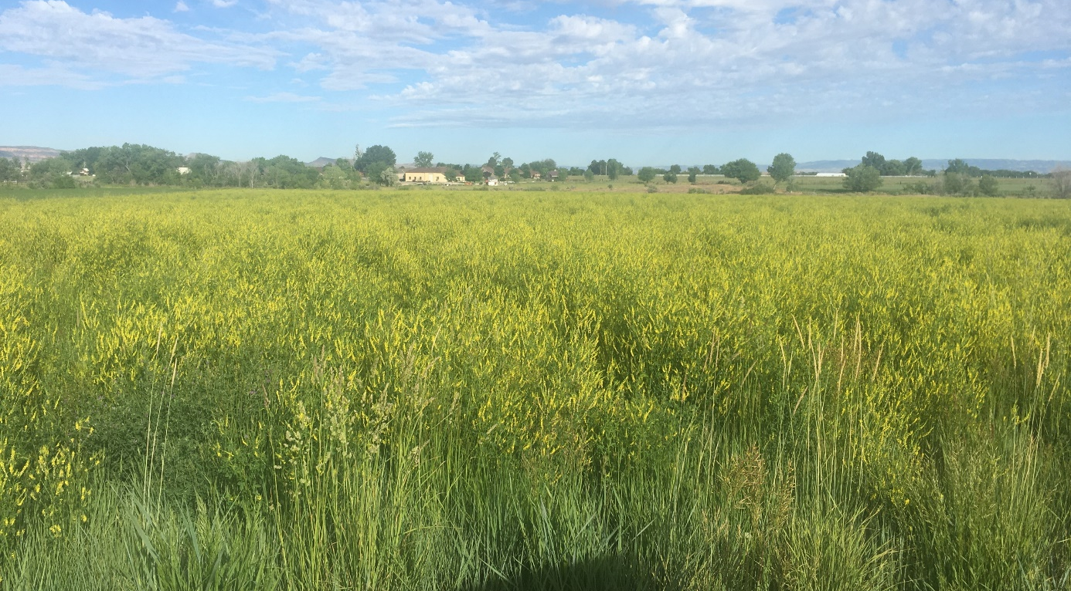
Test the efficacy of a 1-time compost application to..
Project Goals
Increase grass productivity.
01
Collected 2021, 2022, 2023
To sequester carbon and increase soil organic matter.
02
Collected 2022 & 2023
03
To alter species composition.
Collected 2021 & 2023
Notes:
Retta

Slide 30
H3: Compost will increase SOC stocks
After accounting for compost carbon added, SOC stocks will increase with enhanced productivity inputs
Notes:
Reminder of soil carbon cycle. Increase in SOC attributed to either increased inputs, decreased outputs, more efficient microbial transformation of SOC or a combination of these mechanisms.
The main mechanism we expected would increase SOC stocks is productivity, thus if compost enhances productivity inputs then SOC stocks would increase as well.

Slide 31
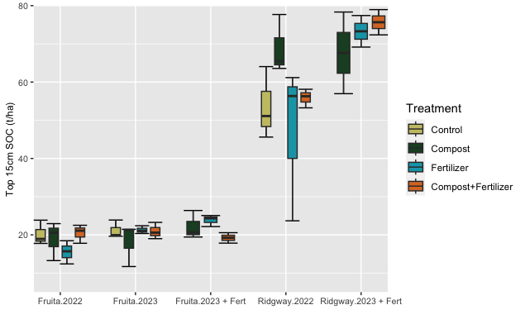
A 1-time application of compost did not increase SOC Stocks. No difference among treatments.
Consistent results down to 50cm…
Notes:
*Tayin to replace graph with correct sp*
Showing top 15cm, but no effect seen down to 50cm depth
Compost Only TRT: C added <10% of SOC stocks at Ridgway (5t/acre vs ~50t/acre SOC), ~13% of SOC stocks at Fruita (2.6t/acre vs ~20t/acre SOC)
C+F TRT: C added 3% of SOC stocks at Ridgway (1.5t/acre vs 50t/acre SOC), ~7.5% of SOC stocks at Fruita (1.5t/acre vs ~20t/acre SOC)

Slide 32
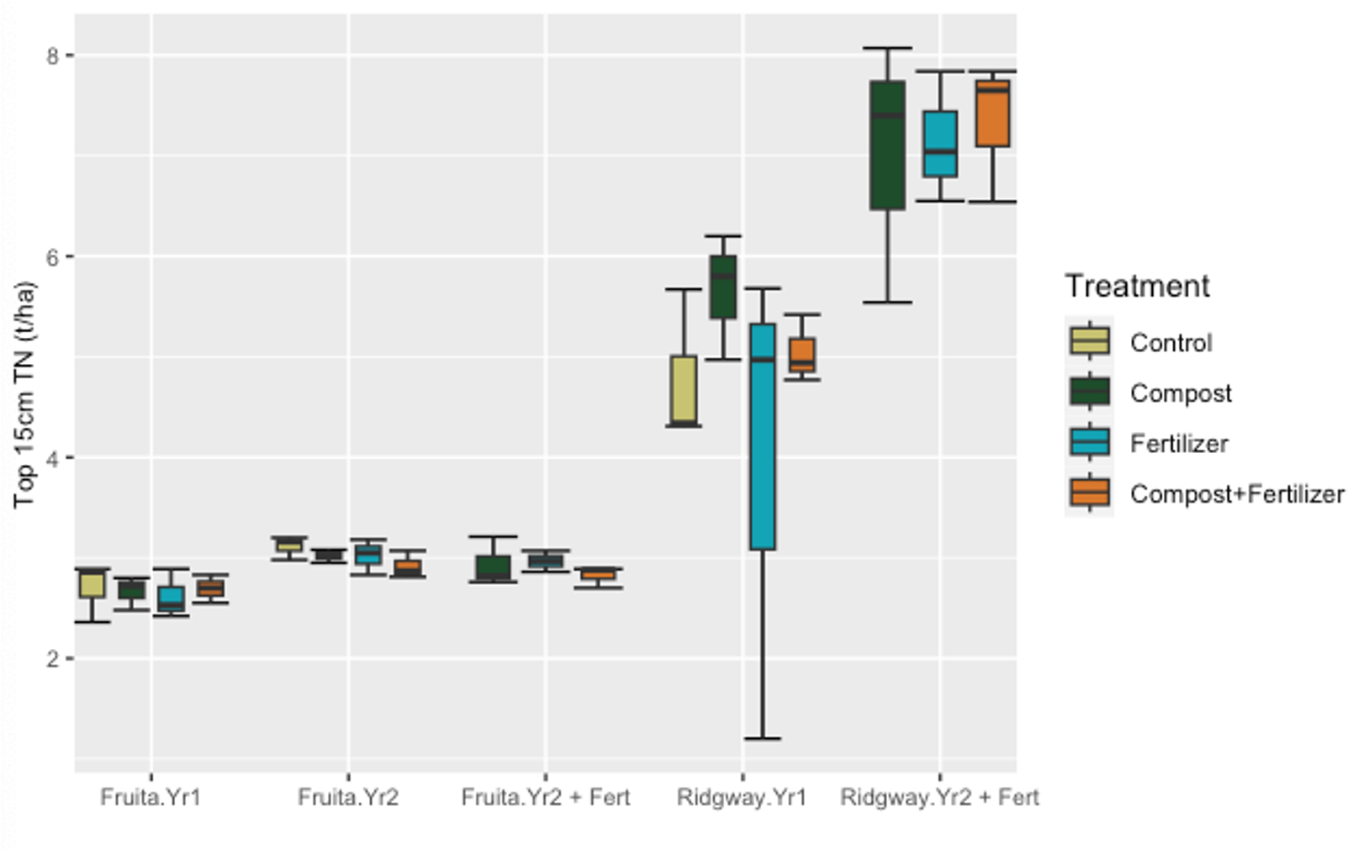
No treatment effects on total nitrogen stocks.
Consistent results down to 50cm…
Notes:
*Tayin to replace graph with correct sp*

Slide 33
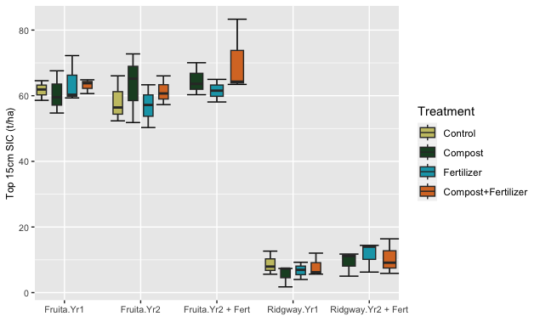
Inorganic Carbon Concentrations a significant component of Total Carbon, which can introduce variability into determining impacts on organic carbon.
~75% of total carbon at Fruita in Inorganic carbon.
Notes:
*Tayin to replace graph with correct sp*
High Inorganic Carbon Concentrations can introduce additional variability in determining effects on organic carbon

Slide 34
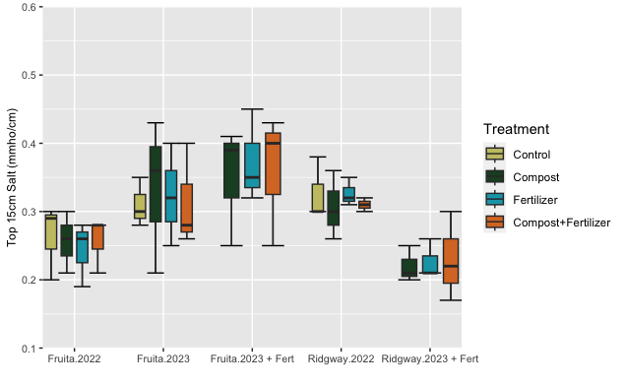
Compost did not increase soil salinity.
(No treatment effects on soil salinity).
Notes:
*Tayin to replace graph with correct sp*

Slide 35
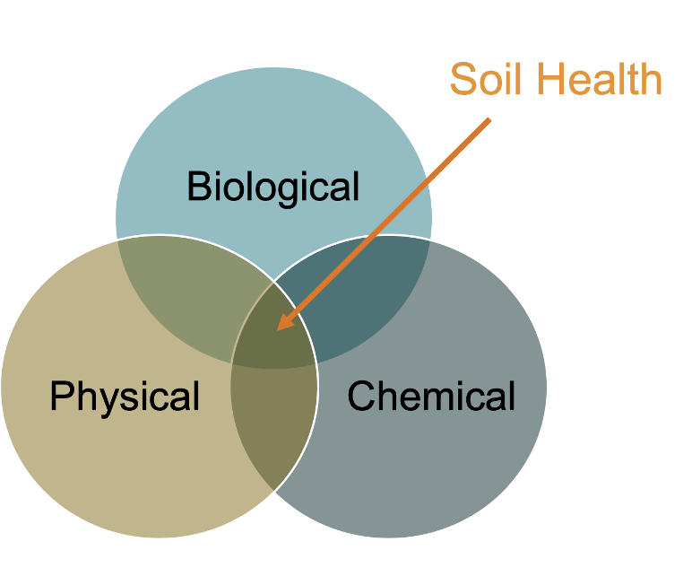
No difference among treatments in soil health metrics analyzed...
Carbon (TC, SIC, SOC)
Nitrogen (NH4, NO3, TON)
Phosphorus (Olsen P)
POX-C (proxy for microbial/active carbon)
Water holding capacity
Beta-glucosidase (Microbial extracellular enzyme)
PH
Soil Respiration
Water Stable Aggregates
CEC (Cation Exchange Capacity)
Salts
Notes:
No significant effects of treatments

Slide 36
Why didn't we see significant treatment effects on soil health metrics?

Slide 37
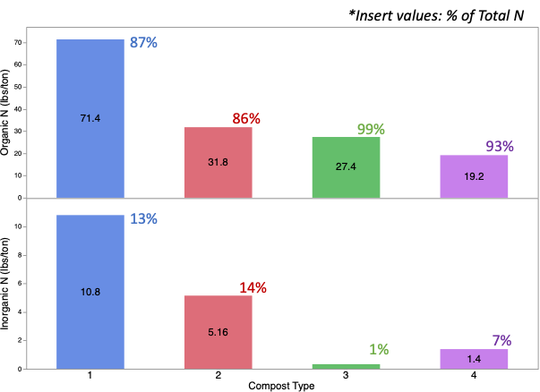
Inorganic vs Organic Nitrogen
Nearly all compost N was organic...
  Inorganic N (ammonium and nitrate) available to plants
  Organic N needs active microbial decomposers
Notes:
Megan
High ON requires microbial breakdown... more time to see an effect? Did not observe lower productivity in compost plots compared to fert plots = a sign of slow release of N from compost? Is this enough to boost productivity inputs to build SOC?
Most composts Inorganic N is < 5% of total N
Composting process temperatures can influence Inorganic N concentrations

Slide 38
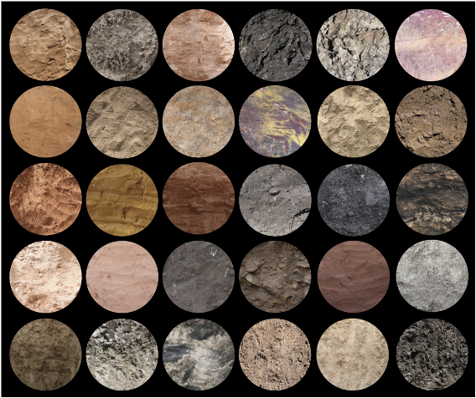



Measurement Challenges
Notes:
Challenges with field experiments- soils are spatially heterogenous which produces large variability in soil metrics
SOC accrual takes time... will discuss more in summary with overview of previous studies so won't go into more detail here...

Slide 39
Goal 2
02
Summary
Fertilized plots in Yr2 were significantly more productive than non fertilized, but no effect on SOC.
No detrimental effect of compost on SOC stocks
Inherent heterogeneity and slow SOC accrual rates can prohibit detecting incremental change in short term
Compost treatment did not lead to increases in productivity or SOC stocks
03
Notes:
Retta

Slide 40

Test the efficacy of a 1-time compost application to..
Project Goals
Increase grass productivity.
01
Collected 2021, 2022, 2023
To sequester carbon and increase soil organic matter.
02
Collected 2022 & 2023
03
To alter species composition.
Collected 2021 & 2023
Notes:
Retta

Slide 41
H3: Compost application will increase weedy species compared to commercial fertilizer and doing nothing.
Notes:
Blumenthat et al 2019 – found cheatgrass to emerge on rangeland many years after treatment applied.
Other studies show cvariable results/
Isbell et al. 2013 – “Our 30-year grassland experiment shows that plant diversity decreased well below control levels after 10 years of chronic high rates (95–270 kg N ha 1 year 1) of nitrogen addition, and did not recover to control levels 20 years after nitrogen addition ceased. Furthermore, we found a hysteretic response of plant diversity to increases and subsequent decreases in soil nitrate concentrations.”
Smooth brome is common across both sites. Beyond this, the sites have different species of interest.
Analyze change in each of these species
Dominant species
Fruita: Intermediate Wheatgrass > Smooth Brome > Bindweed
Ridgway : Western Wheatgrass > Smooth brome > Tall Fescue > Orchardgrass

Slide 42
Cover of exotic spp. did not increase on compost compared to other treatments.
Exotic species included: Desert Alyssum, Thistle, Bindweed, Yellow Sweetclover, Plantain
Notes:
Comp2$Tx <- factor(Comp2$Tx, levels = c ('Control', 'Compost', 'Fertilizer', 'Fert+Compost')) #reorder factors
ggplot(data = Comp2, aes(x = interaction(Year, Site), y = Exotic, fill = Tx)) + stat_boxplot(geom="errorbar") + geom_boxplot() + ggtitle(NULL) +xlab (NULL) + ylab("Proportion Exotic Species") + theme(axis.text = element_text(size = 14),axis.title = element_text(size = 14)) + theme(legend.text = element_text(size = 12), legend.title = element_text(size = 12, hjust = 0.5), legend.key.height = unit(1,"cm"),legend.key.width = unit(1,"cm"), legend.position = c(NULL)) + guides(fill=guide_legend(title = "Treatment")) + scale_fill_manual(values = c("#C8C372","#1E4D2B","#12A4B6","#D9782D")) + scale_x_discrete(labels=c("2021 Fruita","2023 Fruita","2021 Ridgway","2023 Ridgway")) #Just data where fert was applied in Yr2

Slide 43

H3: Compost application will increase weedy species compared to commercial fertilizer and doing nothing.
There were no sig. difference in exotic species pre and post treatment across sites.
Goal 3
01
Test the impact of a 1-time compost application on species composition.
03
Notes:
Retta

Slide 44
How did compost impact proportions of other species?
Notes:
Smooth brome is common across both sites. Beyond this, the sites have different species of interest.
Analyze change in each of these species
Dominant species
Fruita: Intermediate Wheatgrass > Smooth Brome > Bindweed
Ridgway : Western Wheatgrass > Smooth brome > Tall Fescue > Orchardgrass

Slide 45
Fruita Only: Intermediate Wheatgrass. Decline overall, but significantly less decline on controls
Notes:
CompAllFruita$Tx <- factor(CompAllFruita$Tx, levels = c ('Control', 'Compost', 'Fertilizer', 'Fert+Compost')) #reorder factors###
All data THIN6
ggplot(data = CompAllFruita, aes(x = interaction(Year, Site, Yr2FertApp), y = THIN6, fill = Tx)) + stat_boxplot(geom="errorbar") + geom_boxplot() + ggtitle(NULL) +xlab (NULL) + ylab("Composition Intermediate Wheatgrass") + theme(axis.text = element_text(size = 14),axis.title = element_text(size = 14)) + theme(legend.text = element_text(size = 12), legend.title = element_text(size = 12, hjust = 0.5), legend.key.height = unit(1,"cm"),legend.key.width = unit(1,"cm"), legend.position = c(NULL)) + guides(fill=guide_legend(title = "Treatment")) + scale_fill_manual(values = c("#C8C372","#1E4D2B","#12A4B6","#D9782D")) + scale_x_discrete(labels=c("2021", "2023 - no fert", "2023 - fert applied"))

Slide 46
Ridgway Only: Western Wheatgrass. Decline overall, but not in response to treatments.
Notes:
ggplot(data = CompAllRidg, aes(x = interaction(Year, Site), y = PASM, fill = Tx)) + stat_boxplot(geom="errorbar") + geom_boxplot() + ggtitle(NULL) +xlab (NULL) + ylab("Proportion Western Wheatgrass") + theme(axis.text = element_text(size = 12),axis.title = element_text(size = 14)) + theme(legend.text = element_text(size = 12), legend.title = element_text(size = 12, hjust = 0.5), legend.key.height = unit(1,"cm"),legend.key.width = unit(1,"cm"), legend.position = c(NULL)) + guides(fill=guide_legend(title = "Treatment")) + scale_fill_manual(values = c("#1E4D2B","#C8C372","#D9782D","#12A4B6")) + scale_x_discrete(labels=c("2021 Ridgway","2023 Ridgway"))

Slide 47
Ridgway: Orchardgrass increased overall except on fertilized plots (weak sig.)
Notes:
ggplot(data = CompAllRidg, aes(x = interaction(Year, Site), y = DAGL, fill = Tx)) + stat_boxplot(geom="errorbar") + geom_boxplot() + ggtitle(NULL) +xlab (NULL) + ylab("Proportion Orchardgrass") + theme(axis.text = element_text(size = 14),axis.title = element_text(size = 14)) + theme(legend.text = element_text(size = 12), legend.title = element_text(size = 12, hjust = 0.5), legend.key.height = unit(1,"cm"),legend.key.width = unit(1,"cm"), legend.position = c(NULL)) + guides(fill=guide_legend(title = "Treatment")) + scale_fill_manual(values = c("#C8C372","#1E4D2B","#12A4B6","#D9782D")) + scale_x_discrete(labels=c("2021", "2023"))
When did he plant orchardgrass?
Variation in pasture – west to east
Maybe favored slightly in the non- fertilizer plots

Slide 48
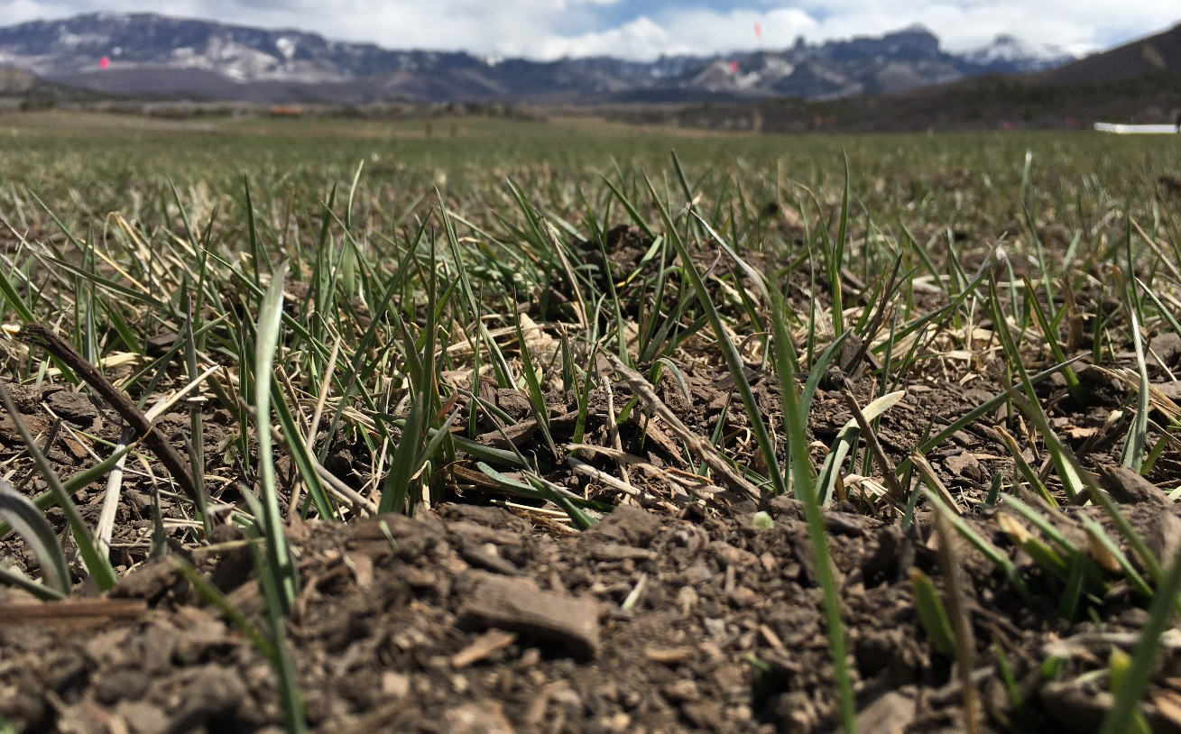
Summary
Exotic species did not increase on compost plots compared to other treatments.
Fruita Only:
Int. Wheatgrass decreased less in Controls compared to Compost (p=0.06) and Fert (p=0.02) (but declined overall)
Ridgway Only:
Orchardgrass increased overall, except on fertilized plots (weak significance).
Goal 3
0
1
Exotic species did not increase on compost plots compared to other treatments.
03
Notes:
Retta

Slide 49
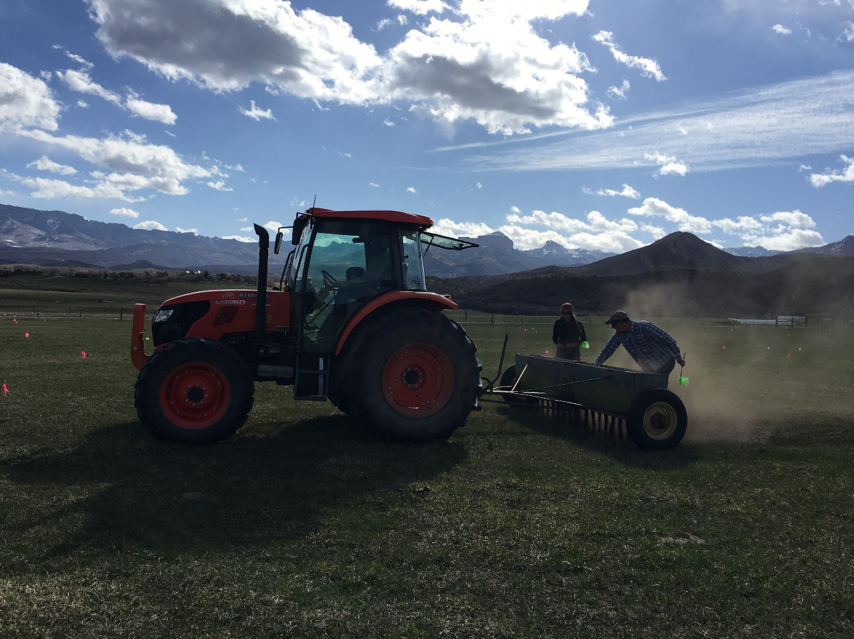
How effective is a 1-time application of compost to
increase soil organic matter and enhance plant growth compared to fertilizer? How appropriate is it for our region?
Project Questions
If effective, we would see an increase in above ground production and below ground soil organic matter and soil C in compost plots
If effective, we would see no adverse impacts from compost compared to fertilizer or doing nothing.
Notes:
Retta

Slide 50

Discussion questions on the results, Part 1
I observe that………
2. I’m surprised to see that………..
Menti.com - Code is 8826 4171 expires in 2 days.
Notes:
10 min small groups
10 min discussing in larger groups
Maybe pair share for this? Depends on groups size. Will think on this.
- Can also be more free-form of a discussion but I do want to touch on these themes. Can keep them as backup if discussion gets stalled.
Code is 8826 4171 expires in 2 days.

Slide 51
Discussion questions on the results, Part 2
3. I believe that data suggests that……….
because…………
4. After seeing this data, I still have questions about…..
Notes:
~ 7 min small groups
~ 7 min larger groups

Slide 52
Meta-results: what did you learn? Part 1
I learned……….from this case study
2. In the future, this information will influence decisions or actions I will take by………………
Notes:
~5 min in small groups
~5-8 min larger groups

Slide 53
Meta-results: what did you learn? Part 2
4. If I were to do this again, I would…..
5. In the future, I would like to see more research into……..
Notes:
~7 min in small groups
~7 min larger groups

Slide 54
Economics – Per N Content
Product | %N | $/ton | $/lbN | Total ($/acre)
Compost | 1.4 | 112.50 | 4.02 | $362
Urea | 46 | 820.00 | 0.89 | $201
MAP | 11 | 304.00 | 1.38 | $362
Notes:
Compost 3cy per ton
Urea 46-0-0
MAP 11-52-0

Slide 55
Economics – Per N Content
Site | Treatment | Compost Added (tons/acre) | Compost (lbs N/acre) | MAP (lbs N/acre) | Urea (lbs N/acre) | Compost ($/acre) | MAP ($/acre) | Urea ($/acre) | Total ($/acre)
Ridgway | Compost | 18.8 | 90 | ---- | ---- | $362 | ---- | ---- | $362
Fruita | Compost | 10.4 | 50 | ---- | ---- | $201 | ---- | ---- | $201
Ridgway | Fert+Compost | 6 | 29 | ---- | 61 | $117 | ---- | $54 | $171
Fruita | Fert+Compost | 6 | 29 | ---- | 21 | $117 | ---- | $19 | $135
Ridgway | Fert Only | 0 | ---- | 10.58 | 79.42 | ---- | $15 | $71 | $85
Fruita | Fert Only | 0 | ---- | 8.46 | 41.54 | ---- | $32 | $37 | $49
Notes:
Compared to fert only, compost is ~4x higher cost/acre ($/lnN*acre)
Compared to fert only, compost + fert is 2-3x higher cost/acre ($/lnN*acre)
Ridgway 4.2x C>F, 2x C+F>F
Fruita 4.1x C>F, 2.8x C+F>F

Slide 56
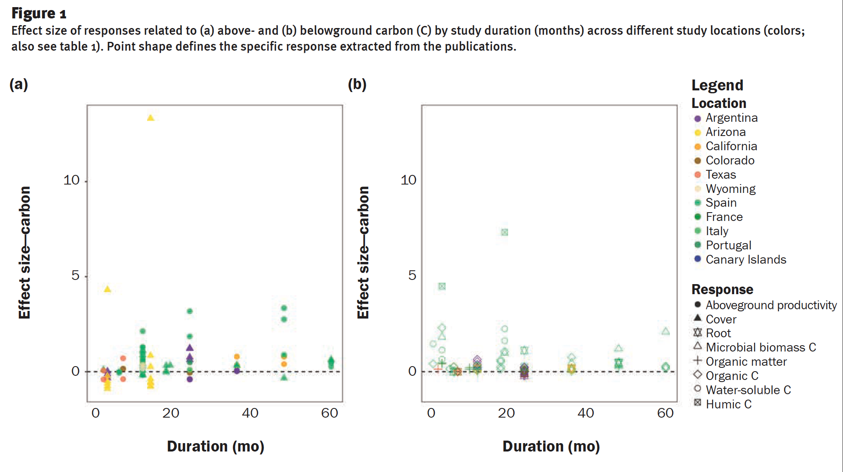
Other Studies
Notes:
Could use this review? Pasted some figs that may be of interest, more in paper.
Kutos, S., et al. "Compost amendment to enhance carbon sequestration in rangelands." Journal of Soil and Water Conservation 78.2 (2023): 163-177.

Slide 57
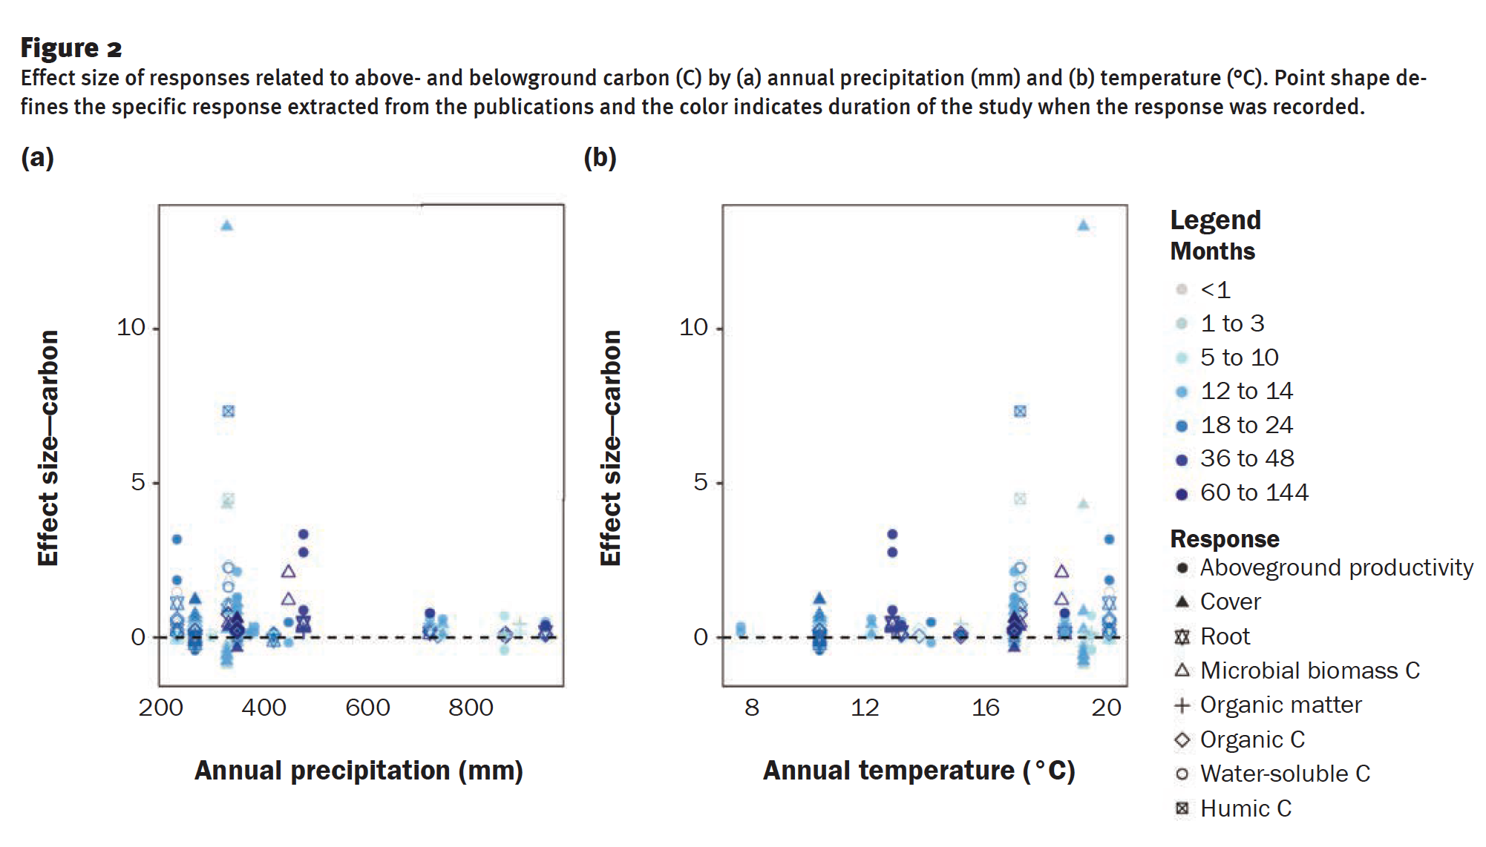
Other Studies
Notes:
200mm=7.8in
400mm=15.7in
800mm=31in
10C=50F
20C=68F
Could use this review? Pasted some figs that may be of interest, more in paper.
Kutos, S., et al. "Compost amendment to enhance carbon sequestration in rangelands." Journal of Soil and Water Conservation 78.2 (2023): 163-177.

Slide 58
Other Studies
Study | Location | Duration of Study | Did compost increase SOM? | Did compost increase production? | Did compost impact species composition?
McClelland, Shelby C., et al. 2022 | Front Range of CO – rangeland and irrigated pasture | 3 years | Yes in irrigated pasture; no in rangeland | Yes in irrigated pasture; no in rangeland | Not addressed
Ryals, Rebecca, et al. 2016 | CA - rangeland | 4 | Yes | Yes | No
Blumenthal, Dana, et al. 2017 | Mixed grass prairie, CO -rangeland | 22 | Not addressed | Yes, YR1 and Y3 | Yes, increased cheatgrass cover
Tautges, Nicole E., et al. 2019 | CA – crops | 19 | Yes compared to fert+cover crops | Not addressed | Not addressed

Slide 59
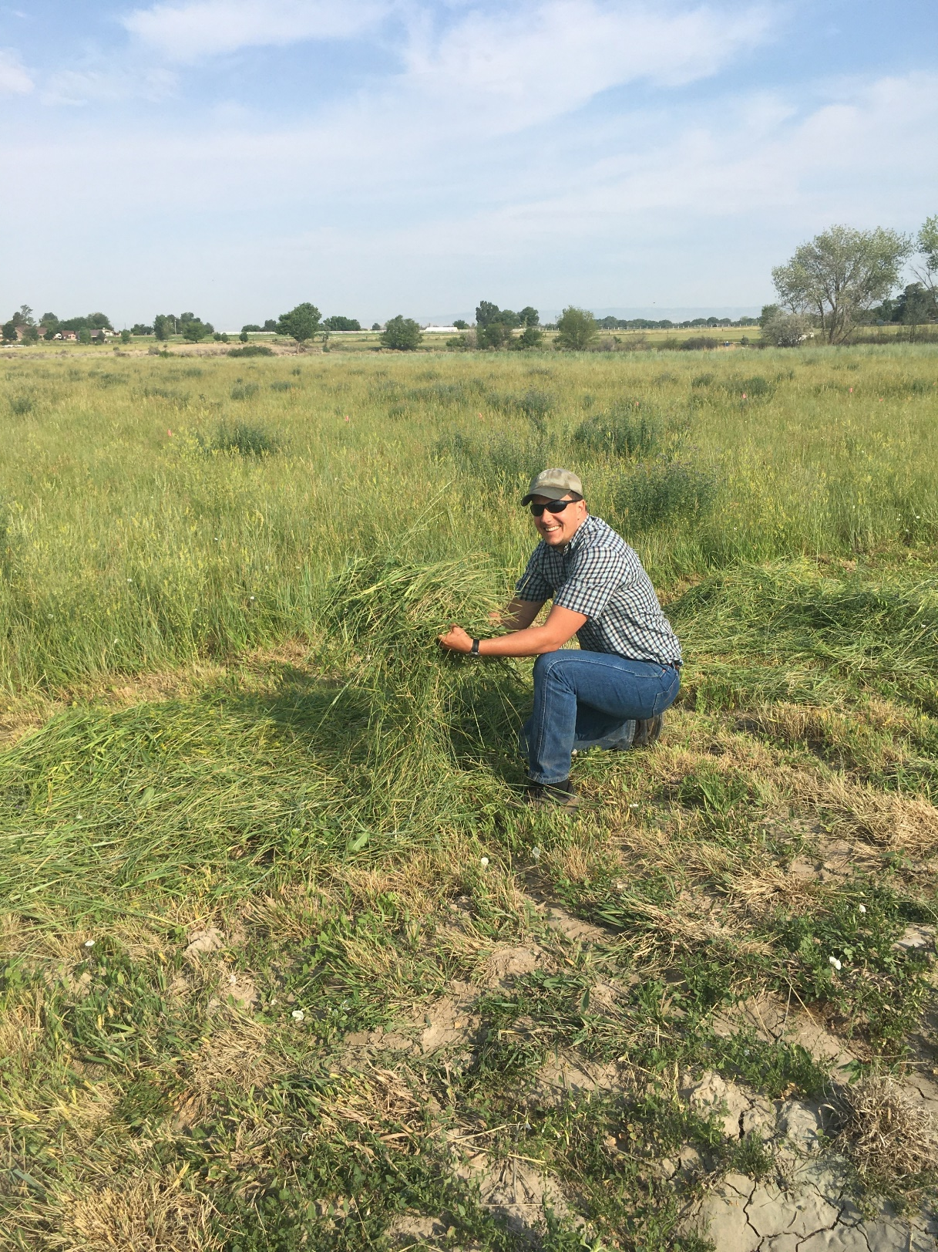

Please take the survey
  https://colostate.az1.qualtrics.com/jfe/form/SV_d0F6Hqv5JOpesWW

Slide 60
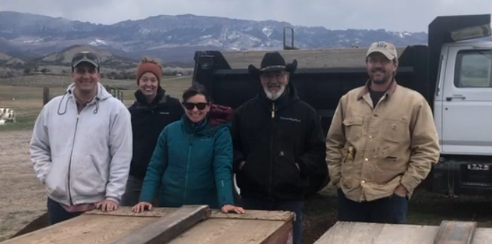

Thank you & GO TEAM
Thank you to Dustin Mullins and Perry Cabot for the fields, Jim Fry for assistance with management, Katie Alexander, Cordelia Anderson, Jenny Beiermann and Analissa Sarno for sampling help, Seth for still talking to us even though he has a new job, Tayin Wang for sampling, data entry, and analysis, and all of the support from you all in this research project!
Notes:
GO TEAM! ;-)

