Slide 1
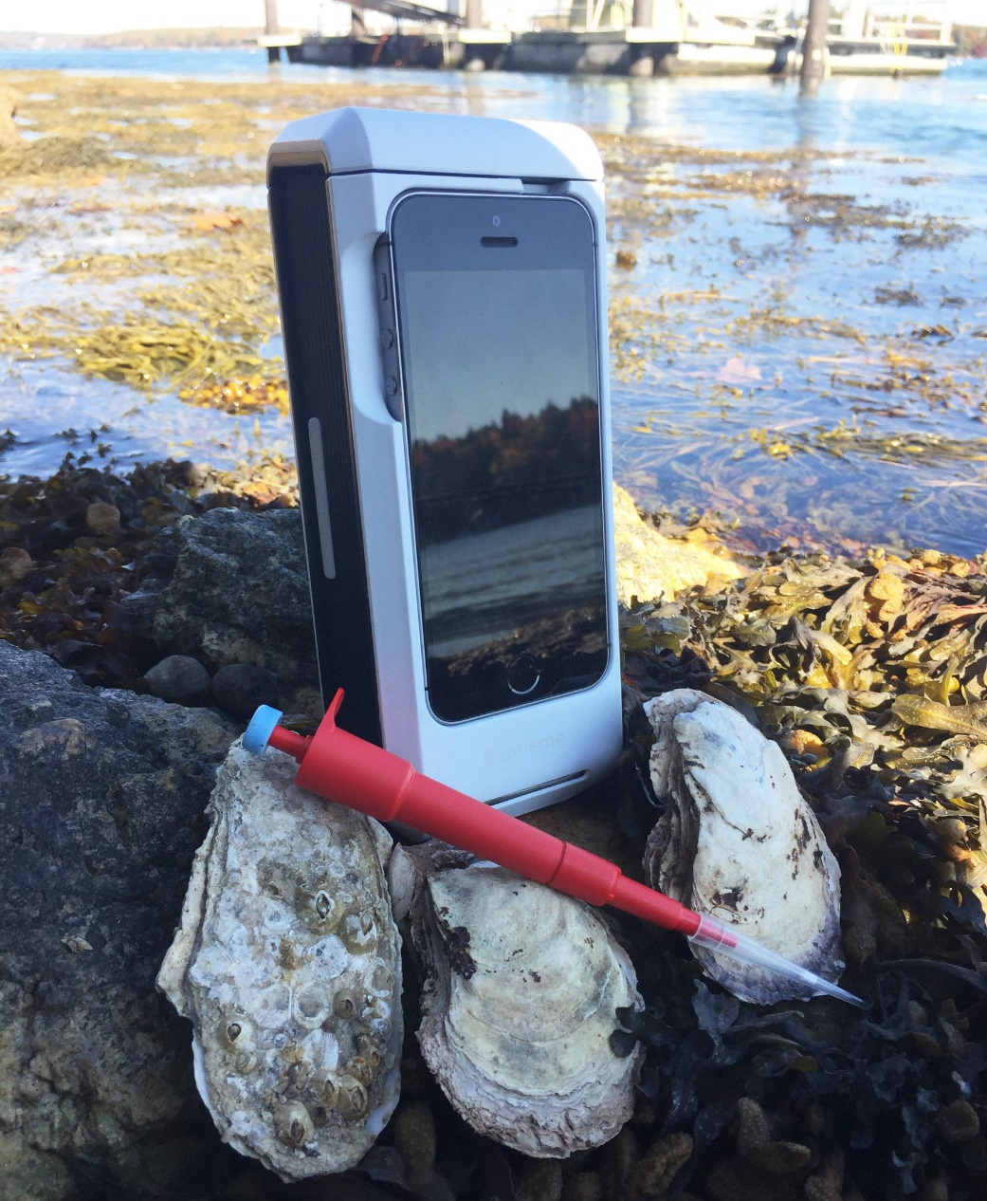
A User-Friendly, Rapid eDNA tool to identify pathogens responsible for diseases in oyster aquaculture
Robin Sleith¹, Ryan McCann^{1,2},
Steve Zimmerman³, Pete Countway¹
1
2
3
Notes:
Collaborative SARE project looking at molecular detection of pathogens.

Slide 2
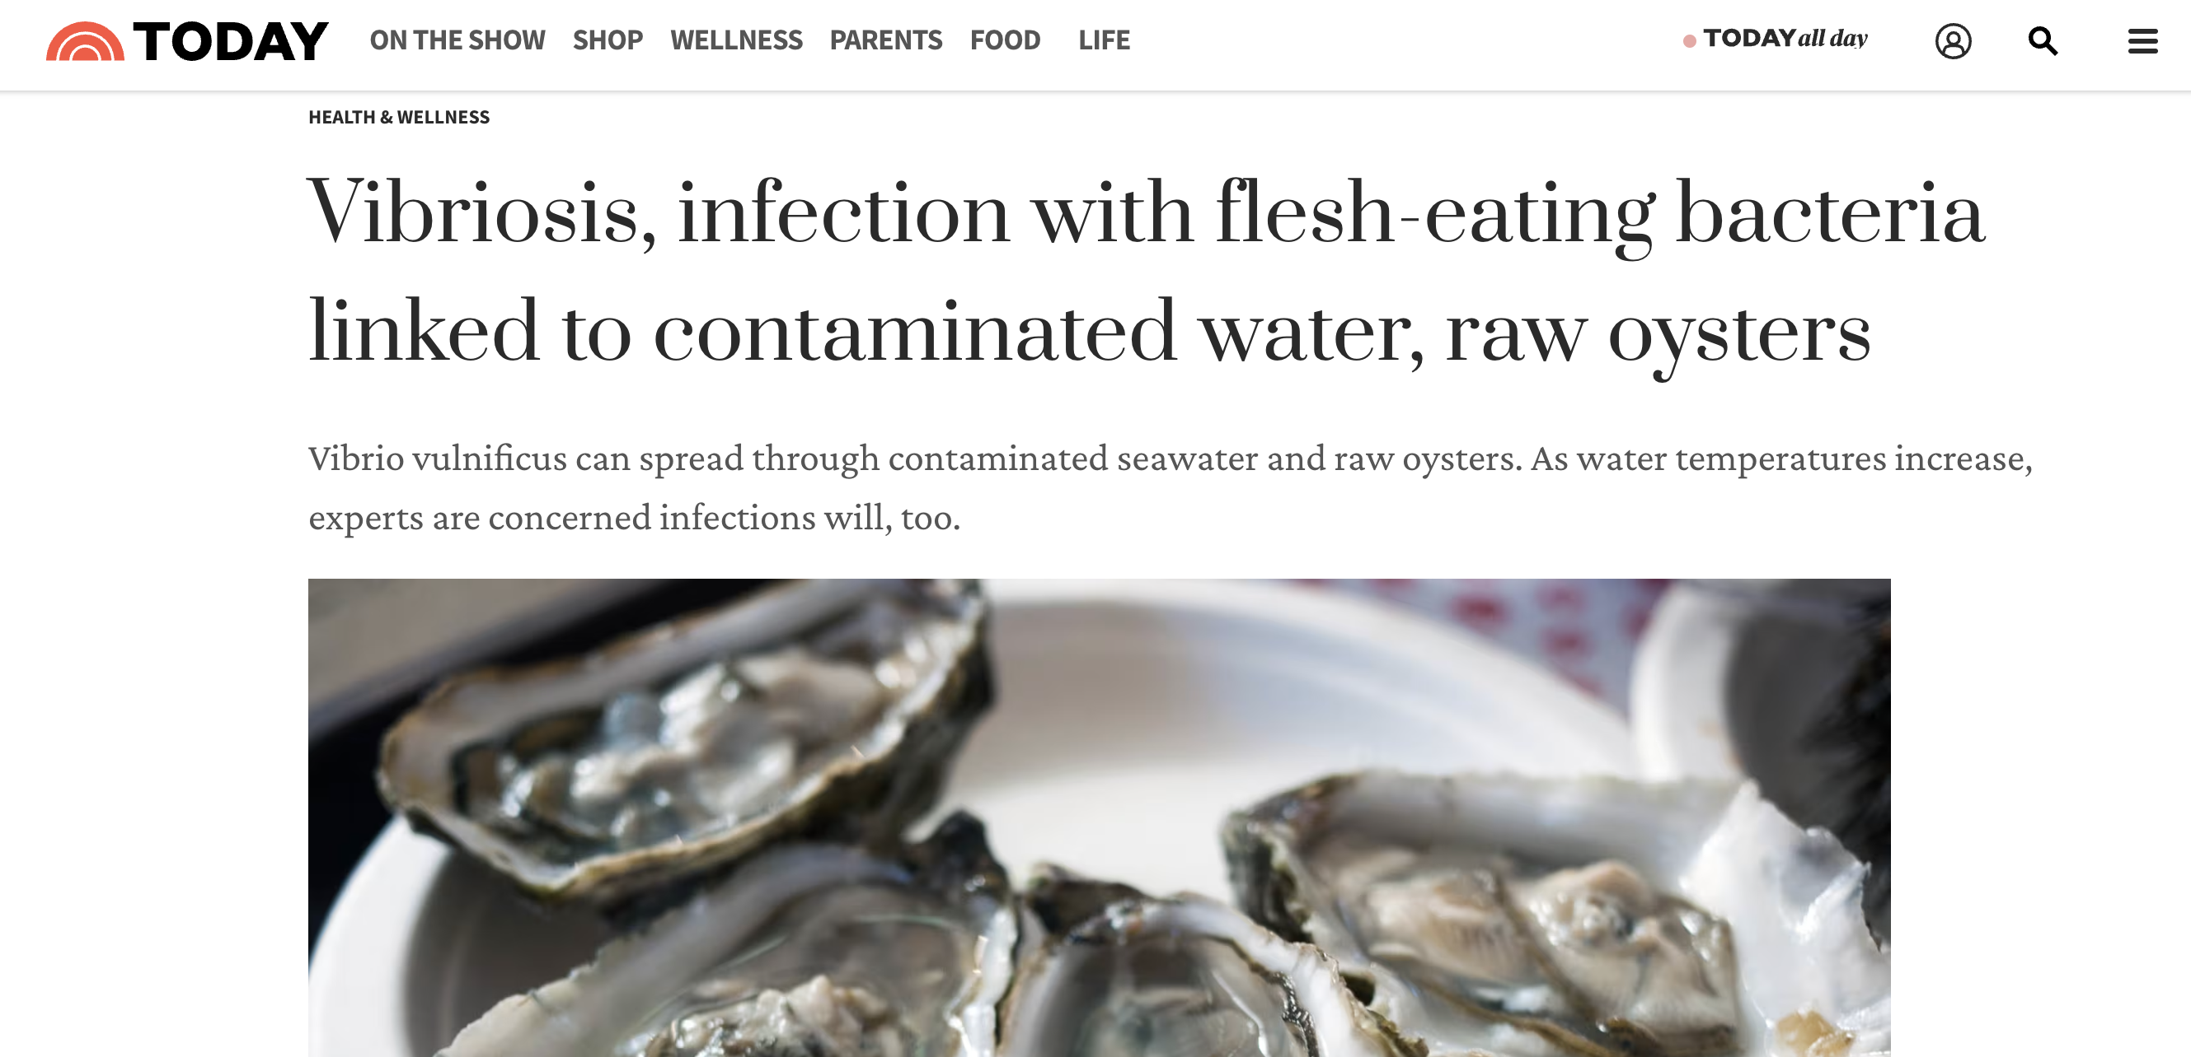
Background – The Elephant in the Room
Notes:
When we start to talk about oysters and pathogens things quickly escalate. Share about my background and how we are approaching this. First of all we are focused on the organisms that impact hatcheries and aquaculture operations, NOT public health. Second, I am a molecular biologist who represents a group of folks including growers, share the science we have been doing to understand oyster pathogens with an eye not toward public health but aquaculture/hatcheries. I am not a pathologist, I am not a public health expert. The tools I am going to talk about represent a first step that we think will save hatcheries time and money.

Slide 3
Background – Oyster hatcheries
Oyster aquaculture relies on hatcheries to provide seed for growers
~40 hatcheries provide most of the seed for East Coast oyster growers
Impact of hatchery failures potentially catastrophic
Notes:
Thanks to Marta yesterday for doing a great job setting up the issue of failures in hatchery settings.

Slide 4
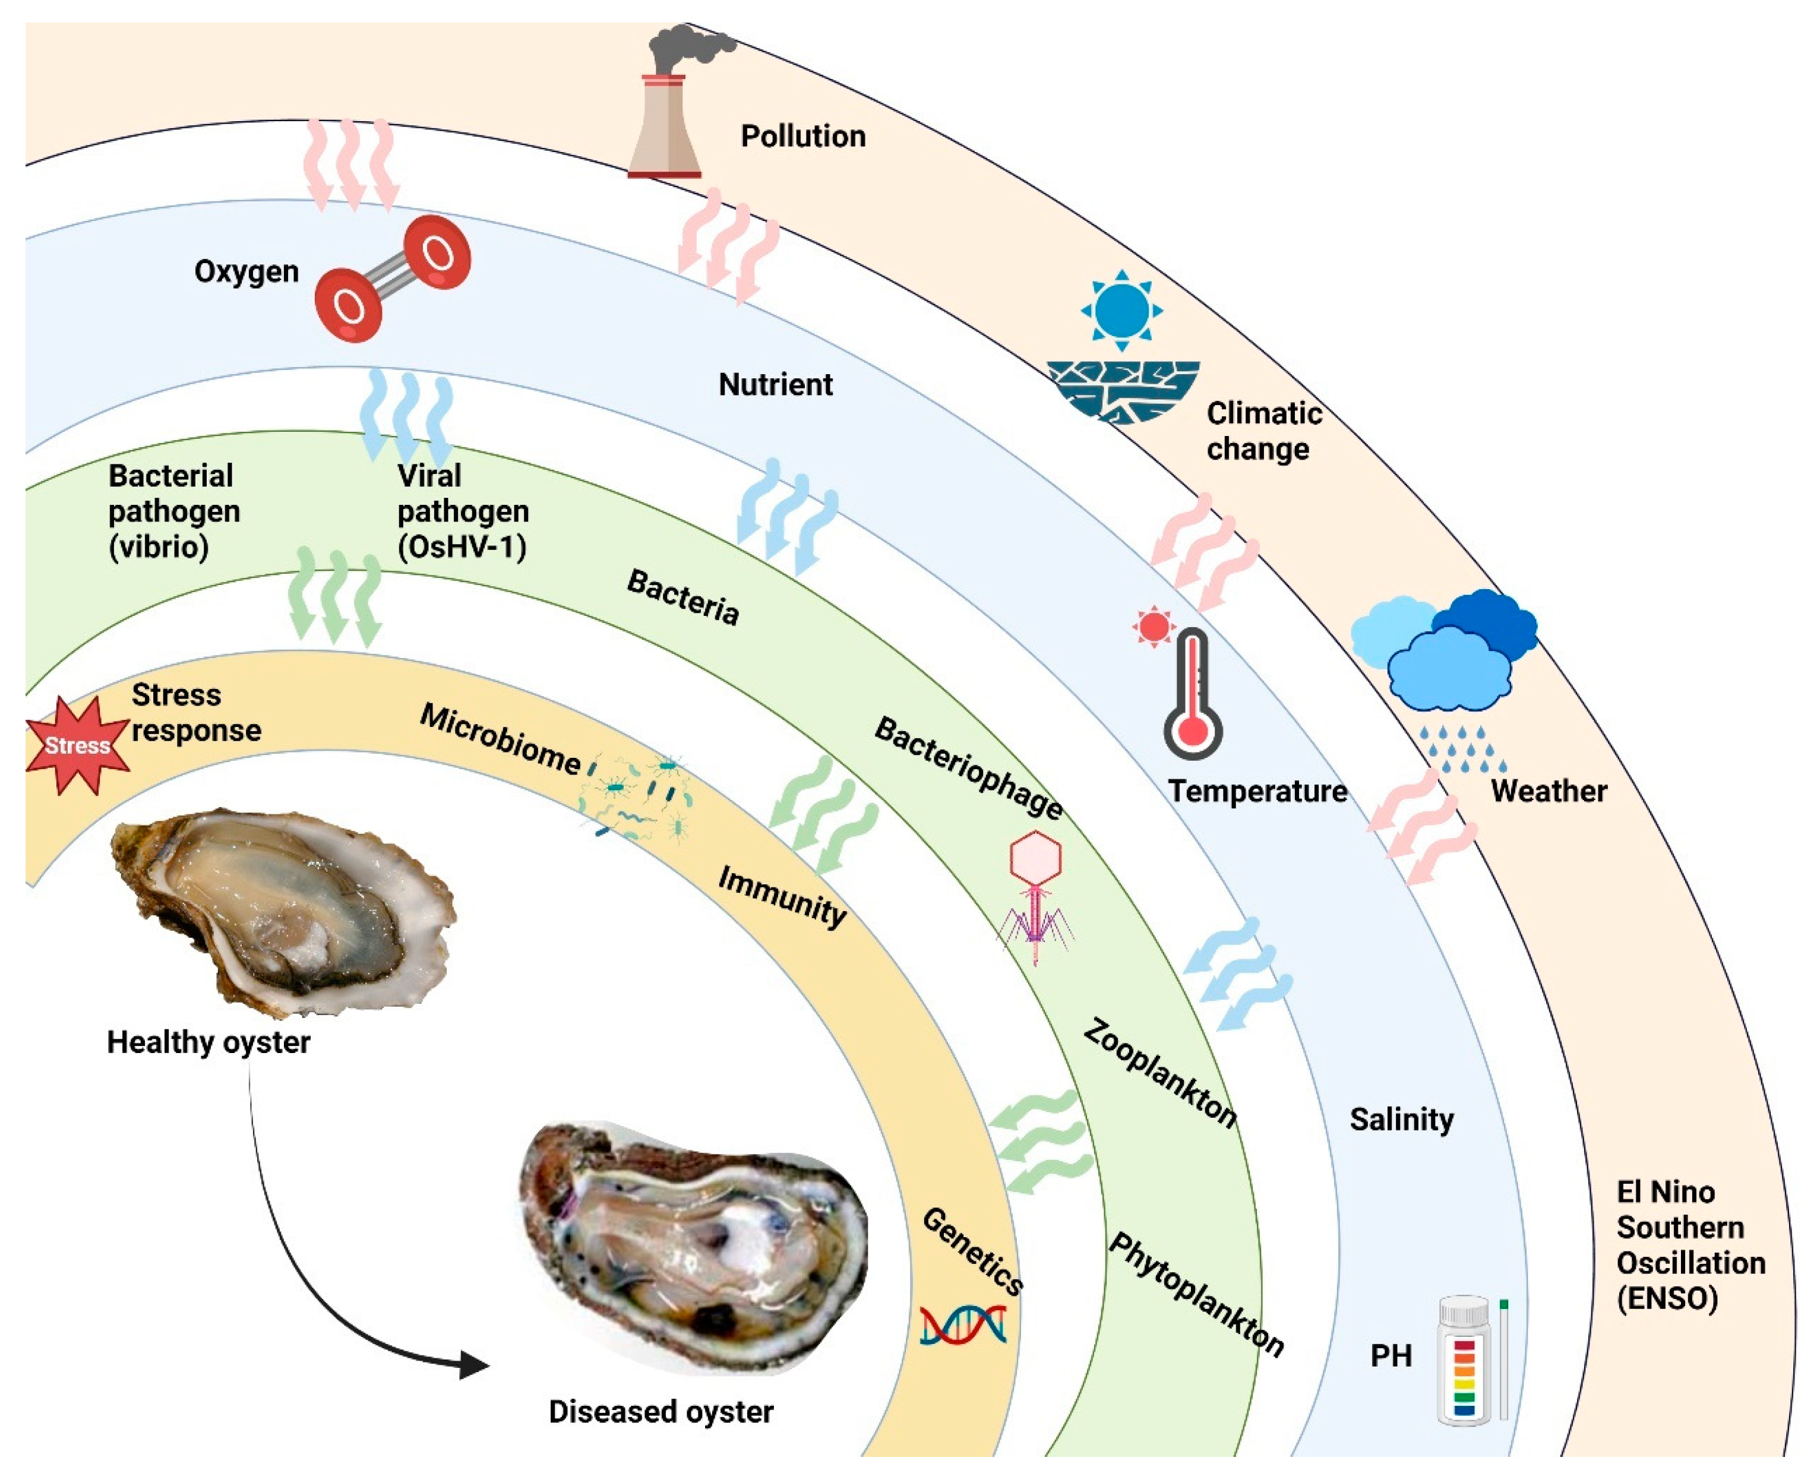
Background – Microbial threats to oysters
Bacterial pathogens can impact many aspects of hatchery operations
Algae
Larval oysters
Market oysters
Vibrio and JOD some of the most common culprits (or at least suspects)
Okon et al. 2023
Notes:
This is what keeps the aquaculture folks up at night. For this we are focused on bacterial threat, but they are part of a large, complex system.

Slide 5
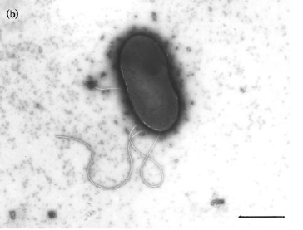
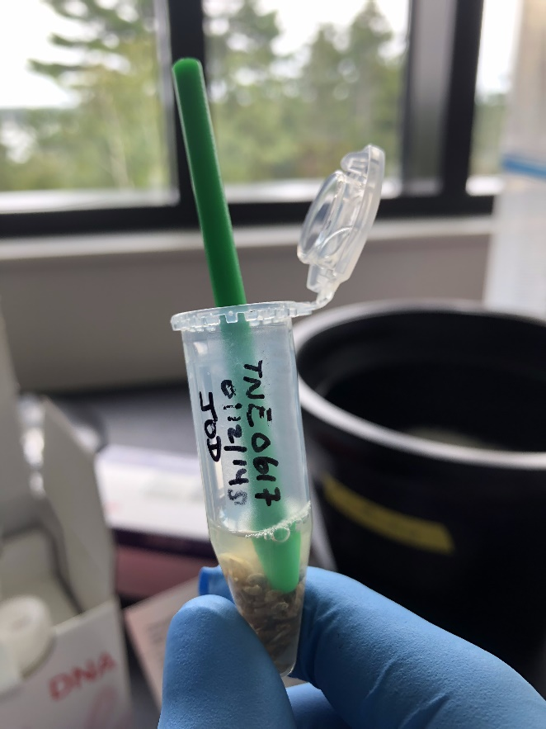
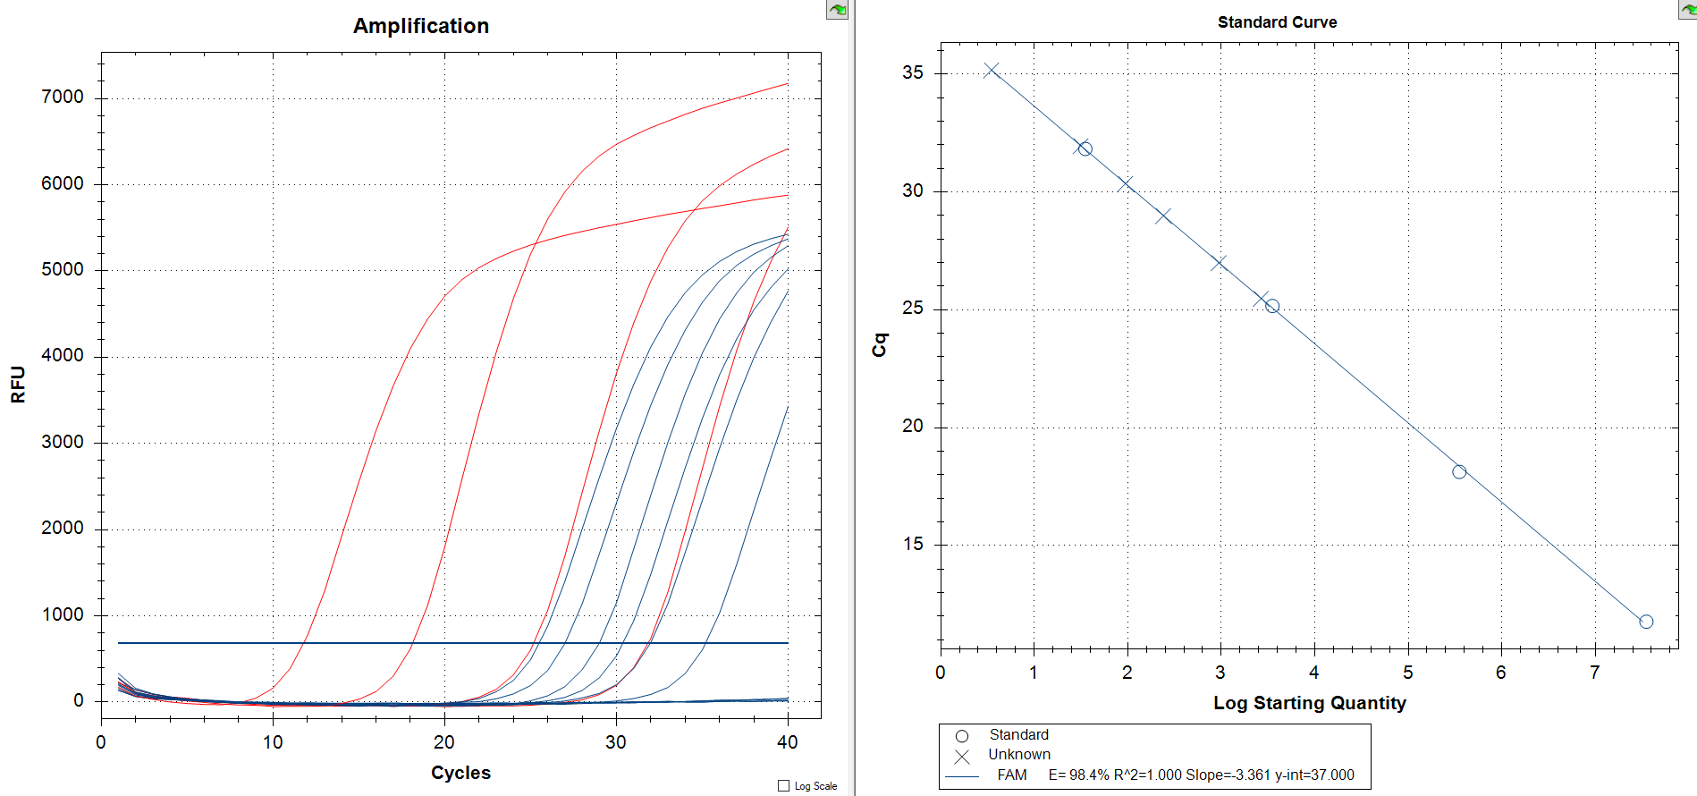
Initial Approach – quantitative PCR for JOD
A
B
C
35
3,500
Boettcher et al. 2005
350,000
35,000,000
A novel qPCR assay was designed for the shellfish pathogen responsible for Juvenile Oyster Disease (JOD), Aliiroseovarius crassostrea.
DNA was extracted from pooled juvenile oysters obtained from different sources (A)
Three of four local samples (x two dilutions each) were positive for JOD (blue curves, panel B).
DNA standards for JOD (C)
5
Notes:
Our first foray into molecular detection of oyster pathogens was with JOD, which was isolated from the Damariscotta River, just upstream from Bigelow. qPCR molecular “gold standard” but requires expensive technology and molecular expertise.

Slide 6
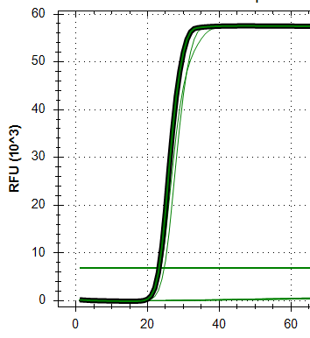
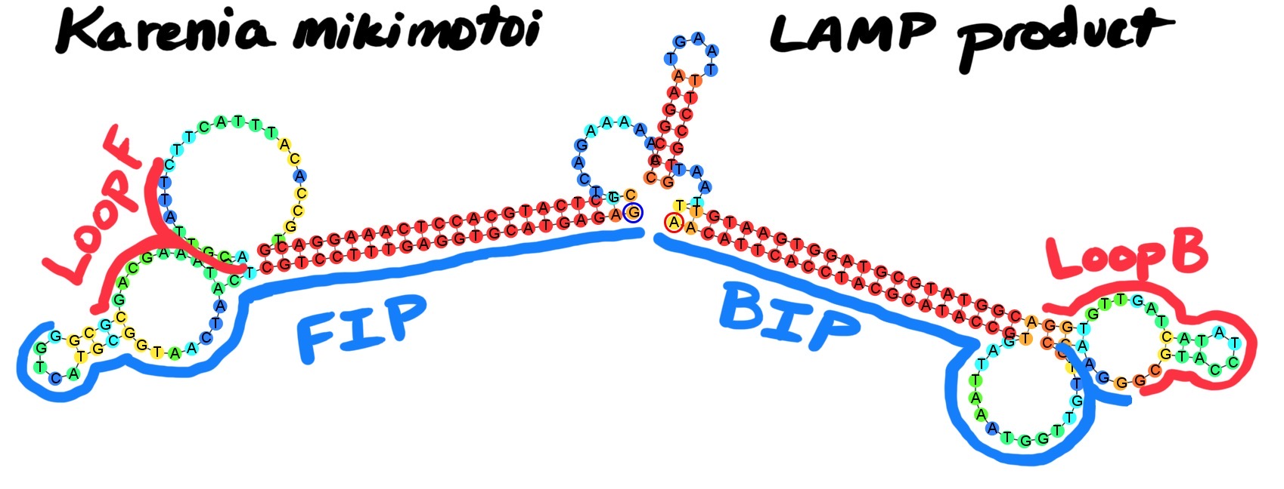
Loop-mediated Isothermal Amplification (LAMP)
6 DNA binding sites on the target – increasing specificity
Isothermal amplification at ~65 ºC
Detection by pH change (colorimetric) or by fluorescence (like qPCR)
Very fast time to results ~30 min reaction
Cheap ($5-10 per sample) and low-tech!
A ‘dumbbell’ LAMP ‘seed’ product
after initial rounds of amplification
Notes:
The answer? LAMP! The hope is that this can be an early warning system, allowing growers to be proactive and make real-time decisions about farm operations

Slide 7
Loop-mediated Isothermal Amplification (LAMP)
Notes:
Key is a strand displacing polymerase! LAMP has been around for 20 plus years. Used for covid detection, an established method!

Slide 8
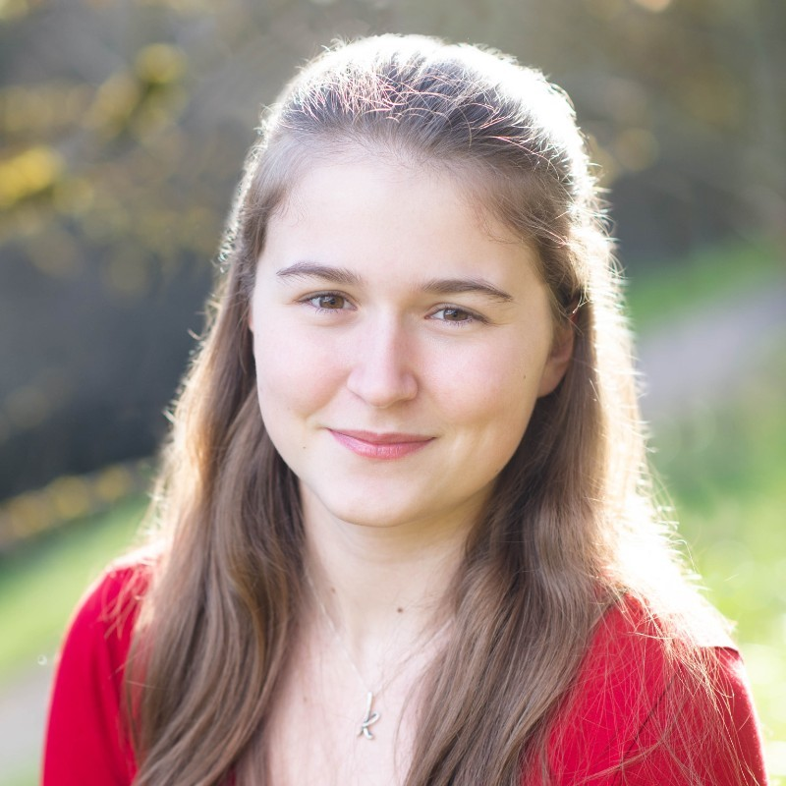
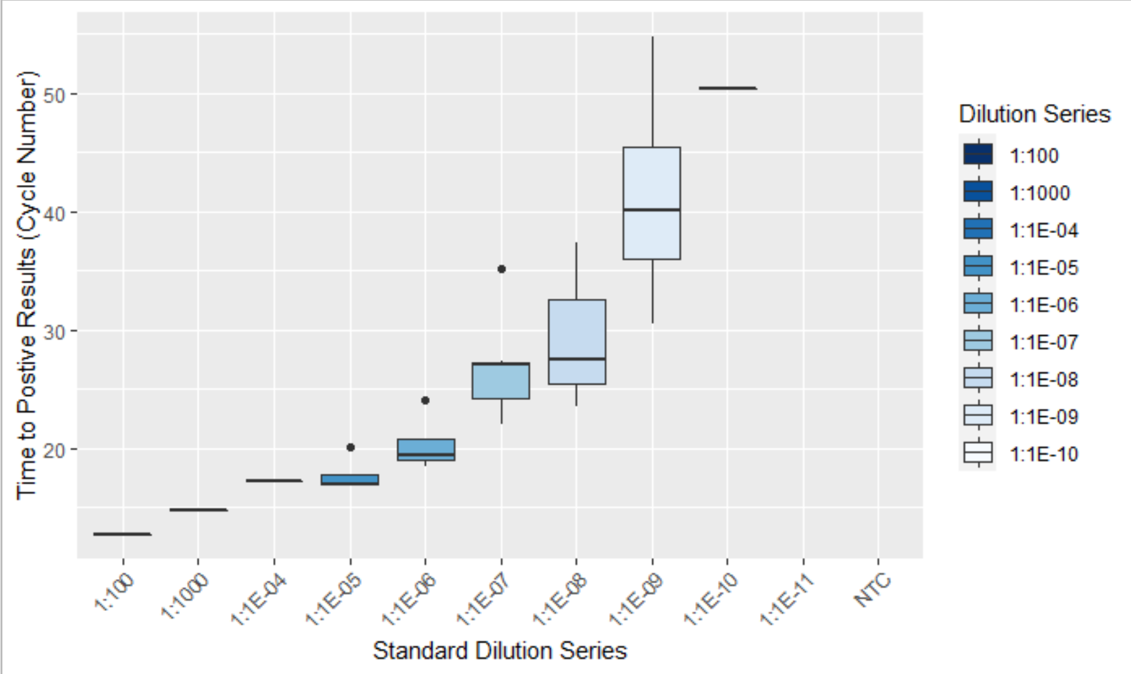
LAMP for Juvenile Oyster Disease (JOD)
A
Kristin Cohrs
Colby College ’25
B
C
Dr. Robin Sleith
-
+
Notes:
First effort to convert existing qPCR assay into LAMP- an undergrad did it! Use dilution series to talk about sensitivity of the assay!

Slide 9
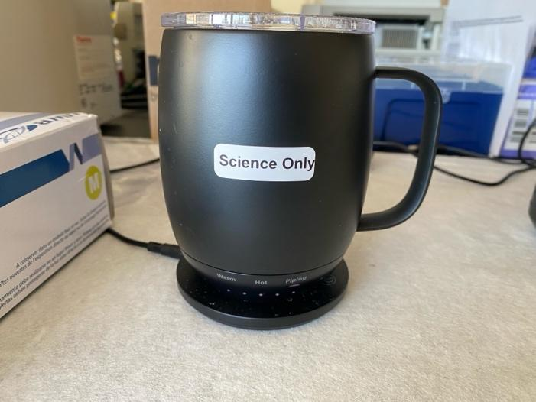
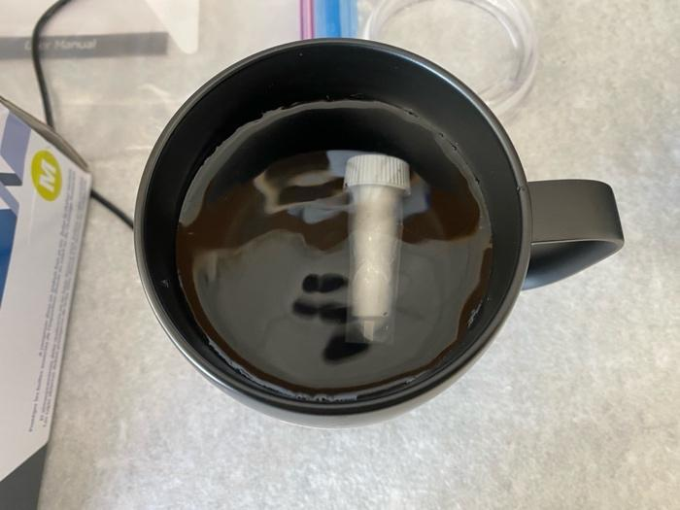
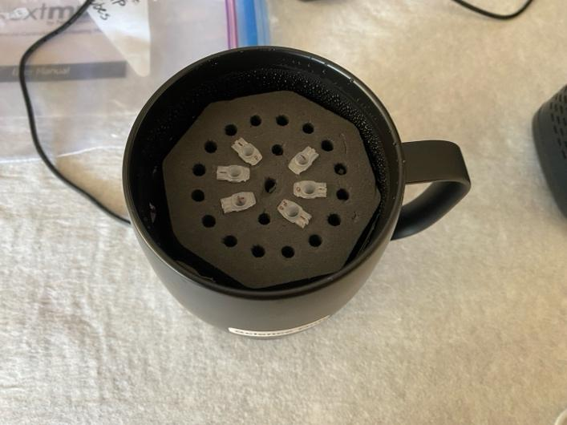
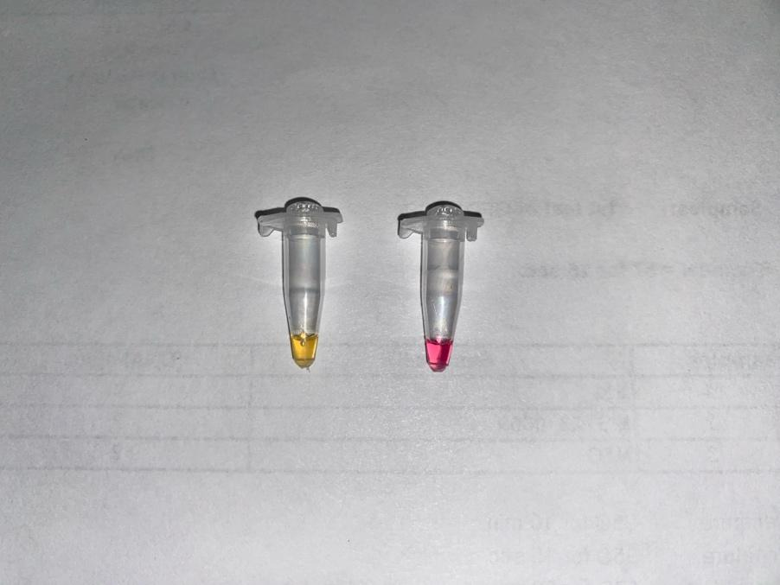
LAMP for Vibrio spp.
Designed and optimized assays for genes linked to pathogenicity
Create user-friendly extraction and LAMP protocol
Ryan McCann
Northeastern:
Roux Institute
Notes:
For Vibrio targets we had a great intern from Northeastern. Example of what an alignment looks like with the LAMP primers (V. alginolyticus). Smart coffecup for incubations!

Slide 10
LAMP Assays
Vibrio alginolyticus: Strain B51, NCMA (USA)
Isolation: Seawater, Stonington, Maine, USA, 2011 (I.C. Gilg)
DNA target: clg (collagenase gene)
Etiology: In C. gigas - connective tissue necrosis, absorptive cells atrophied, open shells (Yang et al. 2021)
Vibrio coralliilyticus: DSM 19607, DSMZ (Germany)
Isolation: Diseased coral, Indian Ocean near Zanzibar, Tanzania, before 2002
DNA target: vcpA (protease gene)
Etiology: In C. gigas and C. crassostrea larval mortality (Richards et al. 2015)
Vibrio harveyii: DSM 19623, DSMZ (Germany)
Isolation: Dead luminescing amphipod, Massachusetts, USA, before 8/20/2007
DNA target: vhh (hemolysin gene)
Etiology: In C. gigas – death of adult individuals after bacterial challenge tests (Wang et al. 2021)
Vibrio splendidus: DSM 19640, DSMZ (Germany)
Isolation: Dead marine fish, before 1958, location unknown
DNA target: toxR (gene for transcriptional regulation of toxin-producing genes in Vibrio)
Etiology: In C. gigas – hemocyte infection, metalloprotease production, mortality (reviewed in Vezzulli et al., 2015)
Vibrio tubiashii Hada et al. : Strain Milford 27 (Type J), ATCC 19109 (USA)
Isolation: Mercenaria mercenaria (hard clam larvae), France
DNA target: vtpA (metalloprotease gene)
Etiology: In C. gigas & C. virginica – tissue necrosis, larval & juvenile mortality (Tubiash et al., 1965, Hasegawa et al. 2008)
Notes:
Genes for pathogenicity – rely on literature here. Happy to chat more about details!

Slide 11
A hatchery-based LAMP workflow
Collect sample
Filter water
Swab tanks
Extract DNA
Lysis buffer
Ball bearing
General Vibrio LAMP
Add primer mix and master mix
Incubate 30 minutes
Specific Vibrio or JOD LAMP
Run all or any species level assay
Incubate 30 minutes
Homogenize tissue
5mL tube
Notes:
Ryan worked out a user-friendly guide to have cheap and easy kit.

Slide 12
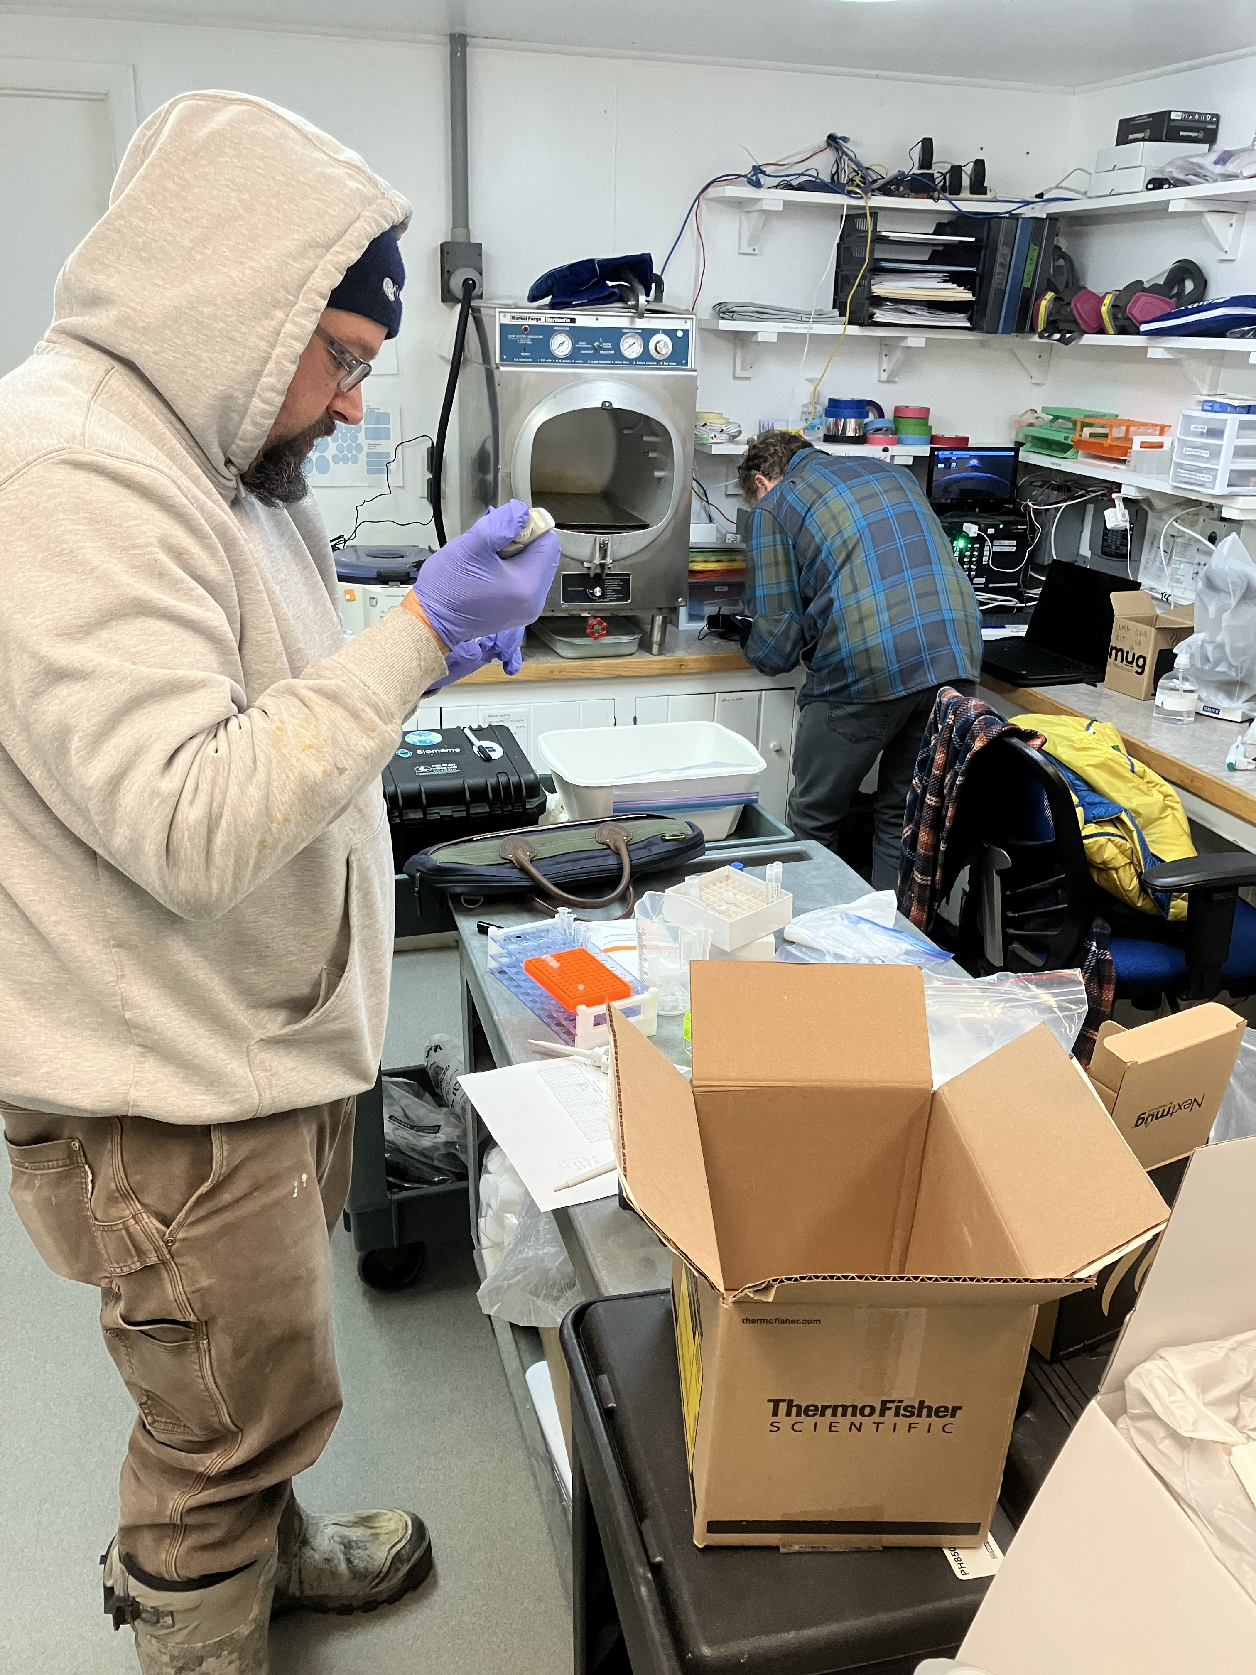
U U + + -
General Vibrio screening
10
(Minutes)
15
20
25
30
35
U U + + -
Notes:
But its going to take end users to really develop the methods! Semi quantitative!

Slide 13
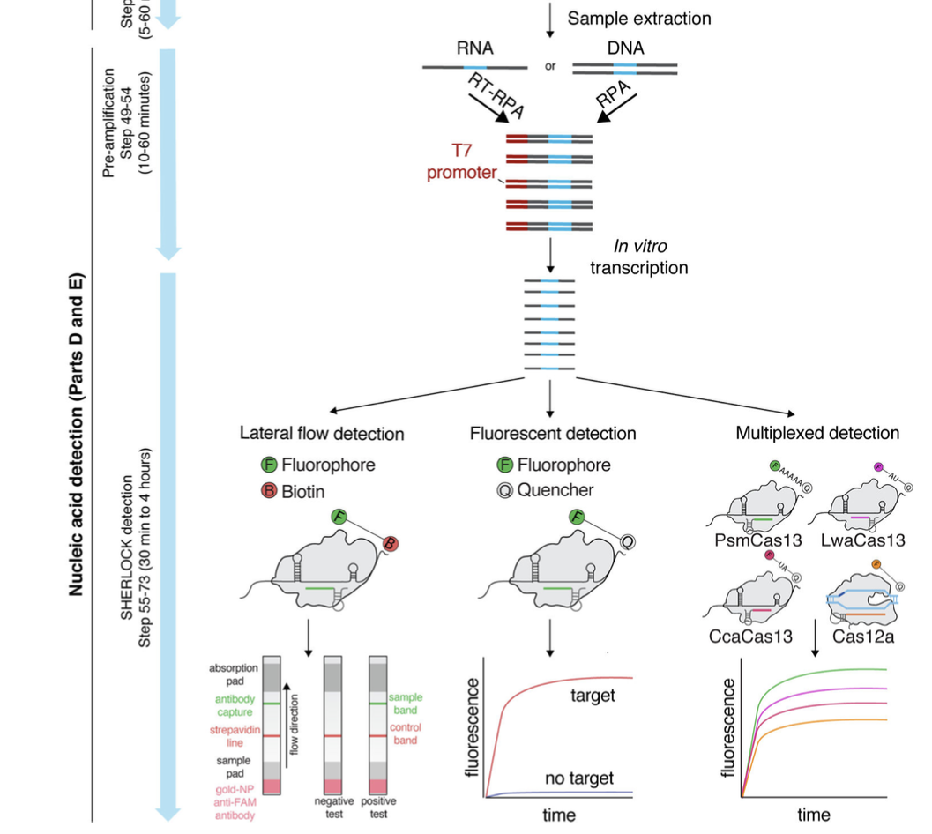
Conclusions and Future Directions
Rapid detection of pathogens can aid hatchery operations
Iterative process, easy to design new assays as we learn more
Working with advisory group to beta test in other hatcheries
Potential for lateral flow detection by incorporating CRISPR technology
Kellner et al. 2019
SHERLOCK: Specific High-Sensitivity
Enzymatic Reporter UnLOCKing

Slide 14
Acknowledgements
Advisory Committee: Hannah Pearson, Steve Malinowski, Dana Morse, Bob Rheault, Harold Schreier
Pete Countway
Kristin Cohrs
Supported by the United States Department of Agriculture - Northeast SARE Research for Novel Approaches Grant LNE22-457R
Ryan McCann
Questions? rsleith@bigelow.org
Supported by the National Science Foundation under Grant No. 11A-1849227

