Slide 1
SARE Final Report
Increasing Farm Profitability through Agritourism Product Development and Marketing
Lisa C. Chase
Natural Resources Specialist, UVM Extension
Director, Vermont Tourism Data Center May 26, 2011

Slide 2
Outputs
Outputs
Activities
1. Agritourism training modules were developed
2. Nineteen workshops were held in ten states (ME, MD, DE, VT, NH, NY, MA, CT, WV, RI) in the Northeast with 763 farm operators. Completed evaluations were received from 143 farms.
3. Farm operators received technical assistance.

Slide 3
Outcomes
Outcomes - Short Term - Learning
First survey (n=126)

Slide 4
Outcomes
Outcomes - Short Term - Learning
First survey (n=119)

Slide 5
Outcomes
Outcomes - Short Term - Learning
First survey (n=116)

Slide 6
Outcomes
Outcomes – Medium Term Projected
First survey (n=125)

Slide 7
Outcomes
Outcomes – Medium Term Projected
First survey (n=125)

Slide 8
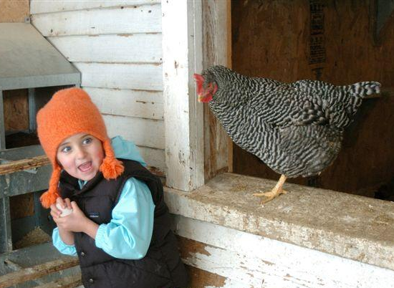
Outcomes
Outcomes – Medium Term
Web survey (n=98)
Farmers will take actions that help them:
(1) start a new agritourism venture;
(2) improve an existing venture; or
(3) decide not to begin a venture based on business analysis.

Slide 9
Outcomes
Outcomes – Medium Term

Slide 10
Outcomes
Outcomes – Medium Term

Slide 11
Outcomes
Outcomes – Medium Term
“Increased involvement in local schools and organizations.”
“Social media marketing.”
“Maple tours for the off-season.”
“Pairing and tasting events.”
“Green Hotel certification.”
“Customer satisfaction survey.”
“Educational nature trails.”

Slide 12
Outcomes
Outcomes – Long Term
Farmers that have adopted new agritourism practices report improved farm viability

Slide 13
Outcomes
Outcomes – Long Term

Slide 14
Outcomes
Outcomes – Long Term

Slide 15
Outcomes
Outcomes – Long Term
Impact on profitability from information received through last year's agritourism workshop or technical assistance. (59 farms with positive impact) n=88
Location | CT | MA | MD | ME | NH | NY | RI | VT | WV
Negative impact | 0 | 0 | 0 | 0 | 0 | 0 | 0 | 0 | 0
No impact | 3 | 2 | 5 | 1 | 5 | 6 | 2 | 5 | 0
Positive impact | 11 | 5 | 2 | 6 | 4 | 9 | 3 | 14 | 5

Slide 16
Outcomes
Outcomes – Long Term

Slide 17
Outcomes
Outcomes – Long Term

Slide 18
Outcomes
Outcomes – Long Term

Slide 19
Outcomes
Outcomes – Long Term

Slide 20
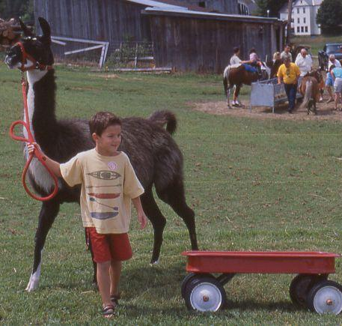
Future Efforts
Continued regional collaboration
Complementary grants
Additional research

