Slide 1


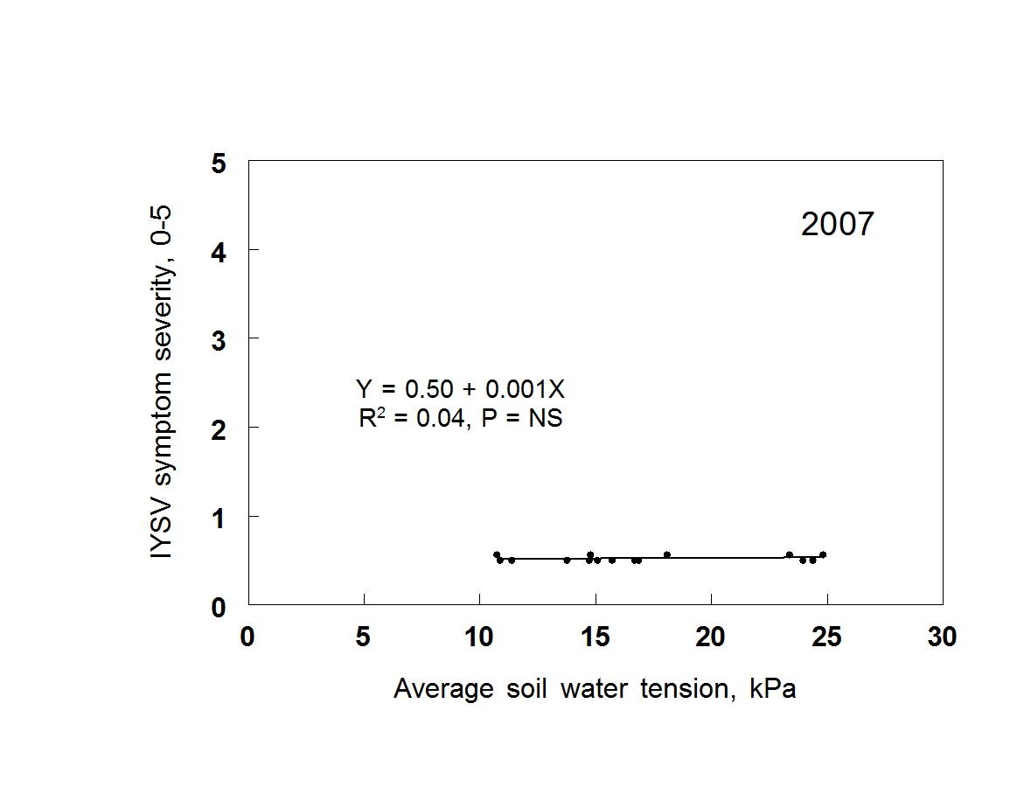
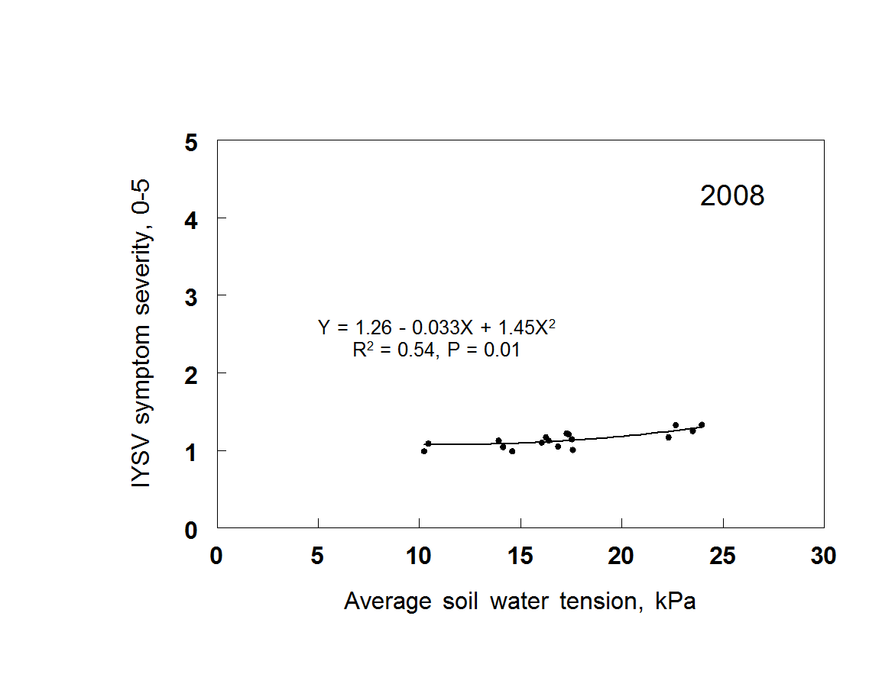
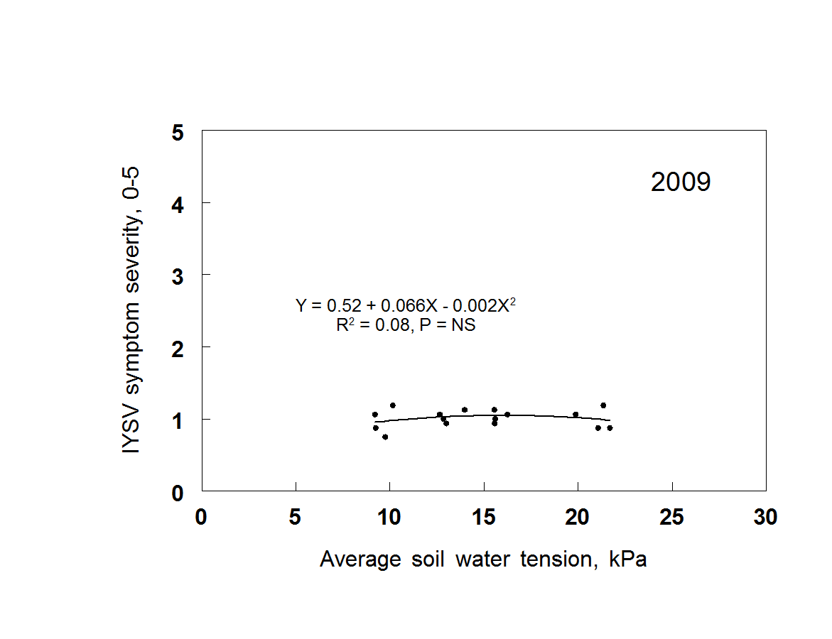

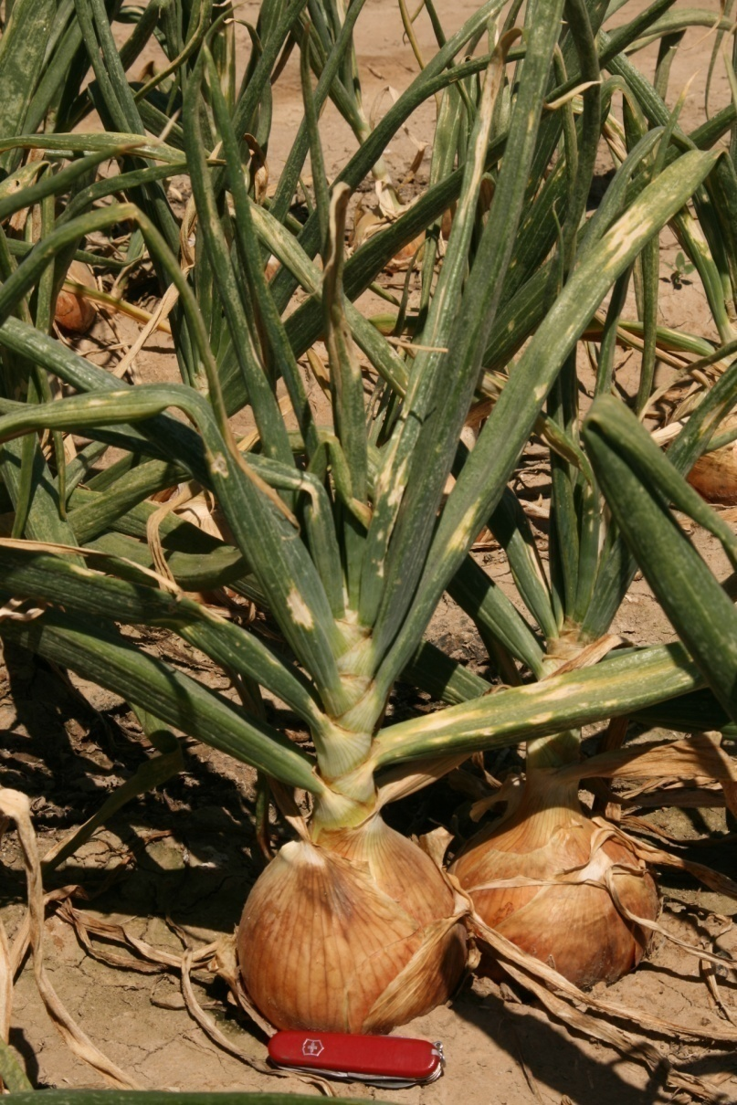
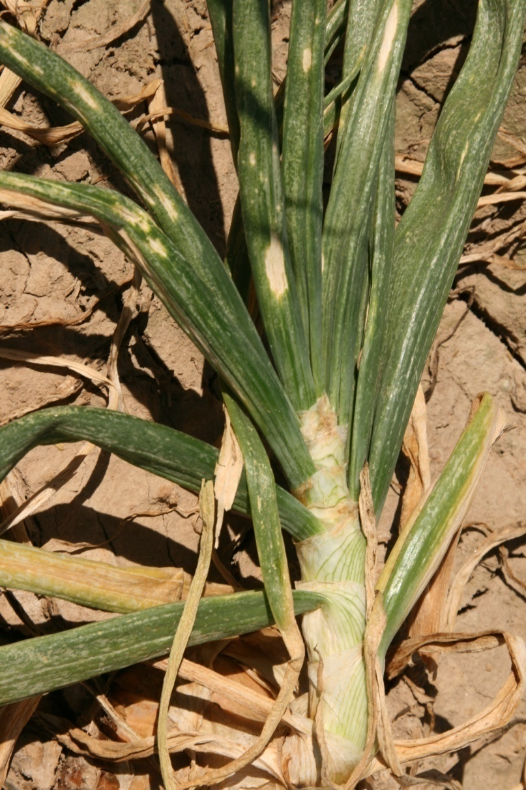
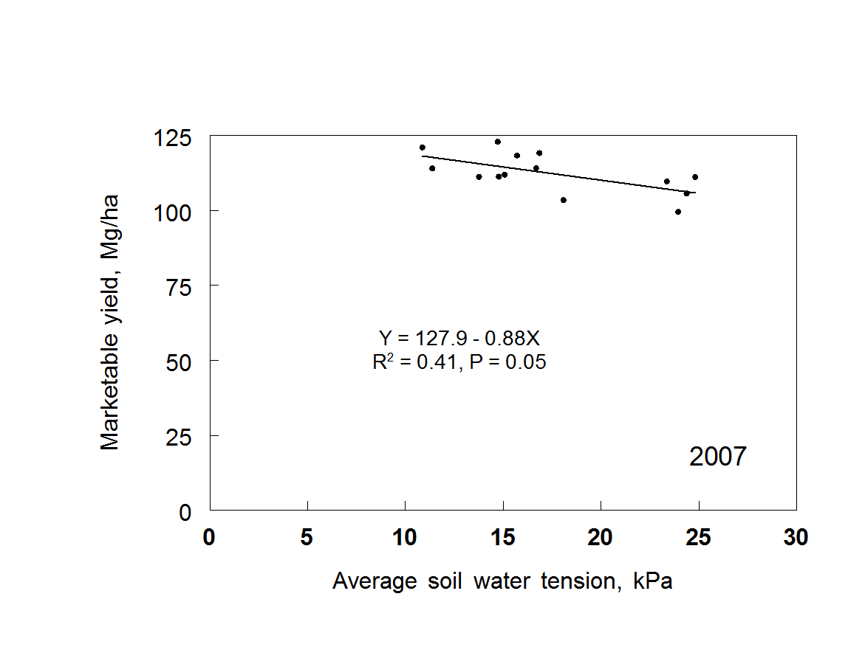
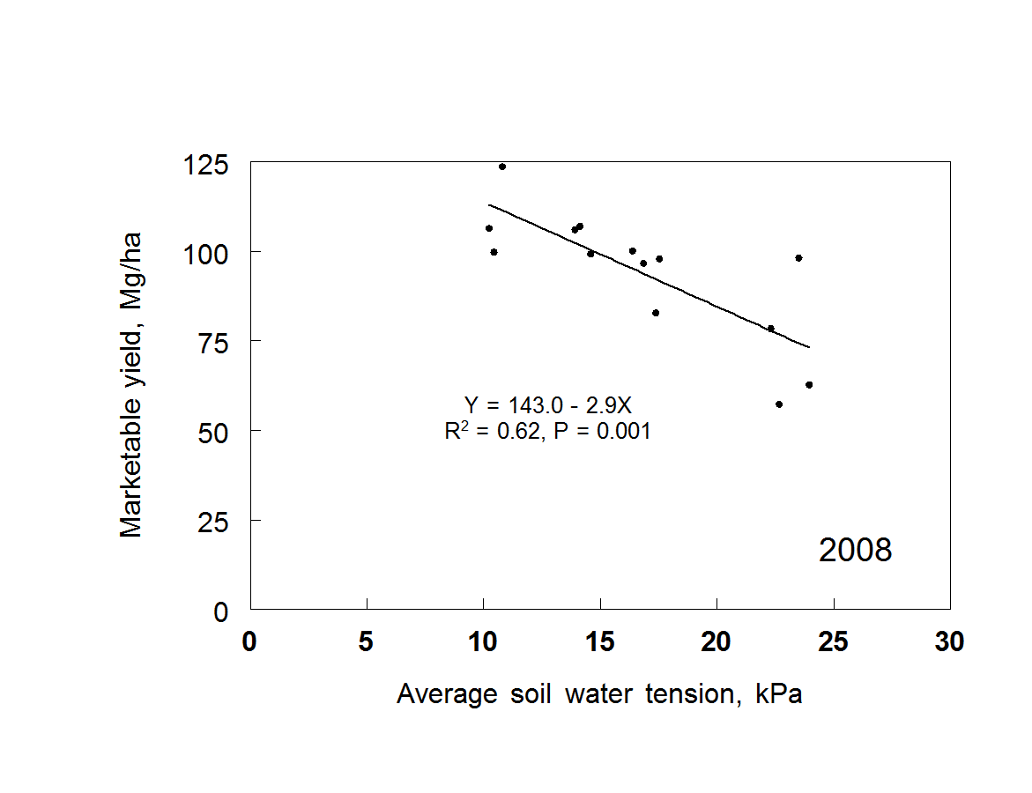
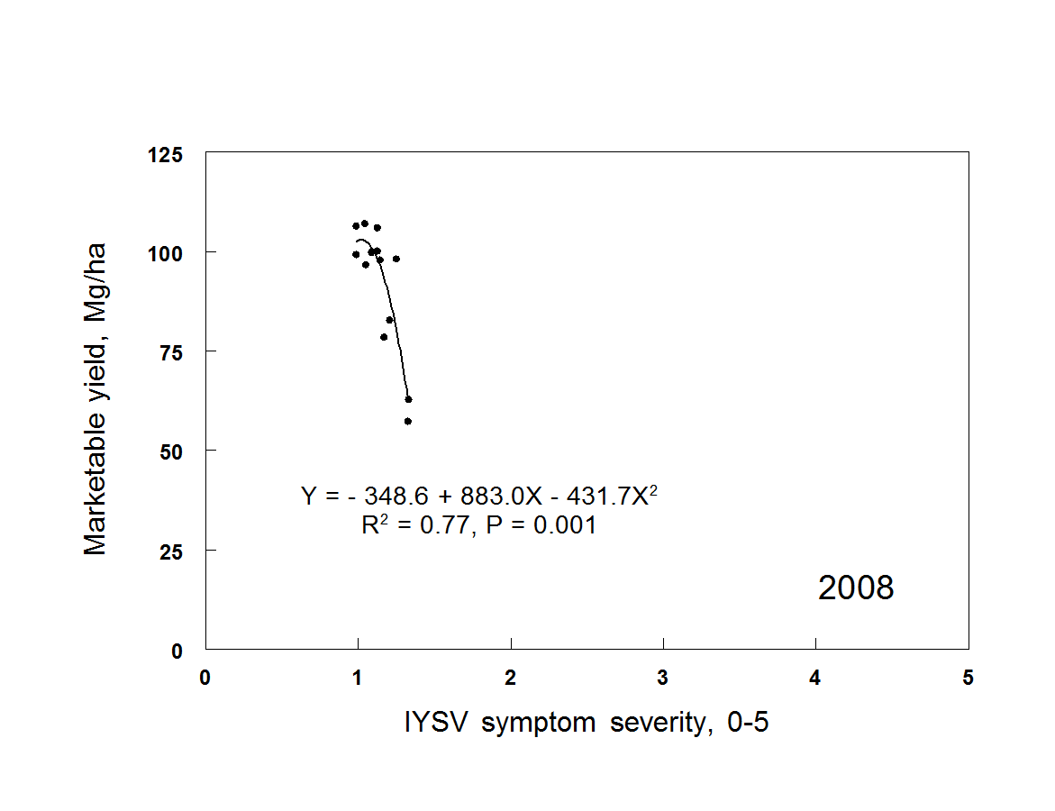
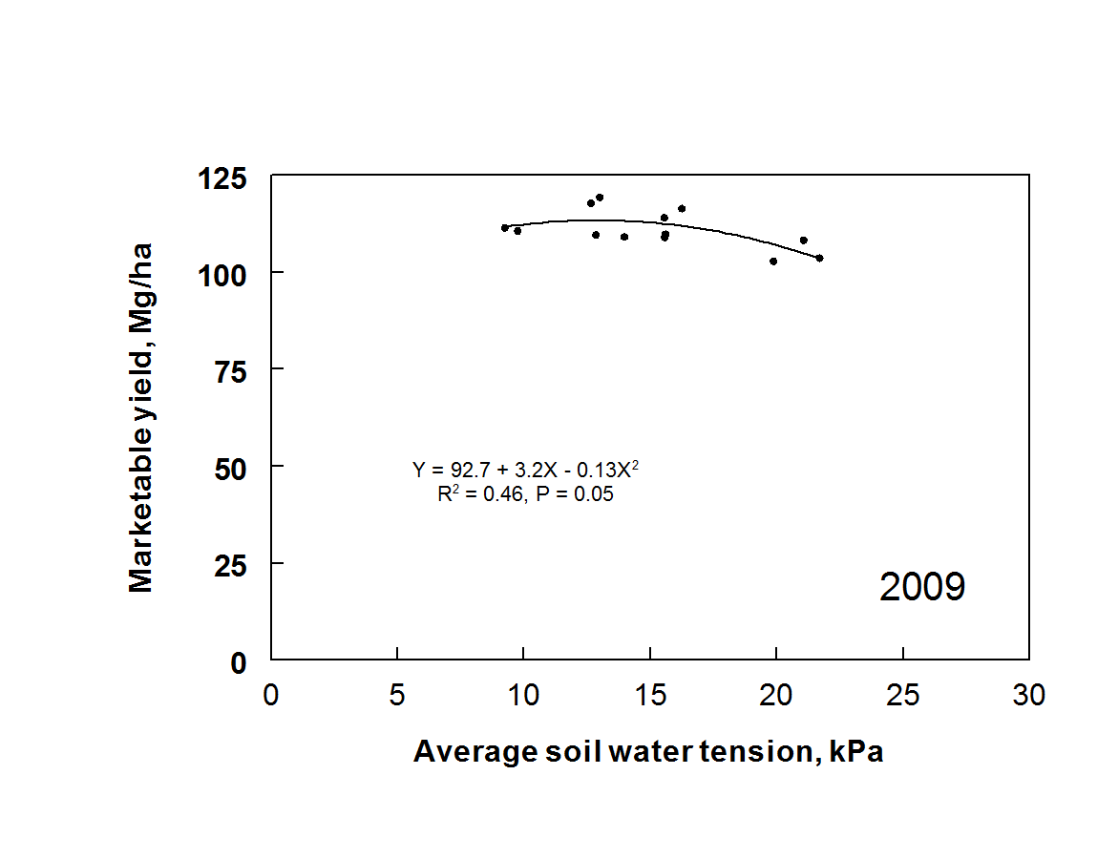
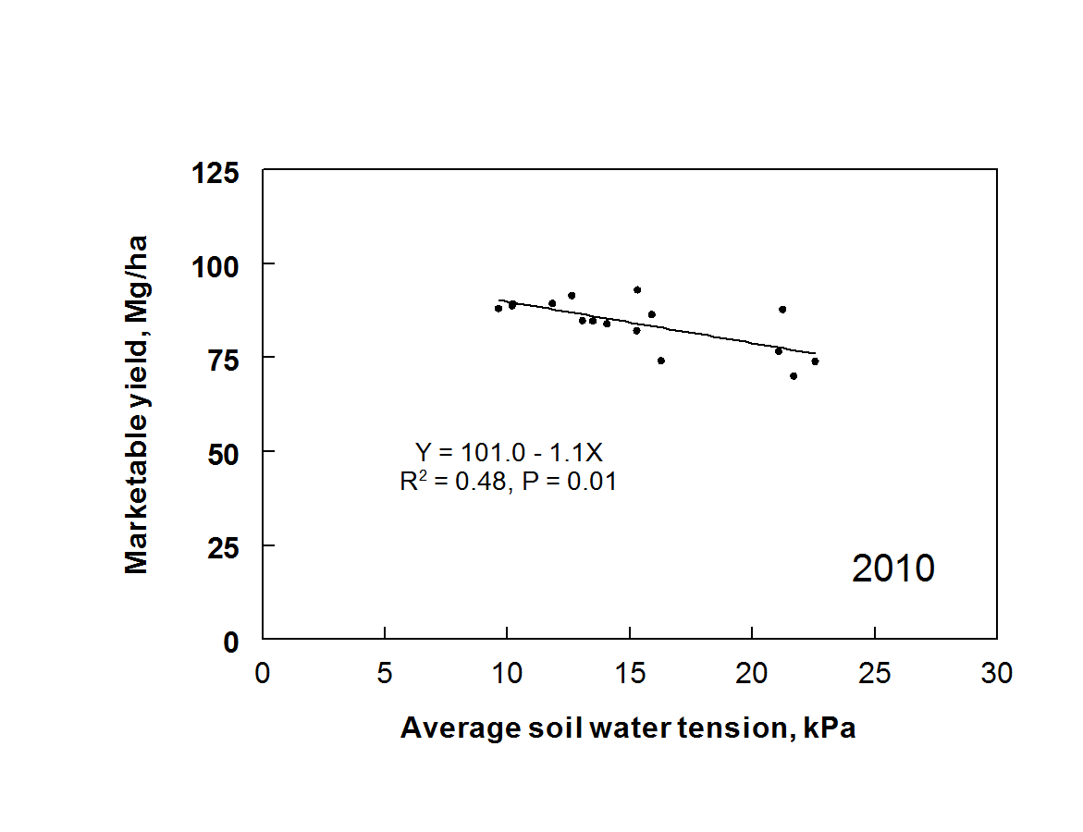
Influence of Selected Cultural Practices on the Expression of Iris Yellow Spot Virus in Onion
Clinton C. Shock¹, Erik Feibert¹ , Lamont Saunders¹, Lynn Jensen¹, Hanu R. Pappu²,
S. Krishna Mohan³, and Ram Sampangi³
Partial funding for this study was provided by the Western Sustainable Agriculture Research and Education Program
¹Oregon State University, Ontario, OR , ²Washington State University, Pullman, WA, ³University of Idaho, Parma, ID
Introduction
Iris yellow spot virus (IYSV) is a major constraint to the production of onion (Allium cepa) bulb and seed crops in the Pacific Northwest of the US. First found locally in the Treasure Valley of Idaho and Oregon infecting onion seed crops in 1989, the virus is now reported from many onion-producing areas around the world. Onion plants infected with IYSV can progressively loose leaf area, resulting in reduced yield and reduced bulb size. The virus is transmitted by onion thrips (Thrips tabaci). This study evaluated whether irrigation and fertilization practices that reduce plant stress might also reduce the impact of IYSV.
Approach
The combined effects of variety, irrigation system, irrigation criterion, and nitrogen (N) rate on IYSV expression and onion yield and grade were evaluated in 2007, 2008, 2009, and 2010 (Table 1).
Fertilization at 112 kg N/ha resulted in a higher onion yield and grade in 2007 than 224 kg N/ha. There were no differences in onion yield or grade between N rates in the other three years, and N failed to influence disease incidence with the exception of slightly higher IYSV in 2010 at 224 kg N/ha. Virus symptom severity (Table 2, Fig. 1) did not respond to irrigation criteria in 2007, 2009, or 2010 (Fig. 2). In 2008, averaged over varieties and N rates, drier irrigation criteria (higher SWT) resulted in significantly more severe IYSV symptoms. Averaged over varieties and N rates, drip irrigation at 30 kPa resulted in significantly lower marketable bulb yield than the wetter irrigation criteria all four years, but the differences were more pronounced in the presence of IYSV in 2008 (Fig. 3). Marketable yield was negatively related to increasing virus symptom severity in 2008 (Fig. 4). There were no significant interactions between variety, irrigation criteria, and N rate. Sprinkler irrigation failed to suppress thrips or IYSV.
Table 2. IYSV subjective symptom severity rating system.
Figure 2. Relationship between average soil water tension and IYSV symptom severity. Malheur Experiment Station, Oregon State University, Ontario, OR
Figure 1. Necrotic lesions caused by IYSV on onion leaves.
Table 1. Irrigation treatments applied to 4 varieties fertilized at two rates of N, Malheur Experiment Station, Oregon State University, Ontario, OR, 2010.
Figure 4. Relationship between IYSV symptom severity and marketable yield in 2008. Malheur Experiment Station, Oregon State University, Ontario, OR
ªsoil water tension at 8-inch depth measured in kiloPascals (kPa). 0 Kpa corresponds to saturated soil.
^{b}15 kPa until July 31, then 25 kPa thereafter.
^{C}0.61 mm/irrigation until July 31, then 1.22 mm/irrigation thereafter.
^{d}total water applied based on limited furrow inflow measurements.
Figure 3. Relationship between average soil water tension and marketable yield. Malheur Experiment Station, Oregon State University, Ontario, OR

