Slide 1
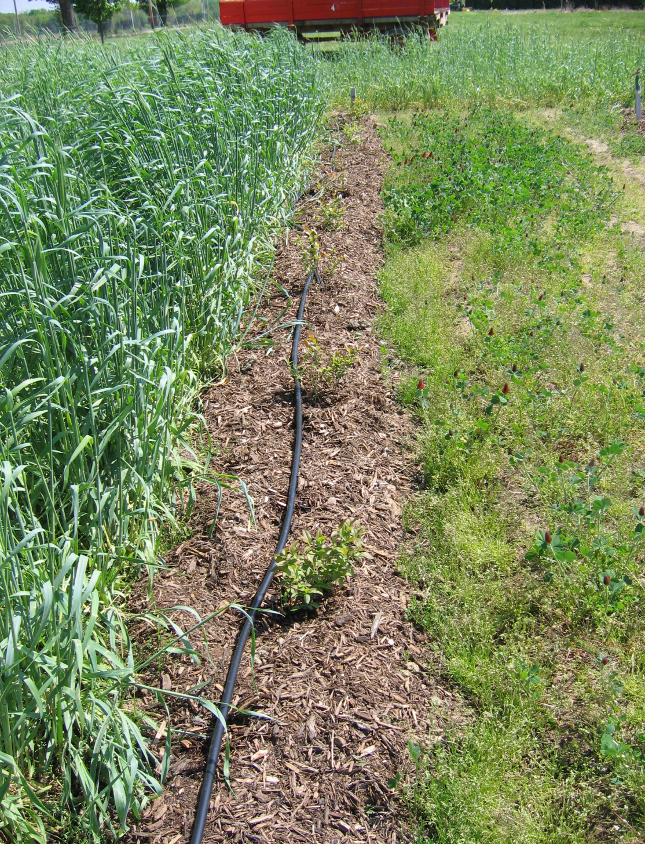
Fig. 1. Newly planted blueberries between rye (left) and crimson clover cover crops in organic blueberry plot.

