Slide 1
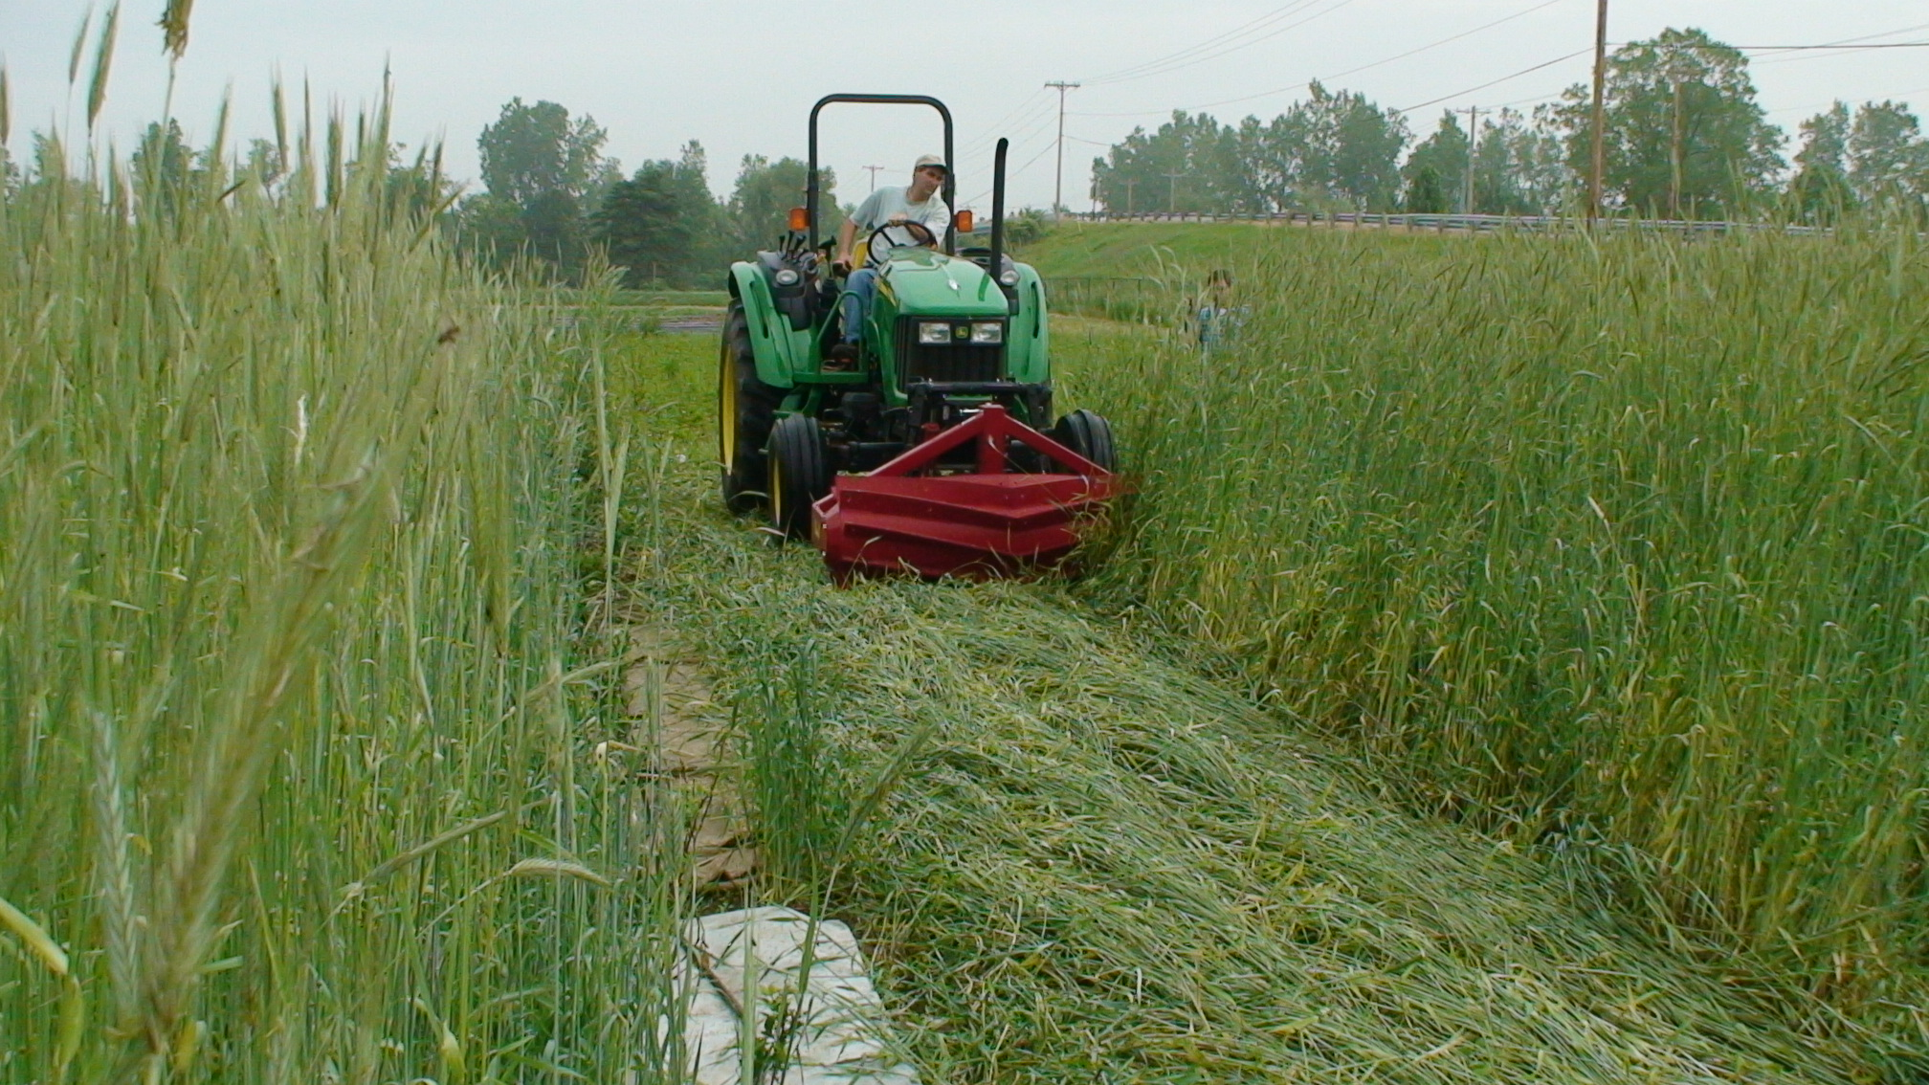
Fig. 2. Rye is flattened with a roller crimper in the MSU Organic blueberry plot in June 2008.

