Slide 1
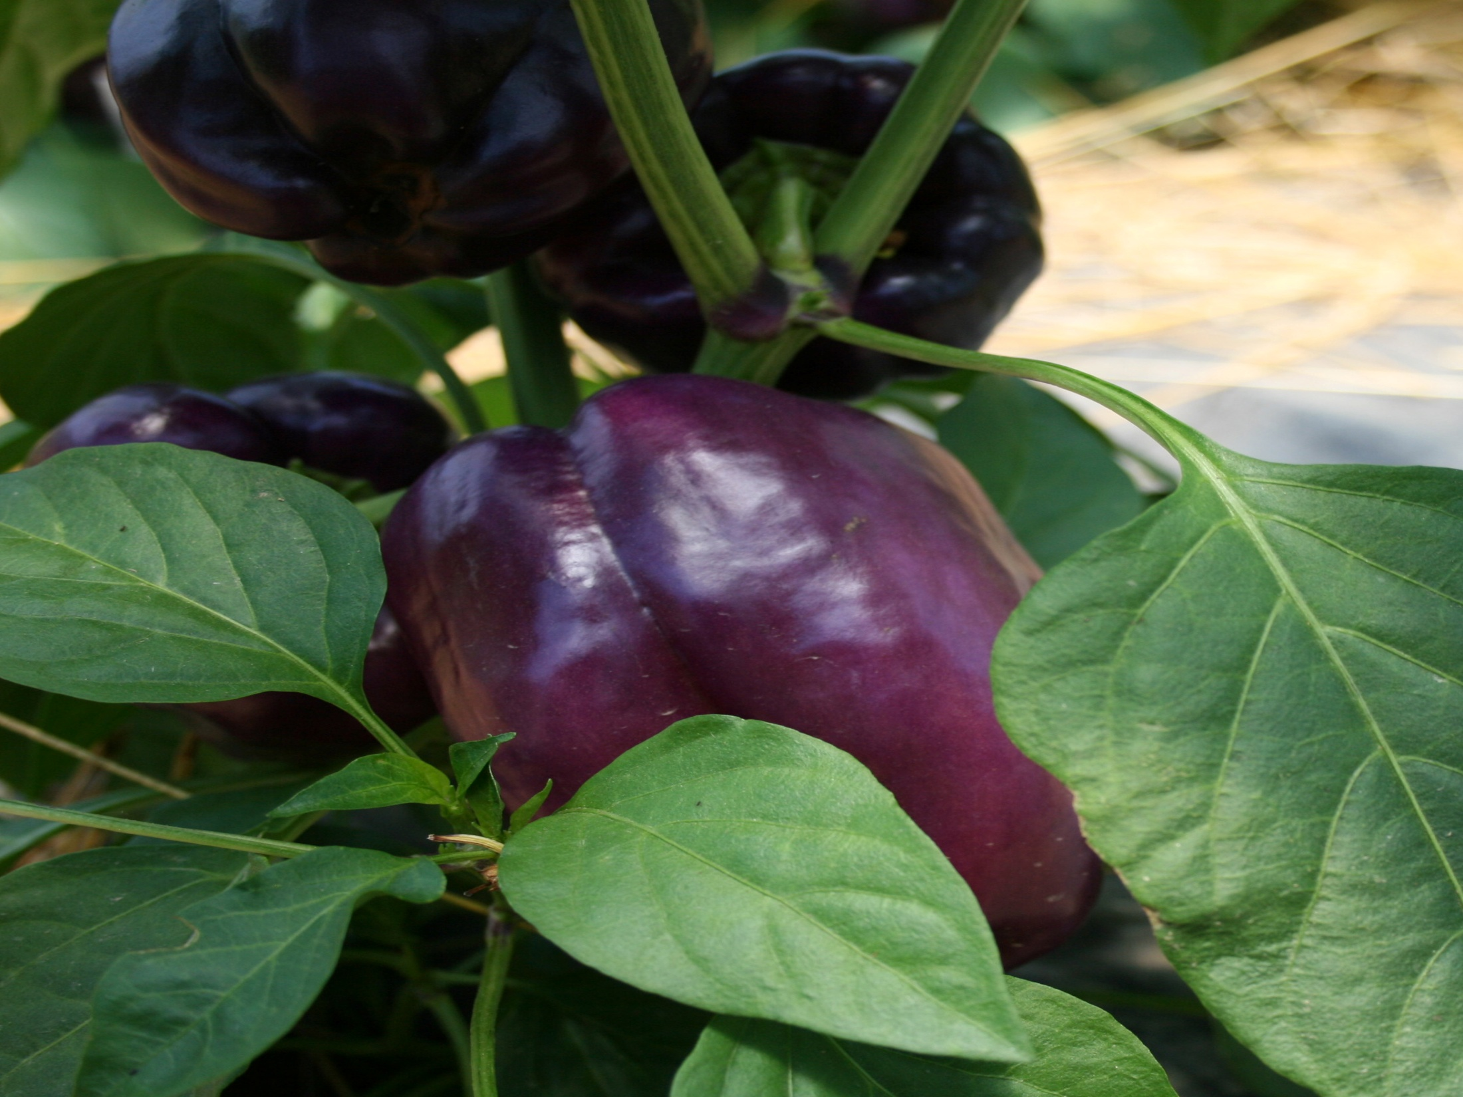
Fertility in organic systems
Dr. Timothy Coolong
University of Kentucky
Department of Horticulture

Slide 2
Fertility strategies
Transplant production
  Fertility is the primary obstacle for organic transplant production
    Media supplemented with readily available fertilizers
Crop production
  Field production relies on building soil and not input substitution

Slide 3
Transplant Production
Purchase premade mix, make your own or custom mix
Method | Advantages | Disadvantages
Premade | Uniform, consistent , easy to document for certification | Costly-shipping
Homemade | Inexpensive | Highly variable within mix and from batch to batch, must document for certification, time
Custom blend | Get exactly what you want | Expensive

Slide 4
Costs of media
Media | Size | Cost $/ft3 | Cost $/flat | Cost $/acre (Tomato) | Manufacturer
BM2 Germinating mix | 3 ft³ loose | $3.32 | $0.47 | $31.33 | Berger
OM2 Organic germinating mix | 3 ft³ loose | $3.92 | $0.56 | $37.52 | Berger
OM6 Organic high porosity mix | 3.8 ft³ compressed (7 ft when opened up) | $2.85 | $0.41 | $27.47 | Berger
Pro-Mix Bx | 3.8 ft³ compressed (7 ft when opened up) | $2.67 | $0.38 | $25.46 | Premier Horticulture
McEnroe Premium Lite Grow mix | 1/20th yd³ | $9.07 | $0.88 | $58.96 | McEnroe Farms

Slide 5
Transplant production
Media is key
  Usually a peat-based mix with vermiculite, perlite and nutrients (compost, worm castings, bone meal, etc)
  All ingredients must be allowable by OMRI
    Wetting agents in peat
  Uniformity of nutrients and salts have been an issue
    Affected by source, temperature, age, etc.
    Sodium levels are often very high (Sodium nitrate)

Slide 6
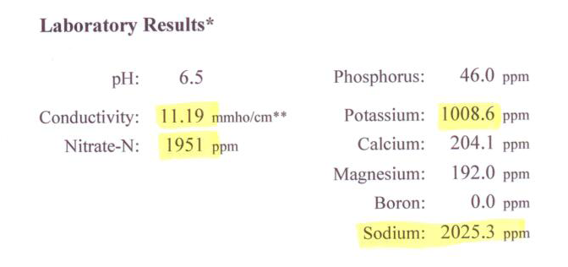
Media analysis for organic media with high salts due to sodium nitrate
Category | Low | Optimal | Very High
Soluble salts | 0.0-1.4 | 2.5-3.4 | >4.5
Nitrate-N (ppm) | 0-49 | 110-174 | >225
Potassium | 0.0-69 | 175-249 | >325
Sodium | - | 0-70 | >100

Slide 7
Organic fertilizers used in media
Materials | N-P-K | Rate of Nutrient Release | Notes
Blood Meal | 12-1.5-0.6 | Med-Fast
Bone Meal | 4-21-0.2 | Very slow
Compost | Varies | Medium-Fast | Raw manure prohibited
Cottonseed Meal | 7-2.5-1.5 | Slow medium | Cannot come from GMO cotton
Fish Meal | 10-5-0 | Medium
Greensand | 0-0-5.0 | Very slow
Bat Guano | 5.5-8.6-2.0 | Medium
Sodium nitrate | 16-0-0 | Fast | Not to be used for more than 20% of N needs of crop + high salts
Worm Castings | 1.5-2.5-1.3 | Medium
Wood Ash | 0-2.5-1.3 | Fast | Very alkaline
Excerpted from “Using Organic Nutrient Sources” Penn State University

Slide 8
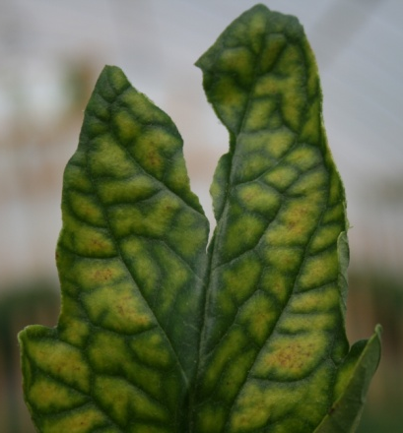
Organic media
Availability of nutrients should align with crop needs
  Ex. Adding greensand to correct a major potassium deficiency will not be effective
Crop requirements
Deficient
Nutrient released
Week
1 2 3 4 5

Slide 9
Media recipes
Available in “Potting mixes for certified organic production” from Attra
  “Cornell mix”
    ½ cu. yd. sphagnum peat, ½ cu. yd. vermiculite, 10 lbs bonemeal, 5 lbs ground limestone, 5 lbs bloodmeal
  “Tipi Produce mix”
    8 cu ft sphagnum peat, 4 cu ft vermiculite, 4 cu ft perlite, + 6 quarts of fertilizer mix of: 15 parts bone meal :10 parts kelp meal:10 parts bloodmeal:10 parts dolomitic lime (80-90 mesh)

Slide 10
Supplemental fertility
You may need to supplement the fertility in a mix
  Due to the slow release nature of some organic fertilizers seedlings may show deficiency early on and then respond to nutrients becoming available in media
  Generally use a liquid organic fertilizer 1-2 times if necessary
    They are usually shipped as concentrates (can burn foliage)
    Generally expensive

Slide 11
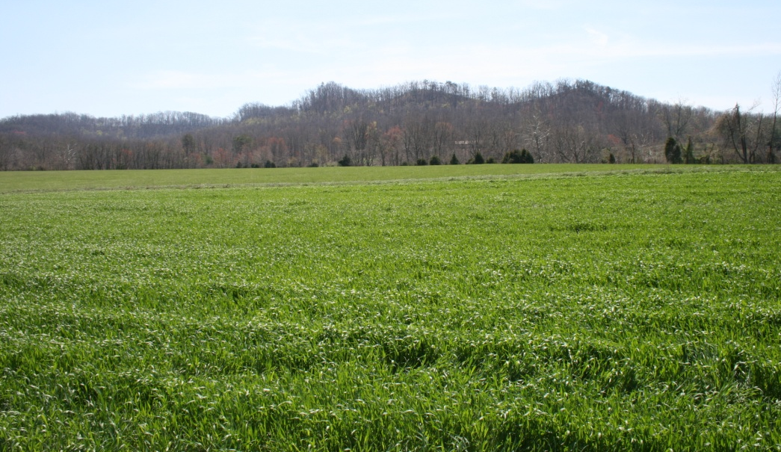
Field production
Must use a systems approach to fertility in an organic system
  Input replacement will not work
  Far too costly and goes against a philosophy of and integrated approach to farming

Slide 12
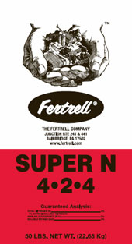
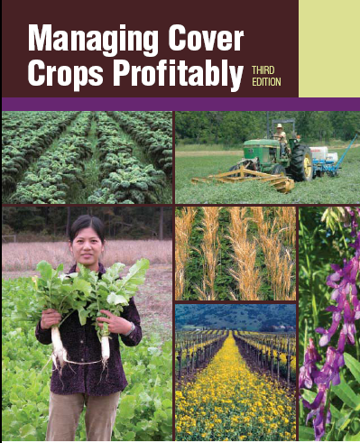
Building soil fertility
Cover cropping and crop rotation
Composting and/or manure
  Integrated animal systems
Supplemental organic fertilizers
http://www.fertrell.com/

Slide 13
Cover crops and nutrition
Erosion protection
  Plant roots help keep soil intact
    Exudates: Polysaccharides and glomalin help improve soil aggregation and stability
Cover crops will improve organic matter
  Plants that are very woody and fibrous (sudex) contribute more to organic matter
  Plants that are very lush and succulent release a lot of nutrients, but contribute less to organic matter
  Conventional tillage makes it difficult to build up organic matter
  Cover crops can contribute roughly the same amount of organic matter as 9-13 tons of farm manure (1.8-2.2 tons dry matter) Sullivan, P. 2003. Overview of cover crops and green manures, Attra.
Increase water infiltration and improve water holding capacity

Slide 14
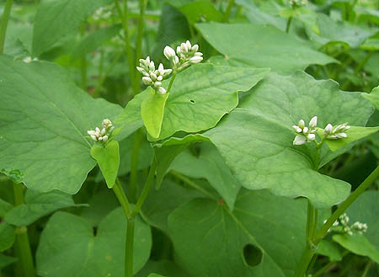
Cover crops and nutrition
Deep rooted cover crops will scavenge nutrients and prevent leaching from winter rains
  Cereal rye is probably best suited for this role Kentucky-
  Many legumes do not establish as well in fall and do not scavenge nutrients well

Slide 15
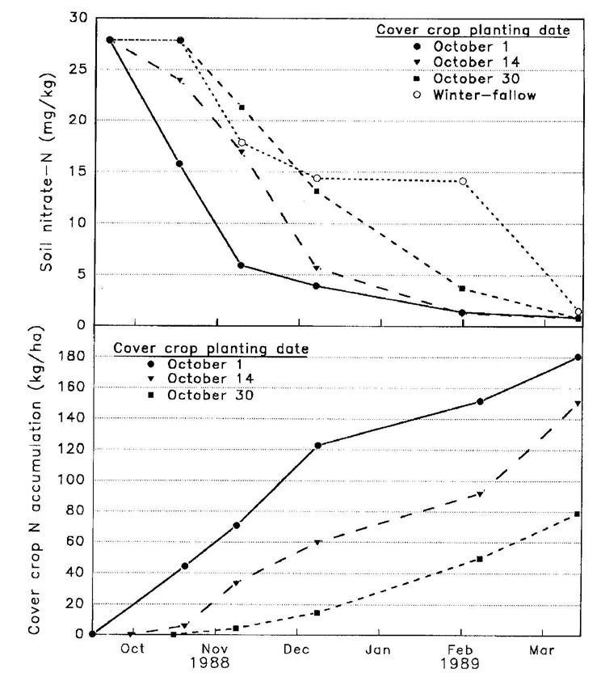
Staver, K.W. and R.B. Brinsfield. 1998. Using cereal grain winter cover crop to reduce groundwater nitrate contamination in the mid-Atlantic Coastal Plain. Journal of Soil and Water Conservation, volume 53, number 3.
Planting earlier to establish cereal rye results in much more N scavenging (seeded 3 bu/acre)
Vegetable growers in conflict with early planting

Slide 16
Biomass yield and nutrient accumulation of cover crops
Biomass yield (dry weight) and nutrient accumulation
Crop | Biomass (lbs/ac) | Nitrogen (lbs/ac) | Potassium (lbs/ac) | Phosphorous (lbs/ac) | Magnesium (lbs/ac) | Calcium (lbs/ac)
Hairy Vetch | 3,260 | 141 | 133 | 18 | 18 | 52
Crimson Clover | 4,243 | 115 | 143 | 16 | 11 | 62
Austrian W.P. | 4,114 | 144 | 159 | 19 | 13 | 45
Rye | 5,608 | 89 | 108 | 17 | 8 | 22
Hoyt, G.D. 1987. Legumes as a green manure in conservation tillage. P. 96-98. In: J.F. Powers (ed) The role of legumes in conservation tillage systems. Soil Conservation society of America, Ankeny, Iowa.

Slide 17
Nitrogen fixing cover crops
N production from legumes can vary from 40-200 lbs+ of N per acre
  Affected by: plant stand, soil pH, nodulation, and soil moisture
The portion of N available in the first year is usually 40-60% the total amount in the plant
  Usually lower (40%) when just left on the surface and higher (60%) when incorporated

Slide 18
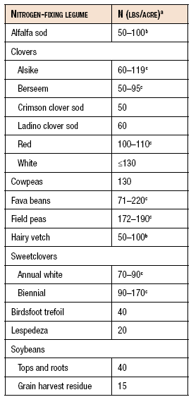
Nitrogen credits from cover crops
How to determine N
  Get a sample for protein analysis then divide by 6.25 to get %N
  The look up biomass yields per acre
  Factor in plant stand
Excerpted from “Using Organic Nutrient Sources” Penn State University

Slide 19
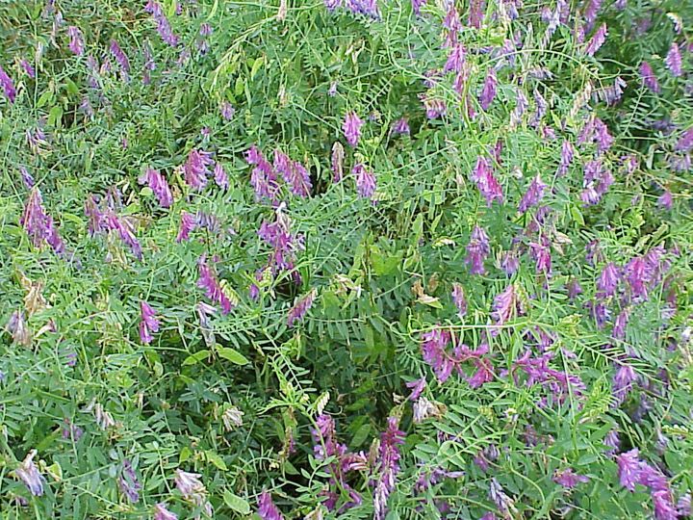
Nitrogen to carbon ratio of cover crops
Want to have a C:N ratio of 25:1 or less
  Higher will mean that soil N is tied up by soil microbes breaking down carbon
C:N ratios of cover crops
Organic Material | C:N ratio
Young rye | 14:1
Mature rye | 20:1
Hairy Vetch | 10:1-15:1
Crimson Clover | 15:1
Corn stalks | 60:1
Sawdust | 250:1
Sullivan, P. 2003. Overview of cover crops and green manures, Attra.

Slide 20
Costs of cover crops
Typically range in cost from $0.50 to $3.00 per pound + shipping for legumes (cheaper for many grains)
  Seed costs per acre can range from $10 to $30 +
  Can replace up to 120 lbs of N for vetch and 70-80 lbs of N with clover per acre
  Cost of $0.50 per pound of N

Slide 21
Cover cropping
Current recommendations for vegetable farms in Kentucky are limited
Crop | Rate per 1000 ft² | Time to seed | Comments
Winter Rye | 3 lbs | Sep-Nov | Excellent growth and yield
Wheat | 3 lbs | Sep-Nov | Plant early for best emergence
Hairy Vetch | 1 lbs | Aug-Sept | Need to get in early, provides much N,
Winter Pea | 2 lb | Sep-Oct | May winter kill, have to mix with a grain for coverage
Buckwheat | 2 lb | Sp-Su | Great crop-bees!
Sudangrass | 1 lb | Su | Tremendous biomass-allelopathic

Slide 22
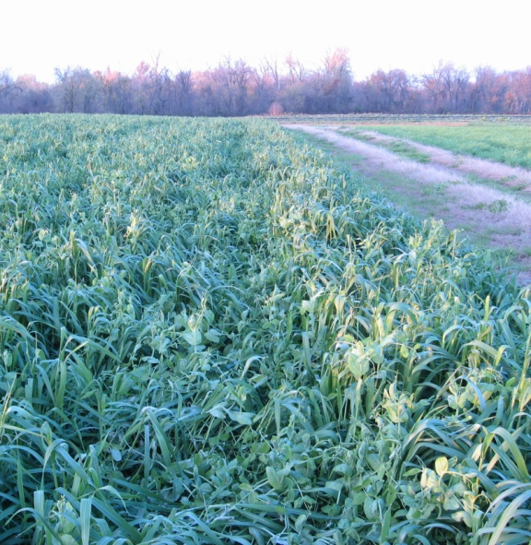
Consider green manure mixes
Be sure to kill prior to seed set
Some will kill by mowing
  Roller crimper- timing is critical

Slide 23
Adding compost
Compost is typically added to build soil quality and give a boost in nutrition
  Composted manures typically do not provide nutrients in the ratio that plants take them up
Source | Average nutrient composition (% DW)
 | N | P2O5 | K20
Dairy cows | 1.3 | 0.9 | 3.0
Horse | 2.3 | 0.9 | 1.7
Poultry | 3.2 | 5.2 | 1.8
Hogs | 3.5 | 0.5 | 0.7
Tobacco Stems | 1.5 | 0.5 | 7.0
Sewage Sludge | 1.5 | 1.3 | 0.4

Slide 24
What is compost?
Must have an initial C:N ratio of 25:1-40:1
Must reach a temperature between 131-170 F for 3 days if in a static aerated pile or in a vessel
  Must reach those temperatures for 15 days if windrowed and must be turned 5 times during that time
  If not composted then treated as manure
  Manure: 90 day and 120 day preharvest interval

Slide 25
Adding compost
Typically 10-20% of the N in compost is available in a given year
  Can vary widely between 10-50% in a year
  Depends on moisture, pH, temperature, compost quality
If you add 1 ton per acre then of 2.5% N compost…..
  You get 50 lbs of N….but at 20% availability then you get 10 lbs of N
If you add enough compost to get total N needs then other nutrients will be imbalanced
  Works well as a supplement

Slide 26
Organic fertilizers
Generally used to supplement fertility provided by cover crops and compost…why?

Slide 27
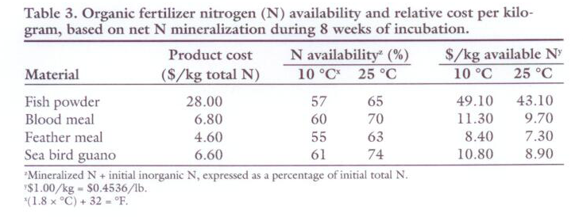
Cost per unit N is relatively high
  Nitrogen availability from high nitrogen containing organic fertilizers, Hartz and Johnstone 2006, HortTechnology

Slide 28
Adding organic fertilizers
Adding organic fertilizers preplant and through fertigation
  Hartz and Johnstone (2006) found that 47-60% of organic N was made available in 2 weeks from organic fertilizers
  Up to 70% was available after 8 weeks
  Temperature had some effect, but not large
  “Chilean Nitrate”= Sodium nitrate
  Nitrogen availability from high nitrogen containing organic fertilizers, Hartz and Johnstone 2006, HortTechnology

Slide 29
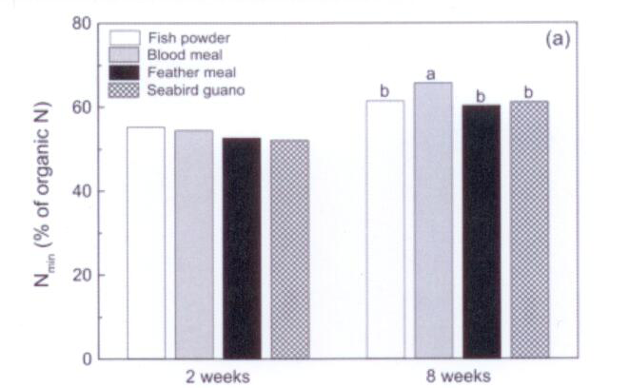
N Availability
  Nitrogen availability from high nitrogen containing organic fertilizers, Hartz and Johnstone 2006, HortTechnology

Slide 30
Water soluble organic fertilizers
Fewer organic fertilizers are suitable for fertigation purposes
Cost vary widely
Must have a good filtration system after injector
  However Hartz, et al., 2010 found that:
    Most of the N is available rapidly
      For animal based fertilizers nearly 79-93% within 1 week
      For plant based fertilizers 48-92% within 4 weeks
Nitrogen availability from liquid organic fertilizers, 2010, Hartz, et al. HortTechnology

Slide 31

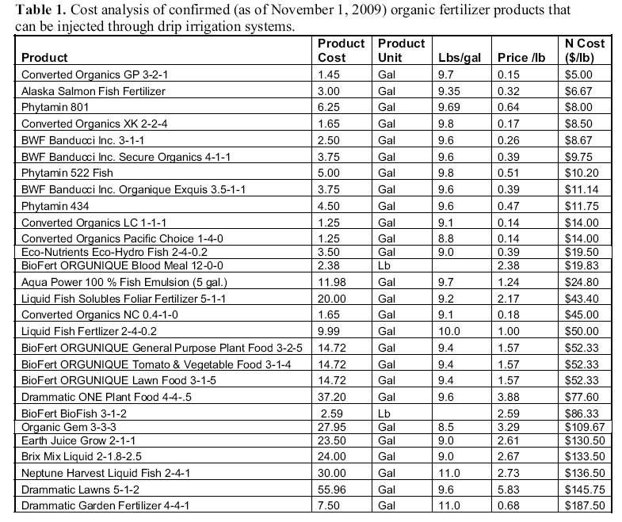
Calcium nitrate (greenhouse grade) 50 lb bag: $17.50 @ 15.5% N = $2.26 lb/N

Slide 32
Fertilization in organic systems
Re-think how we fertilize
  Should rely on cover crops and compost for much your N needs---NOT input replacement
  Organic N (cover crops/compost) is usually available throughout the season, not all at once
  Supplement with organic fertilizers
  Takes a little work than traditional methods

Slide 33
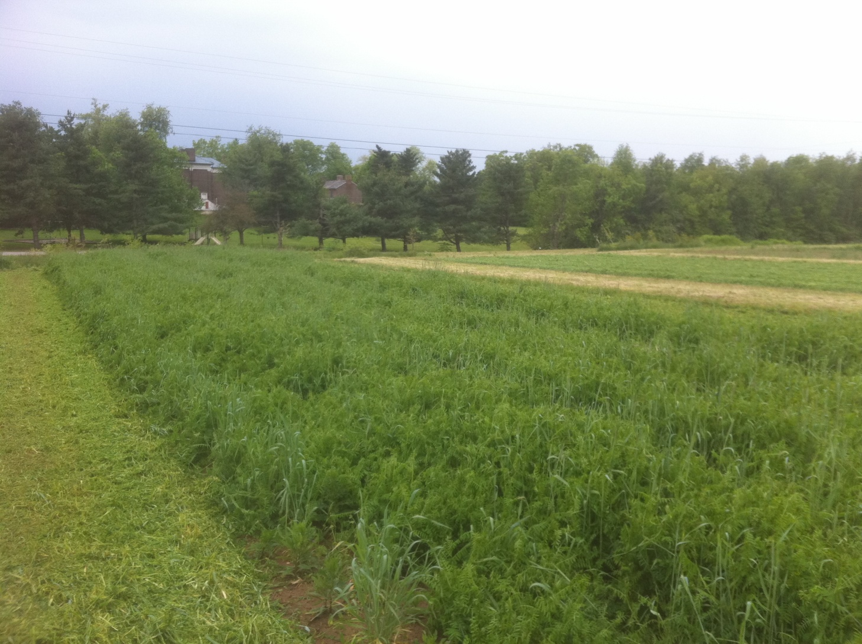
Questions/Thoughts

