Slide 1
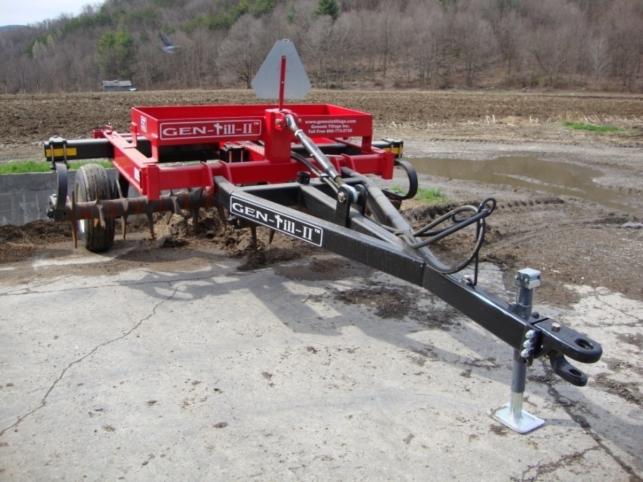
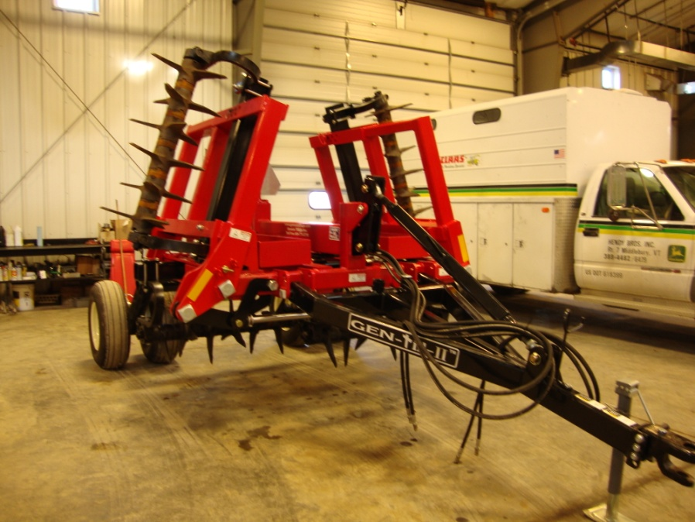


Results Year 2 Aerator Research
This research was made possible with funding through the
Northeast Sustainable Agriculture Research and Education and the
Lake Champlain Basin Program

Slide 2
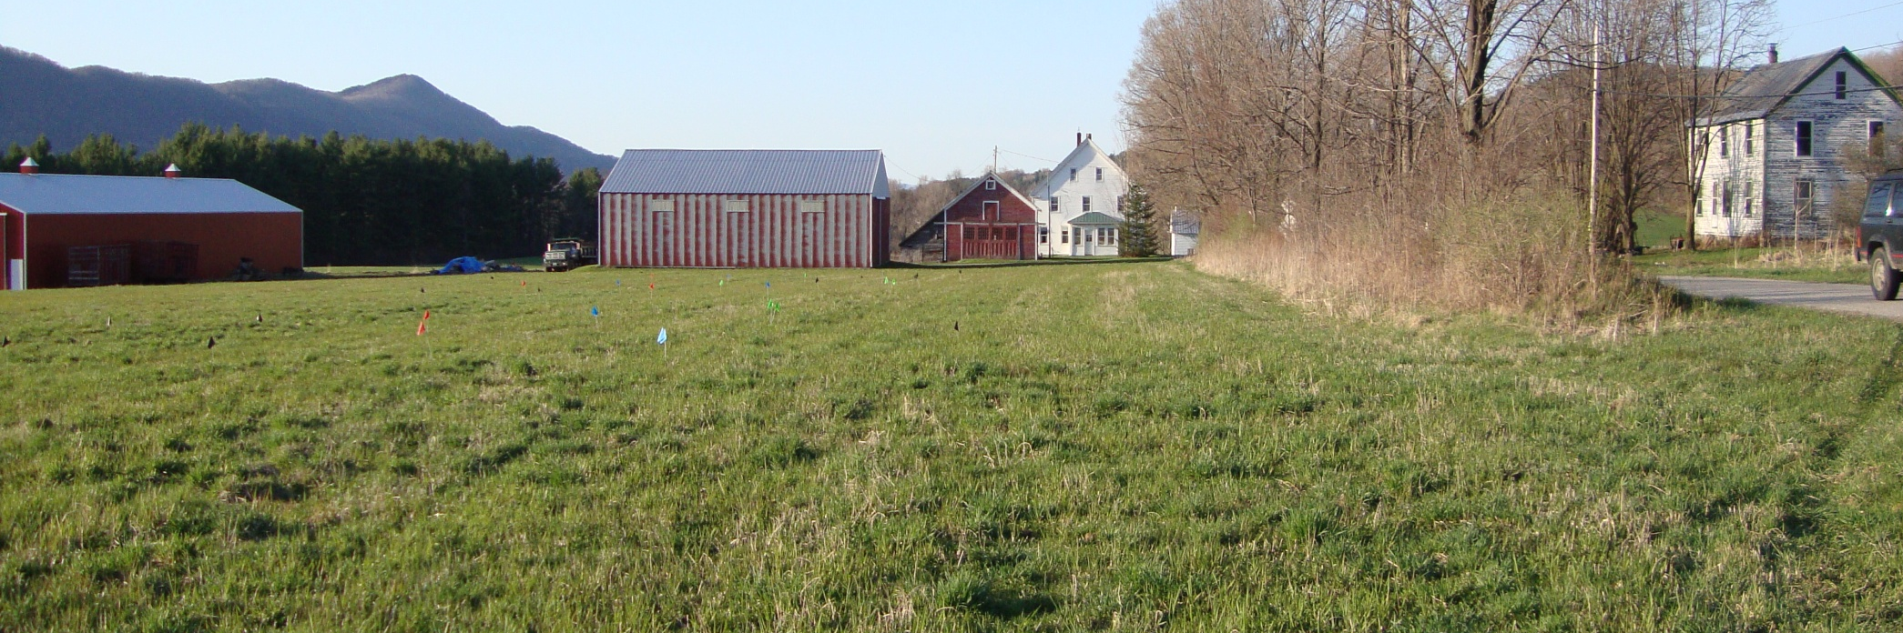
Purpose:
Look at using aerators for the incorporation of liquid and semi-solid manure on hayland
2) Look at the effects of aeration on forage stand density and quality
3) What are the effects of multiple passes of an aerator on forage stands?

Slide 3

Why look at these things?
Aerator companies recommend aerating once a year for light soils (spring), twice a year for heavy soils (Spring and Fall).
Cost share dictates that you aerate every time manure is spread.
Anecdotal claims of yield increases of 50-75% .
Little research with aerators and semi-solid manure
Who wants to risk their crops?
Notes:
Aeration is not a new technology. Been around for 40+ years. Golf courses use it.

Slide 4
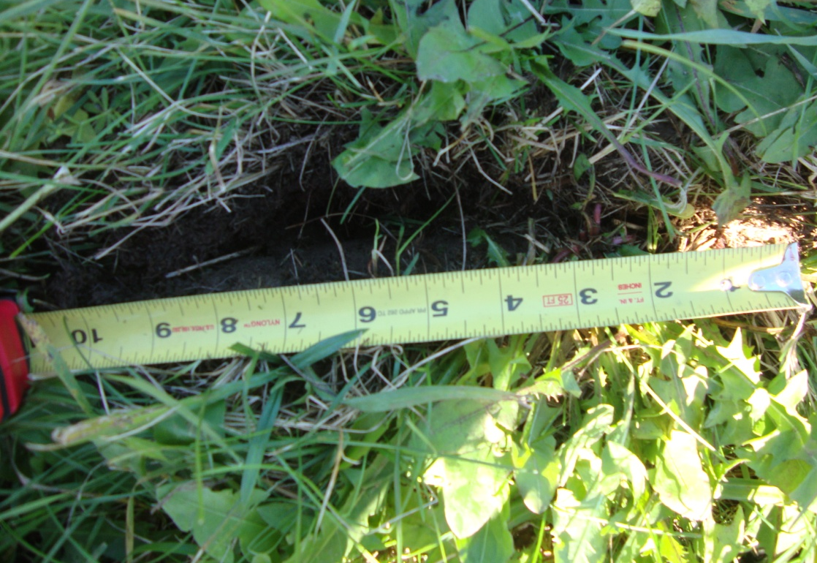
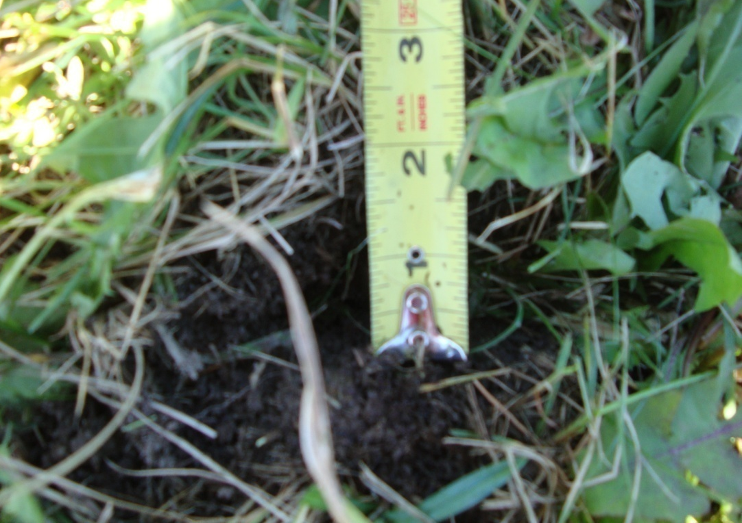
What does an aerator do?
The Gen-Till aerator set at the 0 setting (1st hole) produces a slit in the soil approximately 10” long and ~1.5” at the widest point and between 5 and 6” deep at the deepest point.
Notes:
Local cost share programs have the caviate of you must aerate whenever you spread manure. Manufacture recommendations are 1x a year for light soils and up to 2x a year for heavy soils

Slide 5
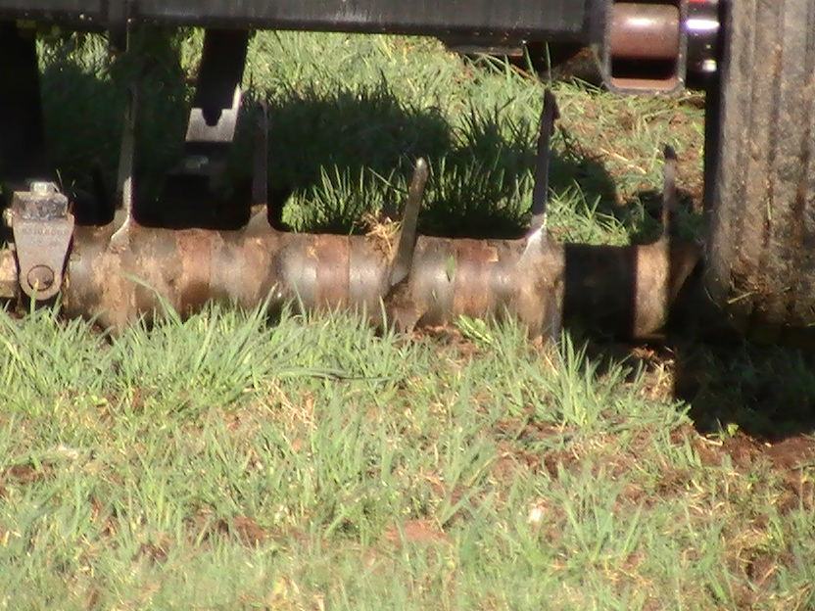
Notice that the tine goes into the soil at a
slight angle and comes out straight

Slide 6
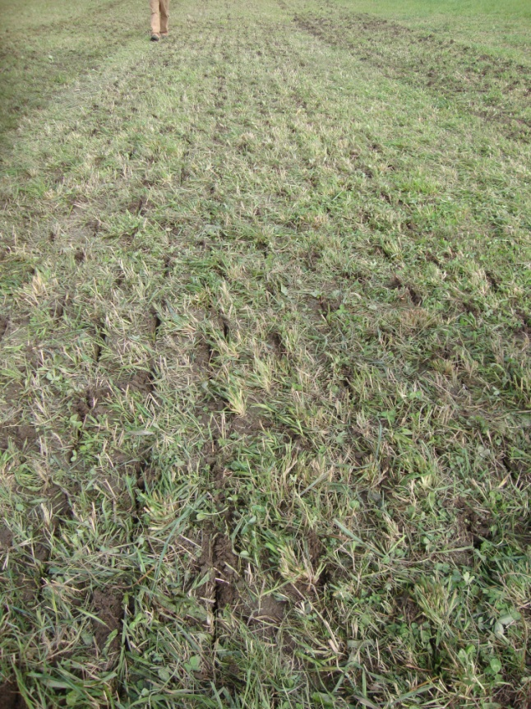
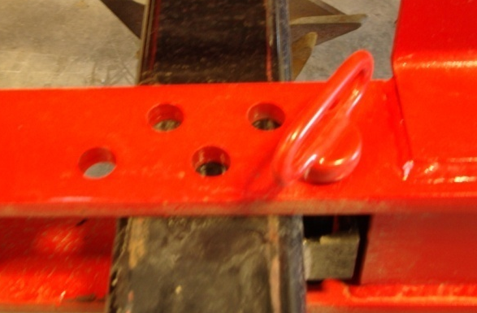
Setting 1 (2.5 degrees) :
More soil disturbance than first setting.
Slits a little wider
Notes:
Little bit of ridging along slit

Slide 7
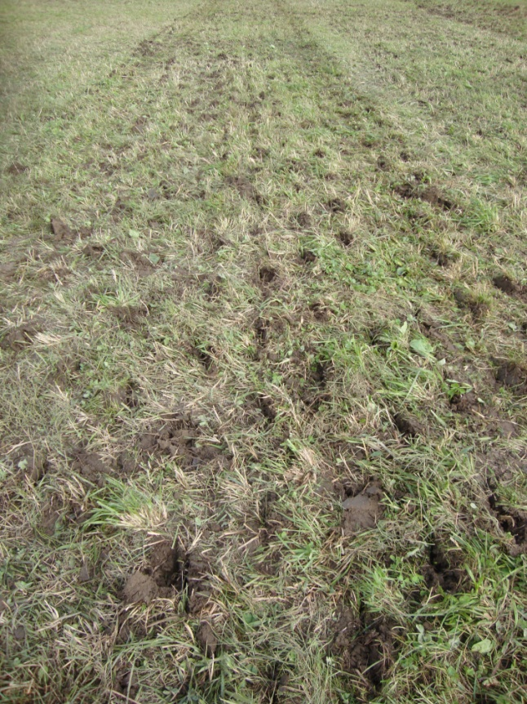
Setting 3 (7 ½ degrees)
Slits are wider yet and soil it beginning to tuff.

Slide 8
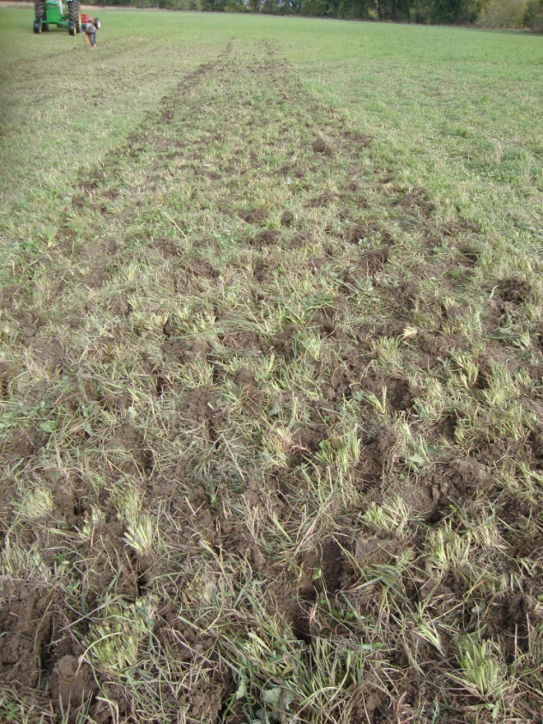
Setting 4 (10 degrees)
Slits widest on this setting. Soil is being thrown with major disturbance.

Slide 9
The faster you go
the more
apt you are to throw soil on
any setting!
If you try and aerate
a WET field,
you WILL
tear it up!
Notes:
Recommended speed is 3-5mpg. Depending upon your soil type, rocks, unevenness of the ground you may be able to go faster or slower.

Slide 10
4 Farm participated in this trial: East Wallingford, Tinmouth, Clarendon, and West Haven. 3 farms had semi solid manure, 1 was liquid manure. Soil types included, Vergennes Clay, Hamlin Silt Loam, Georgia/ Armenia Soil and an Adams Fine Sandy Loam

Slide 11
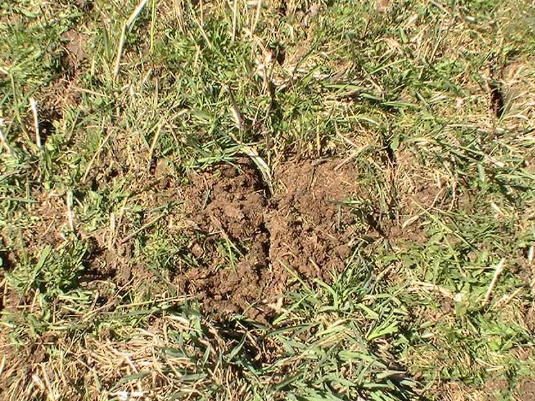
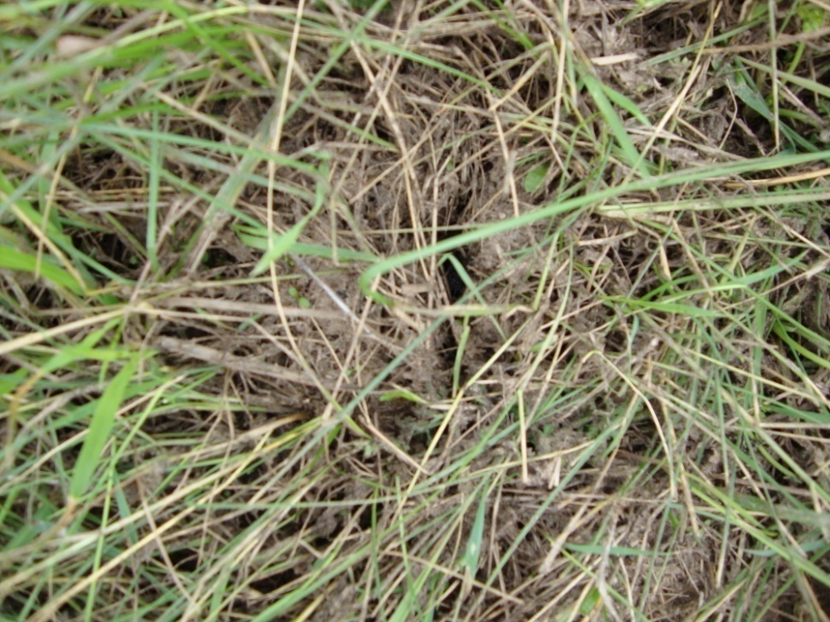
Using aerators for manure incorporation on hayland:
Sequence of incorporation:
Semi-Solid manure:
Spread manure then aerate.
This process should push some of the manure and organic matter into the ground as the aerator tines move over and through the soil.
Liquid manure:
Aerate then spread manure.
This process opens up slit in the soil which the liquid manure can “flow” into.

Slide 12
What we saw with semi solid manure in year 1 and 2:
* It was hit or miss with incorporation
* Very little material was pulled into the holes
* Rain could affect this

Slide 13

What we saw with liquid manure in year 1 and 2:
little to no manure “flowed” into the holes
What could affect this process:
* The organic matter of the liquid manure- the thicker it is, the less it “flows”.
  *The height of forage stubble when the manure was applied (~5-6”)
  *The amount of manure applied (~3000-3500 gal/acre)
  *Rain
  *Slope
Notes:
Also did similar study with another grant on 2 different farms and had the same observations.
** There are several University studies that have proven better nutrient utilization and less run off risk with using an aerator with liquid manure **

Slide 14
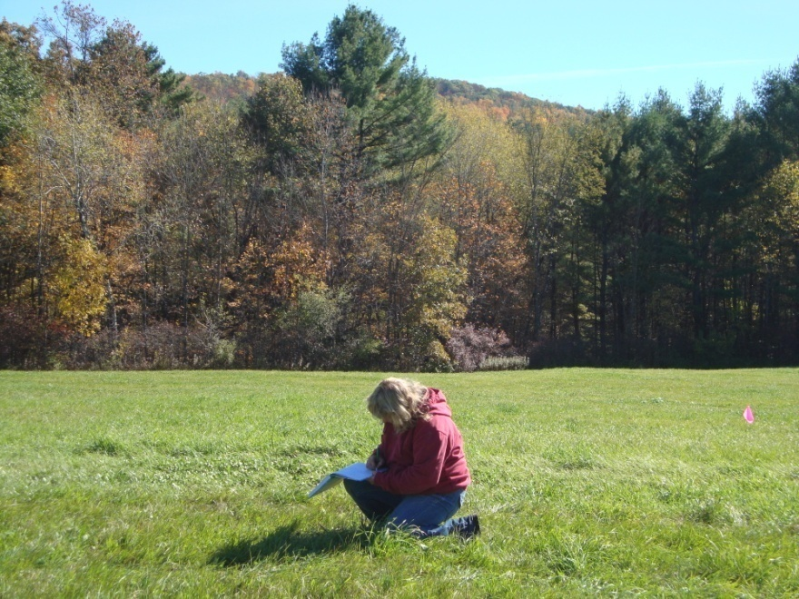
Look at the effects of aeration on forage stand density, quality and
the effects of multiple passes
Monitor growth through out the summer
Hand weigh plot yields
Have the forage tested from the various plots
Visual observation of the plots for increase or decrease of stand density

Slide 15
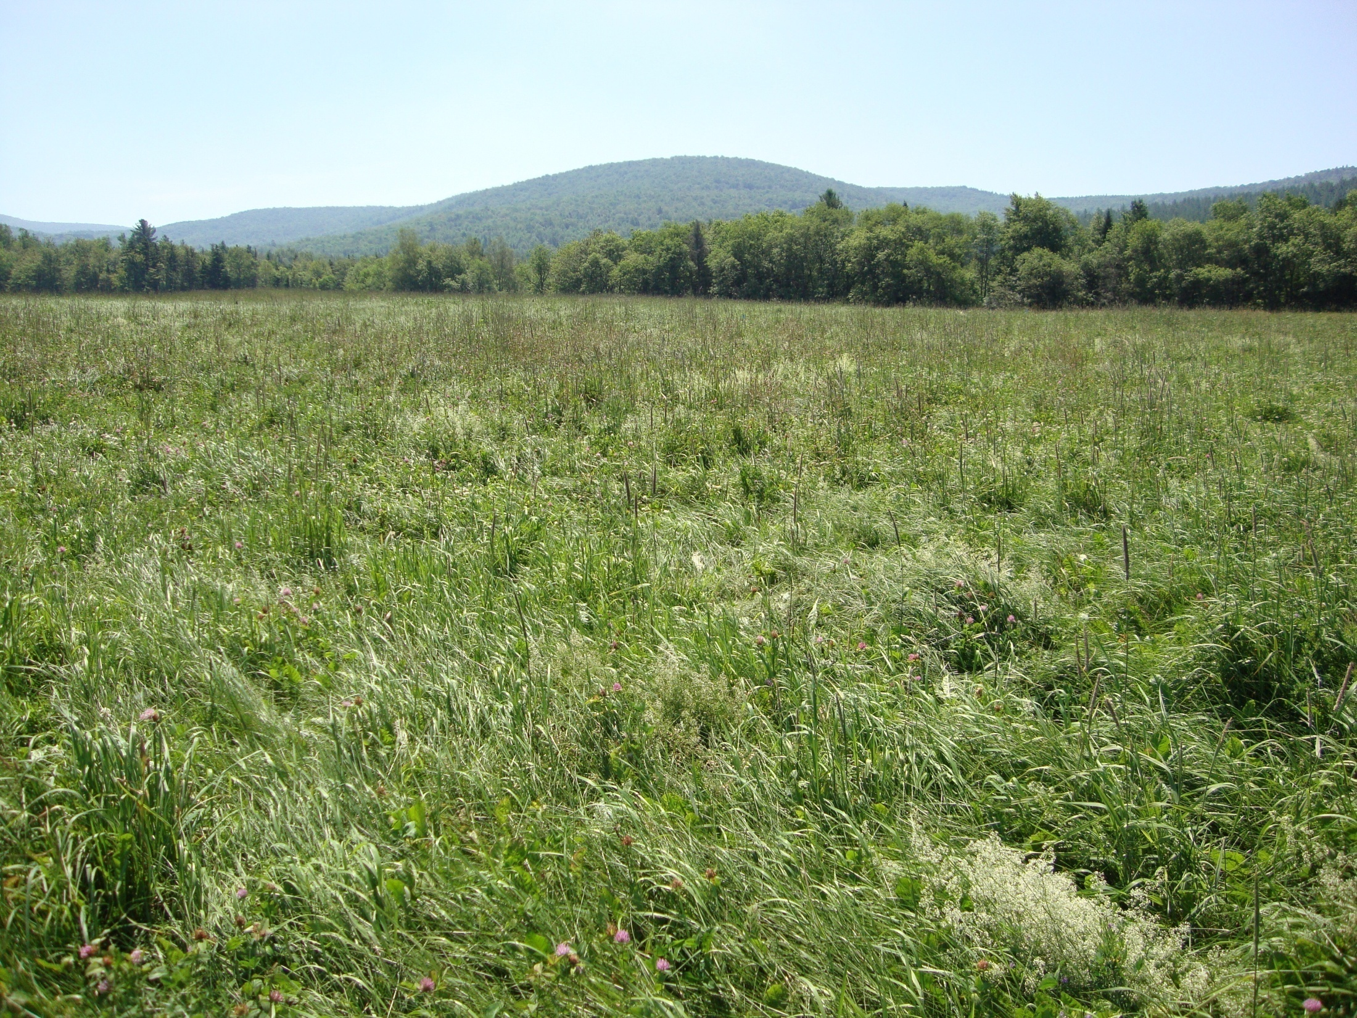
Where’s the test plot?
Notes:
Challenges with test plots. Deer bedding down in the field, grazing, general trampling of the plots. Flags went missing. Along the otter creek in spring all the red and some of the blue flags dissappeared.

Slide 16
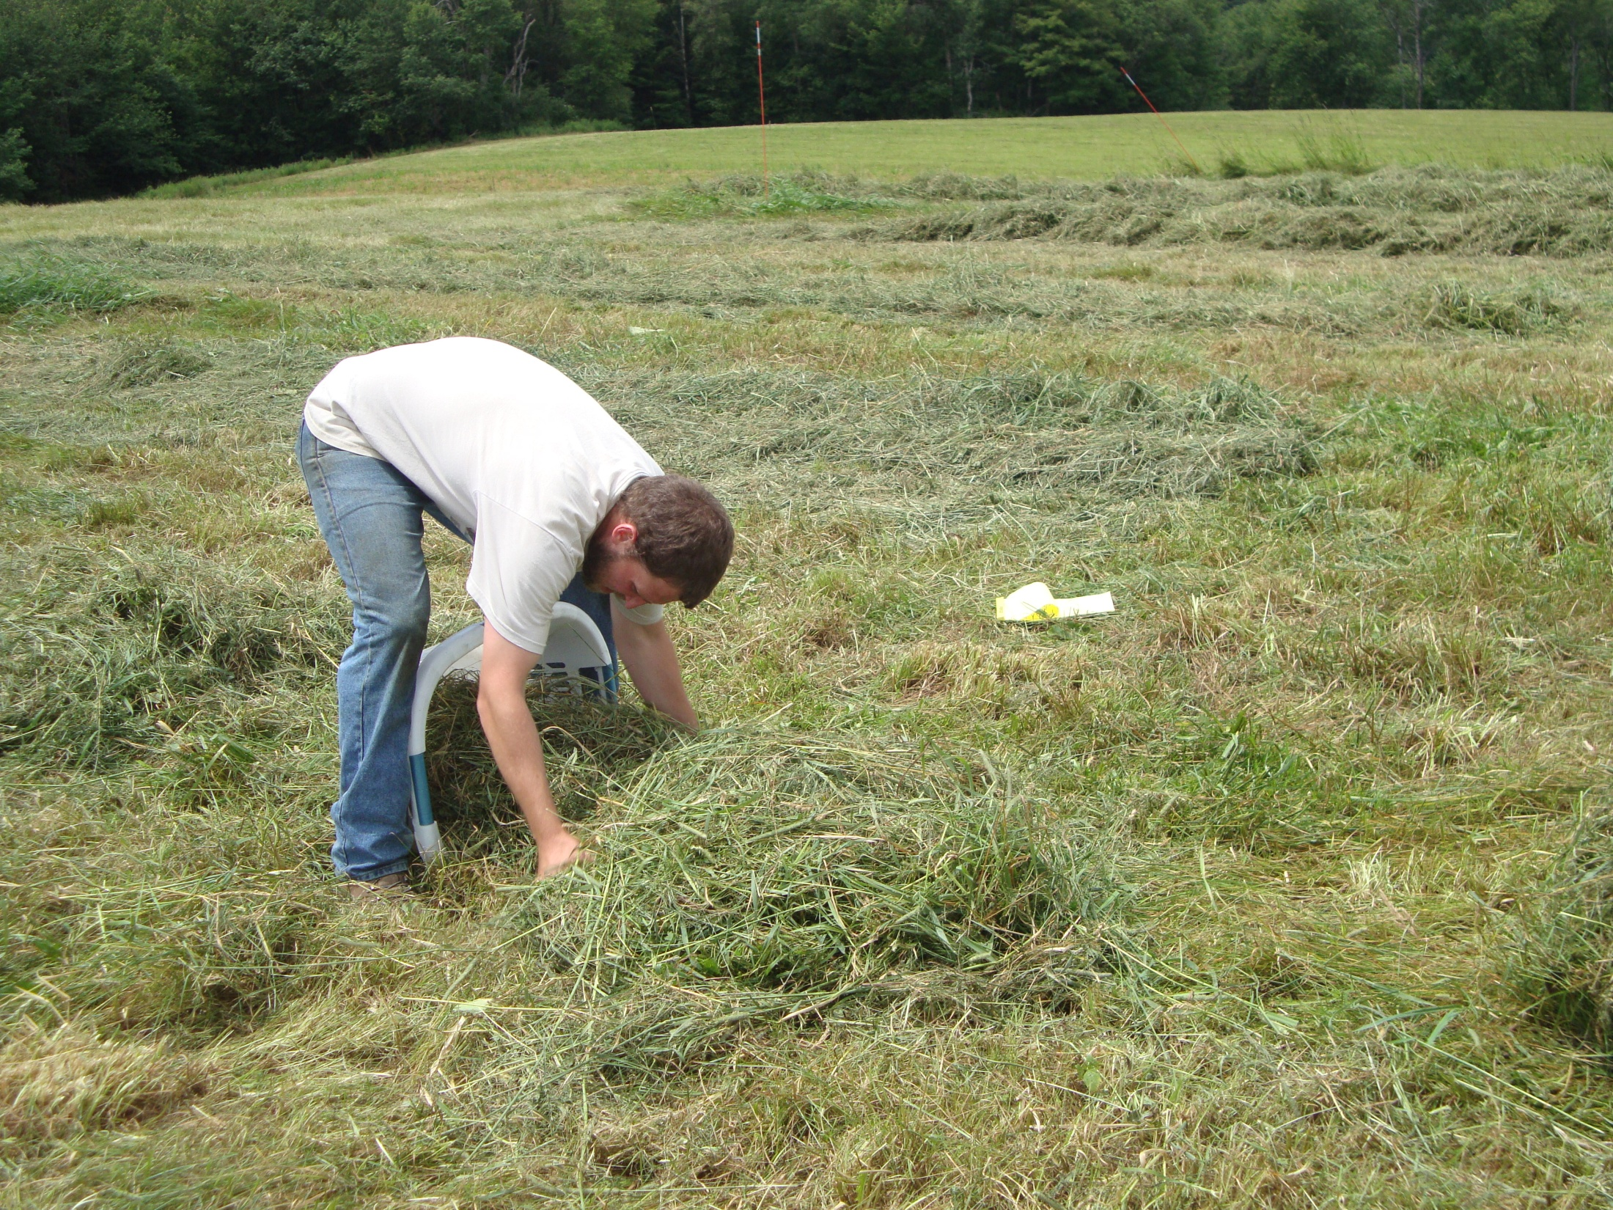
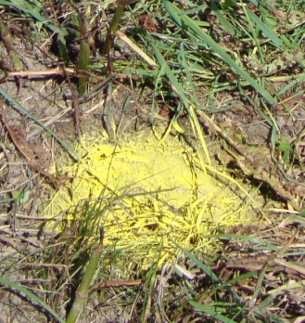
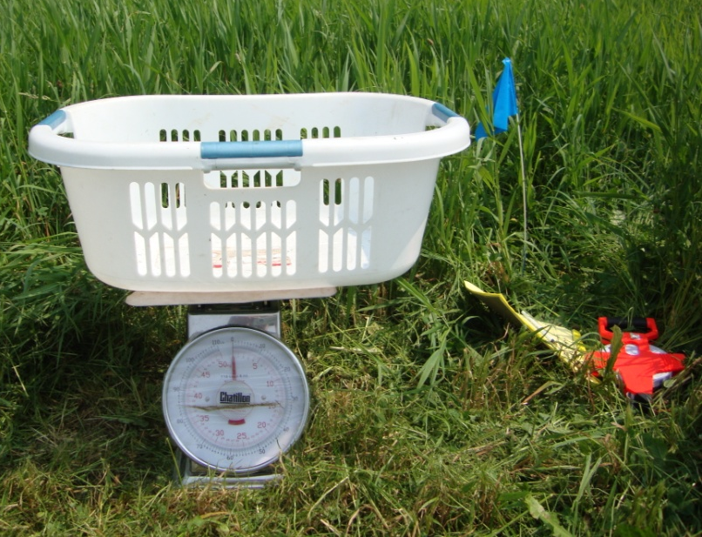
Notes:
10ft sections of windrow were cut and separated, then weighed for the wet weight. 3 handful of sub samples were pulled from each laundry basket, mixed up, then a subsample was pulled for the dry hay equilivant.

Slide 17
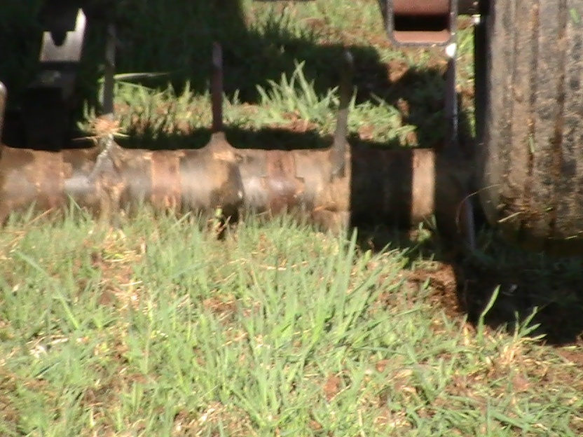
The Fields and Data

Slide 18
West Haven
Rep 1
Rep 2
Rep 3
Two
One
Control
One
Control
three
three
two
one
Slope
control
three
two
Soil Map: Vergennes Clay Hydraulic Group C.
The Cornell Soil Health test classified this soil as a Silt Loam with surface and subsurface compaction. 15.6% Sand, 61.2 % Silt and 23.2 % Clay
Notes:
HEL Field, liquid manure

Slide 19
Growth Charts
West Haven

Slide 20
Notes:
Needs lime, 40-50# N after each cut not to exceed 100-150# per year

Slide 21
Spring 2010 soil test from a different lab had the OM at 4.7%
Fall 2010 Soil Test
Replication #2
Control |  |  | One Pass |  |  | Two Passes |  |  | Three Passes
pH | 6.1 |  | pH | 6 |  | pH | 6.2 |  | pH | 6
Avail P | 0.9 |  | Avail P | 0.7 |  | Avail P | 0.7 |  | Avail P | 0.7
K | 151 |  | K | 132 |  | K | 131 |  | K | 127
Al | 37 |  | Al | 40 |  | Al | 41 |  | Al | 43
OM | 4.60% |  | OM | 4.10% |  | OM | 4.00% |  | OM | 3.70%
Fall 2011 Soil Test
Replication #2
Control |  |  | One Pass |  |  | Two Passes |  |  | Three Passes
pH | 6.1 |  | pH | 5.9 |  | pH | 6.1 |  | pH | 5.9
Avail P | 1.1 |  | Avail P | 1 |  | Avail P | 0.8 |  | Avail P | 1
K | 155 |  | K | 131 |  | K | 125 |  | K | 133
Al | 43 |  | Al | 43 |  | Al | 40 |  | Al | 40
OM | 5.50% |  | OM | 5.70% |  | OM | 4.70% |  | OM | 5.60%

Slide 22
Spring 2010 soil test from a different lab had the OM at 4.7%
Fall 2010 Soil Test
11/18/10
Replication #2
Control |  |  | One Pass |  |  | Two Passes |  |  | Three Passes
pH | 6.1 |  | pH | 6 |  | pH | 6.2 |  | pH | 6
Avail P | 0.9 |  | Avail P | 0.7 |  | Avail P | 0.7 |  | Avail P | 0.7
K | 151 |  | K | 132 |  | K | 131 |  | K | 127
Al | 37 |  | Al | 40 |  | Al | 41 |  | Al | 43
OM | 4.60% |  | OM | 4.10% |  | OM | 4.00% |  | OM | 3.70%
Fall 2011 Soil Test
11/28/11
Replication #3
Control |  |  | One Pass |  |  | Two Passes |  |  | Three Passes
pH | 6.3 |  | pH | 6.1 |  | pH | 6.1 |  | pH | 6.3
Avail P | 1.2 |  | Avail P | 1.1 |  | Avail P | 1.9 |  | Avail P | 1.4
K | 164 |  | K | 139 |  | K | 124 |  | K | 185
Al | 30 |  | Al | 37 |  | Al | 38 |  | Al | 26
OM | 7.20% |  | OM | 5.80% |  | OM | 5.10% |  | OM | 7.30%

Slide 23
Penetrometer Readings Spring 2011
New Haven
Rep 1
Control |  | One |  | Two |  | Three
1 | 5 | 1 | 4 | 1 | 7 | 1 | 7
2 | 5 | 2 | 5 | 2 | 7 | 2 | 8
3 | 4 | 3 | 4 | 3 | 5 | 3 | 6
4 | 5 | 4 | 5 | 4 | 6 | 4 | 7
Average Depth | 4.75 |  | 4.5 |  | 6.25 |  | 7
The average depth is the depth when the penetrometer reads 300psi. At 300 psi, roots will have to use more energy to push through the soil.
Rep 2
Control |  | One |  | Two |  | Three
1 | 4 | 1 | 5 | 1 | 6 | 1 | 8
2 | 7 | 2 | 6 | 2 | 5 | 2 | 7
3 | 6 | 3 | 5 | 3 | 4 | 3 | 8
4 | 5 | 4 | 6 | 4 | 5 | 4 | 9
Average Depth | 5.5 |  | 5.5 |  | 5 |  | 8
Rep 3
Control |  | One |  | Two |  | Three
1 | 5 | 1 | 7 | 1 | 5 | 1 | 7
2 | 5 | 2 | 8 | 2 | 5 | 2 | 7
3 | 4 | 3 | 7 | 3 | 7 | 3 | 7
4 | 5 | 4 | 7 | 4 | 6 | 4 | 8
Average Depth | 4.75 |  | 7.25 |  | 5.75 |  | 7.25

Slide 24
Clarendon
Rep 1
Rep 2
Rep 3
three
two
One
two
three
control
one
Control
three
Control
one
two
Soil Map: Hamlin Silt Loam Hydraulic Group B;
Cornell Soil Health Test classifies this soil as a Sandy Loam with surface and subsurface compaction
64.7% Sand, 34.6% Silt, and 0.6% Clay

Slide 26
Spring 2010 soil test OM at 4.7%
Fall 2011 Soil Test Replication 2
Replication #2
Control |  |  | One Pass |  |  | Two Passes |  |  | Three Passes
pH | 6.1 |  | pH | 5.9 |  | pH | 6.1 |  | pH | 5.9
Avail P | 1.1 |  | Avail P | 1 |  | Avail P | 0.8 |  | Avail P | 1
K | 155 |  | K | 131 |  | K | 125 |  | K | 133
Al | 43 |  | Al | 43 |  | Al | 40 |  | Al | 40
OM | 5.50% |  | OM | 5.70% |  | OM | 4.70% |  | OM | 5.60%
Fall 2011 Soil Test Replication 3
Replication #3
Control |  |  | One Pass |  |  | Two Passes |  |  | Three Passes
pH | 6.3 |  | pH | 6.1 |  | pH | 6.1 |  | pH | 6.3
Avail P | 1.2 |  | Avail P | 1.1 |  | Avail P | 1.9 |  | Avail P | 1.4
K | 164 |  | K | 139 |  | K | 124 |  | K | 185
Al | 30 |  | Al | 37 |  | Al | 38 |  | Al | 26
OM | 7.20% |  | OM | 5.80% |  | OM | 5.10% |  | OM | 7.30%

Slide 27
Penetrometer Readings Spring 2011
Clarendon
Rep 1
Control |  | One |  | Two |  | Three
1 | 6 | 1 | 5 | 1 | 7 | 1 | 12
2 | 6 | 2 | 5 | 2 | 6 | 2 | 5
3 | 8 | 3 | 7 | 3 | 4 | 3 | 7
4 | 7 | 4 | 6 | 4 | 5 | 4 | 5
5 | 5 | 5 | 7 | 5 | 6 | 5 | 6
Average Depth | 6.4 |  | 6 |  | 5.6 |  | 7
The average depth is the depth when the penetrometer reads 300psi. At 300 psi, roots will have to use more energy to push through the soil.
Rep 2
Control |  | One |  | Two |  | Three
1 | 7 | 1 | 6 | 1 | 4 | 1 | 9
2 | 5 | 2 | 8 | 2 | 6 | 2 | 7
3 | 5 | 3 | 6 | 3 | 7 | 3 | 6
4 | 5 | 4 | 6 | 4 | 10 | 4 | 4
5 | 5 | 5 | 6 | 5 | 6 | 5 | 10
Average Depth | 5.4 |  | 6.4 |  | 6.6 |  | 7.2
Rep 3
Control |  | One |  | Two |  | Three
1 | 5 | 1 | 5 | 1 | 7 | 1 | 15
2 | 6 | 2 | 5 | 2 | 8 | 2 | 5
3 | 4 | 3 | 12 | 3 | 6 | 3 | 4
4 | 5 | 4 | 6 | 4 | 7 | 4 | 7
5 | 5 | 5 | 4 | 5 | 7 | 5 | 18
Average Depth | 5 |  | 6.4 |  | 7 |  | 9.8

Slide 28
Tinmouth Field
Rep 1
Rep 2
Rep 3
three
Control
One
two
three
control
one
two
three
Control
one
two
Soil Map: Georgia and Amenia Soil - Hydraulic group C
Cornell Soil Health Test classified this soil as a Clay Loam with some extra surface tension and subsurface compaction 31.4% Sand, 31.2 % Silt, 37.5% Clay
Notes:
Fairly flat field.

Slide 30
Spring 2010 soil test the OM at 2.0%
Fall 2011 Soil Test
11/28/11
This field was impacted by Tropical Storm Irene
Replication #2
Control |  |  | One Pass |  |  | Two Passes |  |  | Three Passes
pH | 7.1 |  | pH | 7.2 |  | pH | 7.1 |  | pH | 7.1
Avail P | 3 |  | Avail P | 2.7 |  | Avail P | 2.9 |  | Avail P | 2.2
K | 21 |  | K | 18 |  | K | 24 |  | K | 20
Al | 5 |  | Al | 5 |  | Al | 5 |  | Al | 6
OM | 3.00% |  | OM | 3.20% |  | OM | 3.50% |  | OM | 3.70%
Replication #3
Control |  |  | One Pass |  |  | Two Passes |  |  | Three Passes
pH | 7.3 |  | pH | 7.2 |  | pH | 7.3 |  | pH | 7.2
Avail P | 3.3 |  | Avail P | 3.7 |  | Avail P | 2.2 |  | Avail P | 2.9
K | 46 |  | K | 33 |  | K | 23 |  | K | 25
Al | 10 |  | Al | 9 |  | Al | 9 |  | Al | 9
OM | 2.90% |  | OM | 3.20% |  | OM | 2.40% |  | OM | 2.40%

Slide 31
Penetrometer Readings Spring 2011
Tinnmouth
Rep 1
Control |  | One |  | Two |  | Three
1 | 4 | 1 | 6 | 1 | 7 | 1 | 8
2 | 5 | 2 | 7 | 2 | 7 | 2 | 9
3 | 7 | 3 | 6 | 3 | 7 | 3 | 10
4 | 5 | 4 | 7 | 4 | 8 | 4 | 9
Average Depth | 5.25 |  | 6.5 |  | 7.3 |  | 9
The average depth is the depth when the penetrometer reads 300psi. At 300 psi, roots will have to use more energy to push through the soil.
Rep 2
Control |  | One |  | Two |  | Three
1 | 3 | 1 | 3 | 1 | 4 | 1 | 5
2 | 3 | 2 | 4 | 2 | 4 | 2 | 7
3 | 5 | 3 | 5 | 3 | 5 | 3 | 6
4 | 6 | 4 | 3 | 4 | 5 | 4 | 5
Average Depth | 4 |  | 3.8 |  | 4.5 |  | 5.75
Rep 3
Control |  | One |  | Two |  | Three
1 | 3 | 1 | 4 | 1 | 0 | 1 | 4
2 | 3 | 2 | 4 | 2 | 0 | 2 | 5
3 | 4 | 3 | 3 | 3 | 0 | 3 | 5
4 | 4 | 4 | 4 | 4 | 0 | 4 | 4
Average Depth | 3.5 |  | 3.8 |  | 0 |  | 4.5
No penetrometer readings were taken on the 2 pass in Rep 3 as the farm had driven all over this plot while moving hay in spring . Tire depression were present in the soil and grass was crushed.

Slide 32
East Wallingford
two
control
control
one
one
two
Laneways: no aeration- 25 ft
two
one
one
control
Control
two
Soil Map: Adams Fine Sandy Loam Hydraulic group A
Cornell Soil Health Test classified this soil as a Sandy Loam with surface and subsurface compaction
57.9% Sand, 41.3 % Silt, .8% Clay

Slide 33
East Wallingford

Slide 34
Spring 2010 soil test the OM at 3.9%
Fall 2011 Soil Test
Replication #1
Control |  |  | One Pass |  |  | Two Passes |  |  | Three Passes
pH | 6.6 |  | pH | 6.8 |  | pH | 7 |  | pH | 6.9
Avail P | 2.8 |  | Avail P | 3.8 |  | Avail P | 3.6 |  | Avail P | 2.9
K | 49 |  | K | 76 |  | K | 69 |  | K | 54
Al | 10 |  | Al | 9 |  | Al | 7 |  | Al | 9
OM | 5.50% |  | OM | 5.40% |  | OM | 5.50% |  | OM | 5.30%
Replication #2
Control |  |  | One Pass |  |  | Two Passes |  |  | Three Passes
pH | 6.6 |  | pH | 6.7 |  | pH | 6.7 |  | pH | 6.7
Avail P | 1.6 |  | Avail P | 1.8 |  | Avail P | 2.2 |  | Avail P | 3.6
K | 43 |  | K | 43 |  | K | 63 |  | K | 84
Al | 13 |  | Al | 9 |  | Al | 10 |  | Al | 11
OM | 4.60% |  | OM | 4.90% |  | OM | 5.40% |  | OM | 5.50%

Slide 35
Penetrometer Readings Spring 2011
East Wallingford
Rep 1
Control |  | One |  | Two
1 | 6 | 1 | 5 | 1 | 6
2 | 5 | 2 | 4 | 2 | 6
3 | 5 | 3 | 5 | 3 | 9
4 | 6 | 4 | 5 | 4 | 7
5 | 7 | 5 | 4 | 5 | 6
Average Depth | 5.8 |  | 4.6 |  | 6.8
The average depth is the depth when the penetrometer reads 300psi. At 300 psi, roots will have to use more energy to push through the soil.
Rep 2
Control |  | One |  | Two
1 | 6 | 1 | 7 | 1 | 5
2 | 4 | 2 | 6 | 2 | 4
3 | 8 | 3 | 6 | 3 | 6
4 | 4 | 4 | 4 | 4 | 7
5 | 11 | 5 | 11 | 5 | 7
Average Depth | 6.6 |  | 6.8 |  | 5.8
Rep 3
Control |  | One |  | Two
1 | 8 | 1 | 8 | 1 | 7
2 | 5 | 2 | 7 | 2 | 5
3 | 6 | 3 | 5 | 3 | 7
4 | 5 | 4 | 7 | 4 | 7
5 | 10 | 5 | 8 | 5 | 7
Average Depth | 6.8 |  | 7 |  | 6.6
Rep 4
Control |  | One |  | Two
1 | 4 | 1 | 6 | 1 | 6
2 | 4 | 2 | 7 | 2 | 6
3 | 5 | 3 | 6 | 3 | 15
4 | 5 | 4 | 6 | 4 | 6
5 | 5 | 5 | 4 | 5 | 6
Average Depth | 4.6 |  | 5.8 |  | 7.8

Slide 36
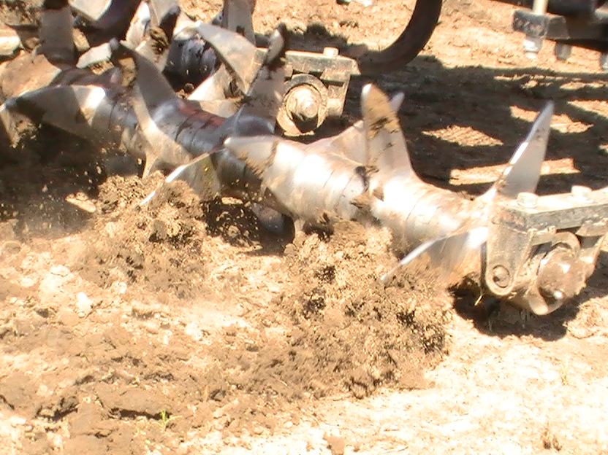
Other things we saw through out the summer

Slide 37
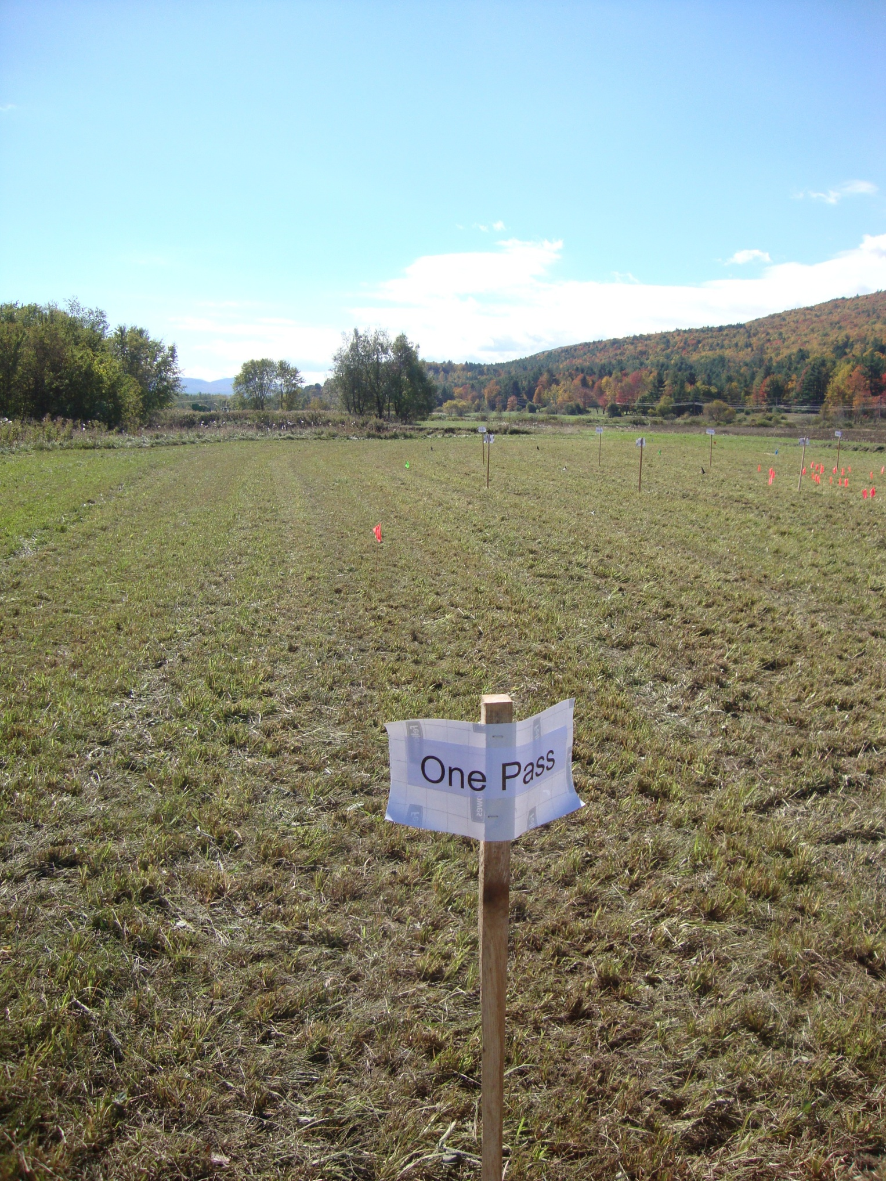
Holes left on October 12, 2010.
Aeration took place in April.
Field had been under water the week previous.
Notes:
Believe it had been flooded a total of 2x after aeration took place, Hamlin silt loam

Slide 38
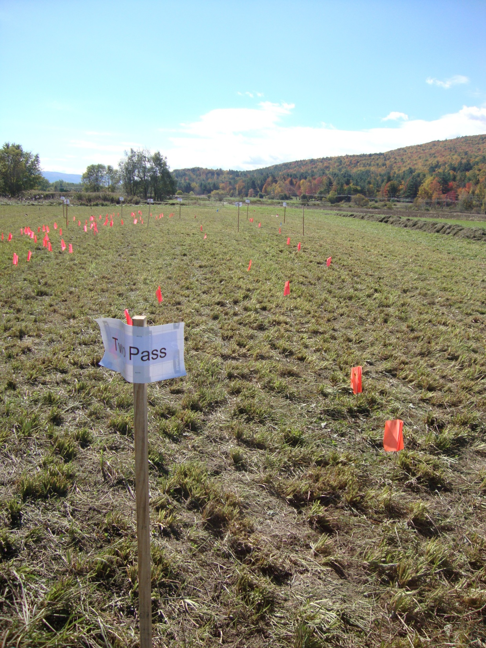
Holes left on October 12 2010.
Aeration took place in April and June.
Field had been under water the week previous.

Slide 39
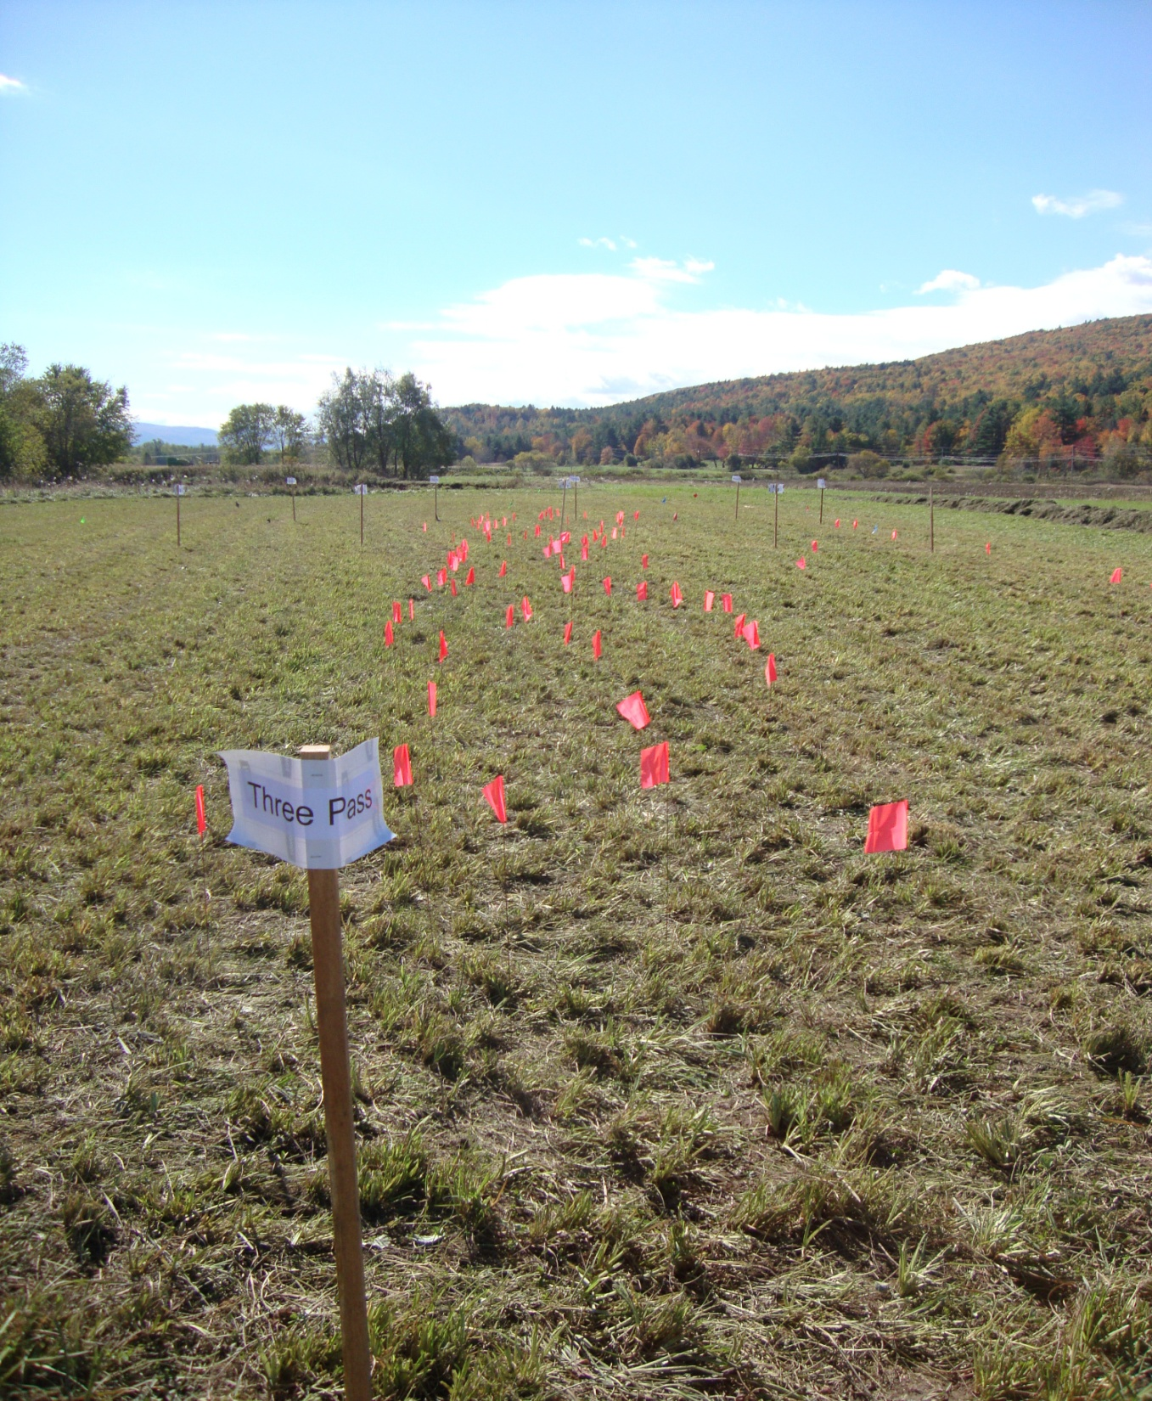
Holes left on October 12, 2010.
Aeration took place in April, June and August
Field had been under water the week previous.

Slide 40
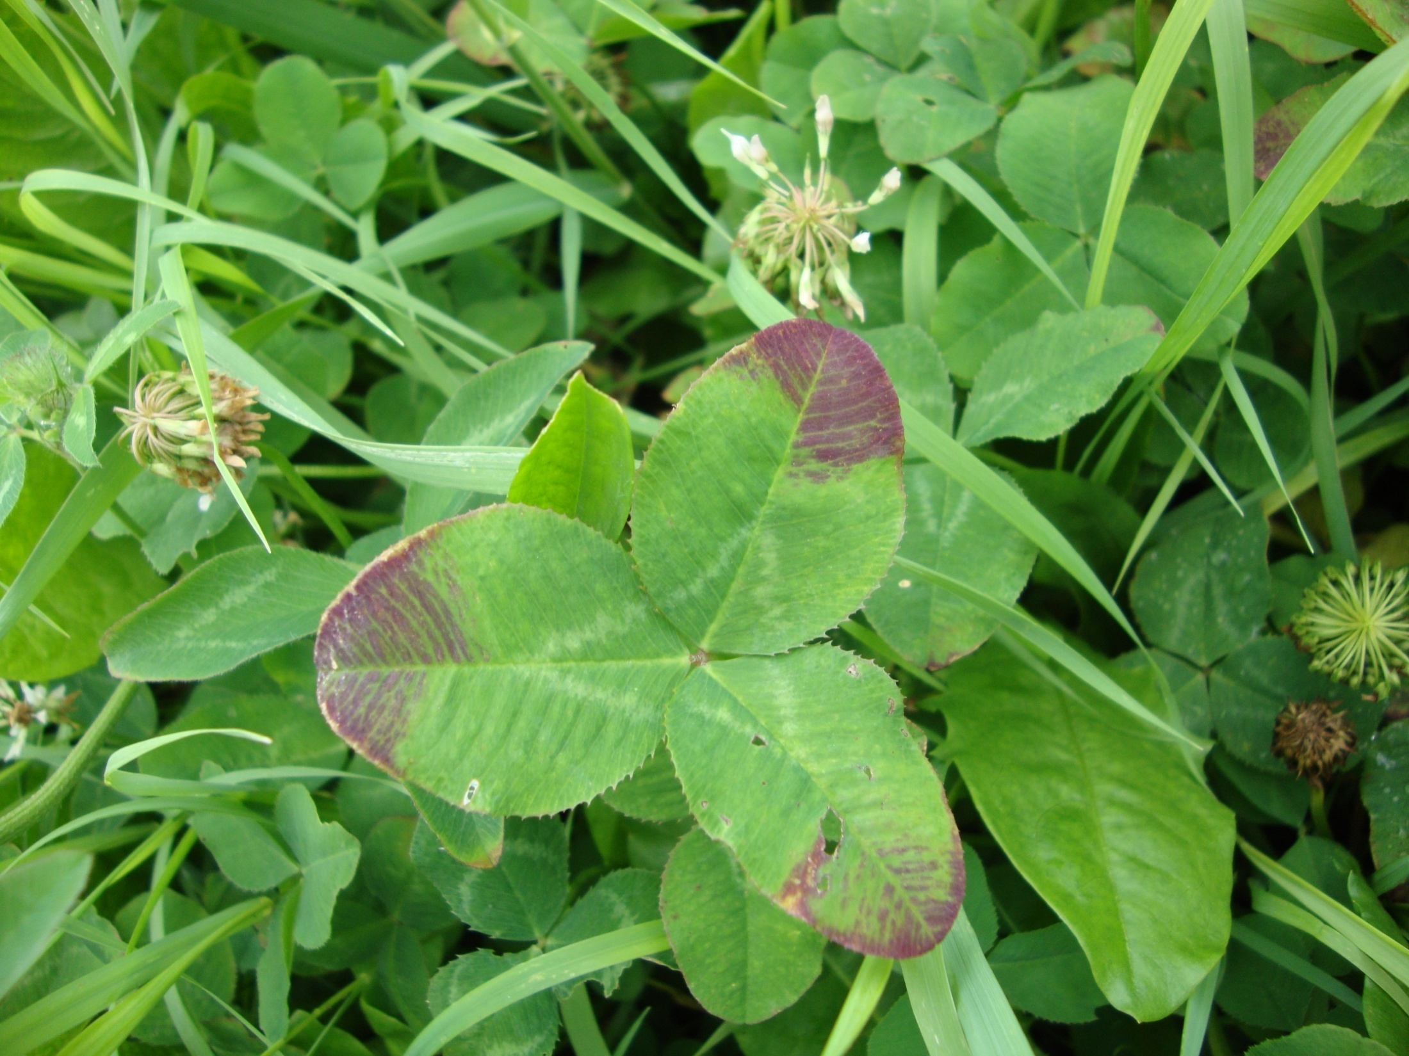
Phosphorous Deficiency

Slide 41
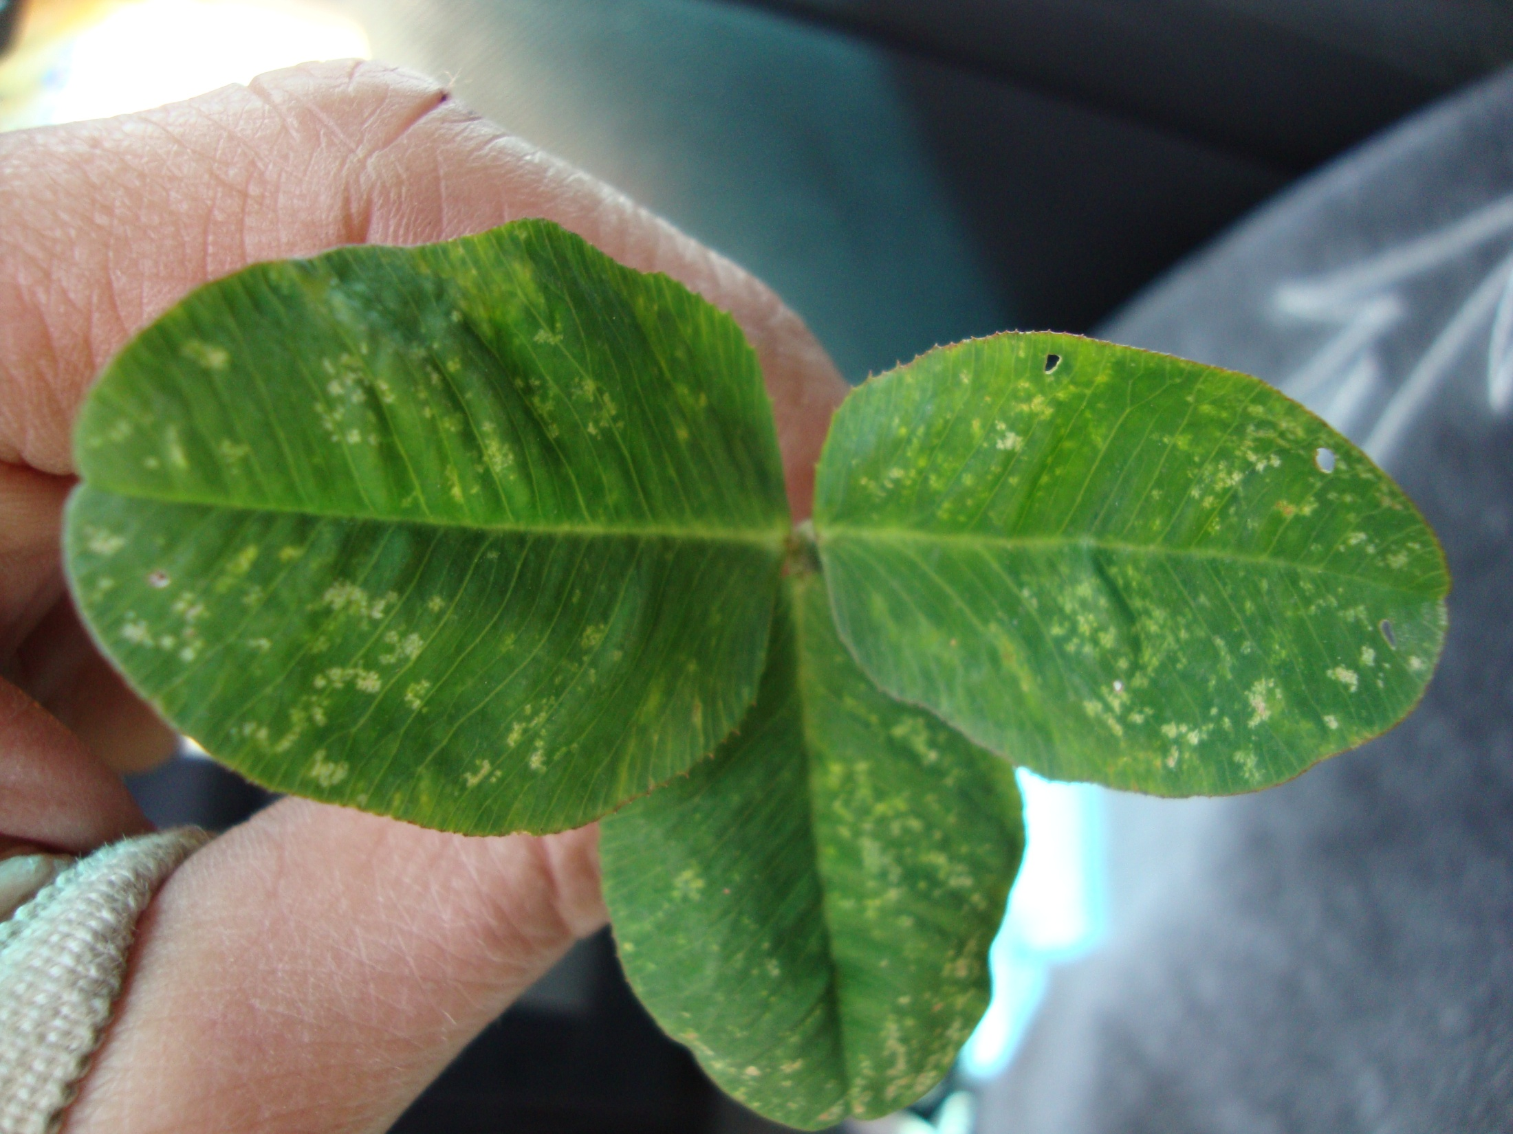
Potassium Deficiency

Slide 42
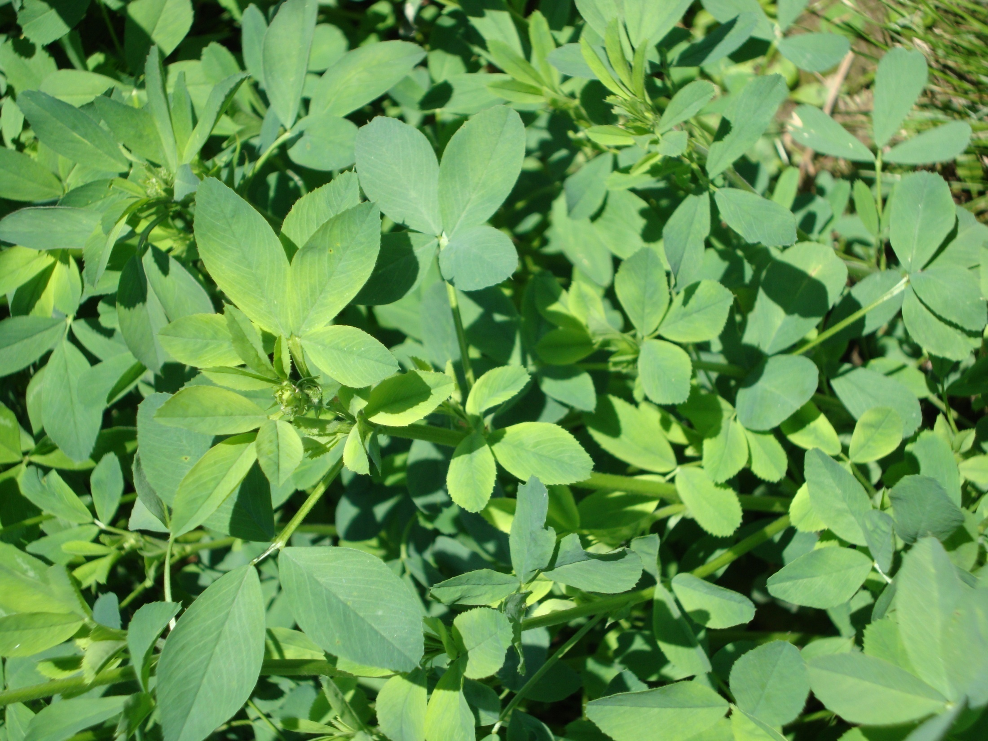
Boron Deficiency

Slide 43
Final Observations :
No statistical difference in yield or growth between the plots regardless of the number of passes with the aerator.
There was no visible detriment to the various plots regardless of the number of
passes with the aerator.
3) Aeration did not seem to affect forage analysis
4) Not see an decrease in OM with aeration
5) In 2011, we saw a decrease in surface compaction in most plots that were aerated, with the greatest increase in plots that were aerated 3 times through out the summer based on penetrometer readings.

Slide 44
Final Observations

Slide 45
No statistical difference in yield or growth between the plots regardless
of the number of passes with the aerator.
There was no visible detriment to the various plots regardless of the number of
passes with the aerator.
Aeration did not affect forage analysis between plots.
No decrease in OM with aeration over 2 years.
Saw a decrease in surface compaction in most plots that were aerated,
with the greatest decrease in compaction in plots that were aerated 3 times
through out the summer.
Most hay fields are not fertilized to promote optimal production.
Notes:
I will be taking penetrometer readings on all plots again this spring.

Slide 46
Remember …
aerators can also be used for:
~ Incorporating manure on corn silage fields
For loosening the soil for cover crop seeding after corn silage harvest
Notes:
Look for a farm to do a one time trial with the aerator and cover crop establishment.

Slide 47

Questions?

