Slide 1
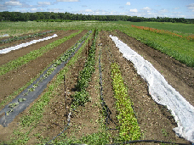
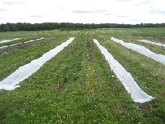
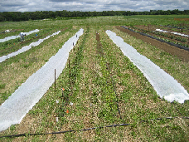
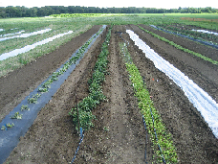
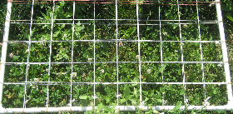
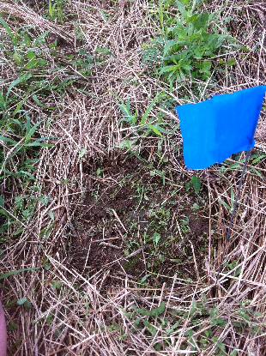
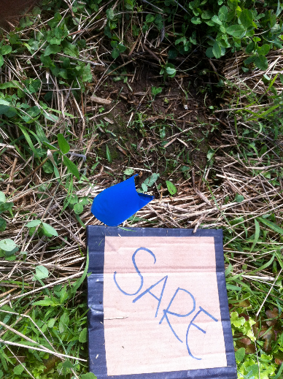
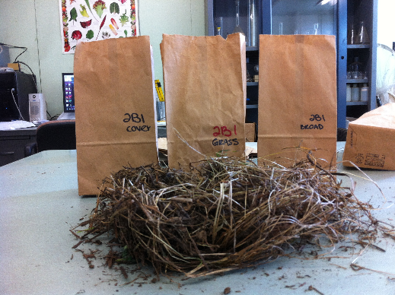
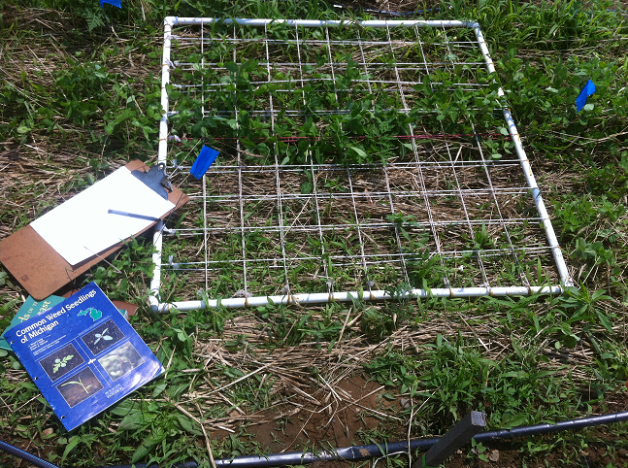
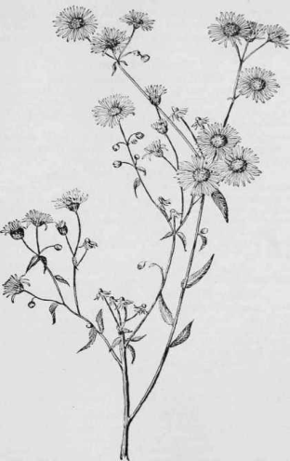
Cover Cropping Techniques and Effects Weed Management
Emily Cotter¹, Jeff Pieper², Dr. Rebecca Brown³
¹²³
INTRODUCTION
DATA AND RESULTS
CONCLUSIONS
Weed management is undoubtedly a crucial factor affecting the success of any agricultural operation. Weeds compete with crops for available nutrients, water, and space, possibly resulting in lower crop yields and decreased soil health. Over the past two years, as an intern at the URI Agricultural Research and Extension Farm in Kingston, Rhode Island, I have participated in an ongoing graduate thesis project in which several cover crop and living mulch treatments are being used to grow mixed vegetable crops. “Cover crops provide valuable erosion control, increase the amount of organic matter in the soil, reduce nitrate leaching, improve soil fertility, keep the soil cooler, improve water infiltration and storage in the soil, and suppress weeds” (Derpsch, 2002). Reduced tillage, including the use of cover crops and living mulch, is a practice that is being embraced by many farmers for its ecological value, but “no-till systems are used on only about 17.5% of the cropland in the United States” (Derpsch, 2002).
This research aims at furthering similar existing research, as well as localizing results to this agricultural region in order to provide valuable information about no-till or reduced tillage agricultural techniques to farmers in the Northeast. This poster will focus on the research relating specifically to weed management using cover cropping and living mulch. If effective cover cropping methods are successful for managing weed density, abundance, and diversity, then farmers in the Northeastern United States can implement these strategies for a more successful crop. An appropriate cover crop can be “indispensable to reduce weed infestation and herbicide costs, reduce diseases and pests, produce the permanent cover needed in the no-till system and increase organic matter content of the soil,“ all of which are results that would benefit both the producer and the cultivated landscape (Derpsch, 2002).
Ultimately, we are interested in which cover crop treatment was most effective in suppressing weed growth. The data and results help to answer this question in several ways. Figure 5 shows the average mass of cover crop that was produced within each treatment throughout the growing season. Because the Conventional treatment (A) is acting as a control treatment, it is to be expected that there would be no cover crop. The lack of cover crop in the Crimson Clover (D) treatment is due to poor cover crop germination and establishment in the 2012 growing season.
Figure 6 shows the total mass of all weeds (broadleaf and grass-like) sampled from each treatment throughout the season. Statistical analysis using SAS Anova Repeated Measures Tests illustrates that A (Conventional) and C (Dutch White Clover and Perennial Rye) were both more effective at managing total weed growth than B (Rolled and Crimped Winter Rye) and D (Crimson Clover). The data from Figure 6 can be broken down into broadleaf and grass-like weed dry weights (Figures 1 and 3). Figure 1 shows that broadleaf weeds are considerably variable in all treatments, but Treatment C was overall more effective at controlling the growth of broadleaf weeds. Figure 2 supports this claim in that the total abundance of broadleaf weeds was lowest in Treatment C. From this graph it can also be seen that abundance of broadleaf weeds in Treatment A is much higher than all other treatments. This is probably due to the frequency of tilling that is necessary for maintaining a conventional plot, which allows more individuals to be counted in the transect as small seedlings. Figures 3 and 4 show similar growth pattern and abundance of grass-like weeds in all treatments, meaning that cover crop treatment had minimal effect on grass-like weed growth.
Figures 7 and 8 illustrate a comparison of weed abundance as sampled with a small transect (0.25 m x 0.25 m) with abundance sampled with a large transect (1 m x 0.5 m). The four most prevalent broadleaf weeds were used for this comparison: Erigeron annus (Daisy Fleabane), Polygonum persicaria (Lady’s Thumb), Portulaca oleracea (Purslane), and Amaranthus retroflexus (Redroot Pigweed). This data could be used to determine whether it is possible to achieve similar sampling results using a smaller transect, thereby saving time and labor. For treatments A and C the results are very similar between the small and large transects, across all species. Treatments B and D, however, show different results between the two transects. Therefore it cannot be stated with certainty that a smaller transect will return similar abundance data to the large transect.
Overall, Treatment C was most effective at controlling weed growth. As living mulch, it can be mowed to control grass-like weeds. Treatment B may have produced the greatest amount of cover crop, but it was not as effective as Treatment C, perhaps because it was not a living mulch. It is relevant to note that this 1.5 acre plot has been in cultivation of mixed vegetables for the past three years, but prior to 2009 these fields were severely under-utilized and under-staffed, which contributed to the large seed bank that is present in these otherwise very suitable agricultural soil.
Figure 1. Averages of dry samples of broadleaf weeds throughout the growing season. Treatment C is significantly different from A, B, and D at P = 0.0223, P = 0.0084, and P = 0.0207, respectively. Treatments A, B, and D do not illustrate significant differences.
Figure 2. Comparison of total broadleaf weed abundance by the average number of individuals per cover crop treatment.
METHODS
Four cover crop treatments were replicated three times in an area of about 1.5 acres at the URI Agronomy Research and Extension Farm in Kingston, RI. The cover crop treatments were labeled as:
A – Conventional tillage
B – Rolled and crimped winter rye,
with crops planted directly into the cover
C – Dutch White clover and perennial rye,
used as living mulch
D – Crimson clover, seeded annually and used as living mulch
Four 1 m. x 0.5 m. plots were marked with flags in each treatment, for a total of 48 marked plots over the three replications. Weed data collection was done on a biweekly basis, and consisted of plant identification, assessment of weed abundance, and collection and sorting bulk samples of plant matter.
Plant Identification:
A 1 m x 0.5 m grid containing 50 quadrants was laid down in each flagged plot,
and all species of weeds in each quadrant were identified and recorded.
Weeds of the Northeast was used as a supplementary reference guide for identification. LARGE TRANSECT
(1 M X 0.5 M)
Assessment of Weed Abundance:
48 different sampling plots were chosen at random, and a 0.25 m. x 0.25 m. grid was laid down upon each plot. The individual plants were counted where possible, and a percentage cover was assessed when necessary. All vegetation was then removed from the plot and sorted into broad-leaf and grass-like weeds, as well as cover crop plant matter. These sorted samples were weighed, allowed to dry for two weeks, and weighed again.
A
B
Figure 3. Averages of dry samples of grass-like weeds throughout the growing season. Treatment A is significantly different from B and D at P = 0.0006 and P = 0.0062, respectively. Treatment B is significantly different from C at P = 0.0156. There is no significant difference between treatments A, C, and D, nor between treatments B and D.
Figure 4. Treatment comparison of grass-like weed abundance by the average percent cover of Digitaria sanguinalis (Large Crabgrass), the foremost species of grass-like weed found in all treatments.
C
D
Figure 5. Averages of dry samples of cover crops throughout the growing season. All treatments illustrate significant differences at P = <0.0001, except for treatments A and D, which are not significantly different.
Figure 6. Averages of total weeds (grass-like and broadleaf) throughout the growing season. Treatment A is significantly different from treatments B and D at P = 0.0022 and 0.0253, respectively. Treatment C is also significantly different from B and D, at P = 0.0012 and 0.0134, respectively. There is no significant difference between treatments A and C, nor between treatments B and D.
ACKNOWLEDGEMENTS
0.25 M X 0.25 M SAMPLING PLOTS,
WITH VEGETATION REMOVED
Thanks to Jeff Pieper and Dr. Rebecca Brown for all of your guidance, and to Grace Hyde and Jim Given for the sorting help.
SAMPLE FROM TREATMENT B,
READY TO BE SORTED
LITERATURE CITED
Derpsch, R. 2002. Making conservation tillage conventional, building a future on 25 years of research: research and extension perspective. In E. van Santen (ed.) 2002. Making Conservation Tillage Conventional: Building a Future on 25 Years of Research. Proc. of 25th Annual Southern Conservation Tillage Conference for Sustainable Agriculture. Auburn, AL. 24-26 June 2002. Special Report No. 1. Alabama Agric. Exp. Stn. and Auburn University, AL 36849
Uva, Richard H., Joseph C. Neal, and Joseph M. DiTomaso. Weeds of the Northeast. Ithaca: Comstock Pub. Associates, 1997. Print.
Figure 7. Treatment comparison of the abundance of the four most prevalent broadleaf weed species by number of individuals per 0.25 m x 0.25 m transect.
Figure 7. Treatment comparison of the abundance of the four most prevalent broadleaf weed species by number of individuals per 1 m x 0.5 m transect.
PLANT IDENTIFICATION PLOT (1 M X 1 M TRANSECT)
IDENTIFYING WEEDS (1 M X 1 M TRANSECT)

