Slide 1
Marine Ornamental Invertebrate Culture Workshop WSARE March 5-8 2012

Slide 2
Objectives
Improve coordination and communication between practitioners (private and public) in the Marine Ornamental Aquaculture Industry in Micronesia.
Improve knowledge of marine ornamental invertebrate farming techniques.

Slide 3
Predicted Outcomes
Greater number of people involved in the field
Larger variety of products being farmed
More stable pricing for products being grown
Higher skill level among outreach and extension professionals in the public sector.

Slide 4
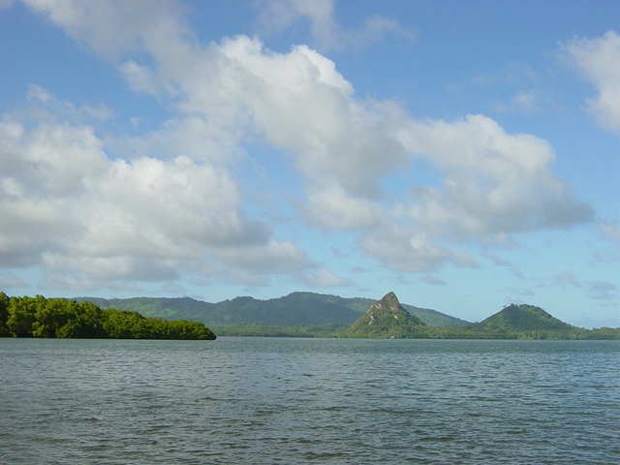
MERIP Mission Statement
To promote sustainable development and livelihoods for Micronesians, through natural resource conservation, and to research, teach, demonstrate and transfer technologies that allow Micronesians to improve their lives while maintaining core traditional values and minimizing impact to the environment.

Slide 5
MERIP Background
Developed a three tier approach to sustainable development:
Product development
Community technology transfer/training
Marketing and market development
Use the Nucleus Estate Model as defined by the FAO

Slide 6
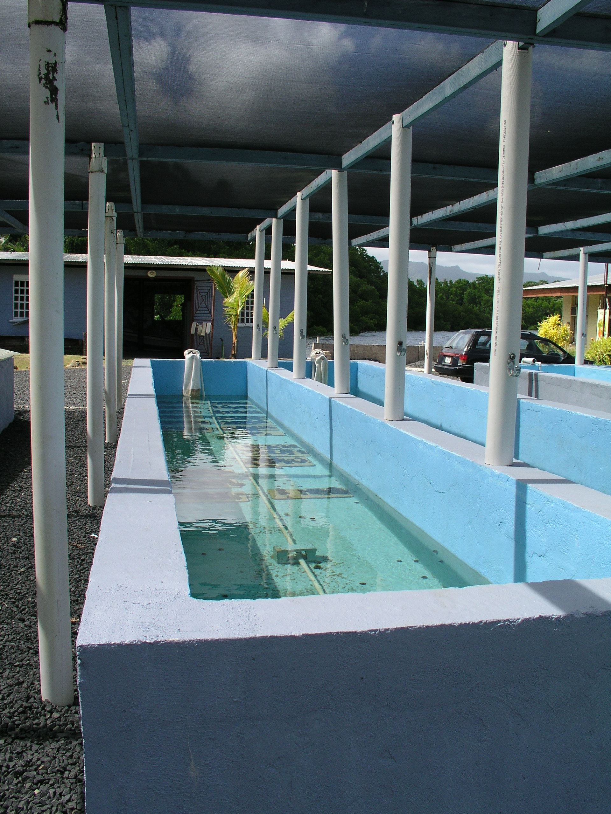
Nucleus Estate Model - FAO
Production by farmers but MERIP retains a central farm to guarantee quality, throughput, seedstock and a place to conduct research.
MERIP provides significant material, training, management and marketing input.
Provides an holistic or fully integrated approach to product development

Slide 7
MERIP Background
Not for profit corporation so operates as a business but can also apply for grant funding
Focus on aquaculture products - marine ornamental invertebrates, bath sponges and to a lesser extent Black pearls
Establish farms with community members, providing training, materials and marketing assistance
Develop methods on a central farm and disseminate methods and broodstock to farmers
Promotes private sector development in sustainable aquaculture in the Pacific region

Slide 8
Products and Product Development
Simple technologies easily adopted by community members
Lightweight or valuable enough to be exported cost-effectively
Environmentally sustainable technologies

Slide 9
Schedule Day 1
Introductions and presentations from private sector (MIMF, MMME, and Palau).
The marine ornamental industry introduction
Giant clam spawning and stocking

Slide 10
Schedule Day 2
Coral and invertebrate farming techniques
MERIP water system
Water quality and key parameters for marine ornamental invertebrates
Permitting, packing and shipping

Slide 11
Schedule Day 3
Surge tank construction
Post-larval capture and culture
Giant clam drain down and stocking.

Slide 12
Schedule Day 4
Wrap up discussions, next steps, any issues to be addressed.
Exit surveys
Field trip to coral farms followed by BBQ.

Slide 13
Discussion Points
Please share your knowledge as much as you can
We at MERIP hope to learn from you as well, as our knowledge is incomplete
Ask for more information if it is not covered
Allow about 75 minutes to drive from town
Lunch and snacks will be provided every day
Don’t chew betelnut, tobacco or smoke around the facility

Slide 14
Extension survey
This will help us to understand who is doing extension work in MOA
Please be as specific as possible.
It will help with future initiatives

Slide 15
www.meripmicronesia.org

