Slide 1
study of Overwintering Lepidoptera Pests in Reduced Tillage
Teresa Rusinek
Cornell Cooperative Extension of Ulster County/Eastern New York Horticulture Team

Slide 2
Project Funded through SARE Partnership Grant
Co-Investigator Chuck Bornt
, Is fresh market sweet corn in reduced-till systems at greater risk to lepidoptera pests?

Slide 3
Suspicion that reduced tillage can lead to higher populations of lep pests in the field
CEW may be overwintering in field in NY now.

Slide 4
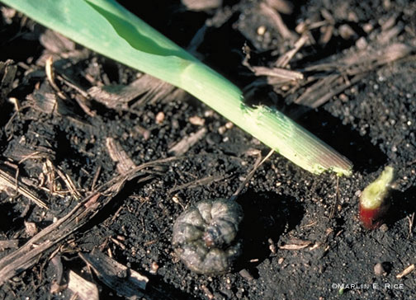
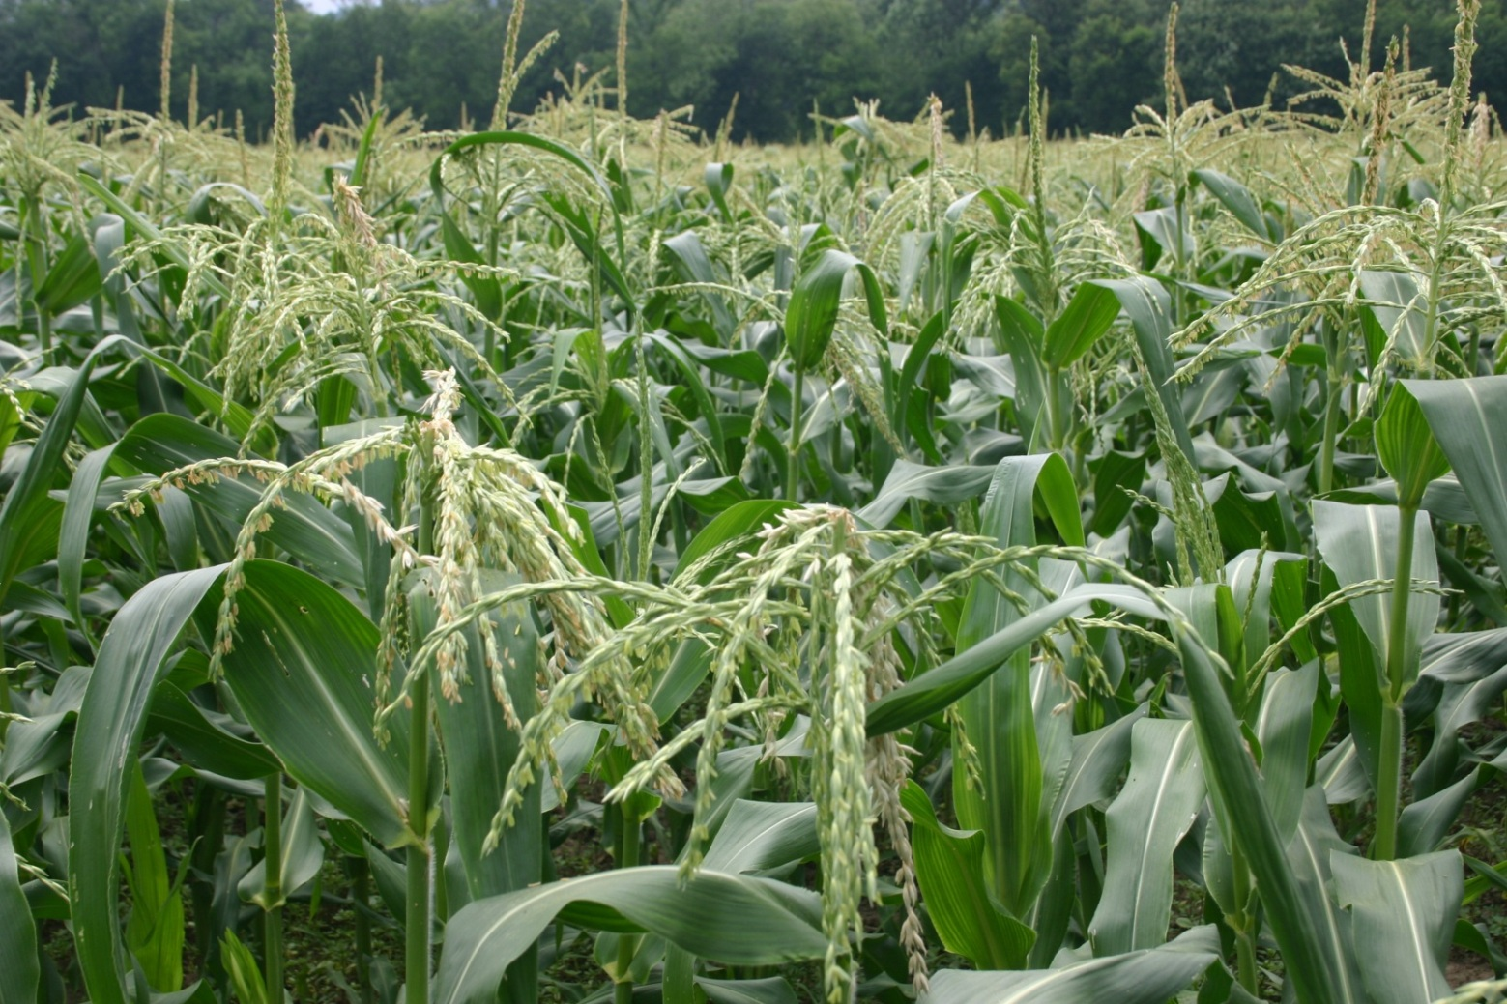
In reduced tillage systems growers do not deep disk or mold board plow thus potentially and inadvertently increasing Lepidoptera populations.
high ECB/CEW populations on reduced tillage farms
Black Cutworms

Slide 5
The most important cultural management technique is to destroy crop residue of infested plants at the end of the growing season by burning or plowing crop residue.
This process will reduce overwintering survivability .
(University of Maine Fact sheet #207).
Those pests that overwinter in the soil or in crop residues benefit from tillage reduction.
They can be more numerous because they have not been exposed to tillage.
Slugs, Black Cutworms, Armyworms
( Washington State University Paper on “Effects of Reduced Tillage on Pest Management”)

Slide 6
compare four Lepidoptera populations among three geographically diverse farms
employing various reduced and conventional tillage techniques
determine the influence of tillage on the pest complex.

Slide 7
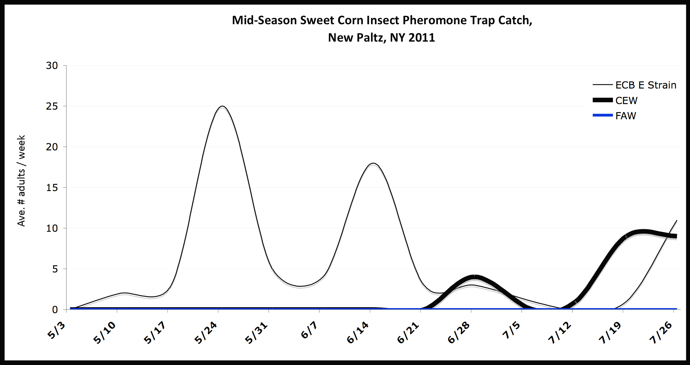
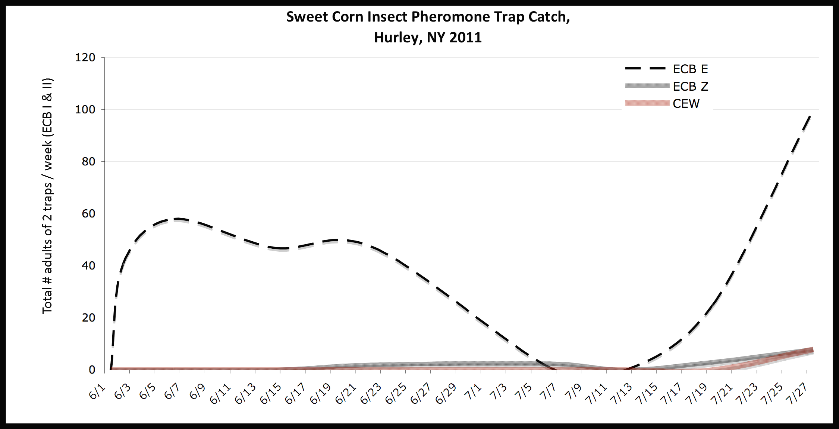
Conventional Tillage 2011 Hudson Valley
Zone tillage 2011 Hudson Valley

Slide 8
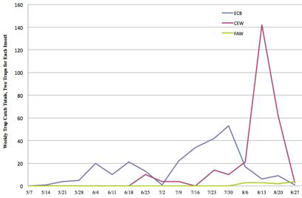
ECB, CEW and FAW Pheromone Trap New Paltz, NY 2012
Conventional Tillage 2011 Hudson Valley

Slide 10
Farm A
Treatment 1 (conventional tillage)
Treatment 2 (single cut Zone tillage)- ears harvested, stalk left behind infield. Fall seeded cover crop, seed and stubble disked in. In spring field is disked again and zone tilled.
Treatment 3 (double cut Zone tillage) - (the difference from treatment two is that crop residue is disked in twice in the fall)
Farm B
Treatment 1 (conventional tillage)- Fall stalks disked in, Spring moldboard plowed, disked and harrowed
Farm C Kinderhook, NY
Treatment 1 (conventional tillage) moldboard plowed, disked and Perfecta harrowed)
Treatment 2 (reduced tillage)

Slide 11
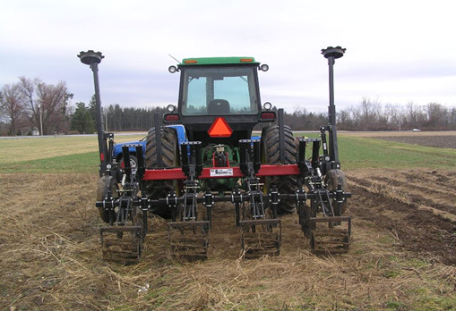
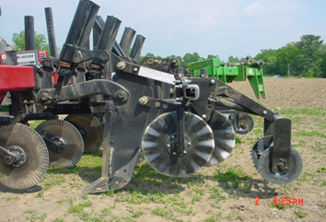
Sub soiling shank followed by a set of fluted coulters and a rolling basket
Rear and side view of the Unverferth Ripper Stripper used in preparing the reduced tillage fields

Slide 12
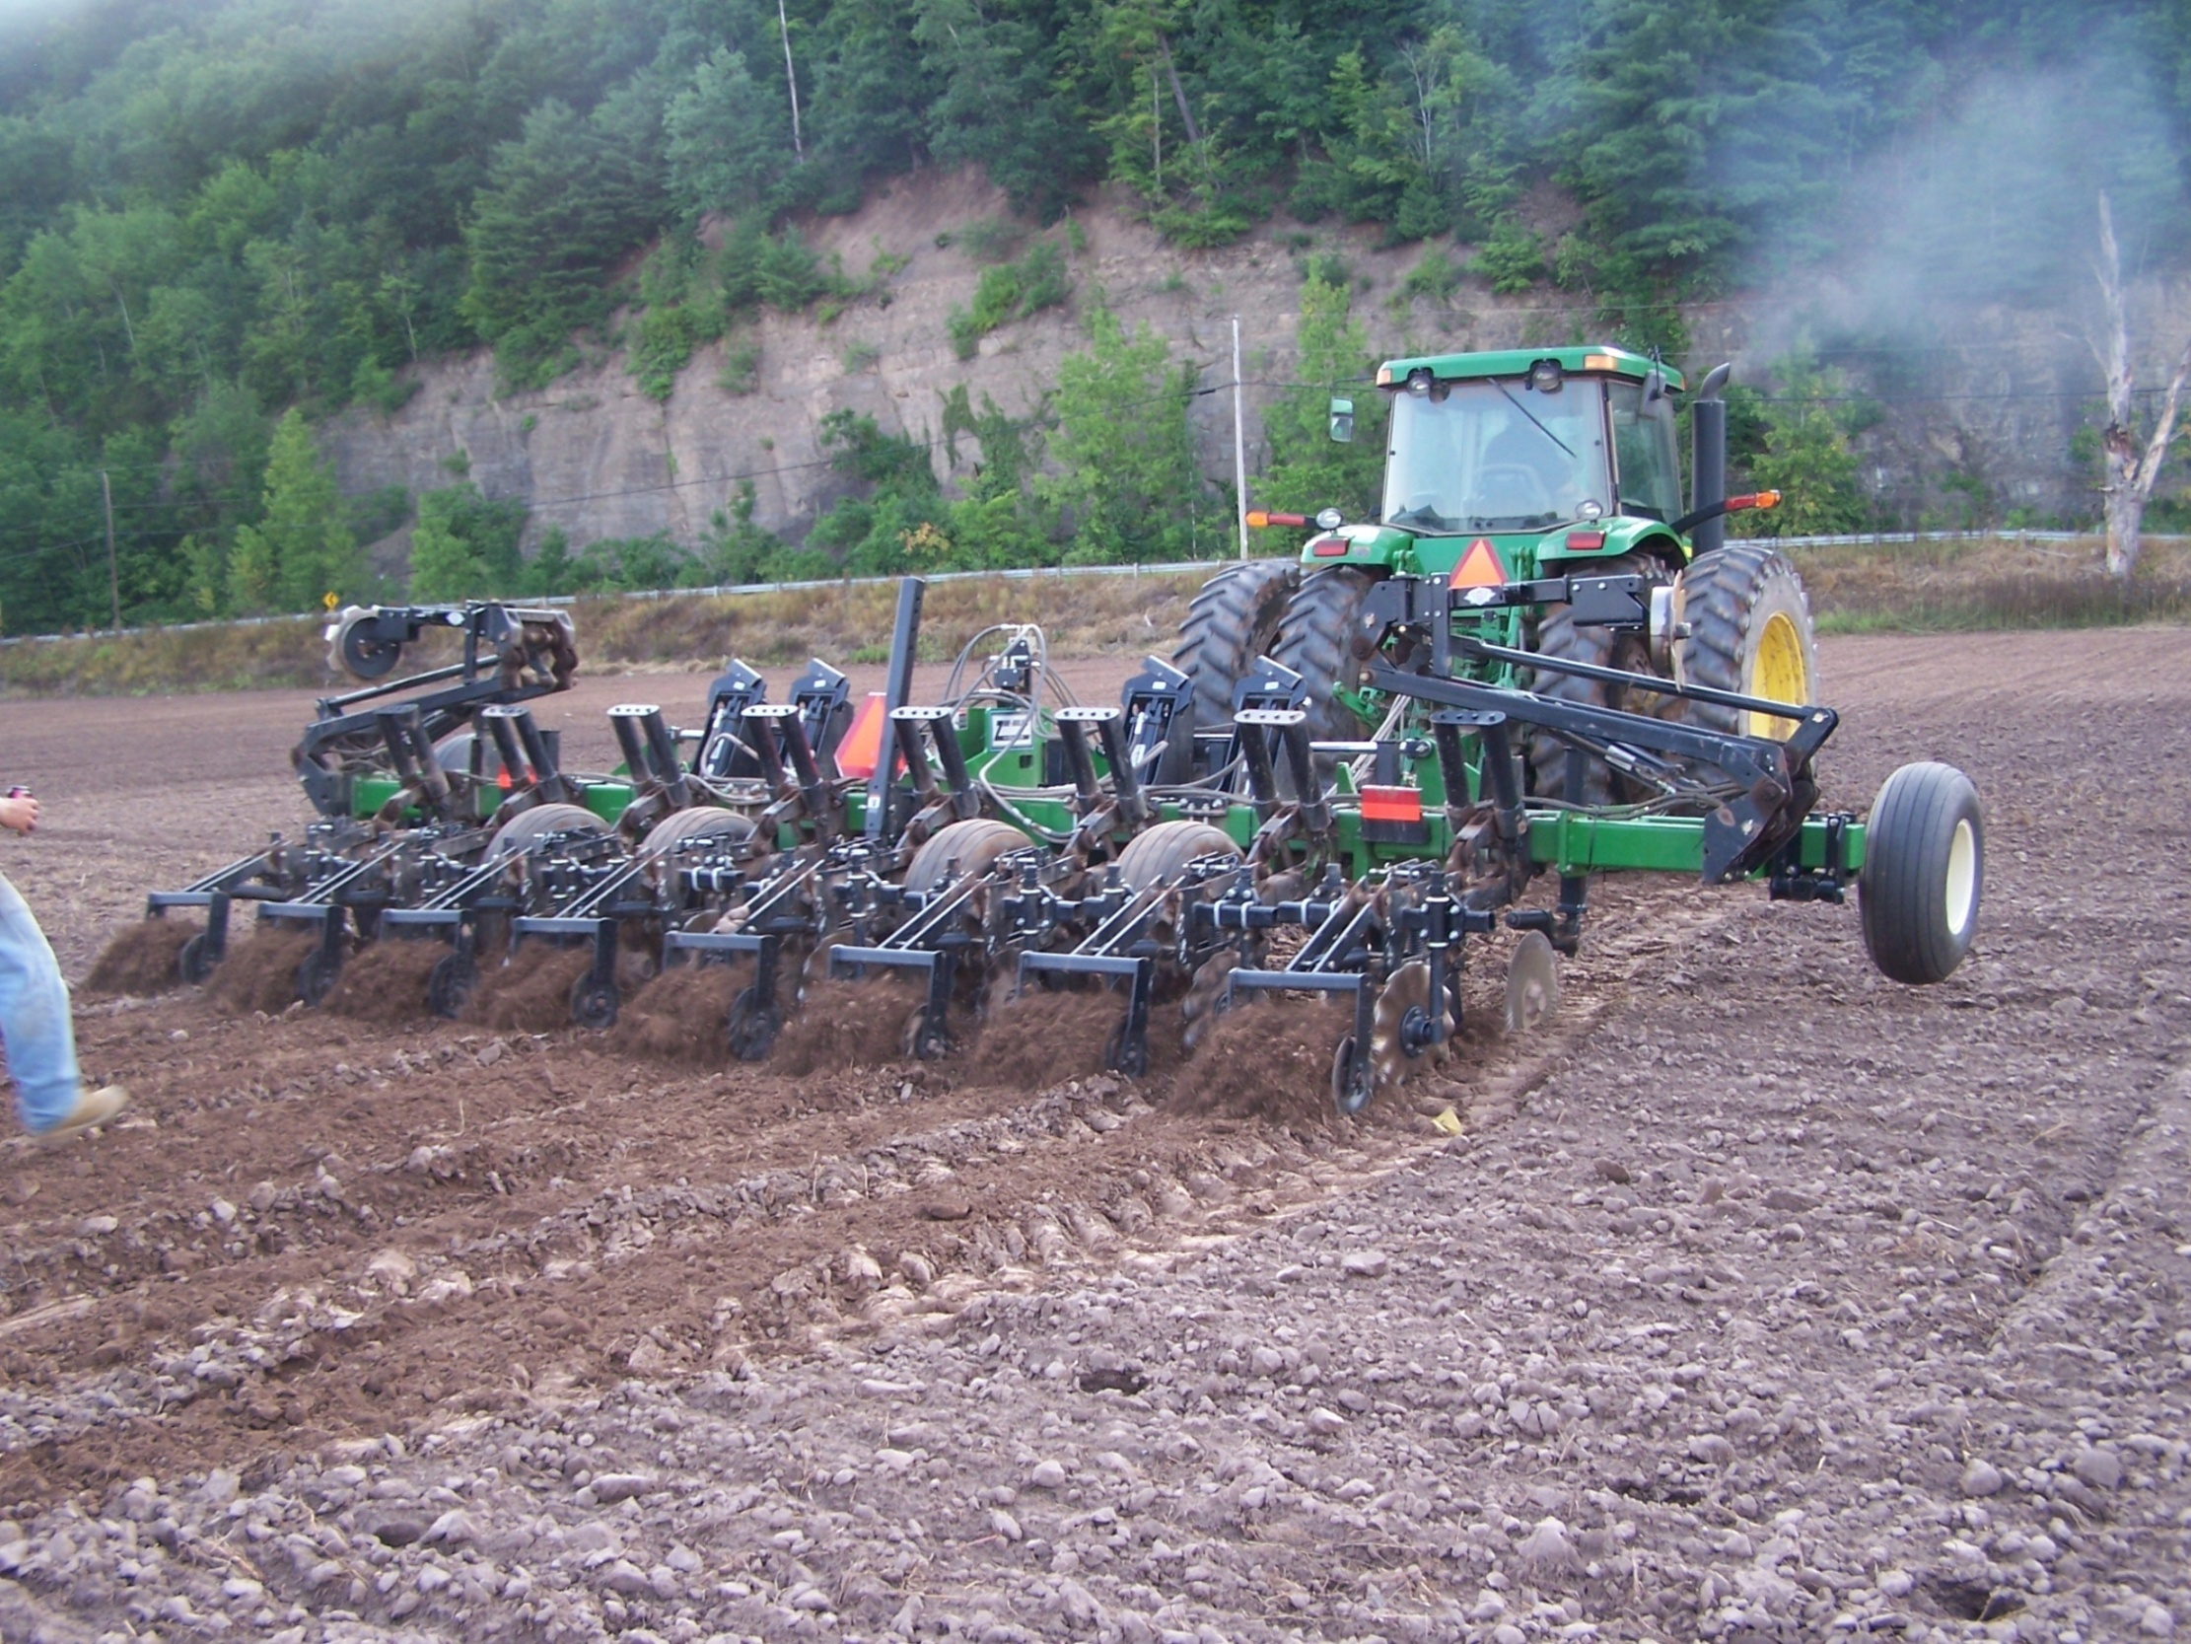

Slide 13
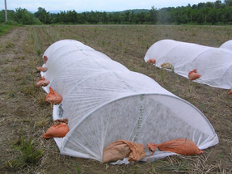
3 (6 foot X 25 foot)Low tunnels set up in reduced tillage experiment with wing traps attached to hoops inside.

Slide 14
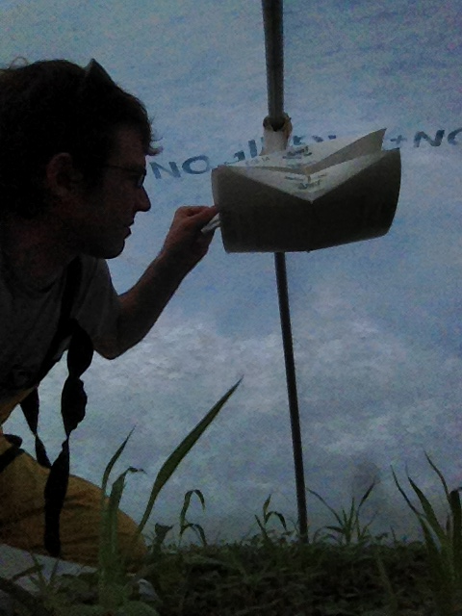
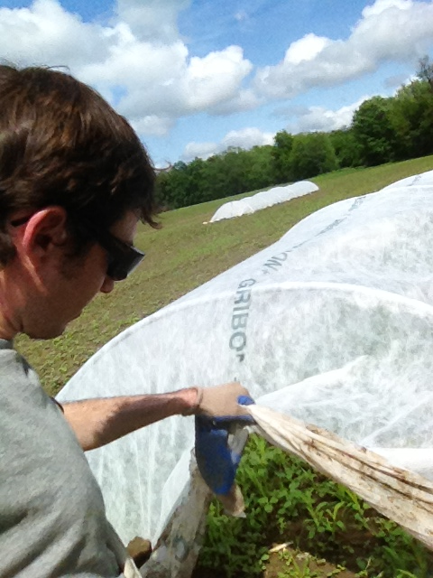

Slide 15
Results & Discussion
No moths were caught in the low tunnels on any farm , any treatment.
Higher number of moths were caught in traps field edges than in the field outside of the low tunnels.
Black Cutworm moths were only caught on one farm, with higher numbers in weedy edges.
Changes in weed management in areas bordering fields may help reduce ECB populations by eliminating refuge areas where ECB successfully overwinter.
Pesticide resistance may be an issue on some farms

