Slide 1
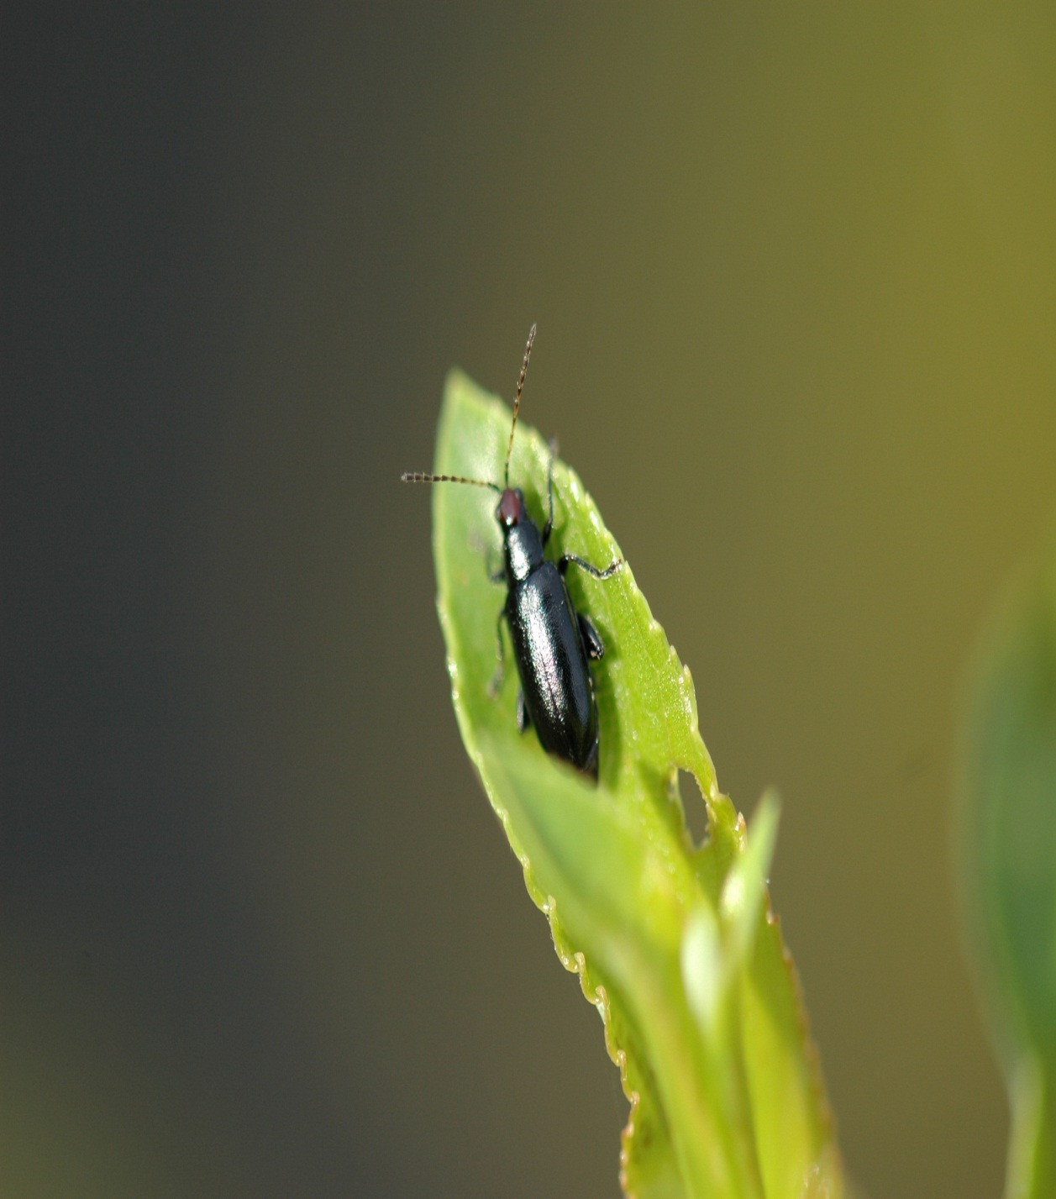
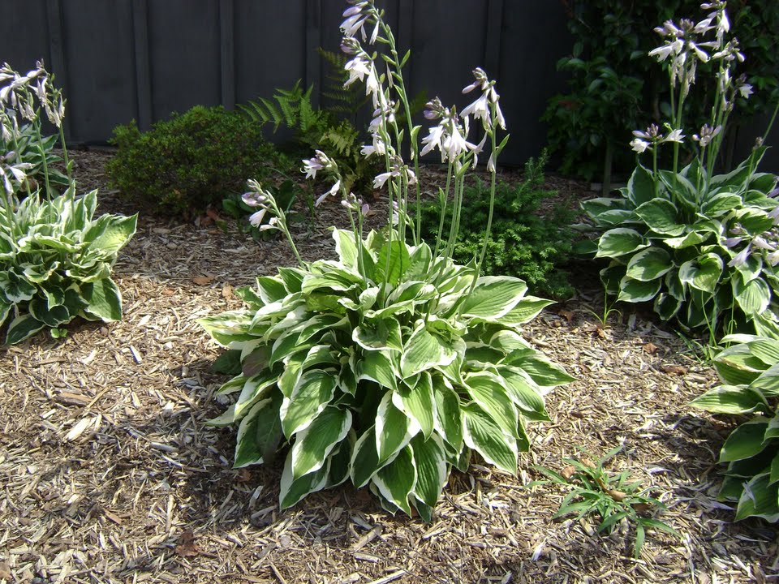
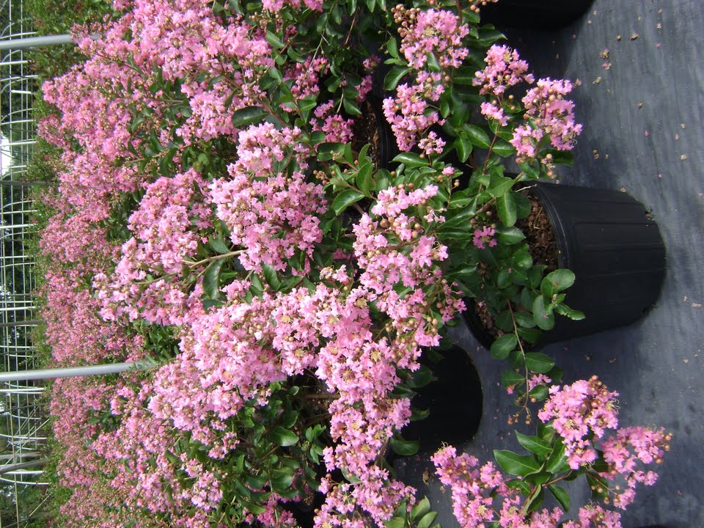
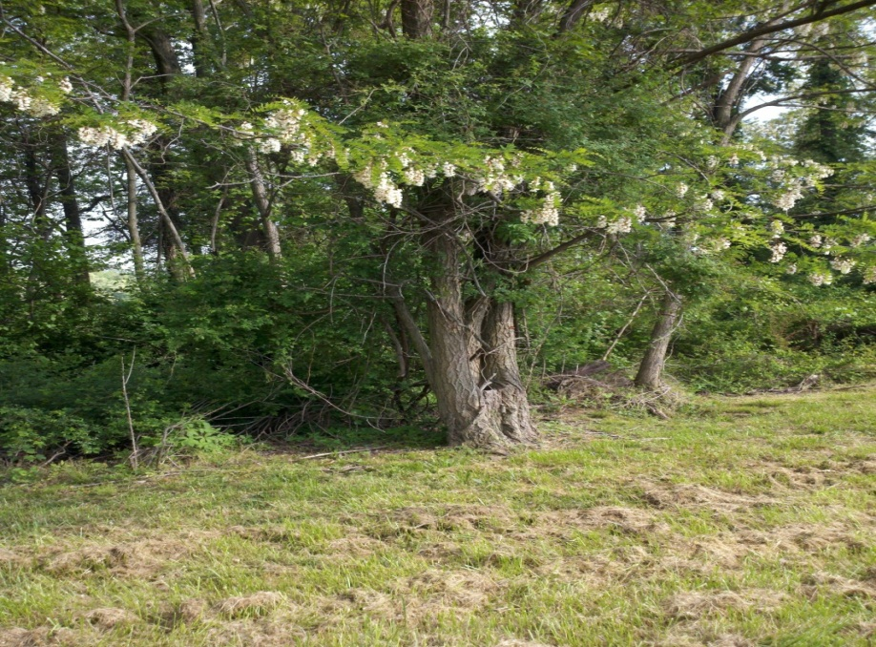
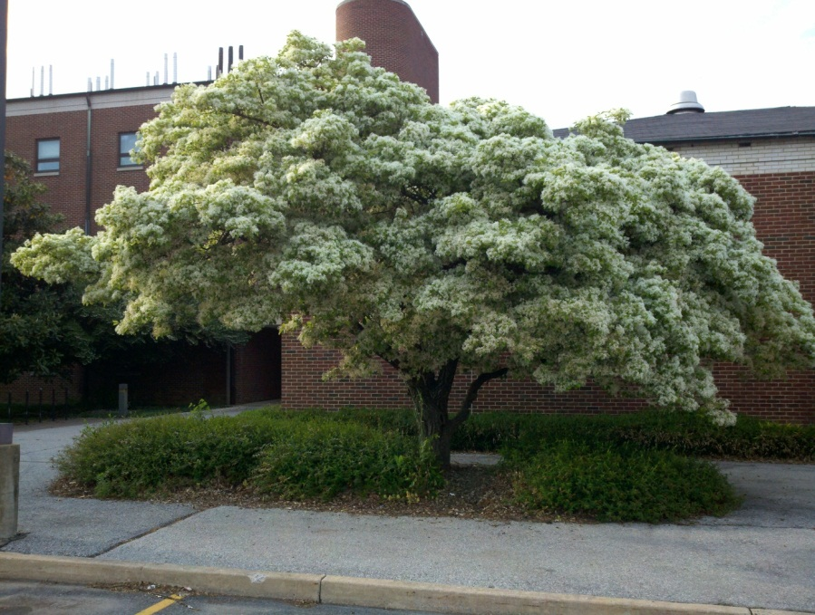
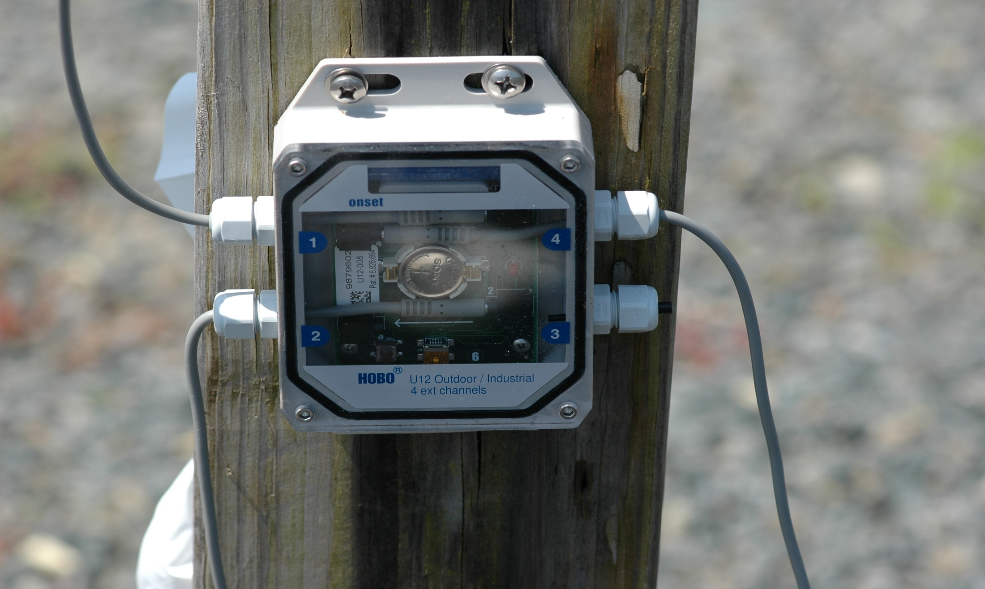
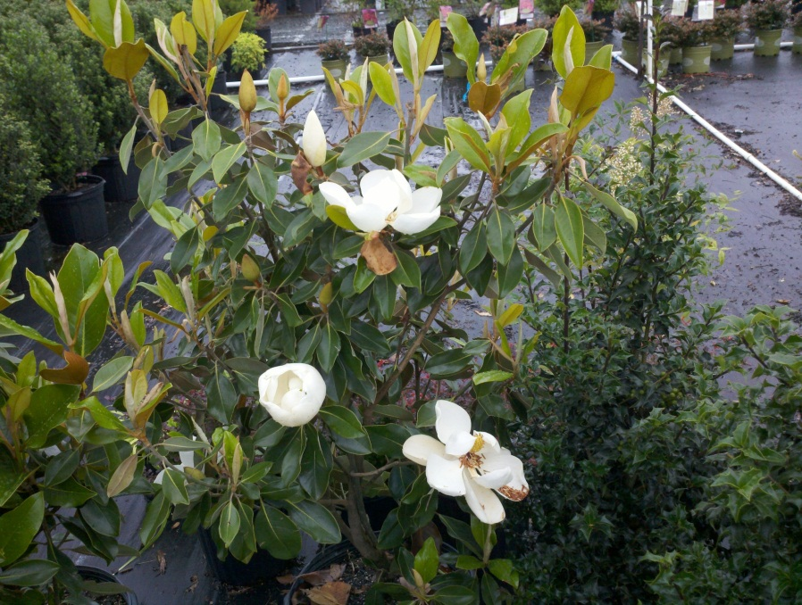
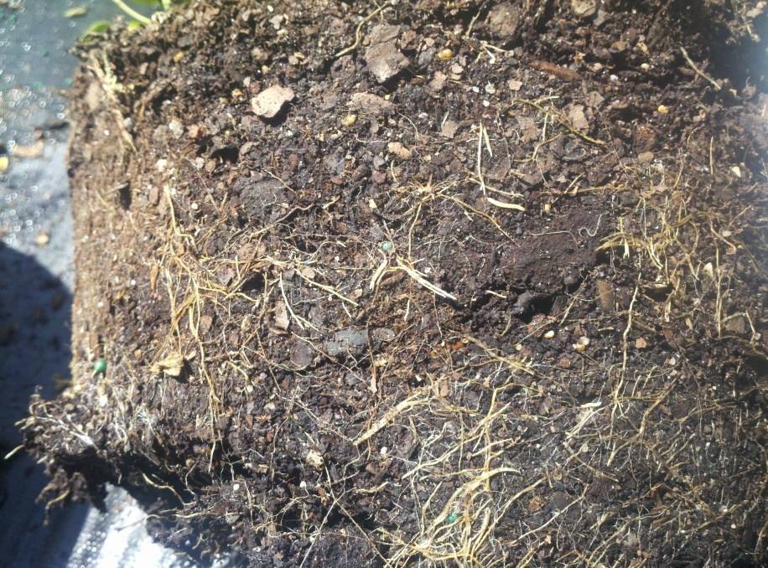
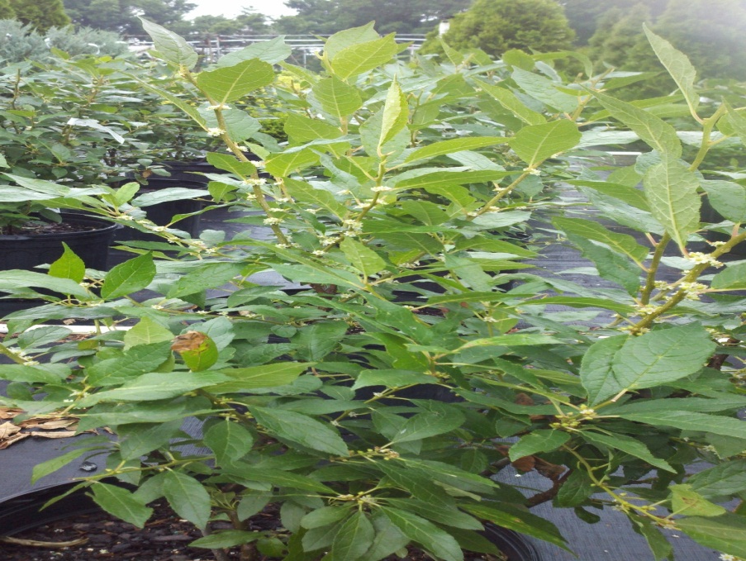
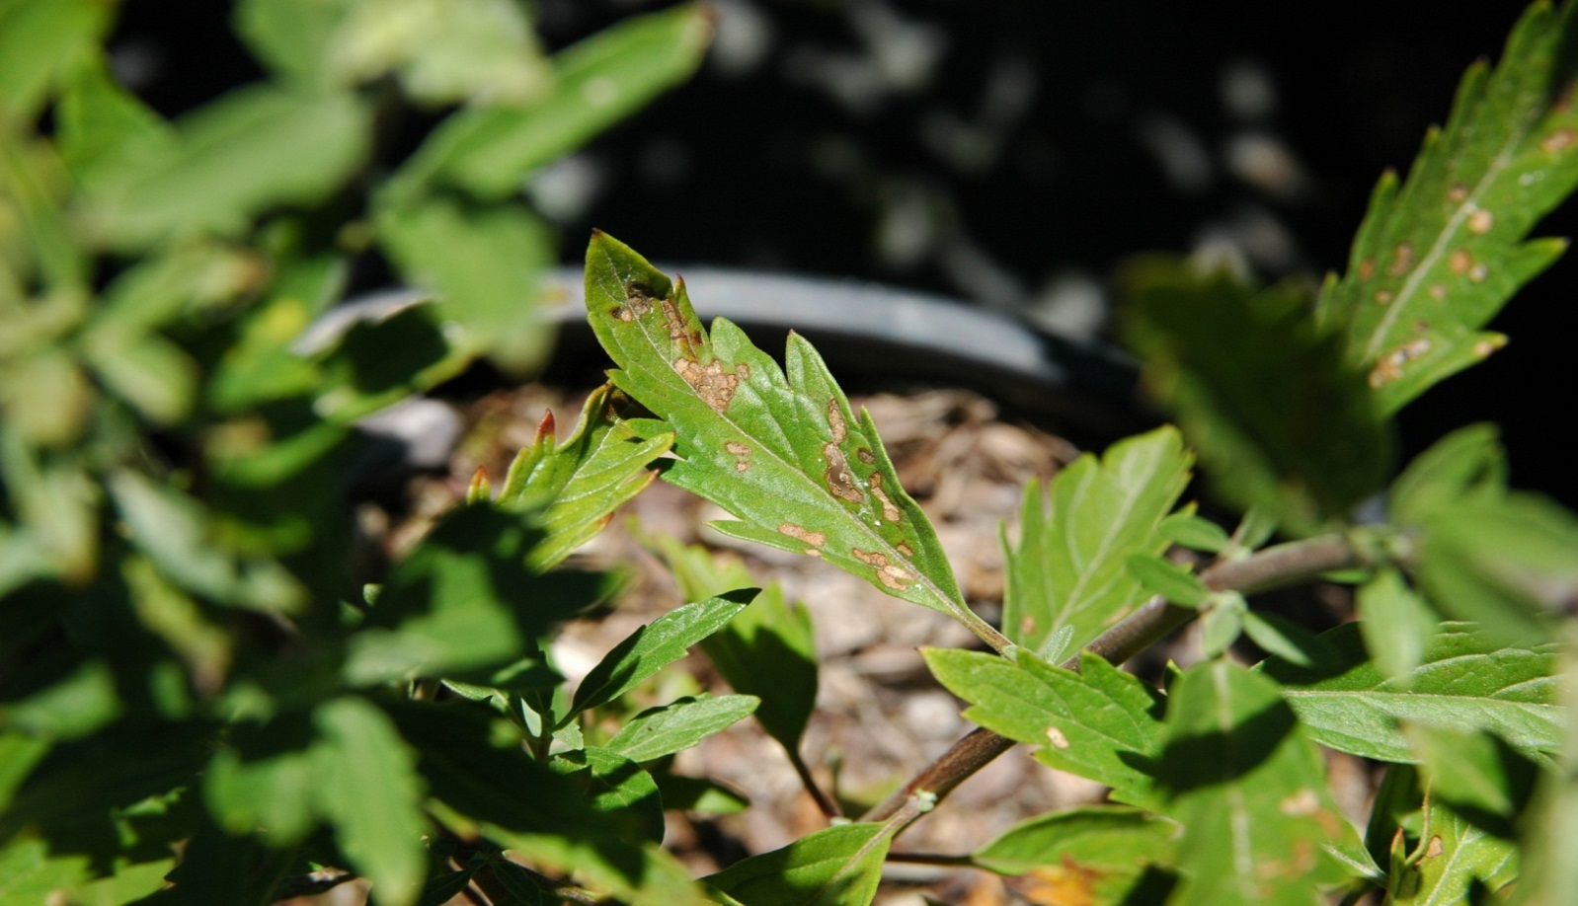
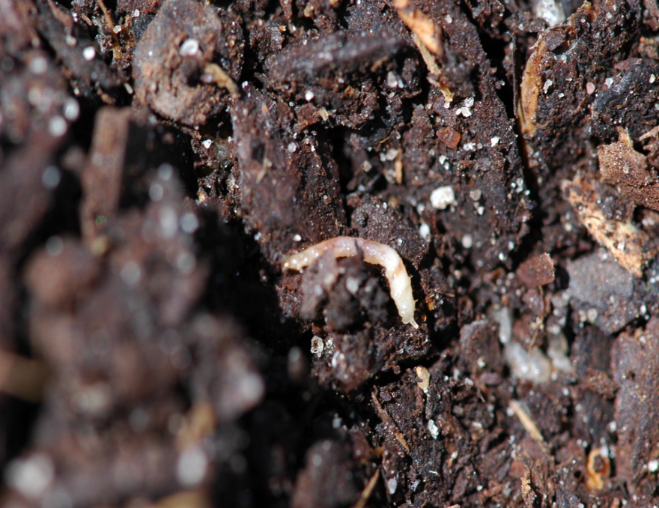
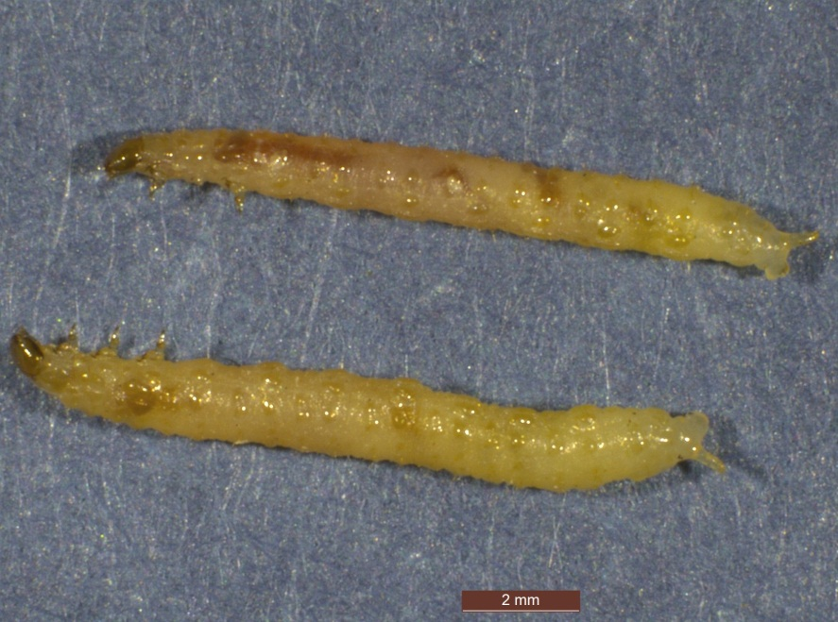
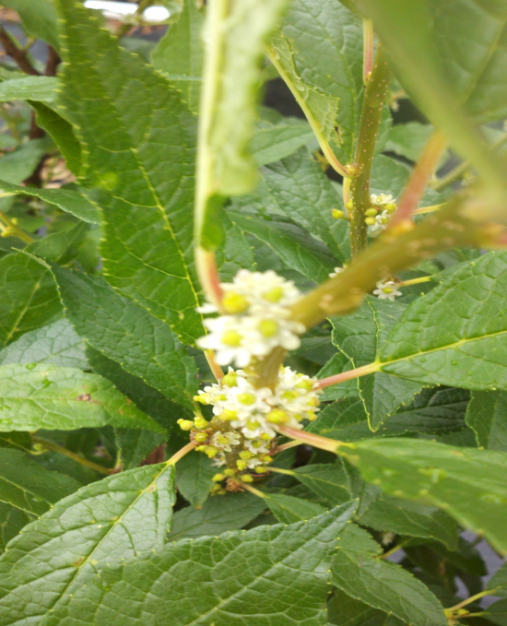
Redheaded Flea Beetles Phenology Indicators
Lianmarie Colon, Andrew Kness and Brian A. Kunkel, Department of Entomology & Wildlife Ecology, University of Delaware, Newark, DE
A
IMPORTANCE:
Common and difficult nursery pest to control in the northeast, mid-Atlantic and southeast United States.
Redheaded flea beetle, Systena frontalis, hatch from overwintering eggs to feed on nearby plant roots.
Feeding rarely affects plant health; however, even slight amounts of adult feeding damage on ornamental plants often renders them unsalable.
Growing degree days & PPI:
B
A
Projects
Redheaded flea beetles were collected from MD, NJ, and DE with experiments conducted between May and August of 2012.
Growing degree days and plant phenological indicators were recorded at a cooperating nursery in Earlville, MD.
Various hosts were tested for feeding preferences
Use of entomopathogenic nematodes as a biological control agent was tested
Growing degree days (GDD₅₀)
Air, soil, and pot temperature data were collected throughout the growing season using a HOBO® weather station (Fig. 1).
Plant Phenological Indicators (PPIs)
Fields were scouted on a weekly basis
Potential host plants were removed from pots and the root balls were visually inspected for larvae (Fig. 2, 3).
Figure 6. Hosta in full bloom (A) and Crape myrtle ‘Hopi Pink’ in full bloom (B).
B
Second generation of flea beetle larvae were first noticed between 1818 – 1860 GDD₅₀
Hosta spp. in full bloom (Fig. 6)
Crape Myrtle ‘Hopi Pink’ bloom – full bloom (Fig. 6); ‘Siren Red’ flower bud swell
Hibisucs spp. in bloom
Cerastigma plumbaginoides in bloom.
Second generation adult emergence was first noticed between 2100 – 2240 GDD₅₀
No identifiable woody ornamental phenological stage was observed.
Figure 4. Black locust in full bloom (A) and Chinese fringetree in full bloom (B).
Figure 1. Hobo weather station
Larval activity (Fig. 3) of the first generation was found between 257 – 481 GDD₅₀
Two trees in full bloom were black locust and Chinese fringetree (Fig. 4).
Host Plant Preferences
Preliminary host preference trials suggested Joe pye weed may be preferred over Itea, Sedum and Weigela.
Additional studies found no differences in preference between those plants.
Further studies to determine preferred host plants are planned
A
Entomopathogenic nematodes (EPNs)
Steinernema carpocapsae provided > 76% in the laboratory
EPNs showed potential in field studies with trends to reduce beetle populations in pots
Future studies look to improve potential
Flea beetle damage
Figure 2. Larva found on root ball (red circle)
B
A
B
C
Conclusions
Results from this project should help with proper timing of insecticide applications.
There are two and possibly three generations, but the overlap of life stages from early August to mid-October makes it difficult to determine with accuracy.
Host plant preferences may provide options for possible trap-cropping or early detection of adult activity.
Figure 5. Magnolia grandiflora in bloom (A), Ilex verticillata in bloom (B), Close-up of I. verticillata flower (C).
First generation adult emergence was observed at 590 – 785 GDD₅₀
Magnolia grandiflora in flower bud swell – bloom
Ilex verticillata in bloom – full bloom (Fig. 5).
Funding:
This project supported by the Northeast Sustainable Agriculture Research and Education (SARE) program. SARE is a program of the National Institute of Food and Agriculture, U.S. Department of Agriculture
Figure 3. A close-up of larva on root ball (A), close-up of larvae with scale for size (B).

