Slide 1
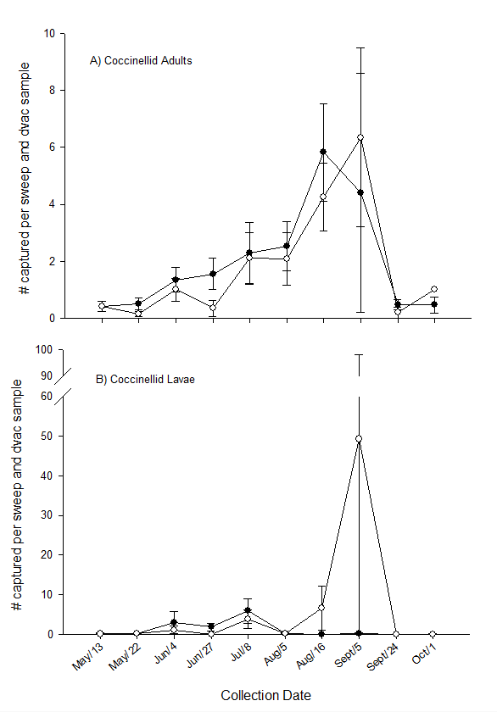
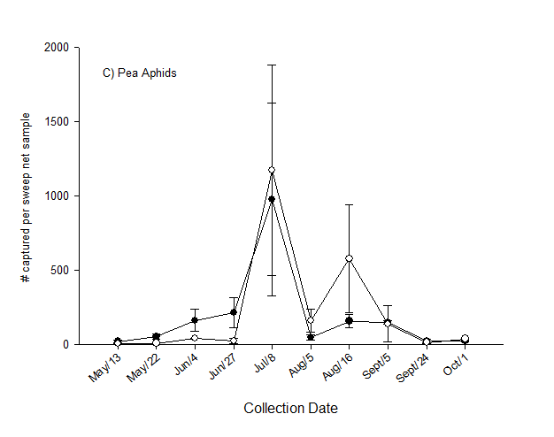
Figure 3. Coccinellid adults (A), larvae (B), and pea aphids (C) in fields treated and untreated for alfalfa weevil. Pea aphids rebound to an average of 600 aphids per sweep net sample during mid-August. For coccinellids, these data represent the average number of specimens obtained per sweep net sample (20 sweeps in a 180 ⁰ arc) combined with the average number of specimens obtained per dvac sample (50 suction contact points with the soil).

