Slide 1
Solid Ground Farm
Sustainable Education & Event Center
Youth Outdoor Adventure Summer Camp

Slide 2
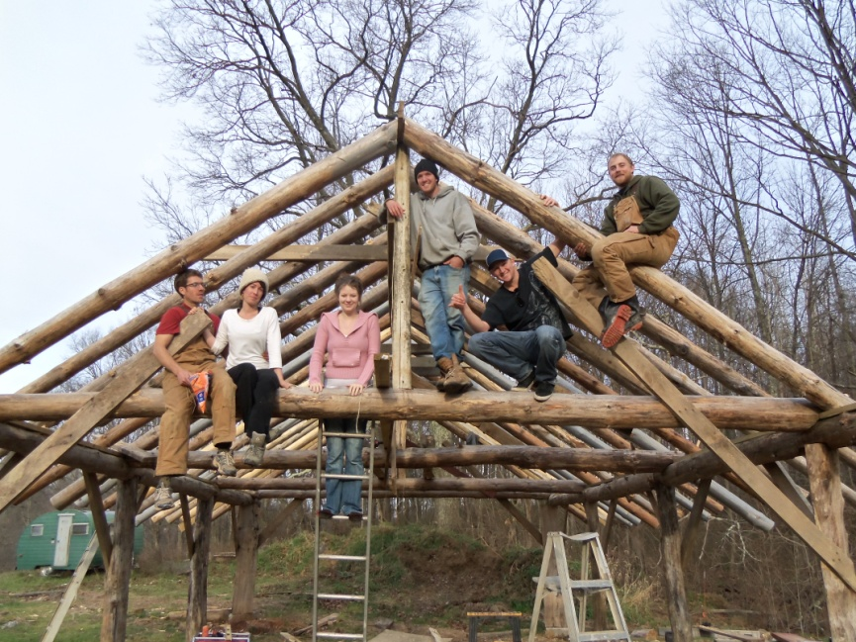
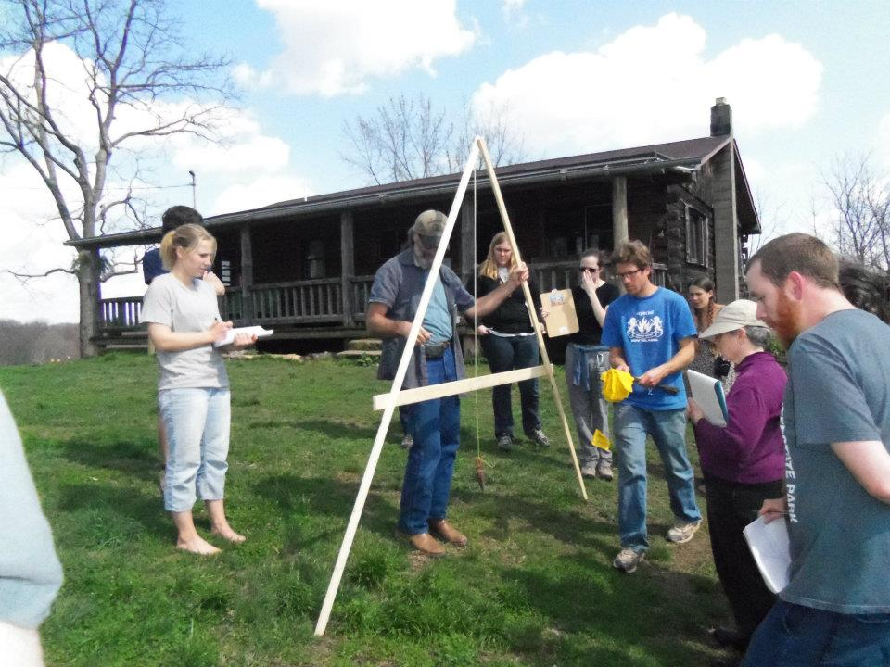
Sustainable Education & Event Center

Slide 3
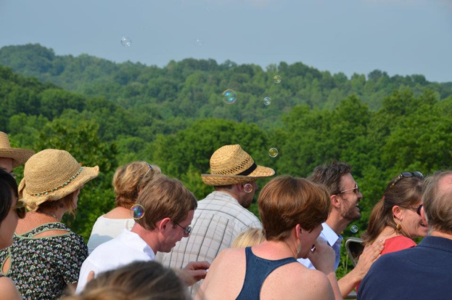
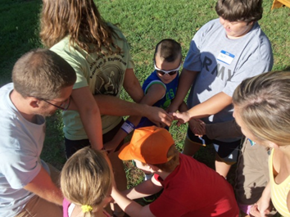

Slide 4
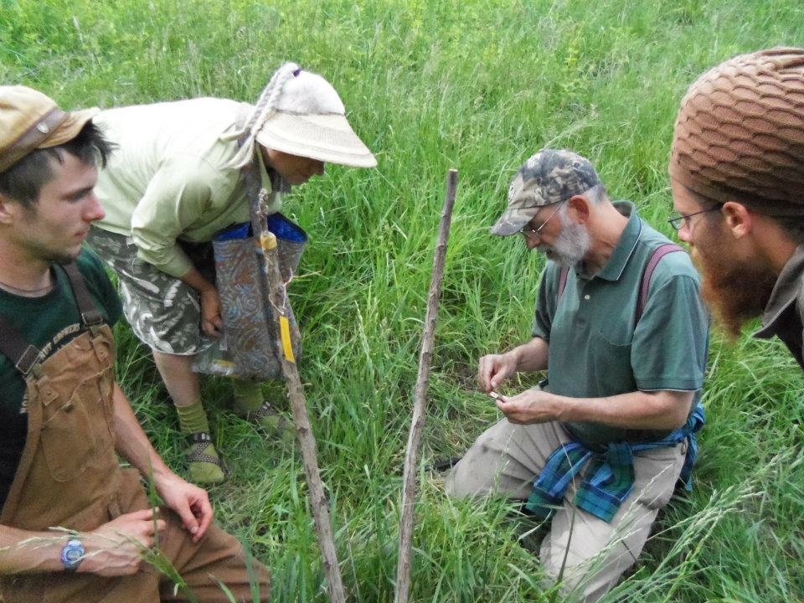
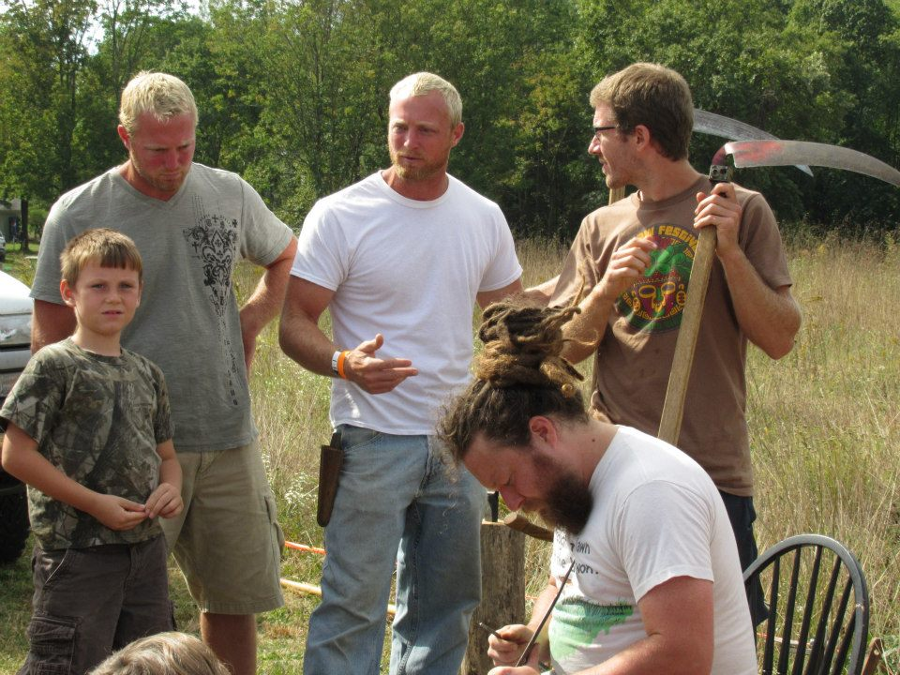

Slide 5
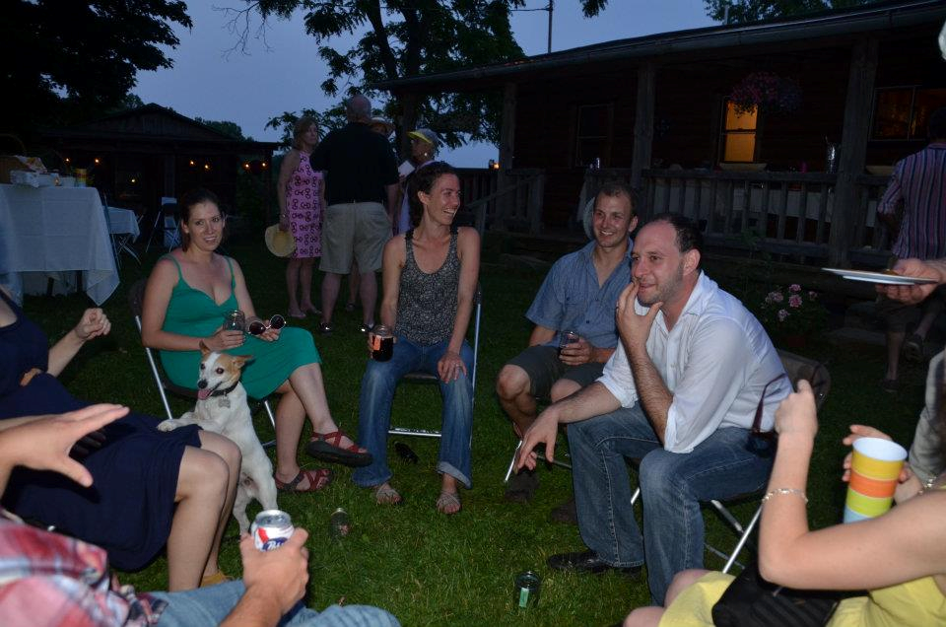
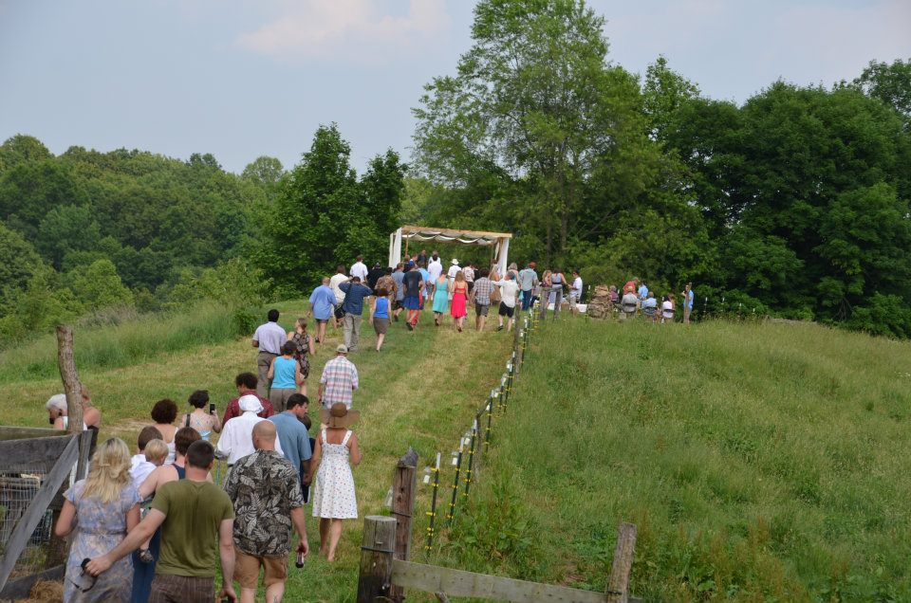

Slide 6
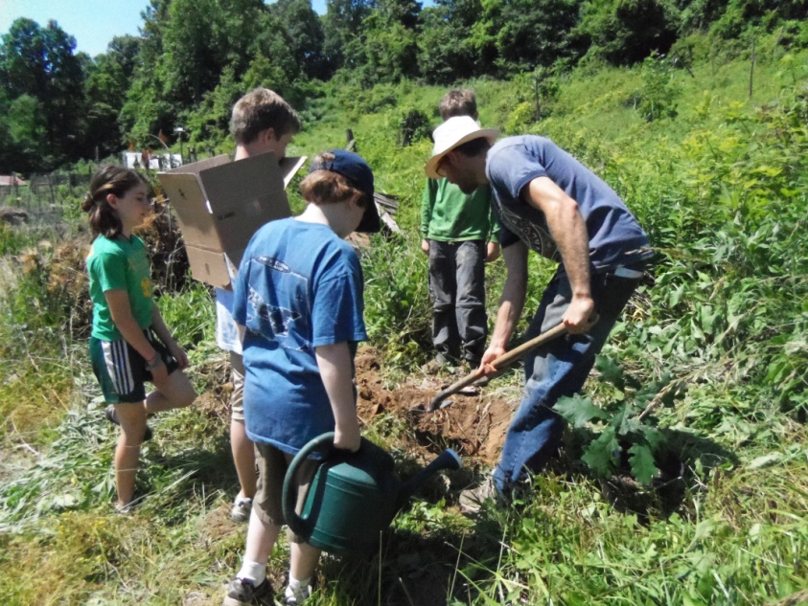
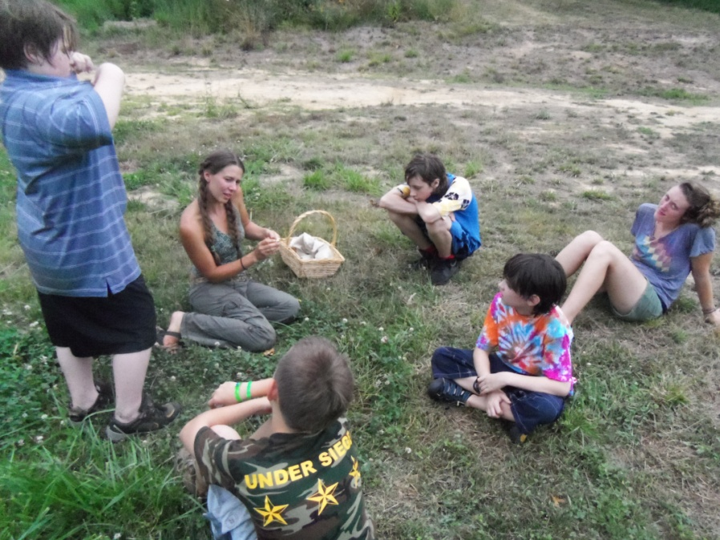
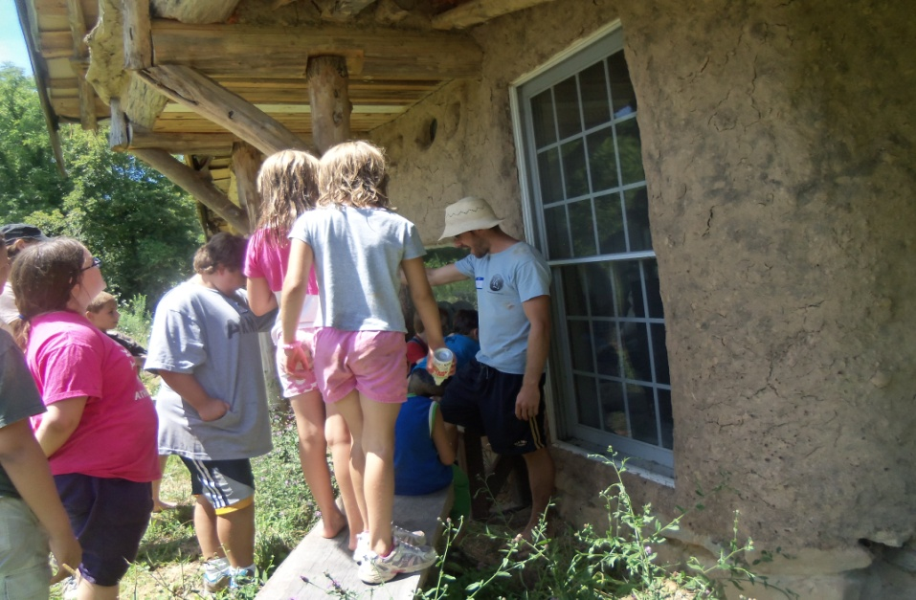
Youth Outdoor Adventure Camp

Slide 7
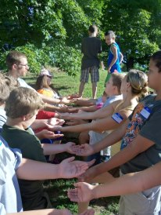
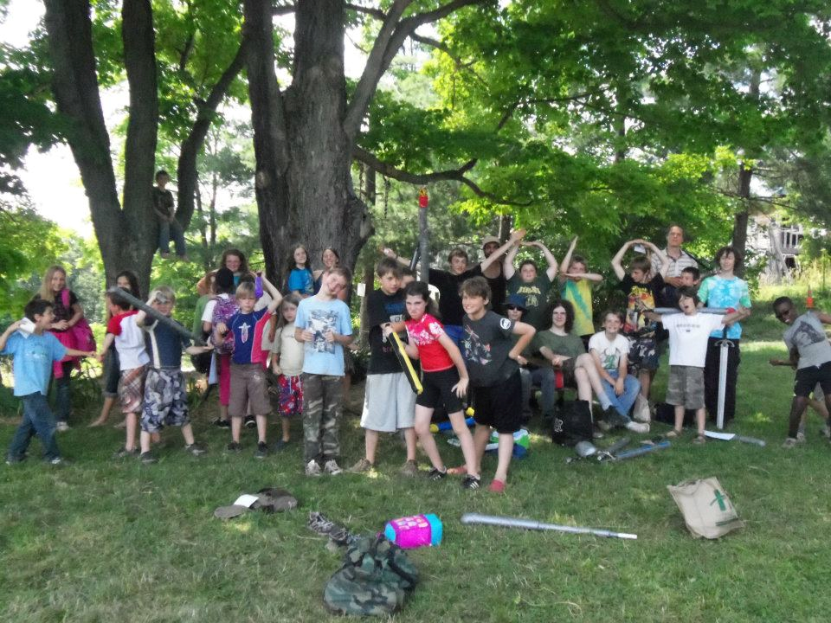

Slide 8
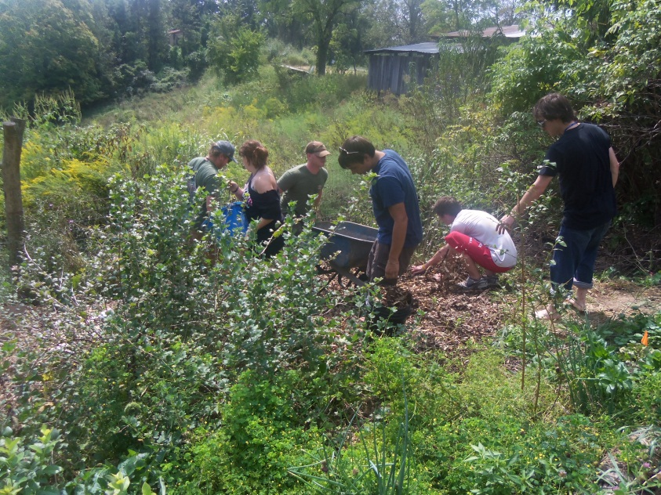
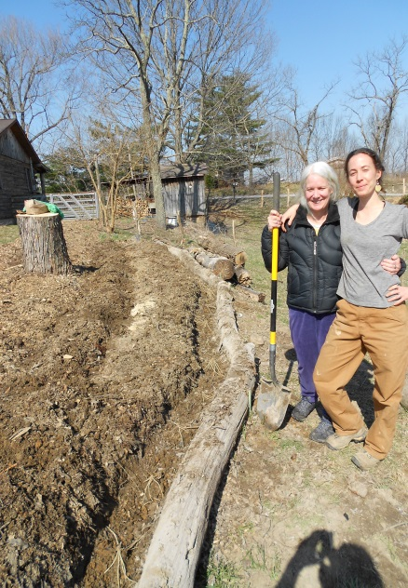
Communal Farming

Slide 9
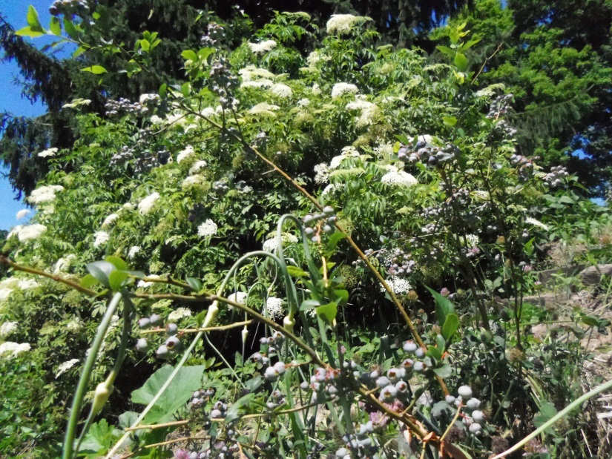
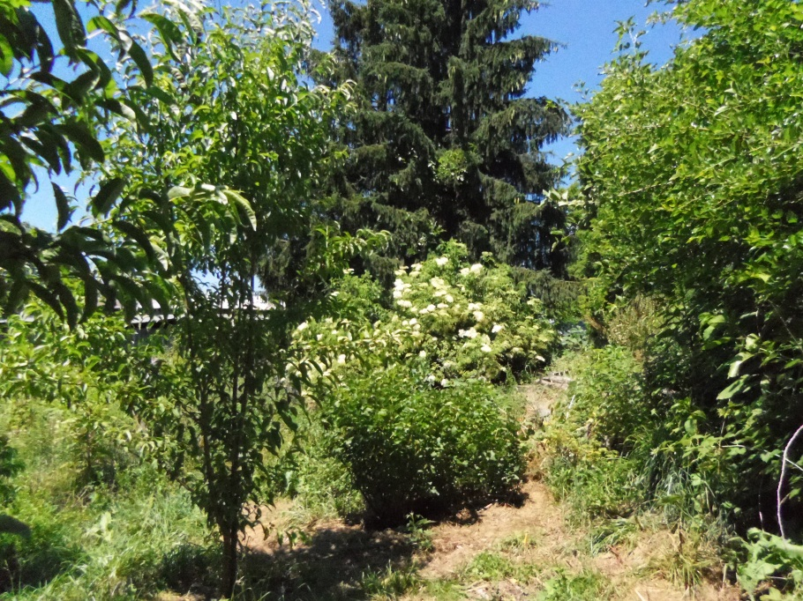
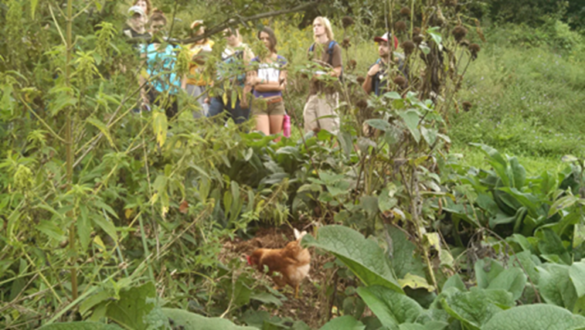
Forest Gardening

Slide 10
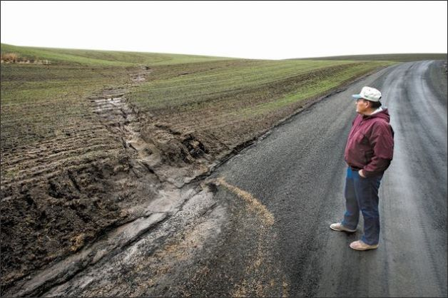
Soil Loss and Degradation
“The nation that destroys its soil destroys itself.”
Franklin D. Roosevelt
Losing 1% of the earth’s topsoil each year: an area the size of Indiana.
At this rate only 60 years of topsoil remain.
Degraded soil holds significantly less
water and grows significantly less food.
Estimate a 30% decrease in food production
capacity with a 50% increase in demand
for food and water over the next 20-50 years
(Time Magazine).

Slide 11
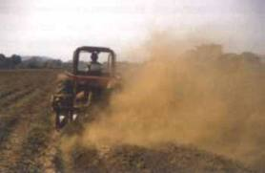
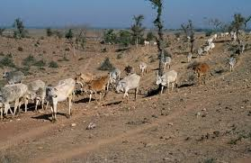
Soil Loss and Degradation
Primary Causes
Conventional agriculture (tilling)
Overgrazing
General poor management

Slide 12
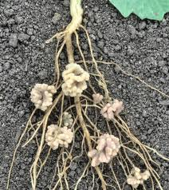
Solutions
Inspiration
Allan Savory and Holistic Management
No-Till Agriculture of Fukouka, Ruth Stout and locally Dave Brandt
Earthworks by those such as Jeff Lawton, Sepp Holzer, and others
Research of Christine Jones on the “Liquid Carbon Pathway”

Slide 13
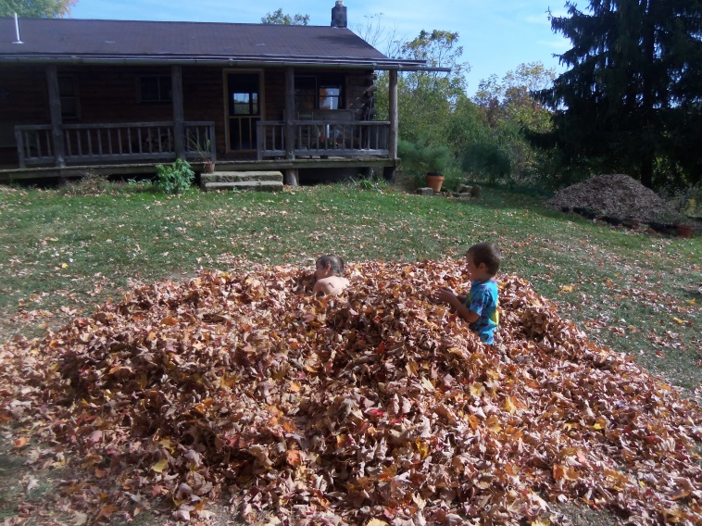
Solutions
Key Concepts
Bare soil is damaged soil.
No-till, don’t overgraze, etc.
Nature knows how to grow food and build soil in a healthy and harmonious way.
Mob Grazing imitates buffalo herds
Cover crops model forest successional processes
Build Soil From the Top Down and the Bottom Up.
Nitrogen Fixers and Dynamic Accumulators
Liquid Carbon Pathway
Mulch

Slide 14
Solutions
Putting it all together.

Slide 15
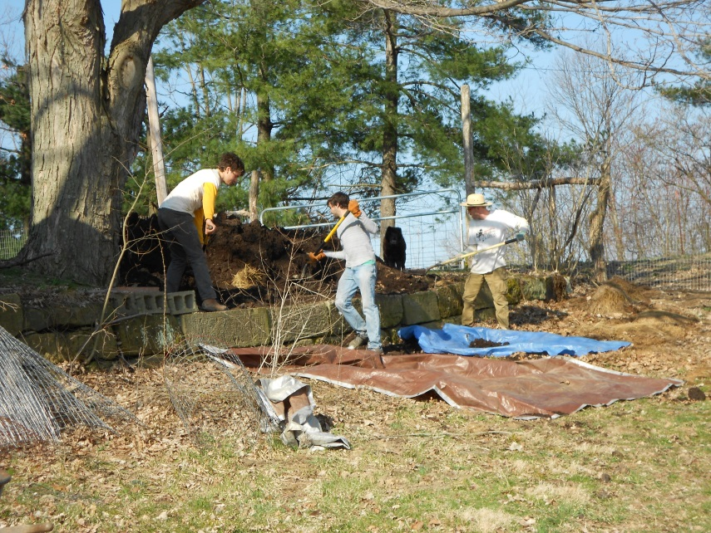
Solutions
Putting it all together.

Slide 16
Solutions
Putting it all together.

Slide 17
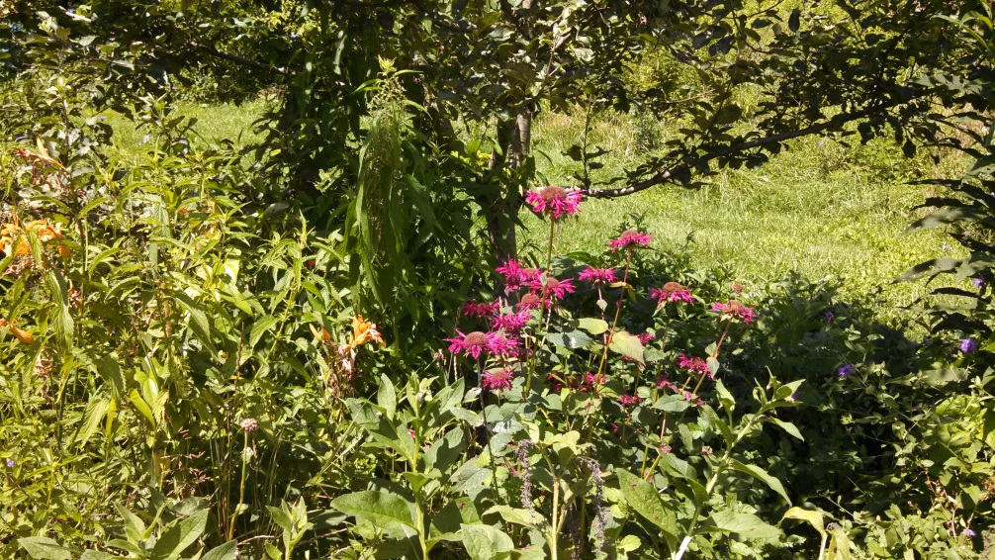
Solutions
Putting it all together.

Slide 18
Solutions
Putting it all together.

Slide 19
Solutions
Putting it all together.

Slide 20
Solutions
Putting it all together.

