Slide 1
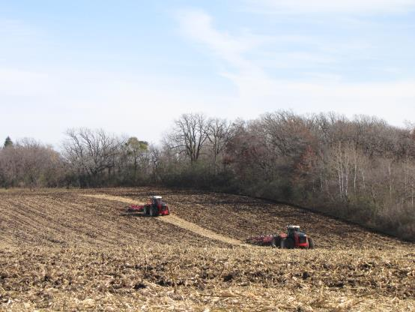
The Dirt on Dirt
Part two – The bridge between what you
have and what you are going to do with it
Notes:
This is the second part of a three part series on Soil Quality. The Soil Science Society of America defines Soil Quality as the ability of the soil to function. This series addresses soil quality by discussing the basic principles of soil science. It is up to the presenter to emphasize how the various concepts discussed relate to the overall concept of soil quality.

Slide 2
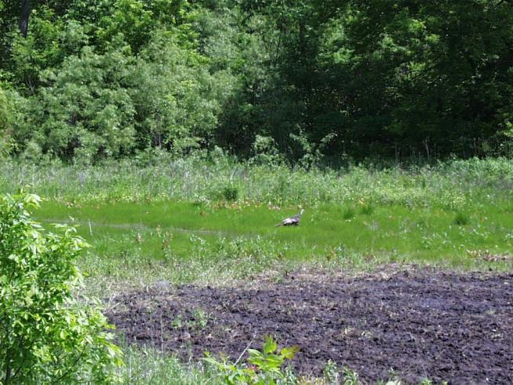
What We Will Cover
Review?
The major components of soil science
Notes:
We won’t spend much time reviewing the last section, rather concentrate on the next level of information, which builds on the concepts outlined in the first session.

Slide 3
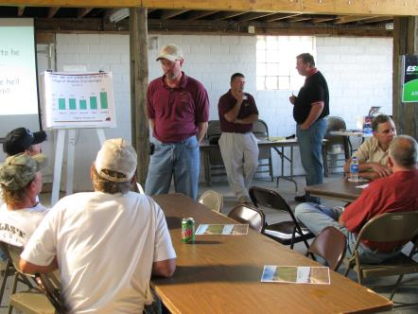
Where are we?
In the last session we covered:
Soil particles
Soil forming factors
Soil classification
Soil chemistry
All of this was in context to figuring out what you have
Notes:
In essence, the first part focused on “what you have.”

Slide 4
Eventually you need to figure out what to do with it.
Notes:
Participants should have discussed with the group and instructor the reasons they are attending the sessions. Overall, they probably have a specific piece of property with specific management objectives in mind. This session is headed in the direction toward how you manage soils.

Slide 5
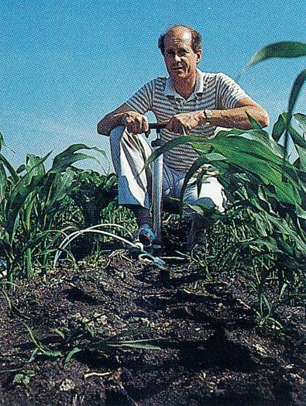
The parts of soil science
Morphology - We already covered this
Chemistry / Fertility - We covered some of this
Biology - We touched on this
Physics
Notes:
If you attended a major land grant institution you will probably find semester long courses on each of these topics (Soil Morphology, Soil Chemistry, Soil Biology, and Soil Physics). We will give a brief overview of these areas for the purpose of understanding soil quality. The first presentation concentrated on Morphology in detail, so we will be looking at the other three aspects in this segment.

Slide 6
Soil chemistry – what we covered
Clay – its influence on fertility
Nutrients present in the environment
Soil pH
Notes:
The instructor can review these principles from the last session for the sake of understanding what we are covering today.

Slide 7
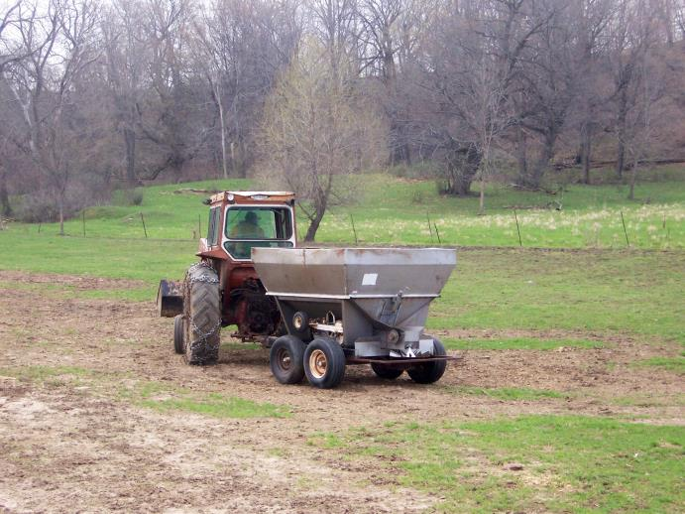
What’s left? - soil fertility
What plants need to grow
Nitrogen N
Phosphorus P
Potassium K
Sulfur S
Anything else?
Micronutrients
Notes:
These are the elements that typically are added as fertilizer, and contribute in a major way to plant growth. Other major building blocks such as Carbon, Oxygen, and Hydrogen are obtained from water and the atmosphere.

Slide 8
What do you need to know?
All essential nutrients are present in soil organic matter to some extent
Nitrogen is the most important building block (besides the free stuff: Carbon, Oxygen, Hydrogen)
Some P & K is found natively in the soil (amounts depend on the parent material)

Slide 9
Nitrogen
Largest component of the air you breathe
Mobile in the environment
- Ammonium and Nitrate move around
Legumes like beans, peas and alfalfa can fix their own via bacteria in the roots
High levels of soil organic matter capable of supplying some
Otherwise you need to fertilize
Notes:
Nitrogen is the single biggest nutrient addition as fertilizer worldwide. The instructor can go through the N cycle if he/she thinks it is appropriate for the audience. Likewise, a discussion on the environmental consequence of excess or inappropriate N fertilizer can also be used here if appropriate for the audience.

Slide 10
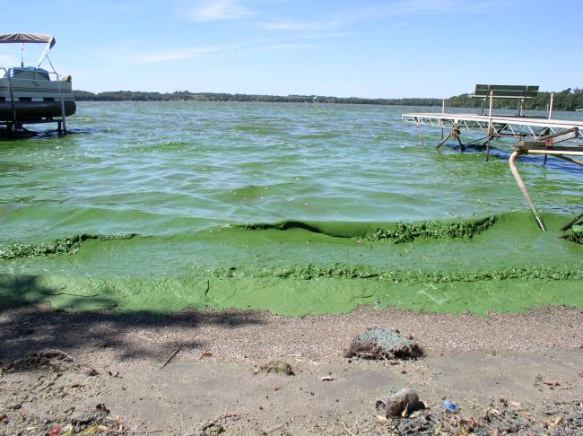
phosphorus
Complex chemistry that is pH dependent, beyond the scope of this presentation
Adsorbs tightly to soil
Major water quality
issue
Soil erosion
Dissolved with
overland flow of water
Notes:
Phosphorus is necessary for plant growth, but is a major problem if it ends up in surface waters. Part three of this series will focus more on the management to prevent loss to the environment, but the instructor may wish to introduce some of the potential problems or causes here if it fits with the audience.

Slide 11
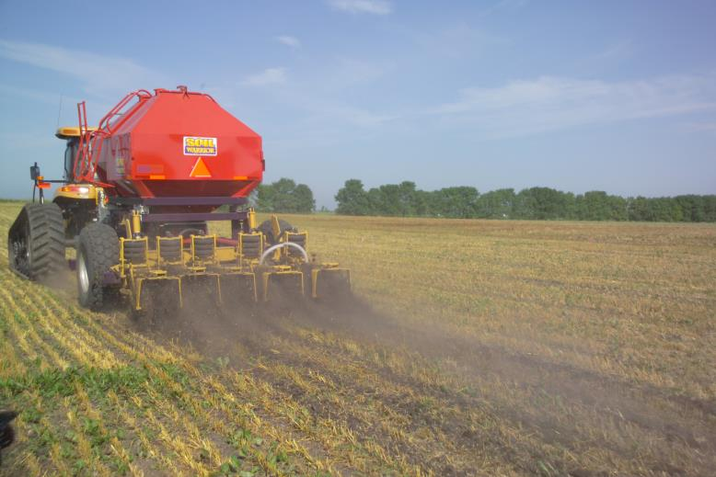
Potassium
Not a major issue in the environment
Mainly an issue because the fertilizer is Expensive!
Notes:
Potassium is not a controversial nutrient, as it does not pose an environmental risk. Nevertheless, potassium containing fertilizer is expensive, and allows the instructor to introduce the fact that economics also need to be considered when making management decisions.

Slide 12
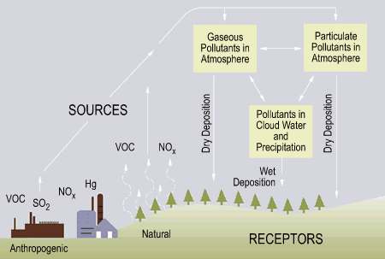
sulfur
Macronutrient or Micronutrient?
Transient in the environment
The role of air pollution
Notes:
Some people consider Sulfur to be a macronutrient, others a micronutrient. The category does not matter, but it should be acknowledged that this nutrient is frequently limiting, and the addition of Sulfur containing fertilizer can often enhance plant growth. This has been especially true over the last decade, as air quality laws have virtually eliminated sulfur emissions to the air, curbing acidic rain, and as an end result eliminating Sulfur deposition to the land. It is believed by many that throughout the last century, plants did not respond to the addition of Sulfur fertilizer because needs were met via atmospheric deposition. It is ironic that we now need to purchase it as a fertilizer, when it used to fall from the sky as pollution for free.

Slide 13
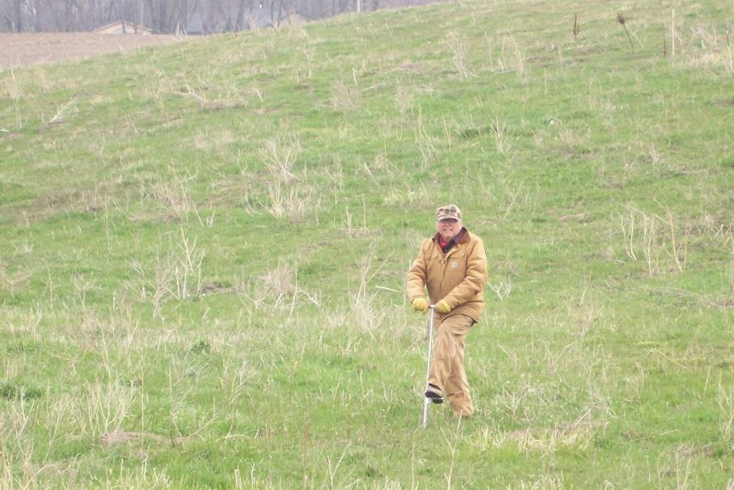
How do I know what to do?
Soil test!!!!!!!!!!
Notes:
Remember to take multiple soil cores to “average” the results. Also remember to take samples to a consistent depth, and from a representative area. You should consult your state’s Extension in order to find out what they recommend for sampling depth and methodology.

Slide 14
The theory of soil testing
You can’t easily measure the grand total of what is in the soil
- It would be a useless number anyway
Soil testing gives you a relative number for comparison (to other soils, to the past, to RESPONSE)
Take a representative sample, use a credible lab
Notes:
The purpose of soil testing is to be able to use the results to make fertilizer recommendations. Since not all of a nutrient in the soil is available to plant growth, it is not advisable to try to determine the total amount. There are many ways to test the soil. Fortunately, the work for this has already been done by your state’s land grant institution. They have determined which test is best for the soils in your state. This is based on replicability, and the usefulness of the results to correlating to plant response. All of your state’s fertilizer recommendations are based on the recommended tests, meaning that the use any non-recommended tests will give erroneous results. From time to time someone will come along with a “new” test touting it as being better. While the test may be real, remember that the results are worthless since the numbers do not correlate to any of the decades of research conducted with your state’s approved test methods. This is also the reason that home test kits (besides being unreliable) do not provide much in the way of useful information.

Slide 15
What about micronutrients
Supplied by soil organic matter
Rarely of importance with respect to needing additions
They are fun!!! (They must be people love to talk about them and add them even when they are not necessary)
Soil test
Notes:
For some reason people become fixated on micronutrients. Remember the “micro” part, meaning that they are required in very small amounts. The claims regarding the necessity of adding these to a fertility plan usually come along with a sales pitch for expensive fertilizer. Most soil tests do not analyze for these nutrients unless specifically requested. Typically the need for micronutrient additions are very specific in nature (meaning specific soil textures, parent materials, use histories, etc.). This is another area where you should consult your state Extension before adding to your fertility plan.

Slide 16
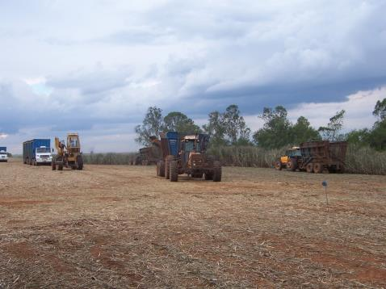
But every once in a while
Soils may need a little Zinc, and rarely Copper and Boron
Some fruit and garden crops need micronutrient fertilizers
Some soils in other regions do need micronutrient additions
Stay focused on what is
most important
Notes:
After managing a property for several years, many people either get bored with doing the same things every year, or may be talked into raising their productivity “to the next level.” Again, this is more often a sales pitch than a real recommendation. Specifically, do not fall for the sales pitch of needing to purchase Calcium. If you are in highly weathered soils in warm climates it is possible that the addition of micronutrients may be necessary, but for most of the American Midwest the need for micronutrient additions is often isolated to sandy and other “young” soils. It can’t be stressed enough that your state has a land grant institution charged with finding the truth regarding these practices. Remember that Extension staff do not stand to profit from your decisions, so you should always look to them as a second opinion if you are being asked to spend money on something that seems unconventional.

Slide 17
Nutrient ratios
Research shows this is not a valid concept
Plants need a total amount of a nutrient, the ratio of it compared to another nutrient is unimportant to the plant
Nutrient ratios are frequently used as an unscrupulous sales pitch
Notes:
Plants need a total amount of a nutrient present in order to achieve maximum growth. The thought that nutrients need to be present in the soil at certain ratios (like the ratio of P to K, or of Ca to Mg) in order to achieve maximum growth is to ignore basic plant physiology. This concept is often used by unscrupulous individuals as a sales pitch, and is not based on science. If you are already at the desired level of a nutrient saying that you need more in order to “balance” the soil is a way of talking you out of your money.

Slide 18
Soil biology
We need to discuss some other concepts first
Notes:
Soil biology was briefly discussed in the last section, and is a logical next topic. Nevertheless, in order to understand it’s importance to soil quality, we need to cover some other things first.

Slide 19
Soil Physics
Not as complicated as it sounds.
Water movement
Temperature
Density
Notes:
The term physics can give some people headaches, but really we are talking about some very simple concepts when it comes to the soil. There are, of course, many complex relationships that can be studied within soil physics too, but that is not within the scope of this presentation.

Slide 20
Water
Water and Oxygen are essential to biology
When water saturates the soil there is no air, inhibiting plant growth
Soil has a “Water Holding Capacity” based on texture and other factors
Notes:
Everyone knows plants need water, but probably have never stopped to break down what is actually happening when it rains, or when plants are watered.

Slide 21
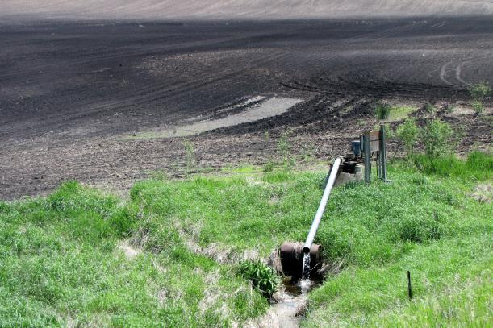
Soil water
Fine textured soils can hold more water
Water moves slowly from fine textured soils
Finer textured soils
(higher clay content)
frequently benefit from
artificial drainage
Notes:
This slide and the next play into the same concept. In addition to water saturated soils causing problems with the simple availability of oxygen, wet soils tend to be cold and lead to delayed seed germination, and stunted plant growth. Some people equate artificial drainage with the loss of wetlands. The truth is that most artificial drainage is done on non-wetland soils to prevent the problems associated with soils being saturated. While soils with a high clay content are often higher in fertility, they can also restrict or prevent water movement to the extent that plant growth is impaired. Anecdotal evidence suggests that a very large percentage of “productivity problems” in home gardens is caused by the soils being too wet. Unfortunately, there is not an easy and cost effective way to alleviate these problems on small plots in urban surroundings. In many agricultural situations the benefits of artificial drainage can be so significant that the investment in an artificial drainage system can break even within five to ten years.

Slide 22
temperature
Air heats quickly, water is slow
Soil needs to reach a certain temperature for biological activity to take place
When soils are wet they are slow to warm, stunting plant growth, and shortening the growing season
Notes:
This was mentioned in the last slide too. It should be pointed out that we usually reference the “growing season” and need to know specifically when the average first and last frost dates are. Any part of the time in-between that is not used for growing a plant is underutilizing your assets. Growing plants can take up a lot of water, so saturated conditions that restrict plant growth are primarily a problem of the early growing season before there are a lot of roots. This is a double whammy, as it is also still relatively cool during this time of year.

Slide 23
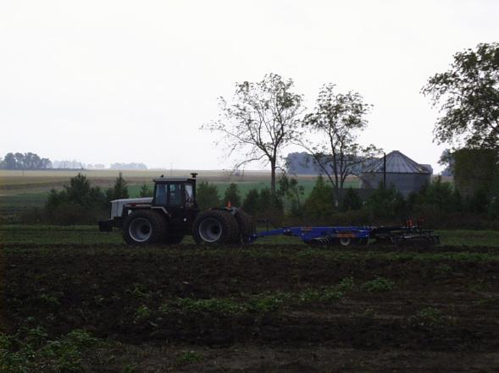
And finally - density
Weight versus volume of the soil
Relative to texture and other factors
If the soil is too dense
it inhibits root growth
and water infiltration
Notes:
Bulk density is an important concept, but is totally relative to the soil texture. This means that we do not often measure the bulk density in order to diagnose problems, as the interpretation of the information can be difficult.

Slide 24
How does it get that way?
Compaction
Weight, clay particles (remember they are flat), and water (which is a lubricant)
And this leads us to the Holy Grail of Soil Quality!!!!!!!!!
Notes:
Soil compaction is one of the single biggest problems with respect to limiting soil productivity. Heavy traffic during times when the soil is very wet can cause significant compaction problems. Compaction close to the soil surface can often be alleviated by tillage or the freeze-thaw cycle in the soil. When compaction extends below the top six inches of soil the damage can be long lasting and difficult if not impossible to remedy. Studies in Western Minnesota have shown that the wagon ruts from the “Wadsworth Trail” are still detectable in virgin prairie, even though the trail has not been used since the 1870s. There is visible stunting of the prairie grass, and increases in bulk density of the soil can be measured. Clearly, mother nature has not been able to eliminate this problem naturally over nearly 150 years of natural conditions. The bottom line is that compaction problems should be avoided, as alleviating them once they exist is not easy.

Slide 25
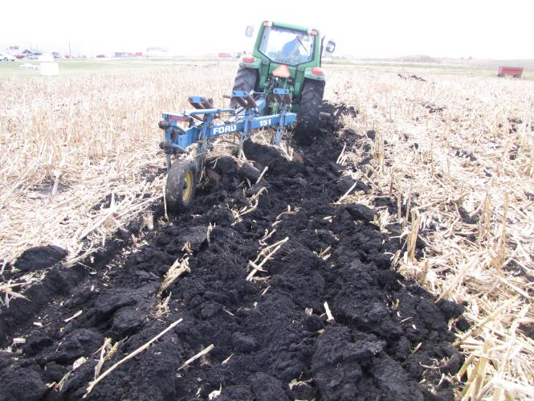
Soil Structure
This is what is meant by the term “tilth”
It can be described, but not easily measured
Simply put, it is how
loose the soil is
on its own
Notes:
We just talked about soil compaction, the opposite of compacted soil is soil with good tilth. A loose soil allows for extensive root growth. Having better root systems allows a plant to better take advantage of nutrients in the soil and makes it less prone to the effects of drought. Soil with good tilth will experience better natural drainage which also magnifies its benefits by giving growing plants the advantages of warmer soils.

Slide 26
Soil structure defined
Terms are used to define the structure
Based on the size of the clump that naturally breaks apart when the soil is exposed
Smallest is “crumb”
The largest is “massive” – meaning that there is no structure at all
Notes:
As mentioned in the last slide, plants growing in soil with good structure have more extensive root systems. Plants will not notice much difference when soil moisture levels are optimum, as this makes root growth easier. It is when water is either lacking or in excess that big differences appear between soils with good structure and those with poor structure. Massive soil structure combined with a lack of moisture will have the same affect as a compacted soil (this goes hand in hand, as a compacted soil often has massive structure). Because biological activity creates structure, things that limit biological activity also have the affect of destroying soil structure. Tillage, specifically, breaks natural root channels, and stimulates the break down of organic matter. Tillage works because it “fluffs” up the soil, or in other words, creates “artificial structure.” The problem with tillage is that because it lacks the elements that create natural soil structure, the soils often “tighten” up by fall, necessitating more tillage to loosen them again. A more detailed discussion of tillage will be in Part 3.

Slide 27
Soil structure illustrated
Notes:
This picture shows how soil breaks down to the “particle” level where there has been a history of tillage. These pictures also illustrate the concept of aggregate stability which will come up later in the presentation.

Slide 28
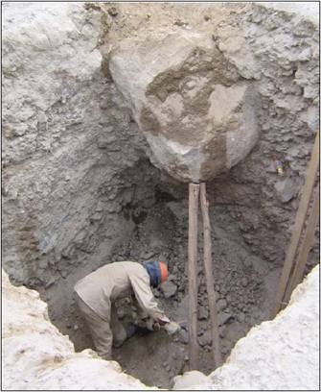
What leads to good soil structure?
Root growth, soil organic matter and other biological activity
Basically, there is a “buffer”
between soil particles
preventing them from
compacting or sticking
together
Notes:
The guy in the hole can be glad that the soil he is working in does not have good structure. If this soil was loose, the rock would probably be on his head. Because of the role that biological activity plays on soil structure one can often predict what the structure is like at a given site based on its use, history, and appearance. We’ll get into this more when we cover soil biology in a few slides.

Slide 29
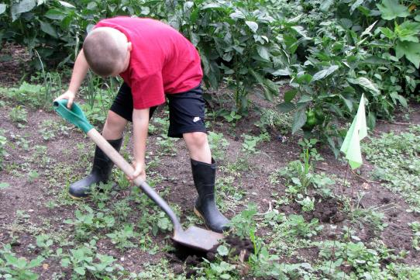
This is so important you need to experience it yourself
Find an altered soil, like a farm field or garden
Find a “virgin” soil like a fence-line, or in a woods
Saturate with water, then
try digging with a shovel
– What do you observe?
Notes:
This is the single most important exercise in this series. If you do anything outside with the class you should do this exercise. Identify an undisturbed soil and a soil with a history of tillage. Saturate them with water (maybe run a garden hose on them for a set time). Then dig into the two soils. This also shows the limitations of tillage with creating “artificial structure.”

Slide 30
Soil biology
We sort of addressed this without addressing it
Soil biology is important because it is the basis for soil structure
Biological activity is temperature and moisture dependent
Notes:
We skipped over soil biology because of the role that it plays in soil structure. By discussing soil physics first, and concluding with soil structure, we already made a case for why soil biology is important.

Slide 31
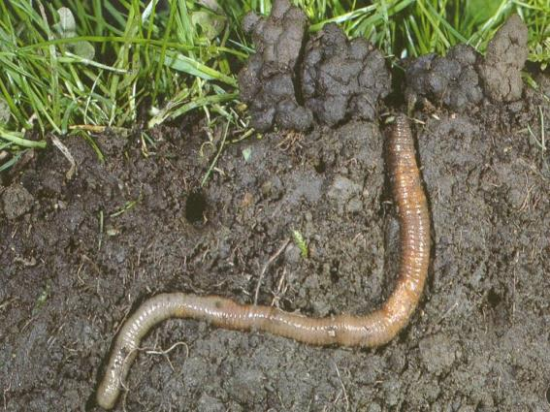
Increased biological activity
Leads to better soil structure resulting in:
Increased water infiltration
Bigger root systems
Higher levels of natural
soil fertility
Faster decomposition of
plant residue
Notes:
All these factors are tied into the concept of soil structure. Plants need water, oxygen and nutrients to grow. Soil conditions that allow for natural drainage of excess water (allowing for the presence of oxygen) and more extensive root systems to capture water and nutrients will meet nearly everyone’s definition of better soil quality. In addition, the ability of the soil to “feed” a growing plant and therefore reducing the need for fertilizer additions is also a desirable condition.
Earthworms and other organisms that live in the soil help stir up the soil, and drive decomposition of organic matter. The presence of these organisms are often used as an indicator of soil quality.

Slide 32
Did you know?
There are more organisms in a shovel-full of soil than there are human beings on the planet Earth!
Ishikawa Masayuki
Notes:
It should be noted that there are bad organisms too. Plant diseases and harmful nematodes can also reside in the soil. As with most things in nature, problems frequently occur when something is out of balance. Specifically, when soils are too wet, compacted, lacking fertility, or drought prone they can end up having a high level of detrimental organisms.

Slide 33
Soil Biology
Is one more important aspect of the soil that can’t be easily measured
Healthy soil is caused by soil biology, and supports soil biology
Physical factors such as tillage, fire, or saturation can alter how living organisms function in the soil
Notes:
We rely heavily on soil testing as a basis for fertility management. It needs to be stressed that other problems such as poor soil structure, or a lack of soil biology can not be tested for.

Slide 34
Aggregate stability
Measures the size of aggregates and their tendency to stick together when wetted
Indicator of both soil structure and biology (but not a direct measurement)
Larger aggregates indicate a healthier soil (remember the pictures of soil structure?)
Check with Extension to find out where you can have tested
Notes:
Aggregate stability is a test that can be run. Most soil testing labs do not offer this as a standard test, as it is difficult to run, and results need a lot of experience to interpret. The test consists of wetting the soil and sieving to find out the size of soil aggregates that remain stable. Results will reflect a percentage of the total that passes a certain size of sieve. These results can not be looked up in a book to determine whether they are acceptable. An experienced person can compare results from one soil to another, changes on the same site, or even a relative measurement based on past experience. Ultimately this measurement is interesting and useful, but probably beyond the scope of any particular individual’s assessment of their site.

Slide 35
And Now for this presentation’s worthless trivia fact

Slide 36
Did you know
Dust from the Sahara desert frequently causes air quality problems in the Southeastern US?
Dust cloud leaving the main
Continent of Africa and headed
to annoy an octogenarian trying to
eat supper at 4:00 PM at an IHOP
in Palm Beach.

Slide 37
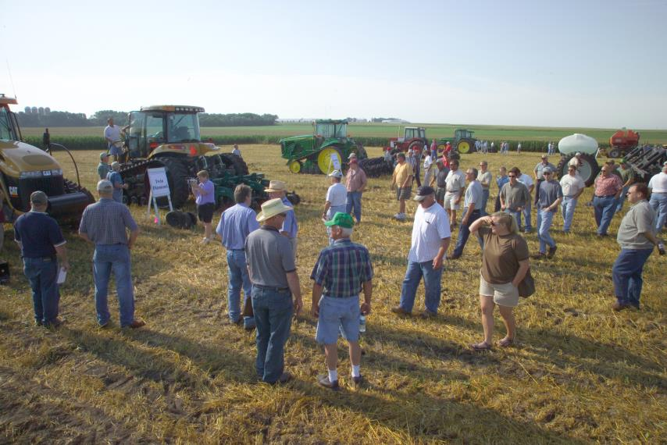
Next time
We will cover Soil Management
Drainage
Erosion
Tillage
Fertility
Conservation
Notes:
Many of the concepts that will be covered in the final segment will be applicable mostly to larger tracts of land. You may want to hide this slide if you do not intend to use part 3.

Slide 38
Thank You!
This product was developed with support from the Sustainable Agriculture Research and Education (SARE) program, which is funded by the U.S. Department of Agriculture — National Institute of Food and Agriculture (USDA-NIFA). Any opinions, findings, conclusions or recommendations expressed within do not necessarily reflect the view of the SARE program or the U.S. Department of Agriculture. USDA is an equal opportunity provider and employer.

