Slide 1
Effect of continuous suckling/”ewe-rearing” and supplementation on growth performance of pasture-raised Katahdin lambs
S.L. Rastle-Simpson, K.N. D’Souza, A.K. Redhead,
Q. S. Baptiste, M. Knights
Division of Animal and Nutritional Sciences, West Virginia University, Morgantown, WV

Slide 2
Traditional Weaning
Common management practice
3-4 months of age
Reduce metabolic demand on the dam
–BCS to recover
–Earlier resumption of postpartum reproductive cycles
Lambs placed into feedlots
Psychological and nutritional stress
Compromise growth, immune function, and welfare of lambs
–Retardation of growth in lambs up to 6 months of age
Leads to overall decline in productivity

Slide 3
Continuous Suckling
Lower susceptibility to parasitism
–Reduced worm burden
–Whether continuous suckling can reduce parasitism under field conditions has yet to be determined
Increased pre-slaughter growth rates
–Depression in growth rate of early weaned lambs

Slide 4
Markets
Increase in demand and price for lighter (<100 lbs.) market lambs in the Northeast.
Market weights can potentially be achieved by 3-5 months of age
Lambs can be finished on pasture while suckling without being placed in a fattening facility

Slide 5
Objective
Determine the effect of continuous suckling with and without supplementation on the growth rate of lambs

Slide 6
Experimental Design
Spring born lambs 2.5-3 months of age
All animals were on pasture for the entire experiment (3 months)
Supplemented lambs received ad libitum access to 16% crude protein lamb pellets
Lambs were weighed approximately every two weeks
Weaned
No supplement
Weaned
Supplemented
Suckling
No supplement
Suckling
Supplemented

Slide 7
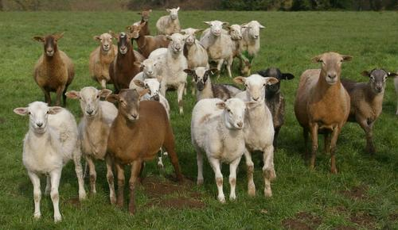
b
a
a
b

Slide 8
a

Slide 9
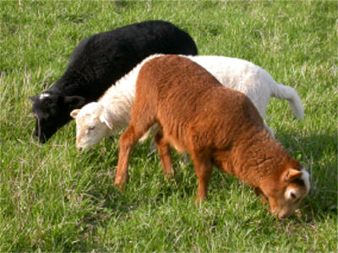

Slide 10
Conclusions
Both suckling and supplementation independently improve growth performance of pasture-raised lambs.
-Gain per period
-Final weights
Continuous suckling improved the overall ADG of lambs.

Slide 12
Further Research
We will be starting a repeat of this trial this spring.
Some of the supplements will be provided.
If interested please contact Stephanie.
Stephanie Simpson
Email:slsimpson@hsc.wvu.edu
Phone: 304-680-4121

