Slide 1

Montgomery County Farm to Community Planning Project
Blacksburg Farmers Market

Slide 2
Producer
Venue
Consumer

Slide 3
Venues
Phone Interviews
In-Person Interviews

Slide 4
Who we talked to
7 Major Grocery
5 Small Grocery
26 Convenience 4 Dollar Store

Slide 5
Where they are located
 | Blacksburg | Christiansburg | Elliston | Pilot | Shawsville | Total
Major Grocery | 3 | 4 | 0 | 0 | 0 | 7
Small Grocery | 4 | 0 | 0 | 0 | 1 | 5
Convenience Store | 10 | 9 | 4 | 1 | 2 | 26
Dollar Store | 2 | 1 | 0 | 0 | 1 | 4
Total | 19 | 14 | 4 | 1 | 4 | 42

Slide 6

What We Found
Major Grocery
Small Grocery
Convenience Store
Dollar Store

Slide 7
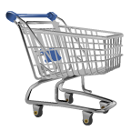
MAJOR GROCERY (7)
All surveyed accepted SNAP/EBT
None currently sold LOCAL
Not conceptually opposed to LOCAL
Internal ordering system/suppliers
Demand too high

Slide 8
What We Found
Major Grocery
Small Grocery
Convenience Store
Dollar Store

Slide 9
Small grocery (5)
All surveyed accepted SNAP/EBT
All currently sold LOCAL
3 Expressed Interest in Expanding
CHALLENGES
Inconsistent Supply (4)
Cost (3)
Quality during season change (1)

Slide 10
What We Found
Major Grocery
Small Grocery
Convenience Store
Dollar Store

Slide 11
Convenience store (26)
22 accepted SNAP/EBT
2 offered LOCAL fruits/vegetables, direct from farmers
5 expressed interest in switching to LOCAL
Challenges | Low Demand/ Spoilage | Unknown Source | Cost | Inapprop for Venue | Inconsistent Availability | Logistics | Quality | Ethnic Varieties Unavail.
Times Cited | 16 | 10 | 10 | 6 | 3 | 2 | 2 | 1

Slide 12
What We Found
Major Grocery
Small Grocery
Convenience Store
Dollar Store

Slide 13

Dollar Store (3)
2 accepted SNAP/EBT
None sold any produce
Price Structure
Storage

Slide 14
Common barriers
1. Demand Issues (Low and High)
2. Unable to find sources
3. Cost
4. Inconsistent availability
5. Inconsistent quality

Slide 15

CARDSTORMING
What are the issues?
What obstacles stand between venues and farmers?

Slide 16
Producer
Venue
Consumer

Slide 17
Producers
Online Survey
Focus Group
Structured Interviews
Notes:
Survey – 31, Focus Group – 6, Interviews - 3

Slide 18
Who We Talked To
Noncertified Organic
Conventional
2. Other
24 produce
19 poultry for meat/eggs
13 livestock
13 value-added
2 dairy
33 TOTAL
Acreage
Annual Sales

Slide 19
What We Found
LAND
TRANSPORT
LABOR
MKTG
Barriers
to
Expansion

Slide 20
What We Found
Local Buyers to Whom They’d Like to Sell
Unable to Produce Adequate Quantity
Marketing Issues
Unable to Sell at Right Price
Unable to Find Info about Local Buyers
Barriers to Doing So

Slide 21
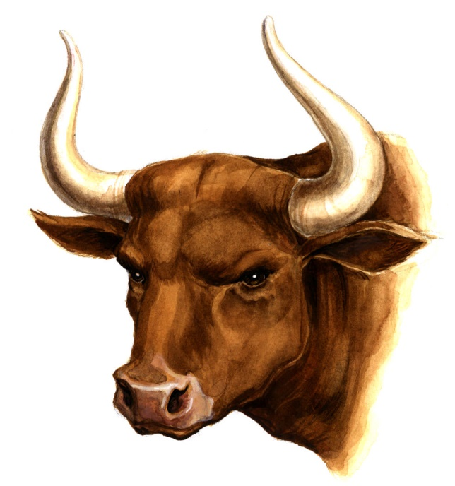
By farm sector: livestock (13)
Sell to
Direct Markets
Restaurants + F2I
Challenges
Price + Quantity
Expansion Challenges
Land + Labor
Transport + MKTG
Training Needed
  Lending + Biz Plan

Slide 22
By farm sector: Poultry (19)
Sell to
Direct Markets
Restaurants + F2I
Challenges
Price + Quantity
Expansion Challenges
Land
Labor + Storage
Training Needed
  Biz Plan
  Lending

Slide 23
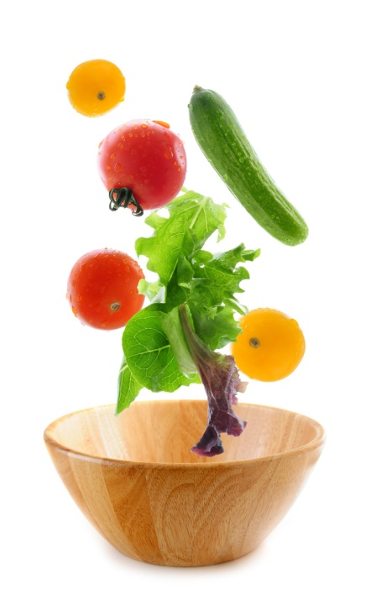
By farm sector: PRODUCE (24)
Sell to
Direct Markets
Restaurants + F2I
Challenges
Price + Quantity
Expansion Challenges
Labor
Transport, Land
Training Needed
  Biz Plan + MKTG

Slide 24
By farm sector: DAIRY (2)
Sell to
Everybody
Challenges
MKTG + Demand
Expansion Challenges
MKTG + Demand
Packaging/Labeling
Training Needed
  Lending

Slide 25
By farm sector: VALUE-ADDED (13)
Sell to
Direct Markets
Everybody Else
Challenges
Quantity
Price + MKTG
Expansion Challenges
Transport
Land, Labor, MKTG
Training Needed
  MKTG, Lending
  Biz Plan

Slide 26
CARDSTORMING
What are the issues?
What obstacles stand between farmers and success?

Slide 27
Producer
Venue
Consumer

Slide 28
Consumers
In-Person Survey
Focus Group
Structured Interviews

Slide 29
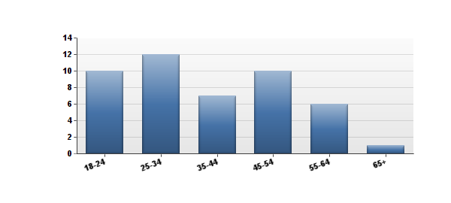
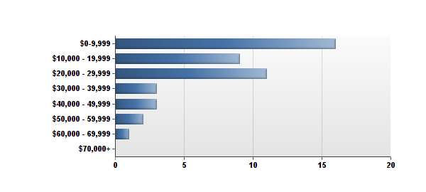
Who We Talked To
Age
Income
Christiansburg (13), Blacksburg (10), Allegheny Springs (2), Belview (2), Belmont (2), Floyd (2), Merrimac (2), Plum Creek (2), Radford (2), Riner (2),Elliston (1), Giles County (1), Longshop (1), Pulaski County (1), Roanoke (1), Salem (1), Shawsville (1)

Slide 30
Food procurement habits
First Shopping Choice
Major Grocery (40)
Roadside Stands (5)
Dollar Stores/Markets (2)
Farmers Markets (1)
Grow at Home/Community Garden (1)
Second Shopping Choice
Major Grocery (18)
Small Grocery (4)
Roadside Stands (3)
Grow at Home/Community Garden (3)
Food Pantry (2)
Dollar Stores/Markets (2)
Farmers Markets (2)
Convenience Store (1)

Slide 31

Why do they shop there?
Convenience (12)
Quality (10)
Price (7)
Proximity (5)
Can’t Grow at Home (5)
Health Concerns Over Safety of Food (4)

Slide 32
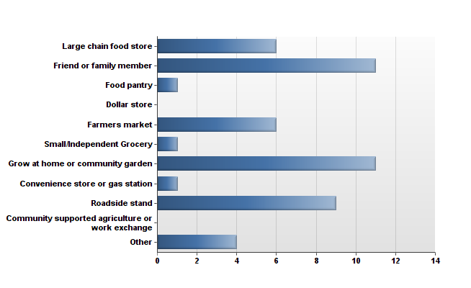
Where they obtain local food
76%

Slide 33
opinions
98% strongly agreed or agree at farming could help Montgomery County’s economy
91% strongly agreed or agreed that it’s important that their food is not sprayed with chemicals
84% strongly agreed or agreed that local foods are of better quality than other foods

Slide 34
WHAT ABOUT THAT AG HERITAGE?
68% Said farming or growing their own food was a part of their family history
¾ Know how to grow their own food
¾ Think a community garden in their neighborhood would help them eat more fresh f/v
½ Didn’t have enough info on how to participate

Slide 35
What about that ag heritage?
87% Think a farmers market in their neighborhood would help them eat more fresh f/v
½ Didn’t have enough information on where and when they occur
8 participants were interested in starting their own food based business

Slide 36

Bburg farmers market double value
69% Were not aware BFM took SNAP/EBT
85% Didn’t know we doubled it

Slide 37
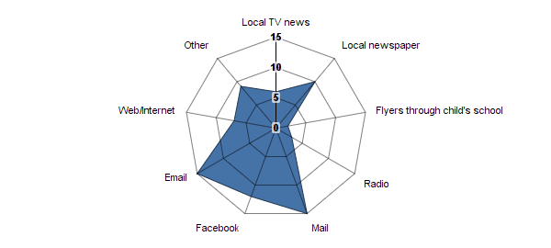
How to reach them

Slide 38
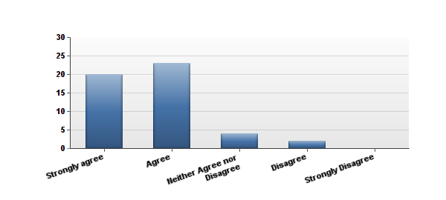
Other facts
54%
Cook with fresh f/v for half their meals
“I know how to cook with fresh f/v.”
94%
Finding own transportation was easy

Slide 39

Other insights from the interviews
Instability keeps people from putting down roots
Move often and rent
Food prices are out of reach, even in grocery stores
Geographic reach of FMs poor

Slide 40
CARDSTORMING
What are the issues?
What obstacles stand between consumers and local produce?

Slide 41
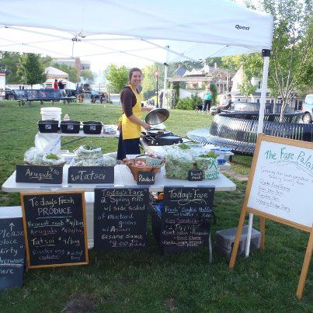
LUNCH!
The Fare Palate

