Slide 1
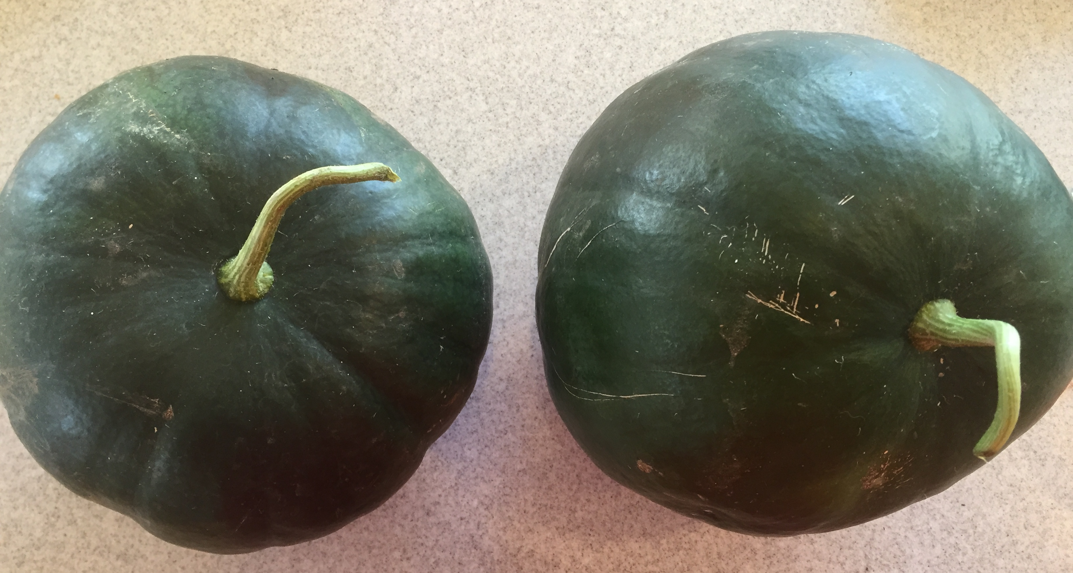
Grafting Watermelons and other Cucurbits.
Presented by Rob Brown, Grower & Owner, Flattop farm
www.flattopfarmak.wordpress.com Flattop Farm
This material is based upon work that is supported by the National Institute of Food and Agriculture, U.S. Department of Agriculture, under award number 2016-38640-25383 through the Western Sustainable Agriculture Research and Education program under subaward number 200592-402. USDA is an equal opportunity employer and service provider.”

Slide 2
What is grafting?
Grafting is a technique where tissue from one plant is combined with another by aligning their vascular pathways so that they heal together. In typical vegetable grafting, one plant acts as the roots and one or more as the shoots.
It can be natural or human made
It is estimated that Europe produces around 100 million grafted tomatoes per year. Asia produces over 1 billion grafted vegetables per year!
With watermelons, the three most commonly employed grafting techniques are Hole Insertion, One Cotyledon, and Tongue Approach. Today we will be discussing Hole Insertion
Notes:
- Grafting by humans can be traced back as far as 3000 years by people in central Asia. Some say even more.
-In the United States, grafted vegetables have been utilized widely by growers for the past 5 years or so as new regulations go into effect for treating soil for commercial growers, and home gardeners are discovering their benefits as retail garden centers begin to make them available.
-Who has tried grafting? Anyone tried grafting watermelons? Success?

Slide 3
Vascular Pathways - Grafting is a technique where tissue from one plant is combined with another by aligning their vascular pathways so that they heal together.
Notes:
-Xylem and phloem are the conducting elements of vascular plants. They function in the transport of water, nutrients, sugars, proteins and RNA throughout the plant. The xylem and phloem are generally found together in vascular bundles and can lie in various positions relative to each other.
-While we can not always perfectly line up these tissues, that is exactly what we are going for in grafting. Think of it like connecting water pipes.

Slide 4
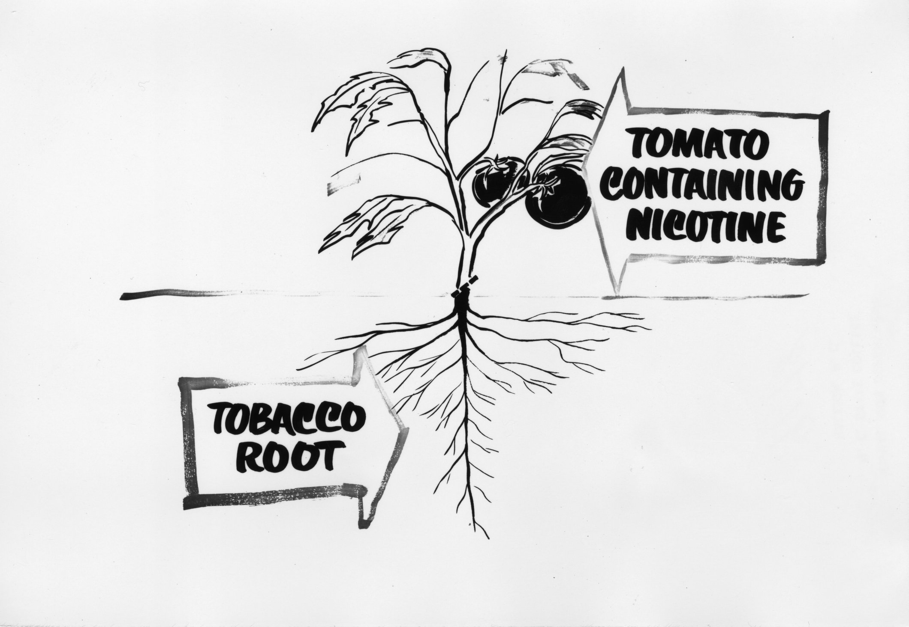
Definitions
Rootstock – the plant that functions as the root system and receives the scion
Scion – the plant that will function as the top or shoot.
Callus – the hardened tissue that forms over a wound and at the graft site.
Notes:
- All commercially available rootstocks are hybrids. Also known as stock.
- Prolific callusing helps graft union success. Root and shoot differentiation occurs from callus

Slide 5
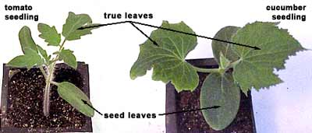
Definitions
Cotyledons or Seed Leaves
True Leaves – The leaves that appear after the cotyledons and are the first leaves that have vascular tissue.
Hypocotyl – the segment of stem between the cotyledons and the soil surface
Hypocotyl
Notes:
Cotyledons - embryonic leaves that appear after a seed germinates. These are not considered “true leaves”

Slide 6
Advantages of grafting
Resistance to soilborne disease and insect pressure
‘Flexifort’ Highly resistant to Fusarium Cucumber wilt, Melon wilt, crown and root (Fusarium oxysporum f.sp. Cucumerinum, meloni, Radicis-cucumerinum)
‘Tetsukabuto’ – Highly resistant to Verticillium, Fusarium Cucumber wilt, Melon wilt, crown and root (Fusarium oxysporum f.sp. Cucumerinum, meloni, Radicis-cucumerinum),
Notes:
In Alaska, soilborne disease is not as much of a concern as more temperate areas, though the rapidly increasing number of high tunnel growers in the state may potentiate soilborne diseases due to limited space for crop rotation. It’s estimated that there are at least 600 high tunnels in the state of Alaska. Most are not moveable and the growing of the same crops in a space that doesn’t have a solid crop rotation plan can allow disease buildup. Using disease resistant rootstocks becomes important if production is to continue in the presence of disease. In Europe, this is the prime motivation for grafting.

Slide 7
Advantages of grafting
Taking cold-tolerant, short season scion varieties and pairing with a more cold tolerant and more vigorous rootstock could be a way of “bridging the gap” between cooler Alaskan soil temperatures and the ideal range of soil temperatures for watermelon. This could allow for earlier planting and enable a better chance of ripening at the end of the season.
Paired with high tunnels and soil warming methods, production opportunities can be maximized and possibly avoid the need for heating the growing space to ripen fruits, saving energy and money.
Notes:
Lycopene content studies have shown no negative effect on lycopene content and some pairings of rootstock/scion have been shown to actually produce more lycopene when plants are grafted.

Slide 8
Advantages of grafting
Successful pairing of rootstock with scion accompanied by proper growing habits and environment can extend harvest season and increase yield. In watermelons, it has been shown to increase rind thickness, which can extend storage time and time left in field.
Notes:
- Larger root system means more water and nutrient uptake – in 2015 & 2016, it appeared grafted varieties had much larger plants, earlier ripening, larger fruit, more harvestable fruit, and much larger root systems than non grafted. We are taking the next two years to evaluate most of these observations and see if there is scientific merit to them.
- Combined, all of these factors should increase production, but you still have to grow it correctly and ensure pollination. It is common practice to supplement commercial watermelon production with European honeybees. In high tunnels, bumblebees may be an effective alternative pollinator.

Slide 9
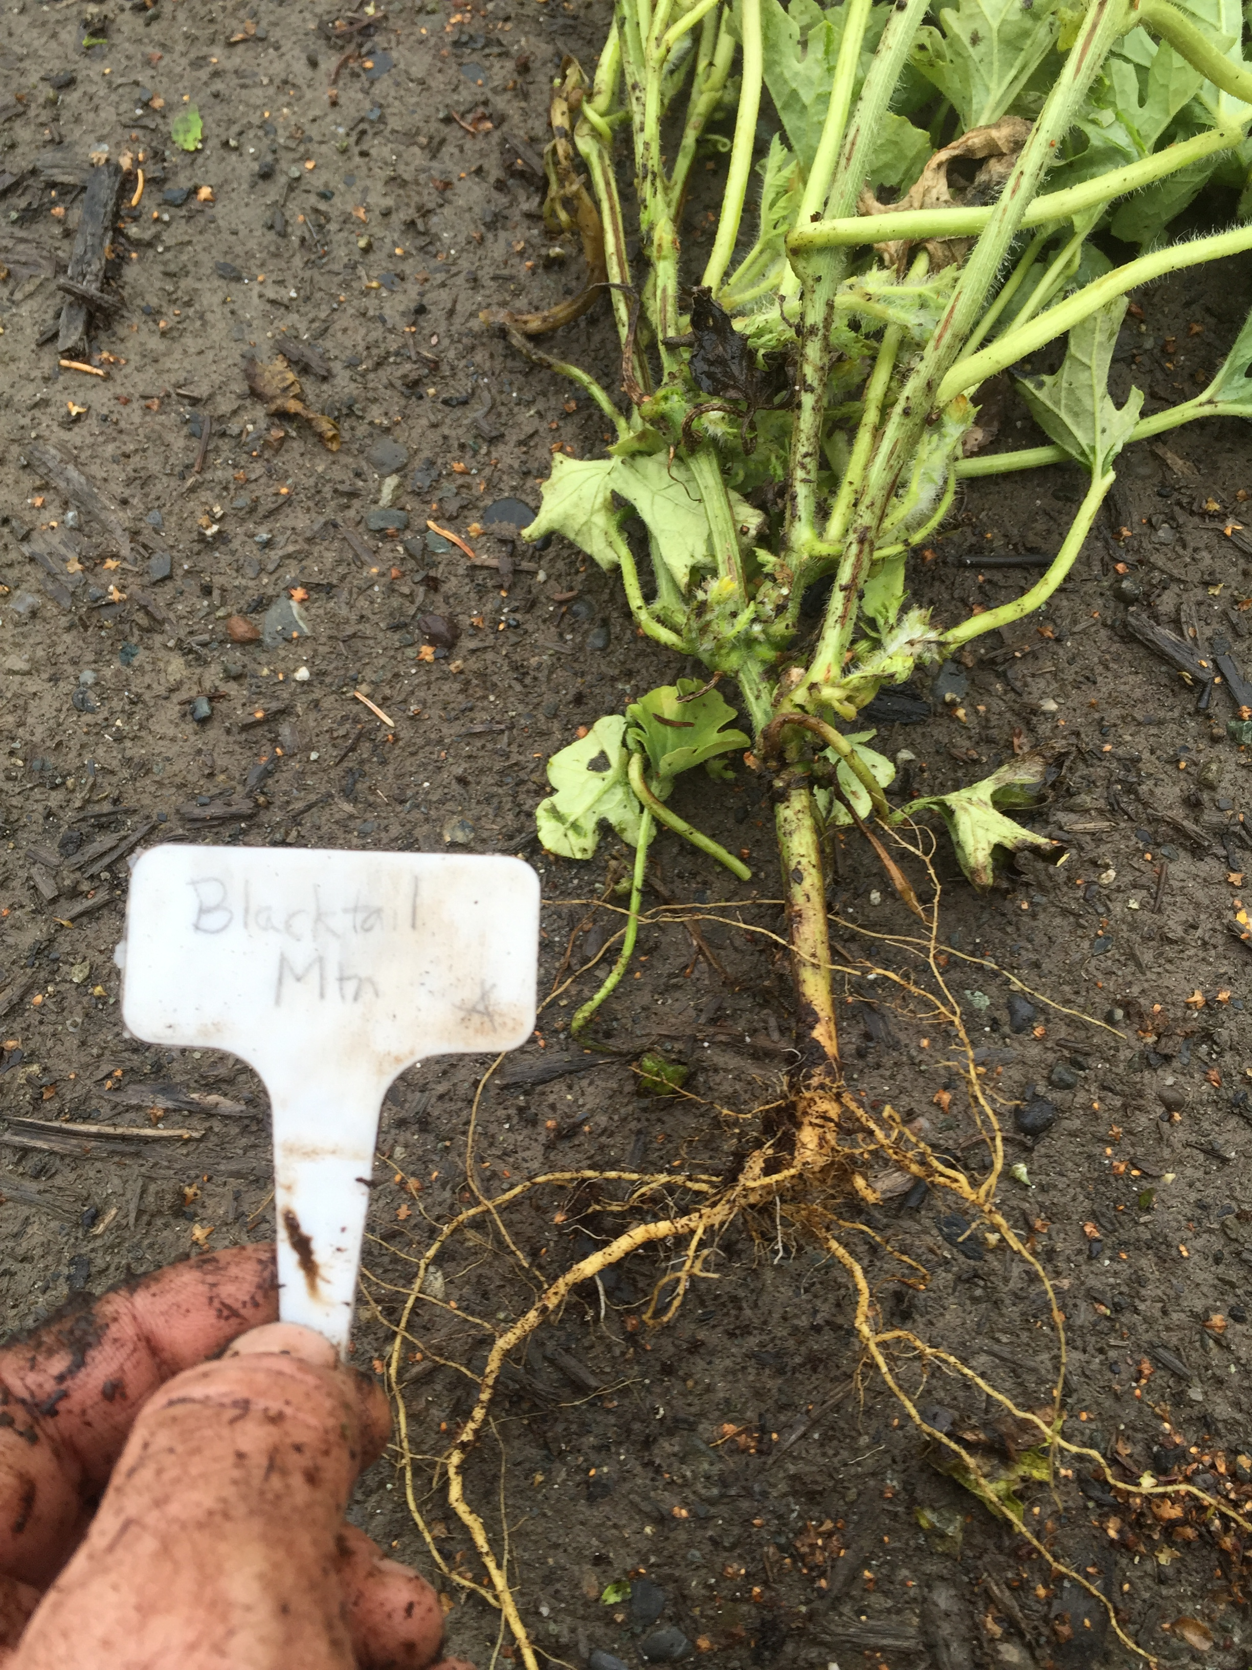
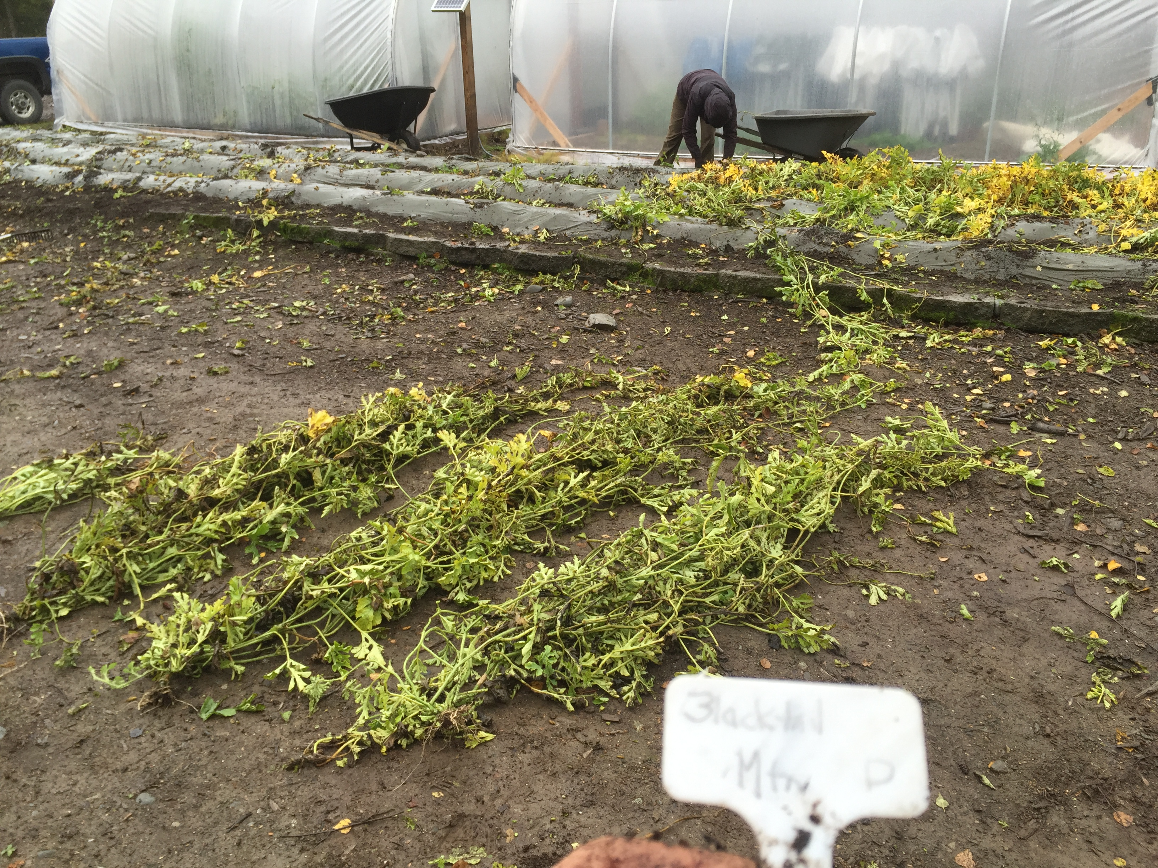
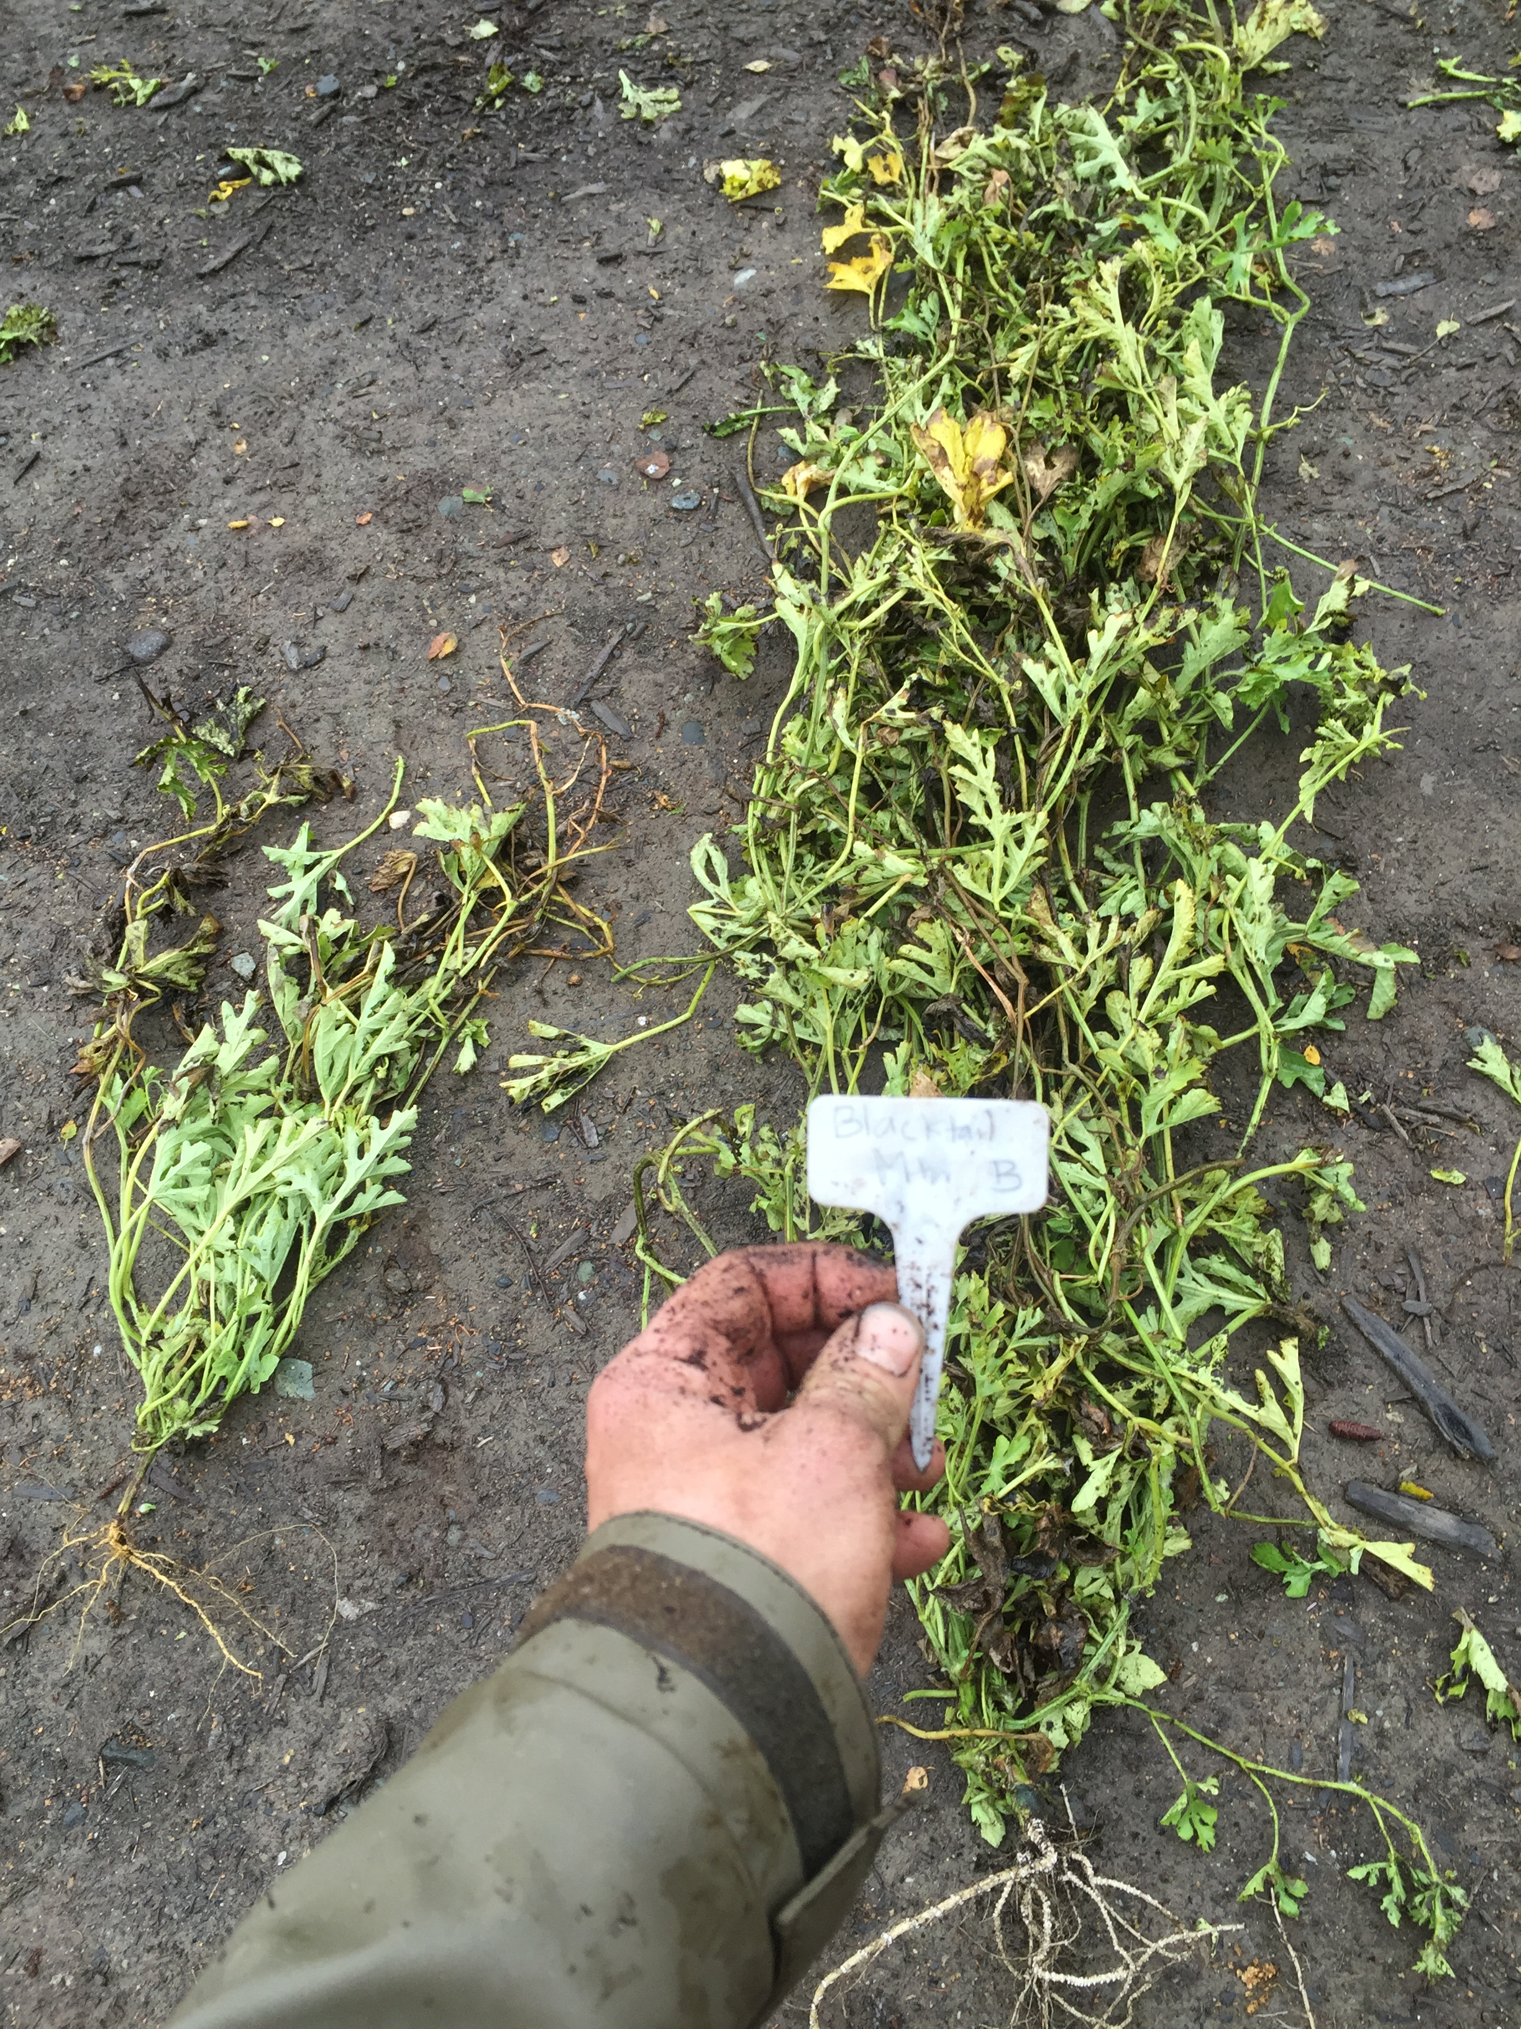
Outdoor Grown using IRT olive plastic.
Blacktail Mtn. grafted with Flexifort rootstock on right. Non Grafted Blacktail Mtn. on left. Seed for scion and NG sown on same day.
Non Grafted Blacktail Mtn.
The right two are Blacktail Mtn. grafted with Tetsukabuto rootstock. To the left are Flexifort and Non grafted.

Slide 10
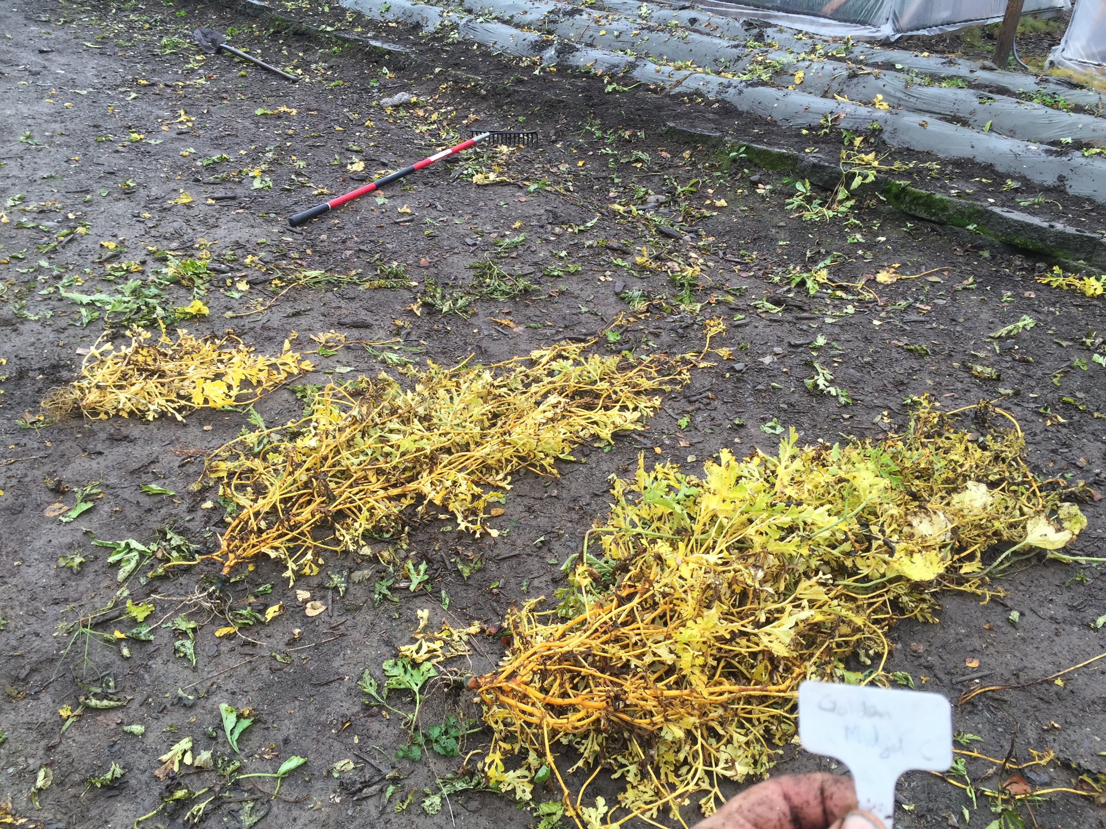
Left to Right: Non Grafted, Flexifort, Shintosa rootstock grafted to Golden Midget Watermelon Harvested 9/16/16. Note the amount of branching.
Graft Union of Golden Midget Watermelon grafted to Shintosa rootstock.

Slide 11
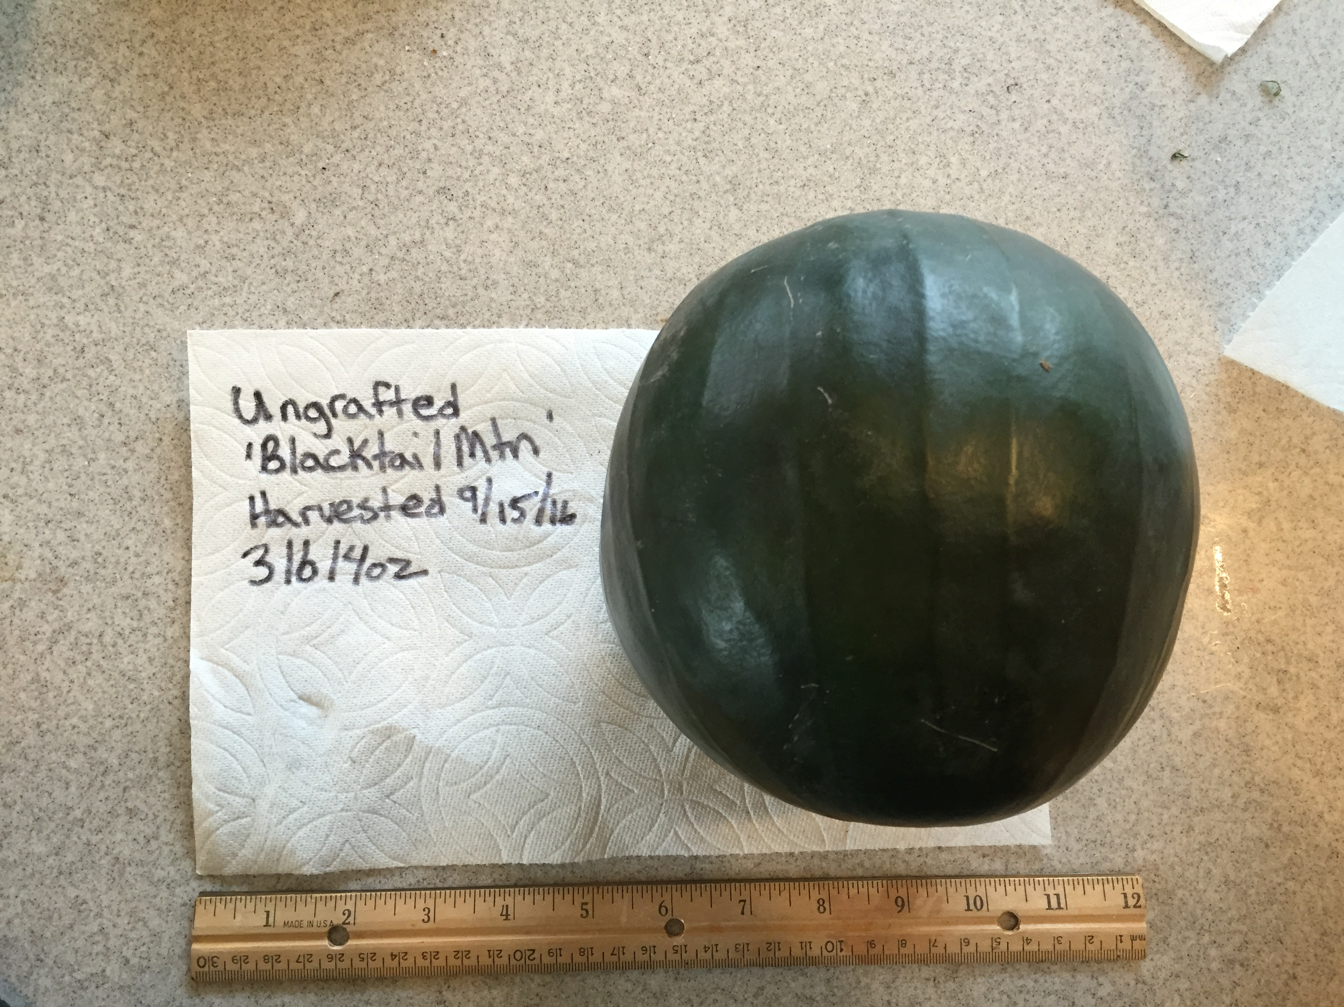
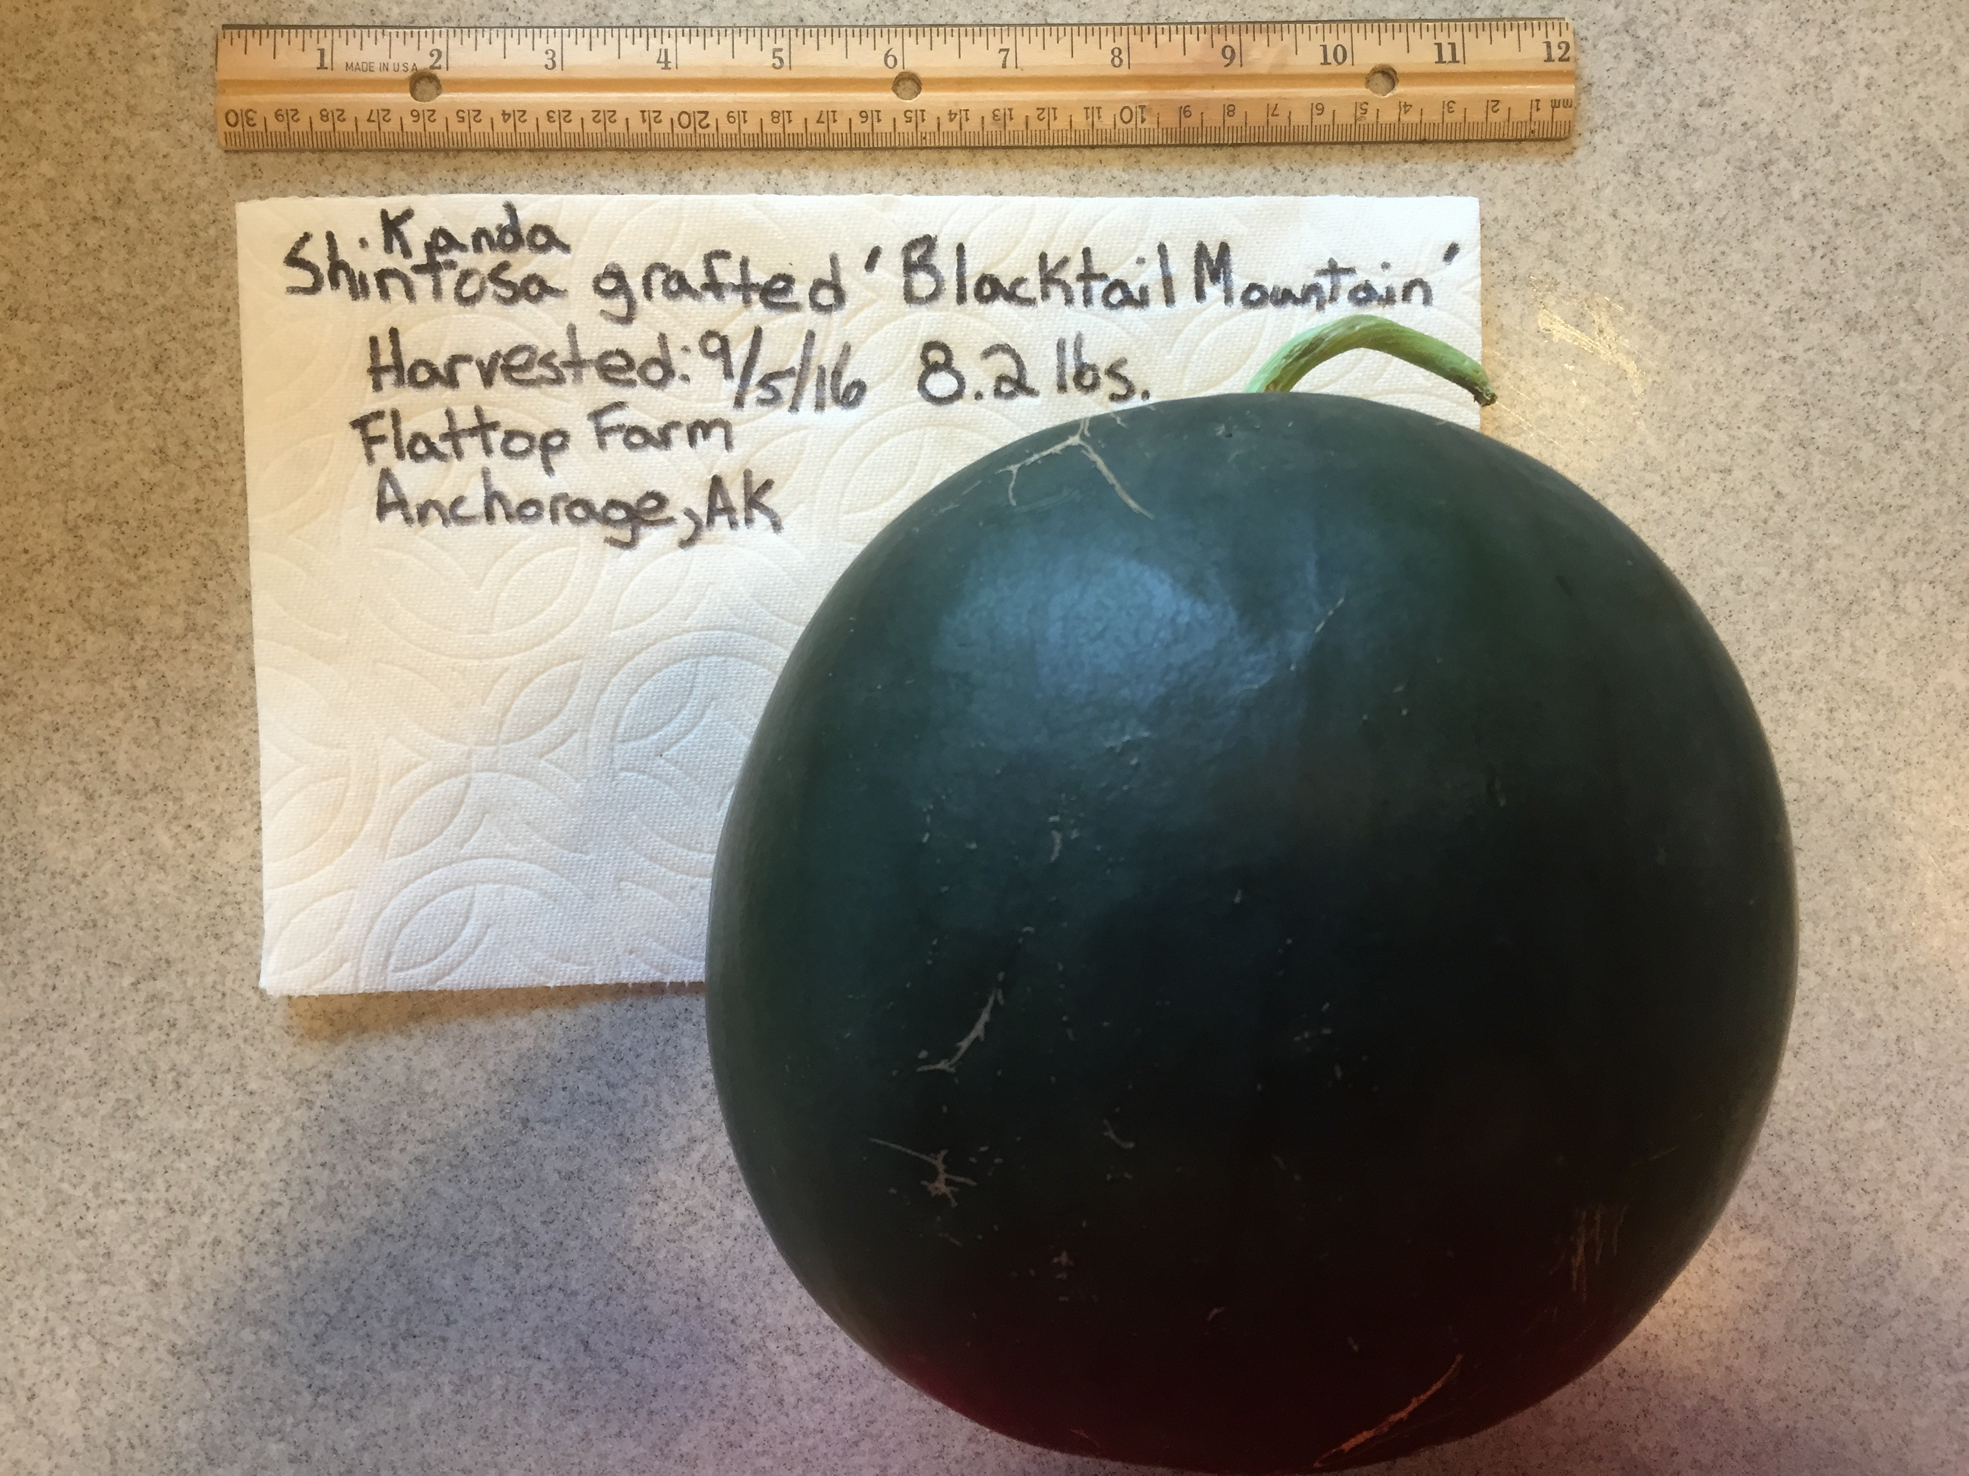
High Tunnel grown Blacktail Mountain Watermelon

Slide 12
Potential pitfalls in grafting watermelons
Cost – If not grafted on-farm, plants must be purchased. In Alaska, there are few economically viable routes to purchase grafted plants. Rootstock seed costs about $0.15 each. Skilled labor for grafting, healing chamber, and growing environment all add to expenses.
Transplant success can be low due to disturbed roots. It is common knowledge that most melons do not like to have their roots disturbed. We have found it best to transplant no more than twice and it’s better to stick the new graft cutting in the final container size – I prefer 32 cell propagation trays if not transplanting and 72 cell trays to transplant to 3.5” tek squares. Allow plugs to fully root out before transplanting. Do not “tease” roots or otherwise disturb the rootball when planting.
Knowledge gap
Notes:
-Knowledge Gap - Consumer is often intimidated to learn about the processes as the necessary amount of information has not always been accessible. However, understanding the principles of grafting opens the door to many possible gardening and farming techniques and so education and research are very important. Many Cucurbits, including Cucumber, pumpkin, muskmelon, and squash can be grafted using the methods described in this presentation.

Slide 13
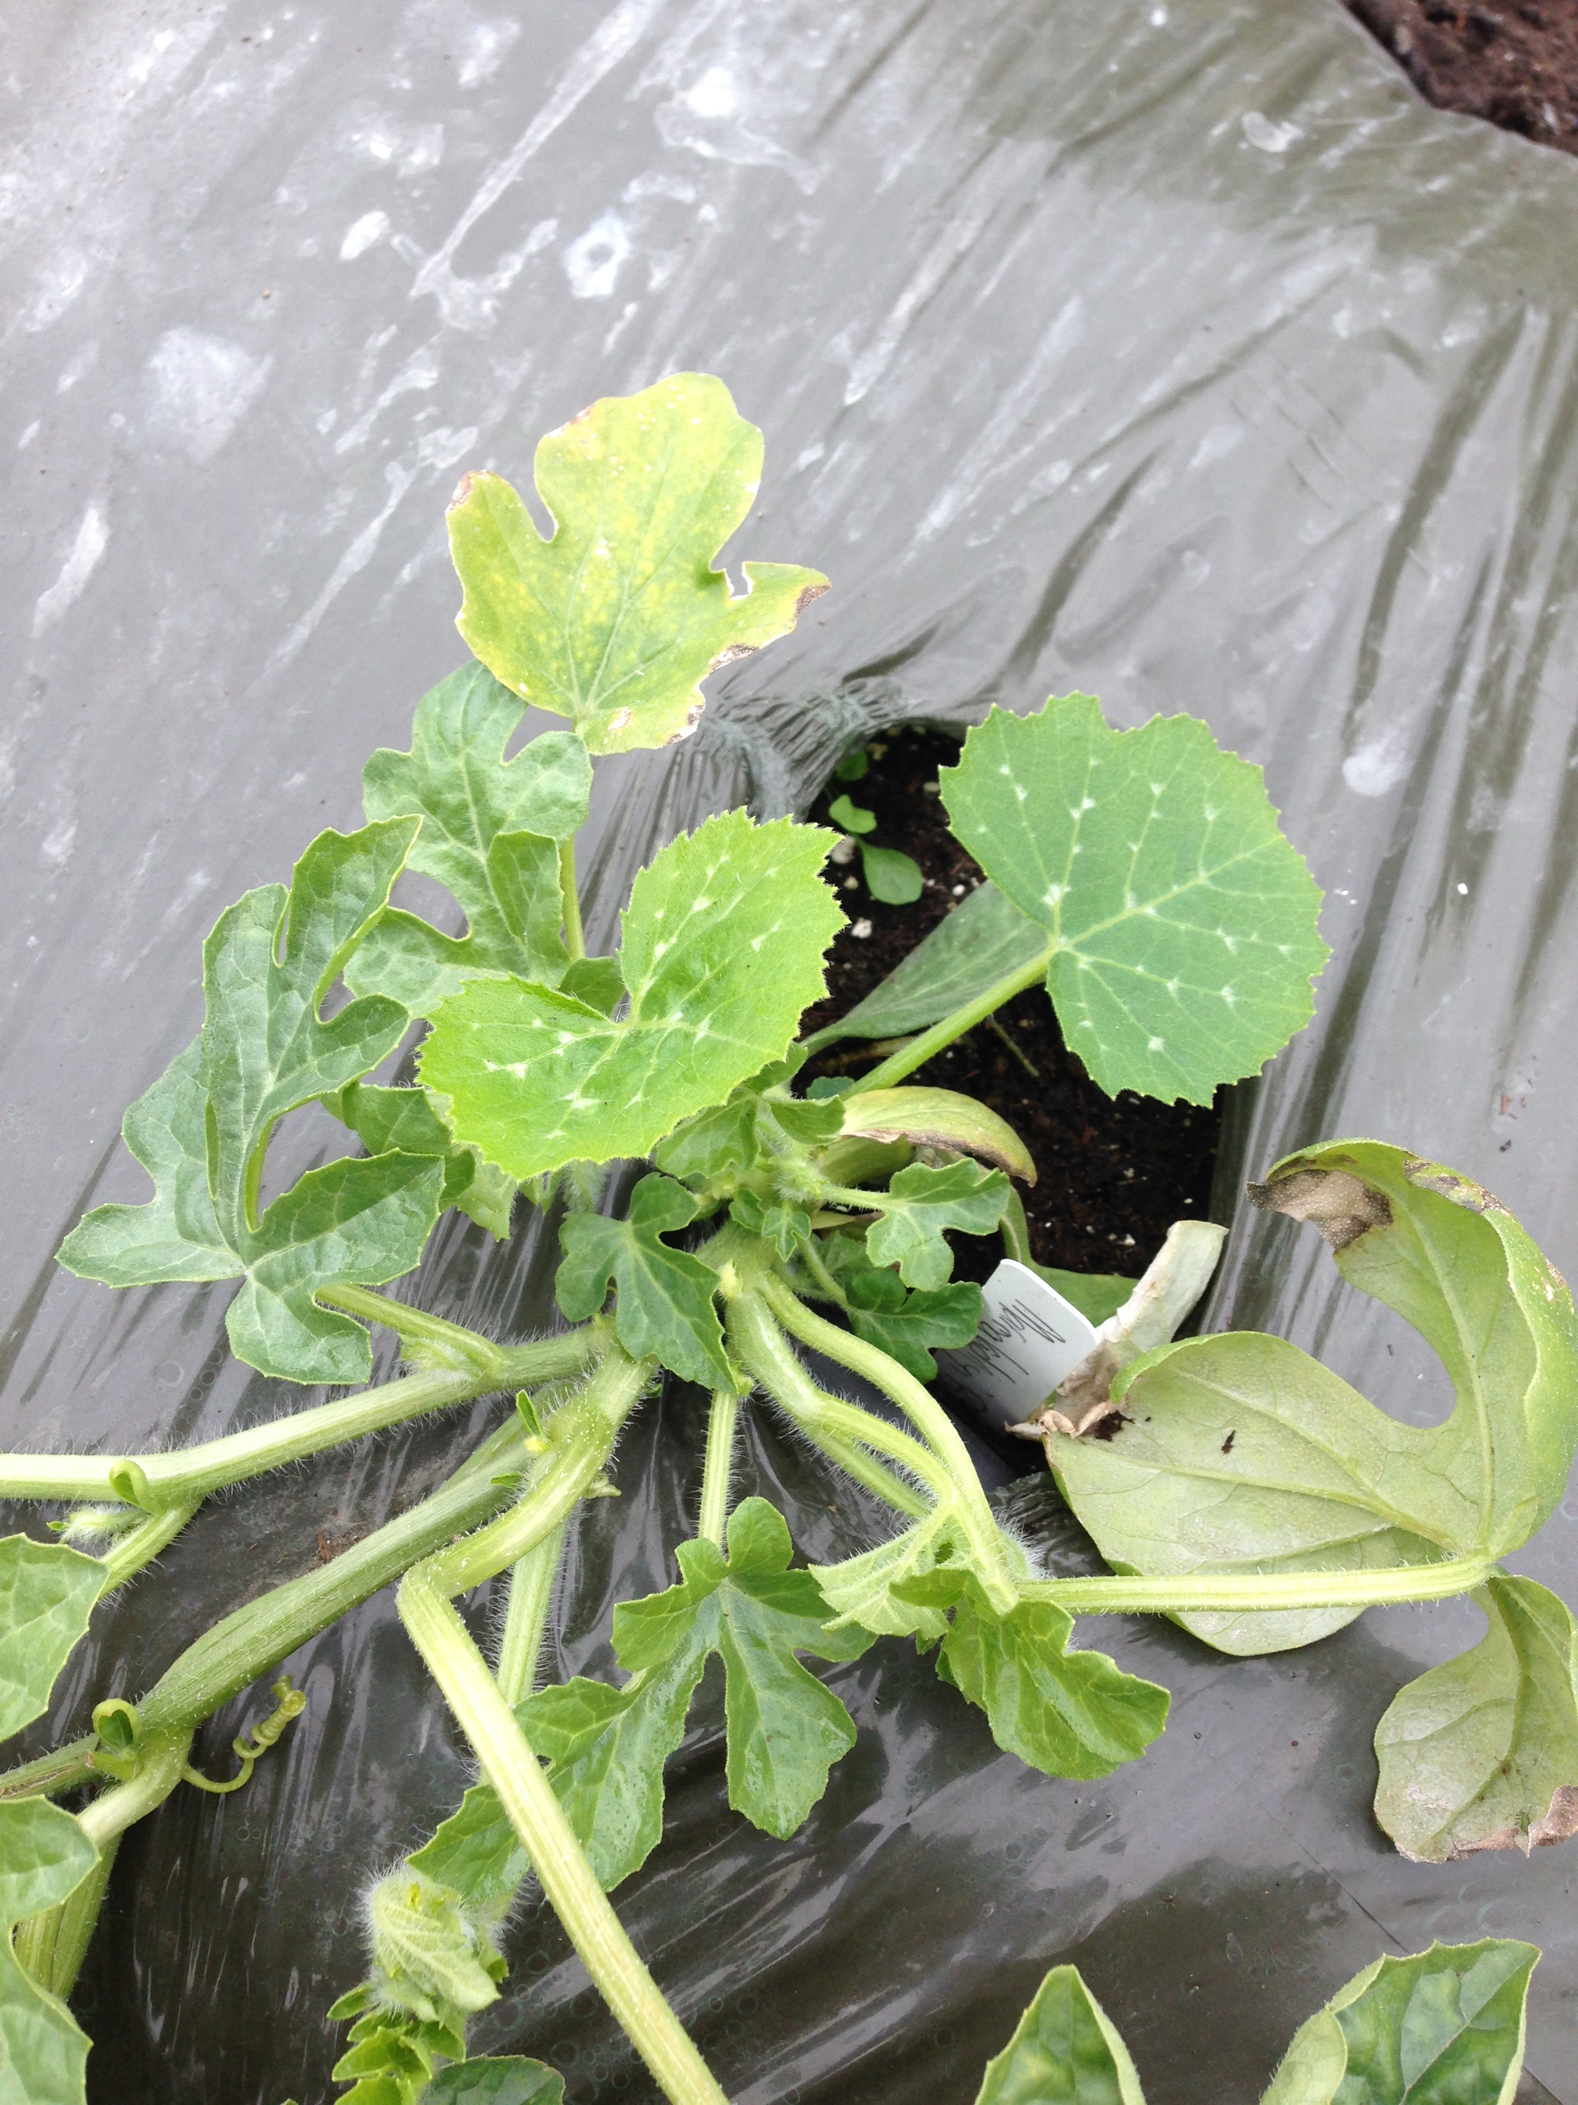
Potential pitfalls in grafting
Rootstock regrowth
Rootstock may regrow from cotyledonary buds and overtake the scion.
Commercial growers are using fatty alcohol solutions like FAIR 85®, Offshoot-T®, & Sucker Plucker® to prevent rootstock regrowth.
Notes:
-It is necessary to ensure full removal of buds at grafting time and to check several times throughout the season. Rootstock leaves are markedly different from scion leaves.
-Most commonly done in one cotyledon grafting. There is some evidence that use of fatty alcohols also increases carbohydrate content and could lead to improved production.

Slide 14
Process
Germination: Seedling heat mat, soilless potting media like Pro-Mix or a seedling mix, light source, container – I prefer starting in 72 cell plug trays. Give them space as their cotyledons are large.
I typically sow Scion seed 2-3 days before sowing rootstock seed. This is the preferred method when using Squash hybrid rootstocks as they are more aggressive growing than watermelon.

Slide 15
Germination
The rootstock seed I am evaluating are Winter Squash x Pumpkin hybrids = Cucurbita maxima (female parent) x Cucurbita moschata (male parent). They have been shown to thrive in cooler temperatures than watermelons, and positively influence the scion’s growth, vigor, and fruit production, among other things
Lagenaria, or Bottle Gourd, rootstock may have even more cold tolerance, though it does not have as much vigor and isn’t able to be used with multiple cucurbits.
Rootstock seeds are planted and germinated at 80-85F in sterile mix 2-3 days after scion seeds are planted.

Slide 16
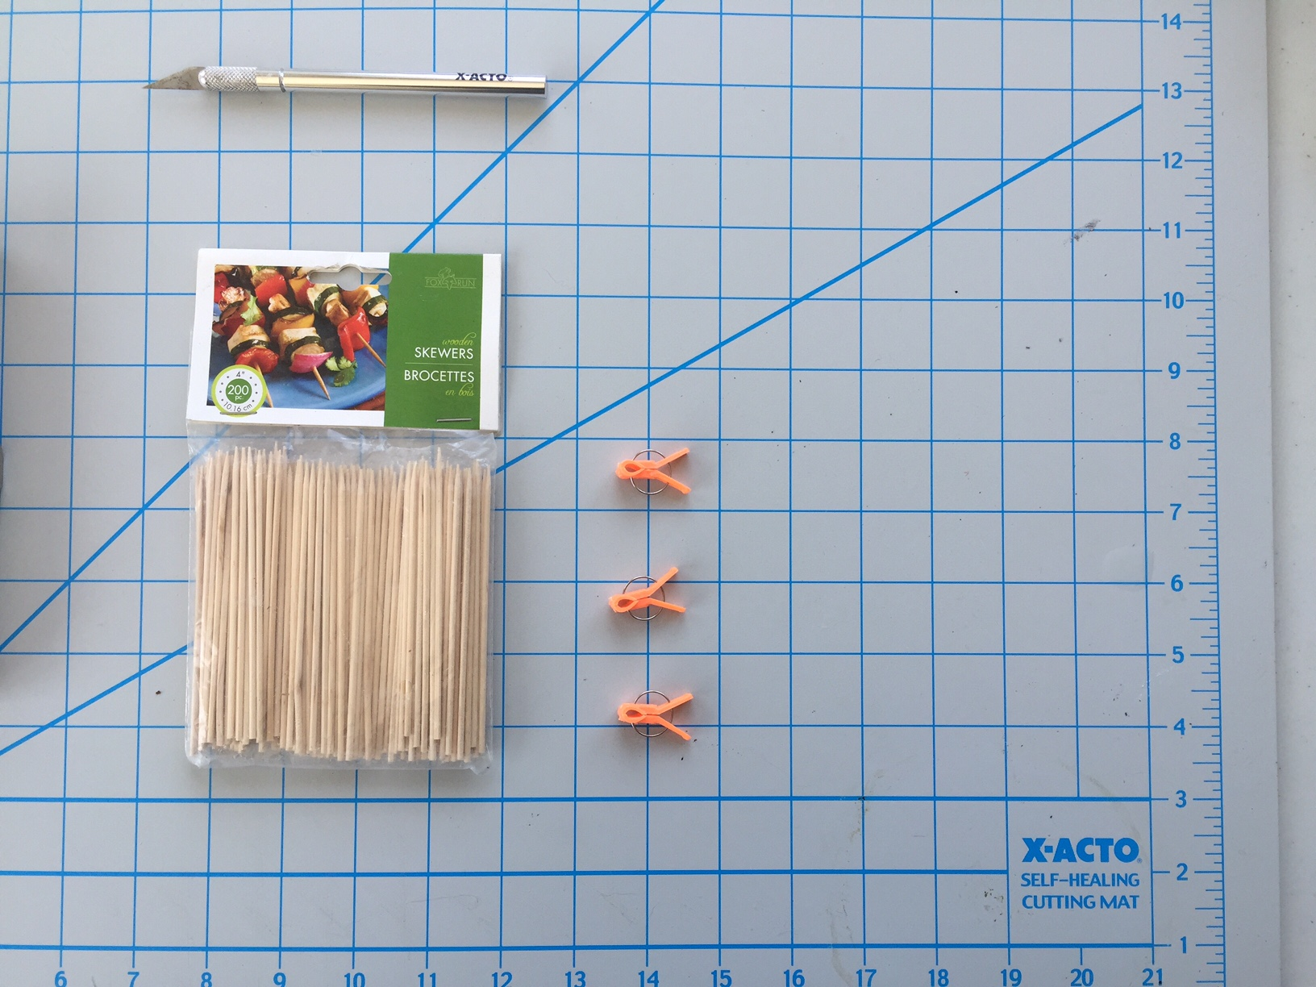
Grafting Equipment
Grafting – 70% Isopropyl (Rubbing) alcohol to sterilize tools and surface.
X-acto knife or surgical sharp knife that narrows to a point
Grafting clip used if stem splits and you think you can repair it
Spray mist bottle with clean water, good lighting, pencil and labels, self-healing pad for cutting on
Sharpened small wooden skewer is no more than 1.5 mm wide or a 1.4 mm drill bit
4” long skewer
Grafting clip

Slide 17
Grafting
Graft Timing is important!: Graft when rootstock’s 2nd true leaf is as big as a kernel of rice or slightly smaller.
Rootstock cutting is taken and allowed to wilt for 20-30 minutes. Stems are less firm than at cutting time but there is no actual wilt. Only cut 10-15 minutes of rootstock work at a time. If it is above 80F, use lower times.
Hypocotyl is cut so it’s long enough to stick the cutting 1.5”-2” deep in potting soil. Cutting should stand on it’s own when planted, but a grafting clip and bamboo skewer may be used as a stake occasionally.
Notes:
-You are allowing the cuttings to lose some stem turgidity so that poking the skewer through does not split the stem.

Slide 18
Grafting
Bamboo skewer or 1.4mm drill bit is inserted at a 45 degree angle from base of one cotyledon to just below the bottom of the other. Skewer is barely protruding through back,
Scion is prepared taking a 1+ inch cutting, trimming it a 45 degree angle, rotate the stem 90 degrees, and cut again at a 45 degree forming an oblique angle.
Remove skewer and insert scion with cut surfaces facing down
Try having the Scion hypocotyl be about the same width as the rootstock stem. Use fresh scions.
Cotyledonary buds of the rootstock are scooped out using knife
Bamboo Skewer
Rootstock Cotyledonary buds
Rootstock hypocotyl
Scion hypocotyl

Slide 19
Grafting
Completed graft is stuck as a cutting in potting soil and placed in healing chamber in total darkness at 75F-80F and 85-95% humidity for 2-3 days. Do not allow temperature to drop below 70F or humidity to drop below 85% during this time. Cooler temperatures and low humidity mean grafts take longer to heal and they may not make a successful union.

Slide 20
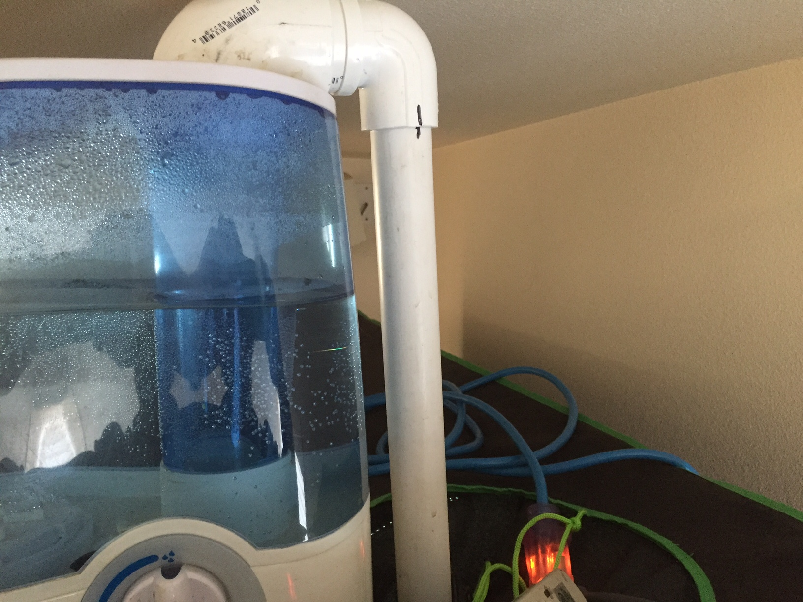
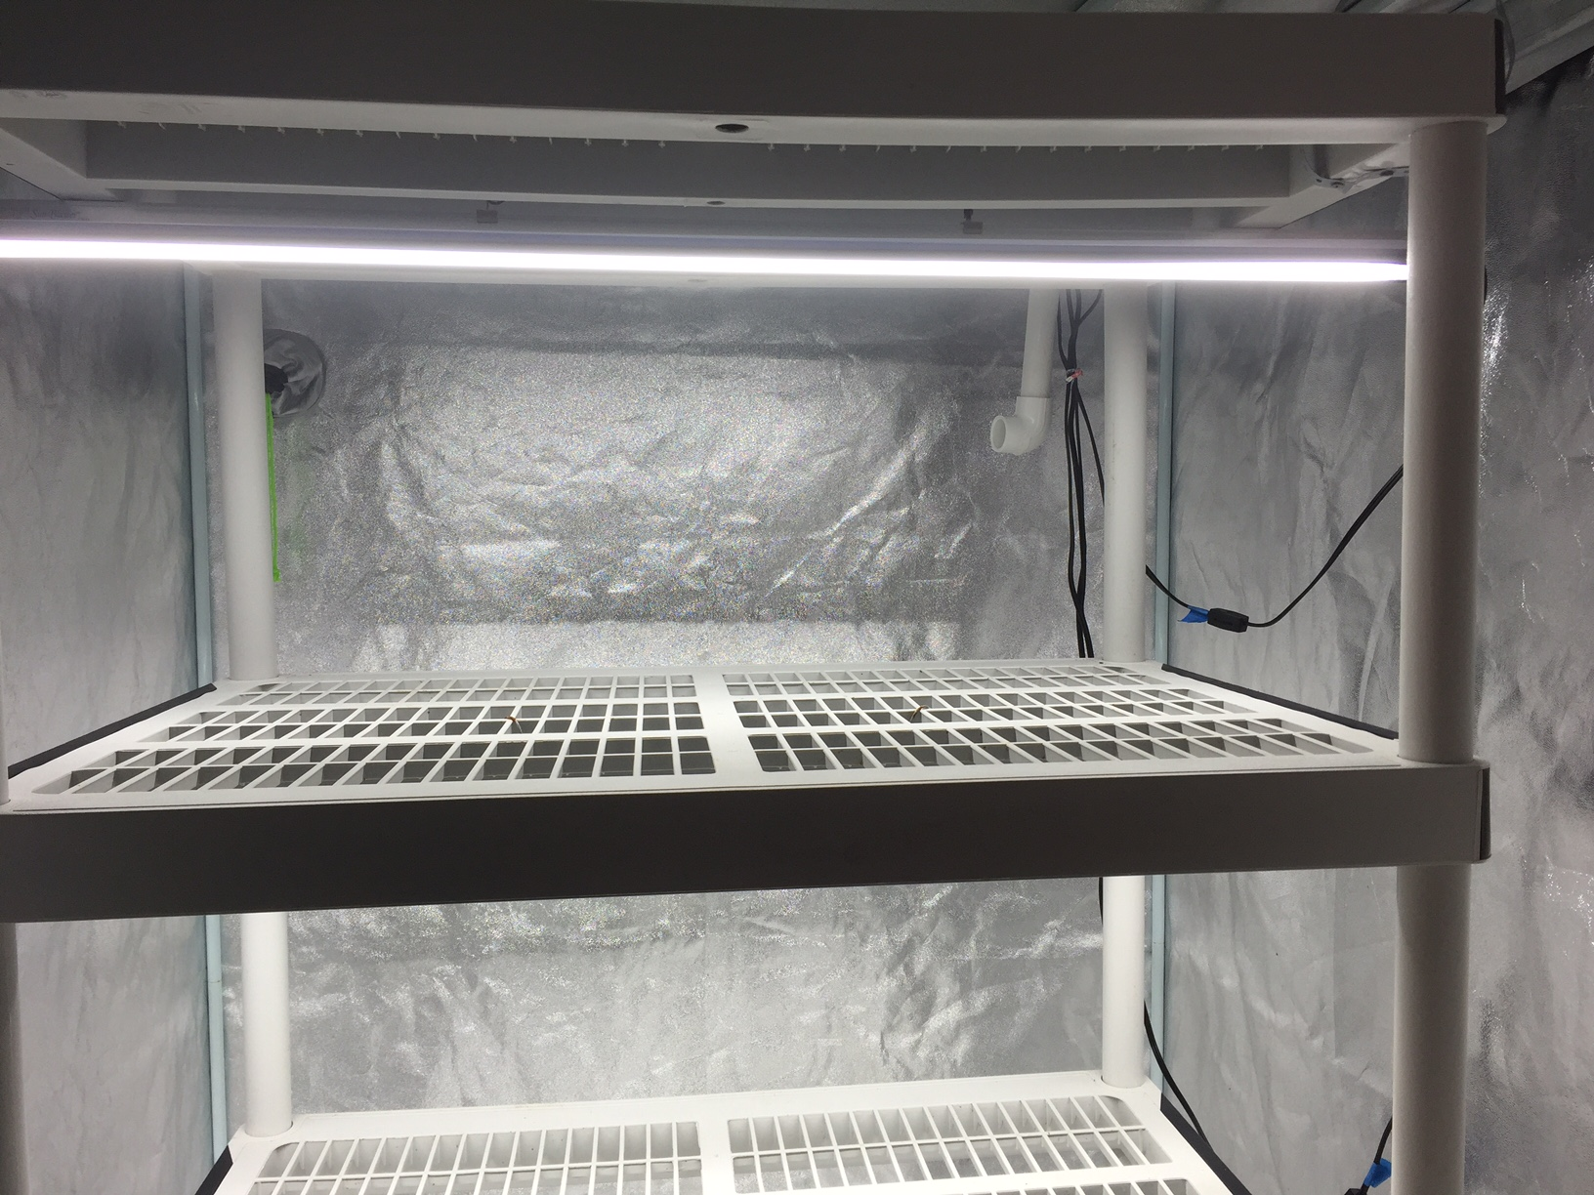
Process
Healing Chamber – Different ways to accomplish this. Constructing a chamber that can be used to hold a steady 85-95% humidity is necessary.
A grow tent or portable mini greenhouse with shelves and a modified humidifier work well. Opaque Rubbermaid-type storage containers inverted, and ½ of the lid filled with perlite and water and the plants sitting on top of that is a good solution (mist chamber with water frequently).
Dark Fabric/black plastic cover, Always have a Mist bottle handy, Heat source enough to keep the chamber at 75-80F constantly. Light source - T8 or T5 fluorescent. A seedling heat mat can help keep the temperature.
Humidistats with switches to turn on/off the humidifier are available
Keep chamber clean and as sterile as possible.

Slide 21
Healing Chamber
Day 1 in Healing Chamber - Keep humidity at 85-95%. It is beneficial to get everything set up and running and tested before you need it.
Keep temperature at 70 – 80F constantly for proper callousing and healing. Yes, 68F will slow down the process and allow for more complications. I shoot for 75F.
Get new grafts into healing chamber right after grafting. Give 48-72 hours of darkness. Check humidity and temp frequently – you may need to mist.
Day 3-4 in Healing Chamber – Introduce light – Keep T5’s minimum 1.5’ and T8’s 1’ at this point – Inspect several times for hard wilt and adjust distance to light.
Day 5-7 in Healing Chamber – gradually increase light. On day 7 start decreasing humidity. Slightly opening the healing chamber is a good way to start reducing humidity. Monitor plants frequently and increase humidity if needed. It

Slide 22
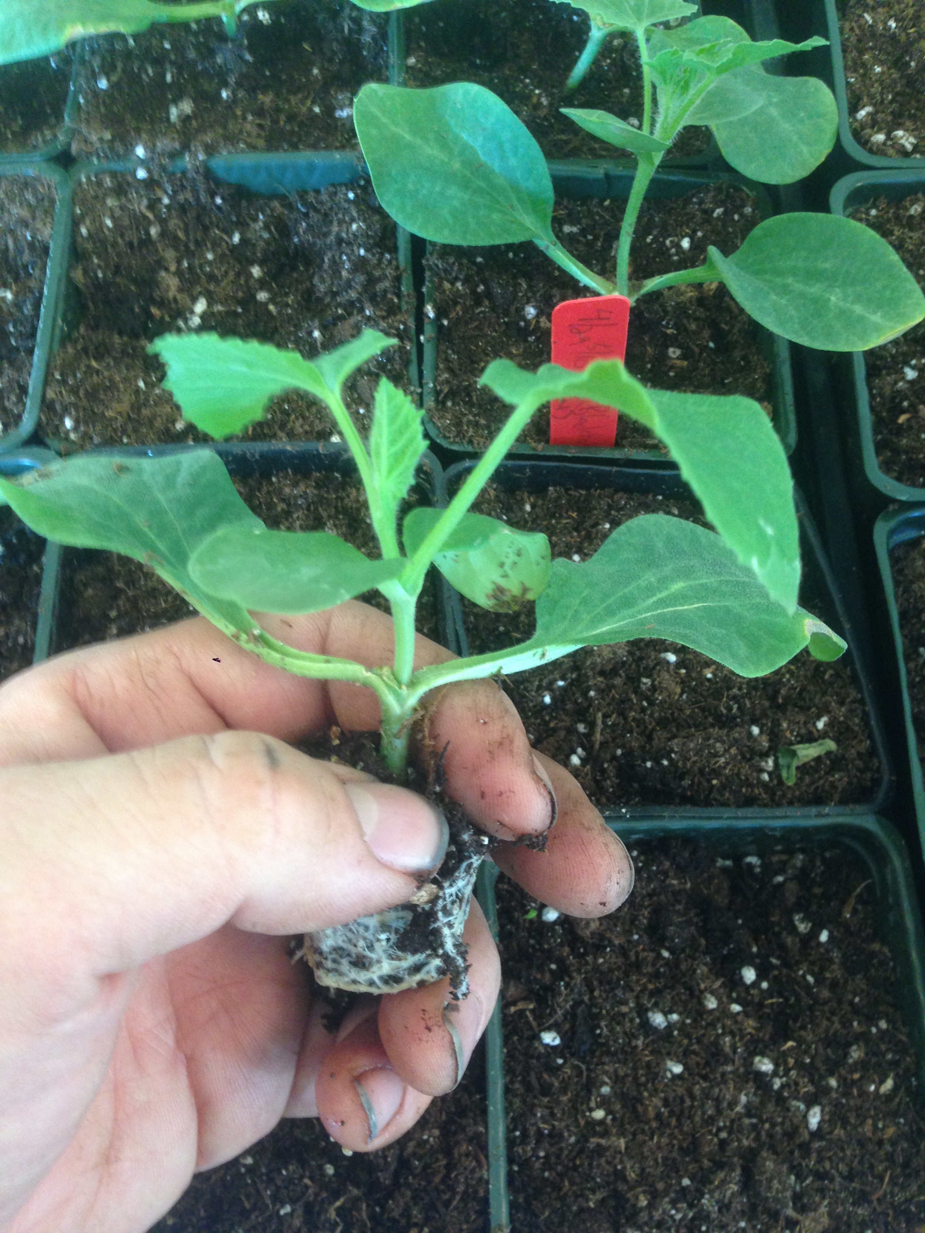
Healing Chamber
Day 7-10 in Healing Chamber – Continue reducing humidity by about 15% a day. Day 10 at the latest, they should be in normal humidity, but may still benefit from some shading. Some grafts may need watering during these days. Take care to water gently without disturbing the graft or water from the bottom.
Take out of Healing chamber and allow plug to root out in proper growing environment (greenhouse or under lights). Plants may need shading for a few days as they acclimate.

Slide 23
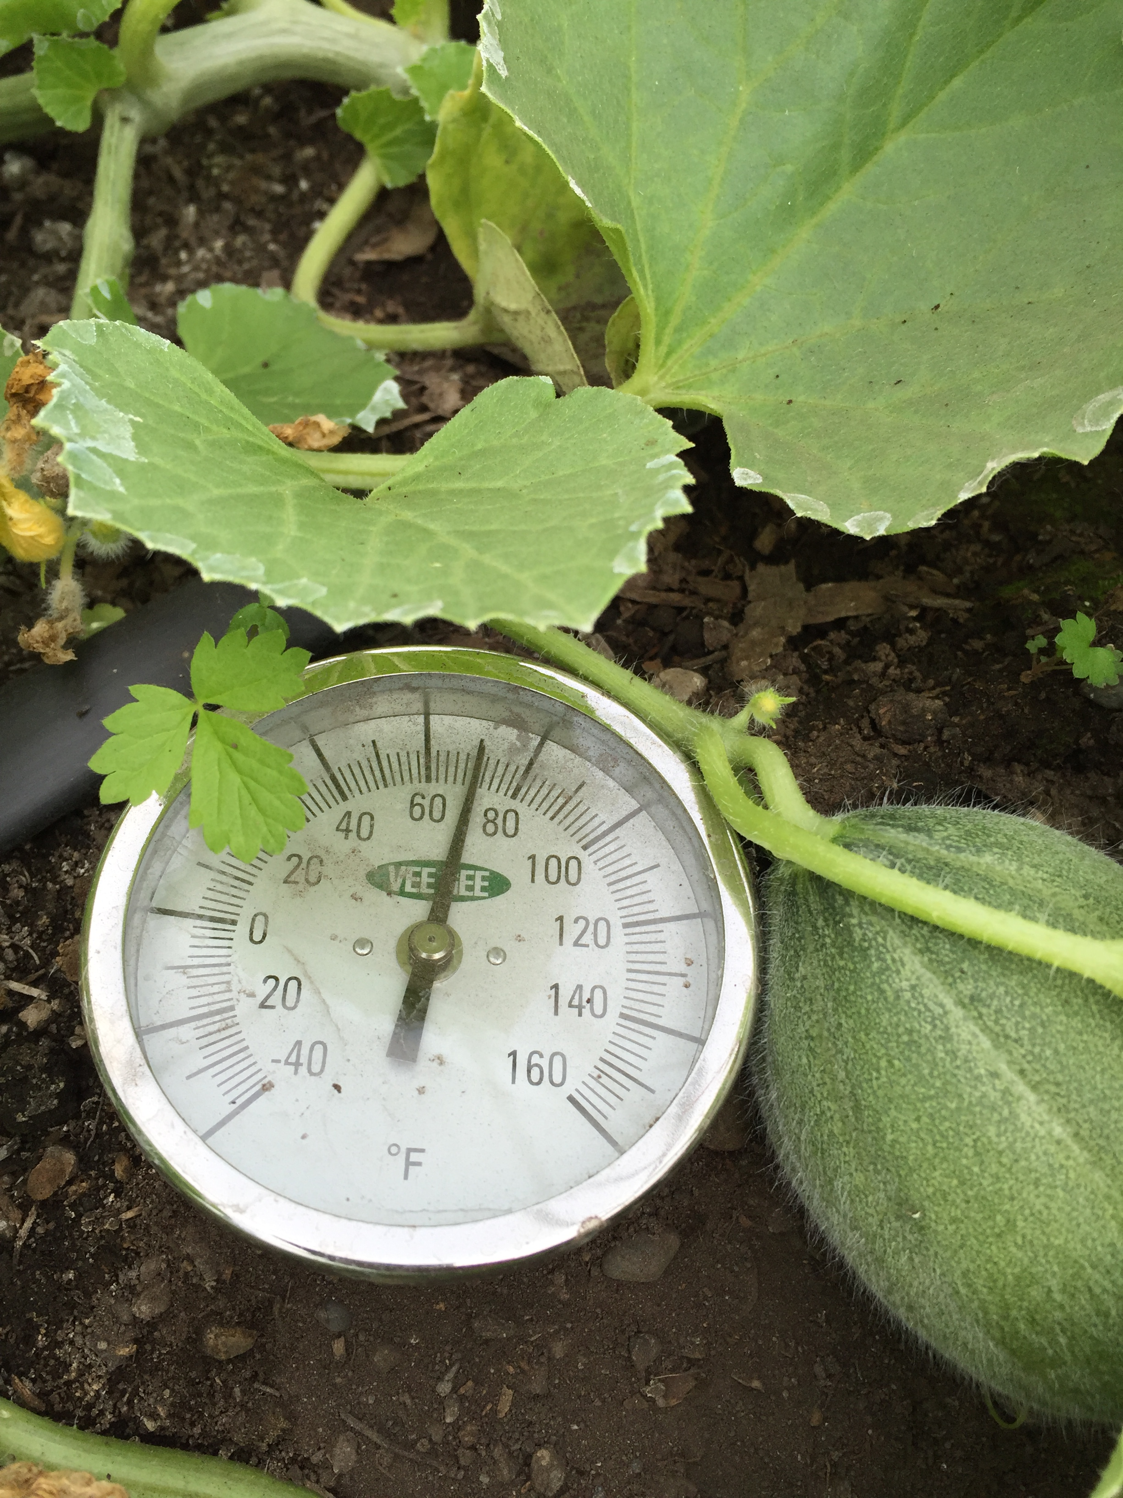
Planting out
Transplant, making sure to not disturb the graft union until it is sufficiently healed and the plant is rooted. NOTE: Do not disturb the roots or “tease” them when transplanting. Melons and watermelons can die with slight root damage. It may be advantageous to wait an extra week when transplanting.
Plugs may be transplanted into another container, though there is a risk of losing plants. I don’t recommend more than one pot change before plants are in final place.

Slide 24
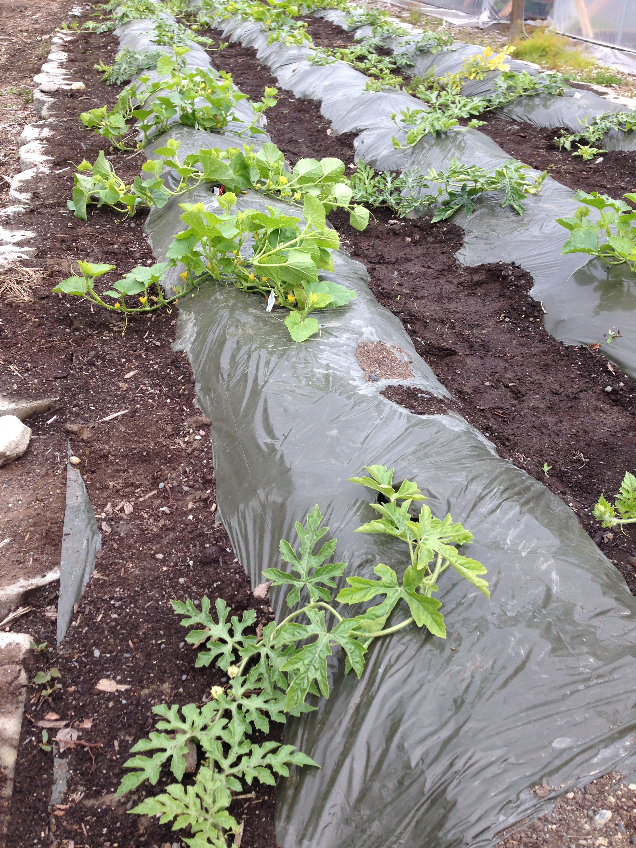
Planting Out
Plant in ground on mounds when soil temperature has reached 65. First Peony to flower is about the right time. Ideally, soil temperature stays at 70-80 degrees Farenheit.
Soil warming techniques such as using InfraRed Transmitting (IRT) plastic “mulch”, high tunnels, and plastic low tunnels shorten production times and may make the difference in getting edible fruits before frost. Drip tube should be installed under plastic mulch.
Biodegradable plastic “mulch” is not recommended for fruits that sit on the ground.

Slide 25
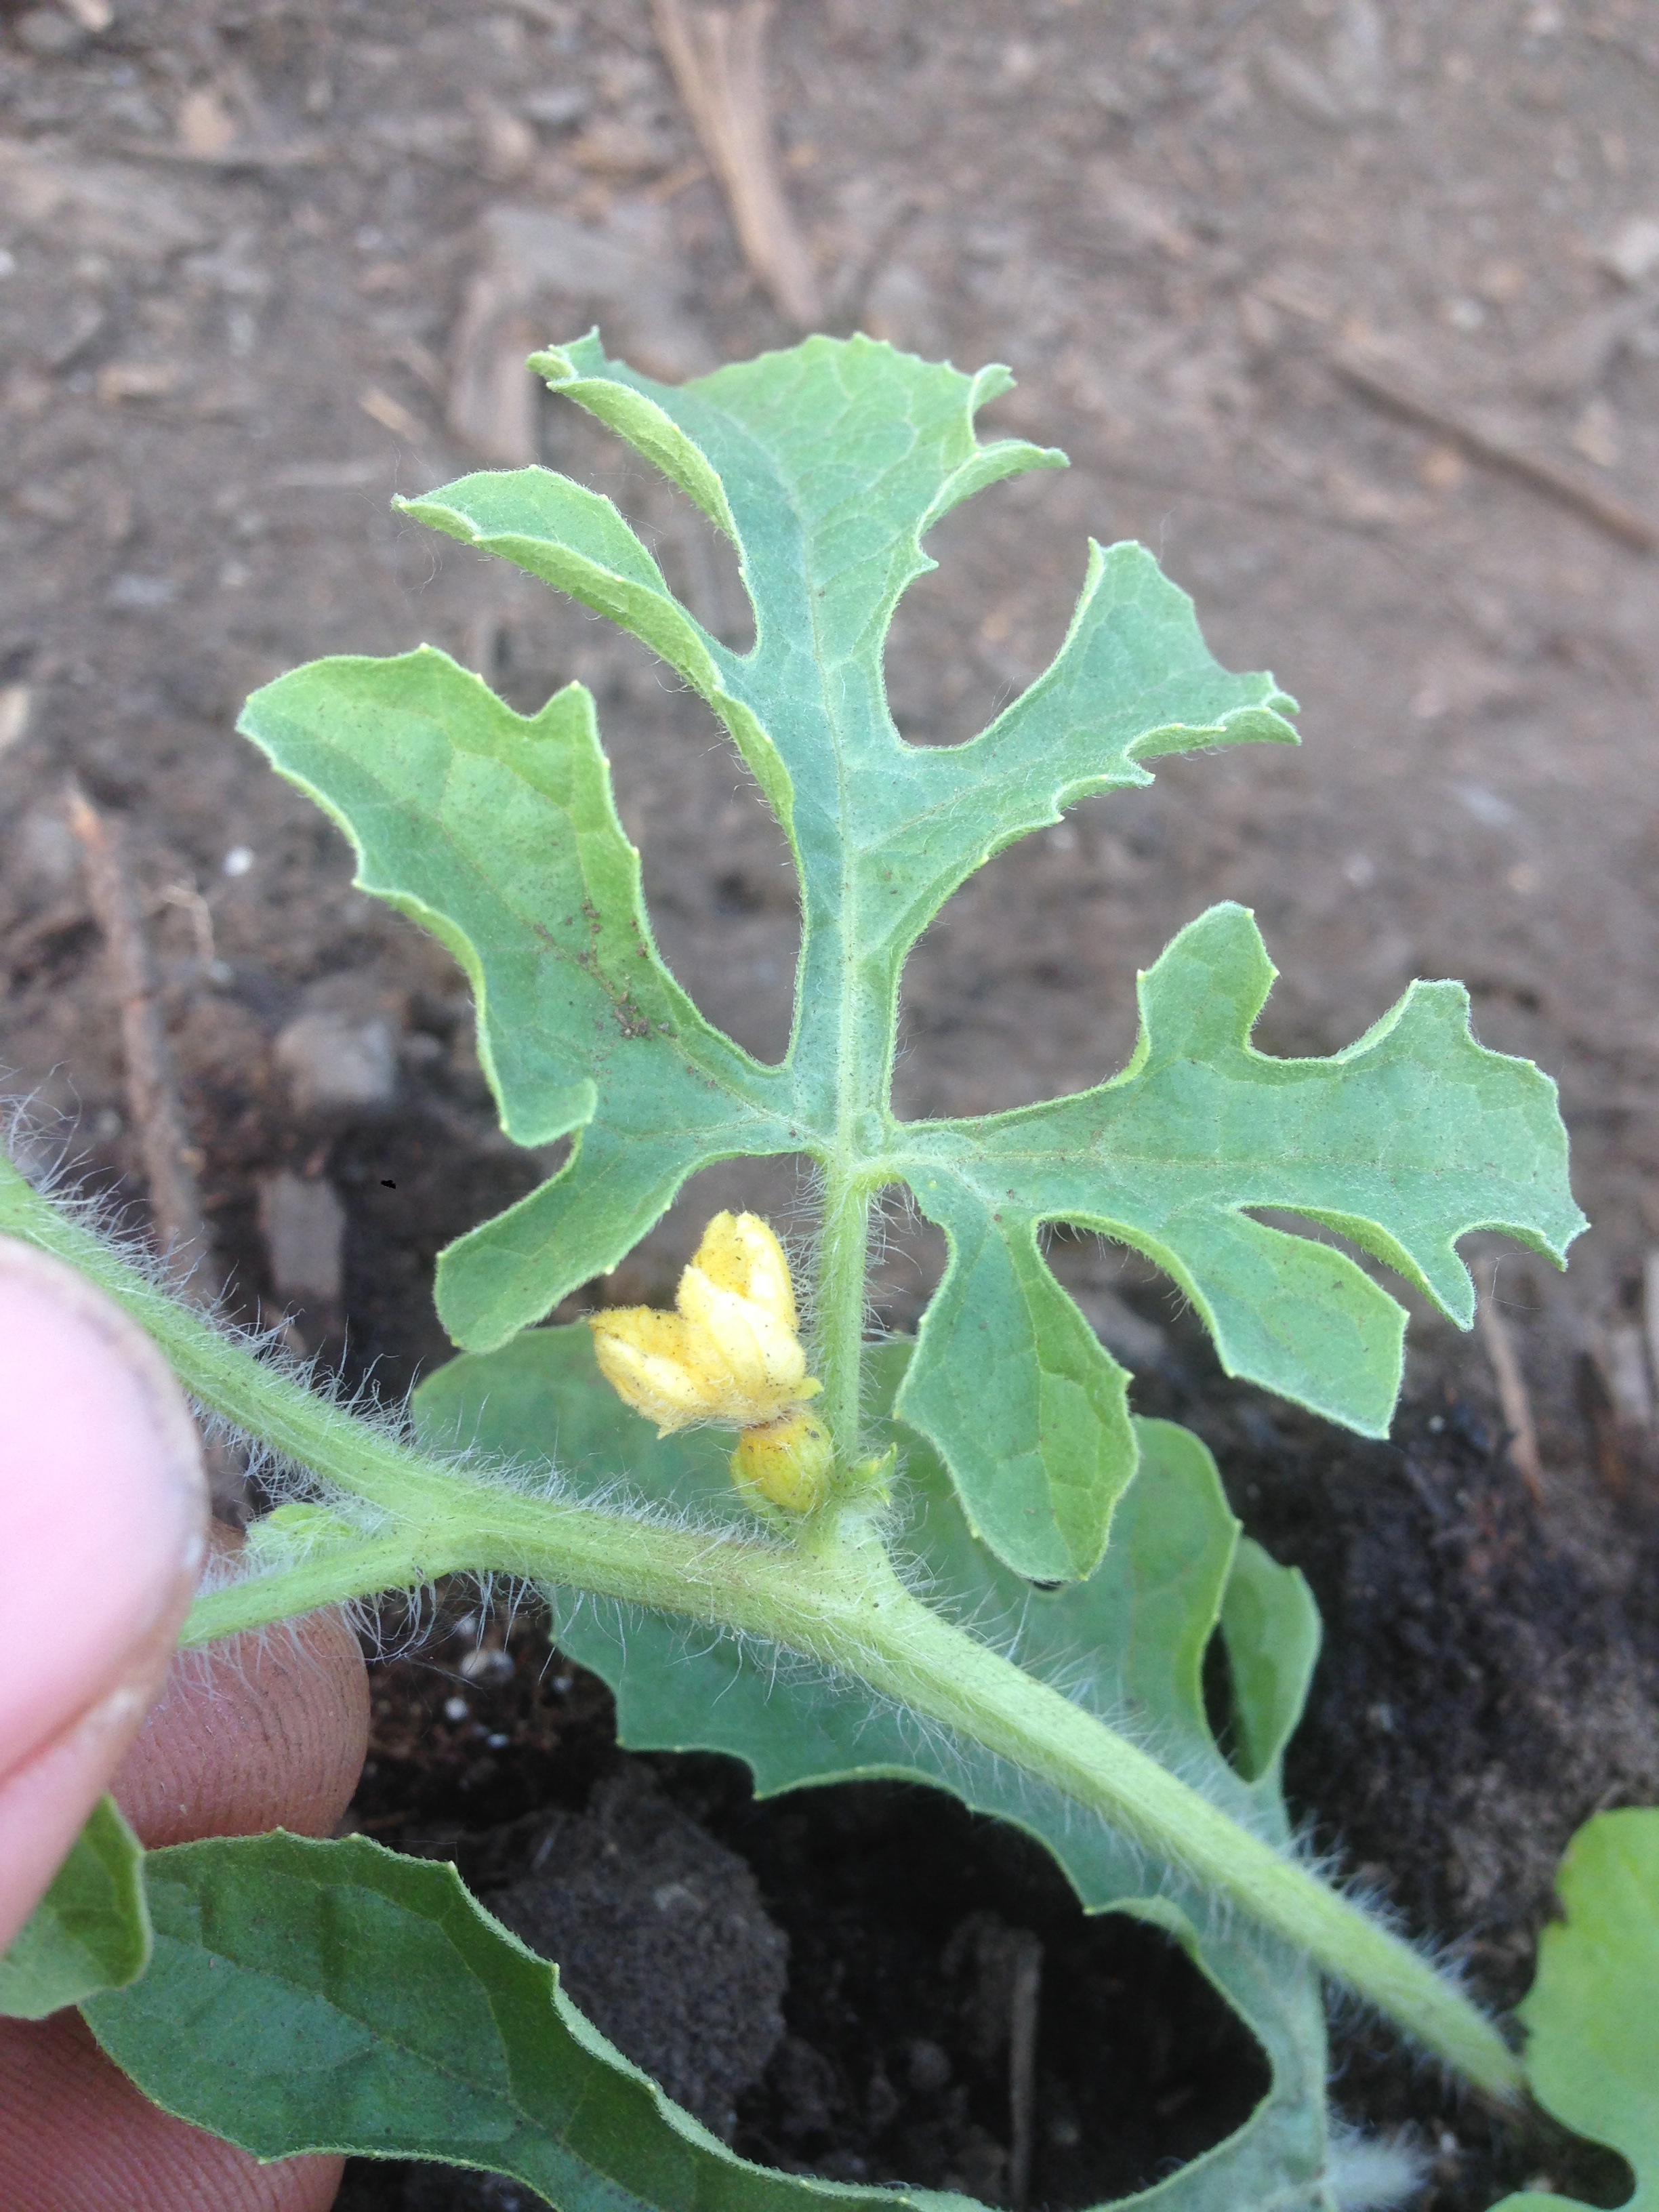
Planting Out
Amend soil with finished compost at rate of 5 cubic yards/1000 square feet and rock powders as recommended by soil testing
Fertilize twice: Once at planting and once when vines are running = tip of runner is 2” off the ground. Hydrolyzed fish and other good nitrogen sources
Enlarged base = Female flower

Slide 26
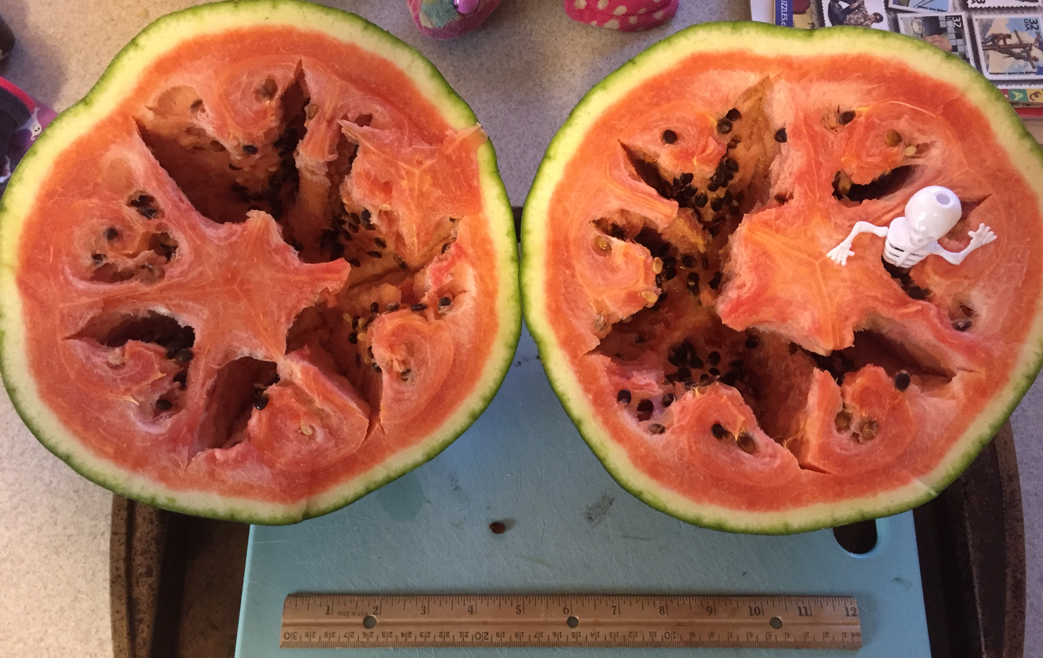
Pollination
Pollination: First flush of flowers will be male. When the female flowers appear, ensure pollination is completed in the morning before 10 am as flowers close during the day and pollen is not viable at higher temperatures.
Hand pollination techniques should be studied and planned for.
Take note of early morning bumblebees as they can be great pollinators of watermelons and work at lower temperatures than honeybees.
Xerces Society and WSARE (Western Sustainable Agricultural Research and Education) have great information on building alternative pollinator habitats
Hollow heart = incomplete pollination

Slide 27
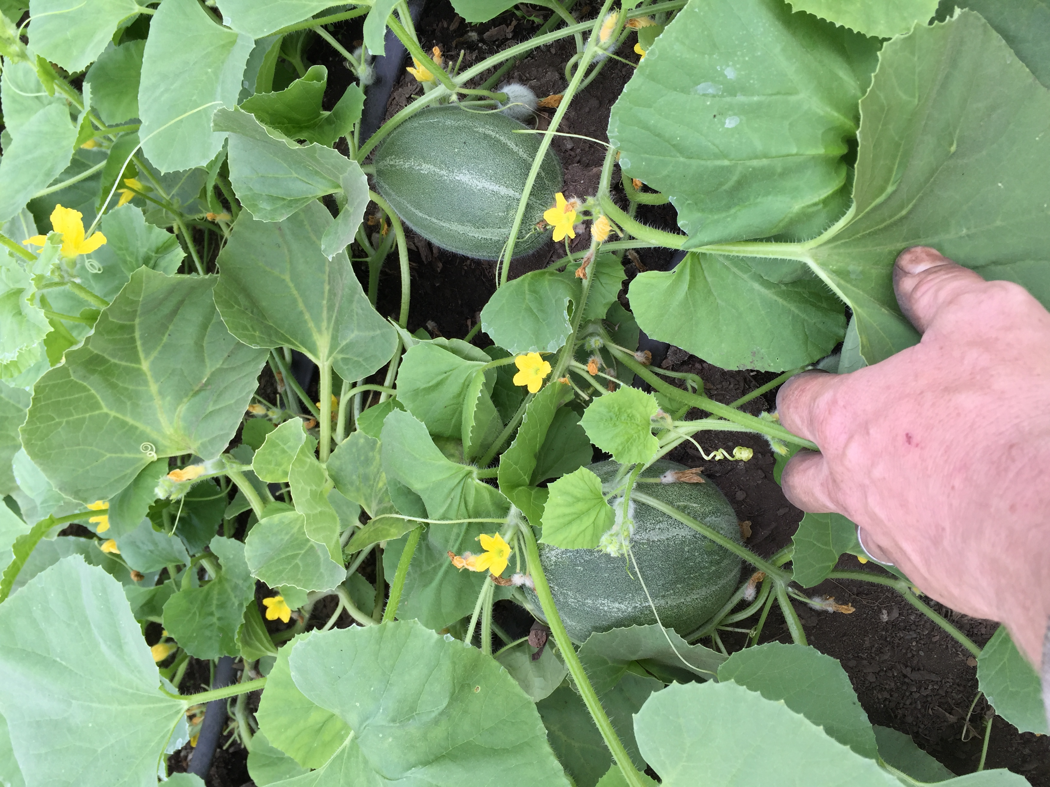
Growing
Fruit may need to be thinned to allow plant’s energy to be put into ripening the first fruits.
Watermelons can typically be thinned to 1-3 fruits.
Don’t remove excess vines until after successful fruit formation. I have sometimes “tipped” or cut the runners that have fruit at 2 leaf sets after the fruit. Though this might not be necessary, some say it speeds ripening.

Slide 28
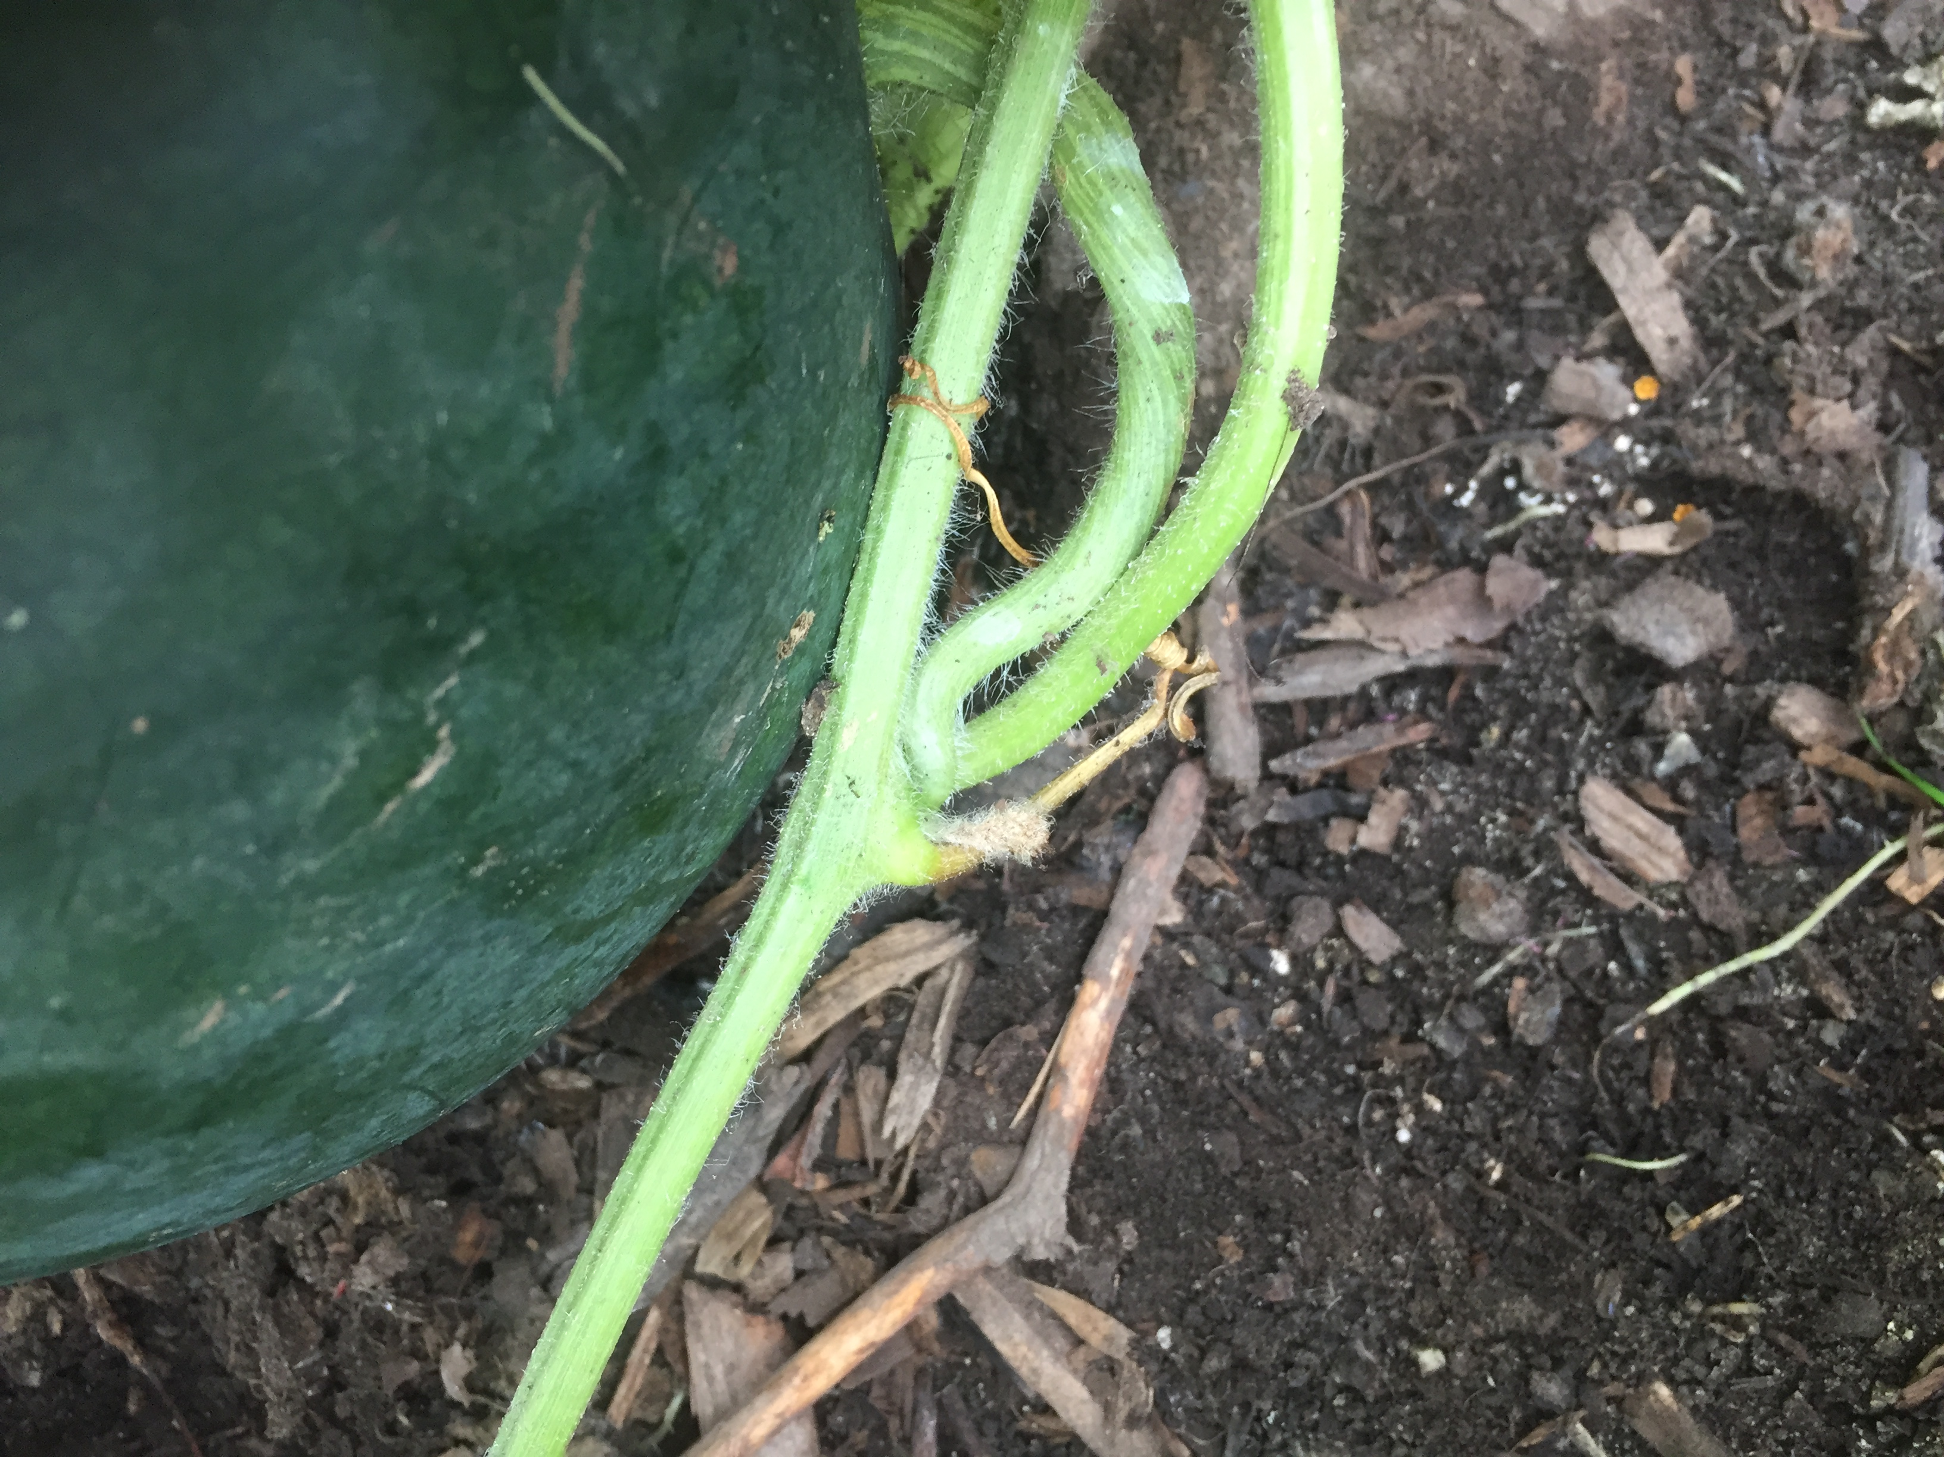
Harvest
Fruits are typically ok to eat when the tendril closest to the ripening watermelon has dried up and the spot on the bottom of the fruit has changed from white to yellow.
Dried tendril

Slide 29
Sources
Rootstock Seeds
Tetsukabuto – Kitazawa Seed Co. http://www.kitazawaseed.com/
Flexifort – Osborne Seed Co. httwww.osborneseed.com/
Scion seeds - Watermelon varieties that I have been trialing are Marmeladnyi, Blacktail Mountain, Katanya, Golden Midget, Bozeman, Sweet Siberian, Cream of Saskatchewan, & Small Shining Light.
Alaska Mill & Feed
Tatiana’s Tomatobase - tatianastomatobase.com/seed-catalog/html/
Terroir seeds - store.underwoodgardens.com/
Fedco Seeds - www.fedcoseeds.com/
Seed Savers - seedsavers.org/
Baker Creek - www.rareseeds.com/
IRT Olive Plastic Mulch, Seedling Heat Mat, propagation trays – Alaska Mill & Feed, Johnny’s seed
Low tunnels, grafting clips, growing tools and some seed – www.johnnyseeds.com

