Slide 1
All about Nutrients
Valerie Dantoin
Northeast Wisconsin Technical College

Slide 2
Nutrients
A nutrient is an elemental mineral molecule required for plant growth or reproduction. This table shows the % dry matter of each that makes up the plant body.
Macro (not nutrient) | Macro (from soil) | Micro (<0.01%)
Oxygen 45% | Nitrogen (N) 1.5 % | Chlorine, Iron
Carbon 45% | Potassium (K) 1.0% | Boron
Hydrogen 6% | Calcium (Ca) 0.5% | Manganese
 | Magnesium (Mg) 0.2% | Zinc, Copper
 | Phosphorus (P) 0.2% | Nickel?
 | Sulfur (S) 0.1% | Molybdenum

Slide 3
Macro Nutrients
Nitrogen-Phosphorus- K Potassium-: These are 3 macro nutrients needed in the highest concentration by plants……
that are typically not supplied by soil alone, thus – they are added as fertilizers.
Three other MACRO nutrients are calcium, magnesium, and sulfur.

Slide 4
Soil testing
When samples are sent to a soils lab for testing, we are typically testing for N-P-K….the big three macro-nutrients.
These are relatively easily measured and relatively easy to prescribe “fixes” for if the soil is deficient.
We should test for more than just N-P-K to get a true picture of our soil and how to improve it.

Slide 5
Roles of Nutrients
In the remainder of the presentation we will look at the role each nutrient plays in the life of a plant.
This will be just an introductory sketch of the role of each nutrient, but it will highlight main points to know so that you will know why the nutrient is important.

Slide 6
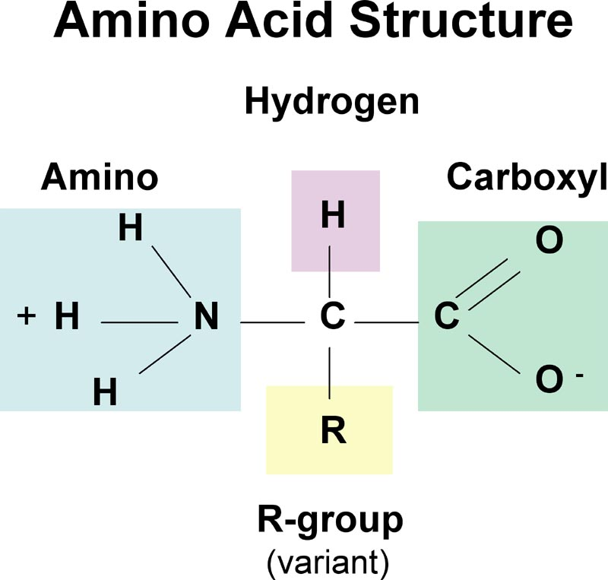
Nitrogen is a building block of all proteins
Proteins are made up of amino acids.
There are 20 different amino acids.
In plants, proteins are found in seeds, stored to be used when an embryo resumes growth at germination
Proteins make up 50% or more of the dry weight of most organisms.

Slide 7
Amino acid
The very definition of amino acid is that it is a molecule which MUST contain nitrogen .
See the N, the nitrogen?

Slide 8
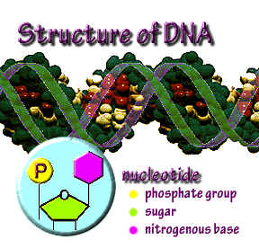
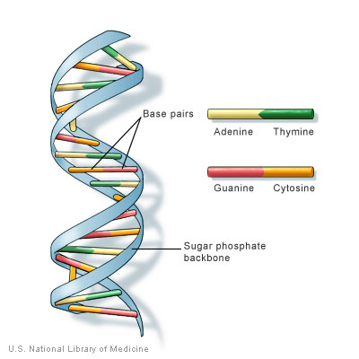
Nitrogen
Nitrogen is in every DNA backbone, it is the N in DNA.

Slide 9
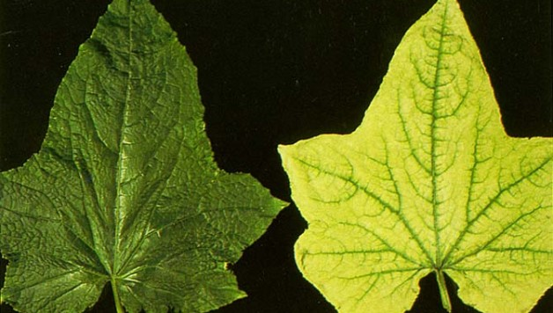
Without nitrogen
A plant cannot grow because cells cannot replicate their DNA. Plants will not be able to perform photosynthesis
Classic symptom of N deficiency is yellow leaves.

Slide 10
Nitrogen Fertilizers
Nitrogen is very abundant in the earth’s atmosphere.
Nitrogen is not a limiting factor in normal plant growth. Plants have grown for millions of years with only the N that naturally cycles through the soil. (forests.)
It is only in high production systems of modern agriculture that nitrogen becomes a limiting factor.
We discuss N fertilizers in another lecture

Slide 11
Phosphorus
This is a nutrient not needed in as great a quantity as nitrogen, but it is often limited in native soils.

Slide 12
Phosphorus
It is the energy transfer molecule
Also an important part of DNA

Slide 13
Phosphorus is the energy transfer molecule in photosynthesis
CO₂ ₊ 2H₂O
The electrons (e-) from light simply provide the “work” or energy needed to knit together the carbon, hydrogen, and oxygen.
ADiP + e- = ATriP
Carbon dioxide & water
Carbohydrate, water, oxygen
Phosphorus is the P in ATP, which is a molecule which slowly moves energy from the sun into the plant.

Slide 14
How do plants grow? Photosynthesis
CO₂ ₊ 2H₂O
e-
Carbon dioxide & water
Phosphorus gently lets the electron energy down to a lower state that is stable.
CH₂O + H₂O + O₂
Carbohydrate, water, oxygen

Slide 15
Phosphorus in animals
Of course in animals phosphorus plays a role in DNA, as does nitrogen, just like in plants.
Animals can’t photosynthesize though, so phosphorus is not used there however, it still is the ATP energy transfer molecule for our biochemical reactions.
Bones of animals contain a lot of P and this is the old way of getting phosphorus as a soil nutrient…grinding bones.

Slide 16
Phosphorus deficiency
Its easy to spot a P deficiency – the plant starts turning purple like this corn

Slide 17
The reverse of photosynthesis is combustion
CO₂ ₊ 2H₂O
Carbon dioxide & water
CH₂O
Carbohydrate
Ash, minerals, potash, potassium (K)
e- electrons are heat energy

Slide 18
Potassium = pot ash
The name of this mineral nutrient comes from the ashes that were left in a fire after plant material (wood) was burned.
The water and carbohydrates burn and release heat energy and the ash left behind is mostly potassium with a few other trace minerals.
You can use some wood as as fertilizer…but watch out for increasing alkalinity

Slide 19
The role of potassium in plants
Involved in osmosis and ionic balance and in opening and closing of stomata; activator of many enzymes.
Think of K, potassium in plants the same way we use it….
as an electrolyte to keep cells healthy

Slide 20
Osmosis & stomata
These are terms from botany.
They mostly have to do with how fluids and nutrients move from outside cells to inside cells.
If you need to know more…. Just google the terms

Slide 21
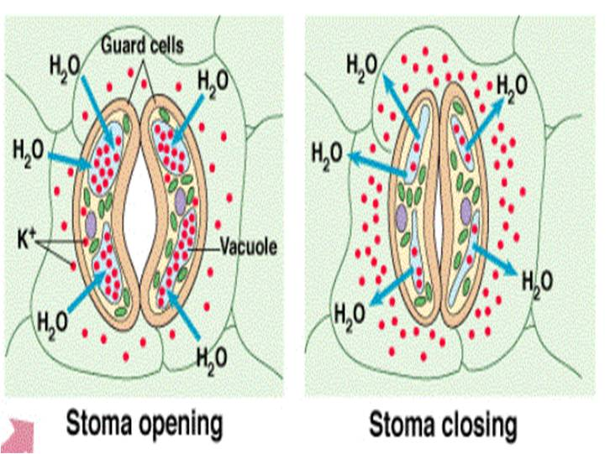
The potassium pump animation
Potassium pump
Click the link at the left to see a neat 2 minute animation on how plant cells open and close

Slide 22
Potassium deficiency
Yellowing or browning at the edges of the leaf is the classic symptom

Slide 23
After the big 3 macros…
The other three macro-nutrients are Sufur (S), Calcium (Ca) and Magnesium (Mg).
Like the big 3, these nutrients are measured in % (percent) in a plant body while the micro-nutrients are measured only in parts-per-million (ppm).
Still, they are needed in lesser amounts than N-P-K so they are call secondary macronutrients.

Slide 24
The Role of magnesium: a tiny part of an important molecule
CO₂ ₊ 2H₂O
Carbon dioxide & water
This cascade uses special molecules to ease electrons (e-) down from a wild, excited state, to a calm, captured state. We sometimes call these molecules pigments, like chlorophyll.
CH₂O + H₂O + O₂
Carbohydrate, water, oxygen

Slide 25
Pigments attract us, these molecules that carry color carry “light” and electrons and energy

Slide 26
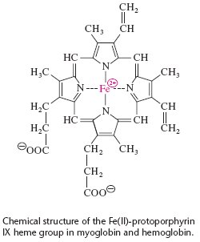
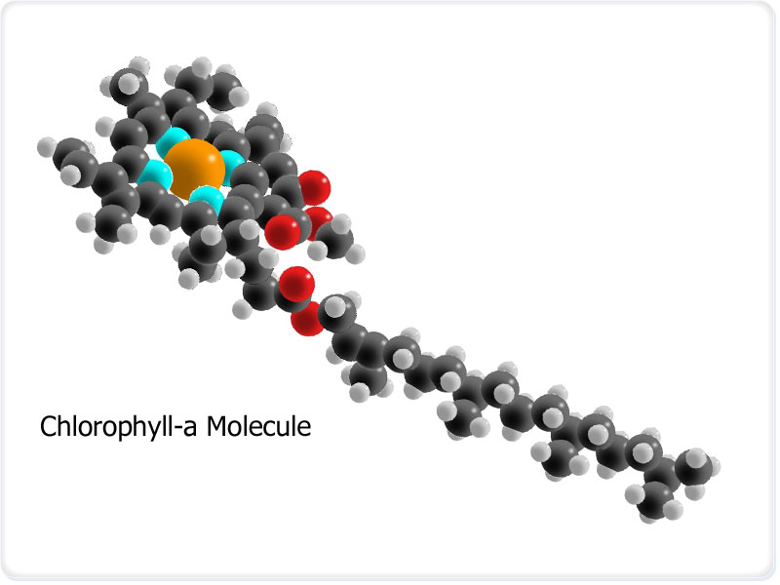
Chlorophyll has a magnesium ion at it’s center.
Our blood uses iron as it’s electron carrier

Slide 27
Magnesium deficiency
Shows up as yellowing between the veins because the plant can no longer perform photosynthesis well

Slide 28
Sulfur
Sulfur is, like nitrogen, a building block for many amino acids and proteins and it is also an important part of chlorophyll.
Wisconsin is lucky to have very high levels of sulfur in our soils and you will not likely need this nutrient unless you are removing a lot of crops from your farm.

Slide 29
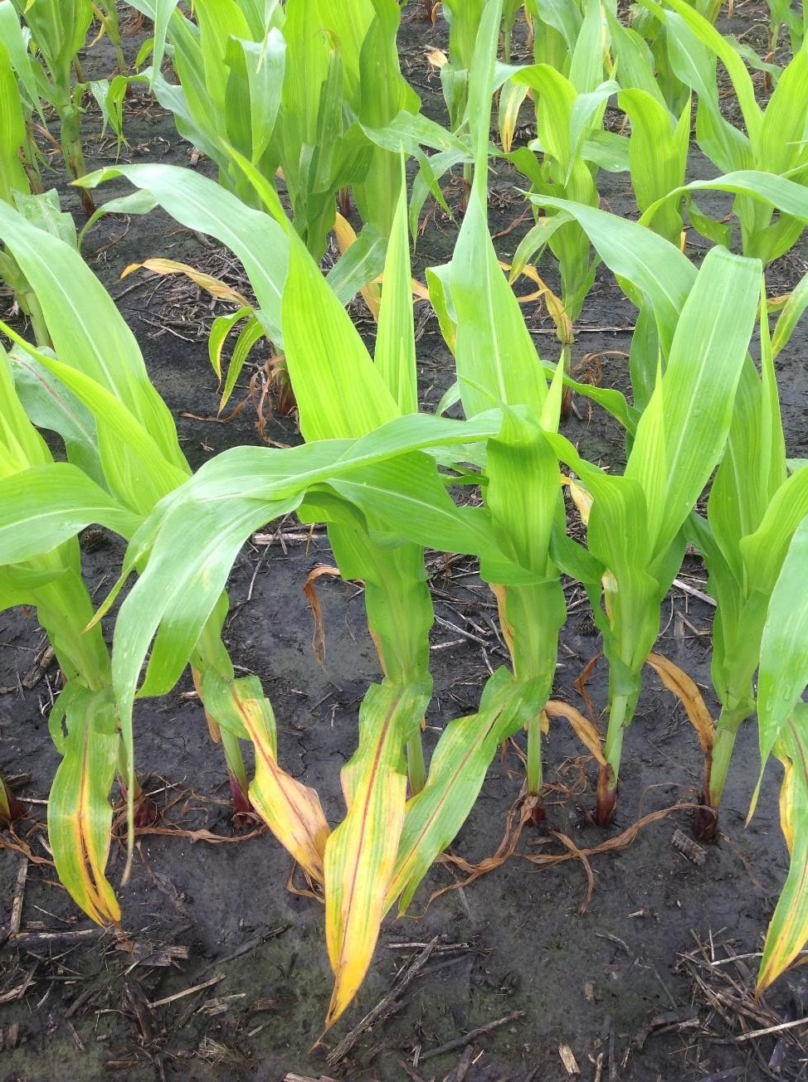
Sulfur deficiency
This resembles nitrogen deficiency, just a little less severe looking. You can take plant tissue in for testing rather than getting soil tested for sulfur deficiency.

Slide 30
Calcium
Calcium is an important component in building cell walls and therefore in keeping the plant safe from invading insects and disease.
Calcium is a cation and it’s availability for uptake by plants may be influenced by pH and other cations in the soil.
Up until just a decade ago, soil scientists in Wisconsin thought calcium was not deficient in our soils, but now, with new understanding of cation exchange capacity, that view has changed.

Slide 31
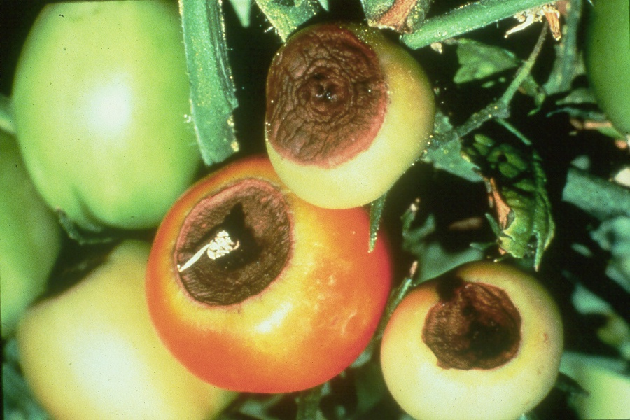
Calcium deficiency
Calcium is important also in fruit formation and a deficiency noticed by gardeners might be blossom end rot in tomatoes

Slide 32
Micro Nutrients
Iron, Chlorine, Manganese, Boron, Zinc, Copper, Molybdenum, (Cobalt, Sodium required in just a few species of plants).
The concentrations in plants are measured in parts per million (ppm) and can almost always be found in sufficient amounts in the native soil.
Round-up herbicide works by chelating micro-nutrients important in making cell walls. Weak cell walls invite fungal pathogens which kill the plant.

Slide 33
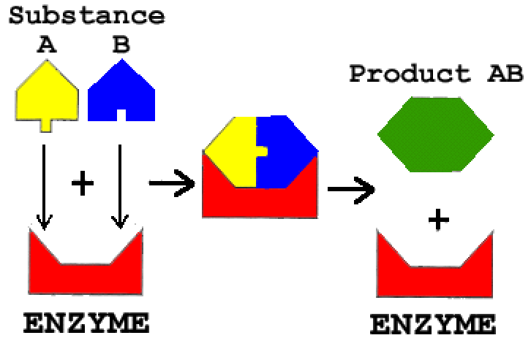
Micro-nutrients are important components of enzymes & vitamins.

Slide 34
Micro-nutrients
Most soils supply enough micro-nutrients that farmers and gardeners don’t really need to test for them.
However, if you have a known “nutrient sucker”, for example sugar beets need a lot of boron, then by all means test for that nutrient.

Slide 35
Overall nutrient levels
It is interesting to note that some plant nutrient concentrations have declined over the last several decades in many plant species.
That means that we have to eat more plants to get the same nutrient levels our grandparents got.
A 2004 study evaluated Department of Agriculture data for 43 garden crops from 1950 to 1999. The researchers found statistically reliable declines for six nutrients — protein, calcium, potassium, iron and vitamins B2 and C — but no change for seven others.

Slide 36
Why the decline?
Scientists are still digging into why nutrients have declined. They suggest several reasons:
1) farmers have changed to “modern” cultivars that grow larger faster
2) global climate change has raised CO2 levels and this makes plants grow faster.
3) soils are becoming depleted
The outcome, no matter the reason, suggests that bigger plants have more diluted the nutrients.

Slide 37
Bottom line
Plants need nutrients to grow and thrive.
Nutrients play many varied roles in the biochemistry of plants.
Some nutrients deficiencies may limit crop growth.
Nutrient concentrations in plants are declining and this may have health implications for eaters.

