Slide 1
Solving the Meat Processing Workforce Bottleneck
Apprenticeship Program Overview
Researchers: Don Arnosti, Maya Benedict, Paul Sobocinski, Ted Suss, & Courtney VanderMey
MAJOR SPONSORS

Slide 2
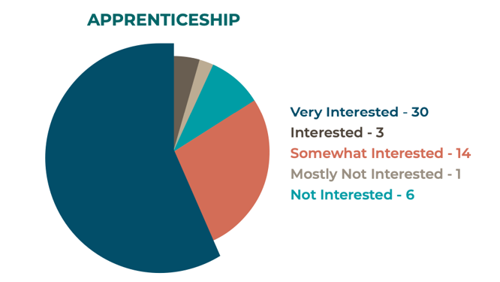
Background
88% of interviewed processors across Minnesota were interested in apprenticeships
Retention desired
Focus groups facilitated by the Latino Economic Development Center (LEDC) found significant interest in processing business ownership
BIPOC processors face barriers to ownership

Slide 3
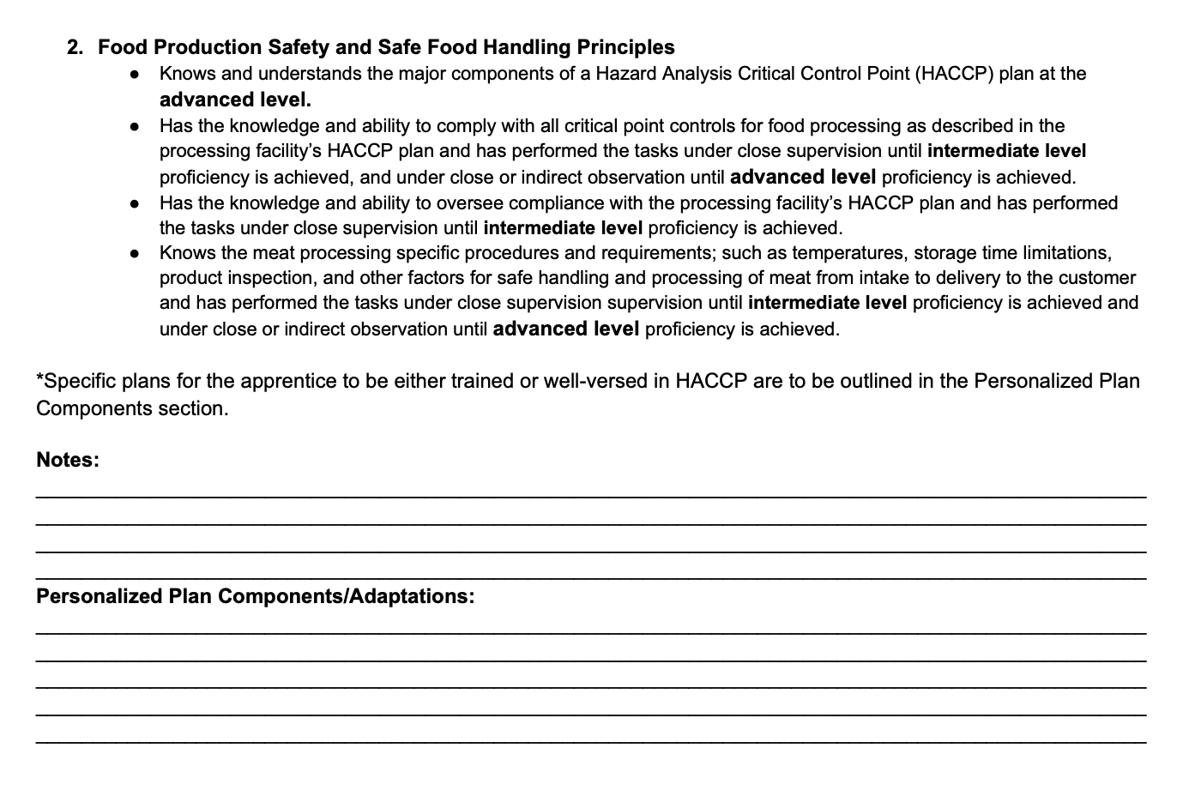
Model Overview
Developed a structured apprenticeship model based on processor interview findings and input
Apprentices will train at the meat processing business site with the intention of employment upon completion of the apprenticeship

Slide 4
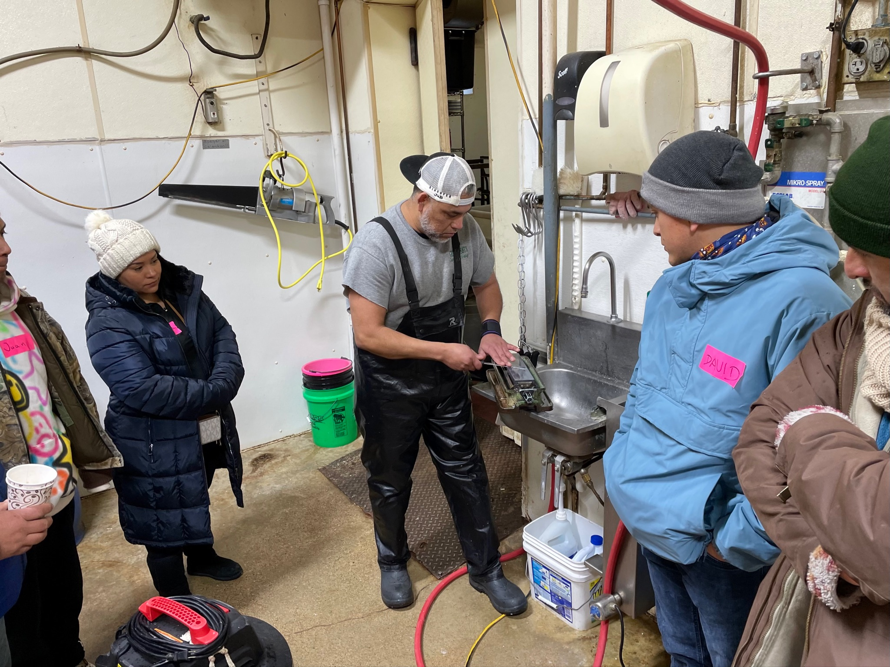
Apprenticeship Program Development
Partnered with LEDC
Model of transition improvement & support
“Matchmaking” for good fit
Pre-apprenticeship experience to gauge comfort with tasks
We identify processors looking to sell/transition, LEDC identifies apprentices

Slide 5
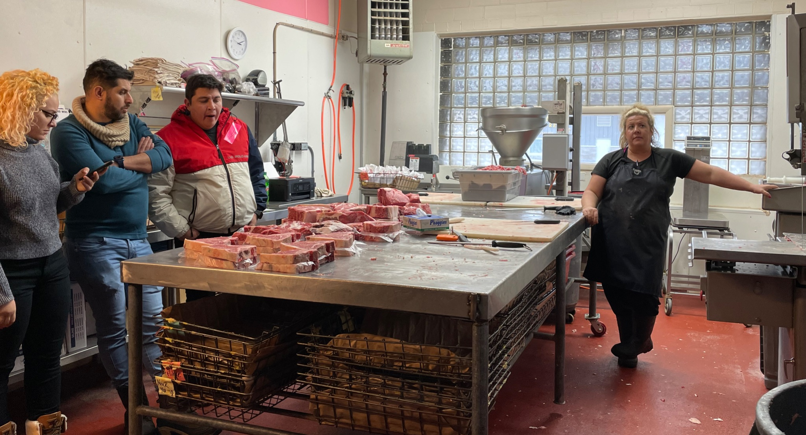

Slide 6
Program Specifics
Full-time, 1 year in length
Meat cutting trained on-site
Business management and financial skills taught online, through post-secondary institutions, or by navigator organization (LEDC)
Apprentices are paid the same rate as the site employees, based on experience

Slide 7
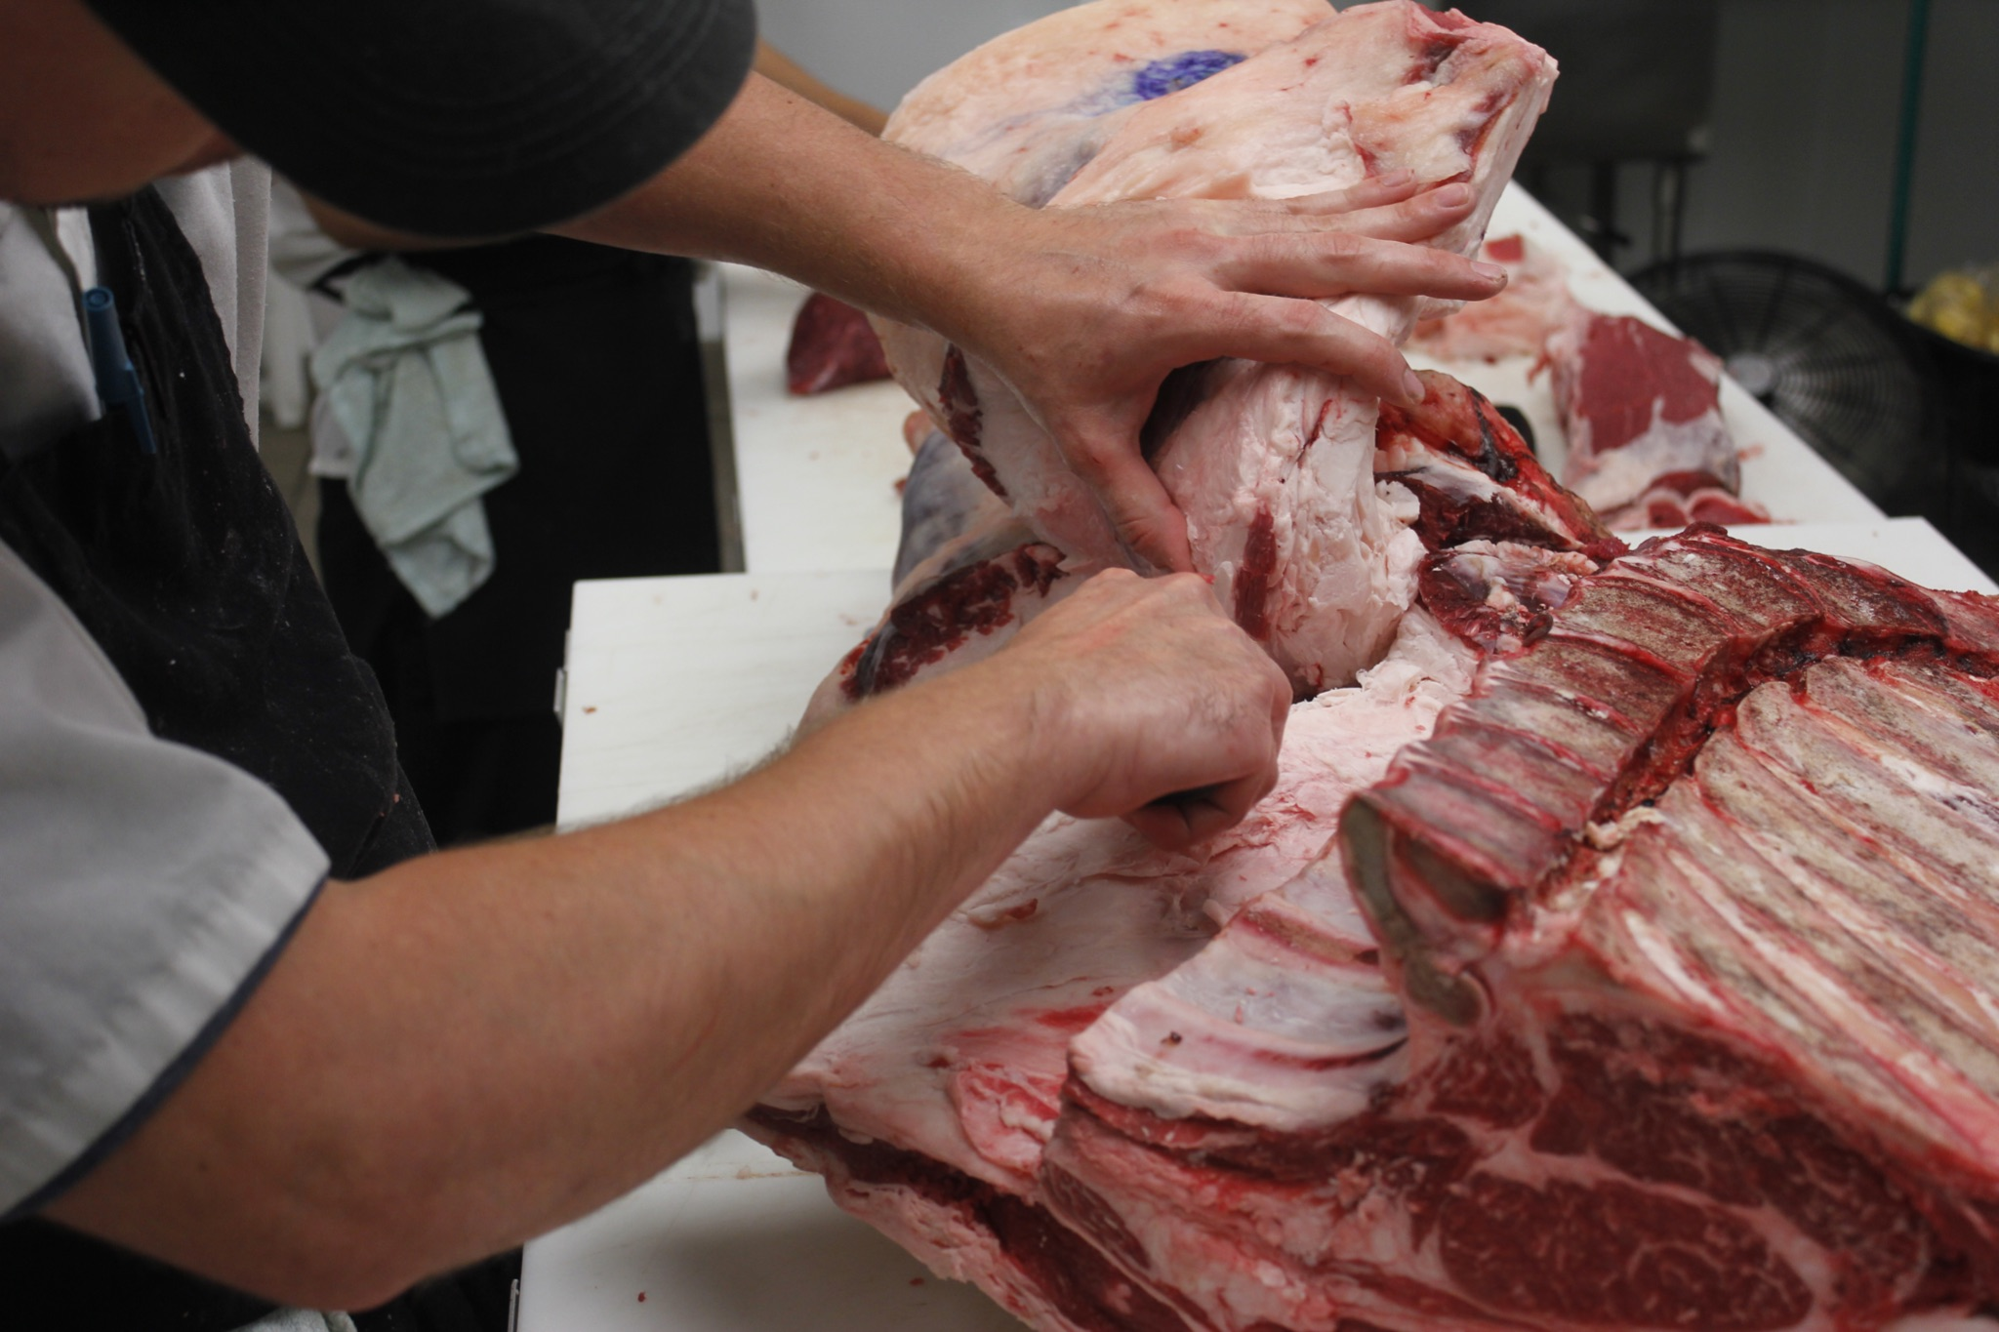
Learner Outcomes
Key component to the apprenticeship is a clearly defined set of processing and business management skills/learner outcomes.
A level of competency is required for each outcome
Trainees will achieve competency in each outcome during the apprenticeship
Most learner outcomes will be achieved on-site, but some business management skills may require outside training

Slide 8
Meat Processing
Business Management
Food production safety, safe food handling principles
Slaughter principles and techniques
Meat cutting principles and techniques
Specialty meat processing
Equipment setup, use, and maintenance
Carcass aging and breakdown
Meat inventory and control systems
Small business plan development
Small business financing and financial planning
Accounting and bookkeeping
Financial management and reporting
Marketing and advertising
Human resource management
Legal issues facing small business (insurance, contracts, etc.)

Slide 9
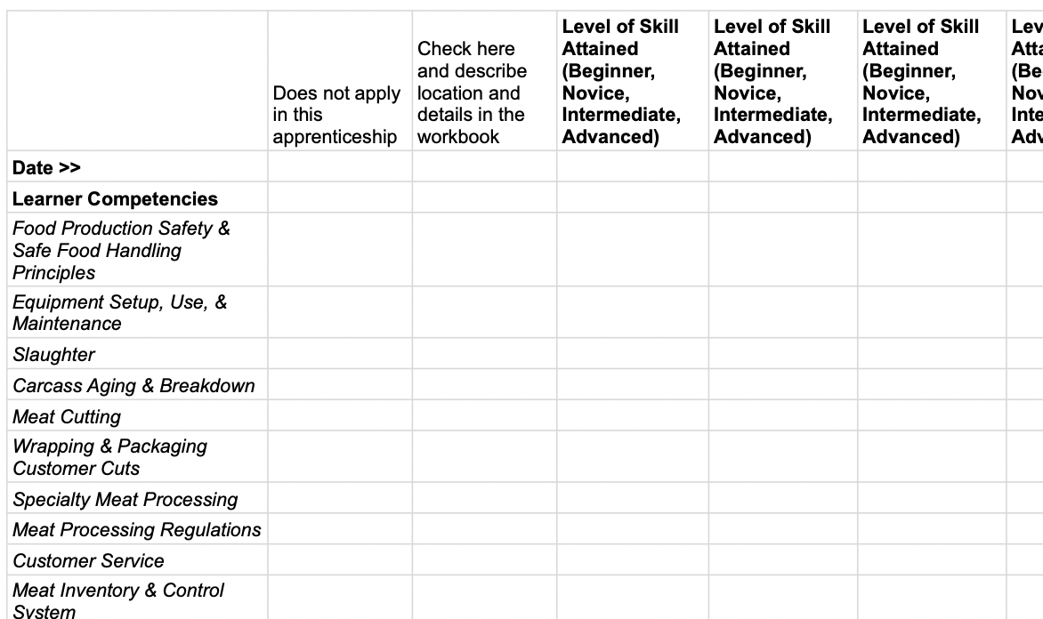
A snapshot of the Progress Tracking Checklist

Slide 10
H2-B Visa Workers Limited to Large Plants
Hy-Life plant closure in Windom, MN
Barriers to small processors accessing H2-B visa workers
Only large plants have the resources for hiring/employing H2-B visa workers
MAMP & LegalCorps immigration webinar shone light on small processor needs
Notes:
Image: https://www.thoroughbreddailynews.com/additional-h-2b-visas-for-fiscal-year-2022/

Slide 11
Thank you to our partners:
Read the full report here: https://misa.umn.edu/meat-processing-bottlenecks

