Slide 1

Impact of Cluster Thinning on
Postharvest Attributes of Table Grapes Grown in a High Tunnel System
Virginia C. Beasley, Graduate Student
Department of Horticulture, University of Arkansas
M. Elena Garcia, Professor
Department of Horticulture, University of Arkansas
Renee T. Threlfall, Research Scientist
Food Science Department, University of Arkansas

Slide 2
U.S. Fresh Grape Production
U.S. Production
Year | Billions of Dollars ($) | Millions of kg
2017 | 1.58 | 934.78
2016 | 1.56 | 943.43
2015 | 1.77 | 947.07
2014 | 1.60 | 955.30
2013 | 1.60 | 1,013.27
2012 | 1.32 | 873.60
2011 | 0.94 | 857.05
2010 | 0.87 | 864.81
2009 | 0.98 | 815.50
2008 | 0.78 | 857.32
2007 | 0.80 | 834.91
40% Table grapes
18% Dried grapes
42% Wine grapes
U.S. table grape dollars almost doubled in the last 10 years
California, having an ideal grape growing climate, holds 90% of U.S. grape production
https://www.nass.usda.gov/

Slide 3
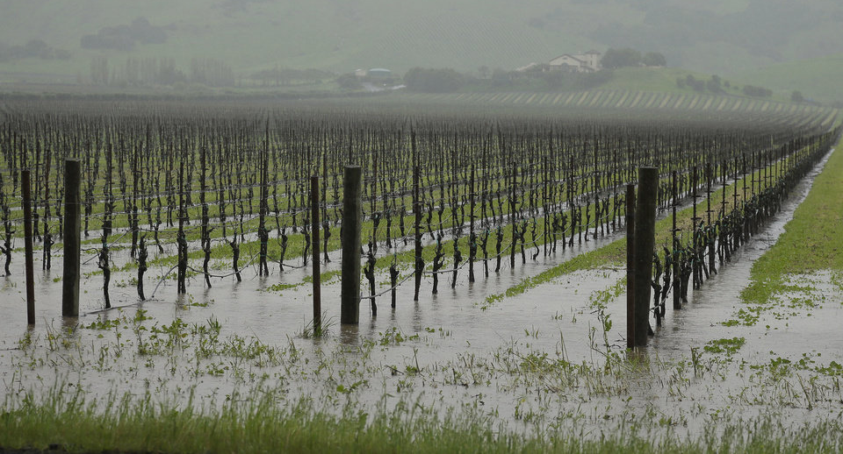
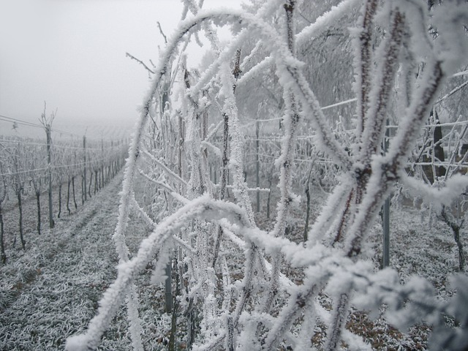
Eastern U.S. Table Grape Production
Biotic and Abiotic Challenges
  Fruit cracking can occur due to rain near or during harvest
Climate issues:
  Hot summers
  High humidity
  Cold winters (depending on area)
Newsok.com
High pesticide inputs
  8 or more fungicide applications
  5 or more insecticide application
Pixabay.com

Slide 4
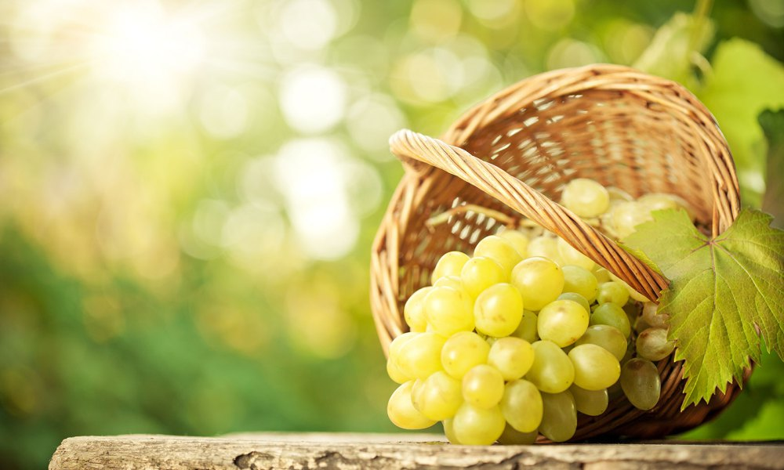
Table Grape Quality
Appearance: larger size, consistent color
Firm Texture
Composition: sweeter flavor
Cluster Appearance/Durability: low berry shatter and decay

Slide 5
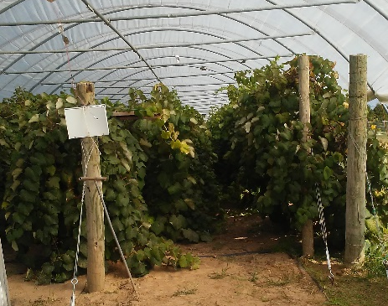
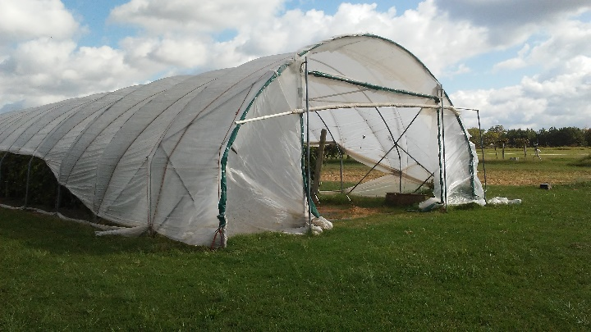
High Tunnel Systems
Controlled Environment Growing Systems
  Extended Growing Season
  Increased Yield
  Protection Against Damaging Precipitation
    Reduced Need for Fungicide Sprays
  Meets Demand for Local Food Production
Notes:
Describe high tunnel structure

Slide 6
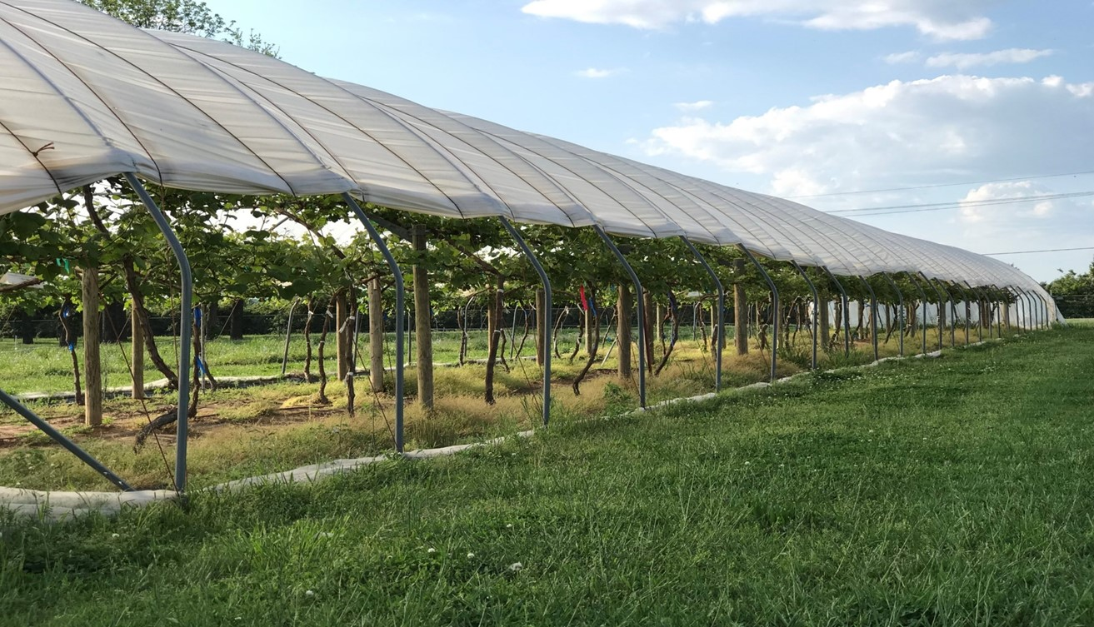
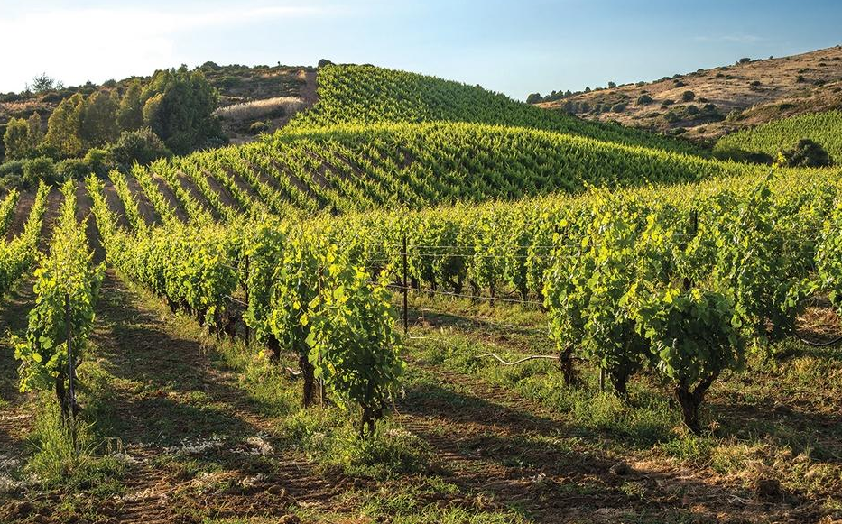
Objective
Investigate the impact of cluster thinning on postharvest attributes of table grapes in high tunnel systems through the evaluation of composition and marketability attributes
High Tunnel System
Conventional System
VS.
Photo by Dirk Langeveld

Slide 7
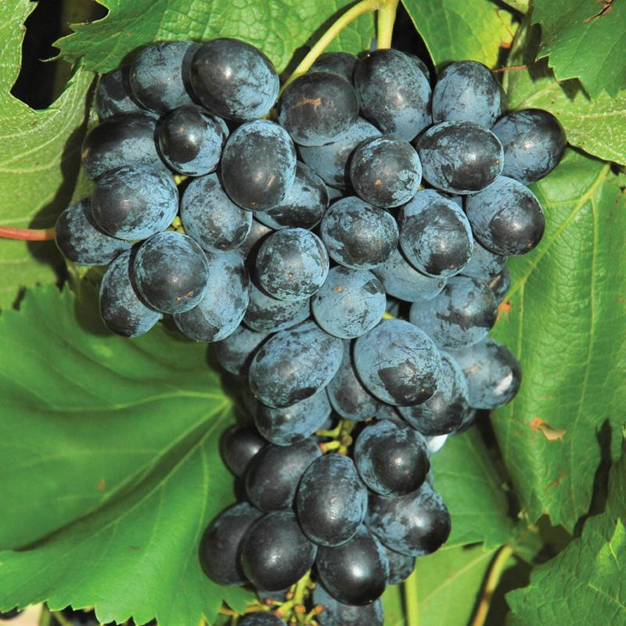
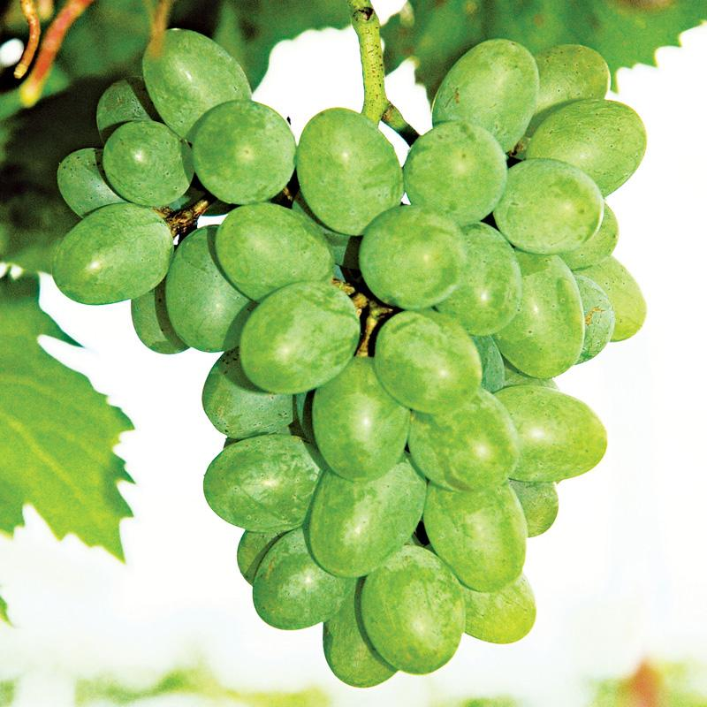
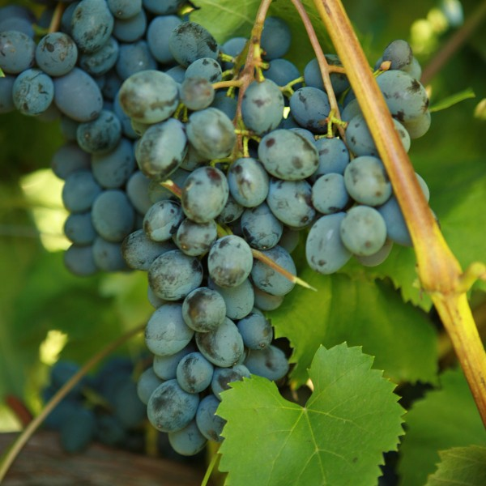
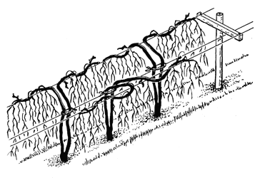
Project Description
Table Grape Cultivars
Cultivars -
Faith
Gratitude
Jupiter
Study Site -
University of Arkansas Research Station, Fayetteville
Location
University of Arkansas Agricultural Research and Extension Center, Fayetteville
‘Faith’
‘Gratitude’
‘Jupiter’
Geneva Double Curtain
Trellis System
Geneva Double Curtain
Image by Ted Goldammer

Slide 8
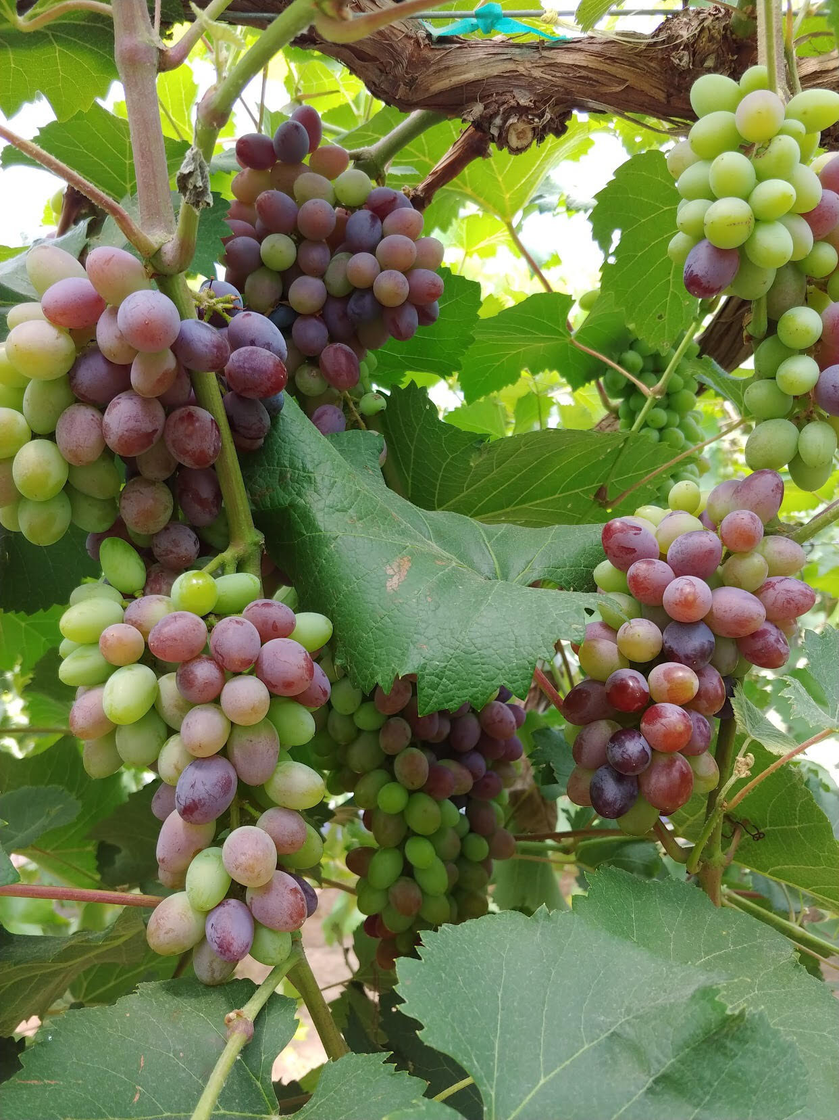
Cluster Thinning Treatments
Cluster Thinning Protocol
  Thinning Treatments
  - None
  - Pea-Sized Berries
  Thinned based on shoot length
  < 8” all clusters removed
    8”-20” kept one cluster
    > 20” kept two clusters
Photo by: Brittany Lowery

Slide 9
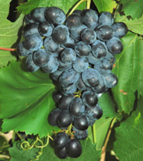
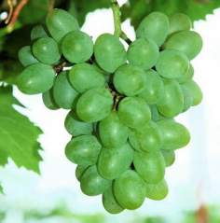
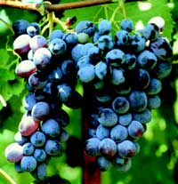
Cultivar Attributes
Characteristics | Faith | Gratitude | Jupiter
Cluster Weight (g) | 158 – 251 | 393 – 515 | 154 – 221
Berry Weight (g) | 4 | 3.5 | 5.5
Ripening Dates | Late July - Early August | Late August | Mid - late July
Color at Maturity | Blue to Black | Green | Blue
‘Faith’
‘Gratitude’
‘Jupiter’

Slide 10
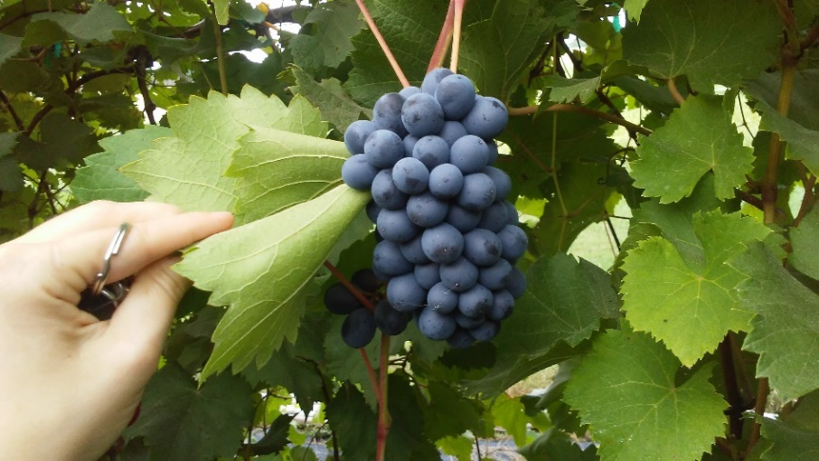
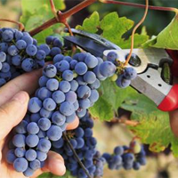
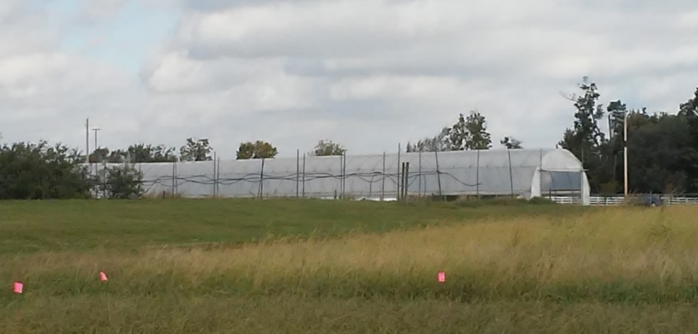
Harvest Procedure
Harvest – July 2018
  1 kg (2 Grape Clusters) Harvested
  Three Replications per Treatment per Cultivar
  Randomization into 0.9 kg Clamshells for Postharvest Storage
http://www.wineguy.co.nz

Slide 11
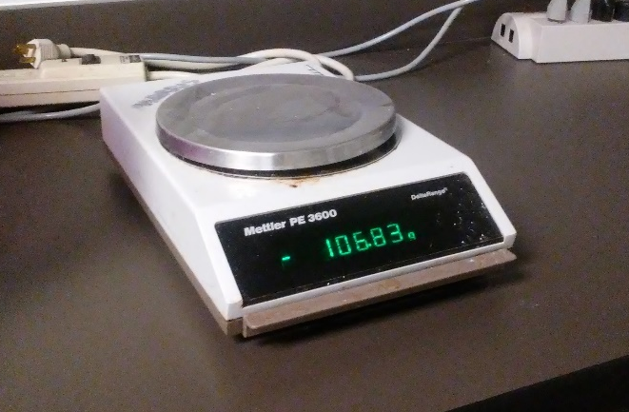
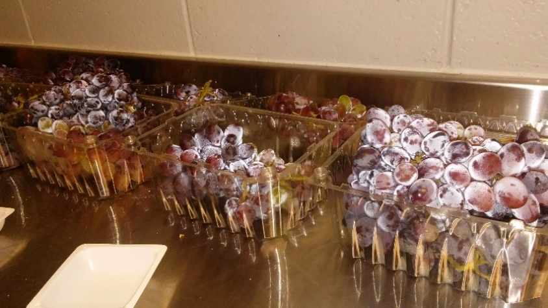
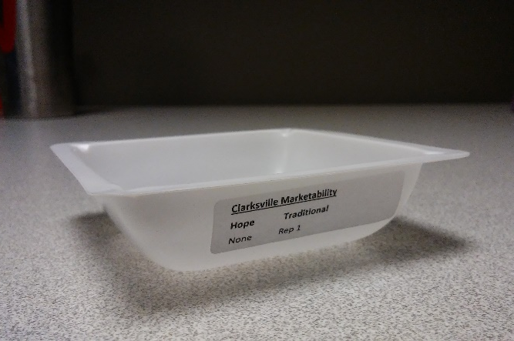
Postharvest Analysis
Storage at 2 °C for 0, 7, 14, 21 days
Composition
  pH
  Titratable Acidity (% tartaric acid)
  Soluble Solids (%)
Marketability
  Weight loss (%)
  Decay (%)
  Shatter (%)

Slide 12
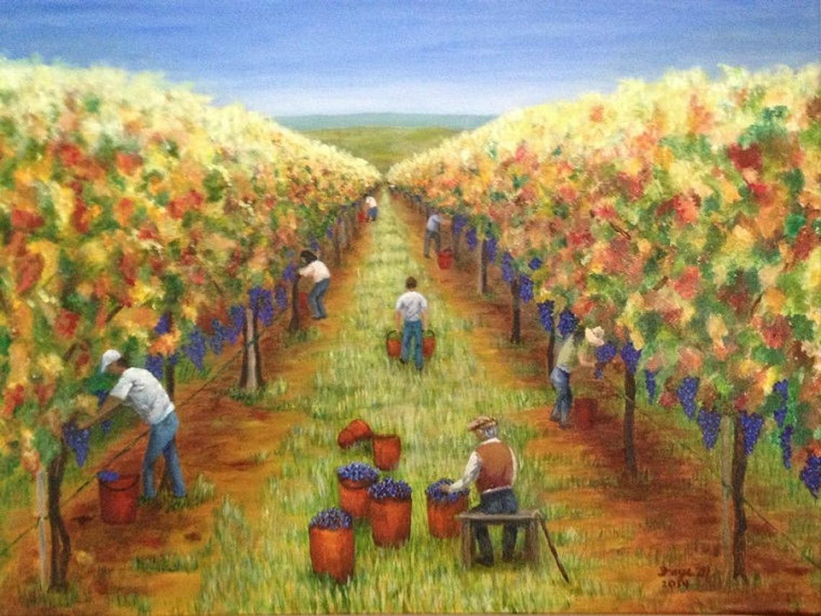
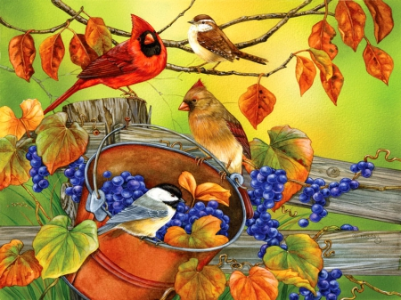
Harvest Results
FineartbyFay.com

Slide 13
a
Table 1. Main and interaction effects for composition of high tunnel table grape cultivars (‘Faith’, ‘Gratitude’, and ‘Jupiter’) with different cluster thinning treatments (none and pea-sized berries) at harvest, Fayetteville, AR (2018)
 | Soluble solids (%) | pH | Titratable acidity (% tartaric)
Cultivar
Faith | 18.85a^{z} | 3.76a | 0.47b
Gratitude | 16.50b | 3.43b | 0.65a
Jupiter | 17.35b | 3.81a | 0.49b
P value | 0.0005 | <0.0001 | <0.0001
Thinning
None | 18.03a | 3.72a | 0.53a
Pea | 17.10b | 3.61b | 0.55a
P value | 0.0209 | 0.0145 | 0.2891
Cultivar x Thinning (p value) | 0.1297 | 0.3040 | 0.2377
^{z}Cultivars were evaluated in triplicate (n=3). Means with different letter(s) for each attribute within effects are significantly different (p<0.05) using Students t-test.

Slide 14
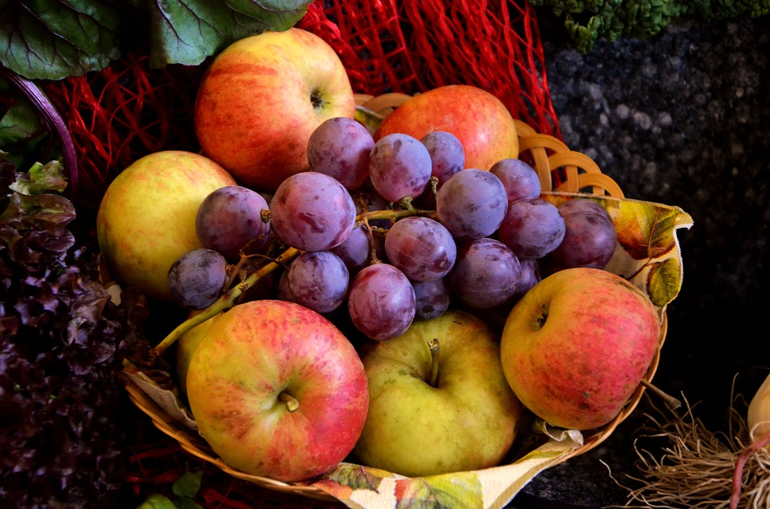
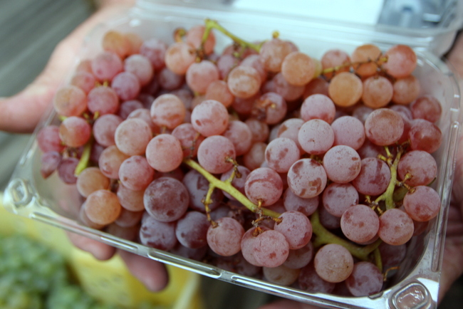
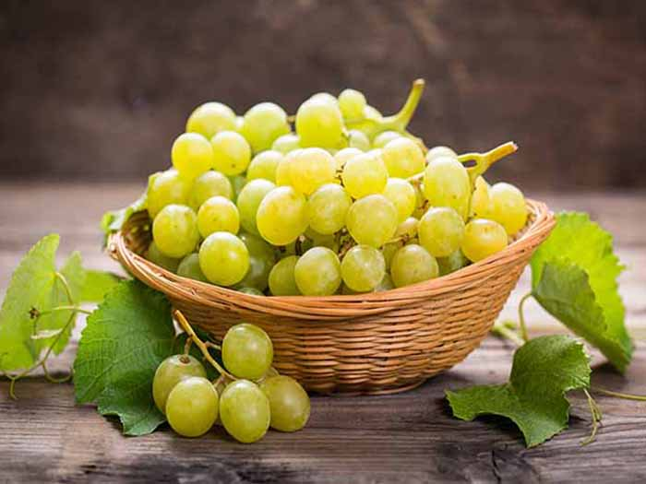
a
Marketability Results
Photo by Kat Robinson
Photo by Kiran Patil

Slide 15
a
Table 2. Main and interaction effects for marketability attributes of high tunnel table grape cultivars (‘Faith’, ‘Gratitude’, and ‘Jupiter’) with different cluster thinning treatments (none and pea-sized berries) stored at 2 °C for 0, 7, 14, and 21 d, Fayetteville, AR (2018)
 | Shatter (%) | Decay (%) | Weight loss (%)
Storage | 0.0040 | 0.0007 | <0.0001
Cultivar | 0.0040 | <0.0001 | 0.0010
Thinning | 0.2560 | 0.0117 | 0.4758
Storage x cultivar | 0.9722 | 0.9861 | 0.0133
Storage x thinning | 0.8831 | 0.5998 | 0.9349
Cultivar x thinning | 0.5117 | 0.0123 | 0.0004
Storage x cultivar x thinning | 0.9984 | 0.9942 | 0.1095
^{z}Cultivars were evaluated in triplicate (n=3). Means with different letter(s) for each attribute within effects are significantly different (p<0.05) using Students t-test.

Slide 16
a
Fig. 1. Main effects for shatter (%) of high tunnel table grape cultivars (‘Faith’, ‘Gratitude’, and ‘Jupiter’) with different cluster thinning treatments (none and pea-sized berries) stored at 2 °C for 0, 7, 14, and 21 d, Fayetteville, AR (2018).
a
a
ab
b
bc
b
c

Slide 17
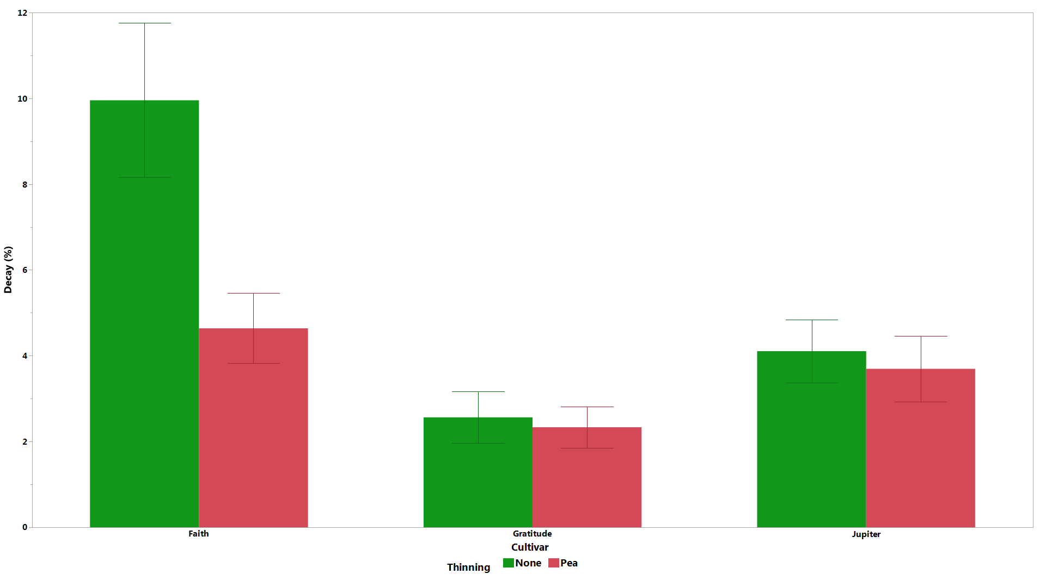
a
Fig. 2. Cultivar x thinning interaction for decay (%) of high tunnel table grape cultivars (‘Faith’, ‘Gratitude’, and ‘Jupiter’) with different cluster thinning treatments (none and pea-sized berries) stored at 2 °C for 0, 7, 14, and 21 d, Fayetteville, AR (2018).
a
b
b
b
b
b

Slide 18
a
Fig. 3. Cultivar x storage interaction for weight loss (%) of high tunnel table grape cultivars (‘Faith’, ‘Gratitude’, and ‘Jupiter’) with different cluster thinning treatments (none and pea-sized berries) stored at 2 °C for 0, 7, 14, and 21 d, Fayetteville, AR (2018)
a
b
b
c
c
d
e
e
e
f
f
f

Slide 19
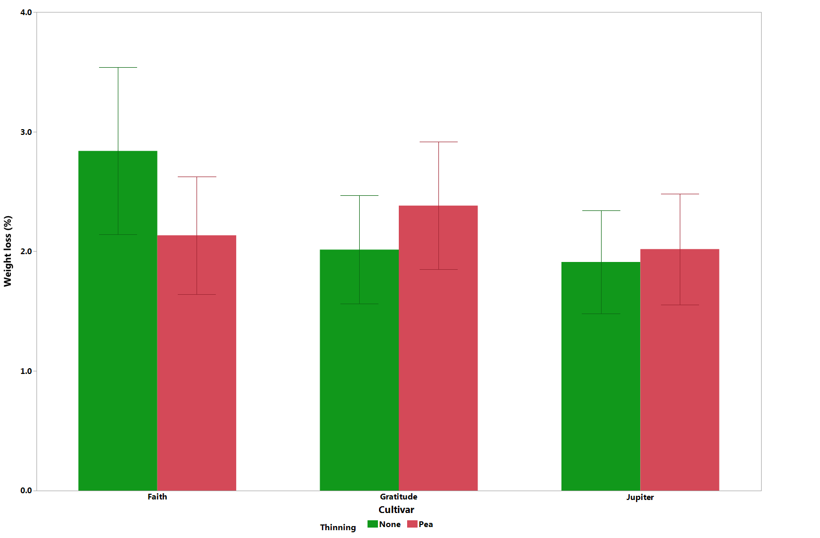
a
Fig. 4. Cultivar x thinning interaction for weight loss (%) of high tunnel table grape cultivars (‘Faith’, ‘Gratitude’, and ‘Jupiter’) with different cluster thinning treatments (none and pea-sized berries) stored at 2 °C for 0, 7, 14, and 21 d, Fayetteville, AR (2018)
a
b
bc
bc
c
bc

Slide 20
Conclusions
Composition
  Cultivars differed in composition attributes at harvest (soluble solids, pH, TA)
  Thinning treatment groups had lower soluble solids and pH than unthinned vines
Storage
  Weight loss and shatter increased with storage time for all cultivars
Overall Marketability
  Variations in marketability attributes were generally cultivar-specific
  Faith appeared to be most effected by the thinning treatment – decay and weight loss were both significantly lower for Faith vines in the pea-sized thinning treatment

Slide 21

Acknowledgements
This research was funded by the Southern Sustainable Agriculture Research and Education Grant, United States Department of Agriculture (RD309-137/S001415).
LS17-282: High Tunnel Grape Production Systems: A Novel Sustainable Approach to Growing Grapes
University of Arkansas Faculty, Staff, and Students
  Dr. Elena Garcia
  Dr. Renee Threlfall
  Karlee Pruitt
  Jose Hernandez
  Sarah Mayfield

Slide 22
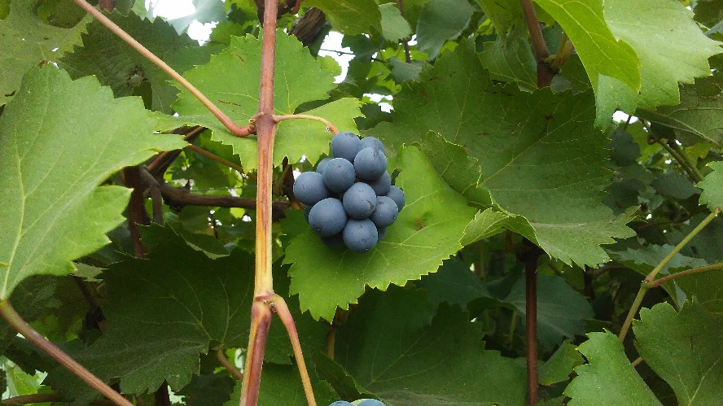
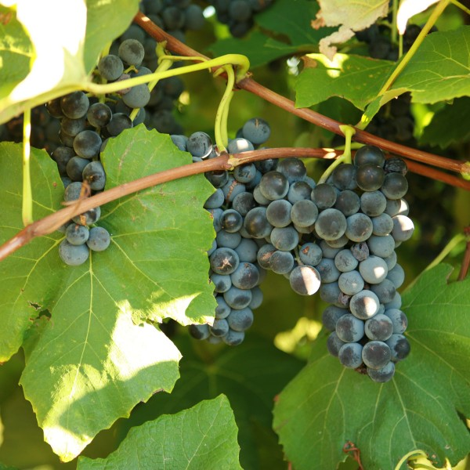
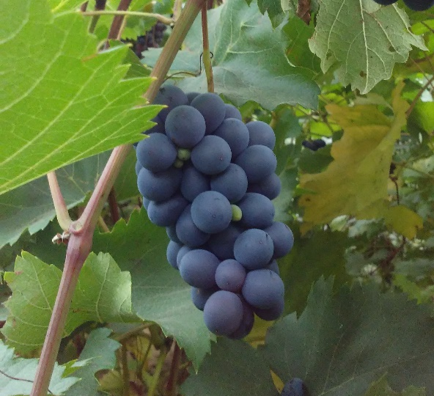
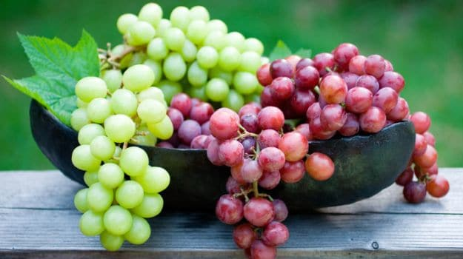
Thank you!
Questions?

