Slide 1
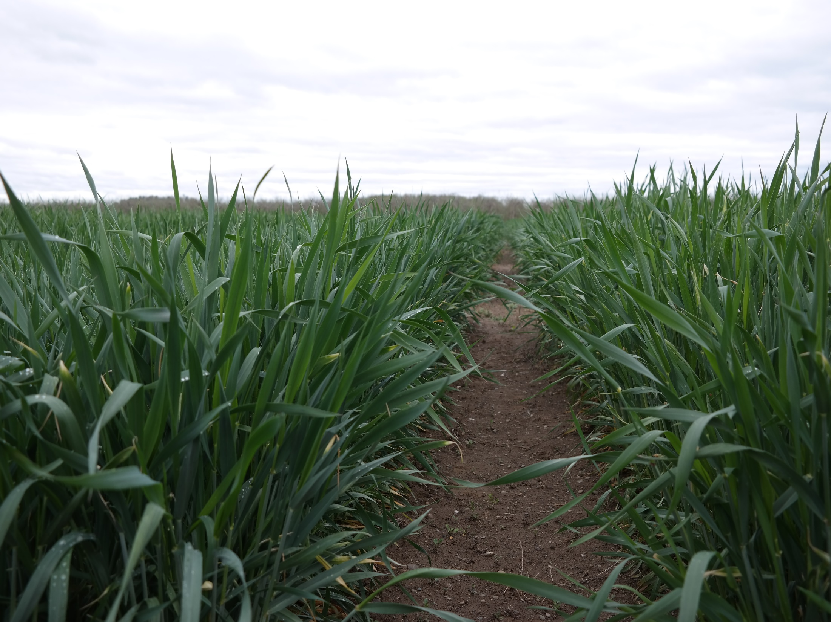
Fall Nitrogen Management for Winter Forage
Tom Kilcer
Advanced Ag Systems LLC
www.advancedagsys.com
Quirine Ketterings, Cornell U
Sarah Lyons, Cornell U
Notes:
Fall Nitrogen Management for Winter Forage
Research presented here was conducted on a number of farms and research facilities across NY. It could not have happened without the farmers, extension and pro dairy specialists, Dr. Kettering’s Cornell staff and especially the funding of the New York Farm Viability Institute.

Slide 2
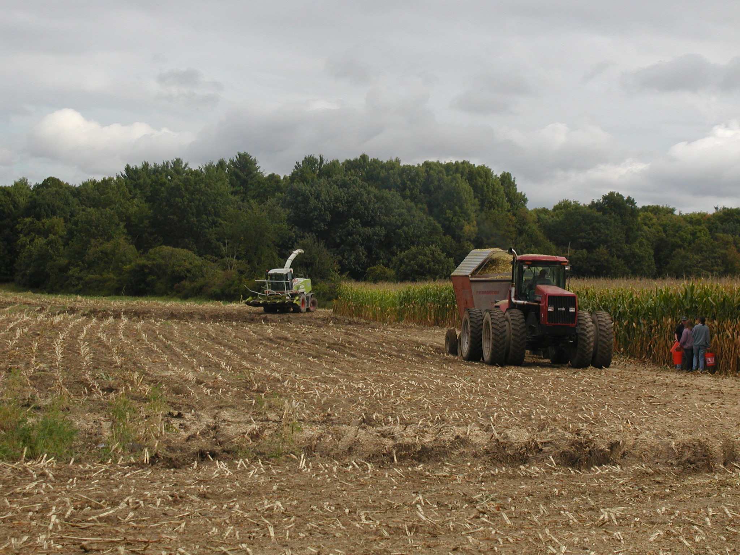
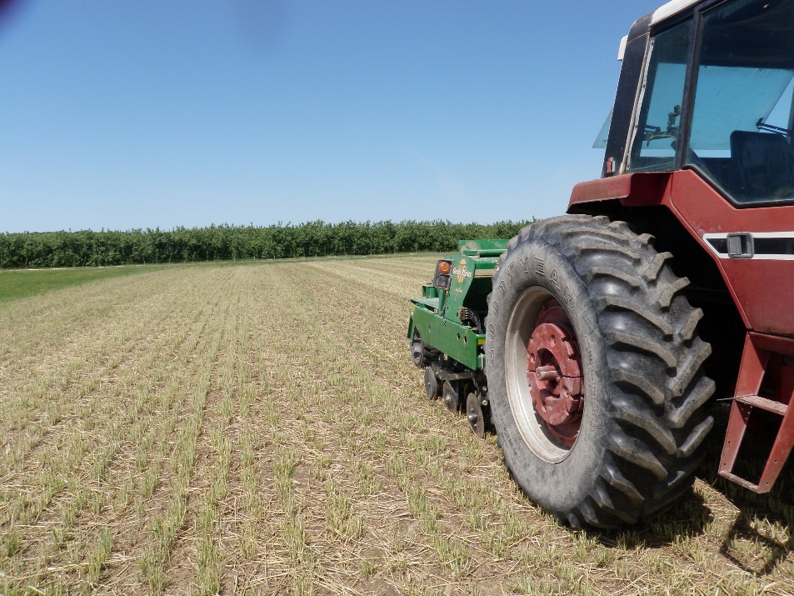
Normal Farming:
Plant in Spring
Harvest in Fall
Notes:
The need for this work arose because in
Normal farming
You fertilize and plant in the spring
Harvest in the fall

Slide 3
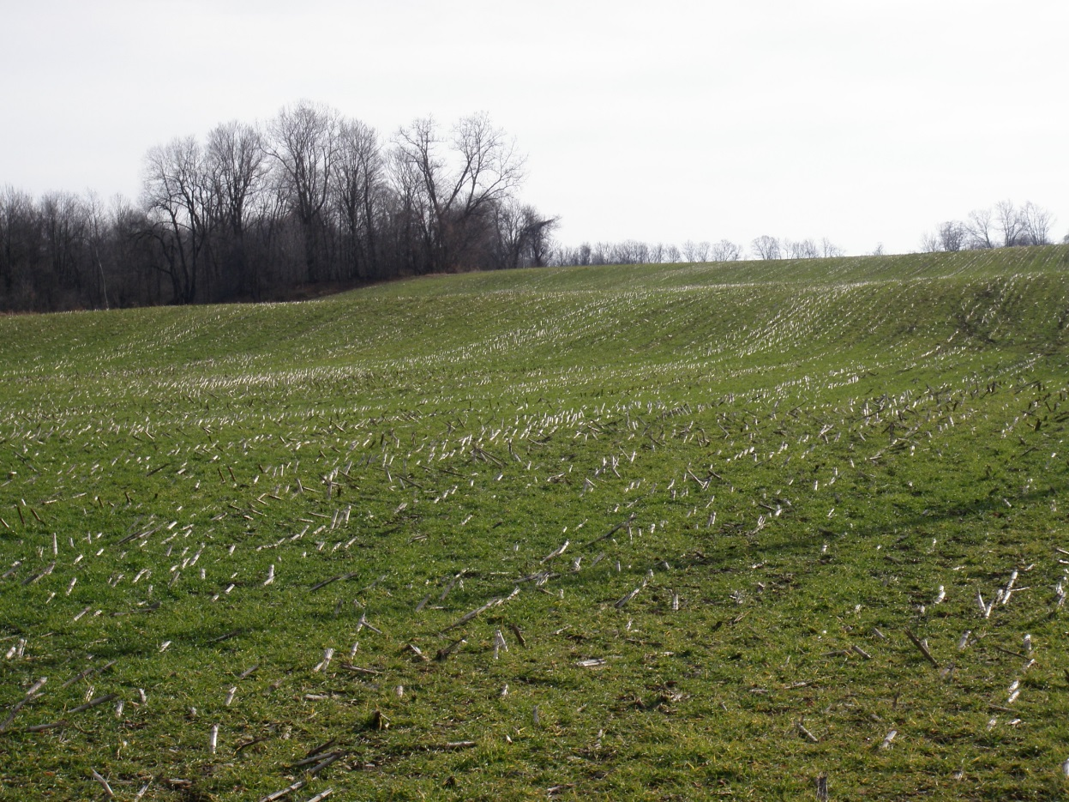
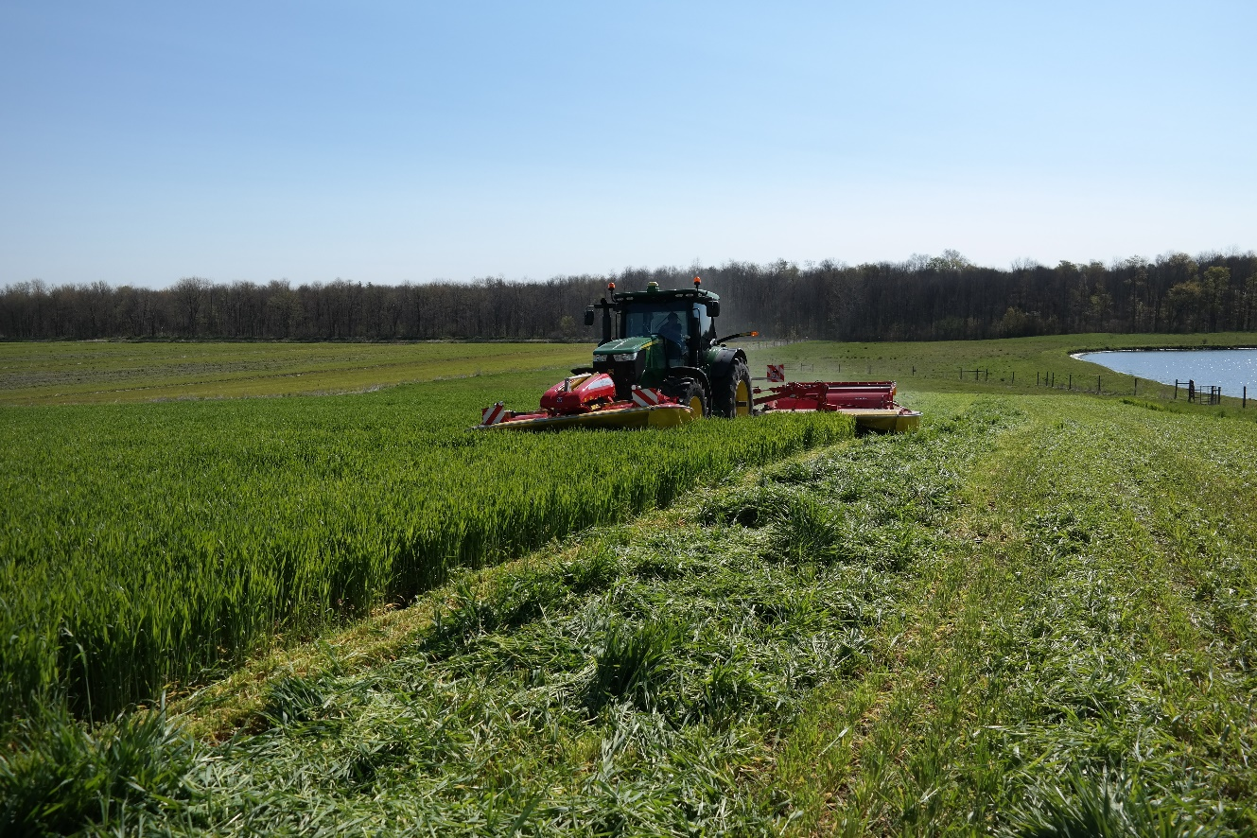
Winter Forage Triticale
Grown as Double Crop
Planted in Fall
Harvested in Spring
Notes:
Winter forage is opposite
Planted in the fall,
Harvested in the spring
This has a major impact on managing the plant nutrients as after a month or two of growing, the crop goes dormant for 3 – 4 months.

Slide 4
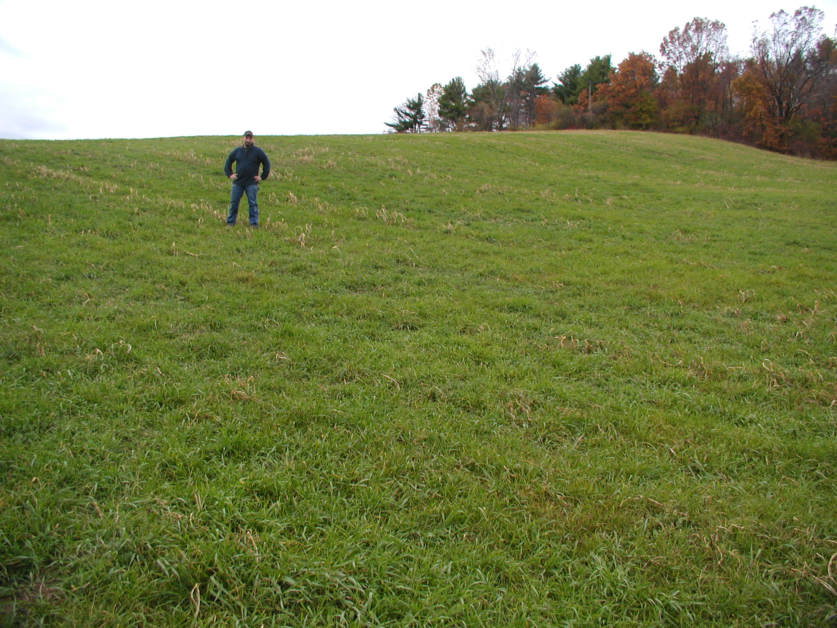
Notes:
Extensive research has shown that cover crops protect the soil from erosion; improve soil health, and retain nutrients – especially nitrogen that would be lost to waters or denitrification over the winter.

Slide 5
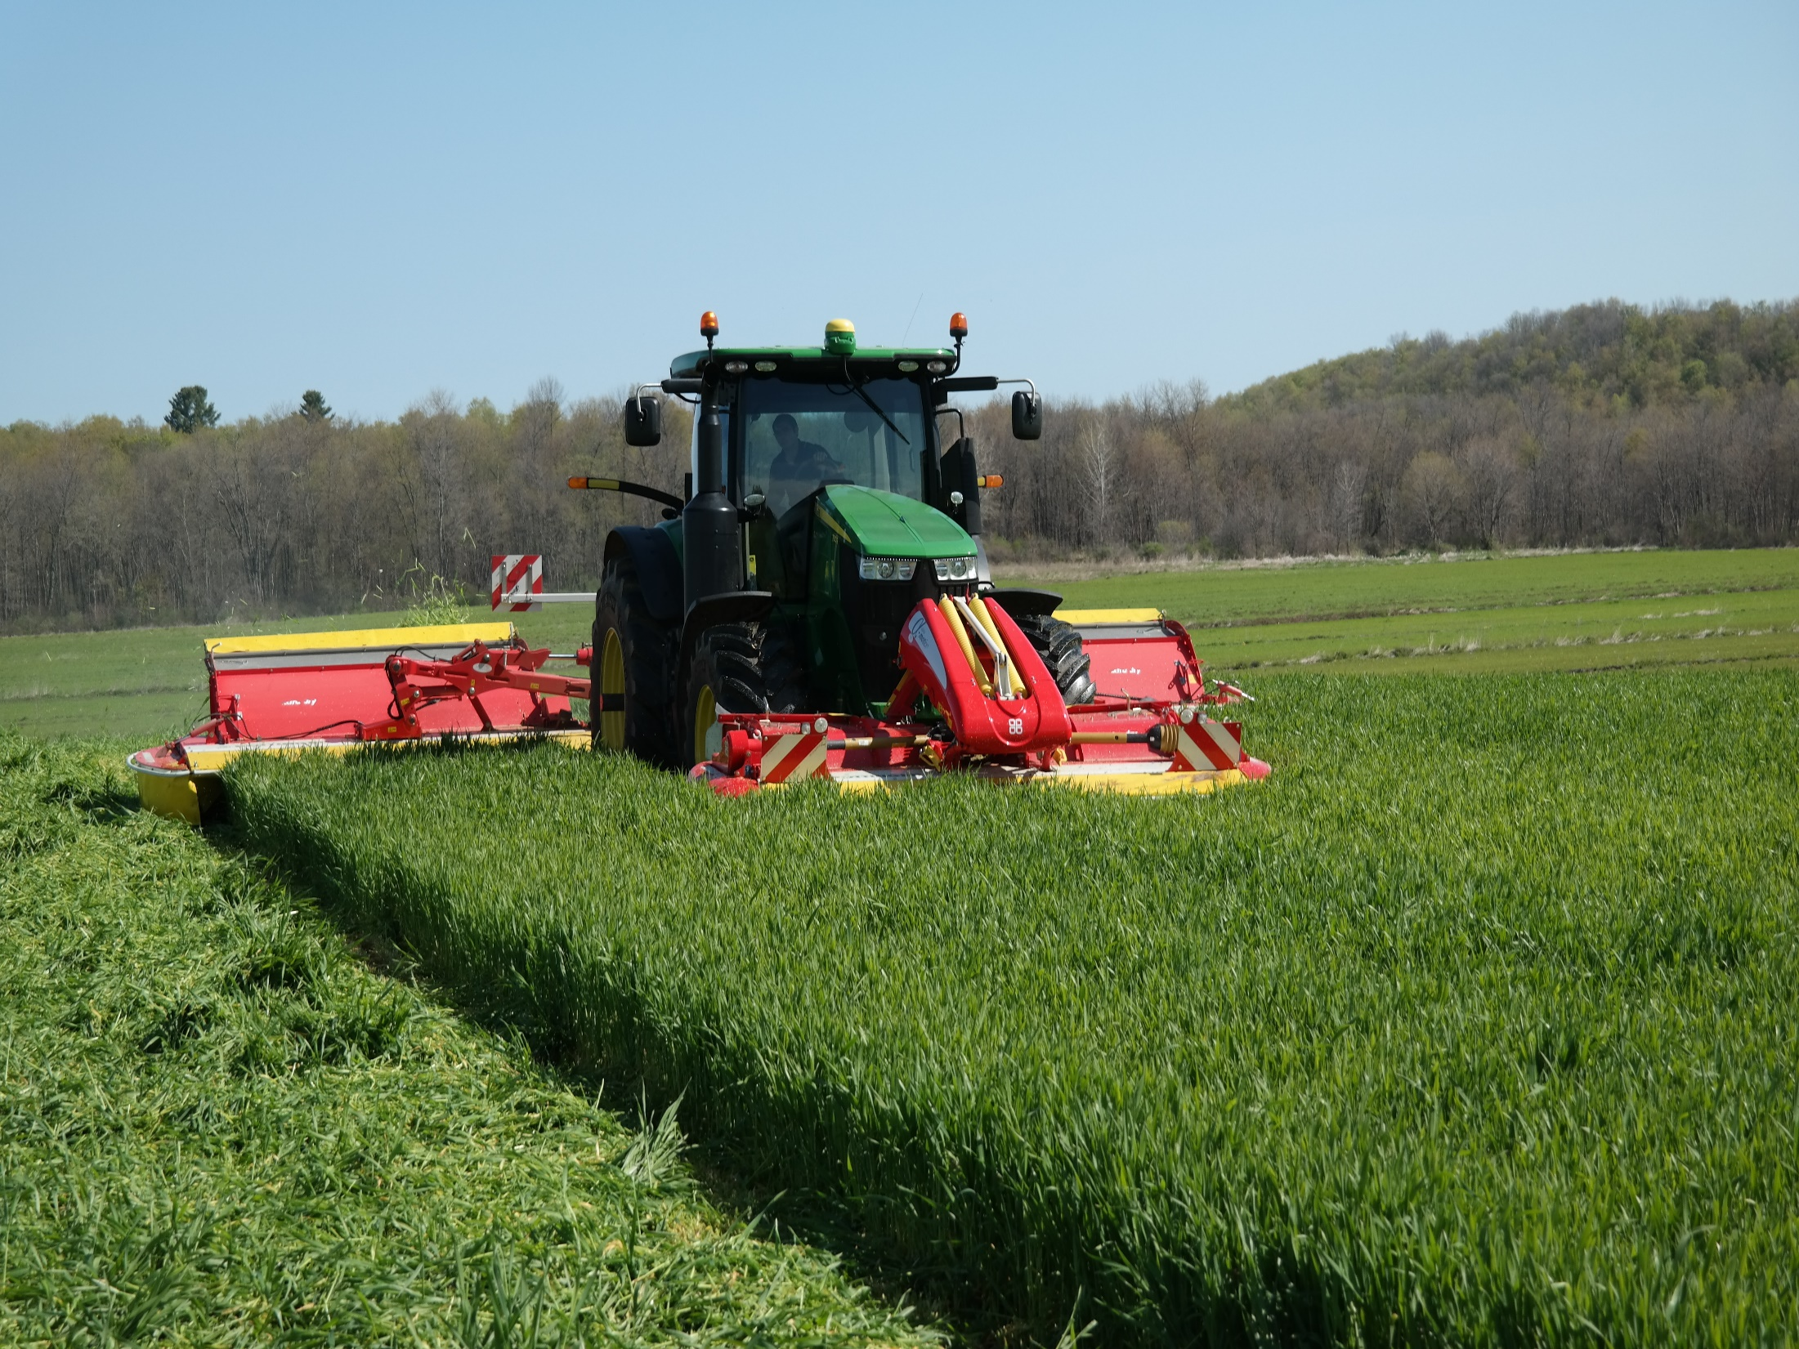
Winter Forages are Cover Crops on Steroids: .
all the soil/nutrient benefits plus immediate return to your checkbook
Notes:
Winter forage, because it produces a very high quality, profitable crop; can respond to higher management. The higher management has the potential to magnify the benefits of cover crops on your farm producing a win/win situation.

Slide 6
Winter Forage Rotation Can:
Improved soil health for long term yield increases and the ability to produce in adverse weather.
Increase corn yields in tilled and no-tilled ground (On going NY work).
Notes:
Both researchers and farmers CLICK are coming to the realization that never leaving the soil bare is critical to building soil health for high yields under a wide range of weather conditions. CLICK Dr. Van Es and others found that a cover continues to pay as it increases the yield of the next crop

Slide 7
Improves Structure Benefits Next Crop
Corn grain increased yield 4 – 7%
Soybeans 3yr avg. increased yield 8 – 15%
Nitrate in drainage water reduced 21-38%
Surface permeability in clay loam increased 7X
Drury et al J. Environ Qual 2012

Slide 8
Winter Forage Rotation Can:
Reduce winter and perennial weeds pressure by competition
Notes:
By not leaving the soil bare for 8 months in New York, CLICK you can reduce perennial weeds and nearly eliminate winter annual weeds from the competition of early planted winter triticale or rye.

Slide 9
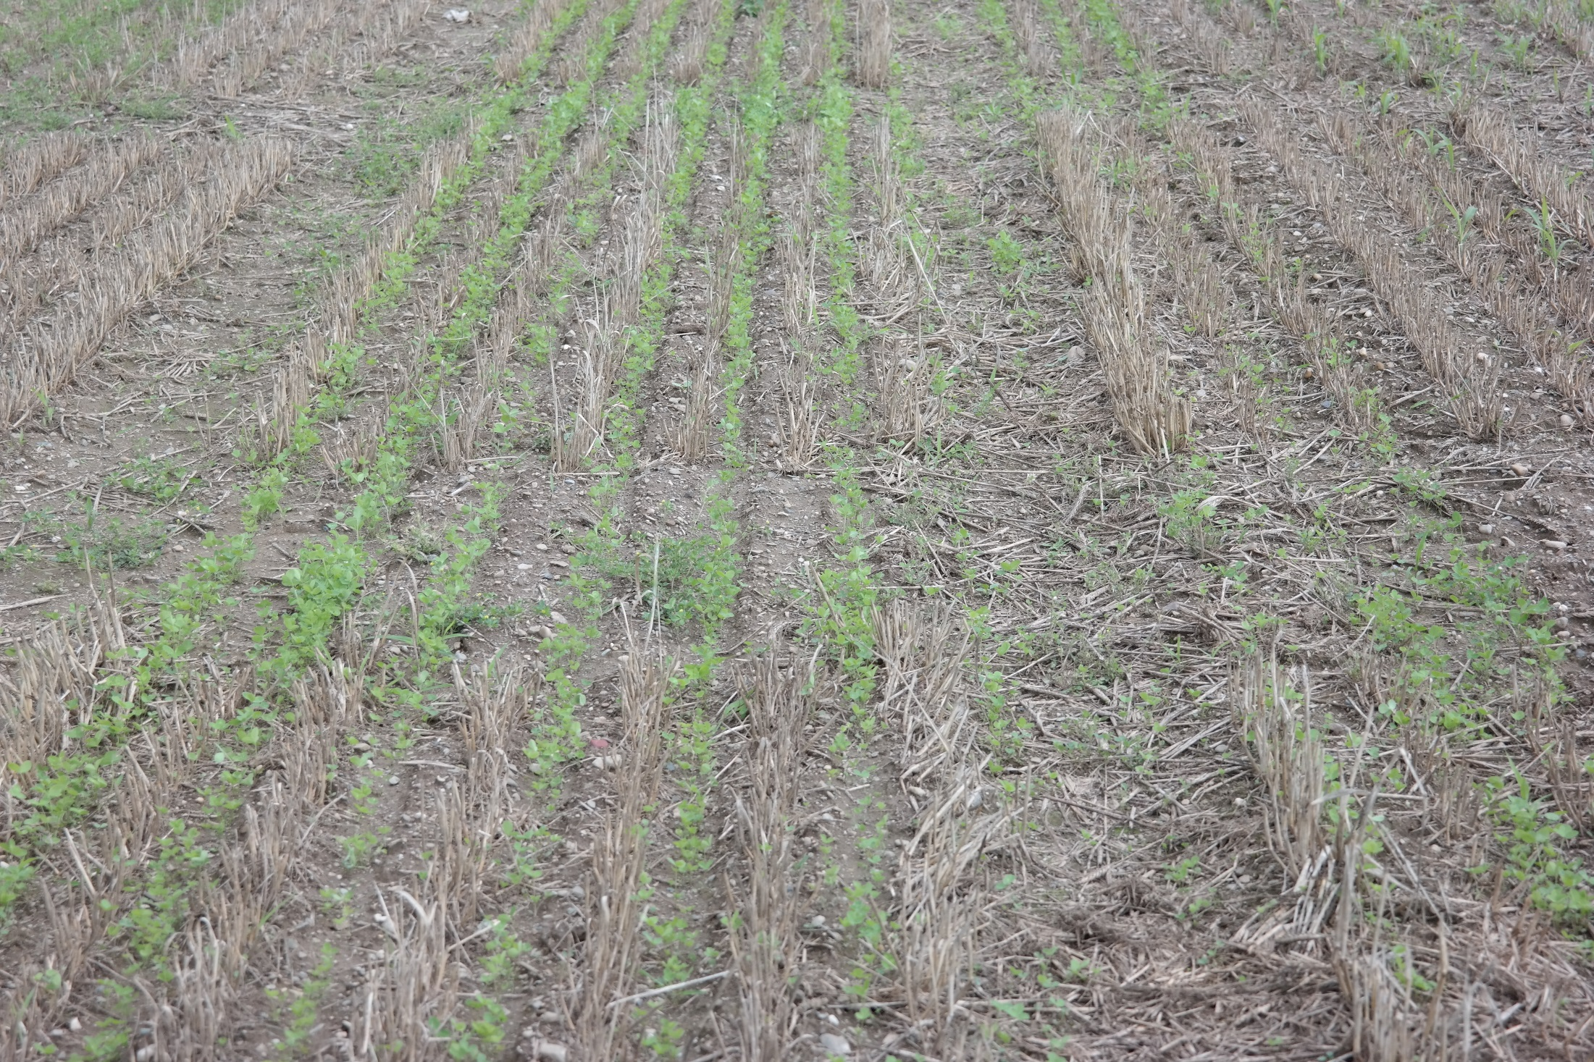
No-Till
Alfalfa
Red Clover
Soybeans
into Winter Forage
Better Stands
No Soil Erosion
Fewer Weeds
Notes:
And as reported last year in CCA, no-till planted alfalfa, red clover, soybeans into winter forage stubble results in crops can be rotated without erosion and with fewer weeds. It gives better stands plus it moves the seeding work load from the early spring madhouse rush to after first cutting haylage.

Slide 10
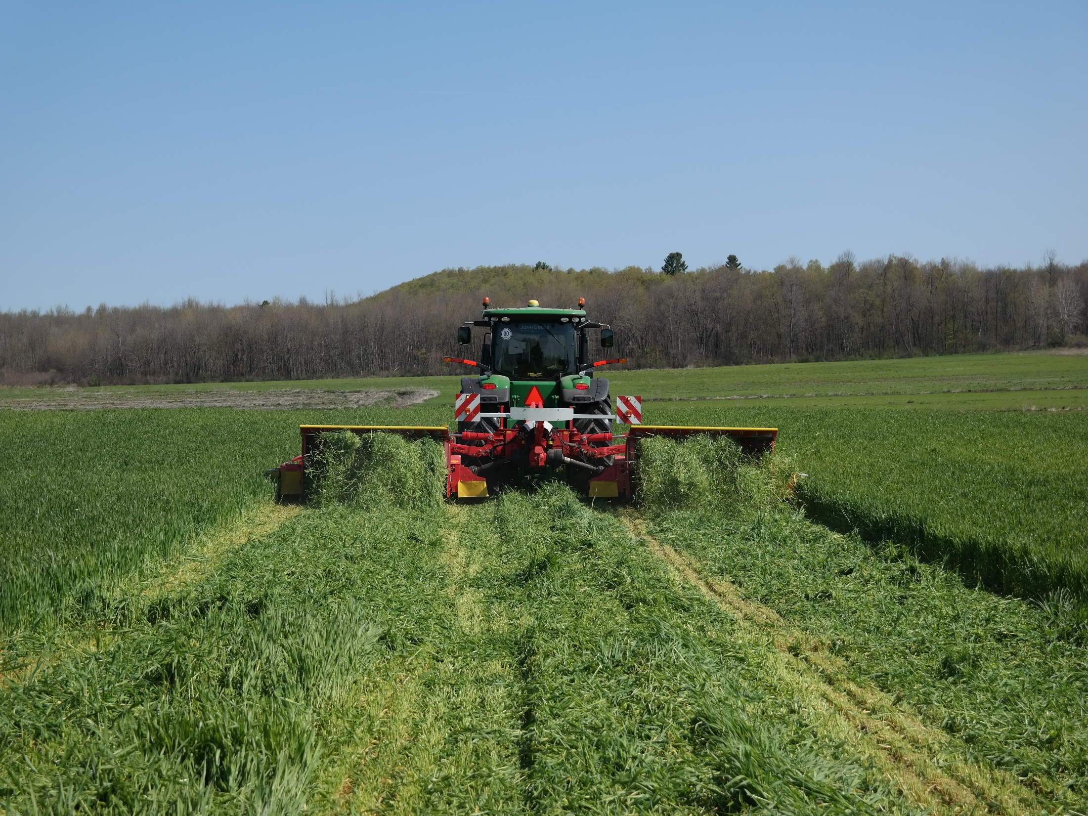
Winter Forage Rotation Can:
Increase dry matter harvested/acre by 25 – 35%
Harvest 6 to 10 tons/acre of high quality silage before spring grasses or legumes are ready.
Notes:
A critical benefit of winter forage is the production of some of the earliest and highest quality forage possible on NY farms. Yield of 6 – 10 tons of silage/acre are not uncommon. By double cropping with shorter season corn or bmr forage sorghums, yield/acre can be directly increased 25 to 35%.

Slide 11
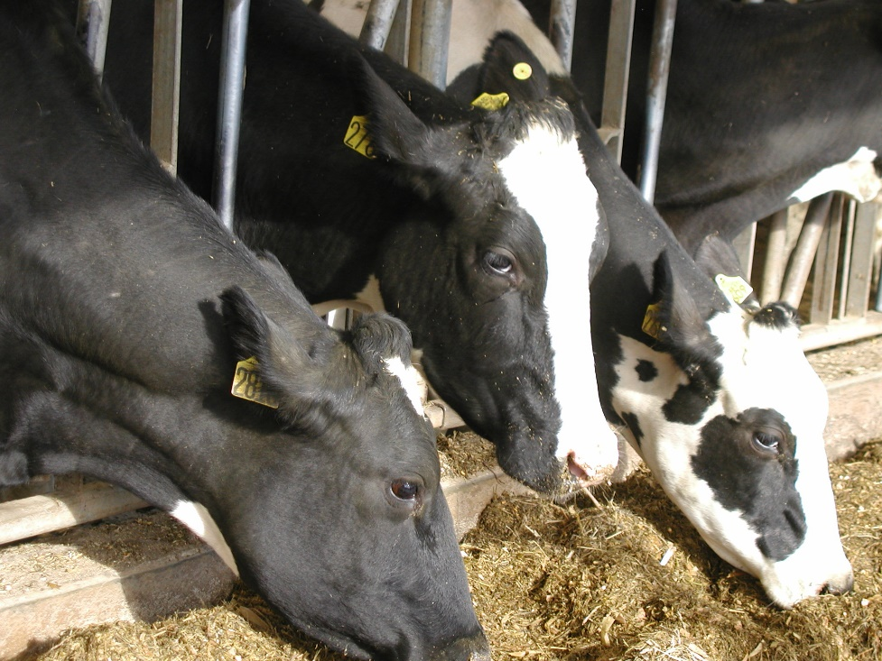
Winter Forage Rotation Can:
Produce forage that supports the very specific diet of the high and fresh cows.
Have forage that farmers and nutritionists report keeps the cows milking in hot weather.
Notes:
Not only do you directly increase your forage supply, CLICK but the feed produced is what is needed to meet the specific diet of the fresh cows and high producers.
CLICK An added bonus is that farmers and nutritionists utilizing the high digestibility of winter triticale report it keeps the cows maintaining production through the hot summer slump.

Slide 12
 | Average | Low | High
DM | 24.28 | 19.93 | 27.5
Crude Protein | 20.35 | 19.71 | 21.07
ADF | 25.42 | 24.06 | 27.53
Ash | 7.61 | 7.38 | 7.93
Lignin | 1.02 | 0.44 | 1.87
Sugar | 6.16 | 4.81 | 7.11
Starch | 4.60 | 2.6 | 5.48
NDFD 30 | 68.21 | 65.57 | 70.21
TTNDFD | 66.45 | 64.11 | 69.44
RFQ | 193 | 176 | 206
RFV | 160 | 147 | 169
Kd%/hr | 5.74
Nel | 0.75 | 0.731 | 0.762
Fermented Winter Forage Samples
Notes:
Properly fertilized with sulfur, CLICK protein equal or exceeds alfalfa. To get this protein production, the nitrogen must be managed to maximize yield while minimizing environmental loss through both the fall and spring portion of the growth cycle.

Slide 13
Benefits Accrue According to Fall Biomass Produced
September 9
October 6
Notes:
Last year’s cca looked at the impact of planting date and fall biomass production as potential drivers of both nutrient re-capture and storage, and potential spring yields.

Slide 14
Winter Cereal Planting and N Rate
Four year-locations in eastern and central NY
Triticale planted at two dates per site
Randomized complete split-split-plot design
Main plots: planting date
Split plots: 5 N rates in fall
Split-split plots: 5 N rates in spring
4 replications
Above-ground forage analyzed for biomass and N content

Slide 15
Winter Cereal Planting and N Rate
A
A
A
AB
B
a
a

Slide 16
Winter Cereal Planting and N Rate

Slide 17
Winter Cereal Planting and N Rate

Slide 18
Winter Cereal Planting and N Rate
Planted 9/16
Planted 10/7
Photos taken 11/16

Slide 19
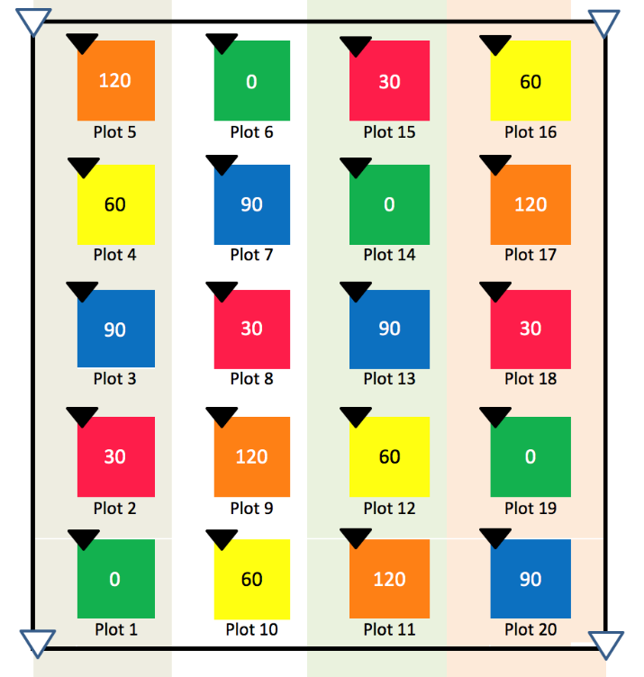
Spring N Needs of Winter Cereals
58 on-farm trials over 3 years
Cereal rye (21), triticale (37)
5 N rates applied at green-up in the spring (Agrotain®-treated urea)
0, 30, 60, 90, and 120 lbs N/acre
Harvest at flag leaf stage in May
Determined the Most Economic Rate of N (MERN)

Slide 20
Spring N Needs of Winter Cereals

Slide 21
What Impacts Spring N Needs? Soil Fertility!

Slide 22
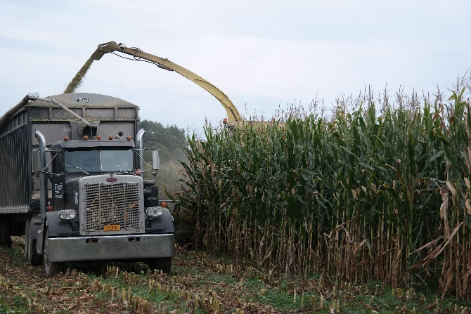
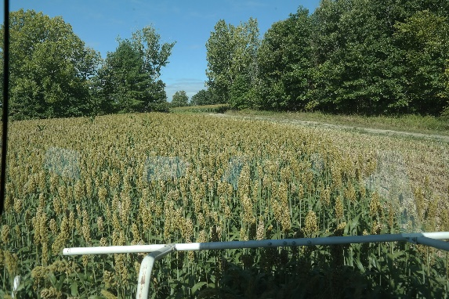
Basic Double Crop System
HarvestTriticale
May 15-18
Sept 10
Manure?
Till/Plant
Triticale
Manure
Till/Plant Annual
Shorter Season Corn
BMR Sorghum sp.
Advanced Ag Systems LLC
Notes:
22
Winter Forage teams up with Summer energy crops for year around cropping system

Slide 23
Double Crop with Short Season vs Straight Traditional Corn Silage
Dr. Cox, Cornell

Slide 24
3/4 ton of silage lost for every 5 day shorter season corn
105-85= 3 tons corn silage
(1.05 Ton DM)
1.05 x 3700 lbs of milk potential/ton =
3780 lbs of milk lost/acre

Slide 25
3 ton of corn silage lost 3780 lbs of milk lost/acre
5.7 – 12 Tons of Winter Forage/A
2-4.2 tons of DM/a @ 4000 lb milk potential/ton DM
8000 – 16,000 lb. milk /A GAIN

Slide 26
Am I a Corn Grower also Growing Winter Forage
Or a Winter Forage Grower also Growing Corn Silage?

Slide 27
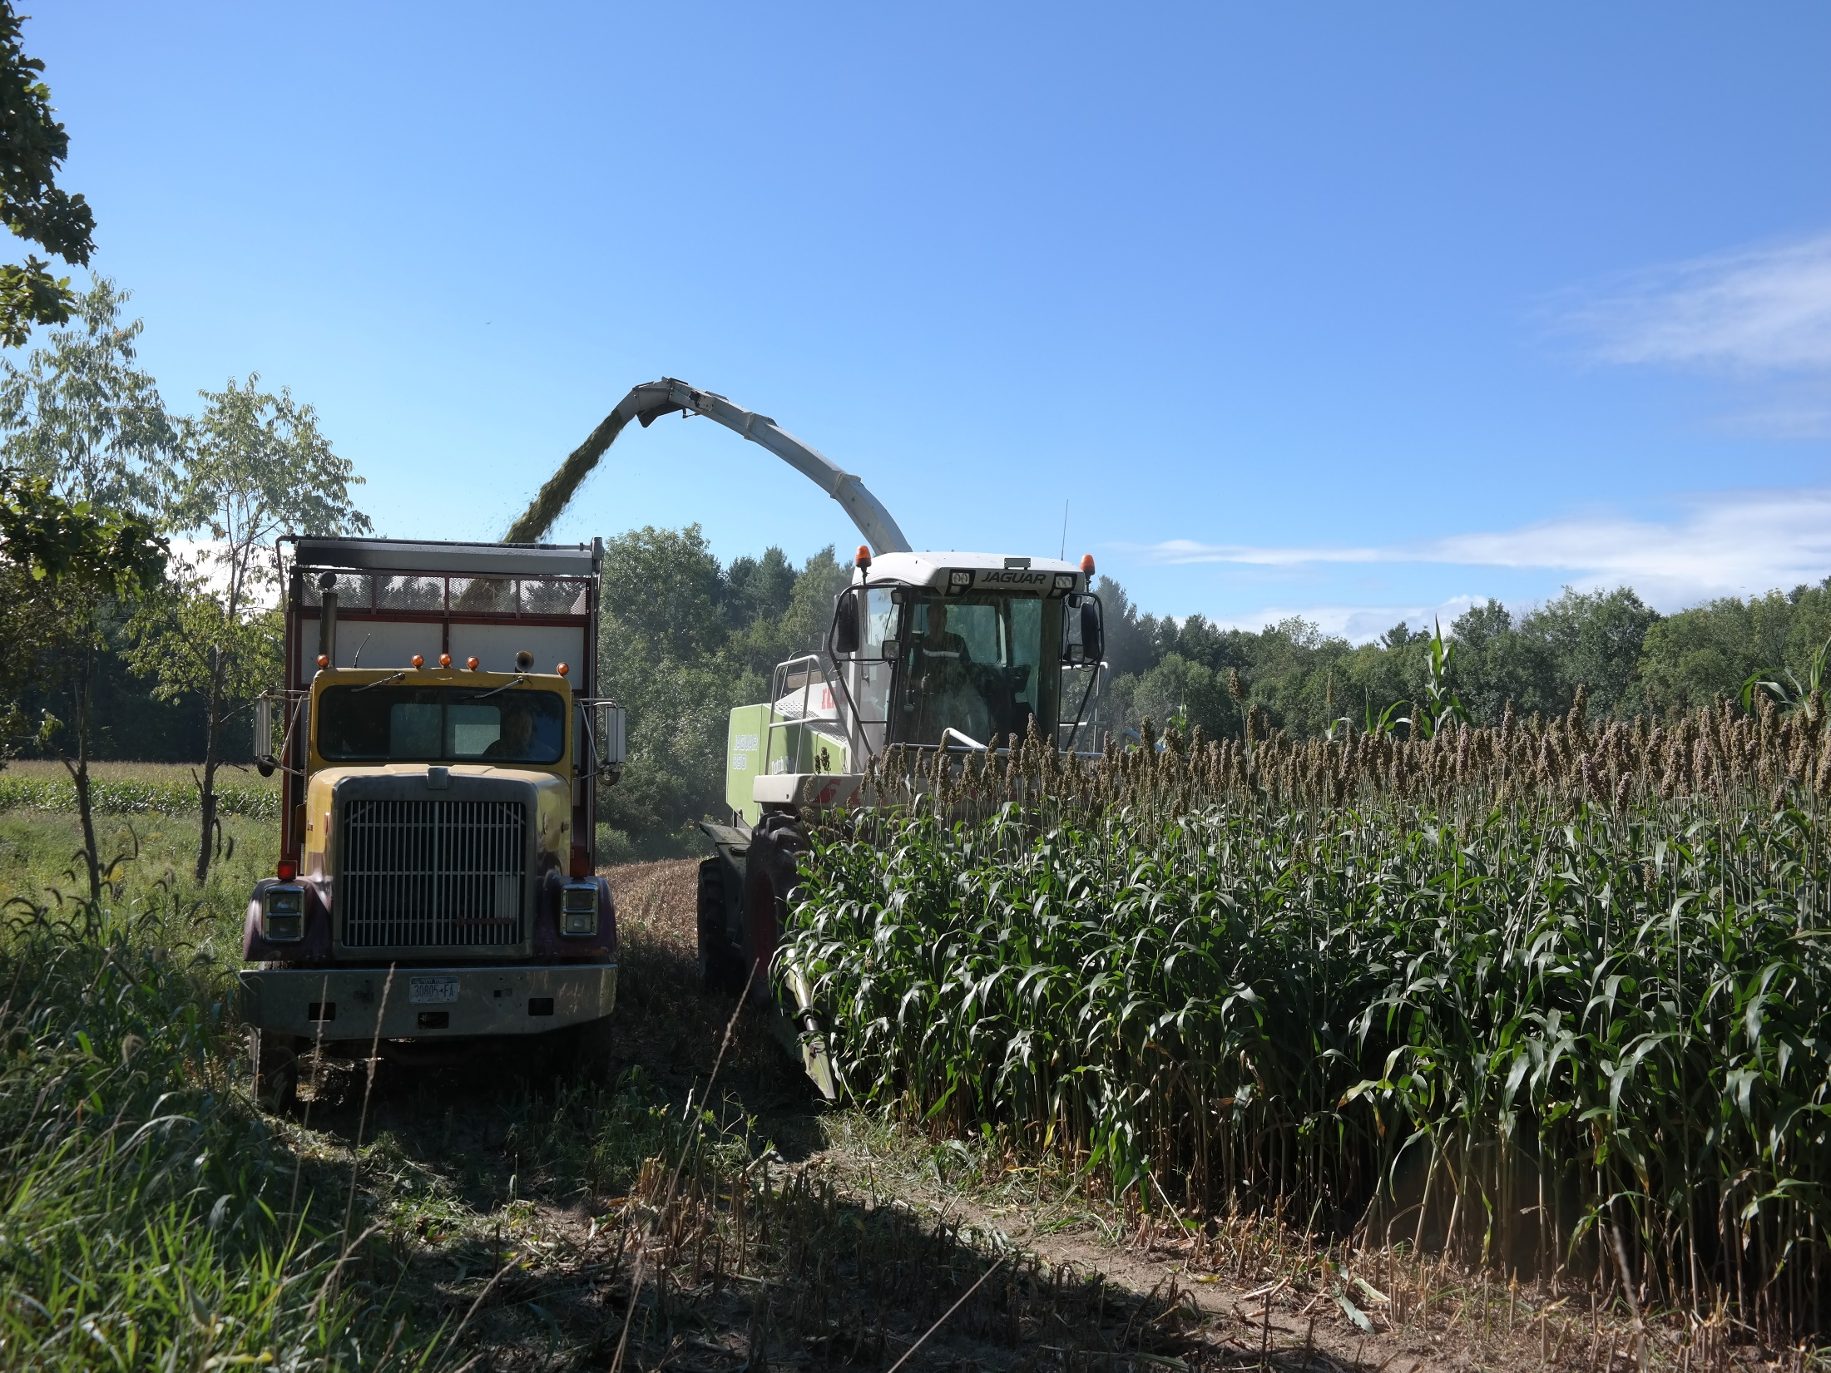
The Other Summer Energy Crops
Between Winter Forage
Harvesting and Planting
Notes:
There are no short season BMR corn crops available yet. There are other short season bmr energy crops that can be successful in NY conditions: BMR forage Sorghum is one.

Slide 28
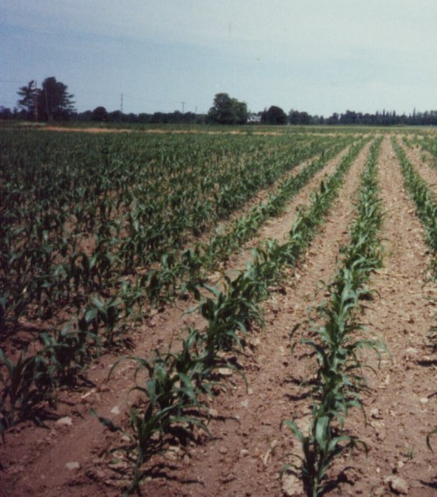
Sorghum sp. can Protect the Environment ½ the soil erosion of conventional corn
Corn
BMR-Sorghum-Sudan
Bare Ground 1 month later
Complete ground cover in 2 – 4 weeks

Slide 29
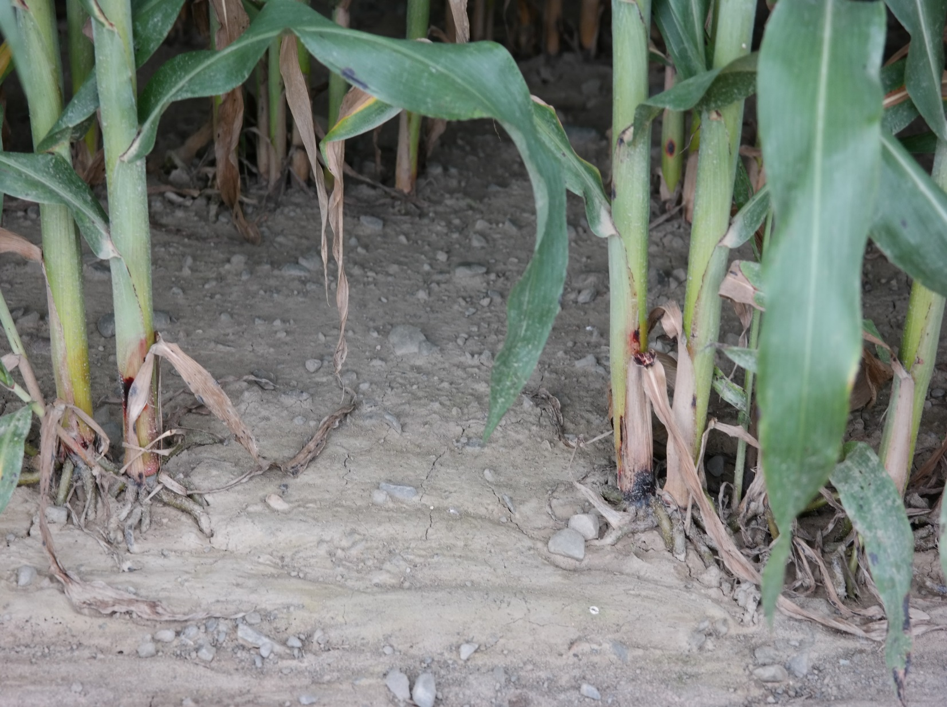
Drilled BMR Forage Sorghum
No Erosion
Erosion
Notes:
BMR forage sorghum drilled for canopy closure to reduce/prevent erosion and late season weed pressure.

Slide 31
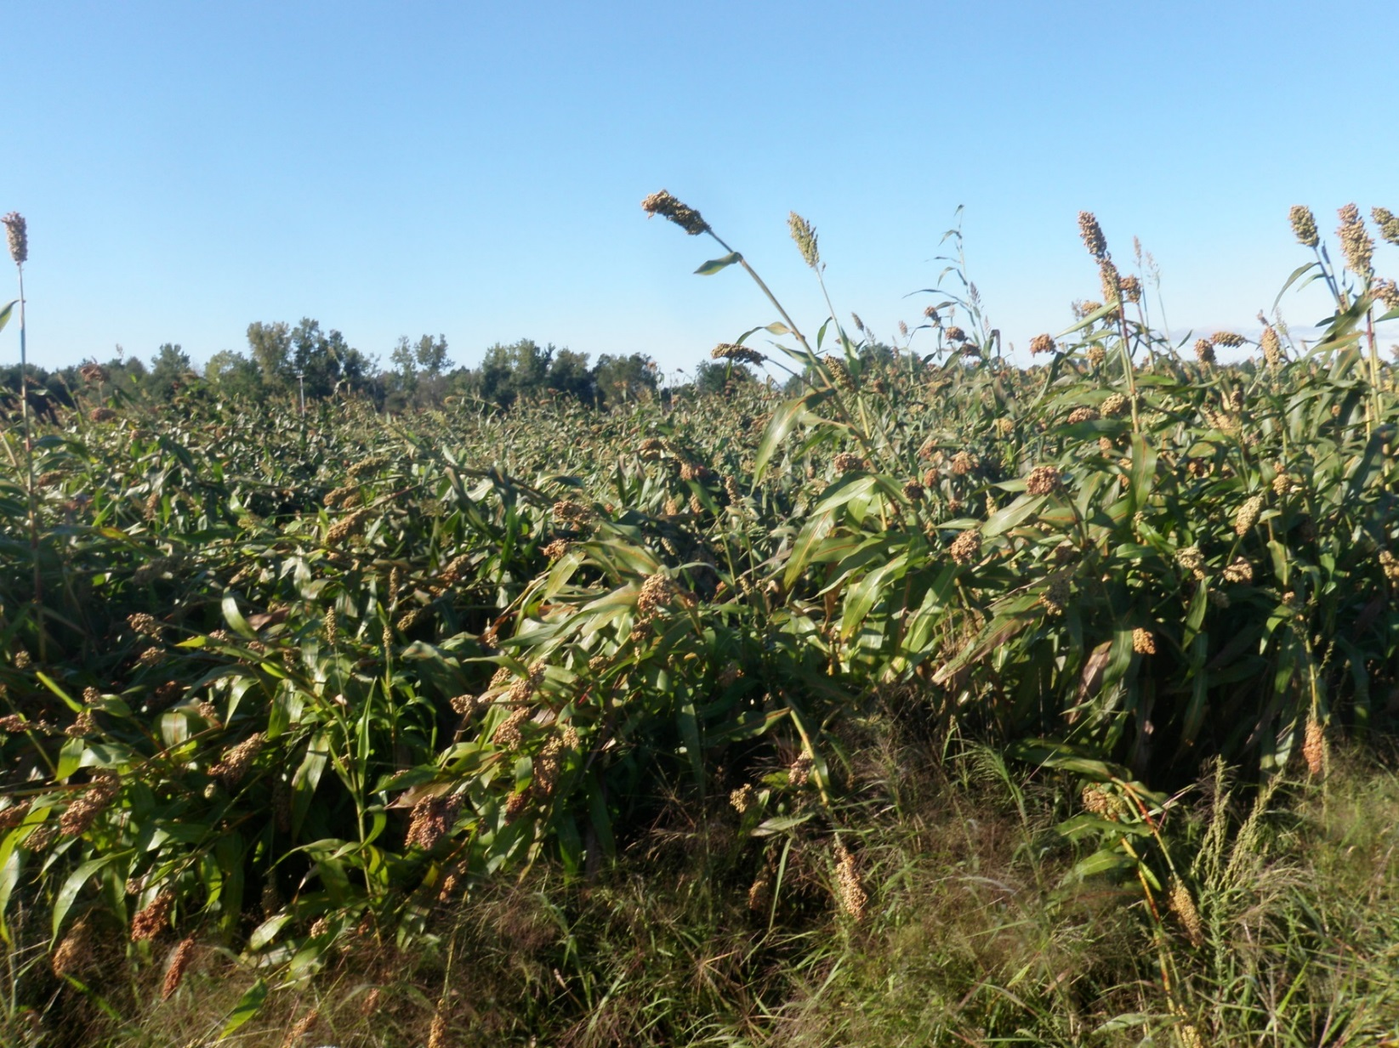
No Crop is Without its Shortcomings - Problems
Pre Harvest Lodging
Notes:
Historically lodging ranked at the top for farmer turnoff.

Slide 32
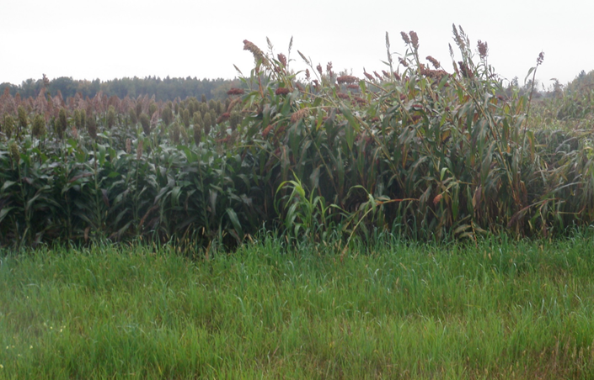
Brachytic Dwarf
BMR Forage Sorghum
BMR Forage Sorghum
Notes:
Brachytic dwarf 85-89 day bmr forage sorghum is a partial answer. It will still lodge if allowed to got to hard dough stage as the plant cannibalizes the stalk to move nutrients to the maturing head.

Slide 33
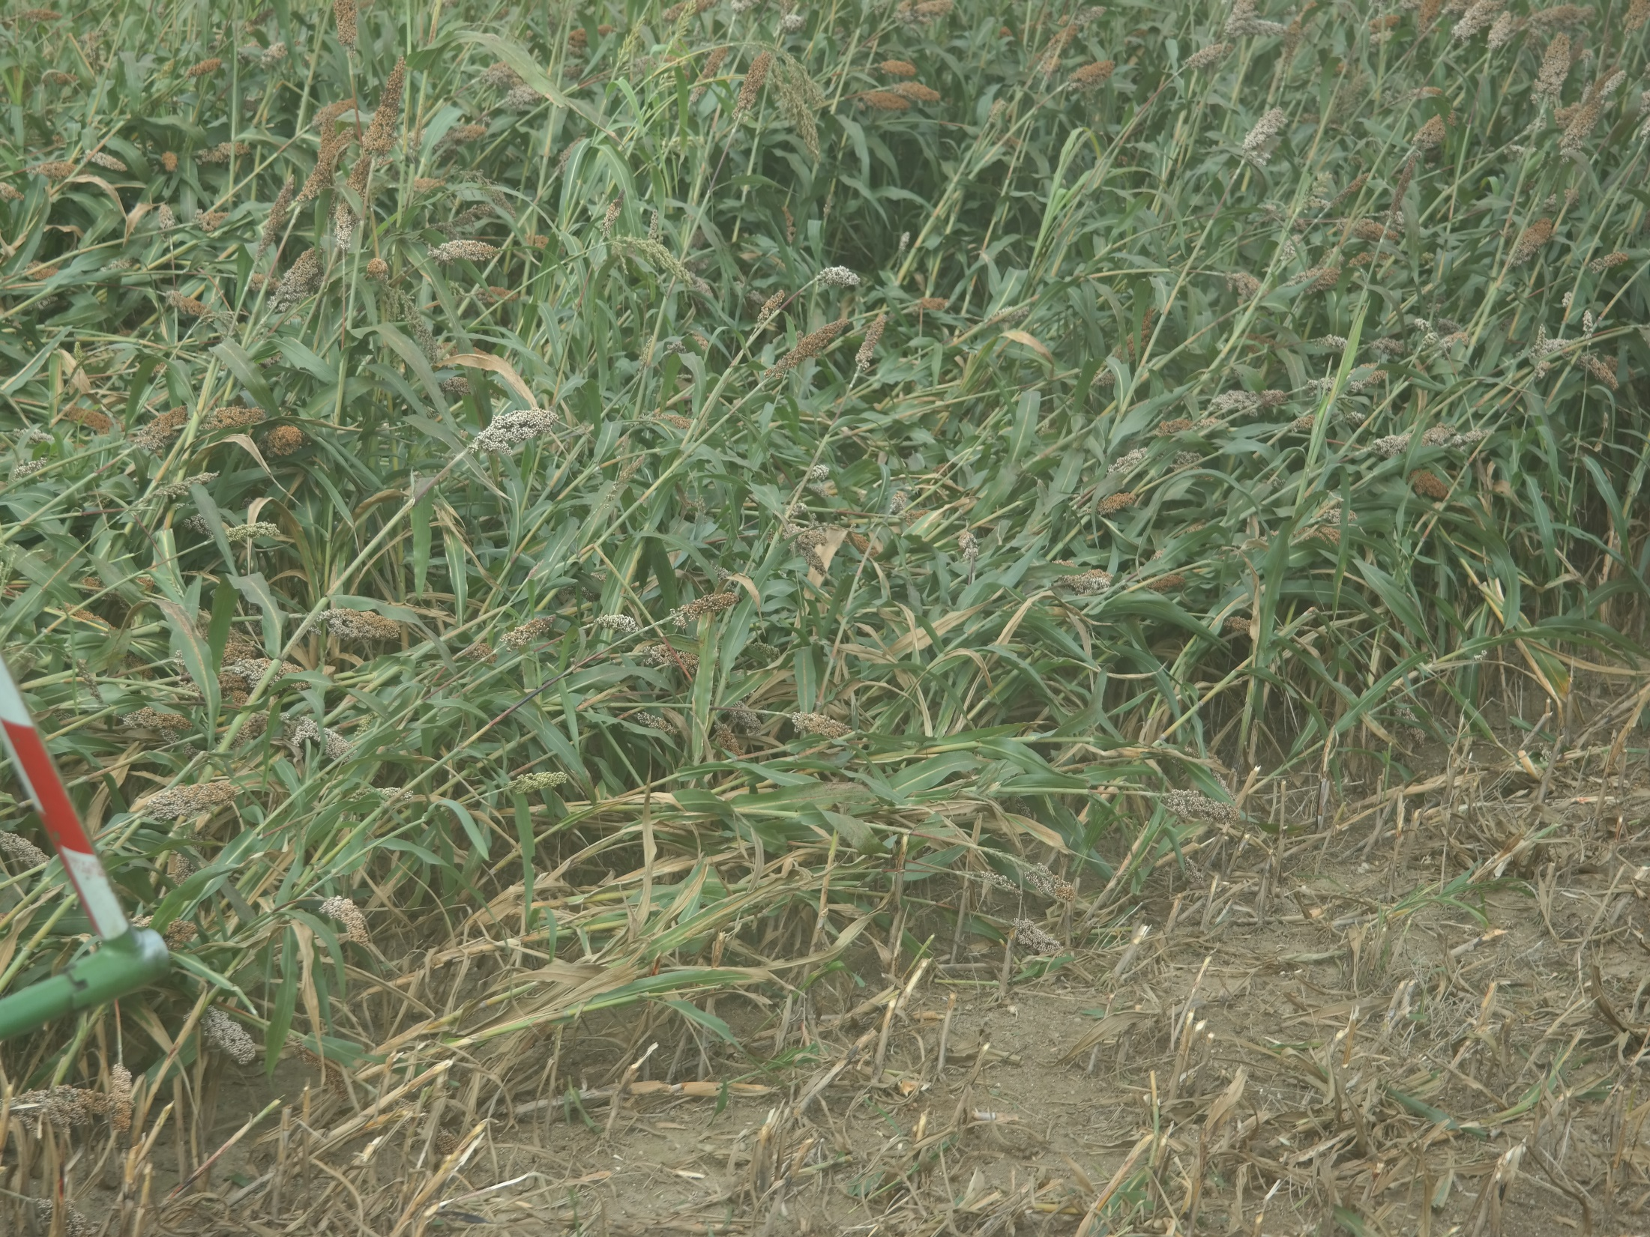
Notes:
Krone chopper was able to get over 95% of the lodged material while going in the direction of the lodging.

Slide 34
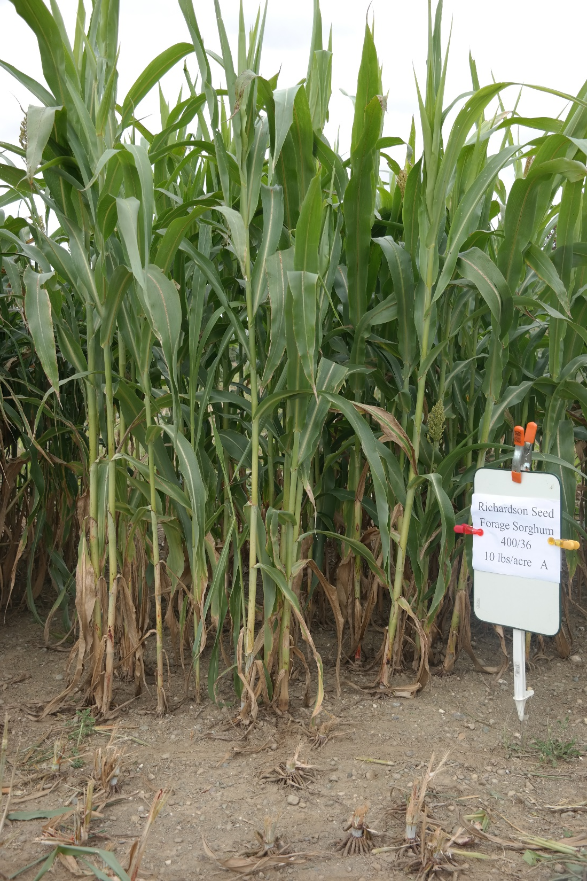
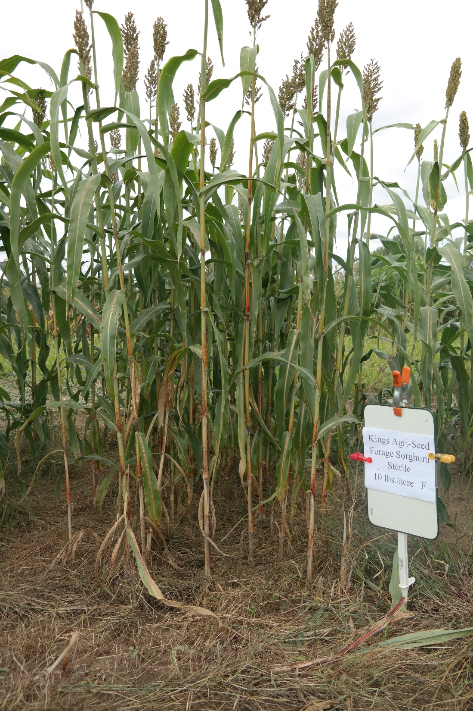
Notes:
Alternative to lodging is to use BMR forage sorghum Male sterile plants that do not have pollen to set a seed head. Thus there is no heavy weight at the top to pull it over and the energy (sugars, cellular starch) stays in the stalk to maintain stem integrity.

Slide 35
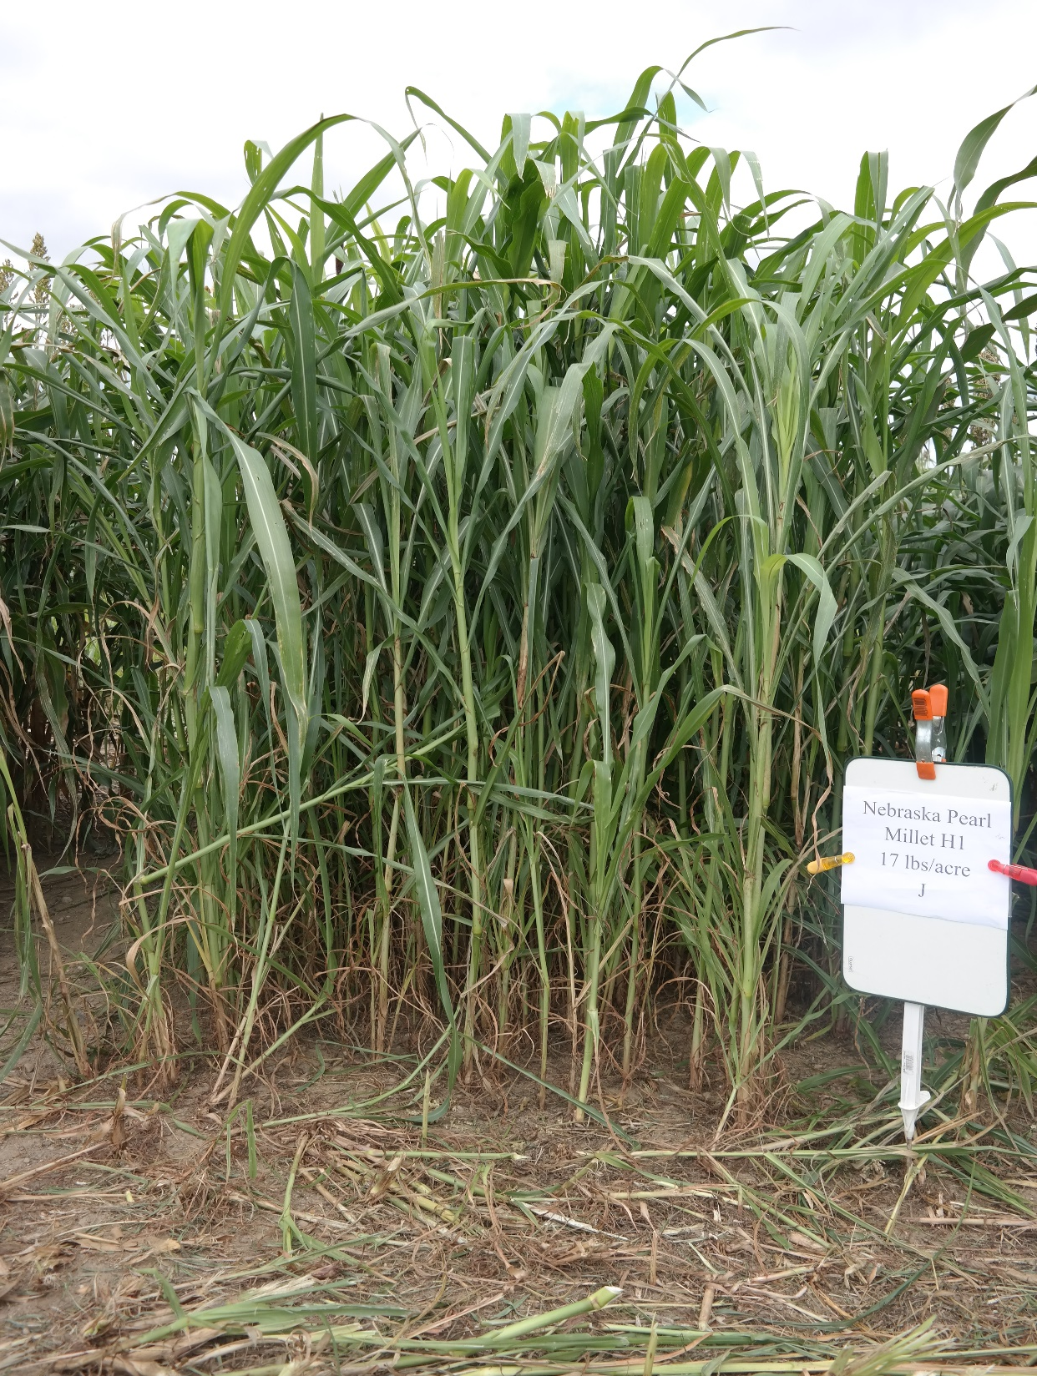
BMR Pearl Millet
July 8, 2015
Oct 6, 2015
25.5 Tons @ 35% DM
22% DM at harvest
Notes:
A third option is a completely different species: BMR Pearl Millet. A high yielding crop with higher protein and digestibility than even the sorghums. In 2016 a July 8 planting yielded 25 Tons/acre of 35% DM silage (actual dry matter was 22%) by the beginning of October. Work is needed to determine feed quality change with maturity for both the male sterile sorghum and the pearl millets.

Slide 36
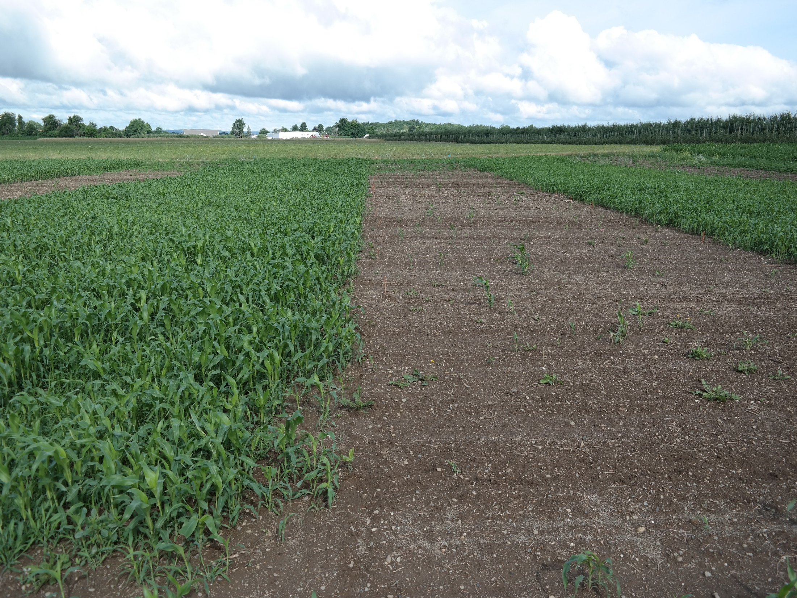
Planted
4” Soil 72 F
4” Soil 58 F
Notes:
This is the variety trial planted June 3 into soil 72F at 4 inch depth
The alleys were planted two weeks later.
The green is the alleys, the brown the plots killed by chilling injury.
The crop needs warm temperatures

Slide 37
Tons 35% DM Silage/A | Yield Mean | Yield Max
2012 | 20.42 | 23.7
2013 | 24.78 | 26.99
2014 | 24.28 | 26.55
2015 | 16.57 | 20.15
+rain | 21.4
2016 | 23.1 | 26.4
irr 2x | 26.8 | 30.5
Notes:
BMR forage sorghum has given consistent yields.

Slide 38
Feeding Value of Brachytic Forage Sorghum Compared with Corn Silage from First or Second Harvest for Lactating Dairy Cows
J. K. Bernard and S. Tao
Results of this trial suggest that silage produced from brachytic forage sorghum, …….. can support similar intake, milk yield and composition as diets based on corn silage.
University of Georgia Brachytic Sorghum Feeding Trial
Notes:
Research in Georgia suggests it is the same as their corn silage in milk producing ability. We have radically different conditions with cool nights and warm days increasing the sugar production and conservation in maturing sorghum plants.

Slide 39
Impact of Nutrient Make-up: BMR Sorghum Sudan pre grain fill
Same Total Energy – Different Source
Plant Fibers & Sugars
Grain & Starch
Notes:
In addition sorghums energy makeup is very different than corn with much higher sugars after fermentation. As the plant moves from pollination to hard dough stage it increases the amount of starch but often also increases the amount of sugar as all photosynthetic material is moved into both energy storages.

Slide 40
BMR Forage Sorghum Quality

Slide 41
Forage Sorghum vs. Corn: Quality
Year | CP at MERN | NDF | TDN | Sugars | Starch | NFC | NDFD₃₀
 | % of dry matter |  |  |  |  |  | %NDF
2012 | 7.0 | - | - | - | - | - | -
2013 | 7.7 | 52 | 68 | 10 | 17 | 38 | -
2014 | 7.2 | - | - | - | - | - | -
2015 | 7.0 | 48 | 70 | 12 | 18 | 41 | 60
2016 | 10.0 | 45 | 71 | 11 | 21 | 42 | 59
Corn* | 7-9 | 36-49 | 68-76 | 2-8 | 25-41 | 37-51 | 46-58
Data is for fresh forages (pre-ensiling)
*Dairy One feed composition library

Slide 42
Forage Sorghum vs. Corn: CNCPS
Animal Inputs
Milk production | 88 lbs/day
Mature weight | 1,650 lbs
Age | 65 months
Days since calving | 120 days
Sorghum quality results were included in a theoretical ration for a NY dairy
Control ration was balanced to meet all animal requirements
Sorghum was substituted at different % of the total corn silage in the diet
Control Diet
Corn silage (30% DM, 41%NDF) | Citrus pulp, dry
Alfalfa silage (20% CP, 40% NDF, 17% LNDF) | Corn gluten feed, dry
Corn grain ground fine | Blood meal
Soybean meal | MinVit
Soybean hulls | Trace Mineral Premix
Cottonseed fuzzy | Soy plus

Slide 43
Forage Sorghum vs. Corn: CNCPS
*P > 0.05
*P > 0.05

Slide 44
Sorghum vs. Corn: CNCPS
*P < 0.05
*P < 0.05
*P < 0.05

Slide 45
Sorghum Time of Harvest 2015
Pollination
Soft dough
Yield
TDN

Slide 46
Sorghum Time of Harvest 2015
Pollination
Soft dough
NFC
Sugars (ESC)

Slide 47
Conclusions
Sorghum is similar in many quality parameters to corn silage
In a TMR sorghum provides more dietary sugars, less starch, and slightly more NDF
MP and ME supply are slightly less but not significant

Slide 48
Conclusions
Sorghum quality and yield does not change too much up to 3 weeks before soft dough stage, potentially allowing for earlier harvests
This allows for earlier winter forage planting and the benefits that go with it.

Slide 49
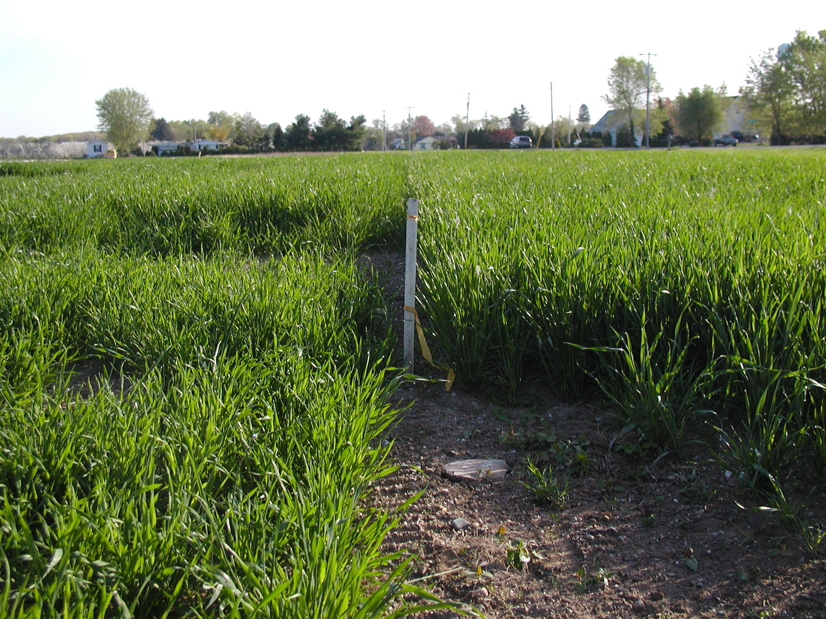
Notes:
Future research funded by New York Farm Viability Institute and conducted by Advanced Ag Systems at the Hudson Valatie Research Farm is determining how much manure can safely be applied to early planted winter triticale forage where the crop has tremendous potential to absorb and hold the nutrients in plant tissue until spring growth – a “green” manure storage as it were. The research is also determining if it is safe with a late planting where the soil temperature drops quickly enough to hold the manure nitrogen in the ammonia form until spring when the new growth will quickly absorb it as it becomes available. Both planting dates are testing if a nitrification inhibitor will help protect the nitrogen from losses.

Slide 50
Acknowledgements
NNADP
NESARE
Federal Formula Funds
Contacts
Tom Kilcer
Advanced Ag Systems LLC
www.advancedagsys.com
Quirine Ketterings
qmk2@cornell.edu
Sarah Lyons
sel248@cornell.edu
Notes:
Thank you to the New York Farm Viability Institute for supporting this critical research in sustainable agriculture.
Additional information can be found on our web site at WWW.ADVANCEDAGSYS.COM or at the Cornell Web site Nutrient Management Spear Program.

