Slide 1
Cover Crop Integration into Vegetable Production for Weed Suppression
Frances Browne, Steve Li, Katilyn J. Price
Auburn University, Auburn, AL
Department of Crop, Soil and Environmental Sciences

Slide 2
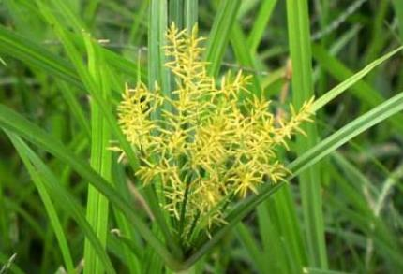
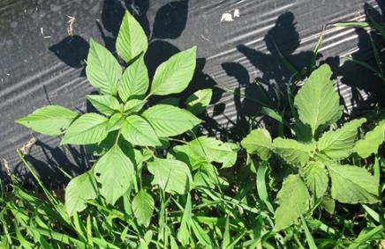
Introduction
Limited number of registered herbicides in vegetable production
Wide plant spacing can lead to early-season weed competition (Monks and Schultheis 1998)
High residue cover crops known to suppress weeds; however, vegetable responses can vary (Bietila et al. 2017)
Cover crop, plastic mulch, and herbicide combinations could reduce weed pressure and maximize yields
10% melon yield loss at 2 plants/m²
90% melon yield loss at 6 plants/m²
(Buker et al 2003; Monks and Schultheis 1998)
Department of Crop, Soil and Environmental Sciences

Slide 3
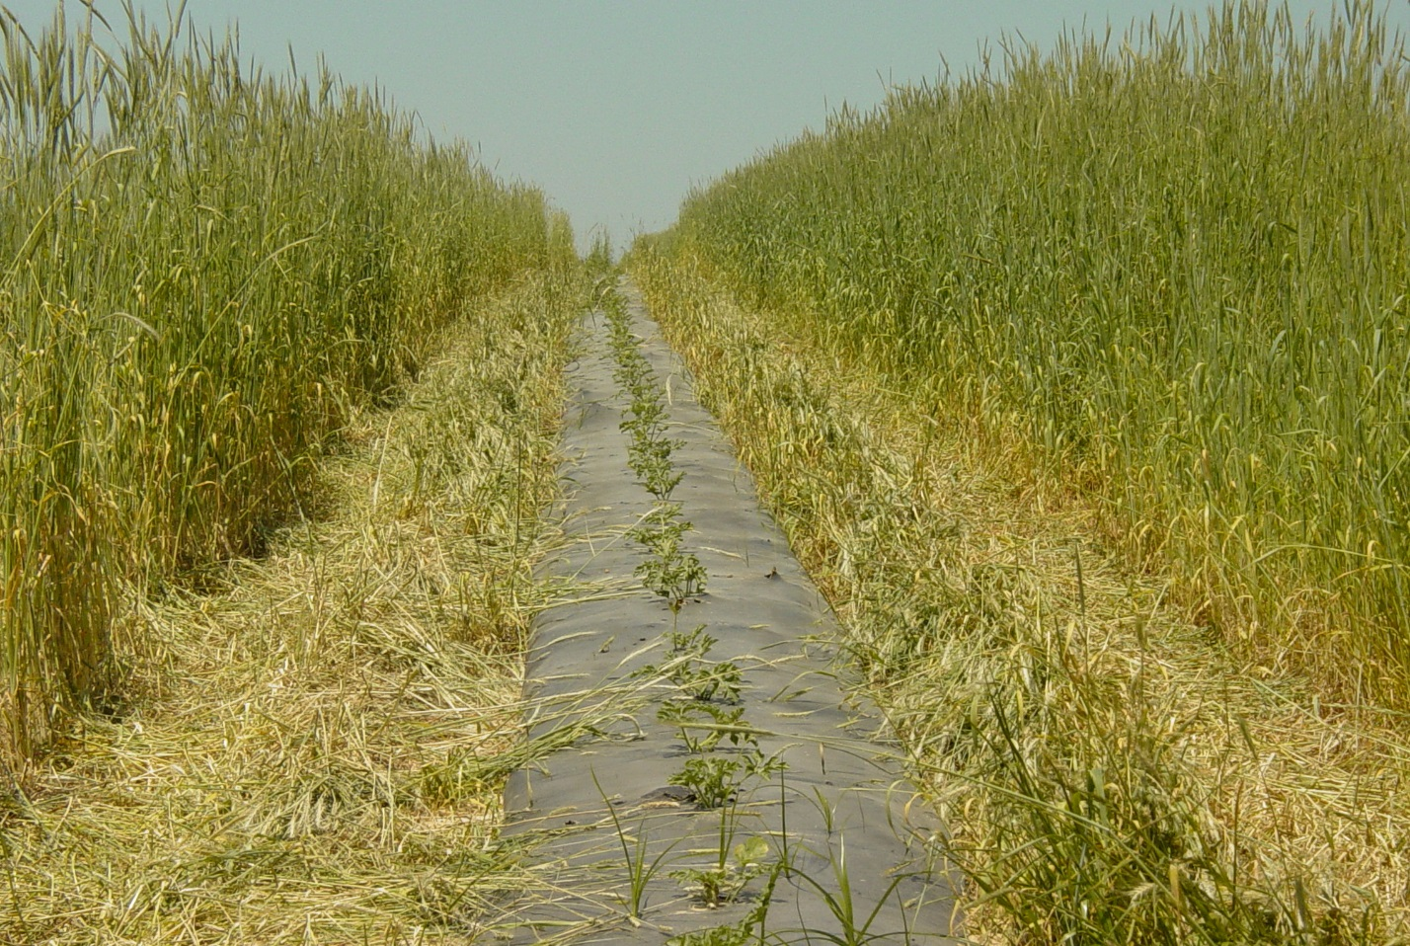

Slide 4
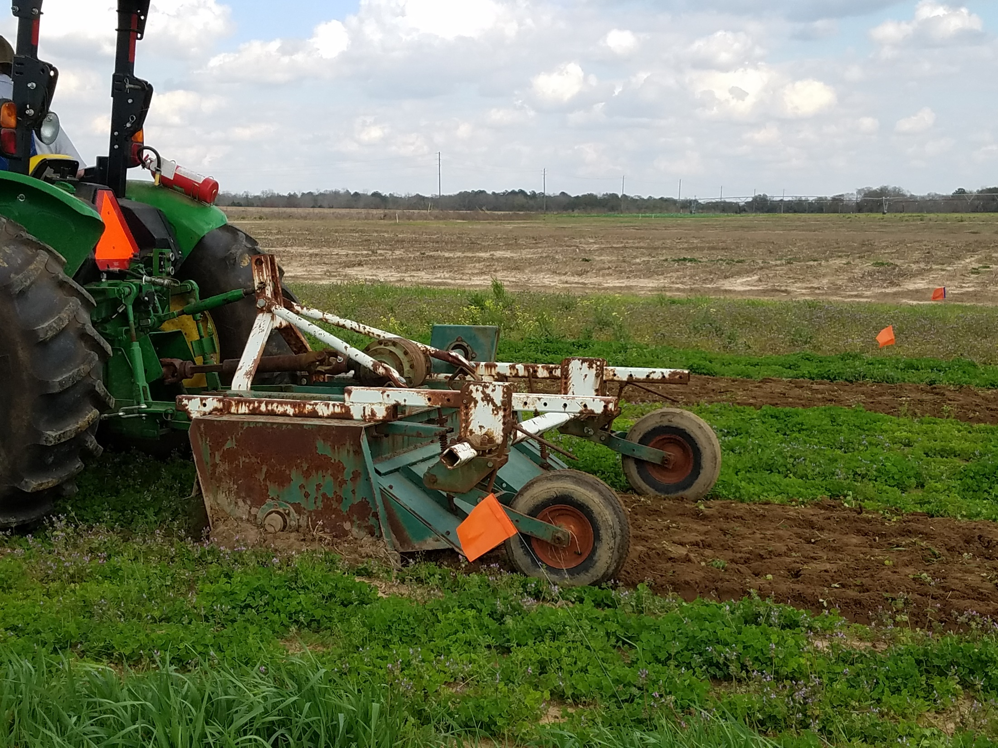
Rototilling in cover crop biomass where plastic will be laid

Slide 5
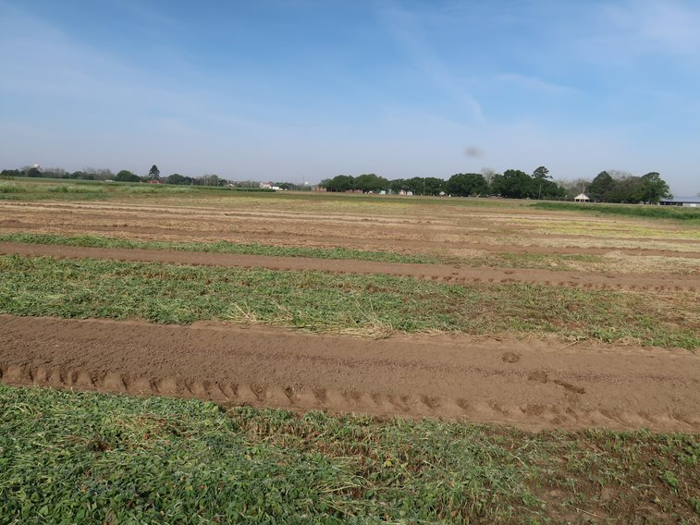

Slide 6
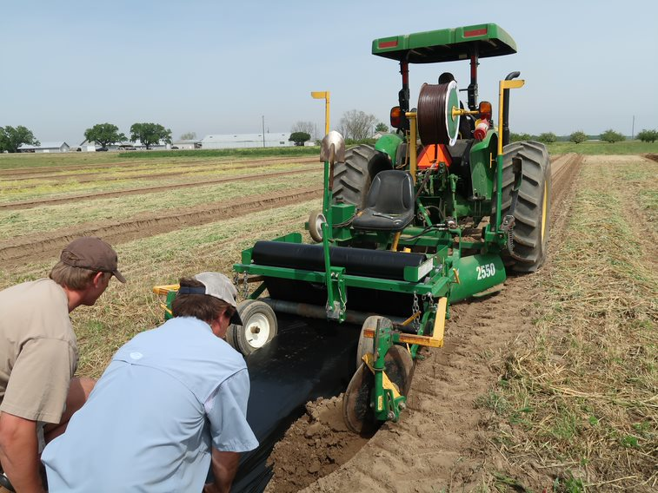

Slide 7
2017/2018 Field trials
Cover Crop | Seeding rate (lb/A) | Biomass at Termination (lb/A)
Daikon radish | 14 | 2732 b
Crimson clover | 25 | 3206 ab
Cereal rye | 100 | 2099 b
Oats | 100 | 3125 ab
Crimson clover + cereal rye | 25 + 100 | 4097 a
Crimson clover + oats | 25 + 100 | 4400 a
^{A} Means followed by the same letter in a column do not differ significantly at P = 0.05. ^{B} Cover crop biomass did not differ across locations, therefore data were combined
Department of Crop, Soil and Environmental Sciences

Slide 8
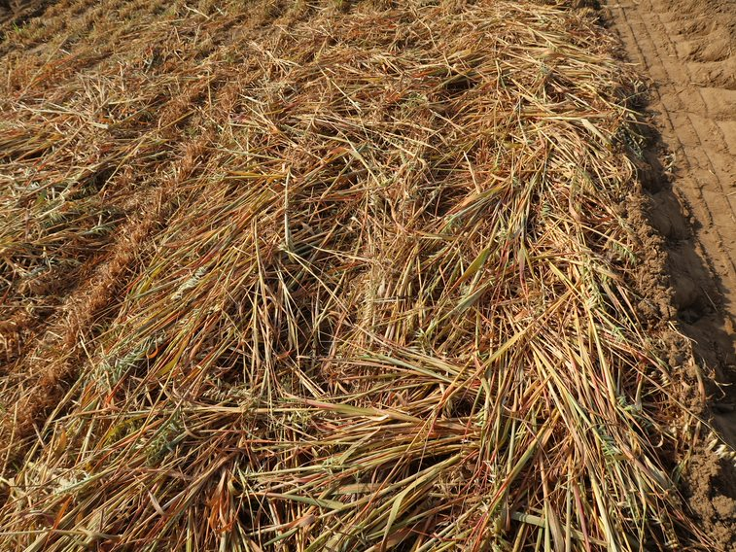
Oats at termination
Field biomass 3125 lbs/A
Department of Crop, Soil and Environmental Sciences

Slide 9
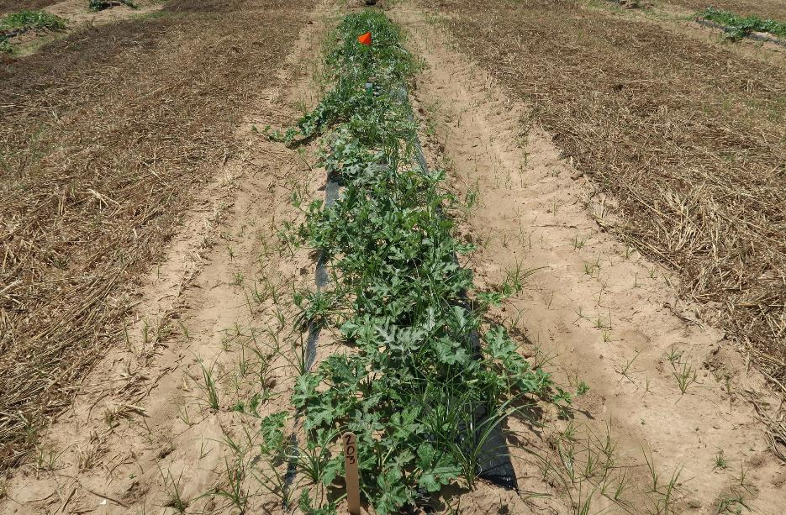
Oats 4 WAP
Department of Crop, Soil and Environmental Sciences

Slide 10
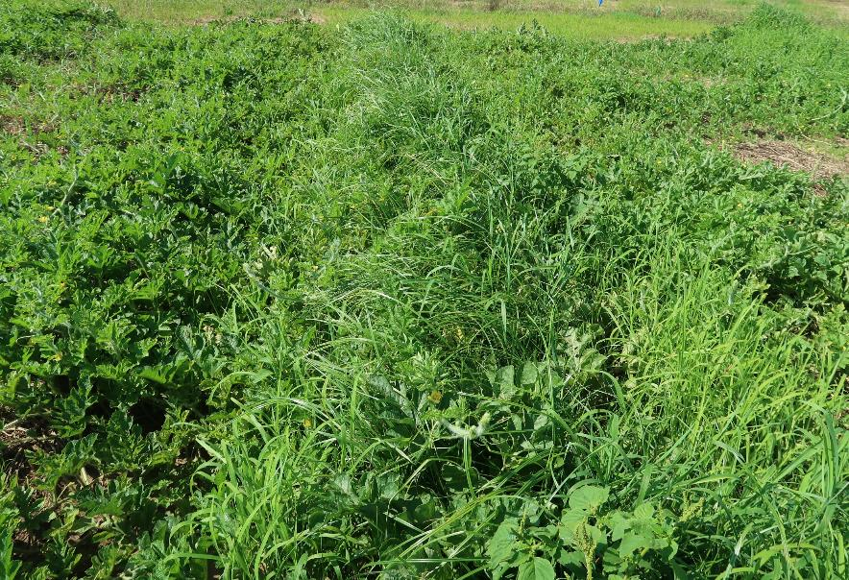
Oats 8 WAP
Sandea 1 oz/A + Select Max 16 oz/A applied to row middles 5 WAP
Department of Crop, Soil and Environmental Sciences

Slide 11
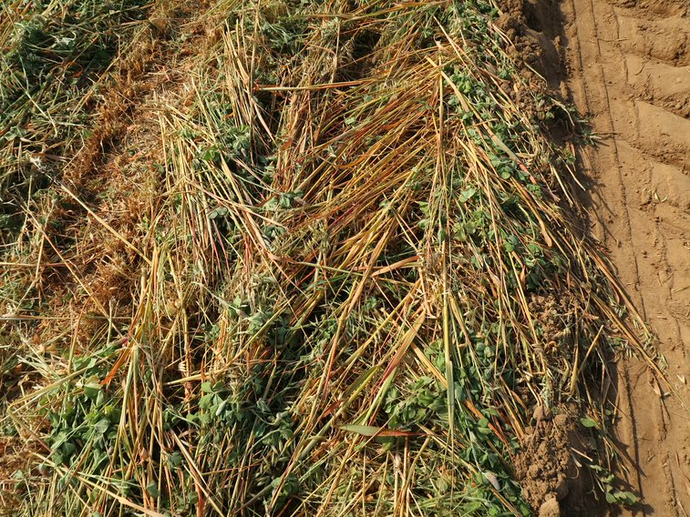
Clover/oats at termination
biomass 4400 lbs/A
Department of Crop, Soil and Environmental Sciences

Slide 12
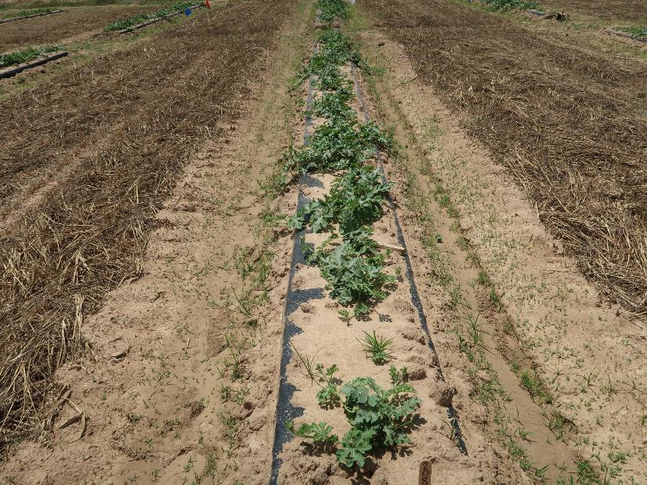
Clover/oats 4 WAP
Department of Crop, Soil and Environmental Sciences

Slide 13
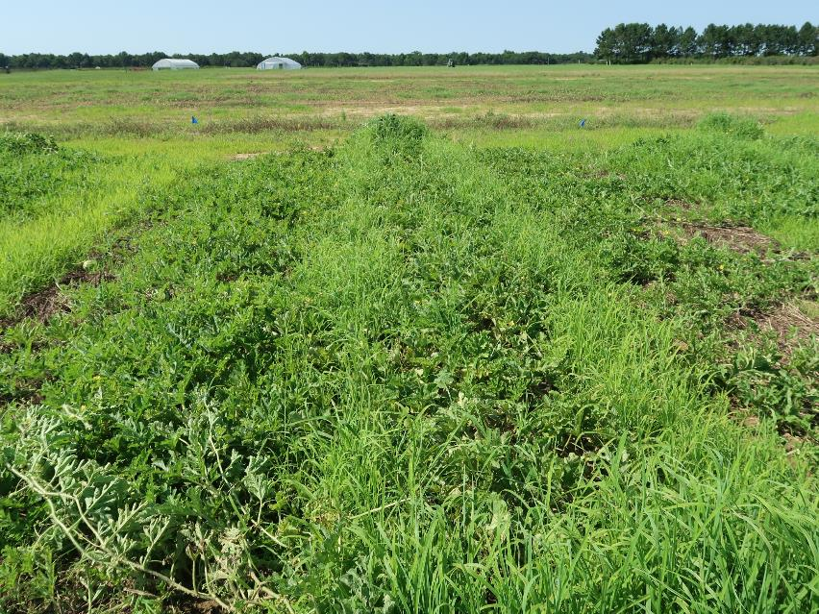
Clover/oats 8 WAP
Sandea 1 oz/A + Select Max 16 oz/A applied to row middles at 5 WAP
Department of Crop, Soil and Environmental Sciences

Slide 14
Weed Density (plants per 10 m²) ^{AB}
 | 4 WAP ^{C} |  | 8 WAP ^{D}
Cover Crop | Henry County | Lee County | Henry County |  | Lee County
 |  |  | Non-treated | Treated | Non-treated | Treated
Bareground | 20.04 a | 11.31 a | 14.51 ab | 17.51 a | 14.24 a | 0.74 a
Radish | 17.80 b | 7.72 b | 25.99 a | 8.32 ab | 12.17 abc | 1.19 a
Clover | 3.30 c | 2.59 cd | 16.23 ab | 4.59 b | 13.56 a | 0.40 a
Rye | 3.95 c | 0.99 d | 23.46 a | 2.45 b | 3.79 c | 0.10 a
Oats | 2.50 cd | 4.00 c | 8.03 b | 1.73 b | 9.55 abc | 0.86 a
Clover /rye | 3.04 cd | 0.95 d | 19.56 ab | 3.49 b | 6.38 bc | 0.26 a
Clover /oats | 1.47 d | 1.82 cd | 9.08 b | 1.86 b | 5.75 bc | 0.46 a
^{A} Weed densities were combined for Amaranthus spp., Cyperus spp., and Digitaria spp. ^{B} Means followed by the same letter in a column are not significantly different at P = 0.05 ^{C} Location x cover crop interaction observed 4 WAP (P < 0.0001) ^{D} Location x cover crop x row middle treatment interaction observed 8 WAP (P = 0.0009)

Slide 15
Notes:
ntc actual 13500 kg/ha

Slide 16
Challenges to be Considered
No weed control adjacent to plastic
Row middles too wide
Possible need for preemergent herbicide when residue biomass is low
Department of Crop, Soil and Environmental Sciences

Slide 17
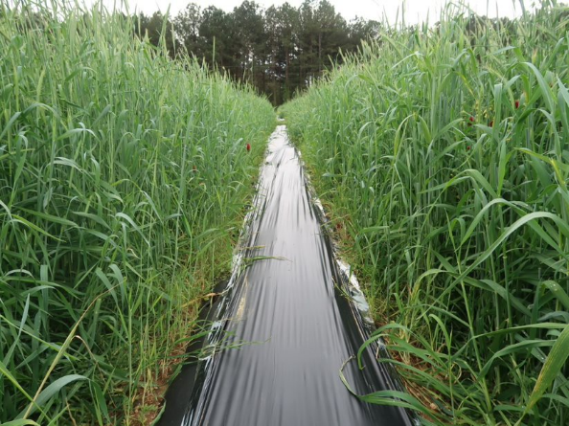
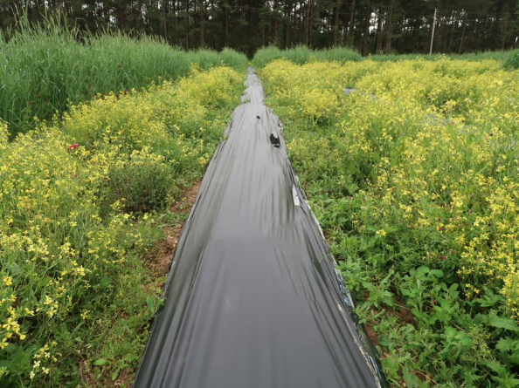
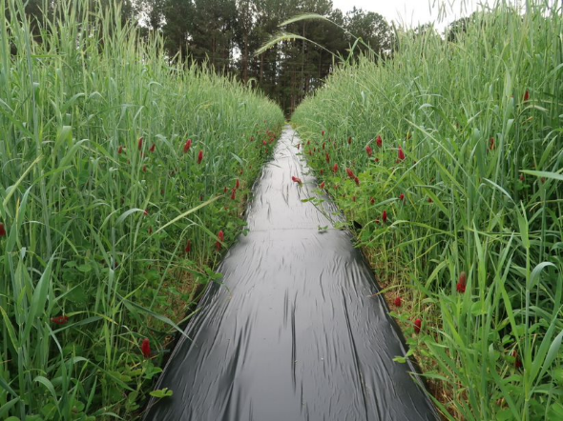
2018/2019 Field Trials
Before termination
Plastic mulch laid in Fall 2018
Cover crops broadcast over the top of plastic
cover crops terminated through chemical means and/or rolling
‘Crunchy Red’ seedless melons and ‘Jambouree’ pollinators planted at 3:1 ratio
‘Aristotle’ peppers
1.8 m row spacing, 46 cm plant spacing, 3.6 x 6 m plots
Every other row planted
Department of Crop, Soil and Environmental Sciences

Slide 18
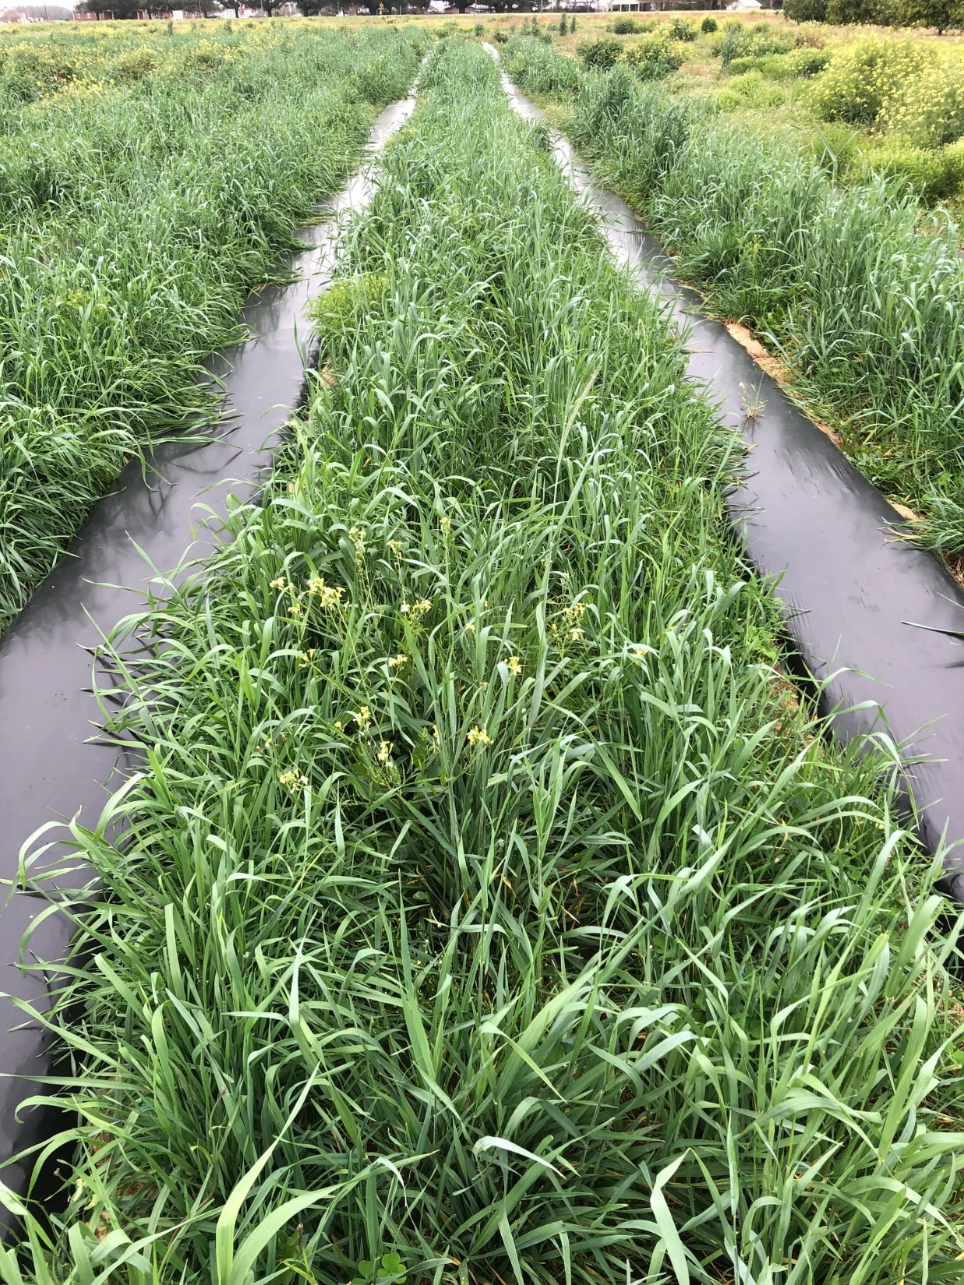
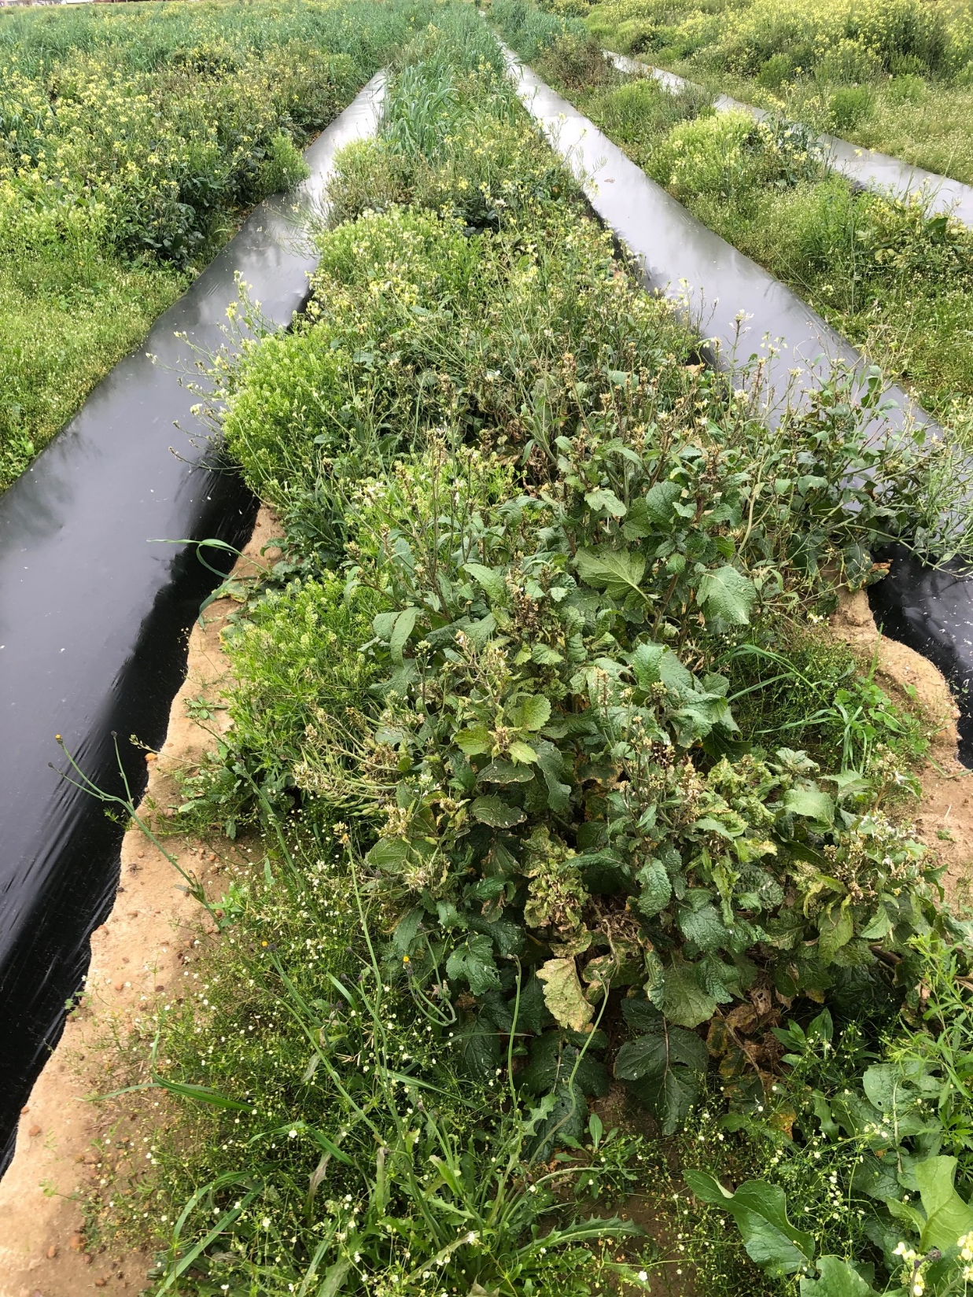
Feb 26 2019 Headland AL

Slide 19
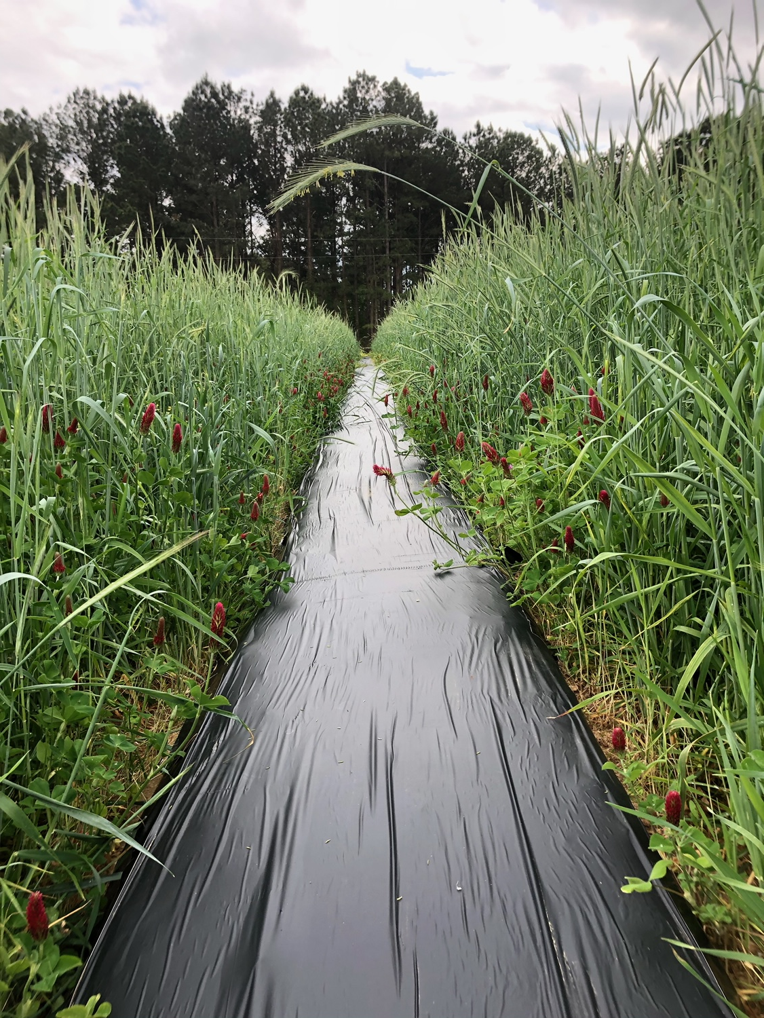
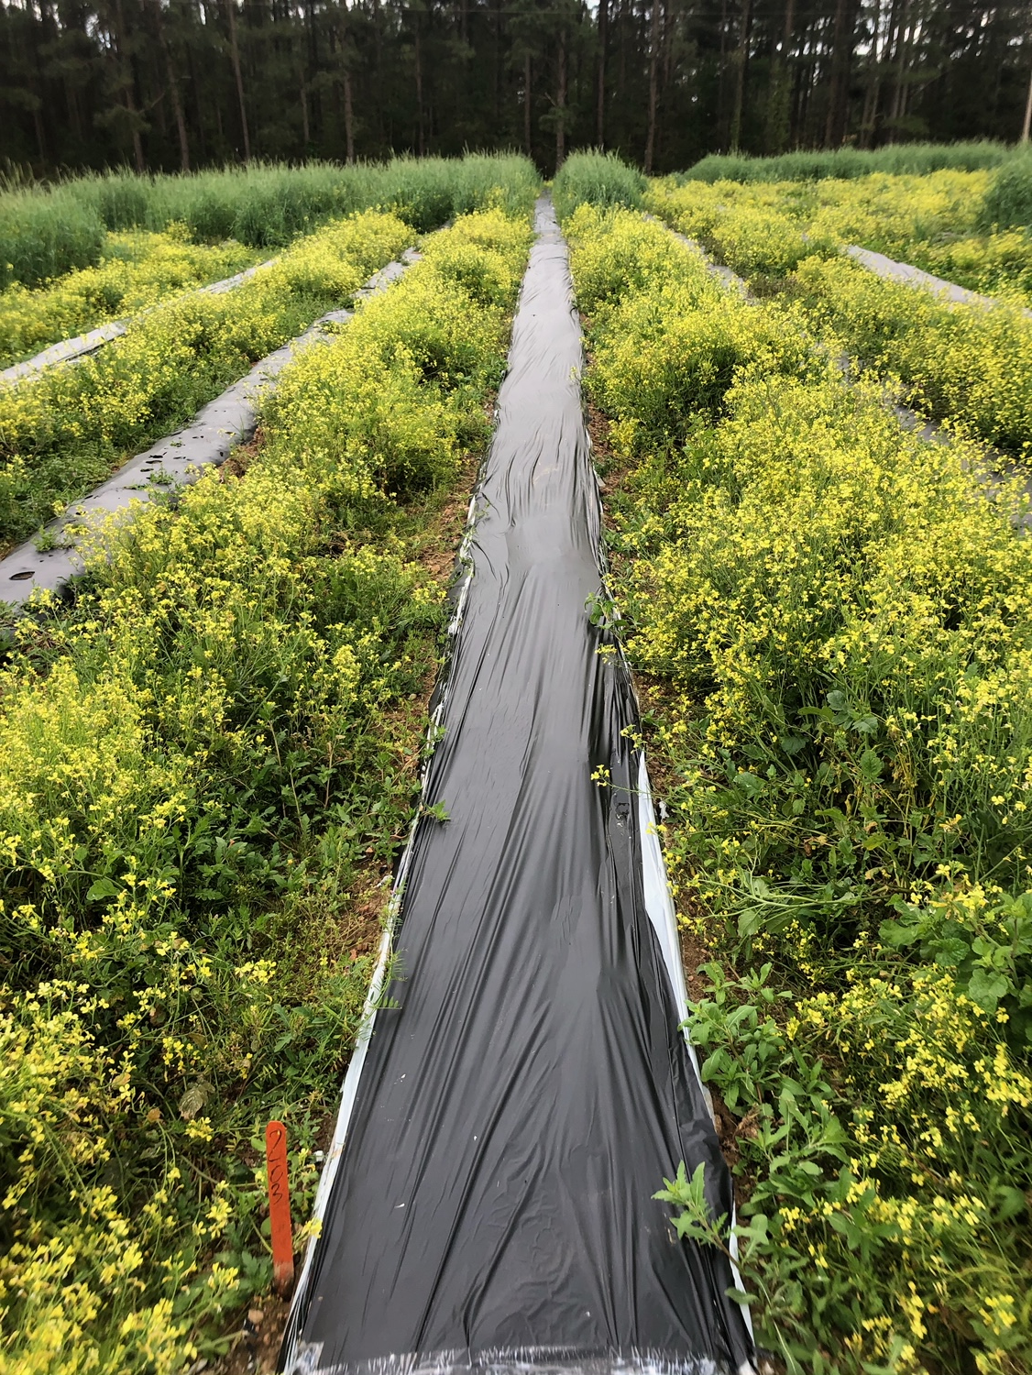
Before termination. Auburn AL

Slide 20
2018/2019 Field trials
Cover Crop | Seeding rate (lb/A) | Biomass at Termination (lb/A)
 |  | Henry Co. | Lee Co.
White clover | 14 | N/A | N/A
Cereal rye | 200 | 4145 | 6108
Cereal rye + Crimson clover | 200 + 25 | 4690 | 4908
Department of Crop, Soil and Environmental Sciences

Slide 21
2018/2019 Treatments
Cover Crop | Termination Method | Herbicides (row middles)^{AB} | ^{# of Herbicide applications}
White clover | Roundup PM (32 oz/A) + Gramoxone (2 pt/A) | PRE | 2
Cereal rye | Rolled green | PRE + POST | 2
Cereal rye | Rolled green | POST | 1
Cereal rye + crimson clover | Roundup PM (32 oz/A), then rolled | PRE + POST | 3
Cereal rye + crimson clover | Rolled green | PRE + POST | 2
Cereal rye + crimson clover | Rolled green | POST | 1
Chemical control | Roundup PM (32 oz/A) + Chateau (4 oz/A) | PRE + POST | 3
NTC | N/A | N/A | 0
^{A} PRE application: Chateau (4 oz/A) + Treflan (2 pt/A) 1 day before transplanting with shields ^{B} POST application: Sandea (0.75 oz/A) + Select Max (16 oz/A) made 5 WAP
Department of Crop, Soil and Environmental Sciences

Slide 22
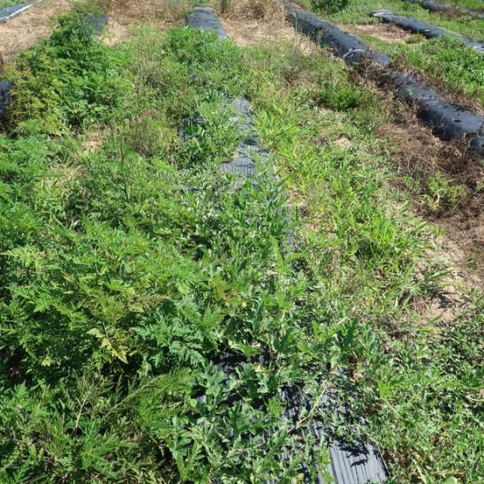
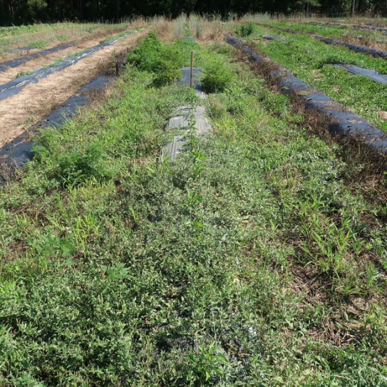
NTC 4 WAP
Melons
Peppers
Department of Crop, Soil and Environmental Sciences

Slide 23
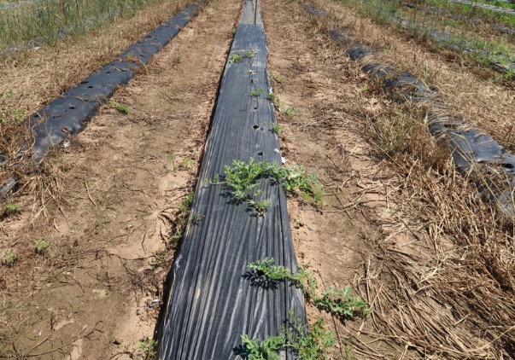
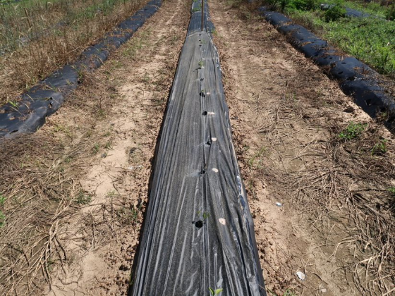
Melons
Chemical Control 4 WAP
PRE
Peppers
Department of Crop, Soil and Environmental Sciences

Slide 24
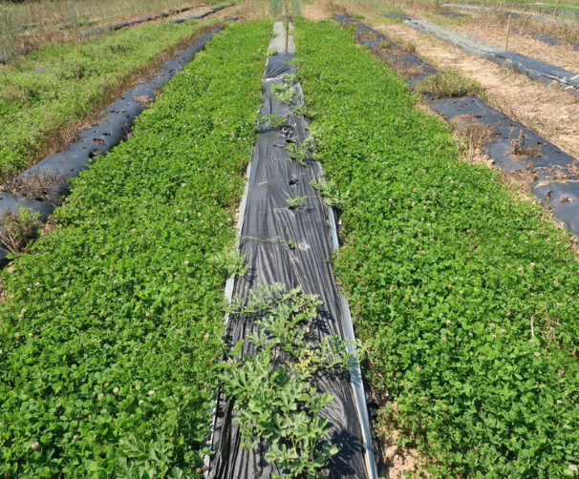
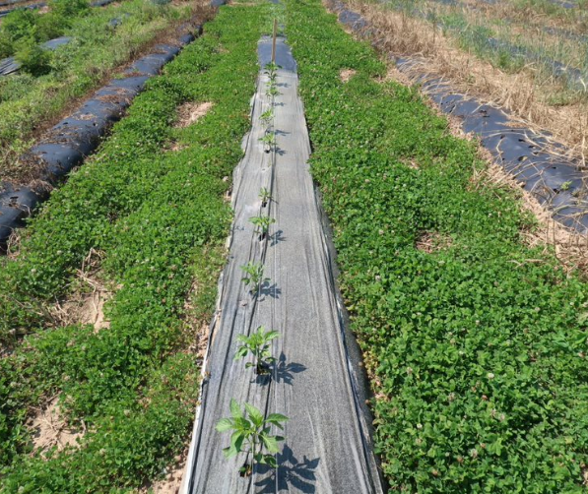
Melons
White Clover 4 WAP
PRE
Peppers
Department of Crop, Soil and Environmental Sciences

Slide 25
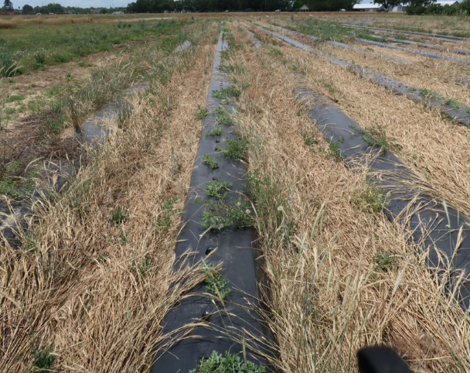
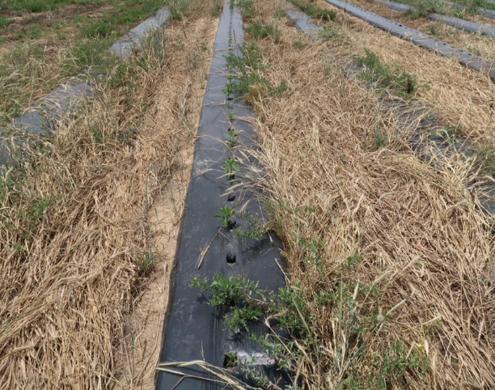
Melons
Cereal Rye 4 WAP
Rolled Green, No PRE
Peppers
Department of Crop, Soil and Environmental Sciences

Slide 26
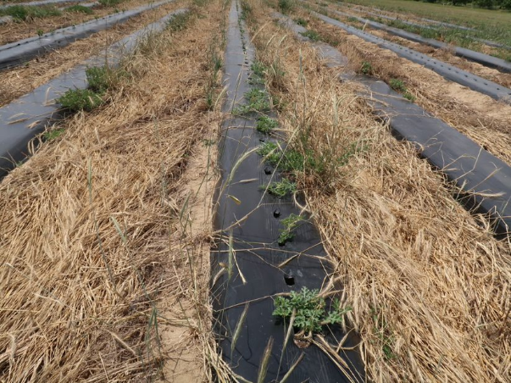
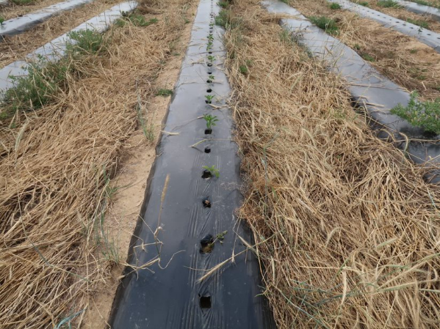
Melons
Cereal Rye 4 WAP
Rolled green, PRE
Peppers
Department of Crop, Soil and Environmental Sciences

Slide 27
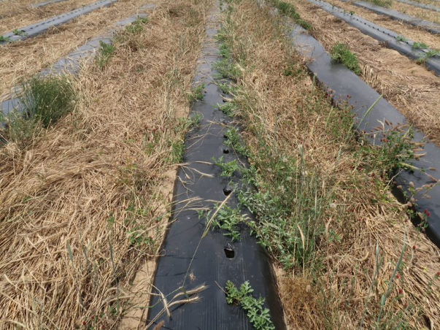
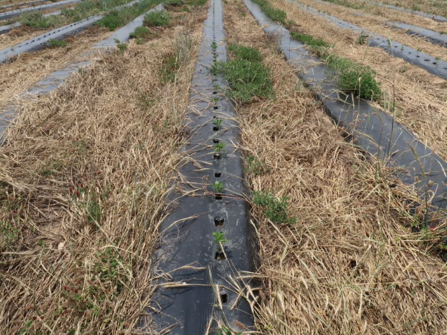
Melons
Cereal Rye + Crimson Clover 4 WAP
Rolled Green, No PRE
Peppers
Department of Crop, Soil and Environmental Sciences

Slide 28
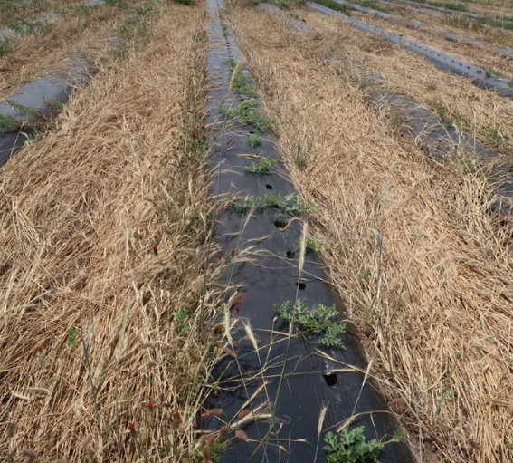
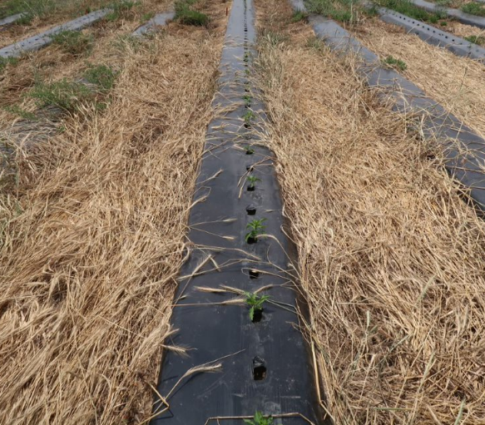
Melons
Cereal Rye + Crimson Clover 4 WAP
Rolled Green, PRE
Peppers
Department of Crop, Soil and Environmental Sciences

Slide 29
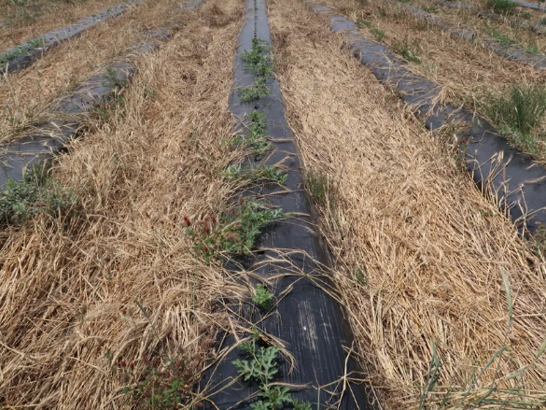
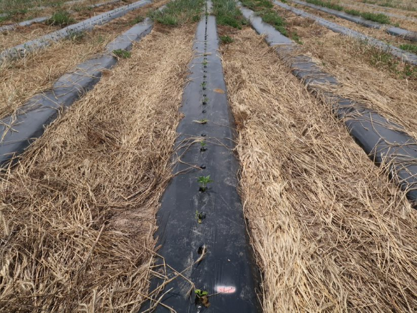
Melons
Cereal Rye + Crimson Clover 4 WAP
Glyphosate then rolled, PRE
Peppers
Department of Crop, Soil and Environmental Sciences

Slide 30
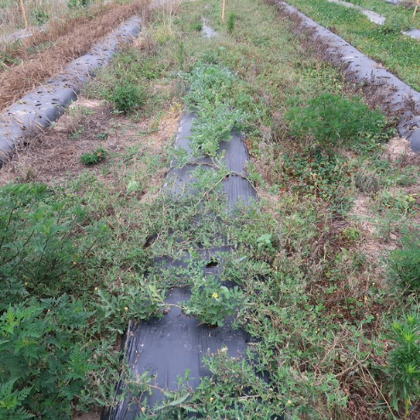
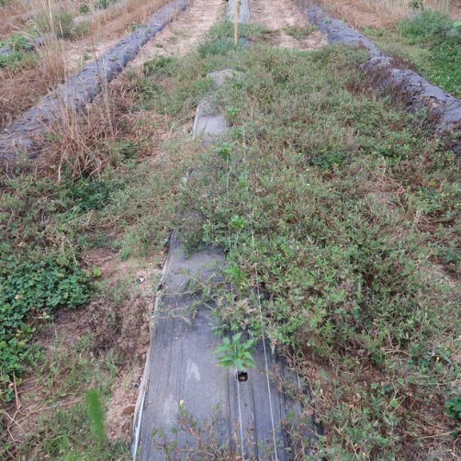
Melons
NTC 8 WAP
Peppers
Department of Crop, Soil and Environmental Sciences

Slide 31
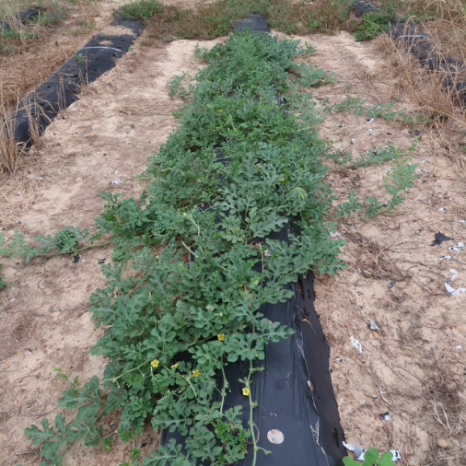
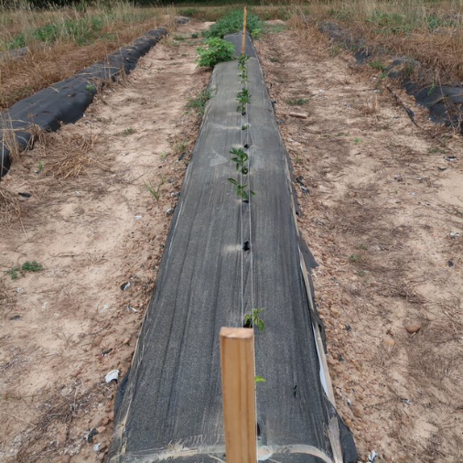
Melons
Chemical Control 8 WAP
PRE and POST
Peppers
Department of Crop, Soil and Environmental Sciences

Slide 32
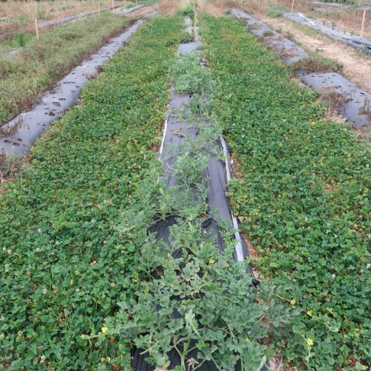
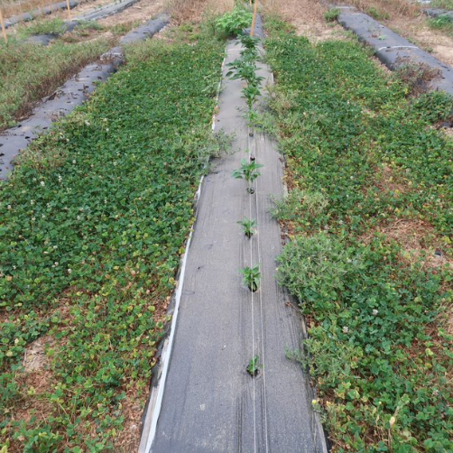
Melons
White Clover 8 WAP
PRE only
Peppers
Department of Crop, Soil and Environmental Sciences

Slide 33
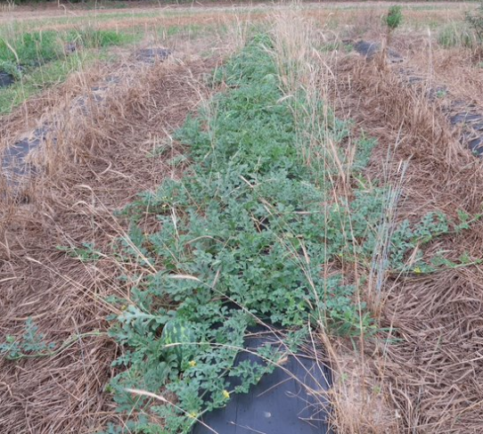
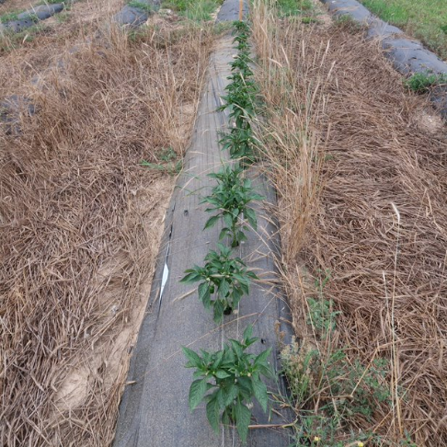
Melons
Cereal Rye 8 WAP
Rolled green, POST only
Peppers
Department of Crop, Soil and Environmental Sciences

Slide 34
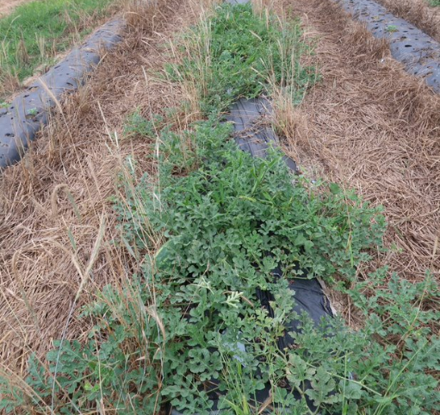
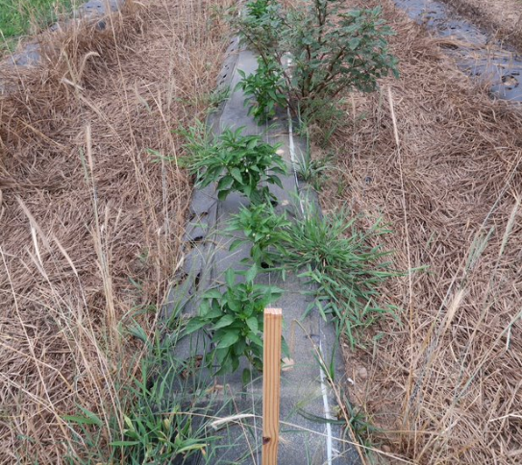
Melons
Cereal Rye 8 WAP
Rolled green, then PRE + POST
Peppers
34
Department of Crop, Soil and Environmental Sciences

Slide 35
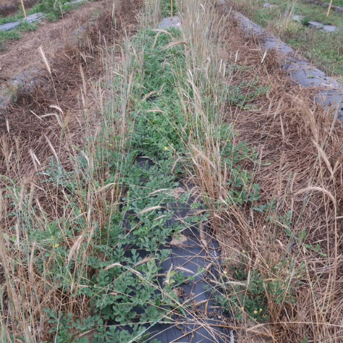
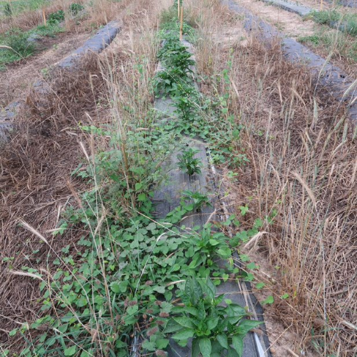
Melons
Cereal Rye + Crimson Clover 8 WAP
Rolled green, only POST
Peppers
Department of Crop, Soil and Environmental Sciences

Slide 36
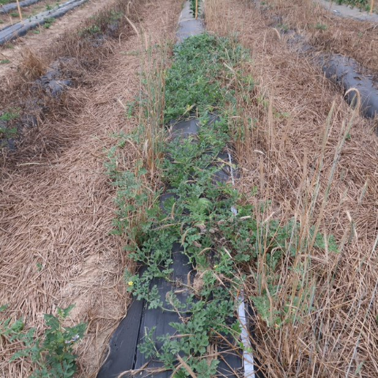
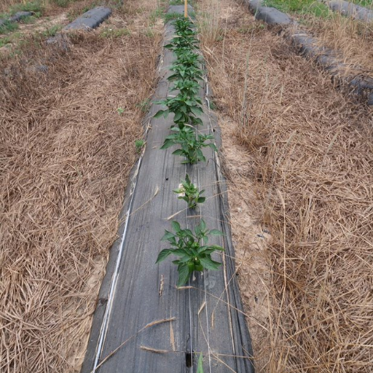
Melons
Cereal Rye and Crimson Clover 8 WAP
Rolled green, PRE and POST
Peppers
Department of Crop, Soil and Environmental Sciences

Slide 37
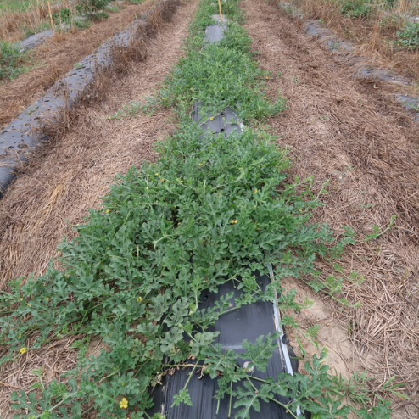
Melons
Cereal Rye + Crimson Clover 8 WAP
Terminated with glyphosate, PRE + POST,
Peppers
Department of Crop, Soil and Environmental Sciences

Slide 38
Weed Density 4 and 8 WAP ^{AB}
Cover Crop | Weed Density 4 WAP ^{C} (plants per 10 m²) |  | Weed Density 8 WAP (plants per 10 m²)
 | Henry Co. | Lee Co. | Lee Co.
White clover | 1.68 c | 6.05 bc | 1.68 b
Cereal rye (rolled green, PRE + POST) | 1.61 c | 4.10 bc | 3.29 b
Cereal rye (rolled green, POST) | 3.49 bc | 5.78 bc | 6.05 b
Cereal rye + crimson Clover (glyphosate, PRE + POST,) | 14.06 b | 2.35 c | 19.10 b
Cereal rye + crimson clover (rolled green, PRE + POST) | 1.54 c | 3.22 bc | 2.35 b
Cereal rye + crimson clover (rolled green, POST) | 2.35 c | 6.79 b | 3.90 b
Chemical control (glyphosate, PRE + POST) | 9.88 bc | 4.17 bc | 10.96 b
NTC | 41.17 a | 26.03 a | 101.45 a
^{A} Weed densities were combined for Amaranthus spp., Cyperus spp., Oenothera sp. and Digitaria spp. ^{B} Means followed by the same letter in a column are not significantly different at P = 0.05 ^{C} Location x cover crop interaction observed 4 WAP (P = 0.0029)
Notes:
No location interaction P= 0.22
no treatment effect p = 0.14

Slide 40
Notes:
Different from complete nontreated control because chemical control was injured.

Slide 42
Lessons Learned
Broadcast seeding over the top of plastic more effective than planting before laying mulch
Chemical termination of cover crops before rolling allows easier cover crop management
Preemergent applications may not be always needed if cover crop residue is high enough
Chateau can seriously injure vegetables when applied over plastic mulch
White clover stand survived following Roundup + Gramoxone, then Chateau + Treflan ???
Monoculture of rye as effective as mixed cultures of rye + clover
Department of Crop, Soil and Environmental Sciences

Slide 43
Biodegradable Mulch
Department of Crop, Soil and Environmental Sciences

Slide 44
Materials
Cornstarch
Cellulose Heavy
Cellulose Std
LDPE Mulch
Department of Crop, Soil and Environmental Sciences

Slide 45
Standard Weight Installation
Department of Crop, Soil and Environmental Sciences

Slide 46
LDPE Mulch 3 WAP
Department of Crop, Soil and Environmental Sciences

Slide 47
Corn Starch 3 WAP
Department of Crop, Soil and Environmental Sciences

Slide 48
Heavy weight Cellulose 3 WAP
Department of Crop, Soil and Environmental Sciences

Slide 49
Standard Weight Cellulose 3 WAP
Department of Crop, Soil and Environmental Sciences

Slide 50
Department of Crop, Soil and Environmental Sciences

Slide 51
Lessons Learned
Cornstarch material easy to install but degrades quickly
Standard weight cellulose mulch difficult to install
Heavy weight cellulose material suppresses nutsedge but can degrade at soil line
Heavy weight cellulose material may warrant further evaluation in future research
Department of Crop, Soil and Environmental Sciences

Slide 52
Questions?
Bietila, E., Silva, E.M., Pfeiffer, A.C. and Colquhoun, J.B., 2017. Fall-sown cover crops as mulches for weed suppression in organic small-scale diversified vegetable production. Renewable Agriculture and Food Systems, 32(4), pp.349-357.
Buker, R.S., Stall, W.M., Olson, S.M. and Schilling, D.G., 2003. Season-long interference of yellow nutsedge (Cyperus esculentus) with direct-seeded and transplanted watermelon (Citrullus lanatus). Weed technology, 17(4), pp.751-754.
Monks, D.W. and Schultheis, J.R., 1998. Critical weed-free period for large crabgrass (Digitaria sanguinalis) in transplanted watermelon (Citrullus lanatus). Weed Science, 46(5), pp.530-532.
Department of Crop, Soil and Environmental Sciences

