Slide 1
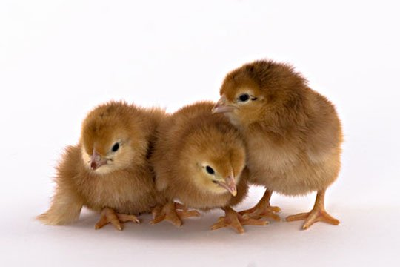
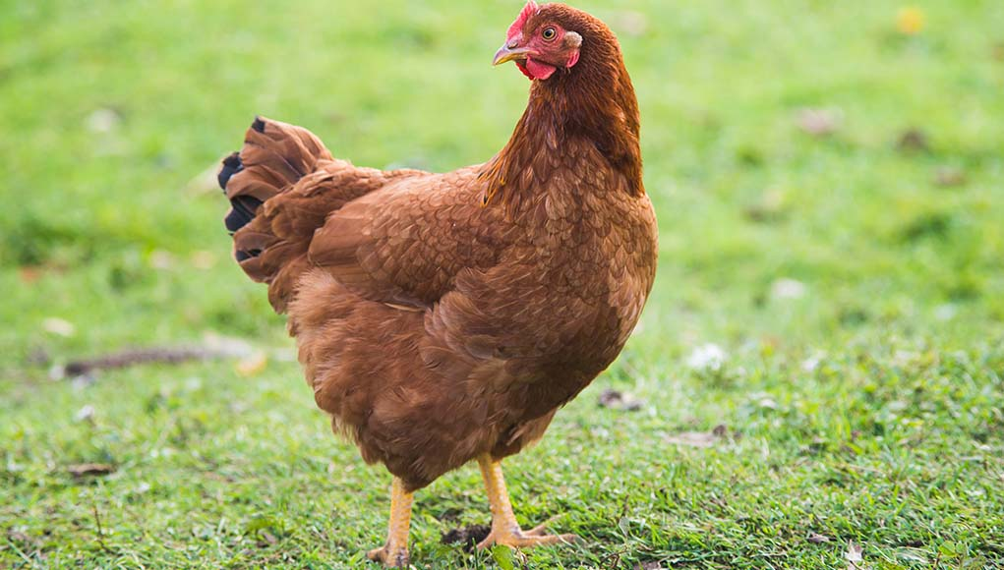
Day 0
20 wks.
32 wks.
TSU Research Farm
(3 replicate each treatment)
Farms of Co-operating Farmers
Susan Kyle
(TRT 4 diet)
Energy level: TBD
Treatment 1
Energy level: 1365 kcal/lb. (Corn-soy diet)
Ron Bridges
Treatment 2
Energy level: 1635 kcal/lb (TRT 1 diet)
Energy level: 1500 kcal/lb. (Corn-soy diet)
Cynthia Capers
Energy level: 1635 kcal/lb. (TRT 1 diet)
Treatment 3
Energy level: 1635 kcal/lb. (Corn-soy diet)
Treatment 1-3: Study of dietary energy impact on performance and assess specific dietary energy that is optimal to calcium absorption
TBD*= to be determined. Energy level in feed is given in metabolizable energy .
Treatment 4 (TSU farm) and farms at the Co-operating farmers will have poultry water supplies sanitation in place (alternate week) and will be subjected for prevalence ( foodborne pathogens) and economic analysis. Treatment 1-3 (TSU farms) will not have water treatments.
Treatment 4
Energy level: TBD*
Soy-free diet

