Slide 1
High Tunnel Study

Slide 2
Material and Methods
Two high tunnel experiments were conducted at Clemson University Coastal Research and Education Center, Charleston, South Carolina on July 27 and August 01, 2022, respectively in a randomized complete block design with three replications.
Two carbon sources (No carbon-control and chicken manure + molasses) used as standard carbon source.
Treatments were assigned at ASD and Non-ASD.
20 commercial watermelon and rootstock cultivars were used in this study.
Oxidation-reduction potential (ORP) and temperature sensors were installed in the center of each microcosm at a 15-cm depth to soil conditions.

Slide 3
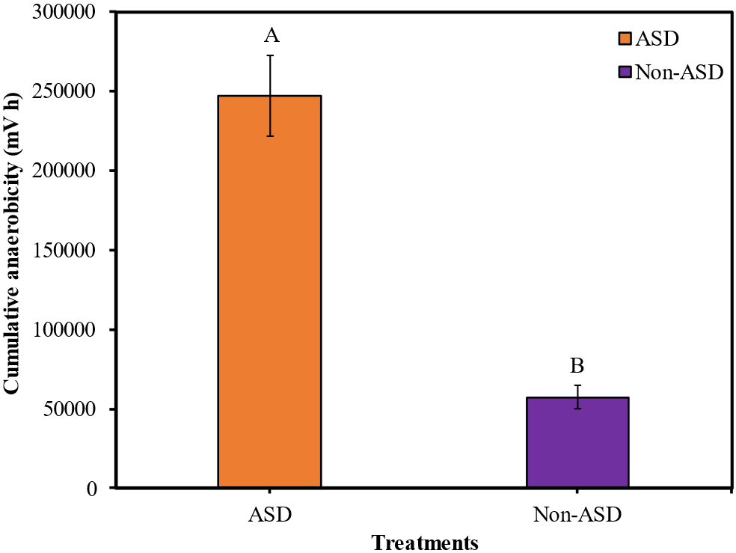
Higher cumulative anaerobicity was recorded in ASD plot compared to Non-ASD treatment.
Higher cumulative anaerobicity indicated that soil amended with carbon sources went anaerobic.
Figure: Cumulative anaerobicity recorded at 4 weeks after ASD initiation. ASD refers as soil amended with chicken manure + molasses and Non-ASD as control.

Slide 4
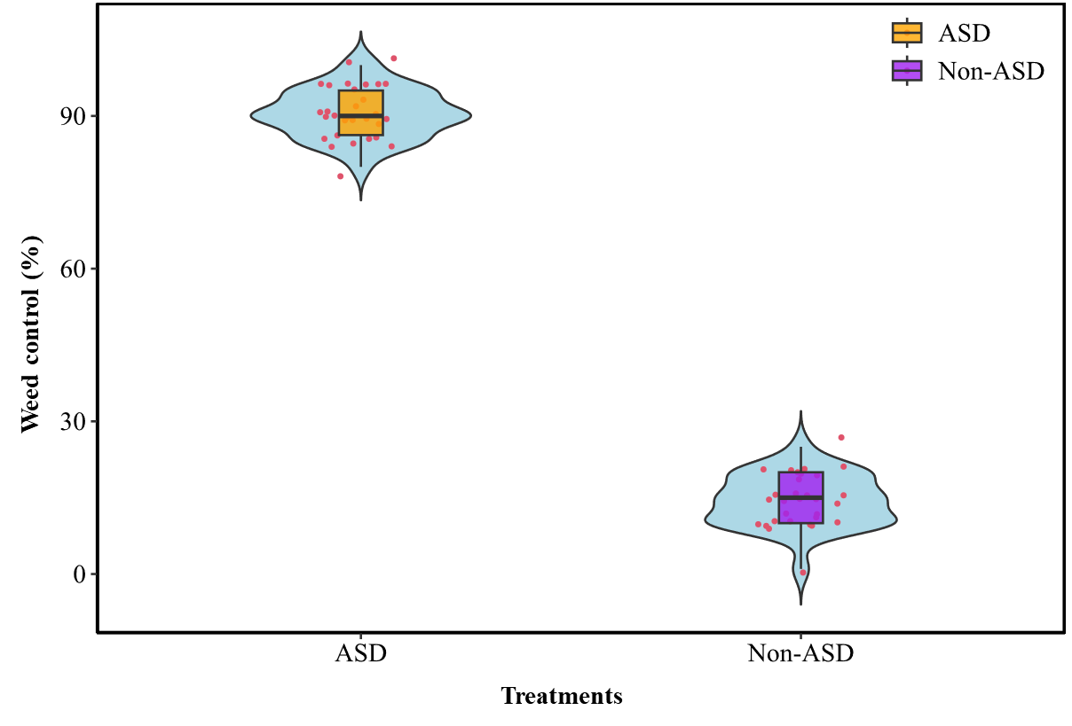
ASD significantly improved weed control percentage and showed inhibitory effect on the germination of weeds.
ASD exhibited 91% weed control compared to Non-ASD treatment which was 14%.
Figure: Weed control percentage taken after 4 weeks of ASD initiation. ASD refers as soil amended with chicken manure + molasses and Non-ASD as control.

Slide 5
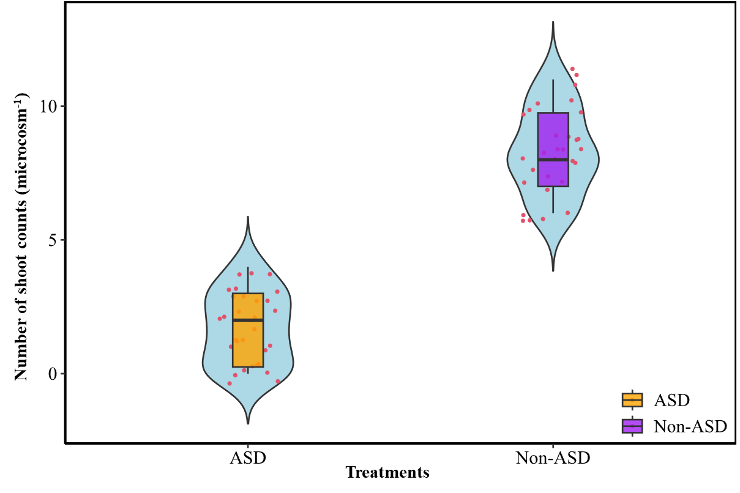
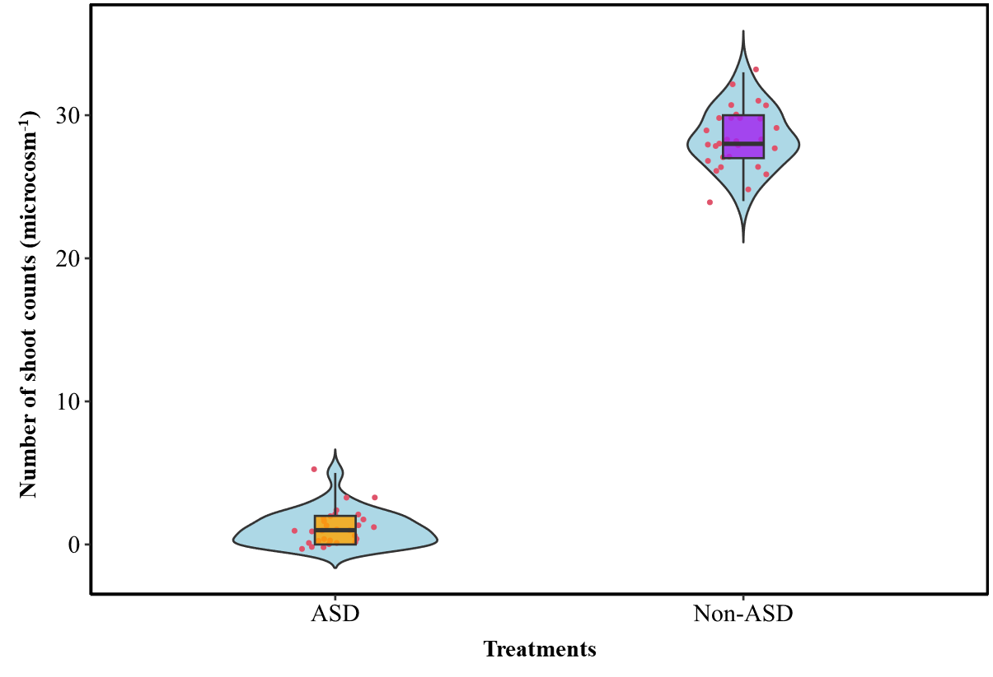
Yellow nutsedge
Yellow nutsedge and palmar amaranth shoot counts were lowest in ASD treatment where soil was treated with chicken manure and molasses.
On an average 1.7 and 8.3, yellow nutsedge shoot counts were recorded in ASD and Non-ASD treatment, respectively.
In case of palmer amaranth shoot counts, 1.1 and 28.4 counts were counted in ASD and Non-ASD treatment, respectively.
Palmer amaranth

Slide 6
(A)
A
AB
AB
A-D
A-D
A-C
A-D
A-D
A-D
A-D
B-E
B-E
B-E
B-E
B-E
B-E
B-E
C-E
B-E
C-E
C-E
C-E
C-E
C-E
C-E
C-E
C-E
C-E
C-E
C-E
C-E
D-F
D-F
C-F
D-F
EF
EF
F

Slide 7
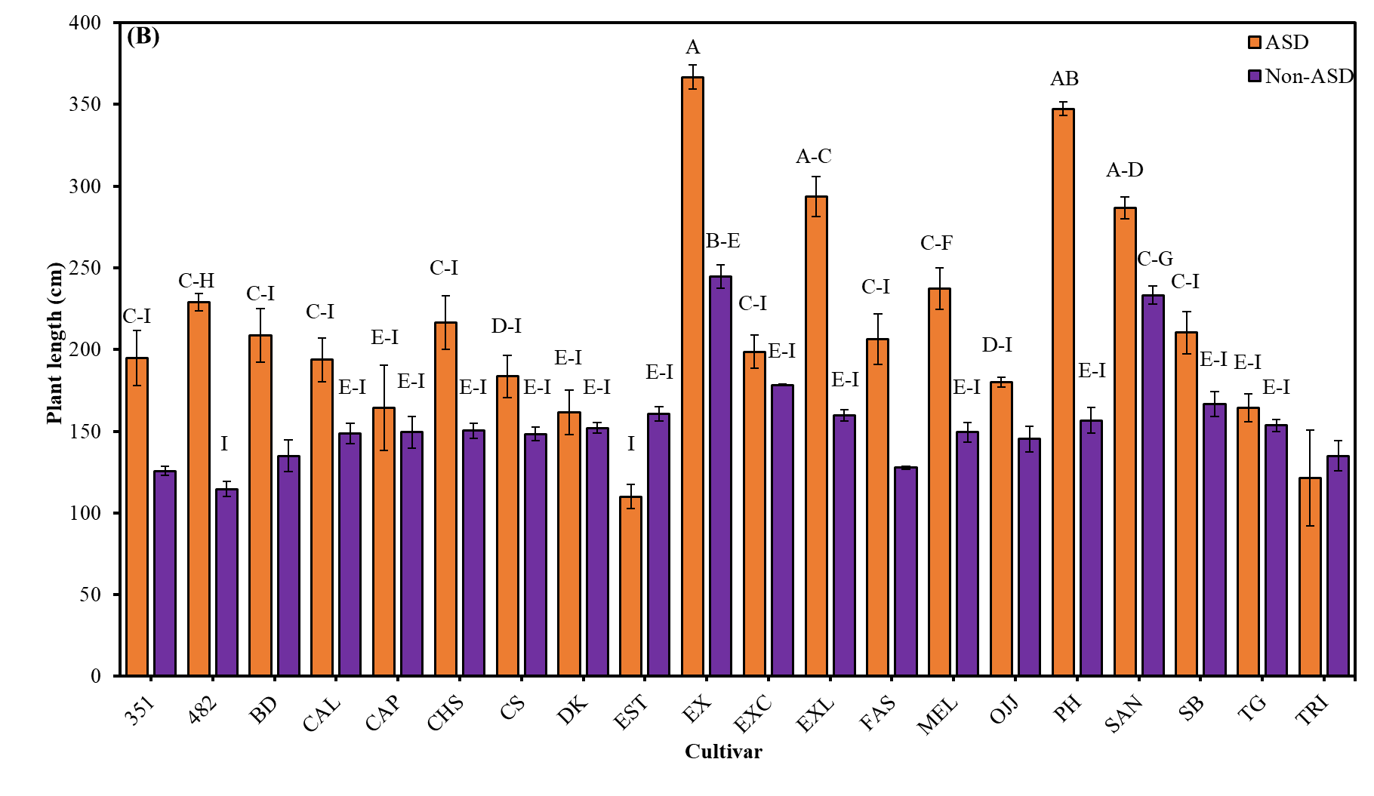
ASD significantly increased the plant length which indicated that plants were more vigorous in ASD treatment compared to Non-ASD treatment. Highest plant length was recorded in Extazy in both trials.
Figure: Watermelon plant length taken after 4 weeks of ASD termination. ASD refers as soil amended with chicken manure + molasses and Non-ASD as control.

Slide 8
(A)
A
AB
A-C
B-D
B-F
B-E
B-G
C-H
B-G
C-I
C-H
C-I
C-I
C-I
C-I
C-I
C-I
C-I
C-I
C-I
D-I
E-I
D-I
D-I
E-I
G-I
E-I
F-I
G-I
G-I
G-I
G-I
G-I
G-I
G-I
G-I
G-I
HI
G-I
I

Slide 9
(B)
AB
A
AB
A-C
B-D
B-D
C-E
C-E
D-G
D-G
D-F
D-H
D-H
D-I
D-G
D-J
D-I
D-J
D-J
E-J
E-J
D-J
D-J
E-J
E-J
E-J
E-J
E-J
E-J
E-J
E-J
E-J
E-J
E-J
G-J
F-J
F-J
J
IJ
H-J
Figure: Watermelon plant biomass taken after 4 weeks of ASD termination. ASD refers as soil amended with chicken manure + molasses and Non-ASD as control.

Slide 10
Treatment, cultivar, and their interaction were statistically significant in both trials. ASD significantly improved the fresh biomass of the plants compared to Non-ASD treatment. Higher aboveground fresh biomass was recorded in Extazy, Powerhouse, Sangria, and Exclamation, respectively.

Slide 11
Summary
ASD increased cumulative anaerobicity and soil amended with chicken manure and molasses went anaerobic compared to control treatment.
ASD decreased yellow nutsedge and palmer amaranth germination and increased weed control %.
Watermelon plants were more vigorous under ASD treatment.
Extazy, powerhouse, sangria, and exclamation performed well under ASD compared to other cultivars.

