Slide 1
IRIS Tube Study

Slide 2
Preliminary IRIS Tube Study
What is IRIS tube?
Over the last several years, there has been a growing awareness of and interest in, using IRIS (indicator of reduction in soils) tubes for measuring or documenting the development of electrochemically reducing condition in soils (Castenson and Rabenhorst, 2006).
Soil reducing conditions are determined based on the loss of iron oxide paints present on the IRIS tubes (Rabenhorst, 2008).
Usually during the period, when soil microbes begin to deplete dissolved oxygen as they oxidized soil organic matter. Once the oxygen has been depleted, the microbes begin to use alternative electron acceptors such as oxidized Fe.

Slide 3
IRIS Tube Study

Slide 4
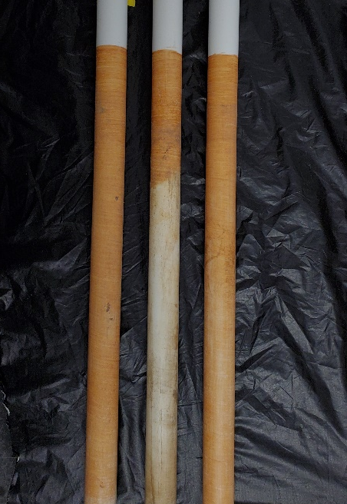
Preliminary IRIS Tube Study
Percent Reduced
Control
Carbon-uncovered
Carbon-covered

Slide 5
Results
Iris tubes percent oxidation (percent that turned rust color) was negatively correlated with cumulative anaerobicity

