Slide 1
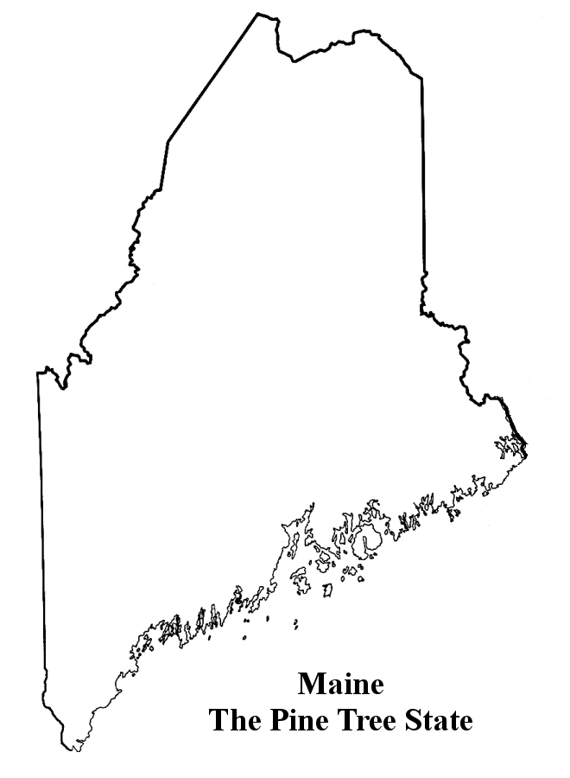
Fall 2016
15)
9)
11)
14)
10)
12)
13)
4)
6)
8)
7)
3)
5)
2)
1)

Slide 2
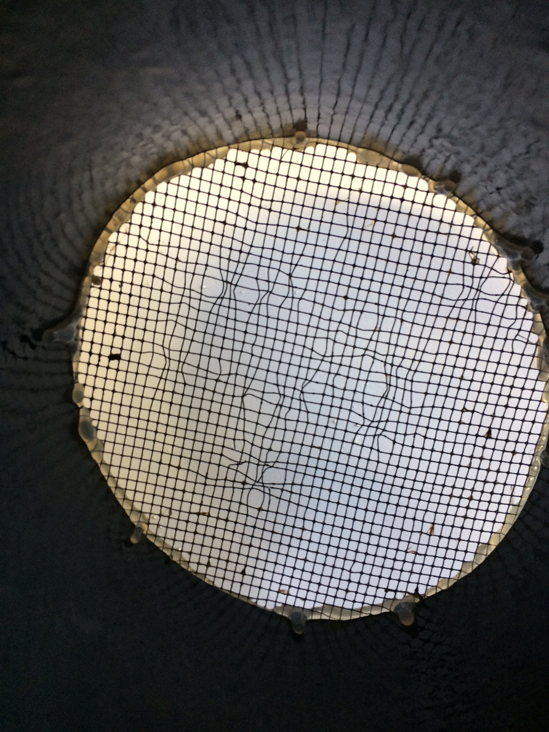

Slide 3
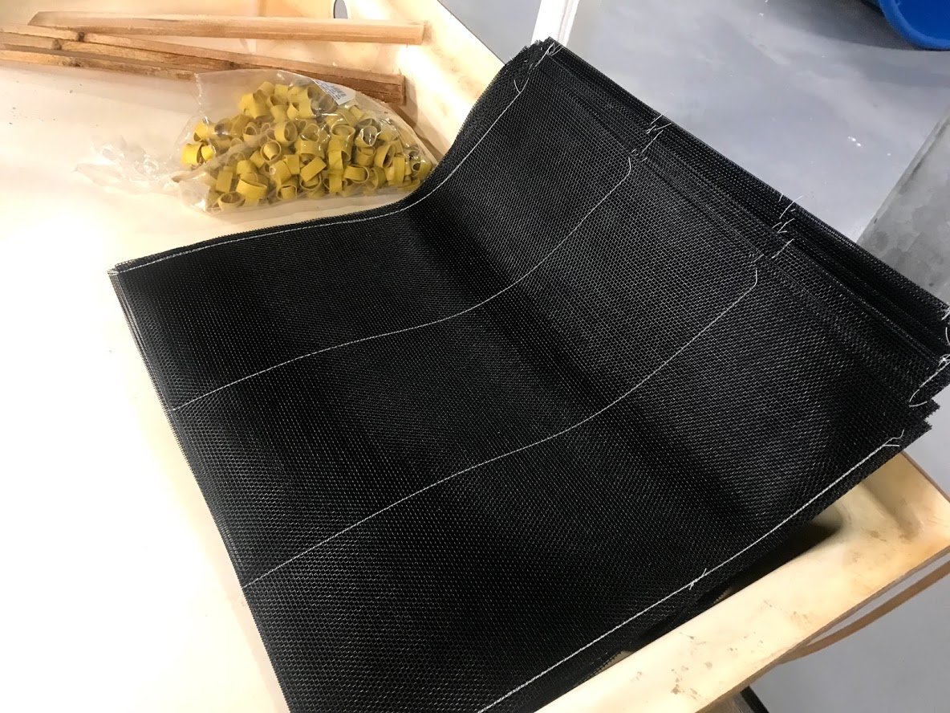
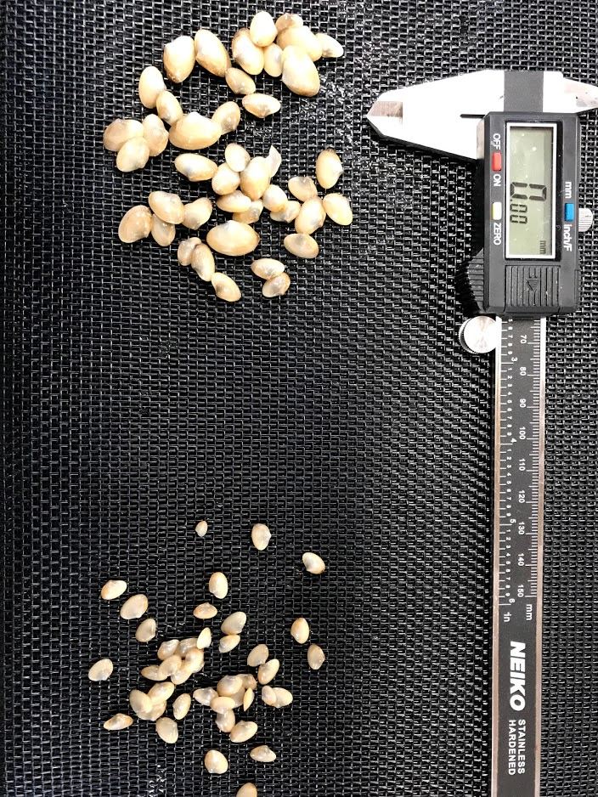

Slide 4
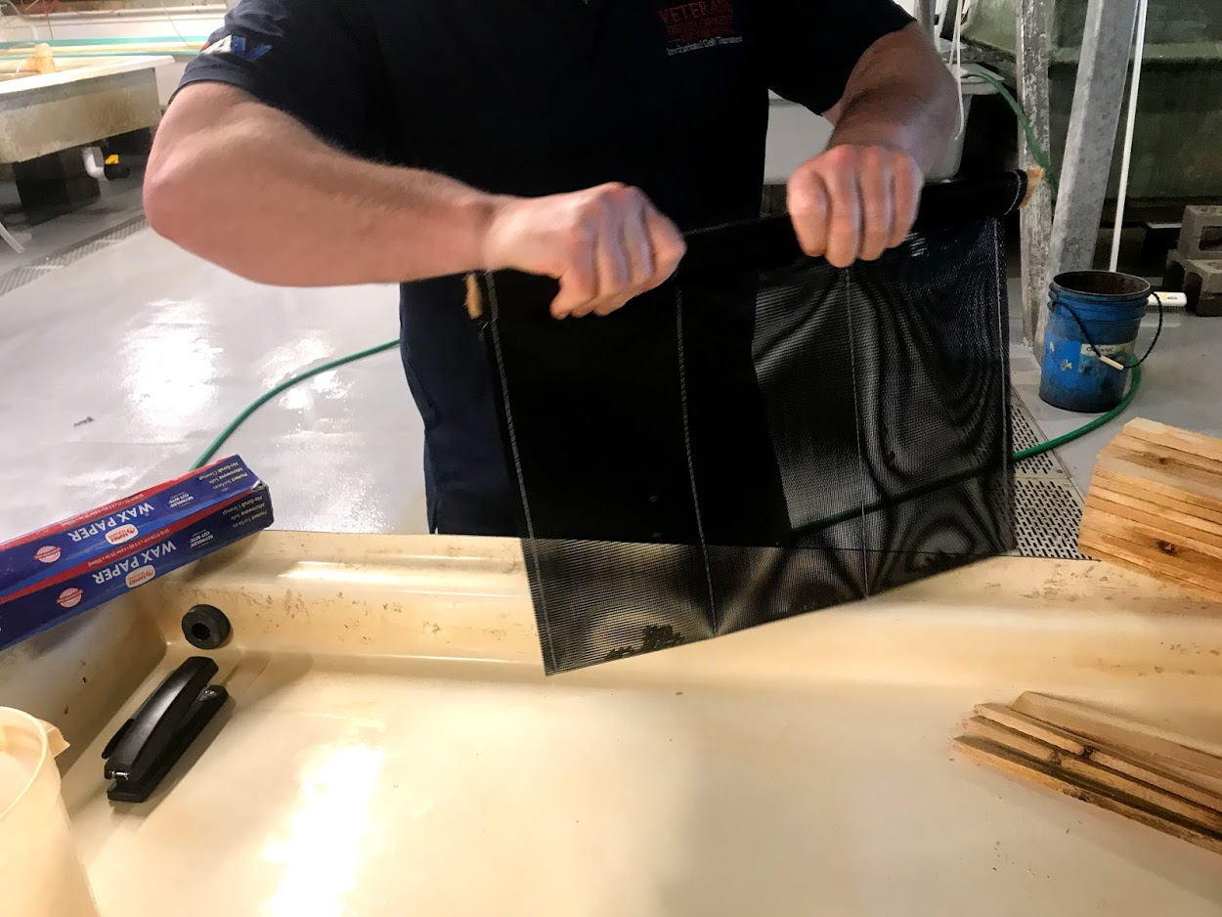

Slide 5
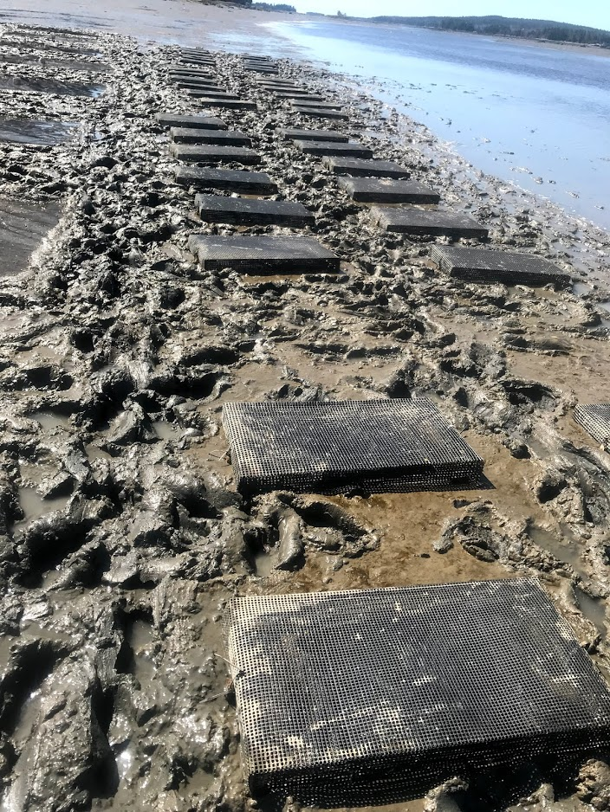
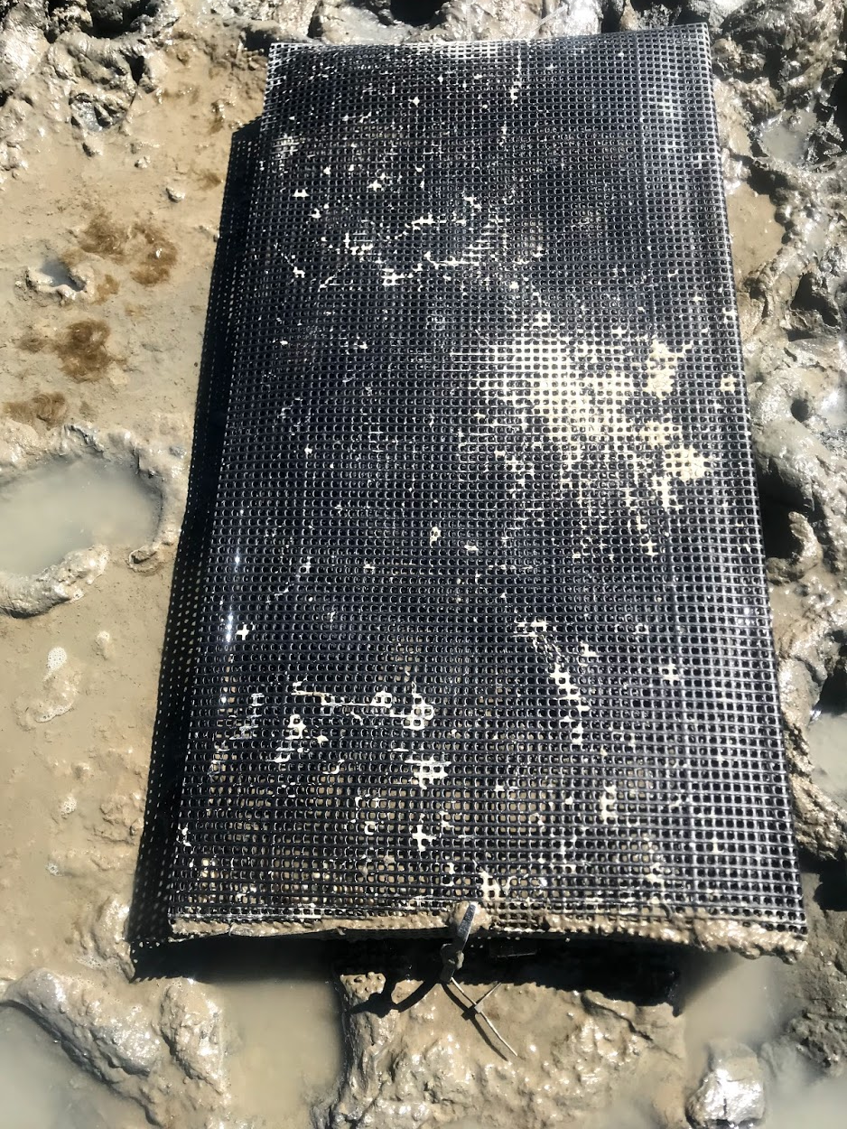

Slide 6
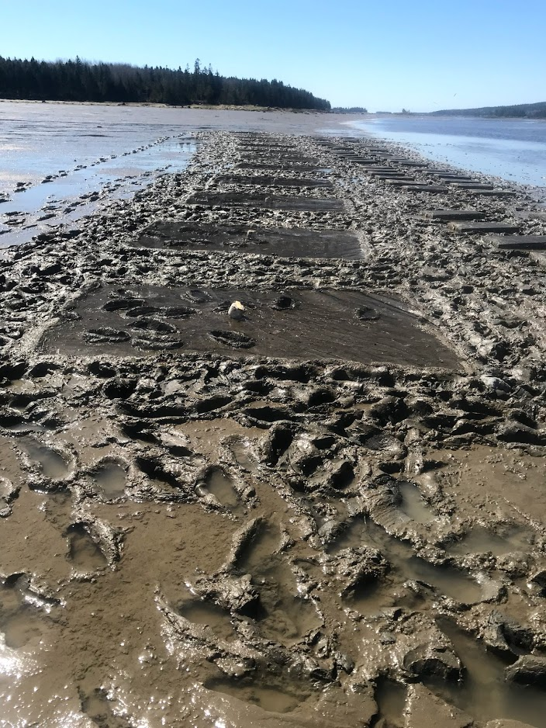
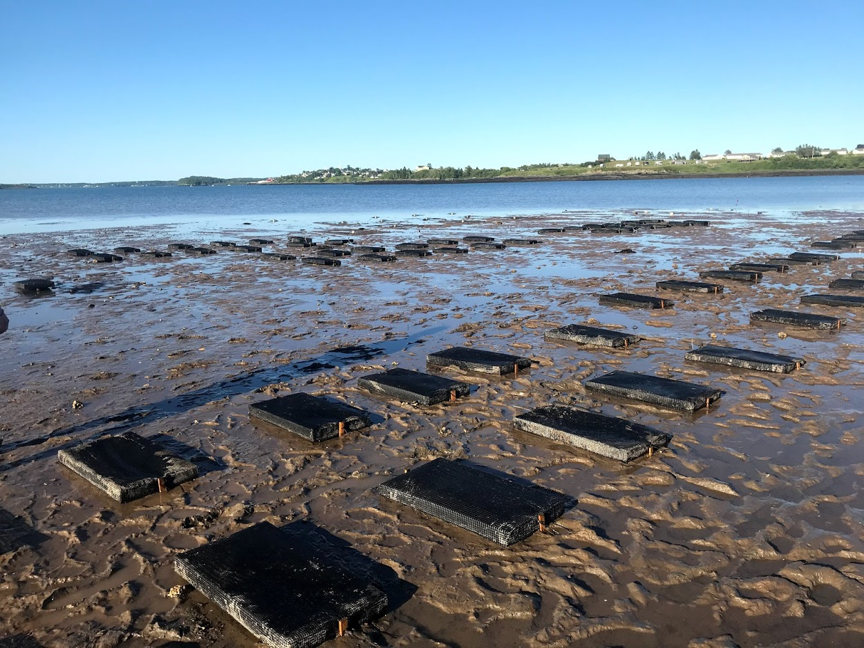

Slide 7
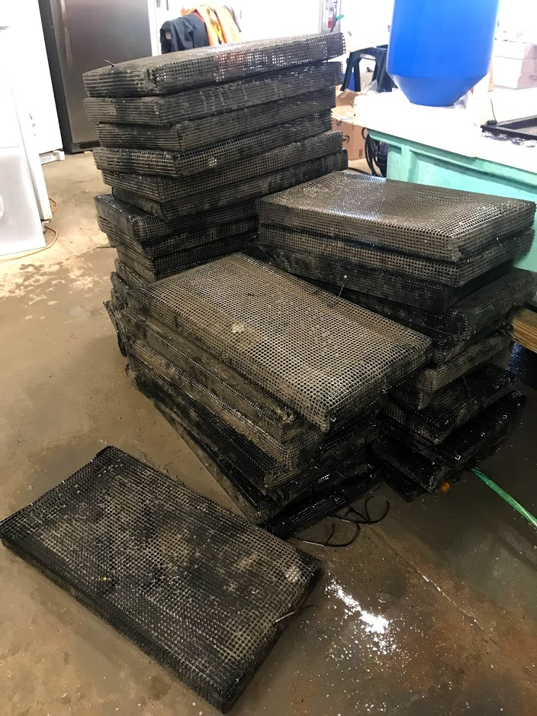
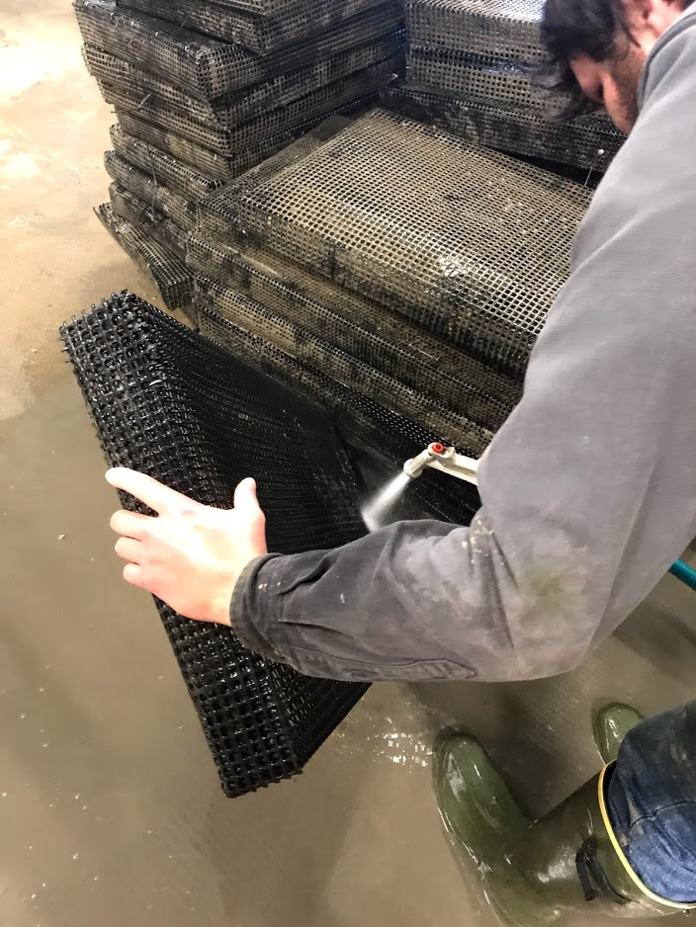
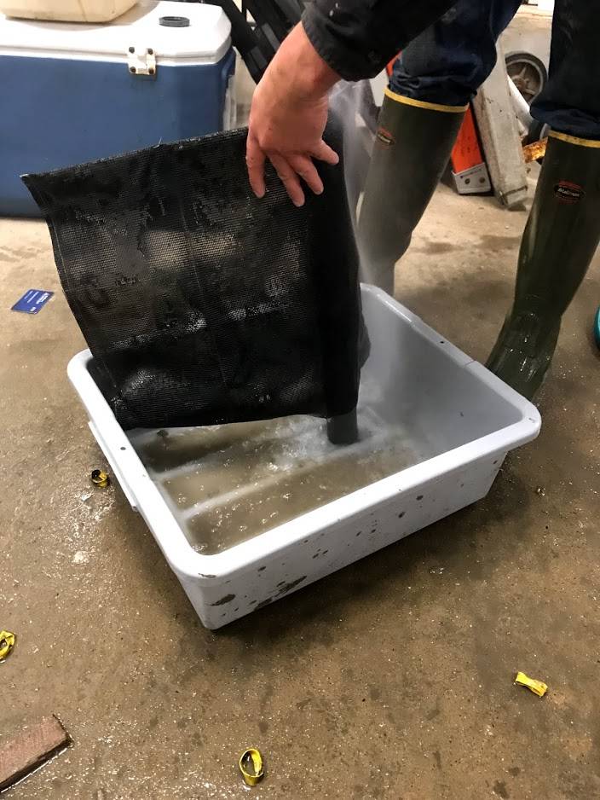
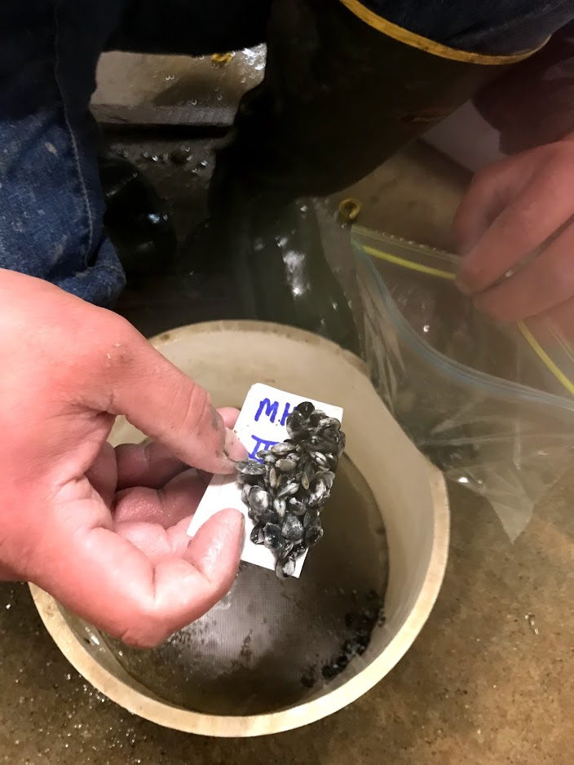

Slide 8
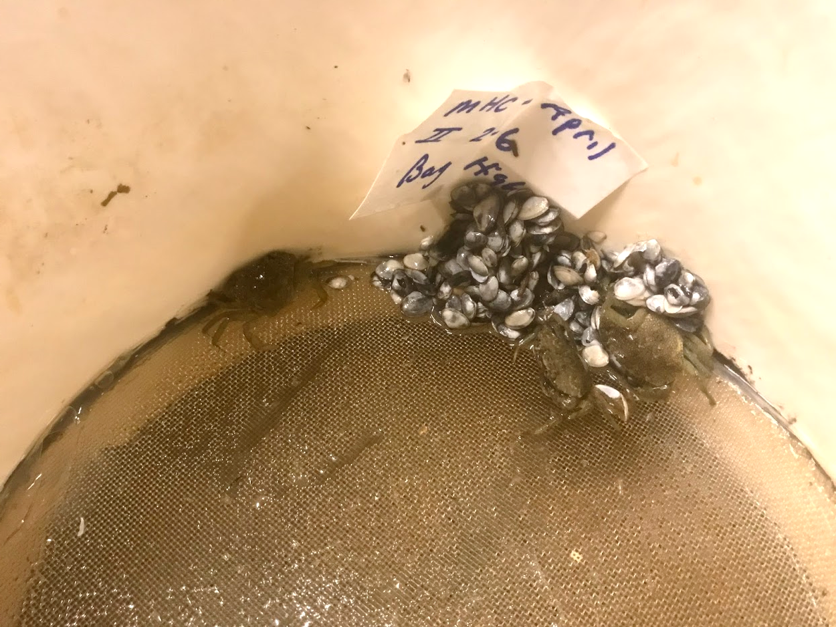

Slide 9
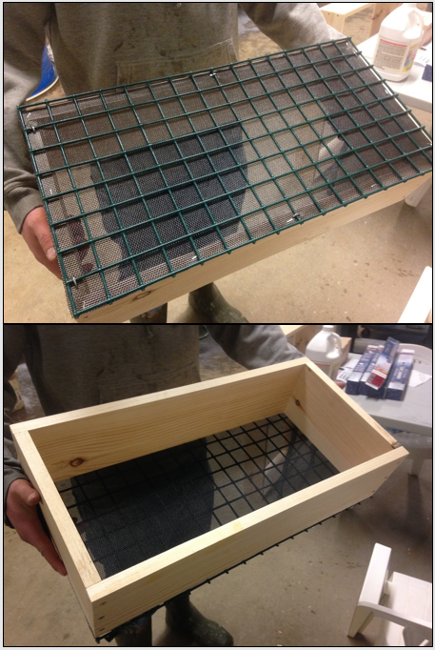
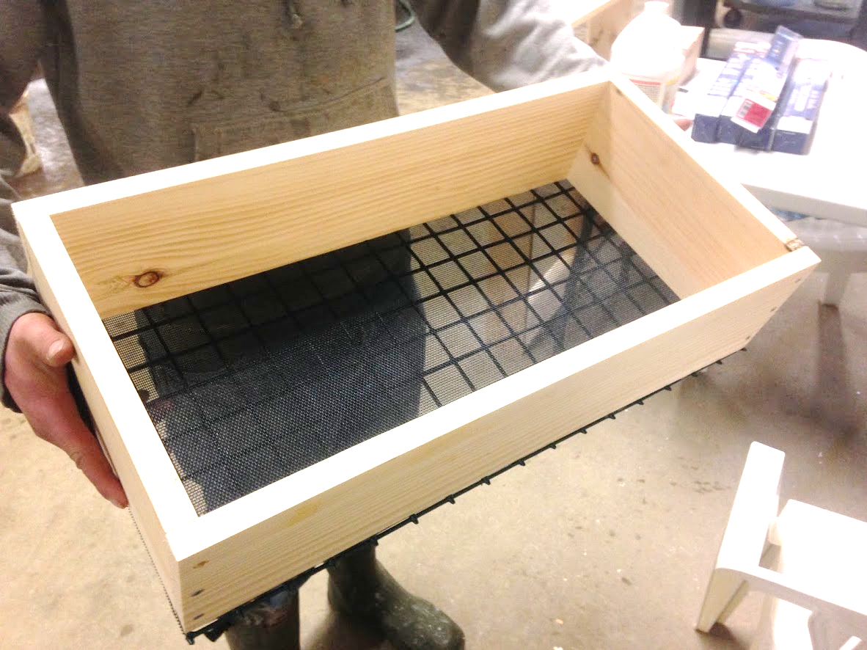
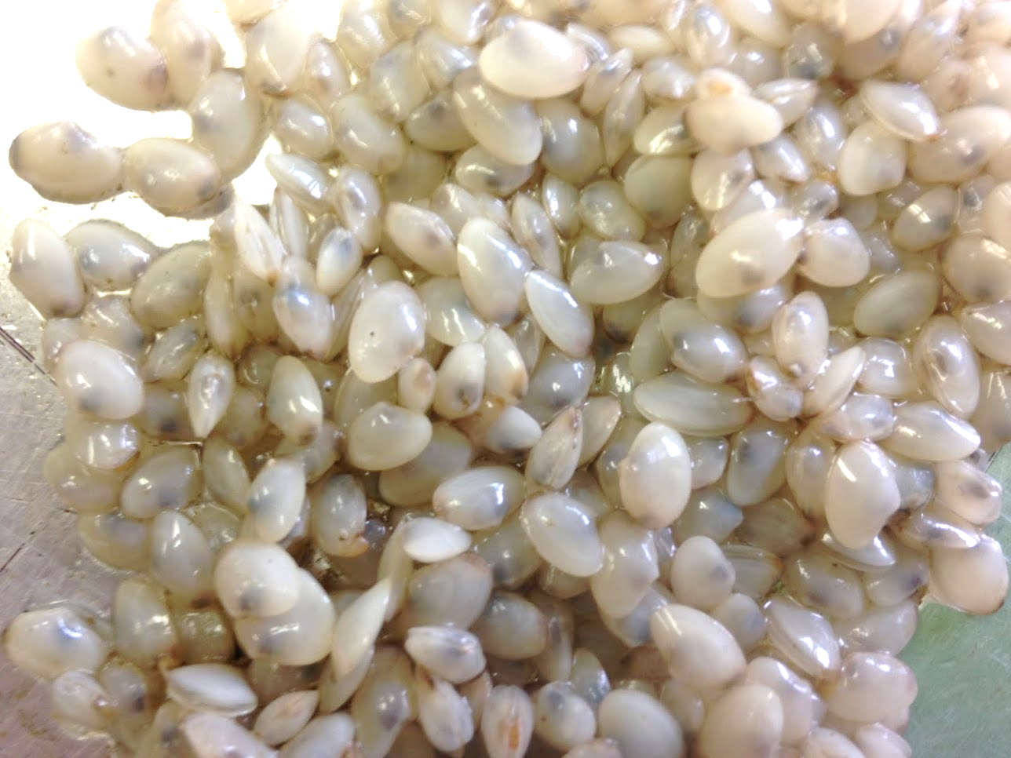
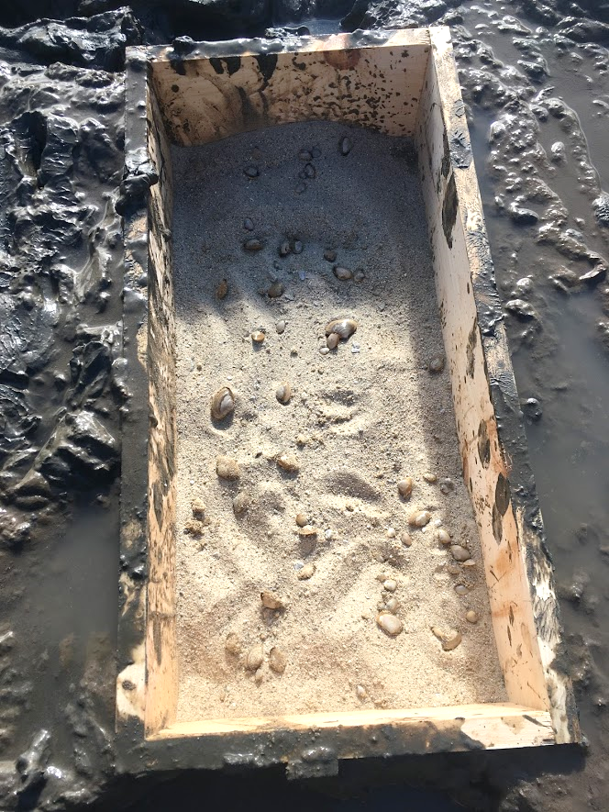
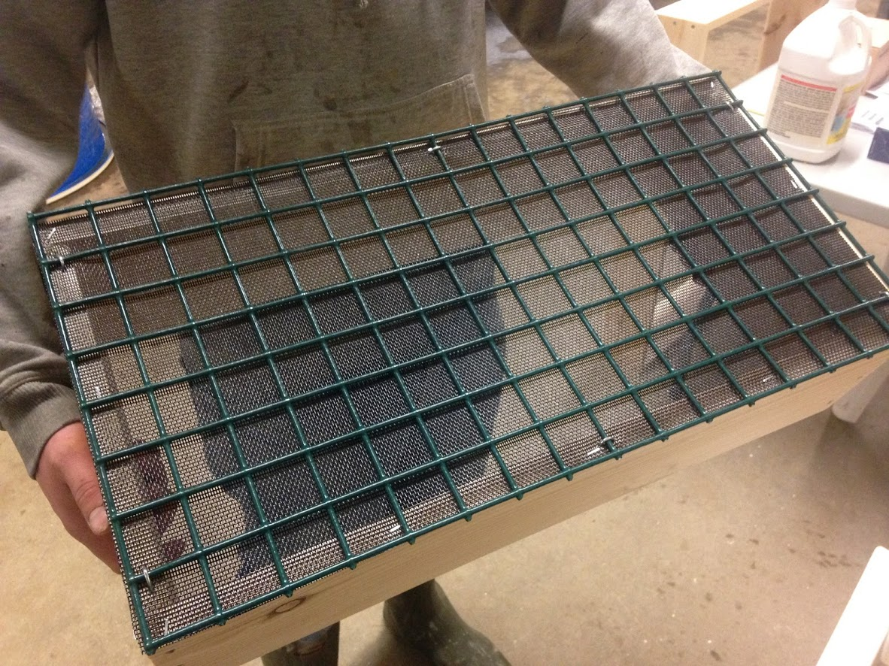

Slide 10
Towards Shore
Towards Shore
100
200
50
100
200
200
50
100
50
100
# Surfclam
juveniles per box
50
50
200
100
200

Slide 11
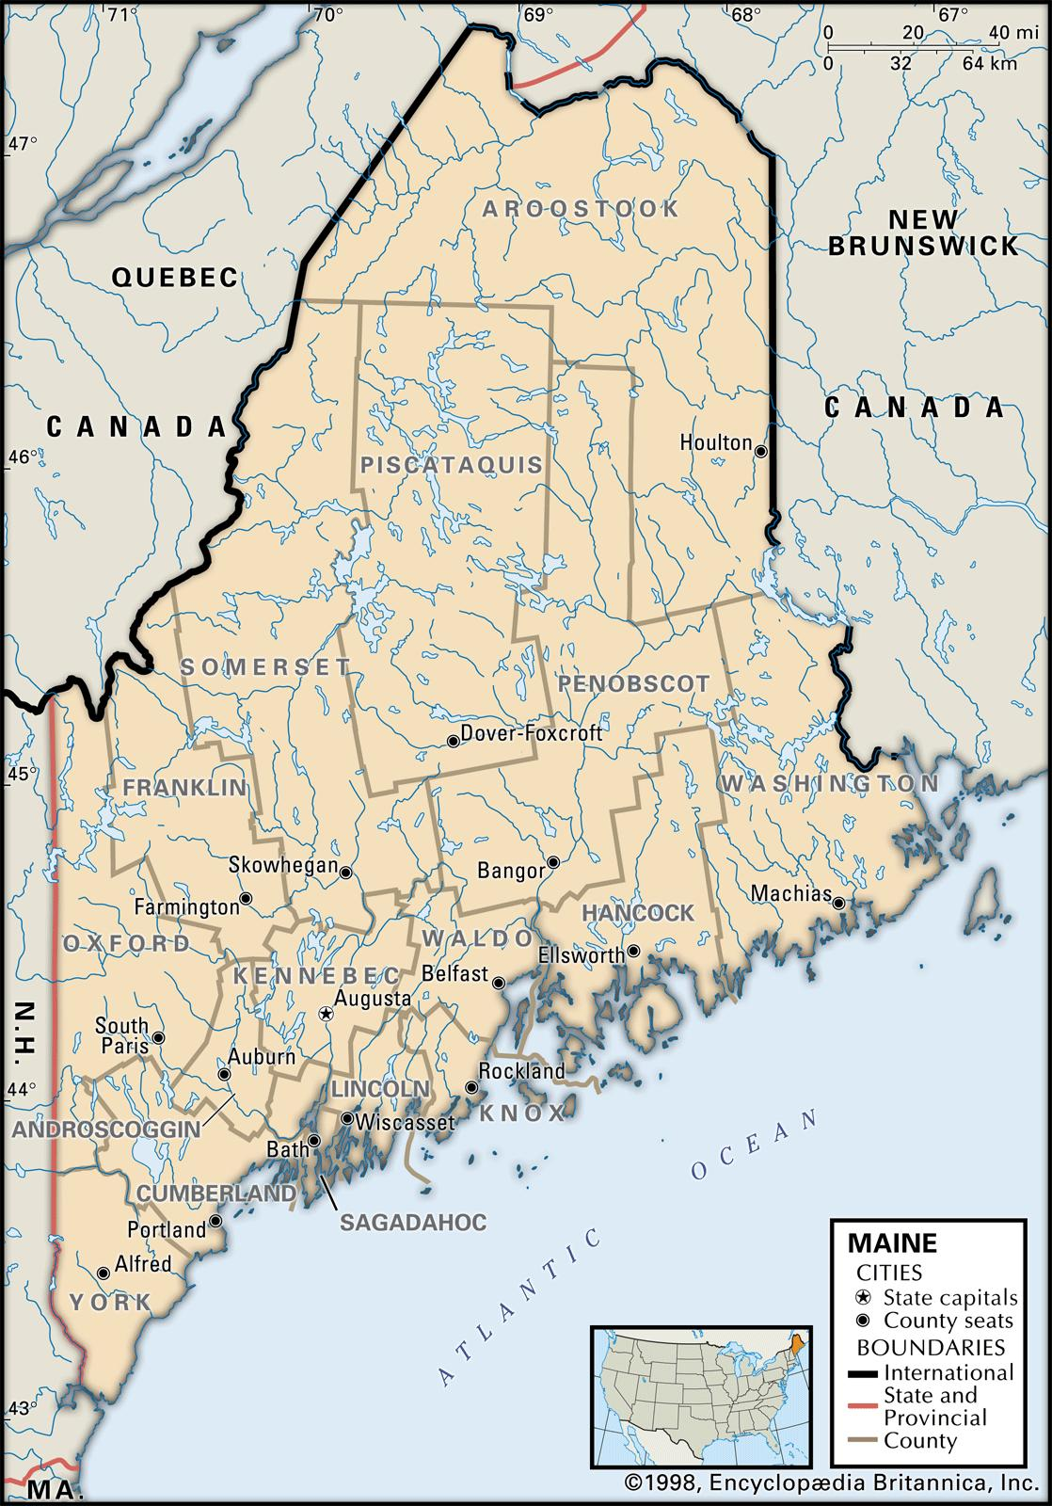
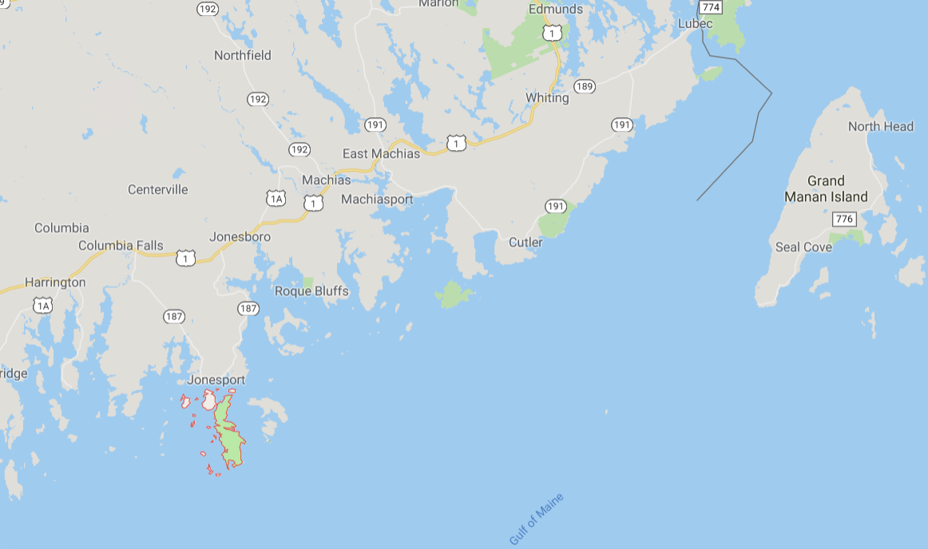
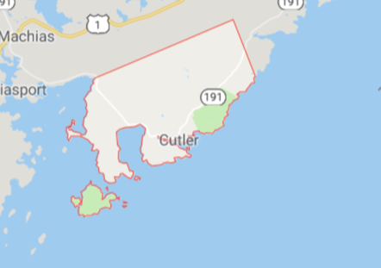
Duck Brook Cove
Cutler, ME
April 18-19 2019
to
Sept 29/Oct 1 2019
Mud Hole Cove
Beals, ME

Slide 12
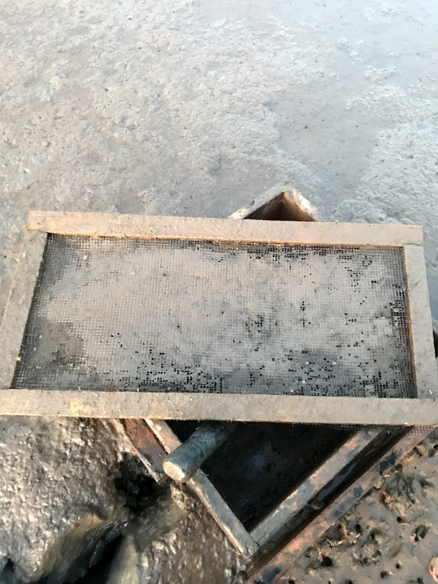
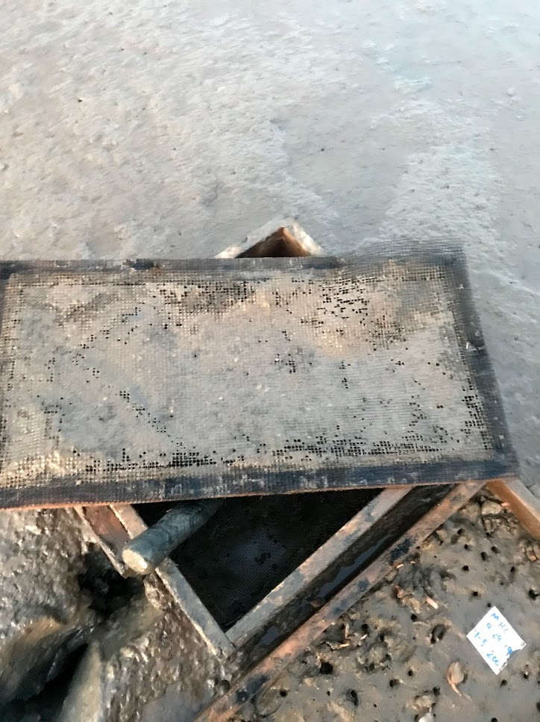
Top of Net
Underside of Net

Slide 13
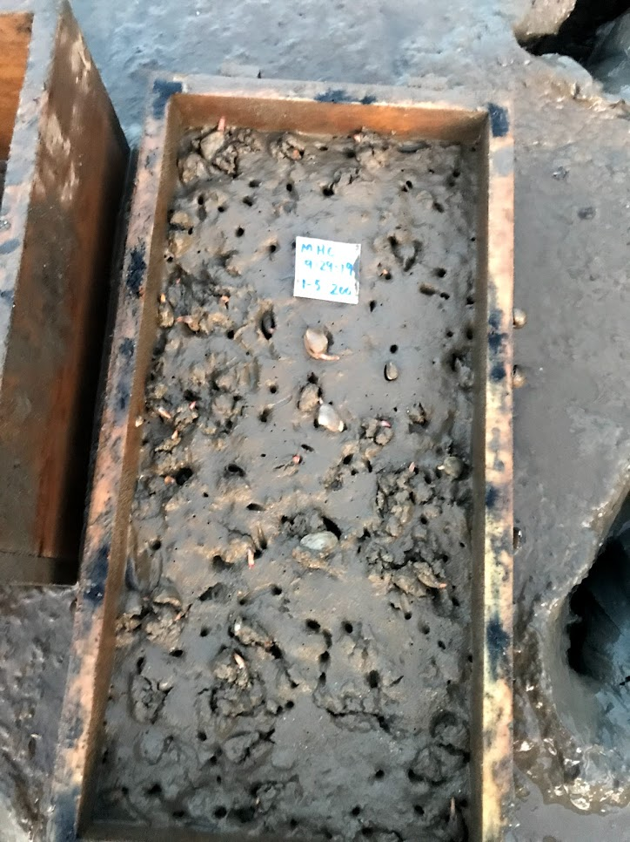
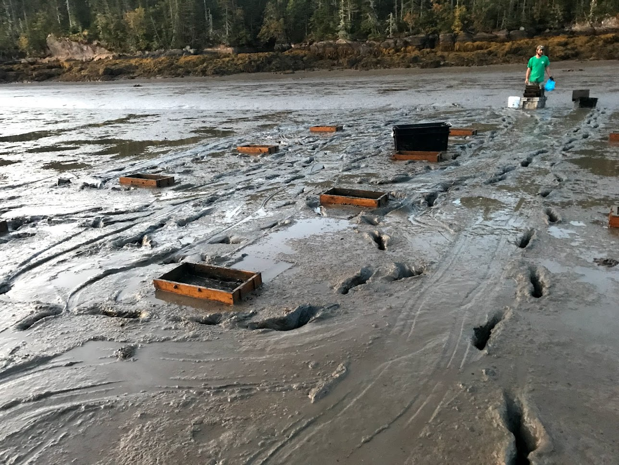
Mud Hole Cove (29 September 2019)

Slide 14
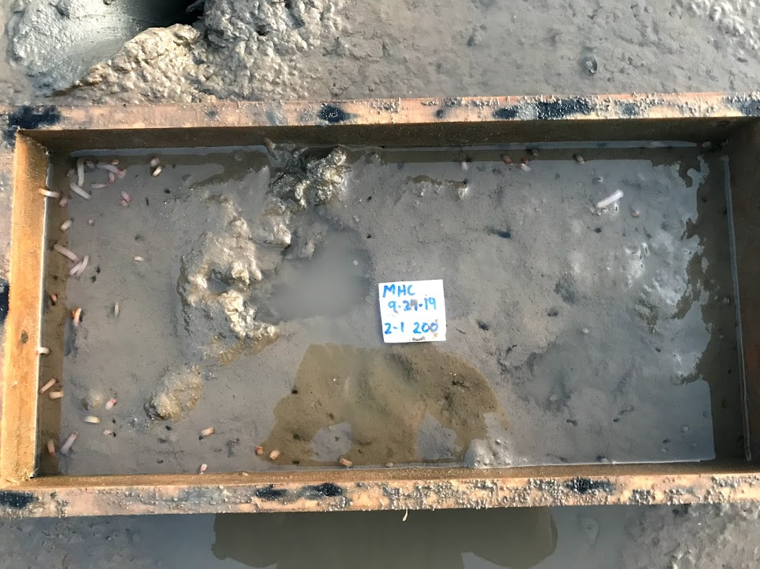
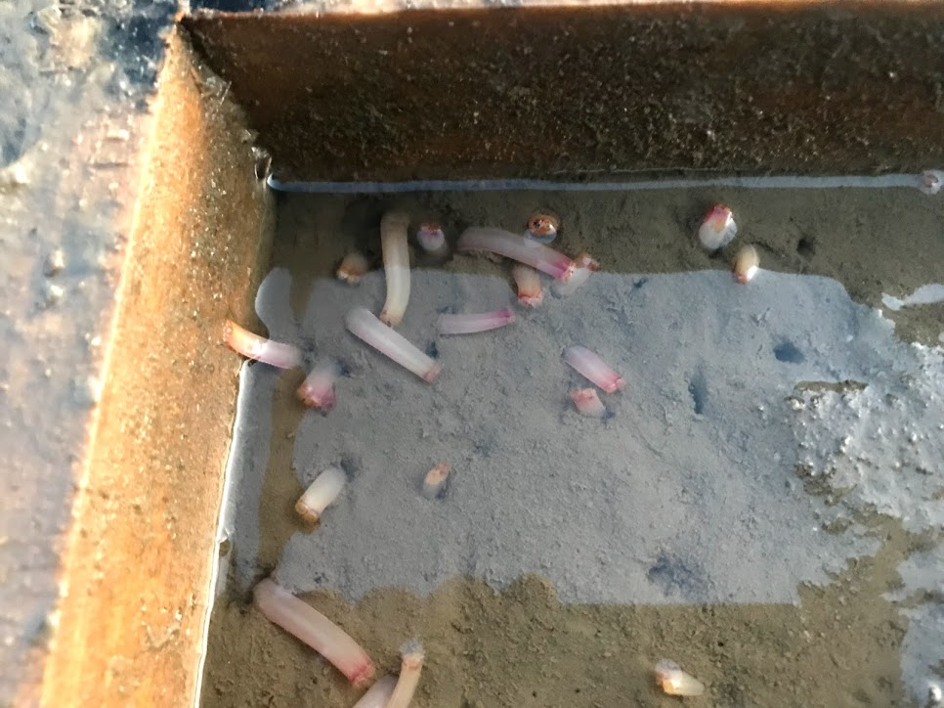
Mud Hole Cove (29 September 2019)

Slide 15
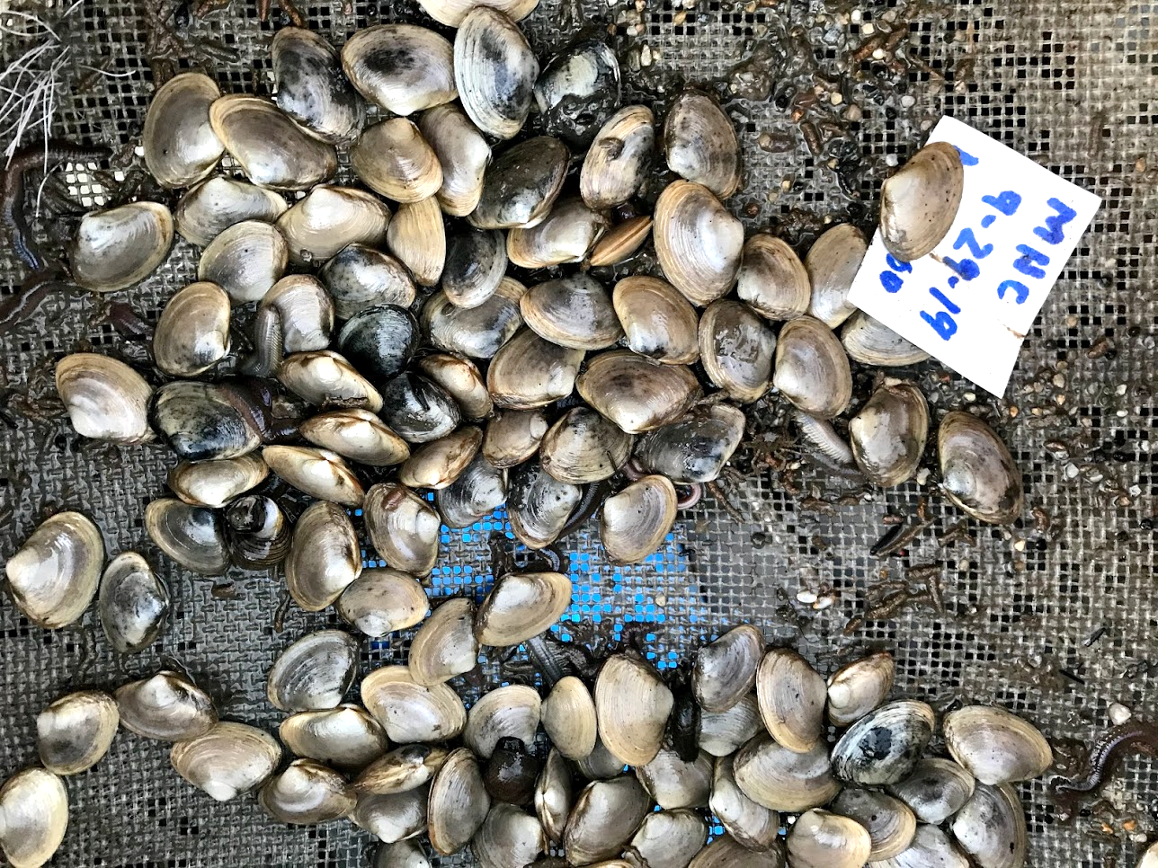

Slide 16
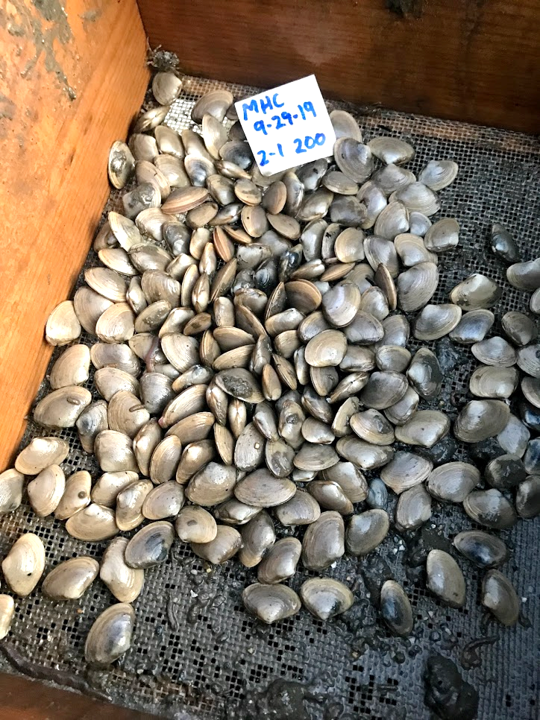
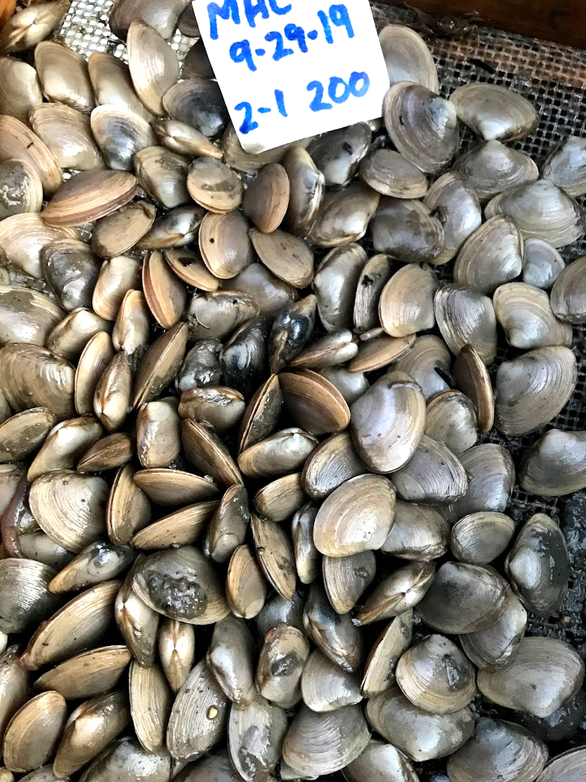

Slide 17
Mud Hole Cove
98.8%
98.2%
99.1%
N = 5
N = 5
N = 5
48
50
50
50
49
99
100
97
98
97
199
200
199
200
193

Slide 18
Mud Hole Cove
17.2 mm
17.4 mm
18.5 mm

Slide 19
Mud Hole Cove
Initial Length
10.9 mm
Final Length
27.9 mm

Slide 20
Duck Brook Cove
N = 5
N = 5
50
0
0
50
50
99
100
84
2
0
194
5
0
85
76

Slide 21
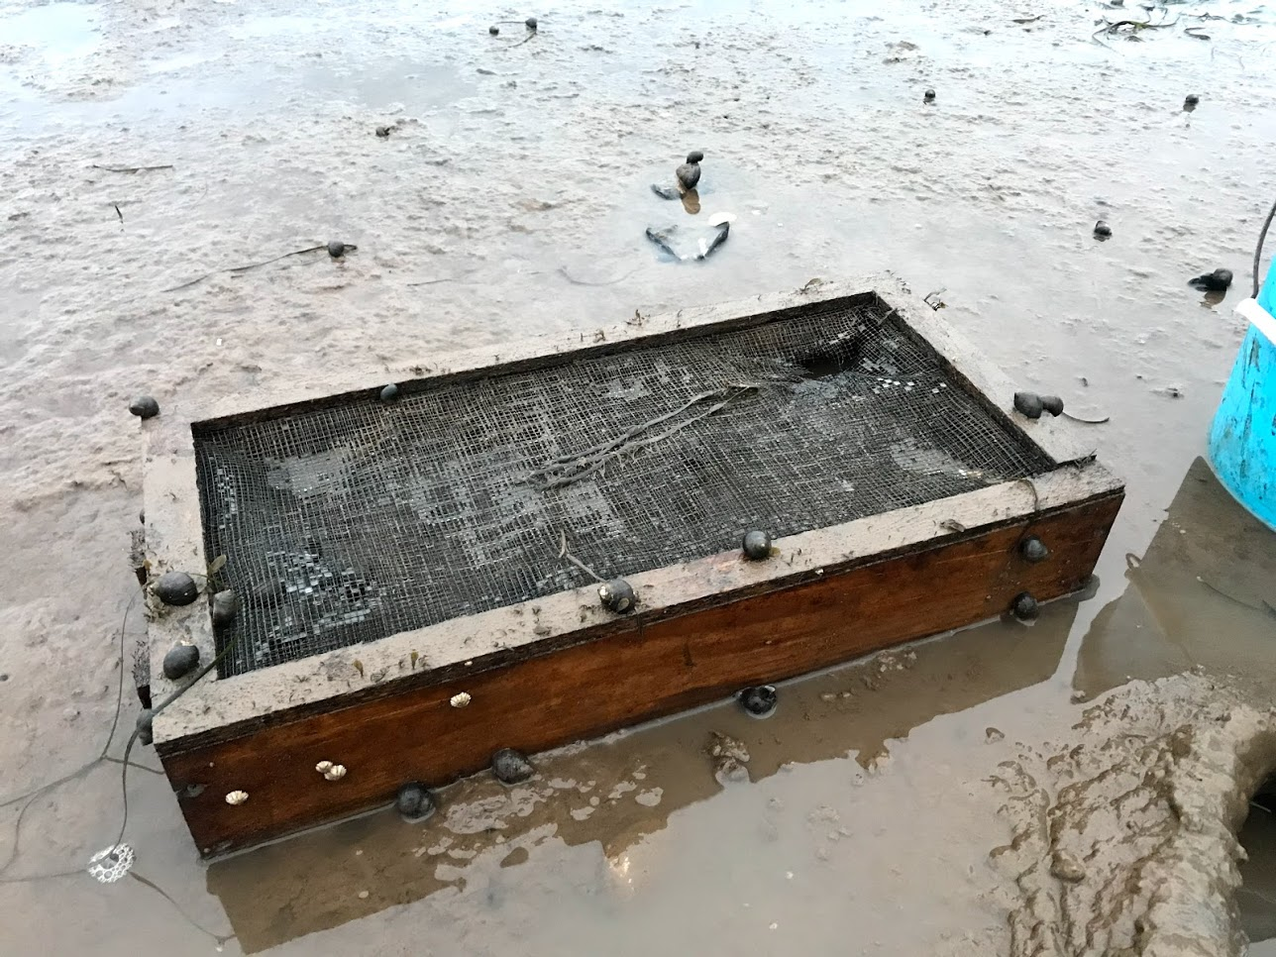

Slide 22
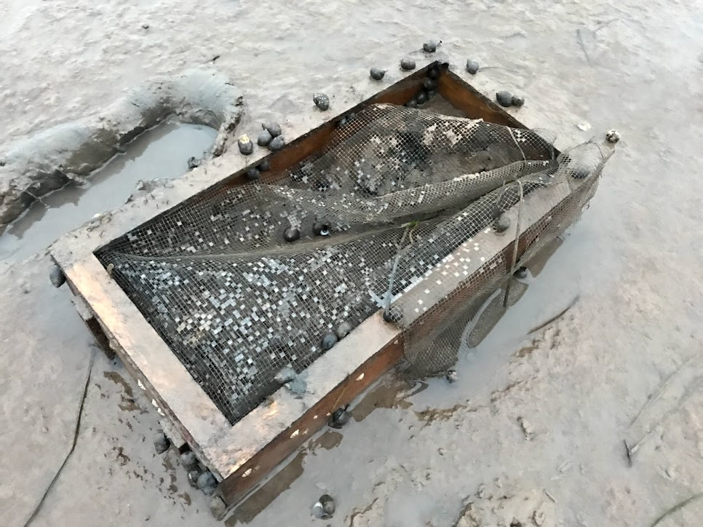

Slide 23
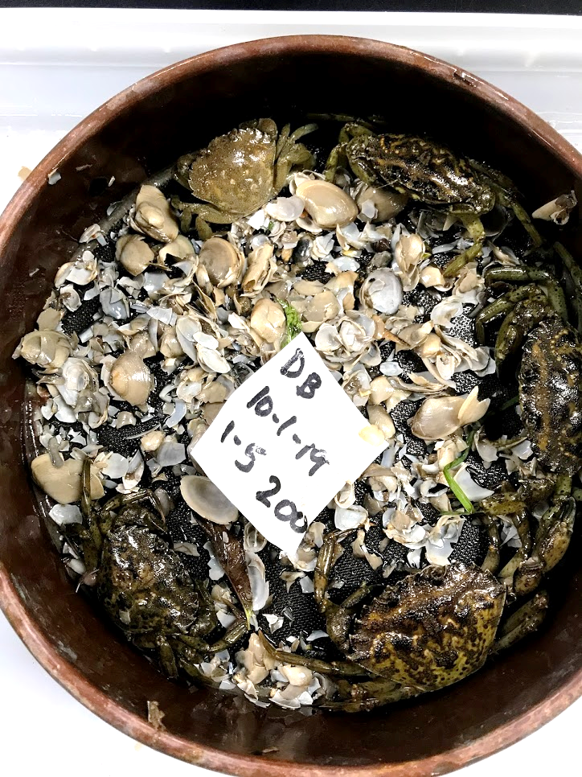
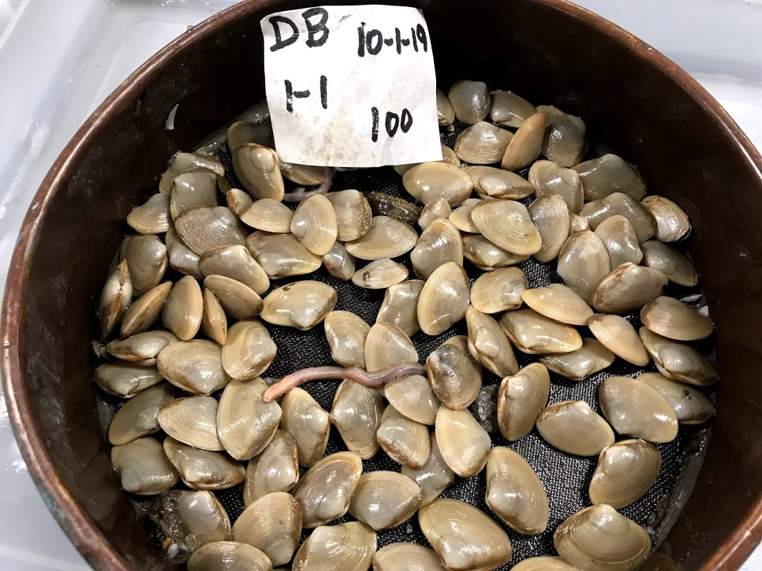
The mesh top of 6 of the 15 boxes
remained intact during the experiment
X
X
X
X
X

Slide 24
Duck Brook Cove
100%
n = 3
99.5%
n = 2
97.0%
n = 1
Survival averaged
99.3% in boxes
where the mesh
tops remained
intact (19 April-
1 October)
194
50
50
50
99
100

Slide 25
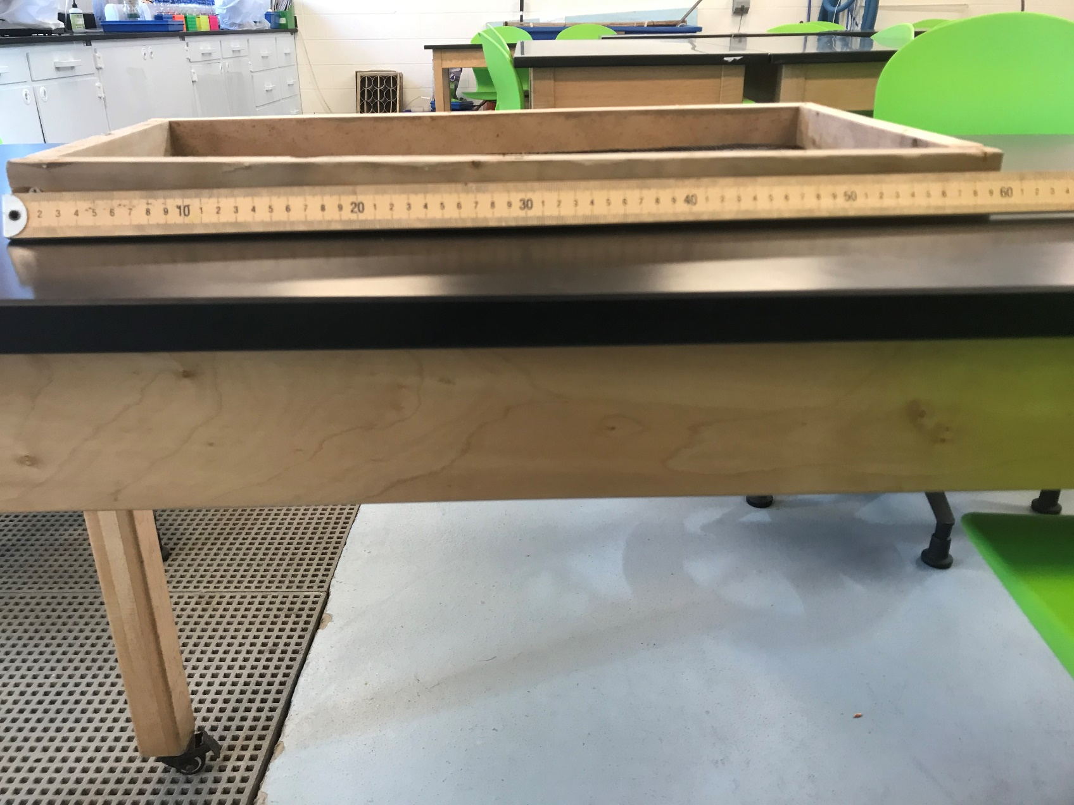
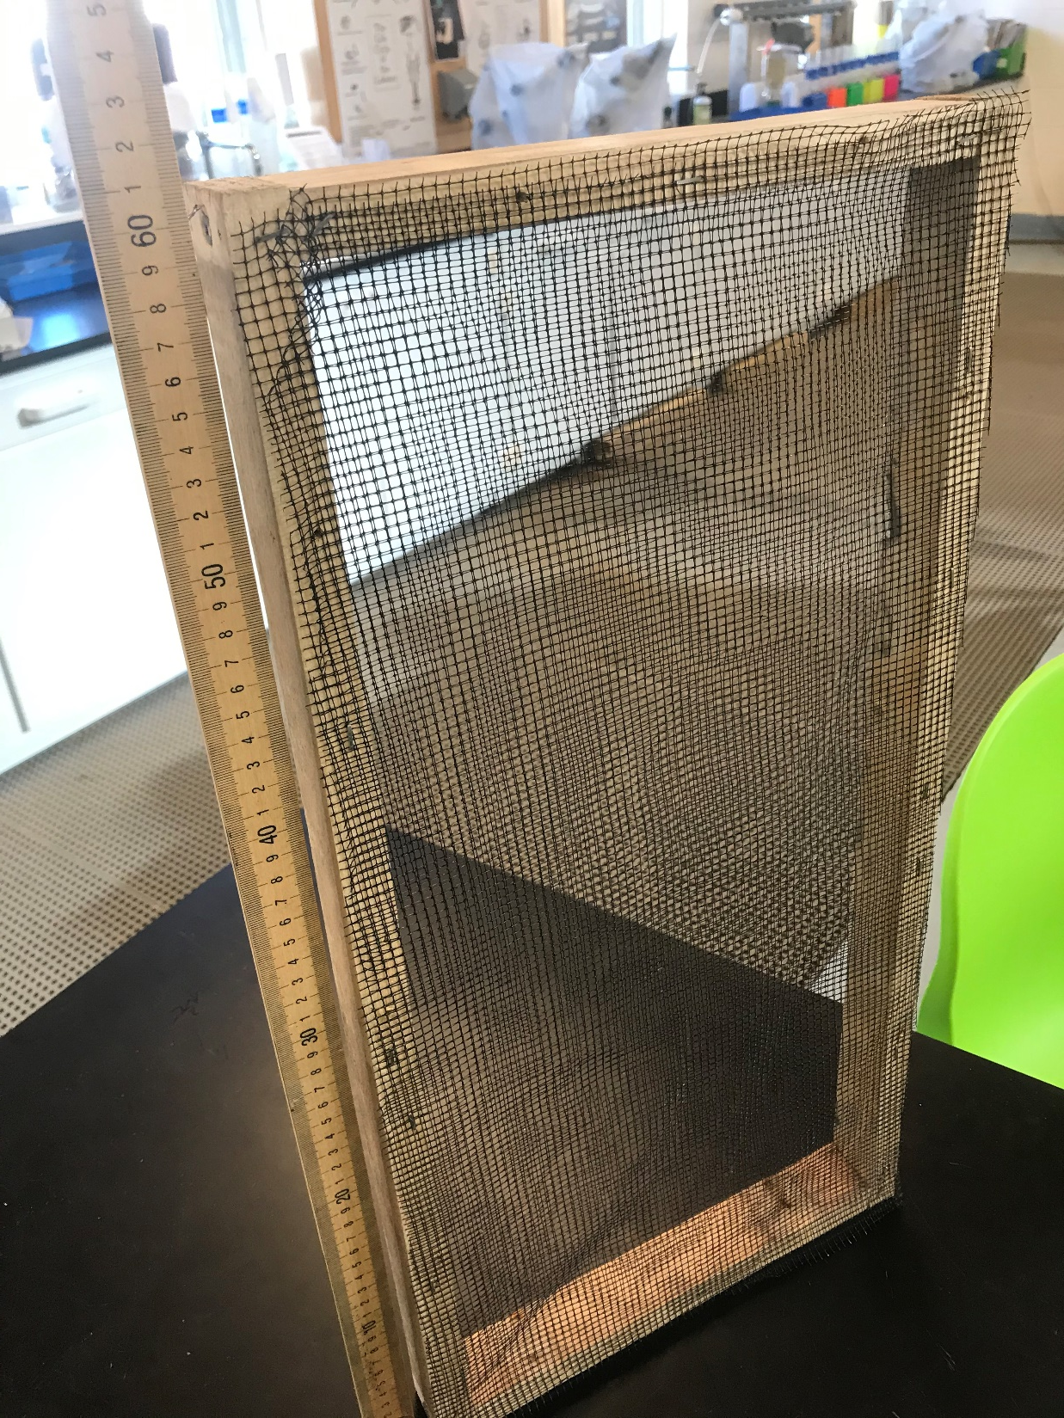
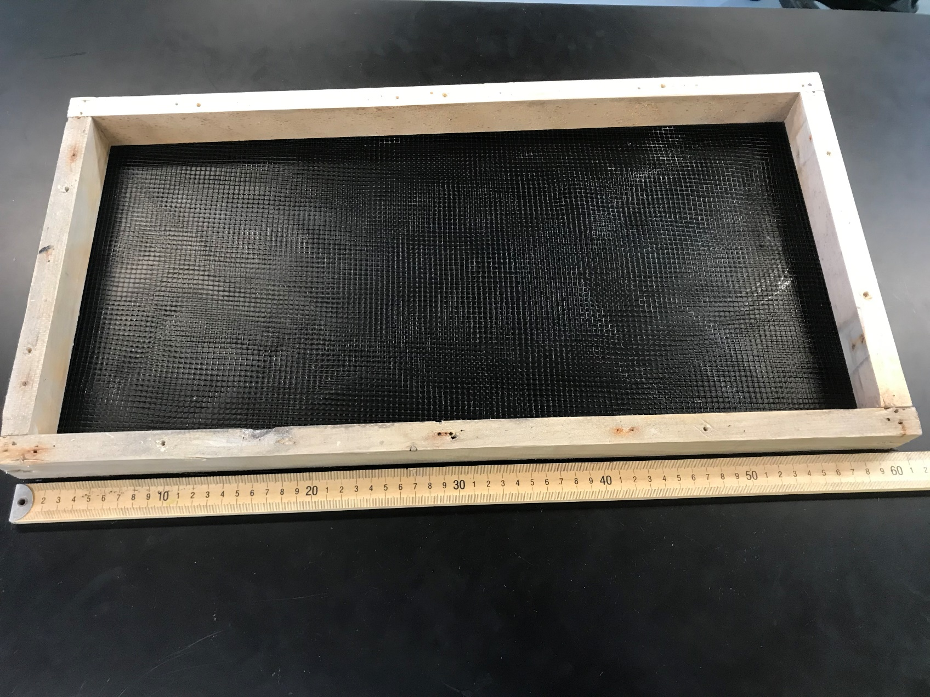

Slide 26
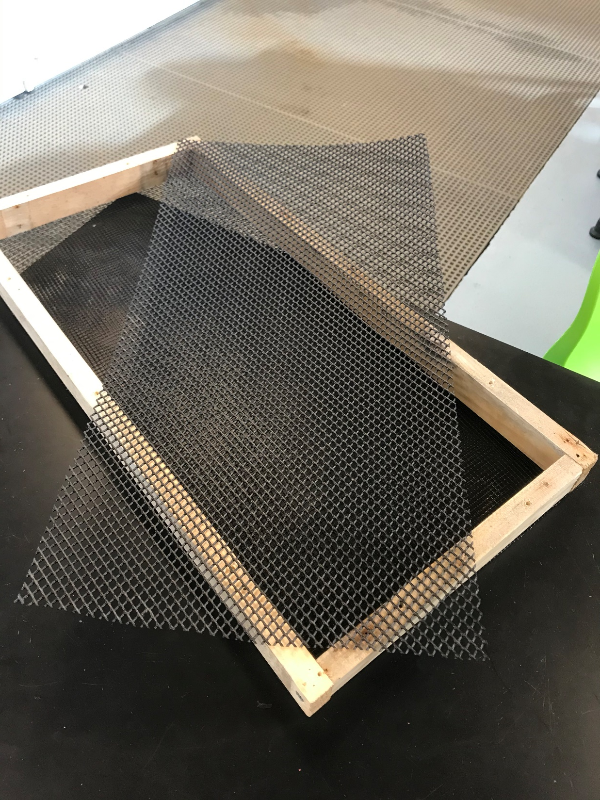
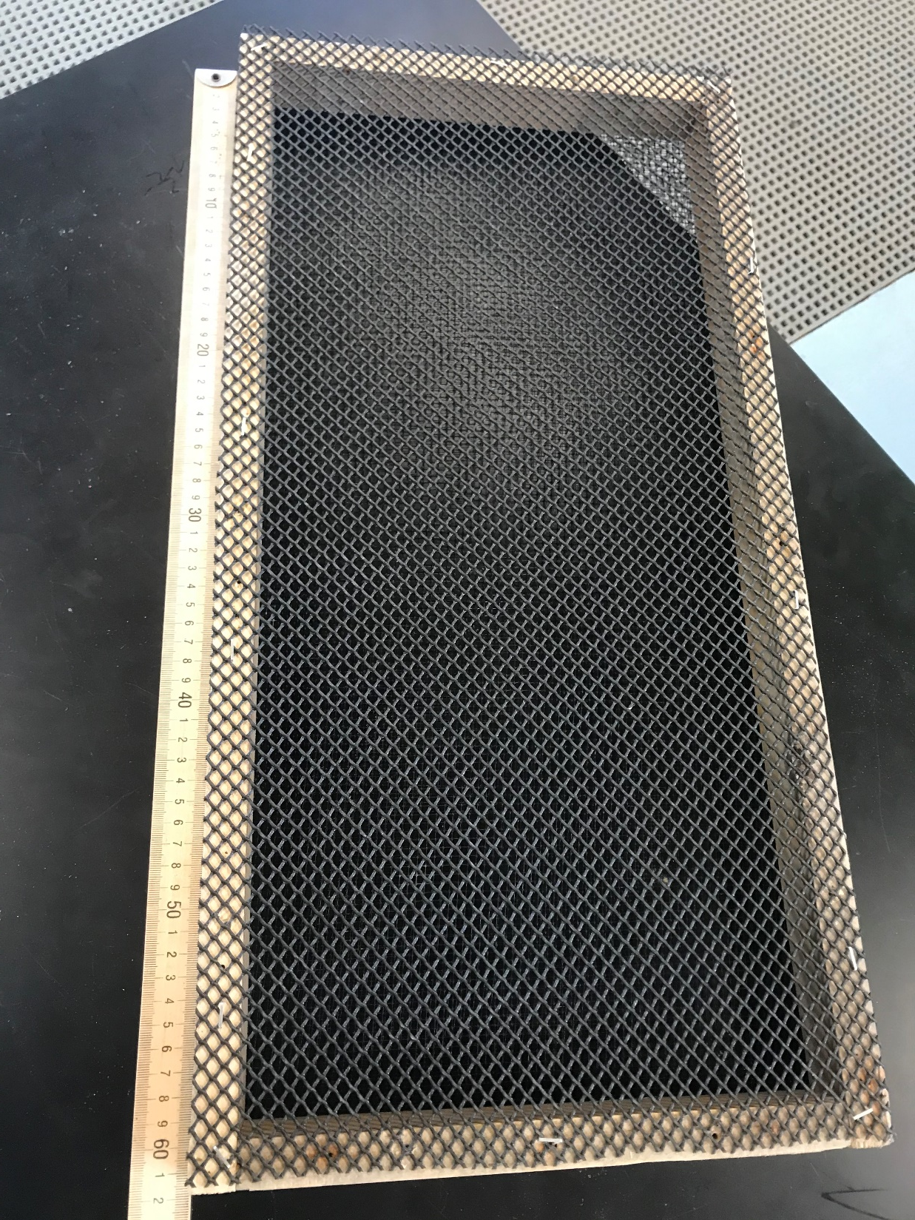

Slide 27
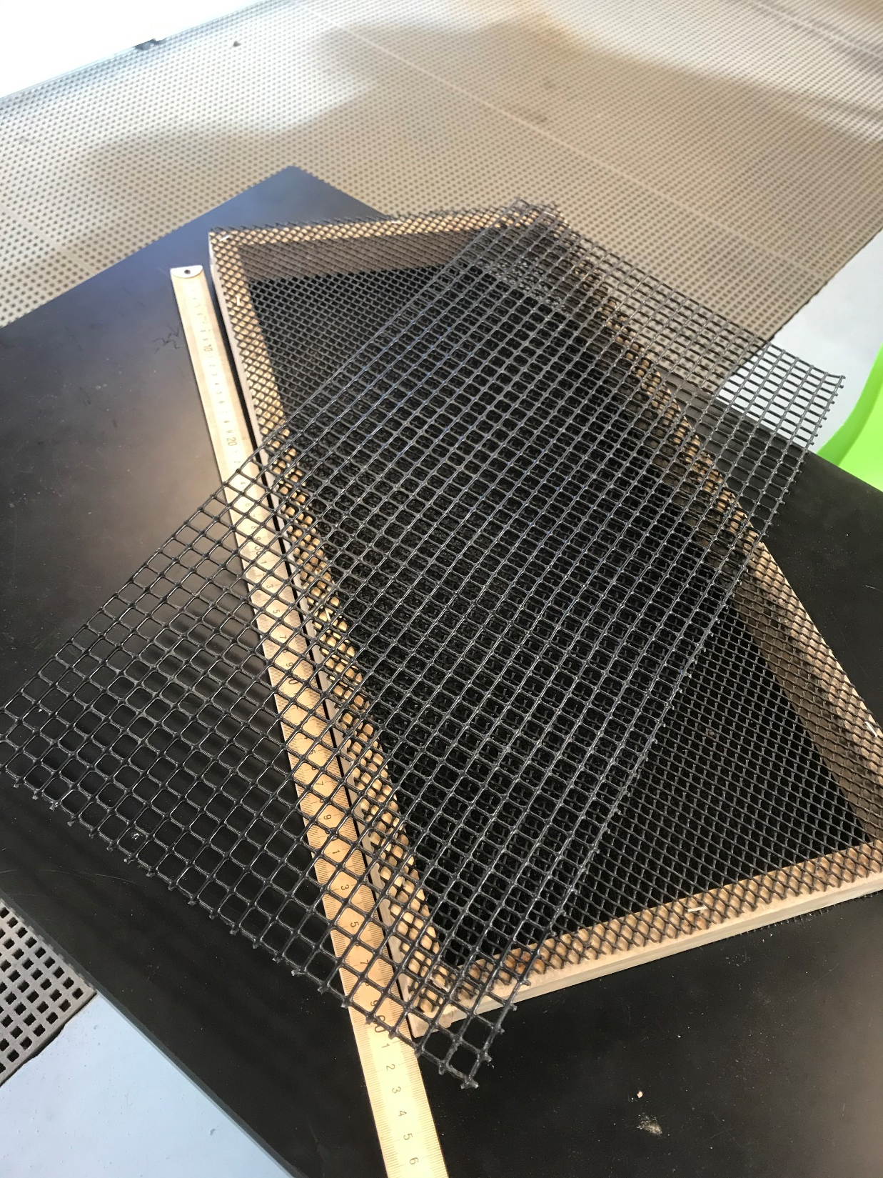
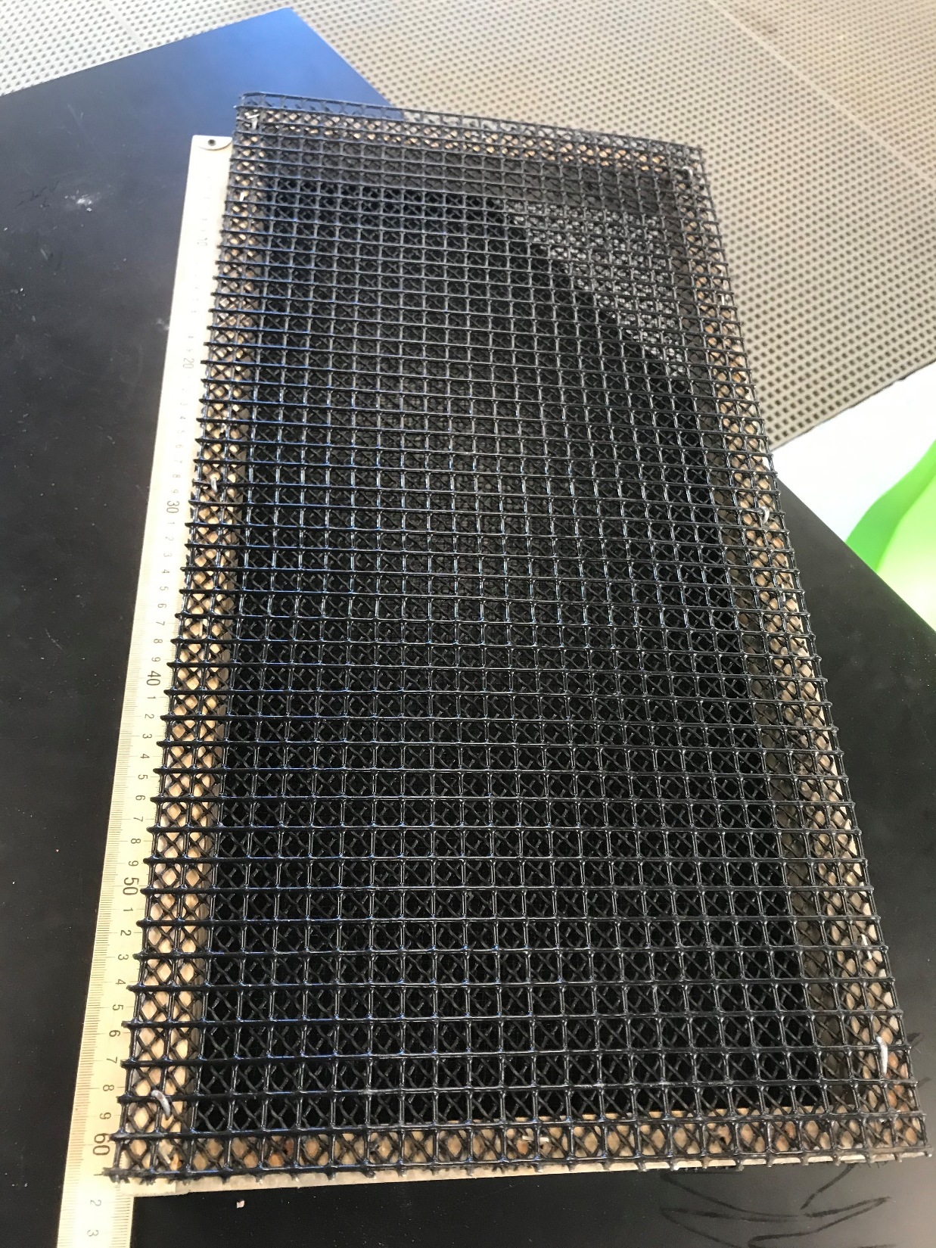

Slide 28
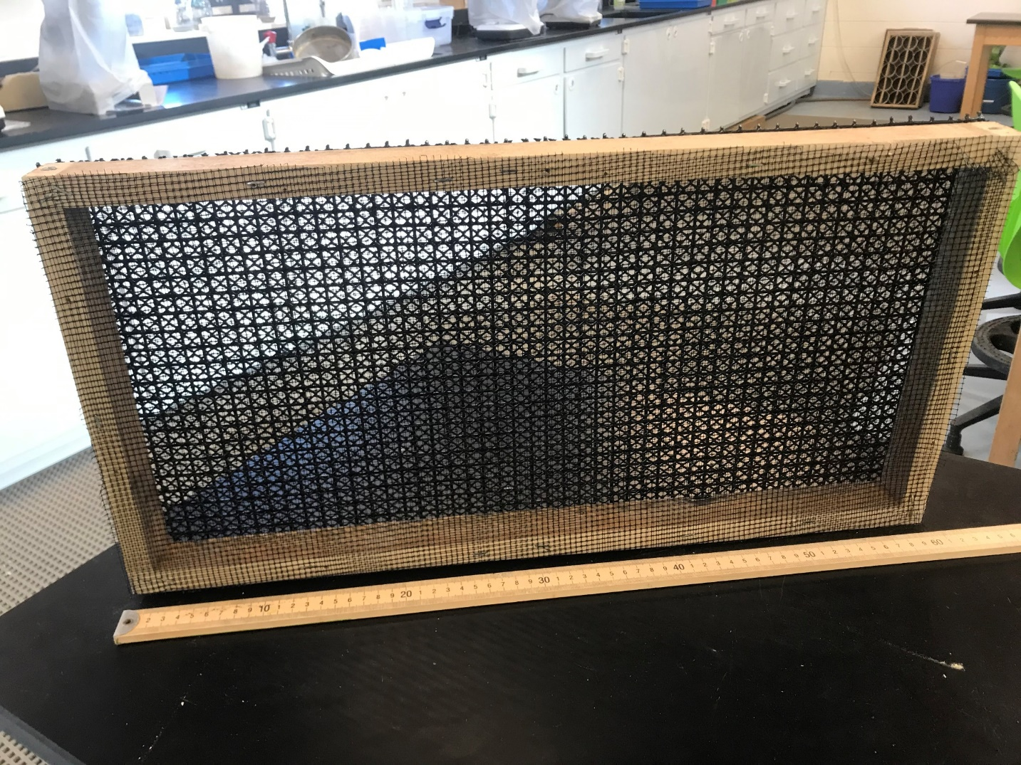
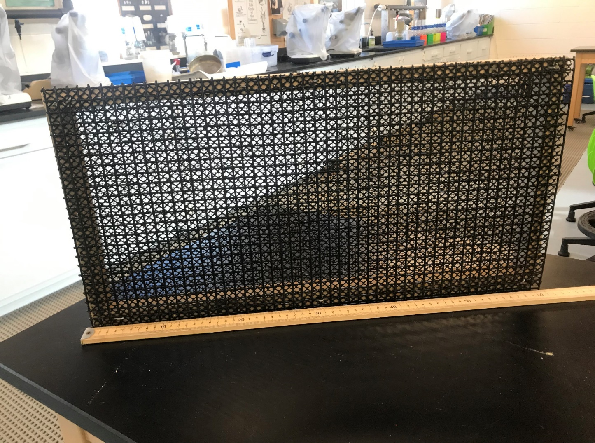
Bottom View
Top View

Slide 29
Three factors
Density (25, 50, or 100/ft²)
Top Thickness (1-inch vs. 2-inch)
Box Size (2 ft² vs. 4 ft²)

Slide 31
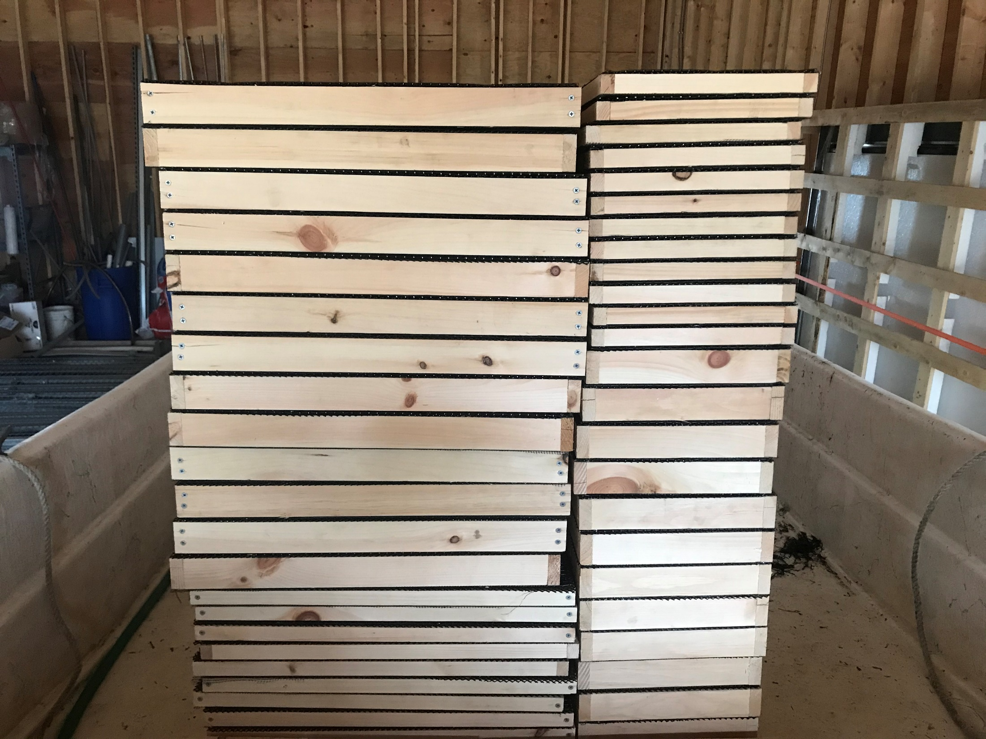

Slide 32
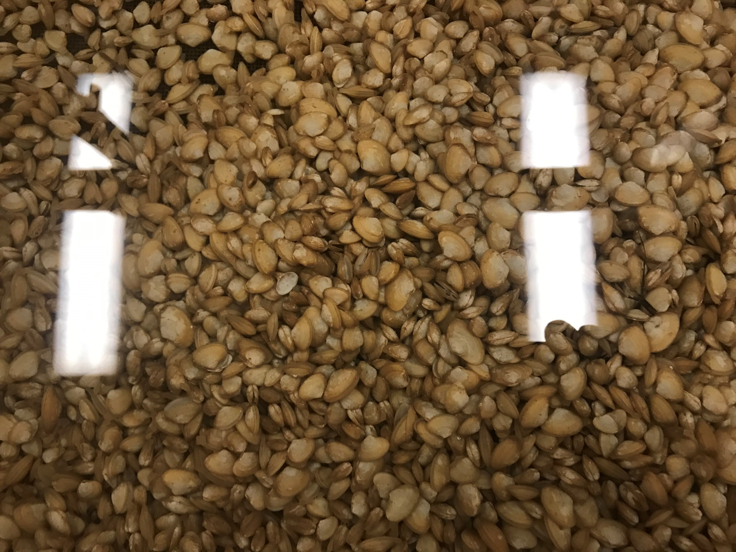

Slide 33
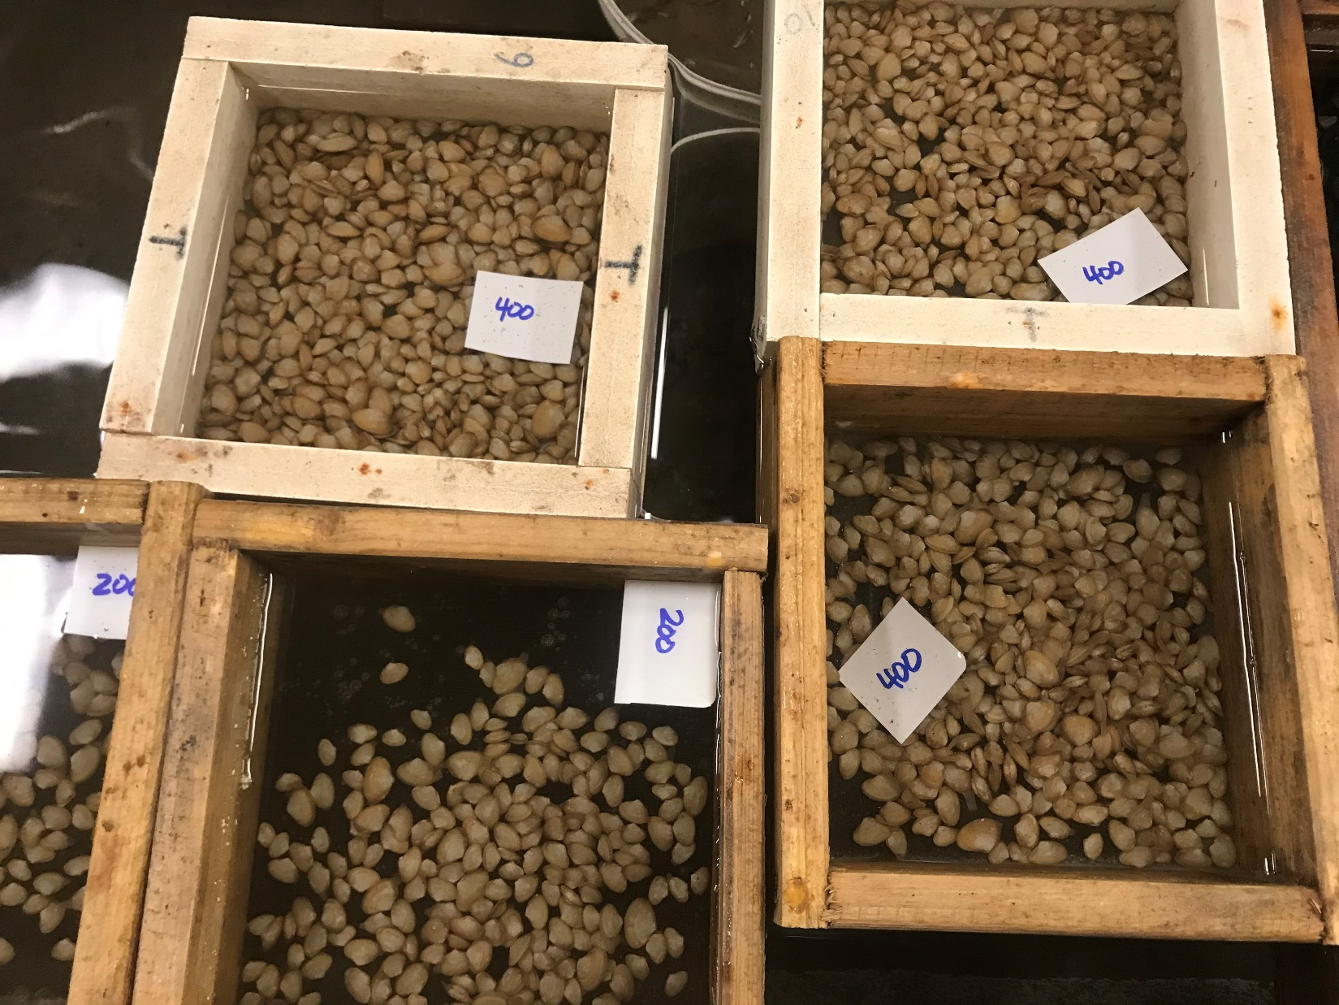
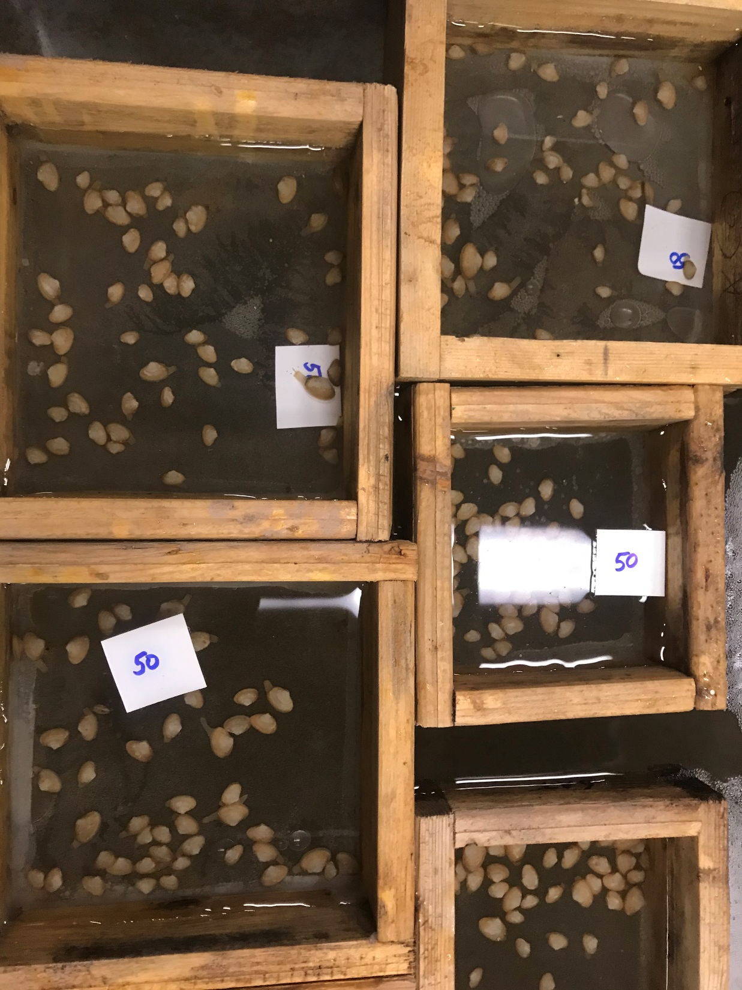
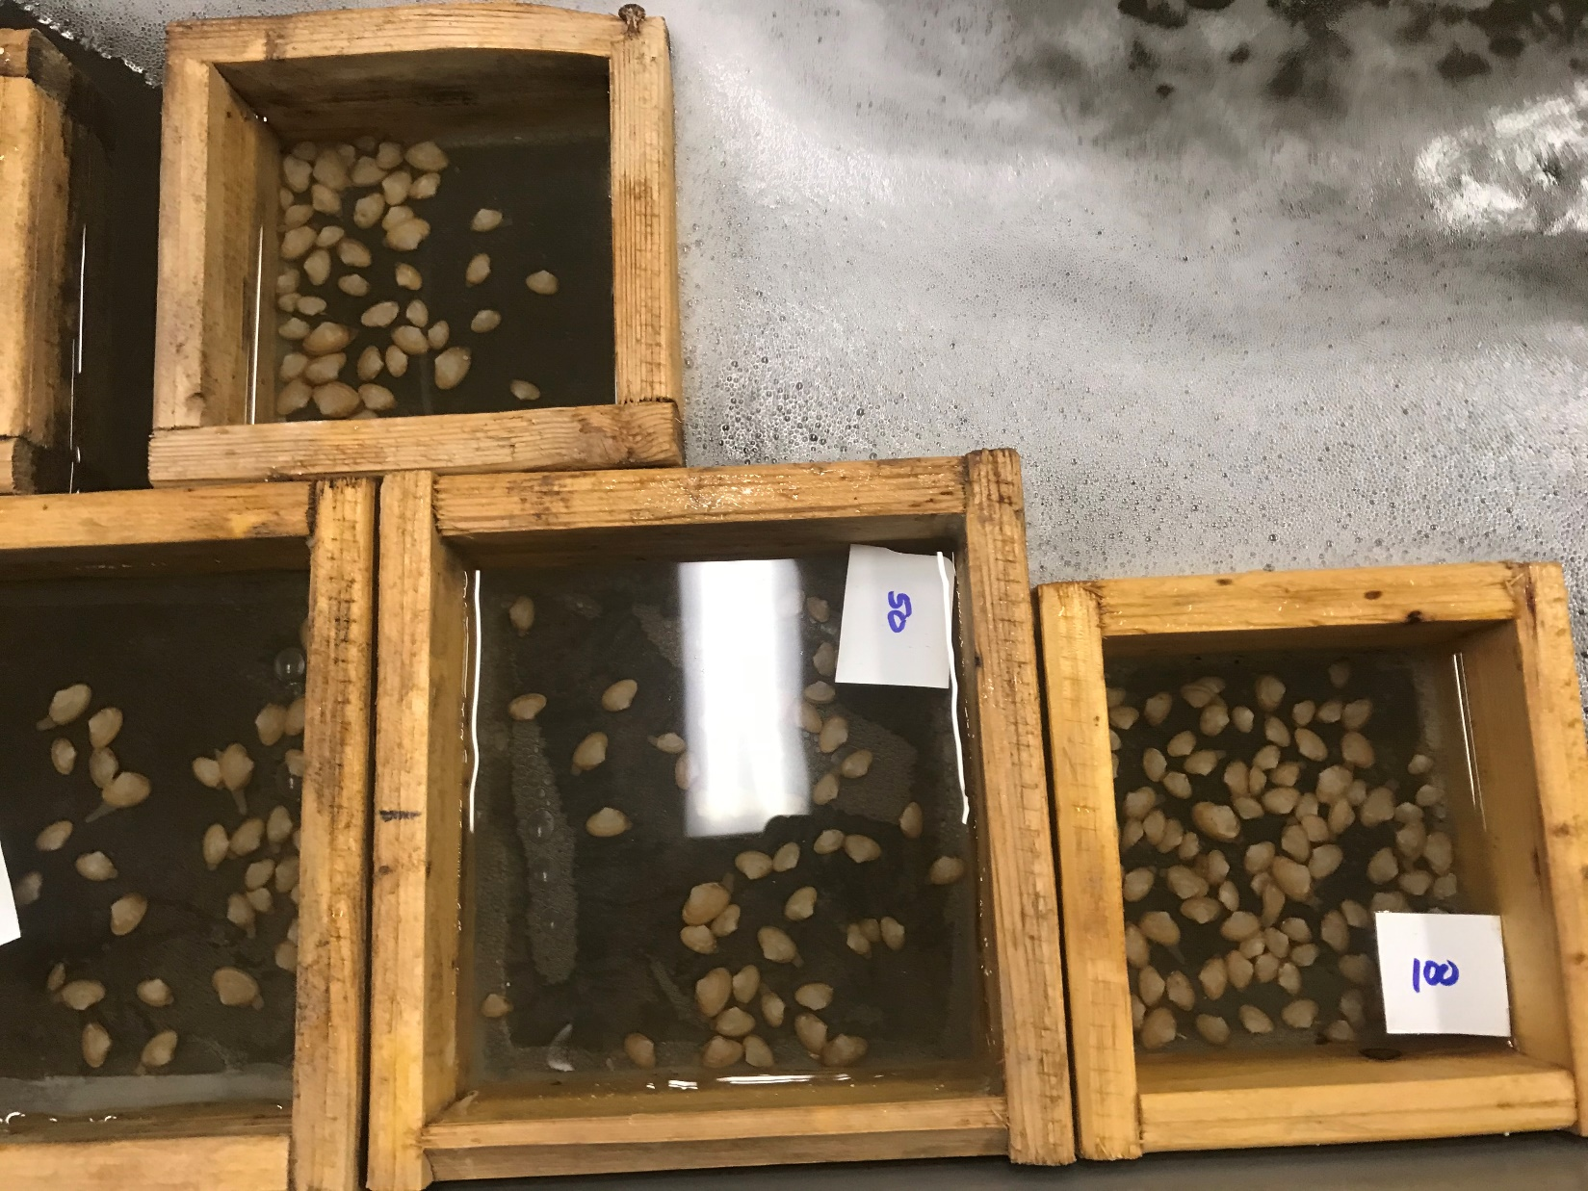

Slide 34
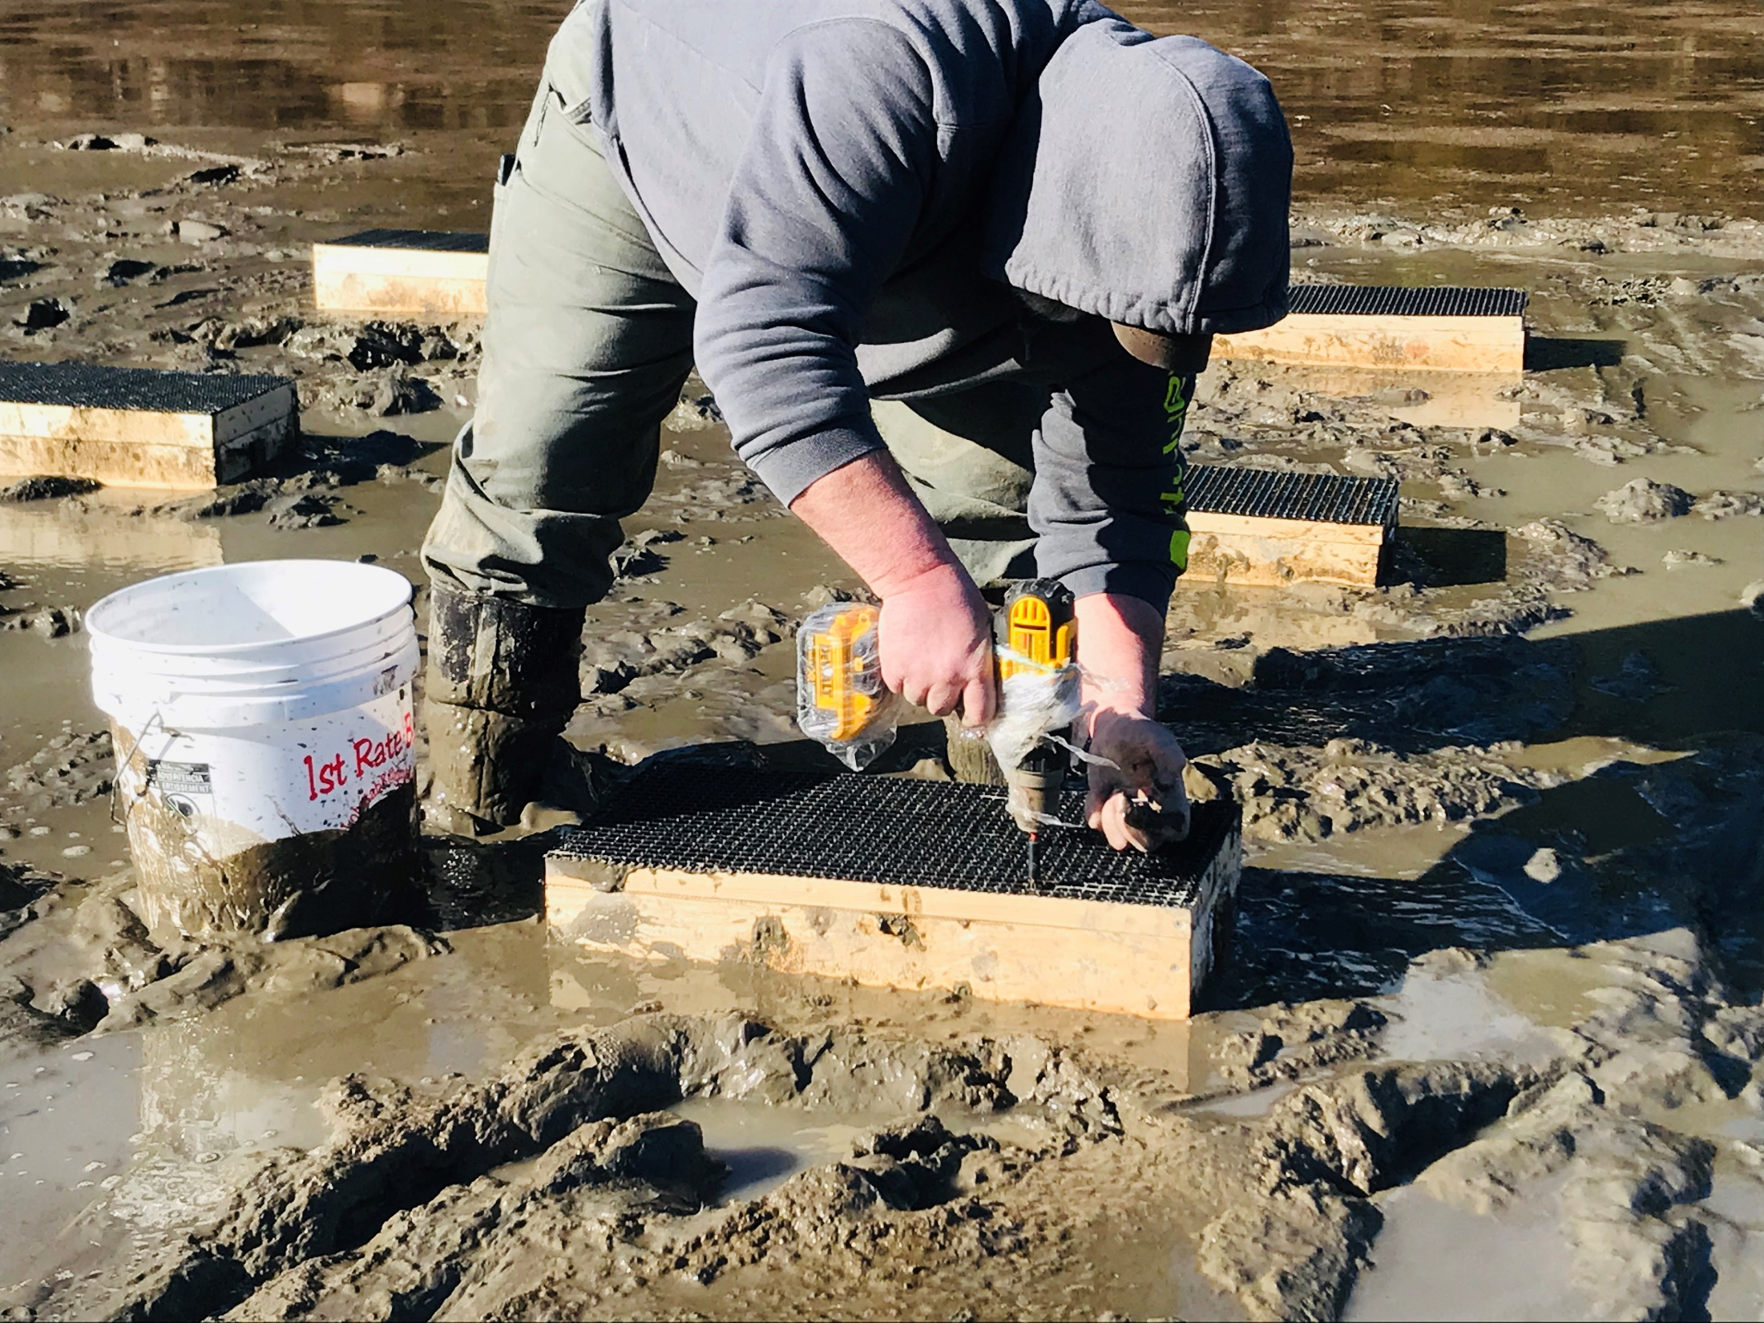

Slide 35
2-inch top
2ft² box

Slide 36
2-inch top
4ft² box

Slide 37
April 6, 2020

Slide 40
n = 20

Slide 41
n = 30

Slide 42
n = 30

Slide 43
Summary
Cultured Arctic surfclams can be grown in the lower intertidal along the Maine coast
Long siphons/shallow burrowing, an unusual combination, creates grow-out challenges
Crustaceans (lobsters, rock crabs, Jonah crabs, and/or green crabs), perhaps working
in concert with gulls, are the biggest nemesis to successful surfclam production
Whether this species emerges as a new culture candidate depends on costs to deter predators
It will take 2-4 years depending on location (southwest - 2 yr; east - 4 yr) for animals to attain
SLs of 40-50 mm)

Slide 45
Acknowledgments

