Slide 1
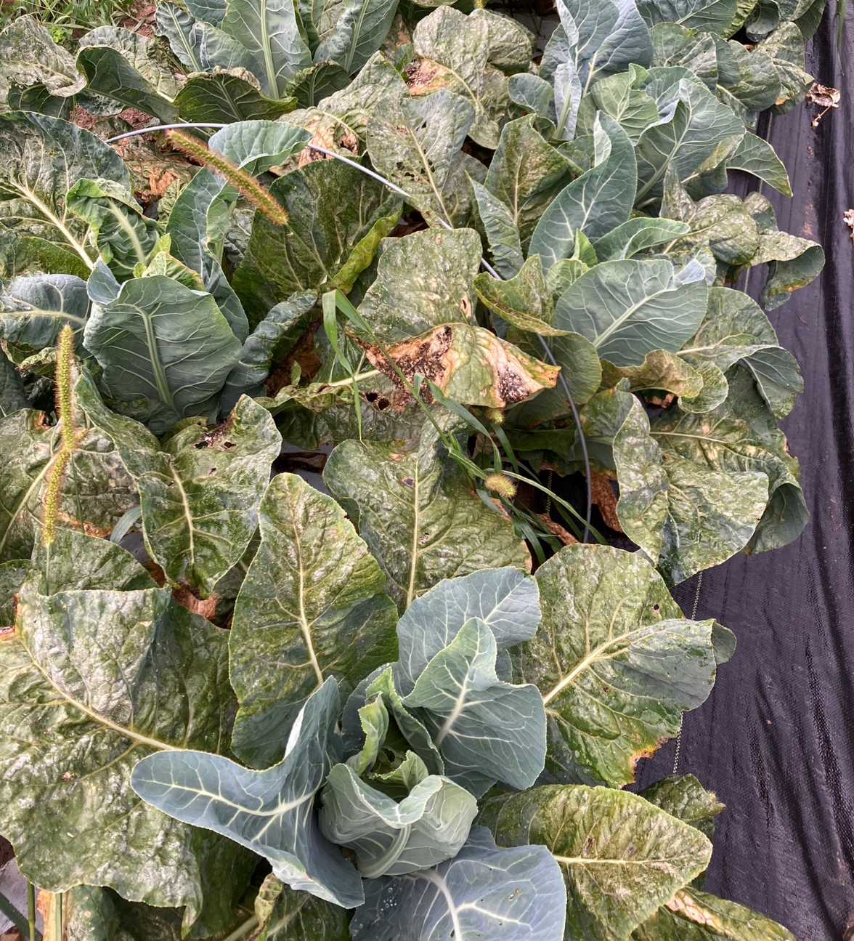
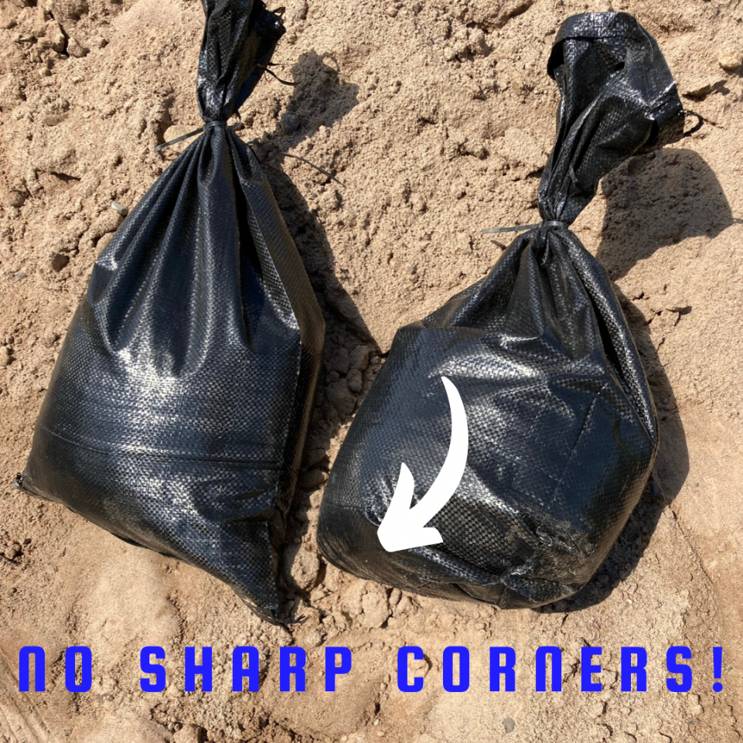
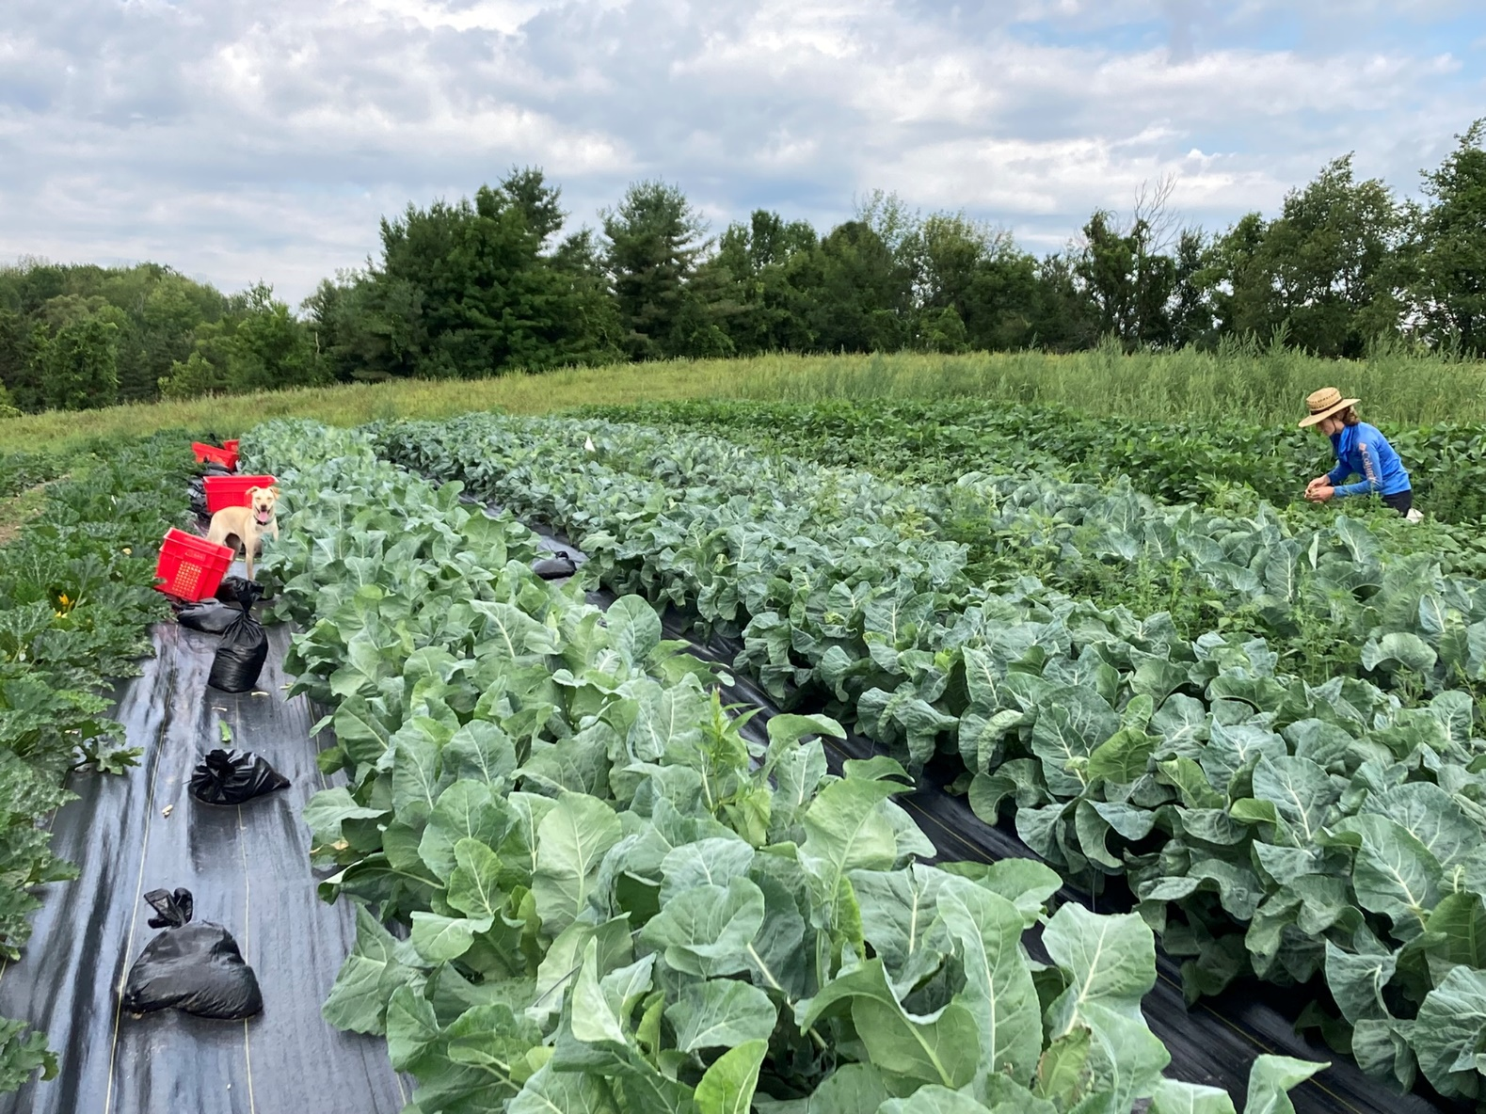
FNE22-030: Determining the Biggest Bang for our (Time) Buck: Dealing with Fall Brassica Diseases in High Humidity Environments
Timing had stronger impact than imagined/anything else—def a mid fall high Alternaria infection period, early/late fine
All quick growing varieties outperformed slow growing ones
Zero fungicide spraying regimens showed efficacy (pest control did work)
Conclusion: quick cultivars, landscape fabric, row cover for 4 weeks-ish, rotate pest control sprays at 1-2 week intervals after covers removed based on scouting
More trials with fewer variables!!!

