Slide 1
Pulse Crops in Maine Potato Rotations - My $0.02
Jake Dyer
Maine Potato Board

Slide 2
About Me…
2001 - UMaine BSc, Sustainable Agriculture
1998-2015 - UMaine J.F. Witter Teaching and Research Center
1998-2001 - Farm Laborer
2001-2010 - Farm Facilities and Field Coordinator
2010-2015 - Farm Superintendent
2008 - Present - VP Benedicta Grain Co., LLC
200 acres organic grain, buckwheat, and field pea
2015 - Present - MPB
Agronomist/Crop and Variety Development Specialist
Investigate cash crop options for 3+ year rotation

Slide 3
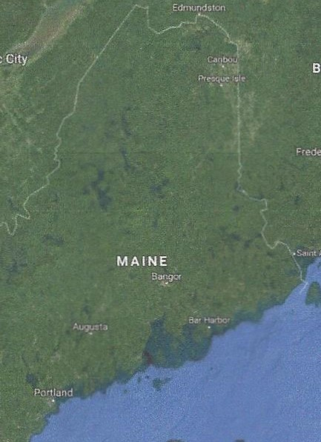
Maine Potato Industry
50,000 acres – average production
Utilization
14% Tablestock
22% Seed
64% Processing
3 geographic areas
Aroostook County
Central Maine
SW Maine
Most acreage on 3 year rotation
Potato-SG w/underseeding-GM

Slide 4
Why Pulses?
No additional equipment purchases
Annual legumes with relatively low fertilizer requirements
N credit to subsequent crop
Timing of harvest generally allows for fall planted cover crop
Adapted to cool climates – frost tolerant/hypogeal emergence (except dry beans)
Adaptable to no till production
Diverse marketplace
Seed – cash and cover crop
Food – minimal demand but growing for local mills – International?
Feed – alternative protein and fiber source – aquaculture?

Slide 5
Concerns going in…
Seedbed prep (rocks, crusting, to roll or not to roll?)
Wet feet
Foliar diseases – especially chickpea, lentil, and dry bean
Ascochyta – major concern in high production areas
White mold – inconsistent fungicide efficacy
Expense of season long fungicide program
Indeterminate growth habit – CP, Lentil
Lodging – harvest difficulty, quality downgrading
Lack of well identified market – new to Maine growers

Slide 6
2015 – 1st go at OG Yellow Peas
Needed cash crop to diversify winter/spring cereal rotation
OG soybeans were hit and miss depending on weather/field history
Did not want to buy additional equipment
Wanted diversity in marketing: seed/food/feed
2013/2014 pea variety trial data from UMaine showed promise
Received Northeast SARE Farmer Grant
4 yellow cotyledon varieties: Agassiz, Nette 2010, Jetset, SW Midas
25 acres

Slide 7
2015 – 1st go at OG Yellow Peas
Field Information
Thorndike shale silt loam
pH 6.2
4.7% OM
P & K sufficient (from soil test)
Field history of spring and fall cereals
Relatively low weed pressure
Relatively flat and well drained

Slide 8
2015 – 1st go at OG Yellow Peas
Seeding Rate
Target Population / (1-% stand loss)
SPP X % Germination
Trial Planting density was 8 plants/ft² (348,480 PLS/A) to ensure enough seed for experiment.
Germination and seed count vary dramatically between seed lots and variety. (Germ 84% to 97% & Seed Count 1830-2168 spp)
Seeding rates ranged from 190 lb/acre to 236 lb/acre

Slide 9
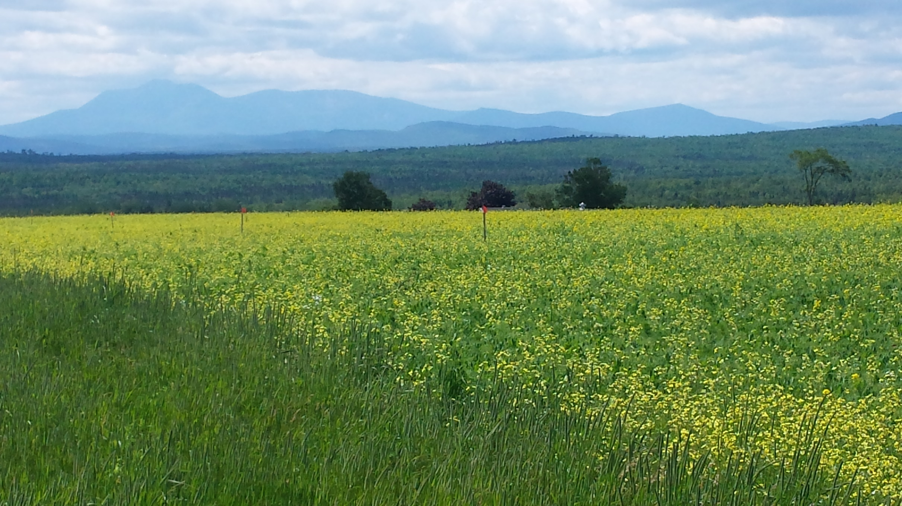
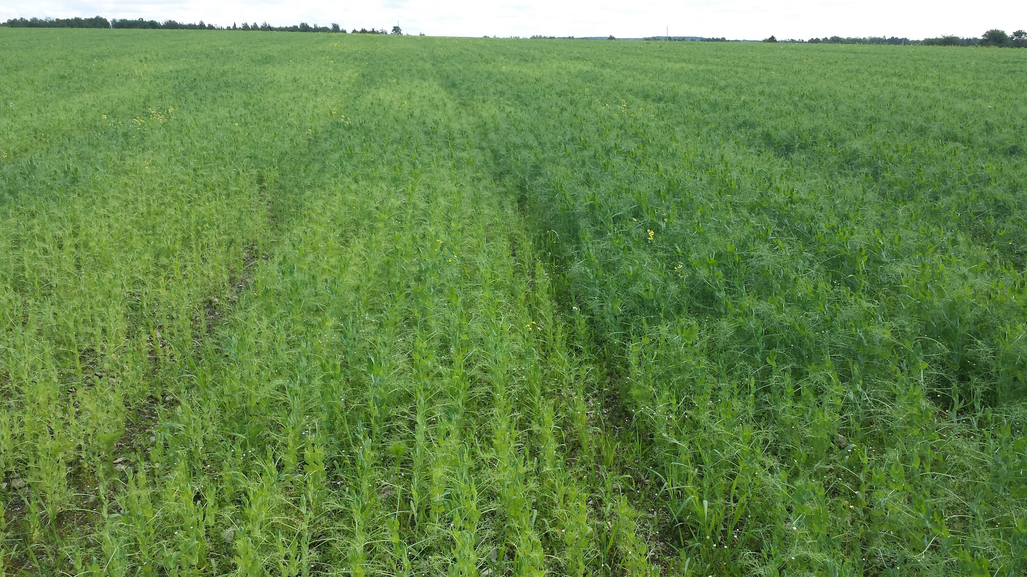
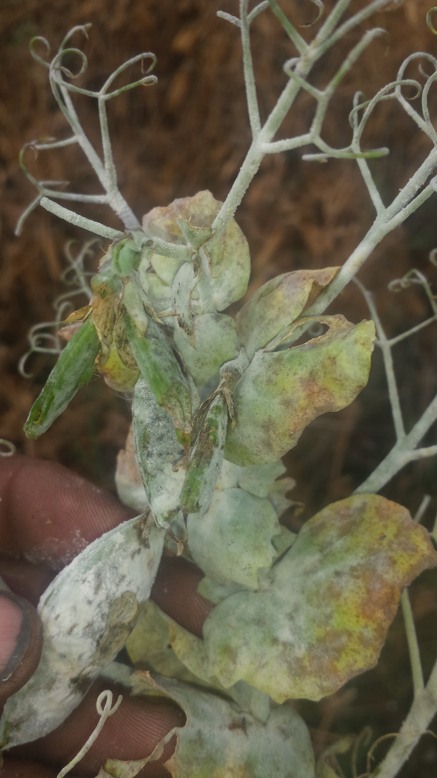
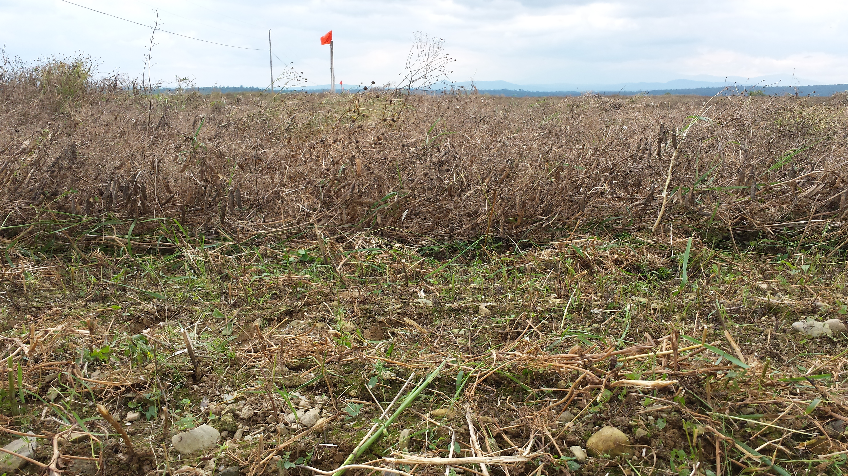
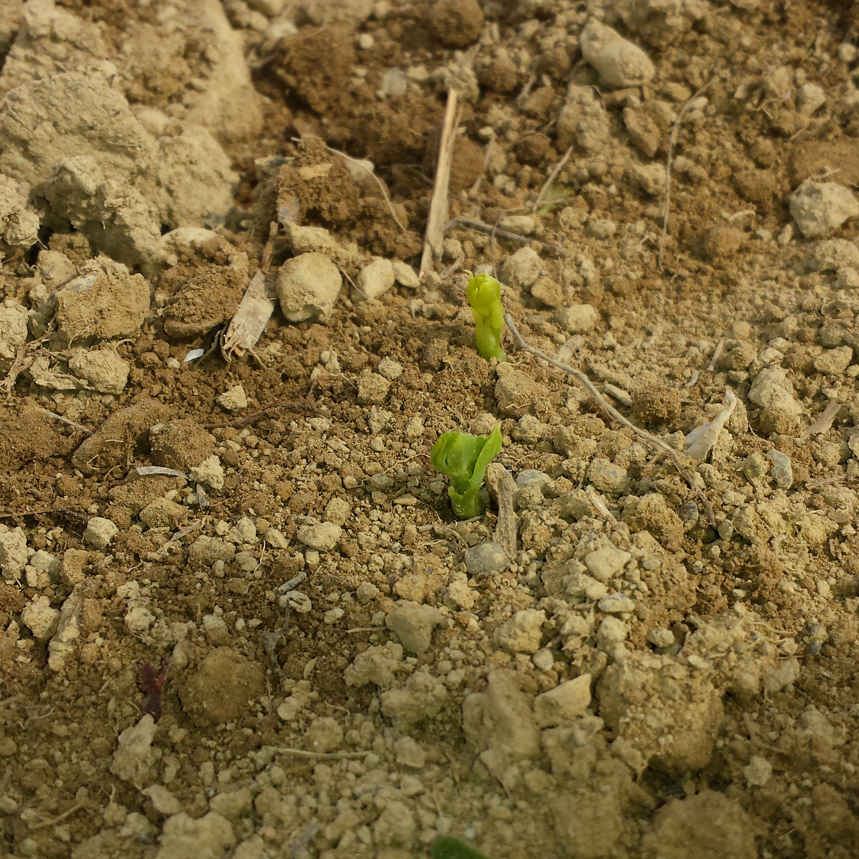
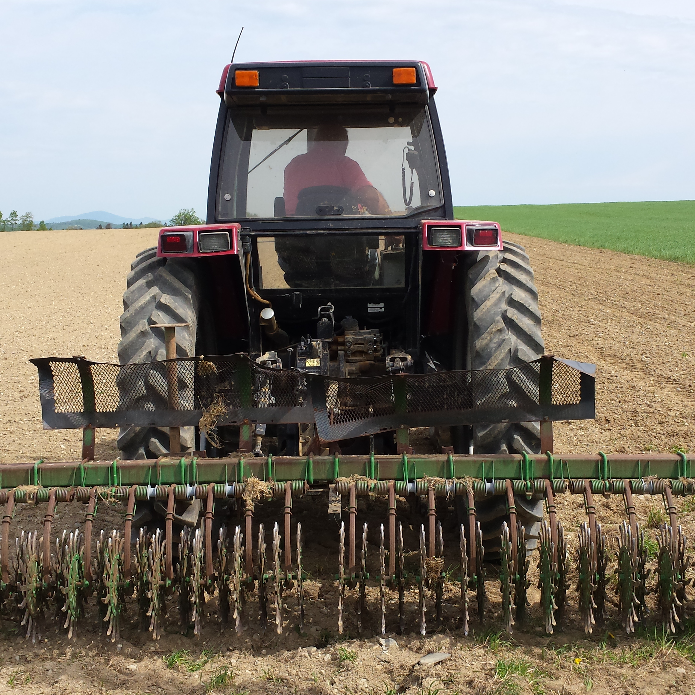
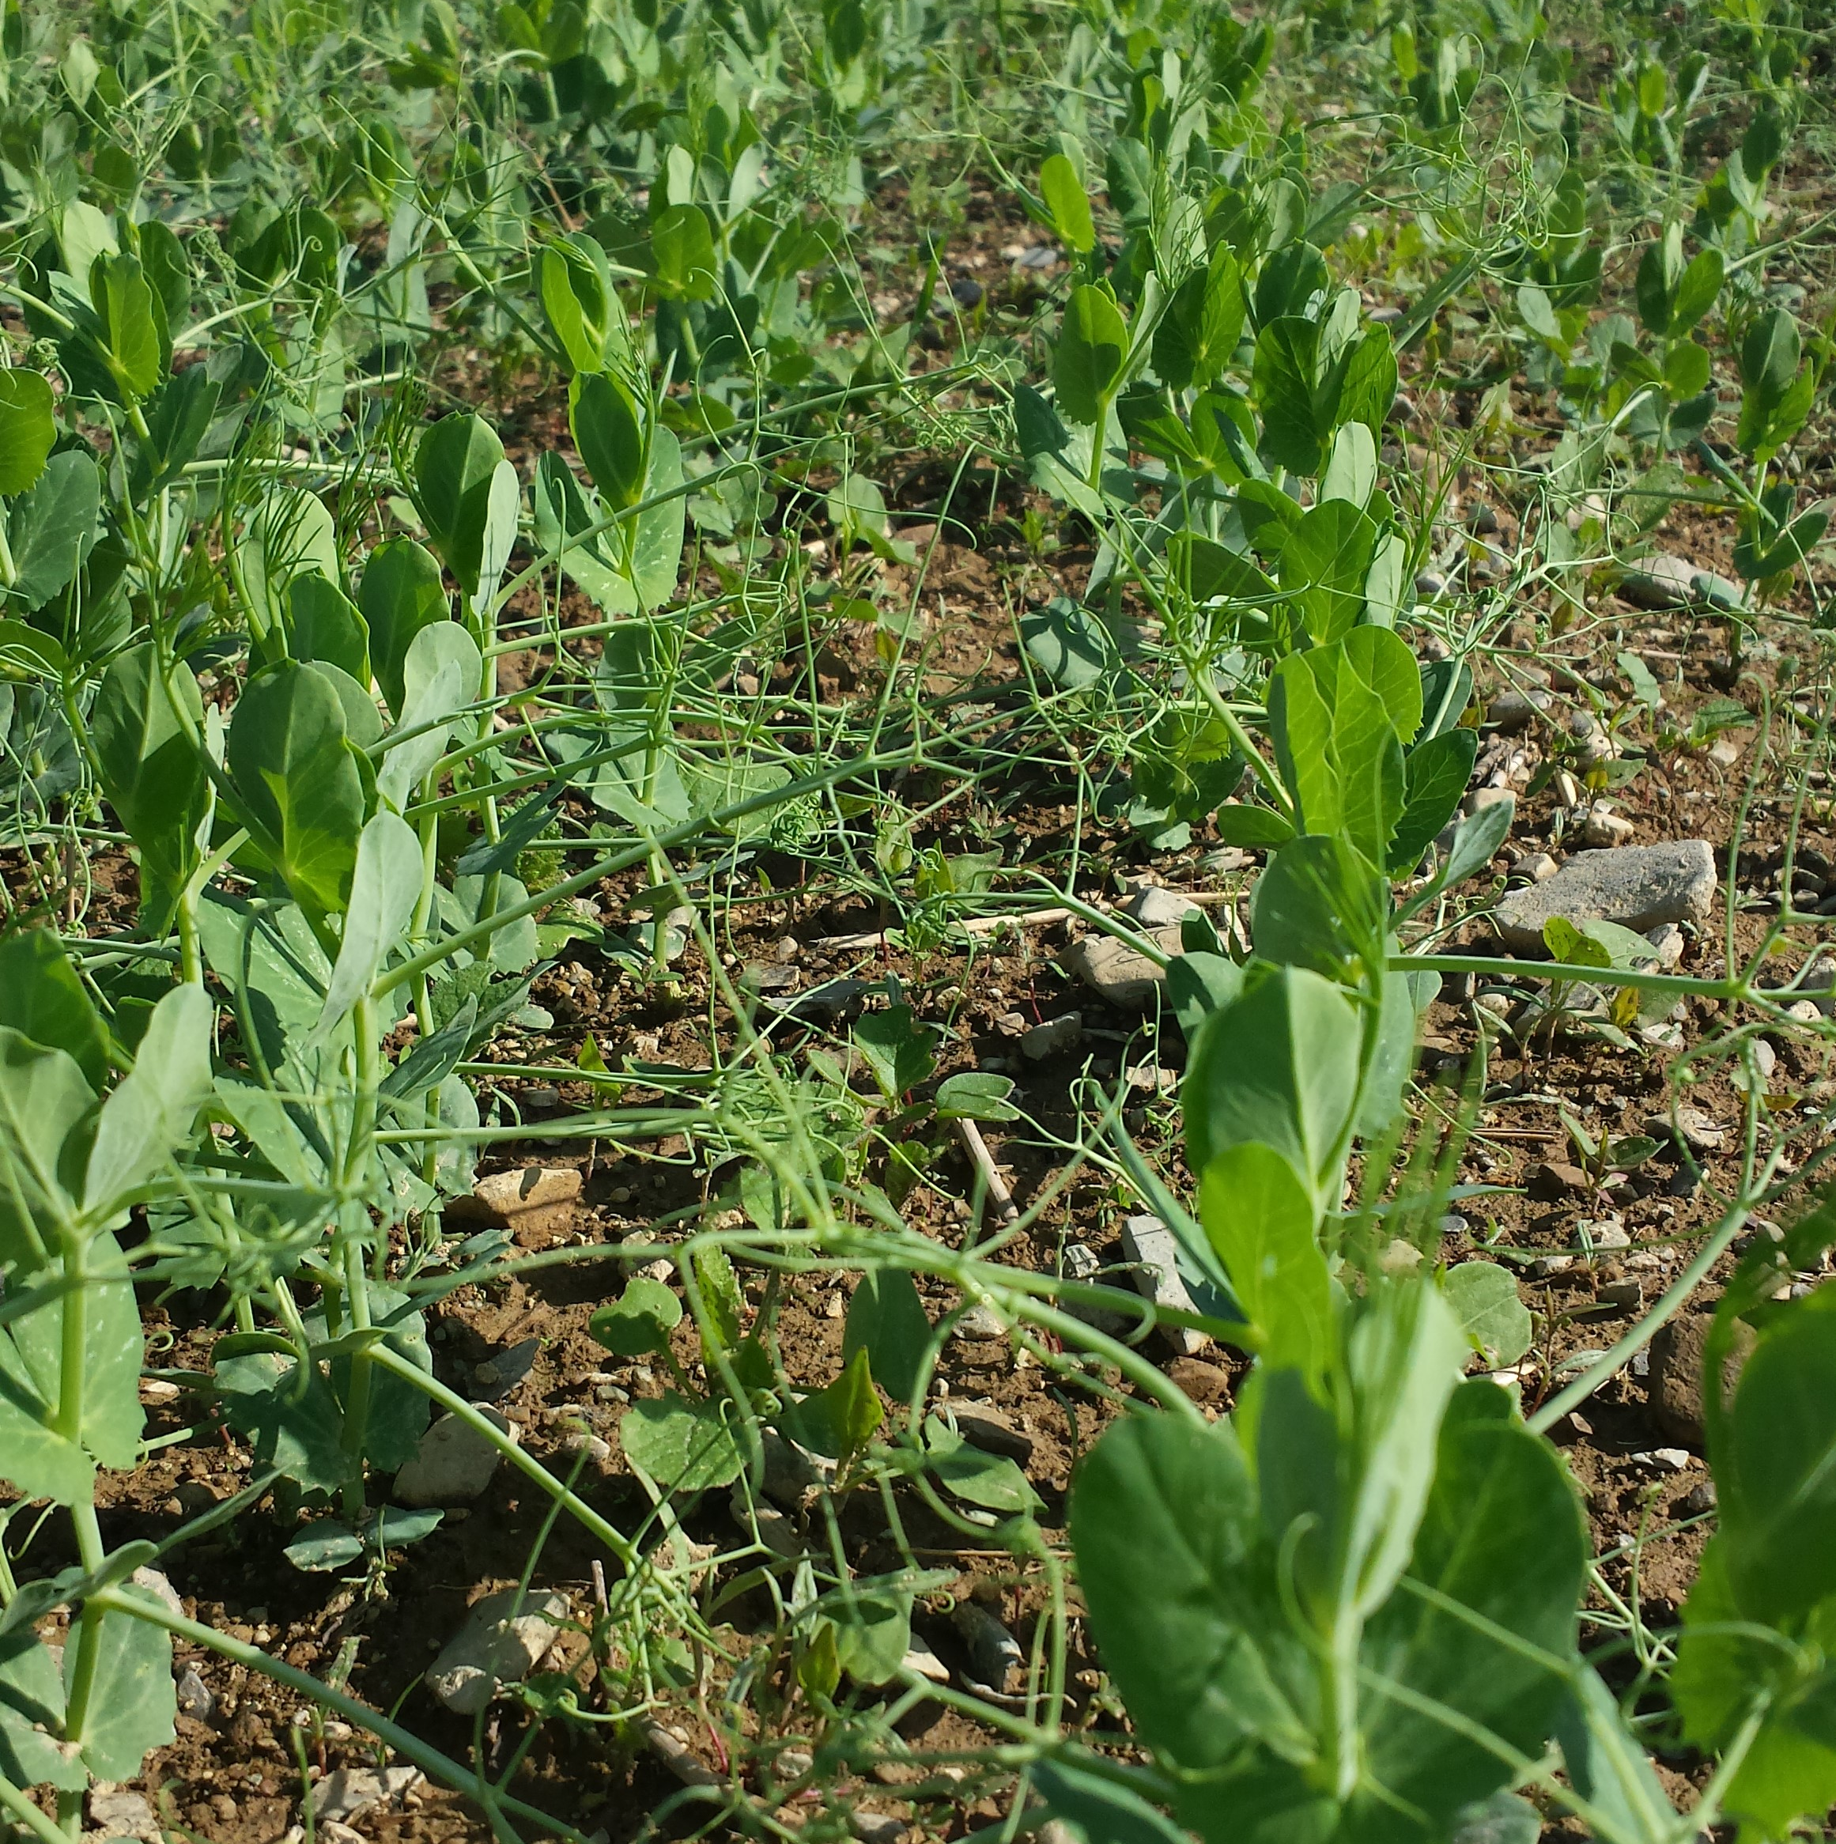
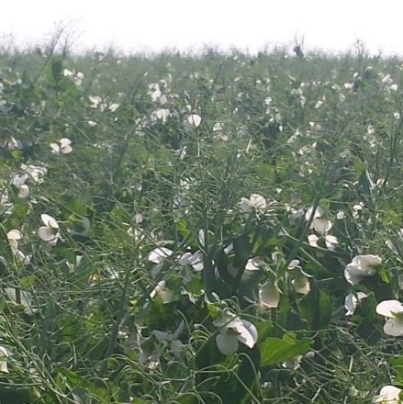
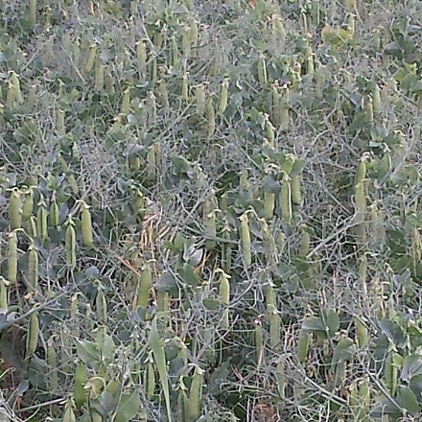
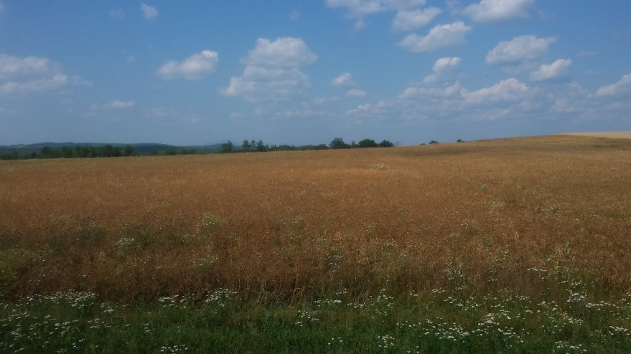
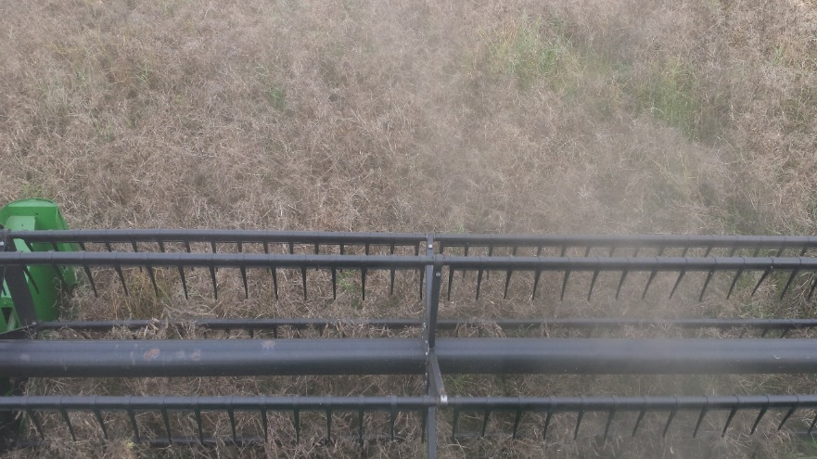
2015 – 1st go at OG Yellow Peas
Planted May 15 – Emergence May 25 – Rotary hoe May 25 (10 DAP) -Flowering July 08 through July 18 (54-64 DAP) - Senescence August 09 (85 DAP) – Harvest August 30 (106 DAP)

Slide 10
2015 – 1st go at OG Yellow Peas
Variety | Harvest Moisture % | Yield (#/A) | Yield @ 14% | Bushels/A
AC Agassiz | 15.9 | 3151 | 3081 | 51.4
Jetset | 13.9 | 4078 | 4082 | 68.0
SW Midas | 15.7 | 3791 | 3716 | 61.9
Nette 2010 | 14.1 | 4094 | 4090 | 68.2

Slide 11
2016 – Replicated Plot Trials
Planted at University of Maine Aroostook Farm
Kabuli Chickpea, Small Red Lentil, Yellow Field Pea
Strip trial to evaluate:
Production practices – population, weed control, harvestability
Yield potential
Disease incidence and severity
Compatibility with potato/grain rotation
Project Details:
Previous Crop: Potato
Soil Type: Caribou Loam
pH: 5.8, OM: 3.4%, P & K sufficient

Slide 12
2016 – Replicated Plot Trials
RCBD – 6 reps - 6’ X 25’ plot dimensions – Hege cone seeder 7” RS
Planting Date – May 19
Production methods based on publications from NDSU and SPG
Seeding Information
Kabuli Chickpea (var. Frontier) – 9 pl/ft² - 250 lb/a – ApronMaxx + Mertect
Small Red Lentil (var. Maxim CL) – 13.5 pl/ft² - 59 lb/a – ApronMaxx
Yellow Field Pea (var. Jetset) - 4 pl/ft² - 204 lb/a – ApronMaxx
Fertilizer – none
Herbicide – CP/FP = 5oz/a Spartan Charge + 1.33 pt/acre Dual II Magnum - PRE
– Lentil = 6oz/a Beyond (imazamox) - POST

Slide 13
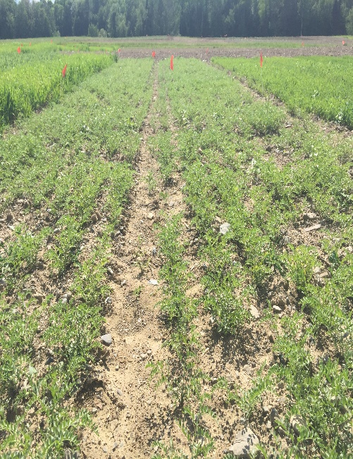
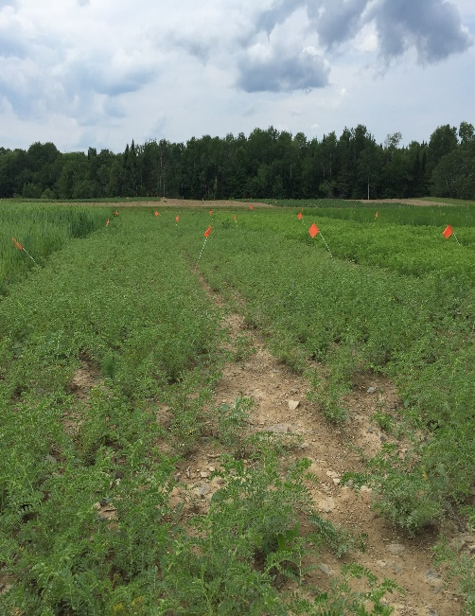
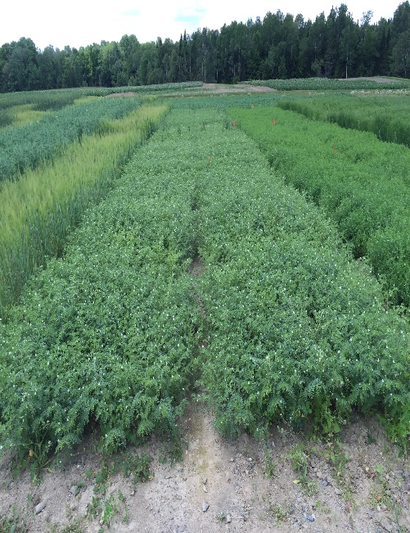
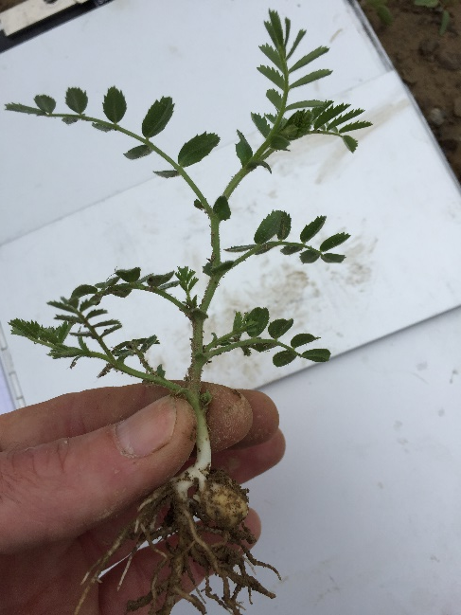
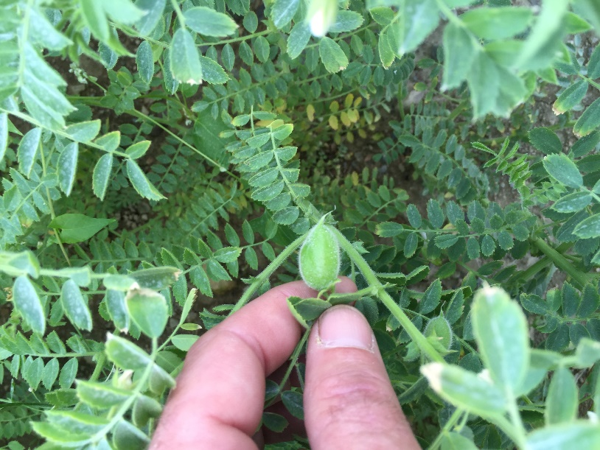
Chickpea
June 07
June 23
July 06
July 22 (64 DAP)
Slow to develop competitive canopy – early weed control important
Flowering began - July 11
Pods beginning to develop – July 22
Bravo applications to prevent foliar diseases

Slide 14
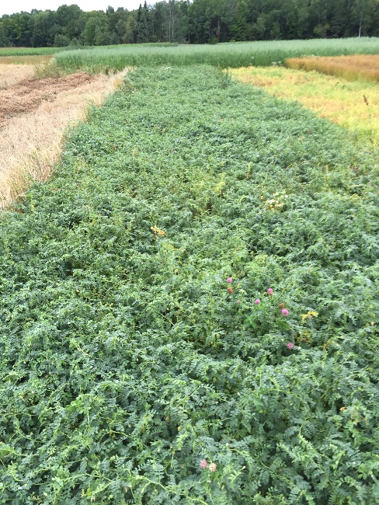
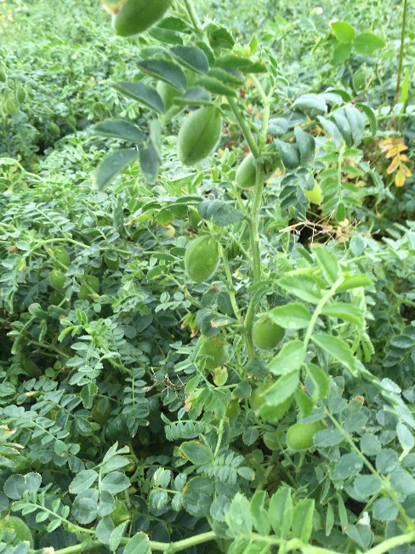
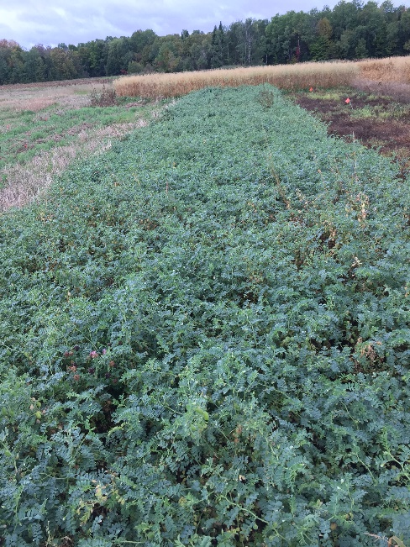
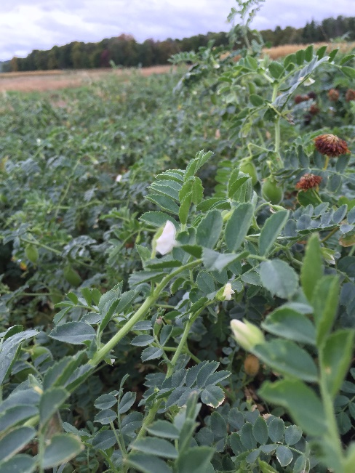
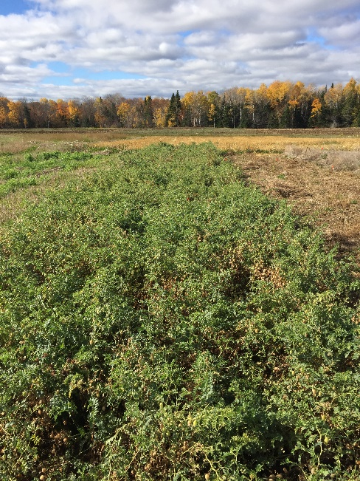
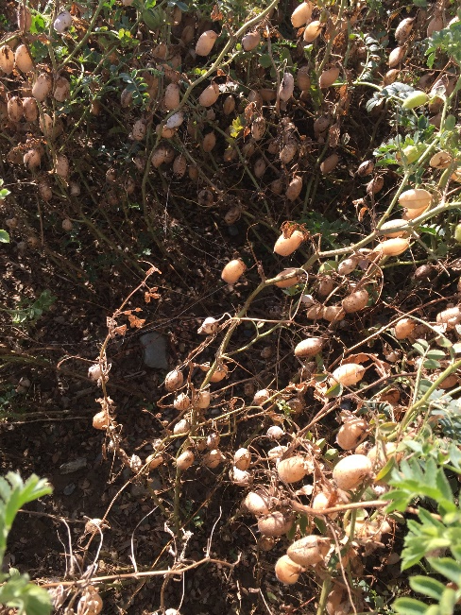
Chickpea
August 22
September 23
Strong indeterminate – flowering continuously since July 11
Dense canopy – very difficult to penetrate – low airflow
Frost tolerant – should have desiccated
Hand harvest on October 20
October 20
October 20 (154 DAP)

Slide 15
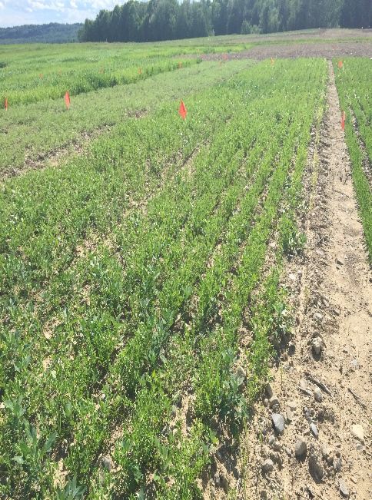
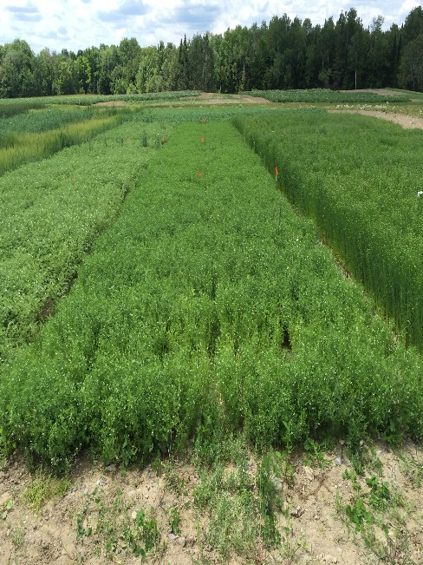
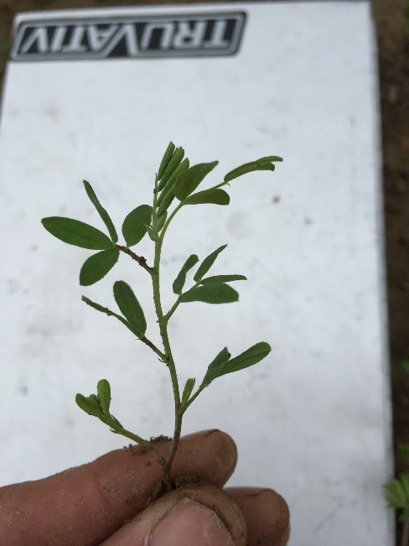
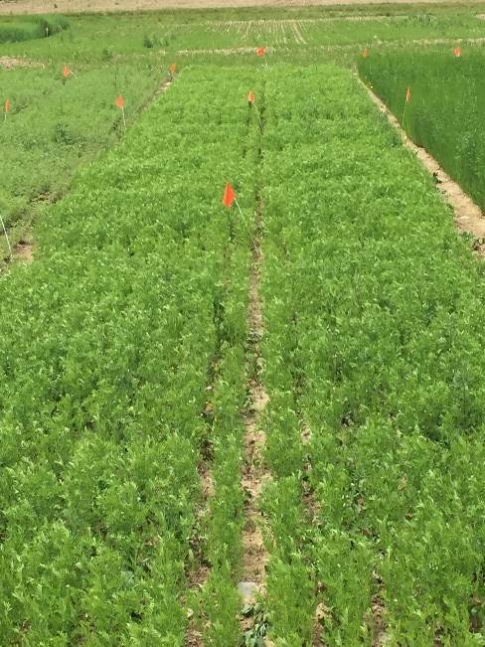
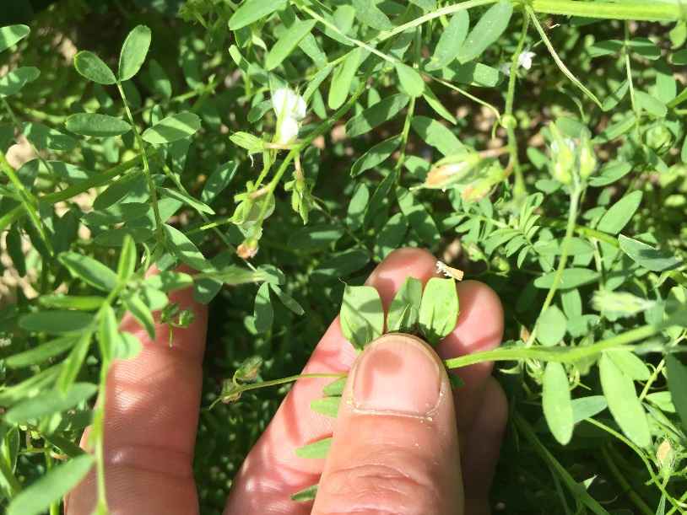
Lentil
June 07
June 23
July 05
July 22 (64 DAP)
Slow to develop competitive canopy – should have used Dual II pre-emerge in addition to Beyond
Flowering began – July 05
Pods began to develop – July 15
Bravo applications to prevent foliar disease

Slide 16
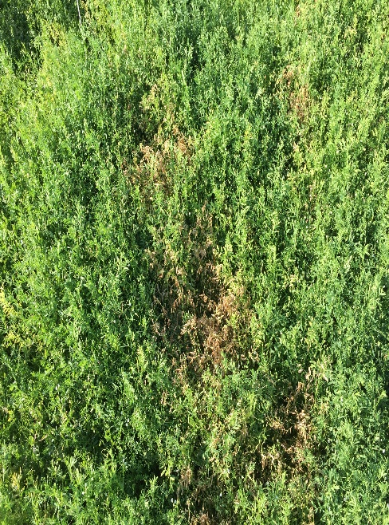
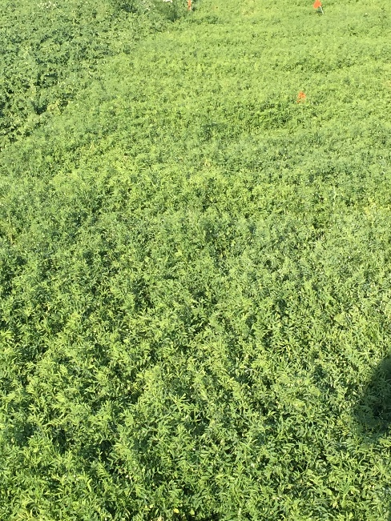
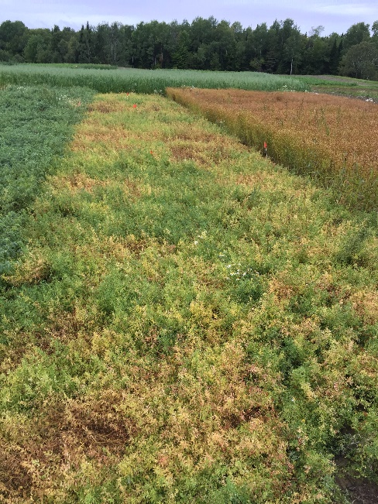
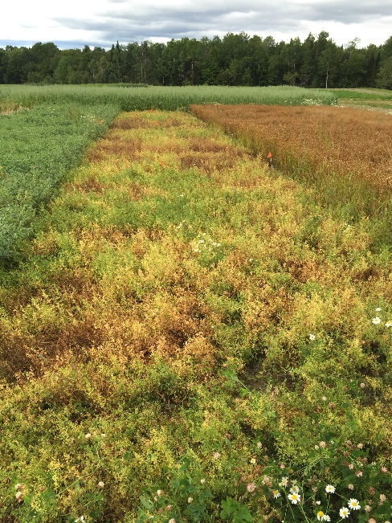
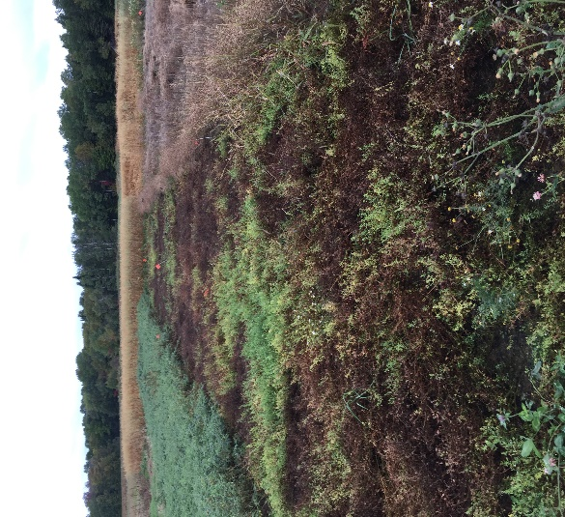
Lentil
Aug 01
Aug 04
Aug 22
Aug 29
White mold progression
Limited efficacy of registered fungicides
Dense canopy – low penetration – low air flow – long flowering period
Harvest on September 29
High harvest losses due to shatter
Sept 23 (127 DAP)

Slide 17
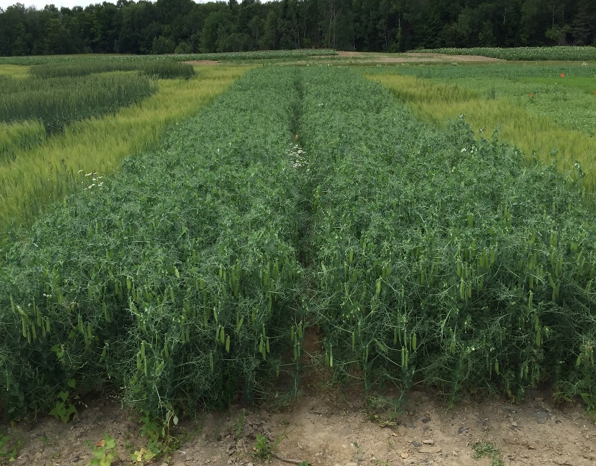
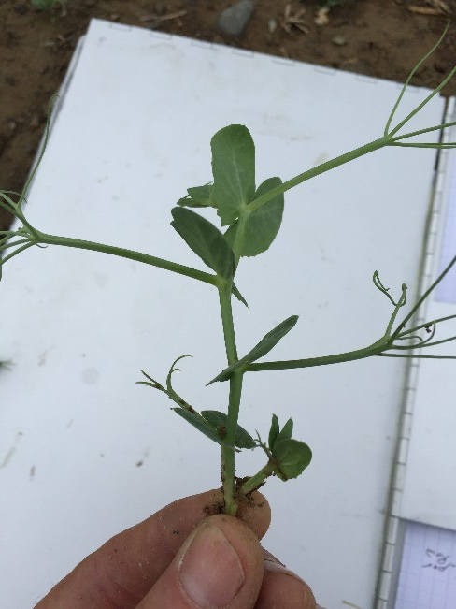
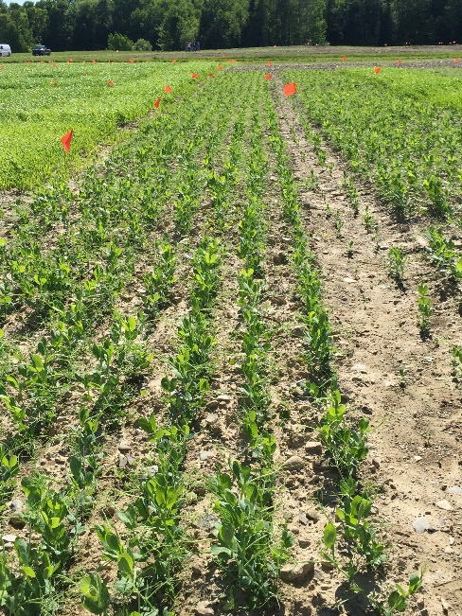
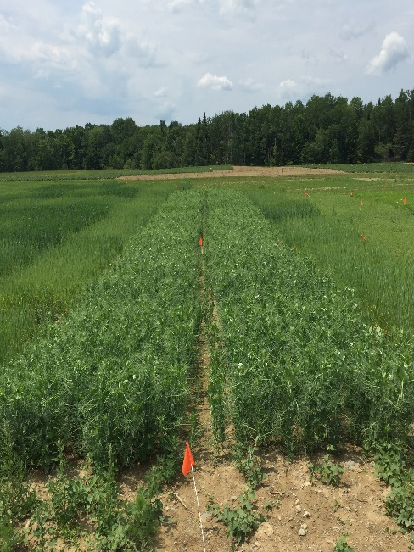
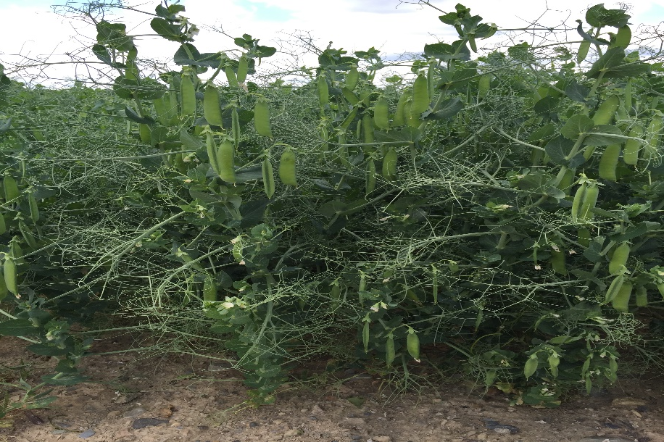
Field Pea
June 07
June 16
July 05
July 22 (64 DAP)
Develop much faster than chickpea or lentil
Canopy closed by start of flowering – July 05
Determinate type – flowering complete in 17 days – matures evenly
Foliar fungicides were not used

Slide 18
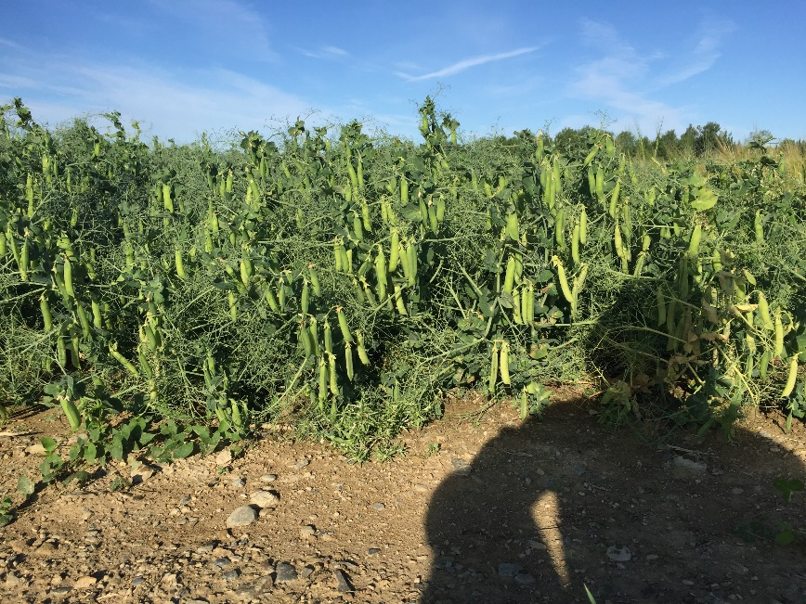
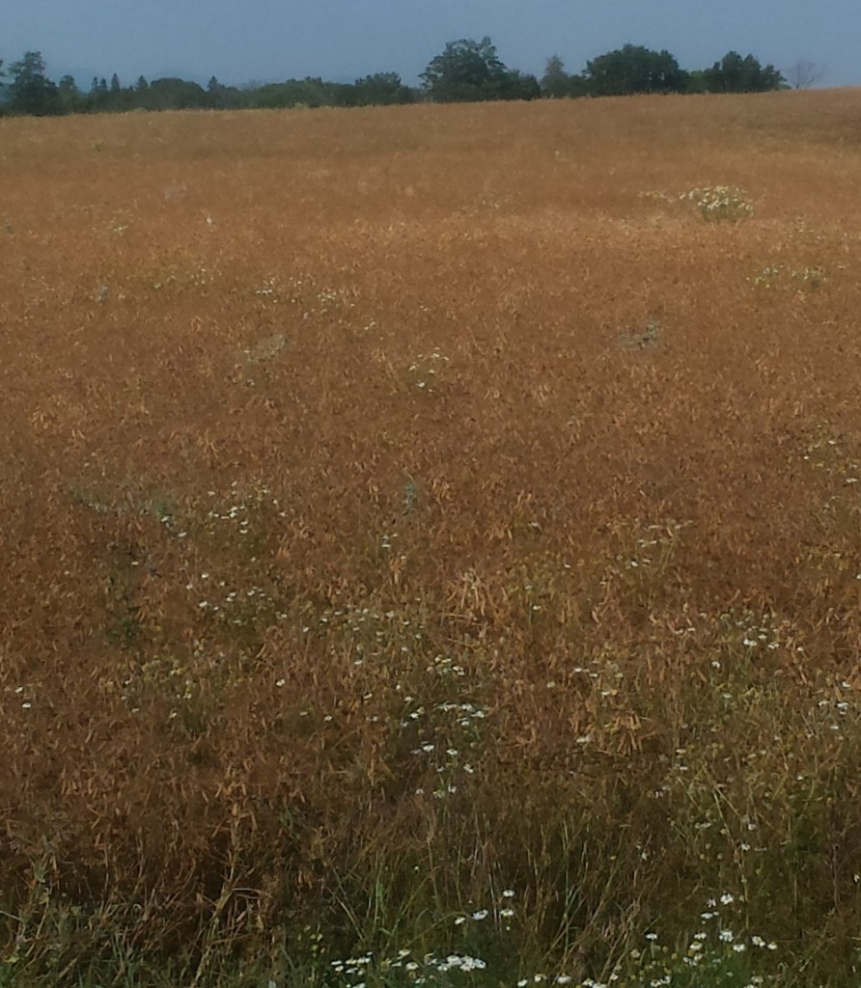
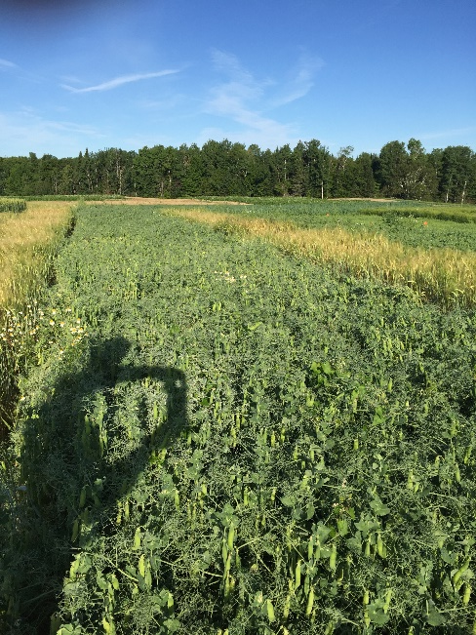
Field Pea
Aug 01
Aug 01
Semi leafless
Bred so that leaflets are reduced to tendrils
Tendrils support adjacent plants – decreased lodging
Less foliage allows increased airflow through canopy
Harvested on August 16 (89 DAP)
Minor lodging
5-7% harvest loss due to shatter

Slide 19
Results
 | Moisture at Cleaning | Yield at Cleaning Moisture | Safe Storage Moisture | Yield at Storage Moisture | Yield at Storage Moisture | 2013-2015 US Average
 | % | Lbs/A | % | Lbs/A | Bu/A | Lbs/A | Bu/A
PEAS | 9.4 | 3422.6 | 16.0 | 3685.0 | 61.4 | 1851¹ | 30.9
CHICKP | 10.5 | 1842.6 | 14.0 | 1895.5 | 31.6 | 1388² | 23.1
LENTIL | 13.1 | 1829.6 | 14.0 | 1843.8 | 30.7 | 1295³ | 21.6
¹ID, MT, ND, OR, WA ²CA, ID, MT, NE, ND, OR, SD, WA ³ID, MT, ND, OR, WA
Source: Crop Production 2015 Summary (Jan 2016). USDA, NASS

Slide 20
Quick and Dirty Economics
 | PEA | CHICKP | LENTIL | OAT³
 | PER ACRE
Seed | $70.00 | $112.00 | $15.00 | $25.40
Inoculant | $18.00 | $14.00 | $4.00 | $0.00
Herbicide | $35.00 | $35.00 | $29.00 | $2.78
Fungicide | $0.00 | $67.00 | $20.00 | $0.00
Fertilizer | $0.00 | $0.00 | $0.00 | $13.00
TOTAL | $123.00 | $228.00 | $68.00 | $41.18
YIELD¹ | 36.9 | 19.0 | 18.4 | 38.0
$/CWT² | $13.33 | $26.00 | $30.00 | $3.94⁴
Gr. REV | $491.21 | $492.96 | $553.20 | $149.72
ROInput | $368.21 | $264.96 | $485.20 | $108.54
¹CWT/A ²USDA/AMS Jan 2016 ³$7/bu seed, 38 lb/bu, 100 bu/a ⁴$1.50/bu

Slide 21
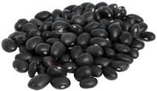
2017 – Black Bean Scene
Why Black Beans?
Typically produced in Northern areas
-ND, MI, NY, MB, ON
Improved varieties
Type II: upright, short vine growth, suitable for narrow row and direct harvest
RM ≤ 100 days
High yield potential of up to 30 CWT/A – Irrigated
Dark seed color – forgiving in event of wet conditions at harvest
Small seed size – can be planted and harvested with grain equipment
High potential return – 3 year average grower price $33/CWT
Marketable – NY buyer interested in working with Maine growers
Michigan Bean Commission

Slide 22
2017 – Black Bean Scene
Limestone
Littleton
New Limerick
Varieties
Zorro and Zenith (2360 and 1836 spp)
Small seeded – grain drill/corn planter
89 day RM
Developed by MSU
52 Acres

Slide 23
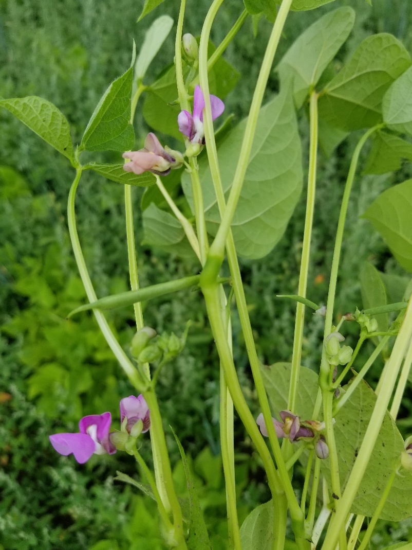
2017 – Black Bean Scene
Planted June 07
Soil Temp 55F
Target population 100,000 pl/A
PRE - Dual II 1.5 pt/A
POST – Reflex 1.25 pt/A
300 lbs 11-14-17
Harvested October 10
2370 – 3000 lb/a
$32.00/cwt
$758 - $960/acre gross

Slide 24
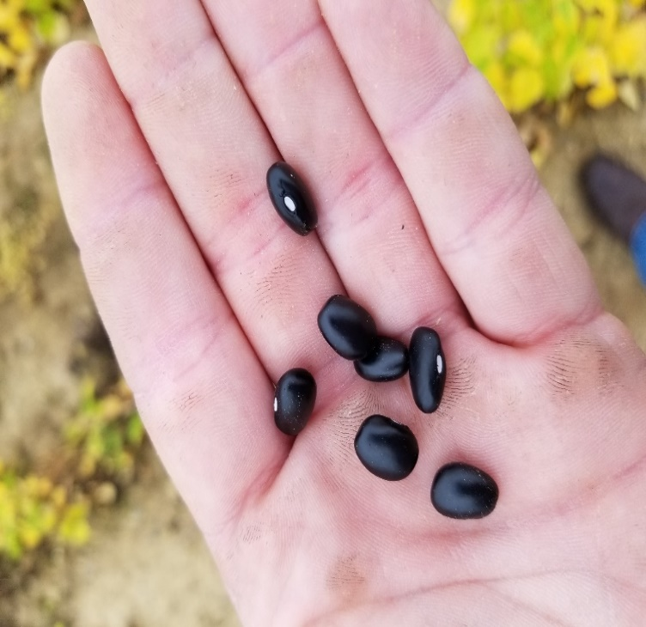
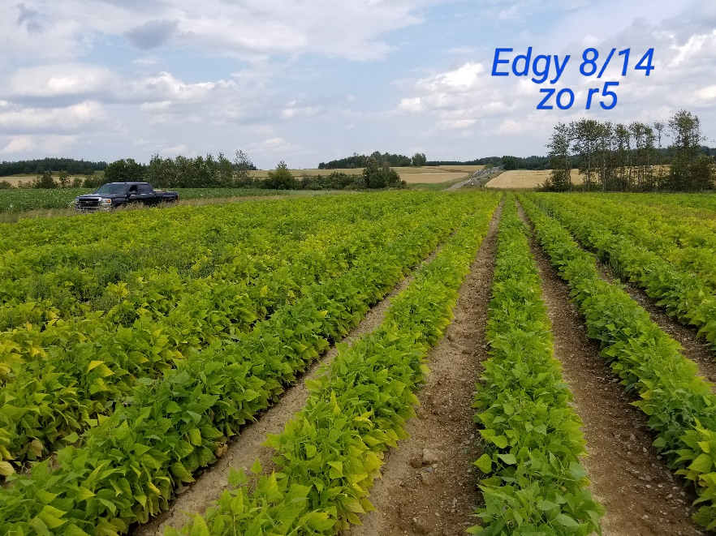
2017 – Black Bean Scene
The Good!
Yielded very well
Marketable
Plant after grain and potato – warm soil
October 10 harvest allowed for fall rye crop
Relatively low fertilizer requirement
Split N application – hindsight
Straight cutting better in 18” rows

Slide 25
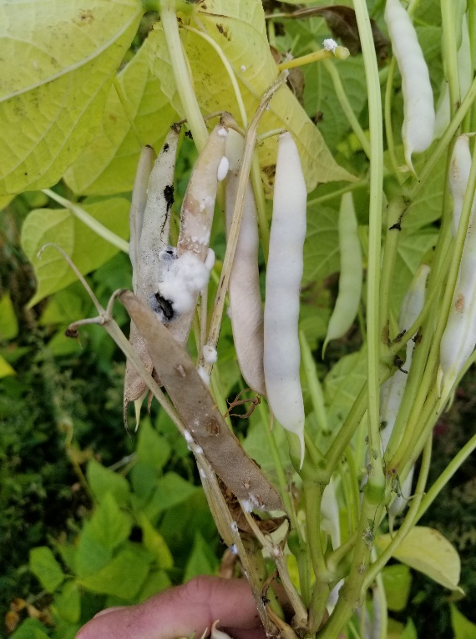
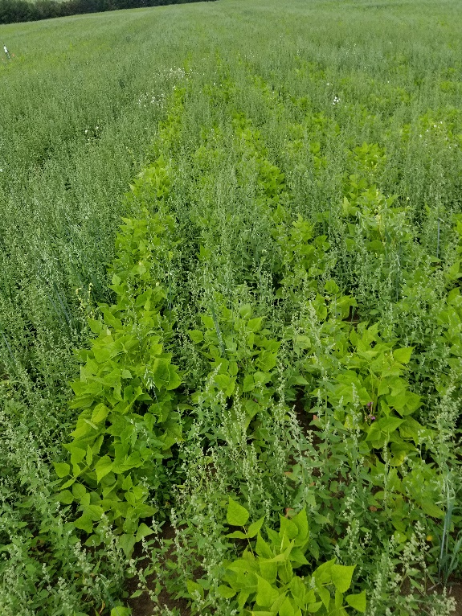
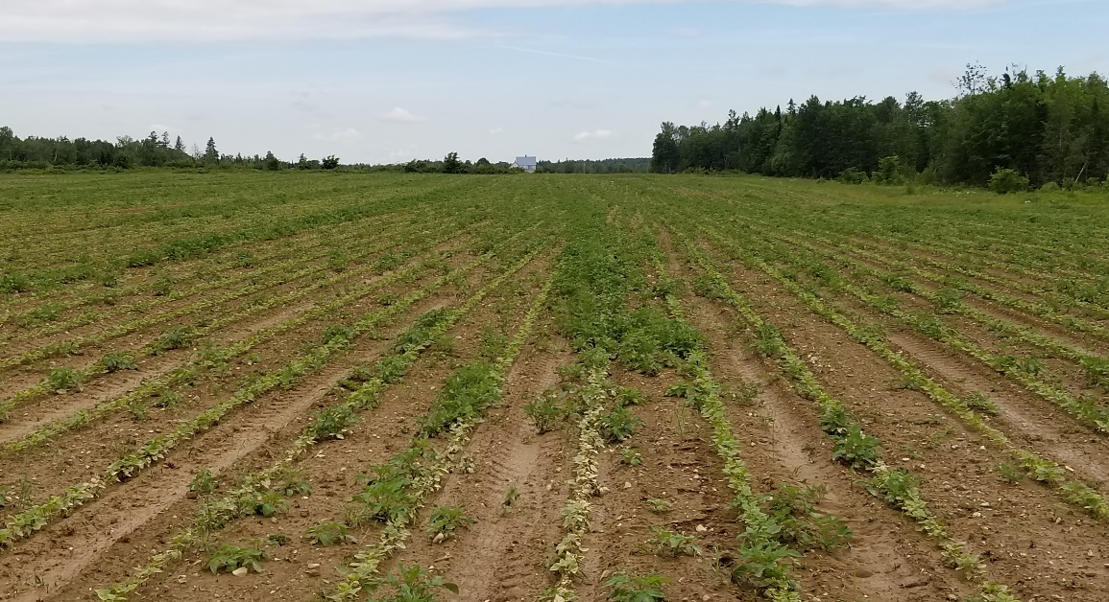
2017 – Black Bean Scene
Challenges
Volunteer Potatoes
Weed control
White mold
Baldhead
Fertilizer
Cold Wet Spring
Heavy showers mid/late season

Slide 26
2018 Pulse Trials
“Developing Best Management Practices for Pulse and Oilseed Crops in the Northeast”
Northeast SARE Research and Education Grant (LNE17-358)
2 years funding for plot and field trials
Variety of pulse crops: Field Pea, Faba Bean, Chickpea, Lentil
Variety of oilseed crops: Sunflower, canola, condiment mustard

Slide 27
2018 Plot Trials
Tried switching things up…
Chickpea – May 16
14” row spacing, fertilizer (200 lb/a AS (21-0-0-24) split application) rather than inoculant – hoping for natural senescence
Limited desiccant options – Reglone not labelled in ME, Paraquat requires training
Disease pressure low, 1 application of Priaxor on July 19
Yield average 1930 lb/acre
Lentil – May 16
7” vs. 14” row spacing – thinking reduction in canopy density may decrease disease
1 application of Priaxor on July 19
2 pass system of Dual II Magnum and Beyond more effective than Beyond-POST
Lodging increased substantially in 14” rows and yield was depressed.
Yield average 1656 in 7” row spacing vs. 1380 in 14” row spacing

Slide 28
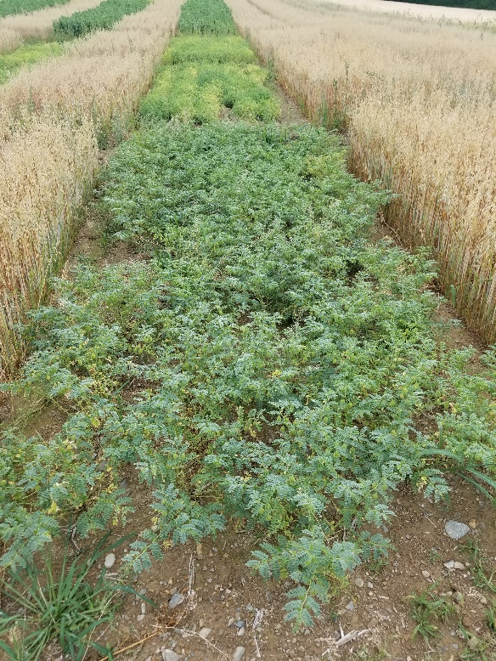
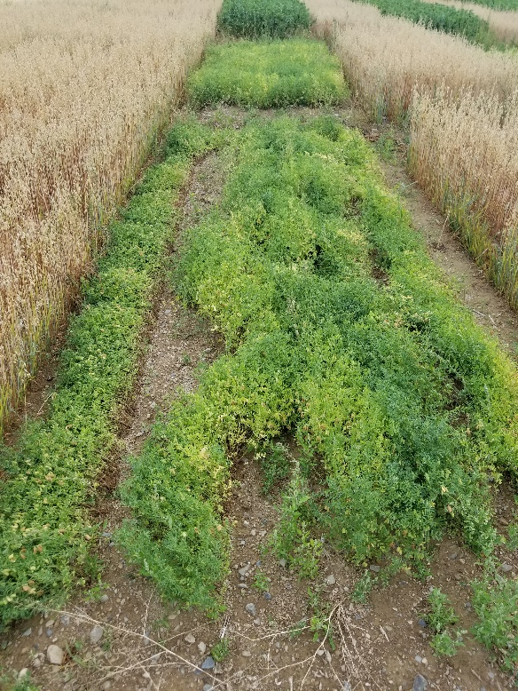
2018 Plot Trials
Chickpea @ 14”
Lentil @ 14”
Lentil @ 7”

Slide 29
2018 Plot Trials
Tried something new…
Faba Bean – May 16 – later than ideal
CDC Snowdrop – low tannin – suitable for feed market
Seeding rate trial – 4, 6, and 8 plants/ft²
No herbicides or fungicides used
Plant height and lodging increased with population
Struggled through hot/dry weather
Yields were inconsistent
1552 lbs/acre @ 4 plants/ft², 1794 lbs/acre @ 6 plants/ft², 1684 lbs/acre @ 8 plants/ft²

Slide 30
2018 Plot Trials

Slide 31
2018 plot trials
Yellow Field Peas – May 16
CDC Saffron and AAC Lacombe
7 treatments – seed treatment, starter fertilizer, K, Mg, S comparison
Saffron – untreated – 0 fertility
Saffron – treated – 100 lbs/a KMAG (0-0-21-10.6Mg-21S)
Saffron – treated – 150 lbs/a Pea Blend (7-19-17-5.5Mg-11S)
Lacombe Pea – treated seed + 100 lb/a KMAG(0-0-21-10.6Mg-21S)
Lacombe Pea – treated seed + 150 lb/a (7.3-18.6-16.8-5.45Mg-10.9S)
Lacombe Pea – treated seed + 0 fertility

Slide 32
2018 Plot Trials
Yellow Field Pea
No SD between Saffron and Lacombe
No SD between fertility treatments
No SD between seed treatments
Yield average 3517 lb/a @ 16% moisture

Slide 33
2018 Field Trials – Chapman, ME
CDC Lacombe Yellow Field Pea
Target Population = 9 plants/ft² (280 lb/acre)
Seeding date = May 19 / Harvest date = September 05
Pre-Emergence Herbicide = Spartan 4F @ 6oz/a + Dual II Magnum @ 1.33 pt/a
Fertility - 150 lbs/a Pea Blend (7-19-17-5.5Mg-11S) alone vs. Pea blend + 100 lbs/a KMAG (0-0-21-10.6Mg-21S)
Vitaflow seed treatment vs. untreated
Rolling prior to and after seeding
Compared foliar fungicides Stratego YLD (Prothioconazole + Trifloxystrobin), Aproach (Picoxystrobin), and Endura (Boscalid).

Slide 34
2018 Field Trials – Chapman, ME
Combine yield monitor used for measurements
Average yield across all treatments = 3007 lbs/acre
Strips where KMAG was used and rolled after seeding yielded 500 lbs more per acre regardless of seed treatment.
No difference between foliar fungicides vs. untreated
Peas were desiccated on August 10 – late season showers caused regrowth and reflowering.
Delayed harvest caused substantial shattering
Fall rye no-tilled into pea stubble – yield 3100 lbs/a 2019

Slide 35
2018 Field Trials – Chapman, ME

Slide 36
2019 Plot Trials
Lentil and Fava Bean not continued in 2019 due to poor performance and impracticality.
Chickpea plot trials expanded to include shorter season kabuli varieties CDC Leader and CDC Palmer, however due to poor stand establishment and ascochyta infection, plots were terminated.
Field pea trialing continued with both yellow varieties (AAC Carver, AC Earlystar, and CDC Saffron) and green varieties (AAC Comfort and CDC Greenwater).

Slide 37
2019 Plot Trials
May was cold and wet!!!
Field peas planted on May 29
Target population = 9 plants/ft² (155-261 lbs/acre)
Spartan Charge/Dual II Magnum herbicide
No seed treatment, fertilizer, or foliar fungicides used.
No desiccant used
Harvested September 03.
Green and Yellow yields similar – No SD – (Y)-3600 (G) - 3740
Lodging was problematic. Saffron (Y) and Comfort (G)

Slide 38
2019 Field Trials – Mapleton, ME
CDC Lacombe Yellow Field Pea
Seeding Date - June 07 – 9 plants/ft² (285 lbs/acre)
Previous Crop - Potato
Herbicide – Spartan 4F + Dual II Magnum
Fertility – None
Foliar Fungicide – None
Desiccated September 10 – Sharpen (saflufenacil) @ 2oz/acre
Harvest – October 14
Yield 3636 lbs/acre

Slide 39
Summary and Conclusions
Full Disclosure – Maine Growers Have Shown Limited Interest
Increased demand for potatoes across all sectors
Most growers content with Potato-SG w/underseeding-GM
Little interest in cleaning/drying infrastructure investment
Uncertainty of market – local/regional/international

Slide 40
Summary and Conclusions
Peas are best choice when considering pulse crop in Maine
Chickpeas
May work - need further evaluation on row spacing, variety selection
Management intensive…heavy fungicide program….profitability?
Seed treatment with Mertect (Thiabendazole) for seed borne acochyta is a must
Lentils
They’ll grow, but can we harvest them?
Faba beans
Need more season than Northern Maine has to offer
Ground is too wet to work in early spring

Slide 41
Summary and Conclusions
Pros
Good avenue for using alternative herbicides (sulfentrazone, s-metolachlor) not commonly used in Maine potato – cereal rotations.
If using glyphosate as desiccant or as burn-off post harvest, helps with perennial grass control.
No SD in yield with added fertility. Base levels in Maine potato fields are adequate. N provided by fixation sufficient.
Adaptable to no-till/min-till system both at planting and subsequent crop
Season length allows for fall cover/cash crop.
Equipment is typically available.
Have not seen any negative effect on potato – however, have not reached potato year of rotation.

Slide 42
Summary and Conclusions
Cons
Adds flowering broadleaf to rotation – white mold is of concern
May work best on 4 year rotation using grass crops between broadleaves
Requires additional management compared to cereals
Seeding by population is very important. Understanding seed tag info is imperative
Tight window for applying effective herbicides
Harvest timing is important. Shatter losses can be excessive. Drying ability is beneficial
Market uncertainty
Lack of local market that can take volume – Small livestock sector – especially in potato production region.

Slide 43
Thank you!!
Jake Dyer
Maine Potato Board
207-769-5061
jdyer@mainepotatoes.com

