Slide 1
RMSA Pup Loaves and Alveograph Analysis
Steve Alston
12/6/2021

Slide 2
Pup Loaf Scores
No discerning power in the scores since they are essentially all the same

Slide 3
Pup Loaf Specific Volume
Specific volume is the average of the two volumes divided by the loaf weight
Removes any bias due to differences in loaf weight
Better discerning power than the loaf scores
Can see differences between the wheat varieties
Turkey Red yielded a loaf with the highest specific volume

Slide 4
Pup Loaf Height
Similar pattern as specific volume
Turkey Red yielded the tallest loaf

Slide 5
Pup Loaf Summary
Loaves made using a quick process with commercial yeast
Would be interesting to repeat with sourdough, may see the same results, may not
I would choose wheat that produced loaves with specific volume >4.5 cm³/g and height >3.5 inches
Turkey Red, Pima Club, and Duramonte meet these criteria
That said, I would try all of them, but have low expectations for Iraq Durum, Sin El Pheel, and Khorasan

Slide 6
Falling Number
FN ranged from 344s to 417s for all wheat varieties
>300s indicates no sprouting in the field, which is good
>300s is also considered to have weak α-amylase activity which yields an underdeveloped bread with low volume and dry crumb (true for modern, industrially processed breads, but not long-fermented sourdough)
Industrially these flours would either be blended with flours that have high α-amylase activity (FN <220s) or would have diastatic malt added to them
Don’t need to do this for sourdough because of long fermentation
Based on FN, any one of these varieties would be fine for making sourdough bread

Slide 7
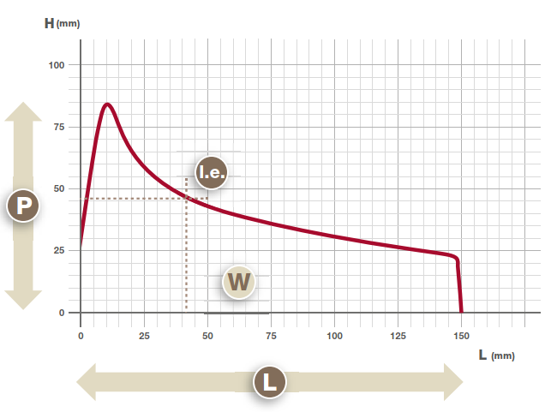
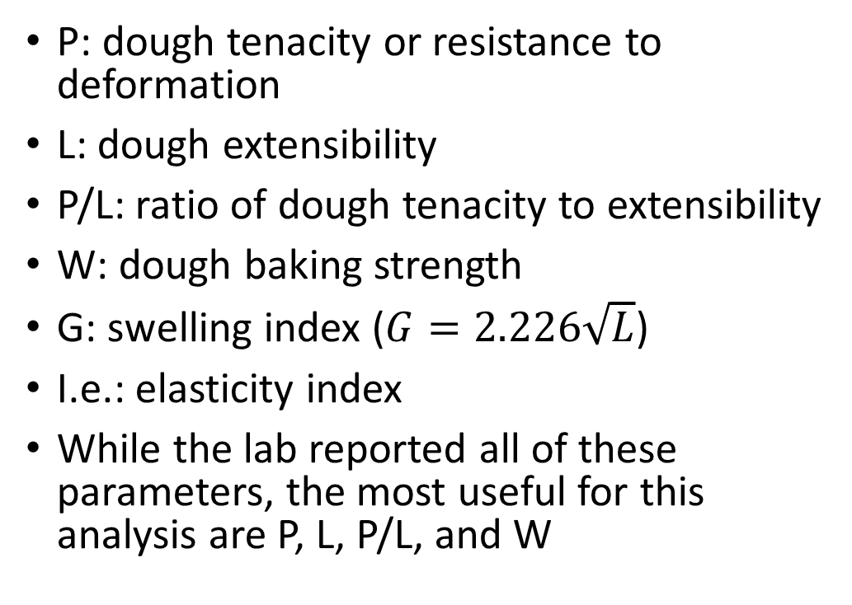
Alveograph Data
P: dough tenacity or resistance to deformation
L: dough extensibility
P/L: ratio of dough tenacity to extensibility
W: dough baking strength
G: swelling index ($G=2.226\sqrt{L}$)
I.e.: elasticity index
While the lab reported all of these parameters, the most useful for this analysis are P, L, P/L, and W

Slide 8
P & L
Higher P values indicate dough that is more resistant to deformation
Doughs with high P will be hard to stretch and roll out and will tend to break
Lower L values indicate dough is less extensible
Doughs with low L will expand little during fermentation
P and L are negatively correlated in this data set (see appendix for correlation analysis)
Doughs with high P have a low L and vice versa

Slide 9
P & L
P is negatively correlated with pup loaf specific volume
Wheats with higher P produced pup loaves with lower specific volume
L is positively correlated with pup loaf specific volume
Wheats with higher L produced pup loaves with higher specific volume

Slide 10
P/L Ratio
Relationship of dough tenacity to extensibility
Index of gluten performance
Ideal range 0.4-0.7
Will yield a dough that is both elastic and extensible
Higher P/L (>0.7) indicate flours that are more difficult to work with
Higher tenacity with low extensibility
Less developed bread with compact crumb
Lower P/L (<0.4) indicate flours that are weak and too extensible
Will yield a very sticky dough
Low oven spring due to inability of dough to hold in developing gases

Slide 11
W
Baking strength of the dough
Also indicates water absorption capacity of dough
W | Flour Characteristics | Use
<160 | Weak flour, absorbs ~50% of its weight in water | Biscuits, wafers, crackers
160-250 | Medium strength flour, absorbs between 55% and 65% of its weight in water | Soft doughs, French bread, rolls, pizza
250-310 | Strong flour, absorbs between 65% and 75% of its weight in water | Pizza, egg pasta, long leavened pastries
>310 | Very strong flour, Absorbs 90% of its weight in water | Long fermentation doughs, strengthen weaker flours

Slide 12
W

Slide 13
W vs P/L
W ideal range 160-310
P/L ideal range 0.4-0.7
These fall within or close to the ideal ranges

Slide 14
Alveograph Summary
Based on P/L (0.4-0.7) and W (160-310) selection criteria, Marquis, Sonoran White, and Pacific Bluestem should be good for quick, industrial process bread making
Turkey Red, Pima Club, Red Fife are close seconds (P/L slightly below 0.4)
Iraq Durum, Sin El Pheel, Khorasan, Duralis Durum, and Duramonte Durum all have high P/L and W
Not suited for quick, industrial process bread
Doughs won’t stretch and will be prone to tearing
Will yield a dense, dry crumb
Duramonte is the outlier, had the second highest loaf specific volume
Use these to strengthen weaker flours or for long fermentation breads

Slide 15
Summary of Data
These data are used to select flours for quick, industrial processing to make bread
Based on pup loaf data, falling number, and alveograph should select Turkey Red and Pima Club
Duramonte is the outlier – alveograph data says it shouldn’t be good, but it meets criteria based on pup loaf specific volume and height
This all changes when using sourdough
Italians make Pane d’Altumara using mostly durum flour and long fermentation to get a nicely risen loaf
Again, would be interesting to repeat the loaf tests using sourdough techniques
Personally, I would try all of them but would have lower expectations for Iraq Durum, Sin El Pheel, Khorasan, and Duralis

Slide 16
Appendix

Slide 17
Correlation of L and P
L is negatively correlated with P
R²=0.69 for a good correlation

Slide 18
Correlation of Specific Volume to P & L
P and L correlated with pup loaf specific volume
For P, R²=0.37 for a moderate negative correlation
For L, R²=0.33, for a moderate positive correlation

