Slide 1
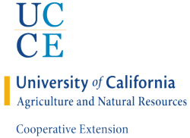

Measuring Ecosystem Function Across Farming Systems
Dr. Fadzayi Mashiri
County Director (Mariposa)
Livestock and Natural Resources Advisor (Merced and Mariposa)
University of California Cooperative Extension

Slide 2
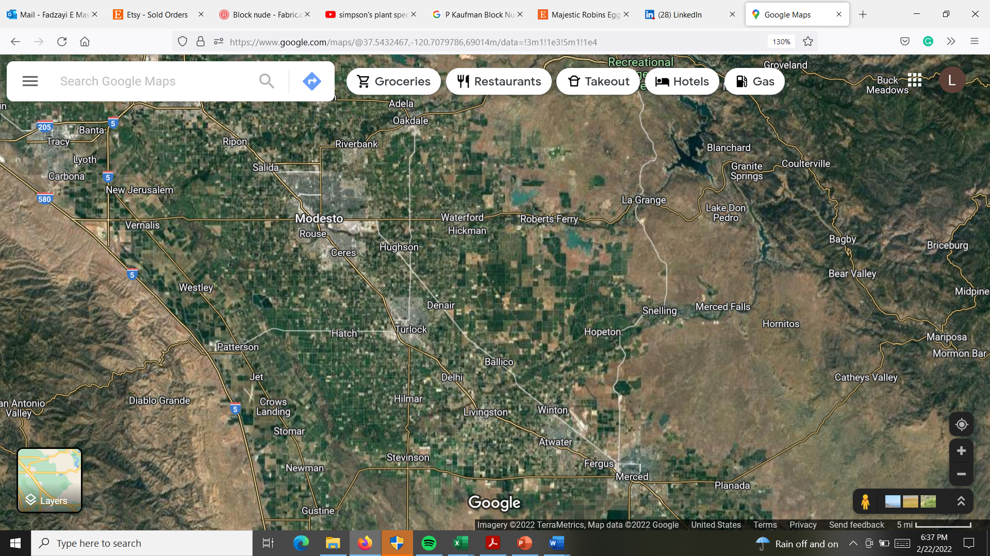
Introduction
Landscapes dominated by rangeland and cropland
>20,000 acres/yr rangeland lost cropland, mainly almond orchards
In Central Valley 74% went to agriculture
Statewide 40% to agriculture
Ecosystem service loss
High water use – SGMA curtailing water use

Slide 3
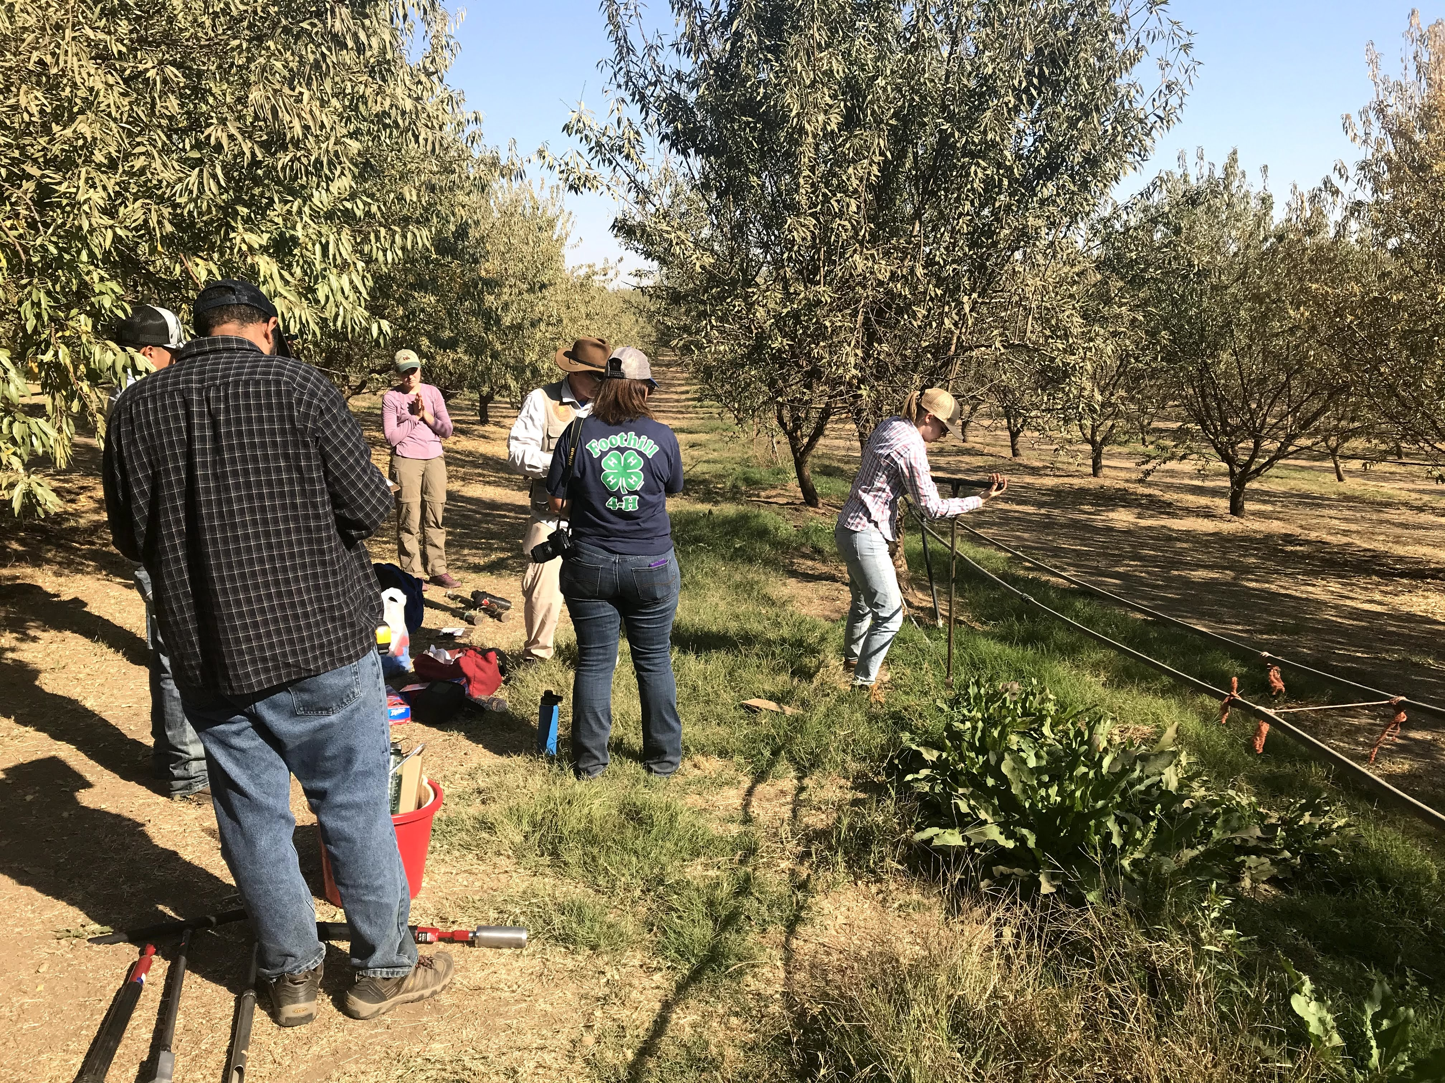
Introduction cont.
Ecosystem function - capacity to provide goods and services
  Nutrient cycling
  Plant production
  Water circulation
  Resilience

Slide 4
Methods
3 sites
  Rangelands
  Orchard
Measured:
  soil conditions
  plant diversity
  insect diversity
  hydrologic processes

Slide 5
Resilience to change
Regenerative young highest
Old Conventional lowest
Forage value:
Regenerative > rangelands > conventional
Results

Slide 6
Plant species diversity
Highest on rangelands
Except on sites dominated by
Juncus bufonius (rush) **
(Rangeland 2 and conventional
young)
Regenerative young high
Regenerative old low
Conventional – low in old orchard
*

Slide 7
Regen > Conventional - both age groups
Conversion releases C
SOM build-up as trees mature
Old Regenerative almonds > rangelands

Slide 8
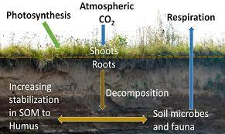
Measure of biological activity
Regenerative > Rangelands > Conventional
Young orchards > Old
soilhealth.cals.cornell.edu

Slide 9
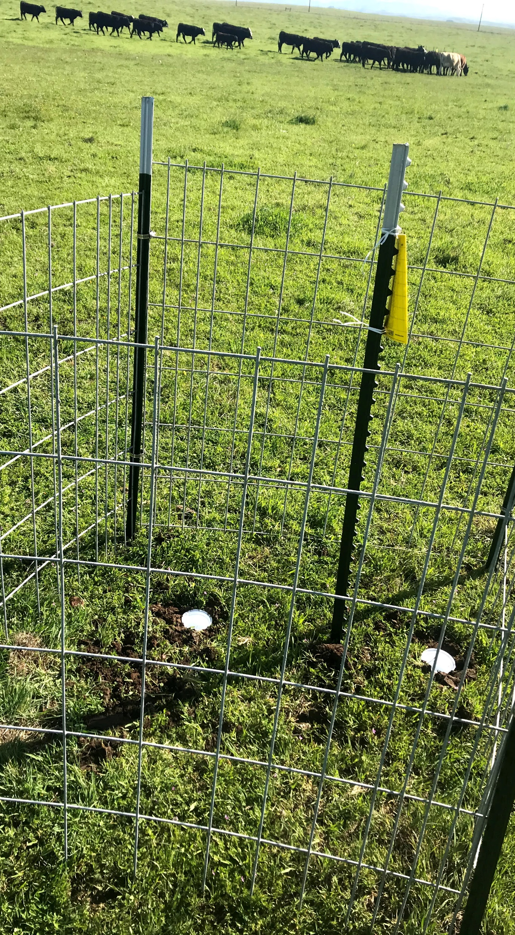
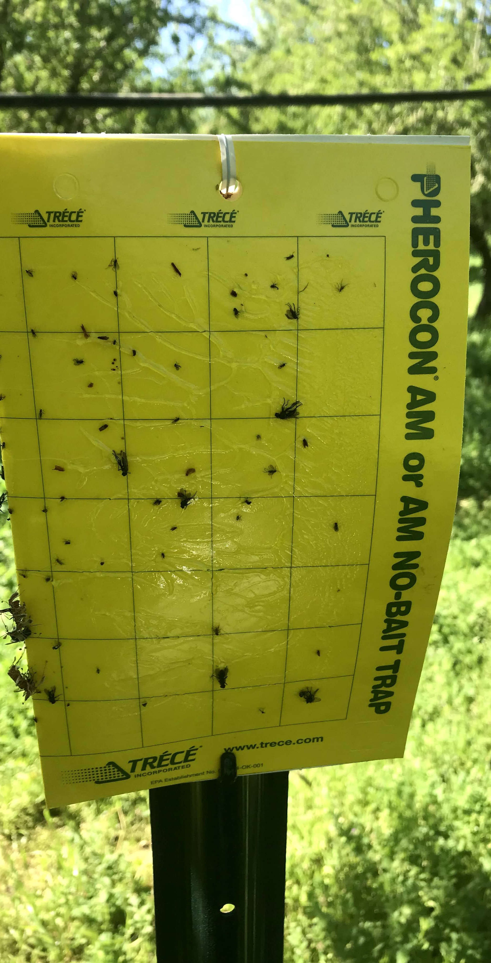
Insect diversity
Pit fall traps and sticky traps
Regenerative highest
Seasonal differences

Slide 10

Conclusion
Field or rangeland level
Landscape level processes important
Identify areas to focus remediation/conservation measures to optimize ecosystem health while maintaining/improving economic returns
TEAM
UCCE: Theresa Becchetti, Anthony Fulford, Phoebe Gordon, Roger Duncan, Jhalendra Rijal, Pam Kan-Rice
UC Berkeley: James Bartolome
UC Davis: Daniel Sumner
Illinois: Laurent Ahiablame, Kofi Akamani

