Slide 1
Rationale and Project Goals
Fall-seeded crops and environmental stability/sustainability
Diversification of cropping systems in the High Plains
(WF, WCF, WMF, WCMF)
Market demand
Grower’s request
Project Goals:
Identify suitable varieties for winter feed barley (6-row) that perform stably in semi-arid conditions
Validate recommendations on seeding rates
Identify fertility regimens for yield AND grain quality, particularly for pearled feed

Slide 2
Target Quality Parameters
Test weight > 50 lb/bu, optimally > 54 lb/bu
High seed yield (weight/seed after hulling and pearling)
PHS tolerance
Low scab pressure (<2 ppm vomitoxin)
Protein < 12%
Photos: G. Dorn

Slide 3
Experimental Approach
Variety Test:
20 varieties (UNL Small Grains, USDA-ARS in Stillwater OK, Limagrain Cereal Seeds)
3 locations 4 reps
Population Experiment:
1 variety (NB15420)
5 populations (500,000 s/a to 1,500,000 s/a)
3 locations
4 reps
Fertility Optimization:
1 variety (NB15420)
2 locations
Semi-stepwise approach evaluating N and P/S/Zn

Slide 4
Experimental Approach
N:
25, 50, 75, 100 #/a
P+S/Zn:
20, 40, 60 #/a
P:
20, 40, 60 #/a
+ control

Slide 5
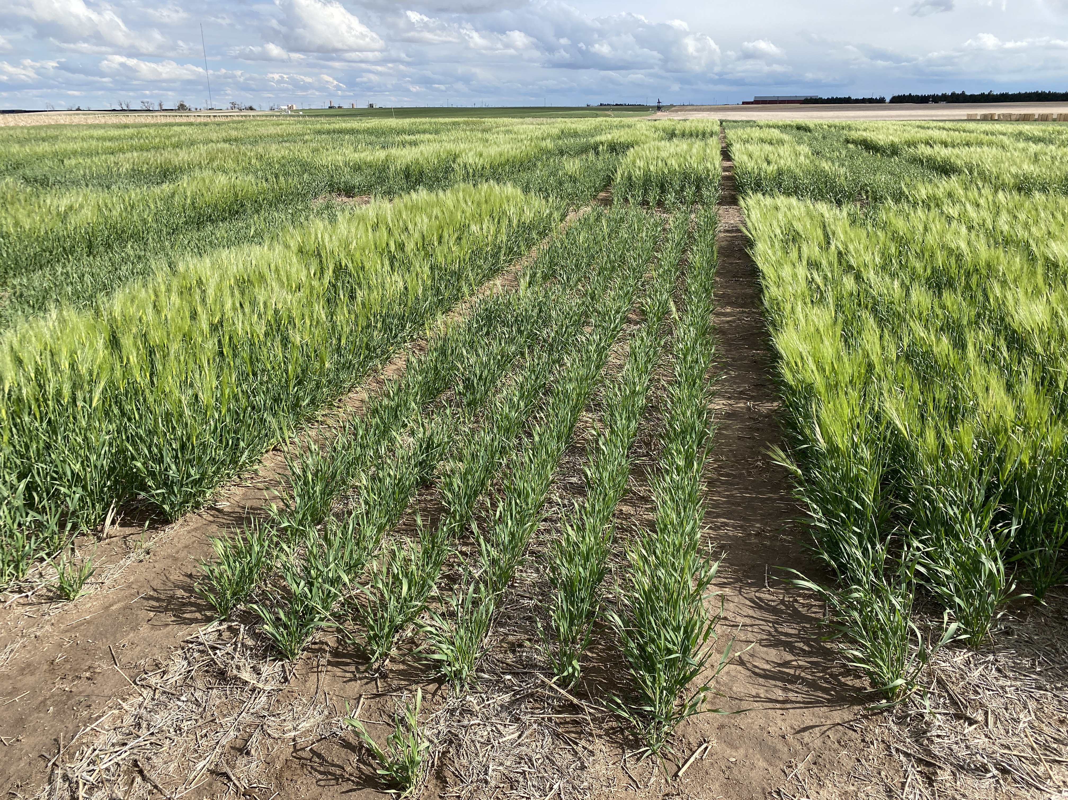
60# P as 11-52-0
+ 50# N
40# P as 40 Rock
+ 50# N
50# N
(no P)

Slide 6
Error bars: SE

Slide 7
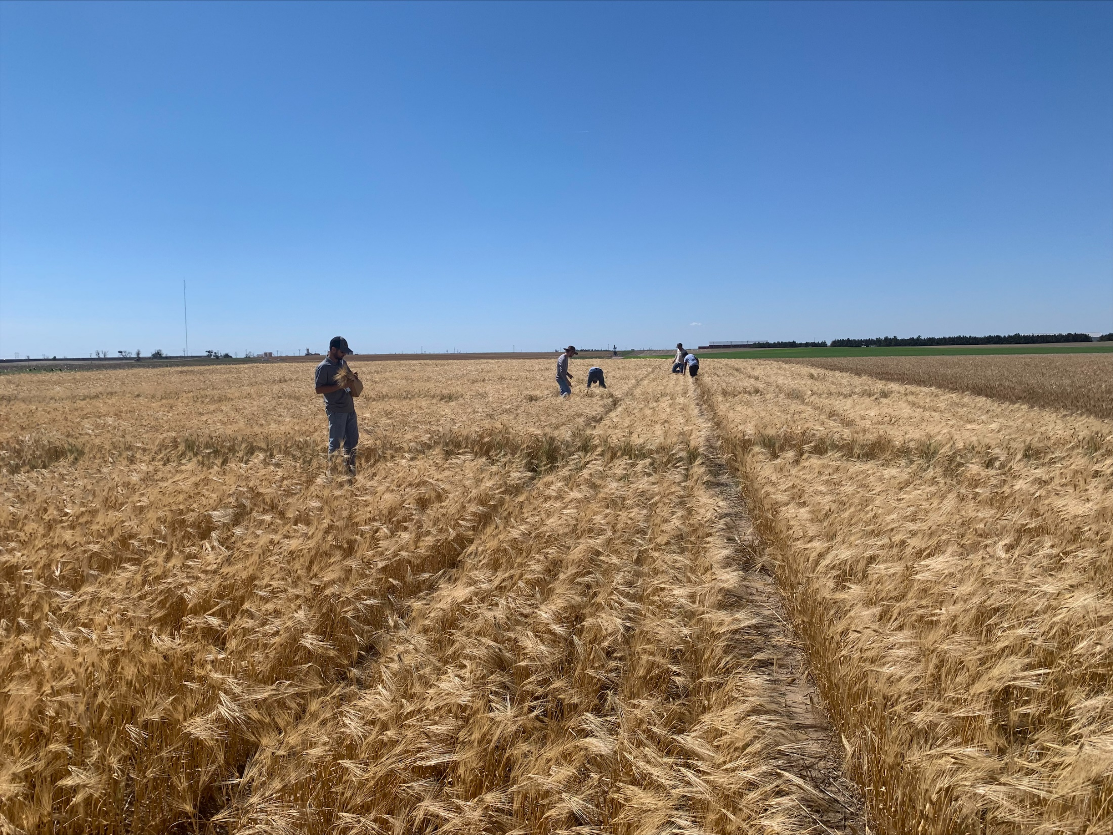

Slide 8
Error bars: SE

Slide 9
Data courtesy of Scott Baker, Ardent Mills

Slide 10
Variety | Source | Note
NB18411 | UNL | Experimental
NB20419 | UNL | Experimental
…
NB15420 | UNL | Experimental
P-954 | UNL/Paramount Seeds | Released
P-919 | UNL/Paramount Seeds | Awnless, dual use, released
NB10425 | UNL | Released in 2021
LCS Saturn | Limagrain Cereal Seeds | Forage, adapted more to NW
USDA Fortress | USDA-ARS, Stillwater | RWA/GB
Mesa | USDA-ARS, Stillwater | RWA
STARS 1803B | USDA-ARS, Stillwater | Hulless, RWA/GB
STARS 1805B | USDA-ARS, Stillwater | Hulless, 2-row, RWA/GB
20 total entries

