Slide 1
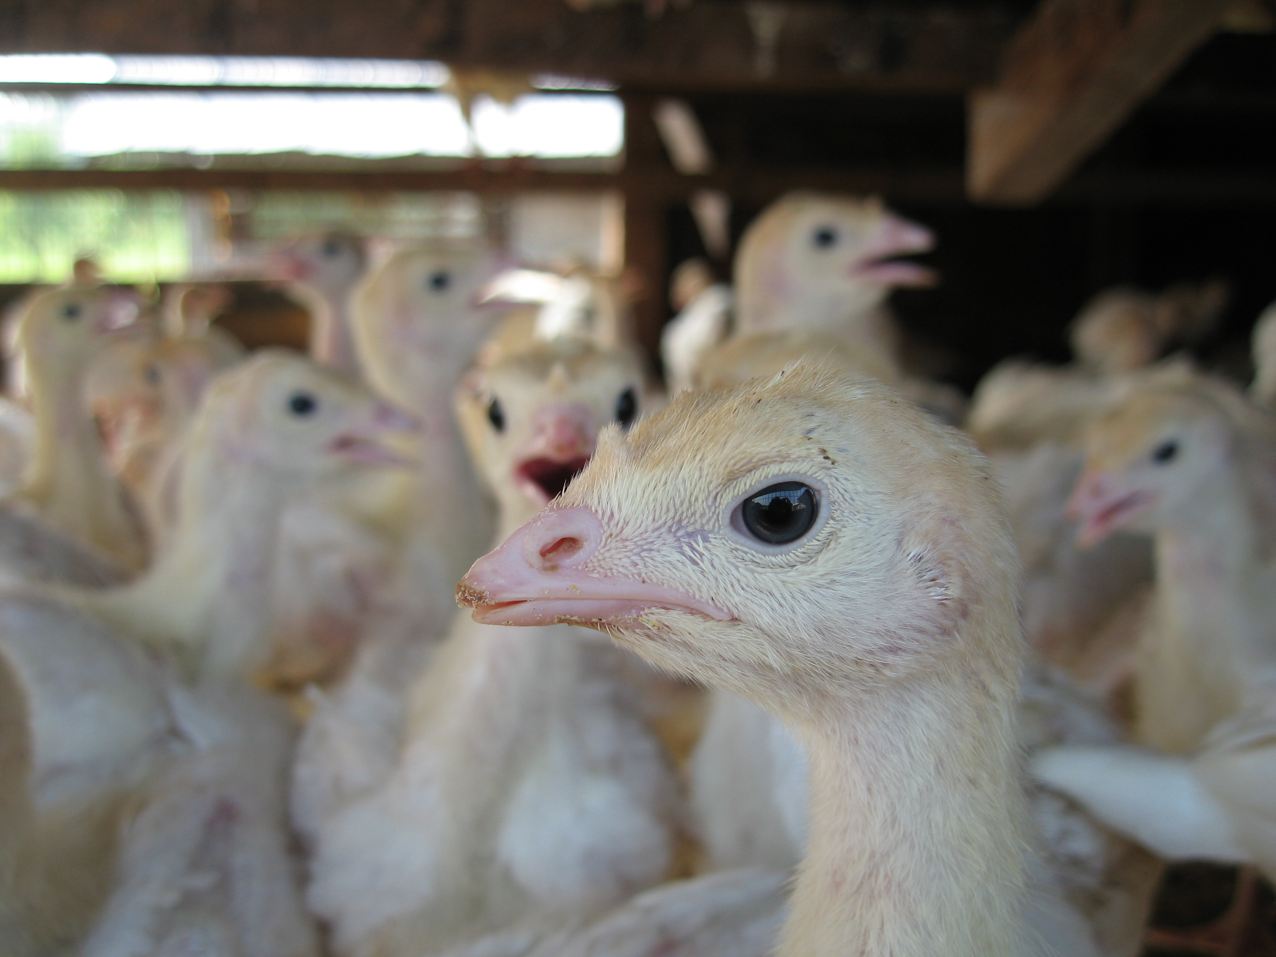
PITTMOSS POULTRY LITTER GRANT WORK
PITTMOSS POULTRY LITTER GRANT WORK
Significant Findings Overview

Slide 2
STACKED LITTER PROJECT AT DAVE JONES TURKEY FARM
OBJECTIVES
Compare the effect of three formulations of PittMoss ROOST to traditional sawdust.
Make observations while using stacked litter methods.
Evaluate the influence on important production factors:
In production (airborne ammonia, moisture on the bedding surface)
For sustainable farming (reduced air pollution, sequestration of nitrogen and phosphorus)

Slide 3
STACKED LITTER PROJECT AT DAVE JONES TURKEY FARM
METHODS:
A brooding room was divided into four uniform sections.
Bedding was spread (3”) within each quadrant containing one of the four types (Sawdust, PM-A, PM-B, PM-C).
Grew young turkeys for 2 (+/-) weeks.
Observed birds on each bedding and took ammonia gas readings over each bedding and took liter samples.
Moved birds to grow-out pens with sawdust bedding and top dress each test quadrant with 1” of the respective bedding and introduced next batch of birds growing again for 2(+/-) weeks.
Repeat with ammonia measurements and litter samplings for a total of 5 sets of birds with new additions of litter (stacked litter).
Final set of birds remain in test pen to full growth with additional final sampling.

Slide 4
SUMMARY OF SOME OF THE MOST SIGNIFICANT OBSERVATIONS
When compared to sawdust, PittMoss ROOST products:
Can absorb more moisture than other bedding materials while remaining dry for increased bird comfort and improved health.
Reduce ammonia gas emissions and conversion to ammonium when compared to sawdust, increasing bird survivability and growth.
Capture and sequester nitrogen and phosphorous very effectively, reducing risk of runoff and nutrient loss.
Maintain a litter bulk density similar to sawdust despite higher moisture holding and nutrient retention ability.

Slide 5
MOISTURE HOLDING PROPERTIES OF DIFFERENT BEDDING MATERIALS Higher moisture retention ability by the bedding means birds stay drier and healthier, even in used bedding

Slide 6
AVERAGE MOISTURE OVER ALL SAMPLINGS Lower average litter moisture content means birds stay drier and that their feet and feathers stay clean
Grow-Out Pens
Sawdust Only
PittMoss ROOST Blends

Slide 7
TOTAL NITROGEN CAPTURED IN LITTER AT THE END OF CROPPING Higher nitrogen capture means less runoff to sensitive and regulated waterways

Slide 8
AVERAGE AIR AMMONIA LEVELS IN RESEARCH PEN AND PRODUCTION PENS Less ammonia improves survivability and growth of poults—ammonia damages poultry respiratory tracts

Slide 9
LITTER AMMONIUM CONTENT IN THE LITTER AT THE END OF CROPPING Ammonium can cause contact injuries Less conversion to ammonium improves survivability and growth of poults

Slide 10
PHOSPHORUS IN LITTER AT END OF CROPPING Increased phosphorous retention reduces excess nutrient pollution in sensitive and regulated waterways

Slide 11
AVERAGE LITTER BULK DENSITIES OVER ALL SAMPLINGS PittMoss versions remained dryer except for Sawdust P2, which had more ventilation

