Slide 1
Transitioning to Organic Grain Production in Maryland: Evaluating Soil Health Impact of Four Strategies
Biwek Gairhe and Ray Weil
Department of Environmental Science and Technology
University of Maryland – College Park

Slide 2
Background
Organic transition:
Opportunities vs. Challenges
Crop productivity
Soil health
The “sweet spot”
Typical organic grain farmers | “Conventional” Maryland grain farmers
Tillage for weed control, making seedbeds | No-till (74% of cropland)
Animal manures, legumes for soil fertility | Strict nutrient management plans, Chicken manure, Cover crops including legumes (41% of the cropland).
Profitability
Soil disturbance
Notes:
Last week, I was attending an event where the CEO of Perdue farms was the keynote speaker. He said that they have a major line of organic chicken products but 90% of their organic grain for the chicken feed is imported from outside of the us. What I am trying to convey here is there is still a great need and opportunity for American farmers to transition to organic. Some major challenges that the farmers face specially during the transition phase are maintaining soil fertility, controlling weeds and pests, getting reasonable yields and finally making profits. To meet some of these challenges. Conv vs Maryland. Begs the question. Overall research goal was to test different strategies to find what I like to call a “sweet spot”, where we can balance the soil health, crop productivity, and profitability aspects during the organic transition phase.

Slide 3
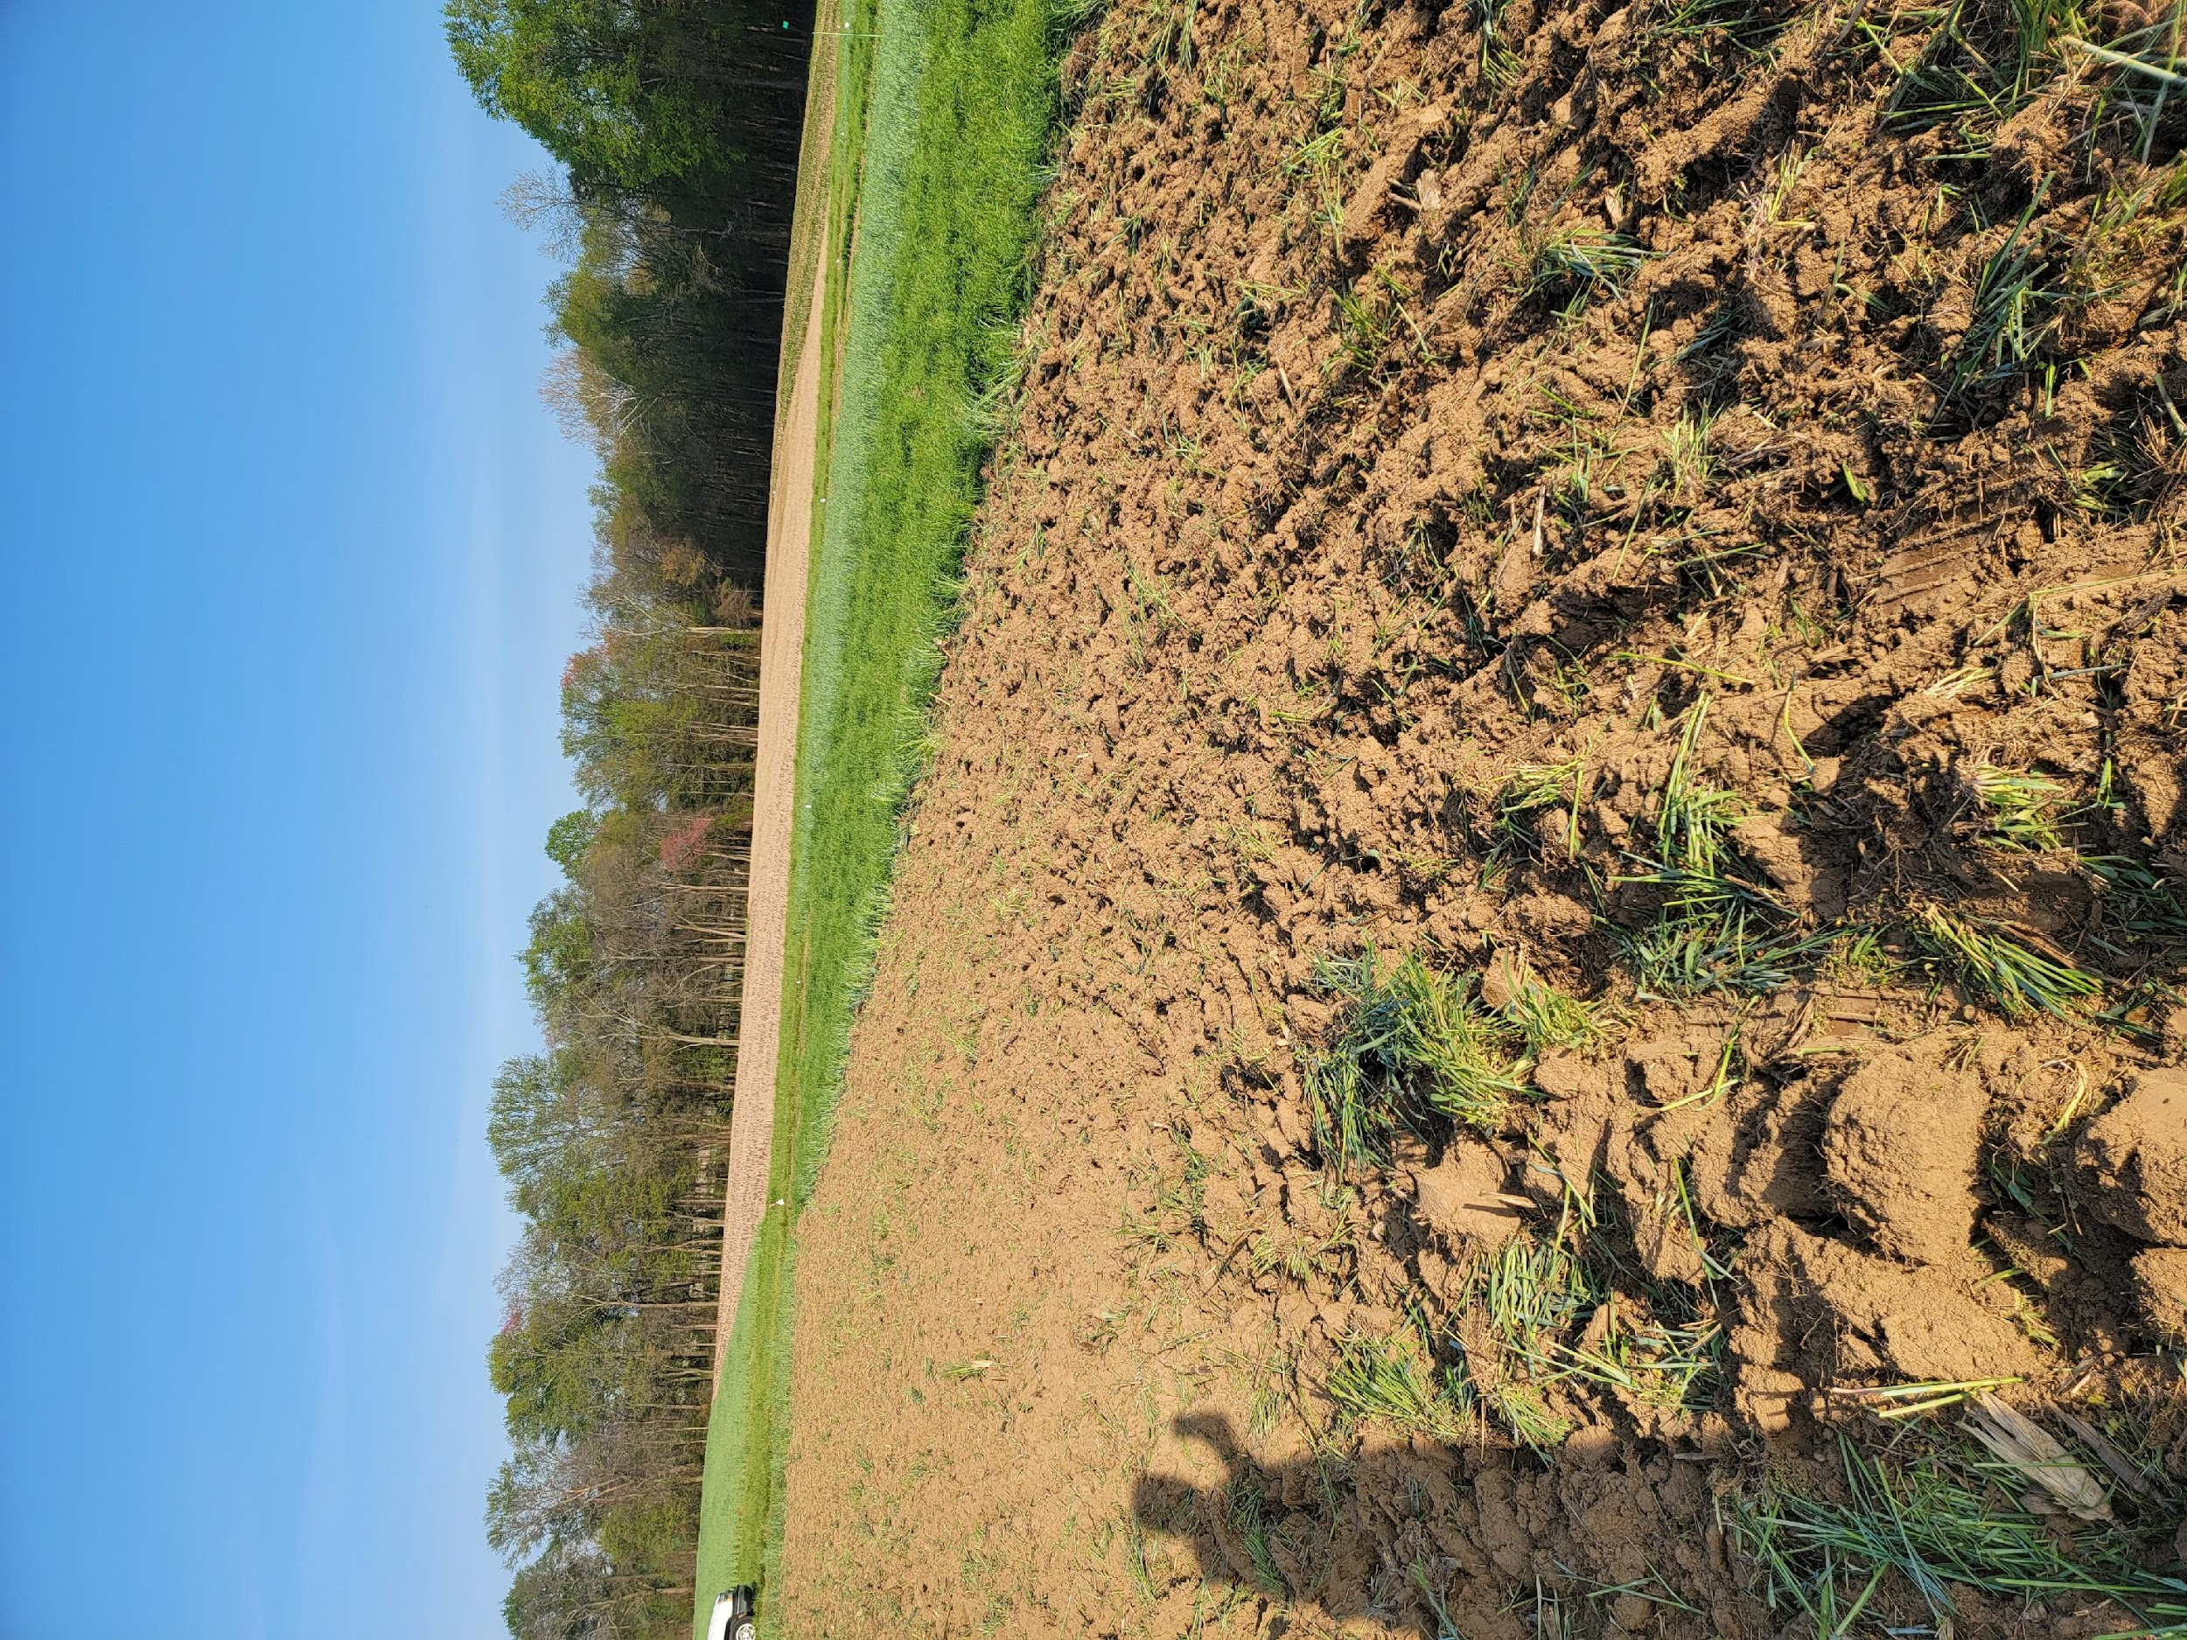
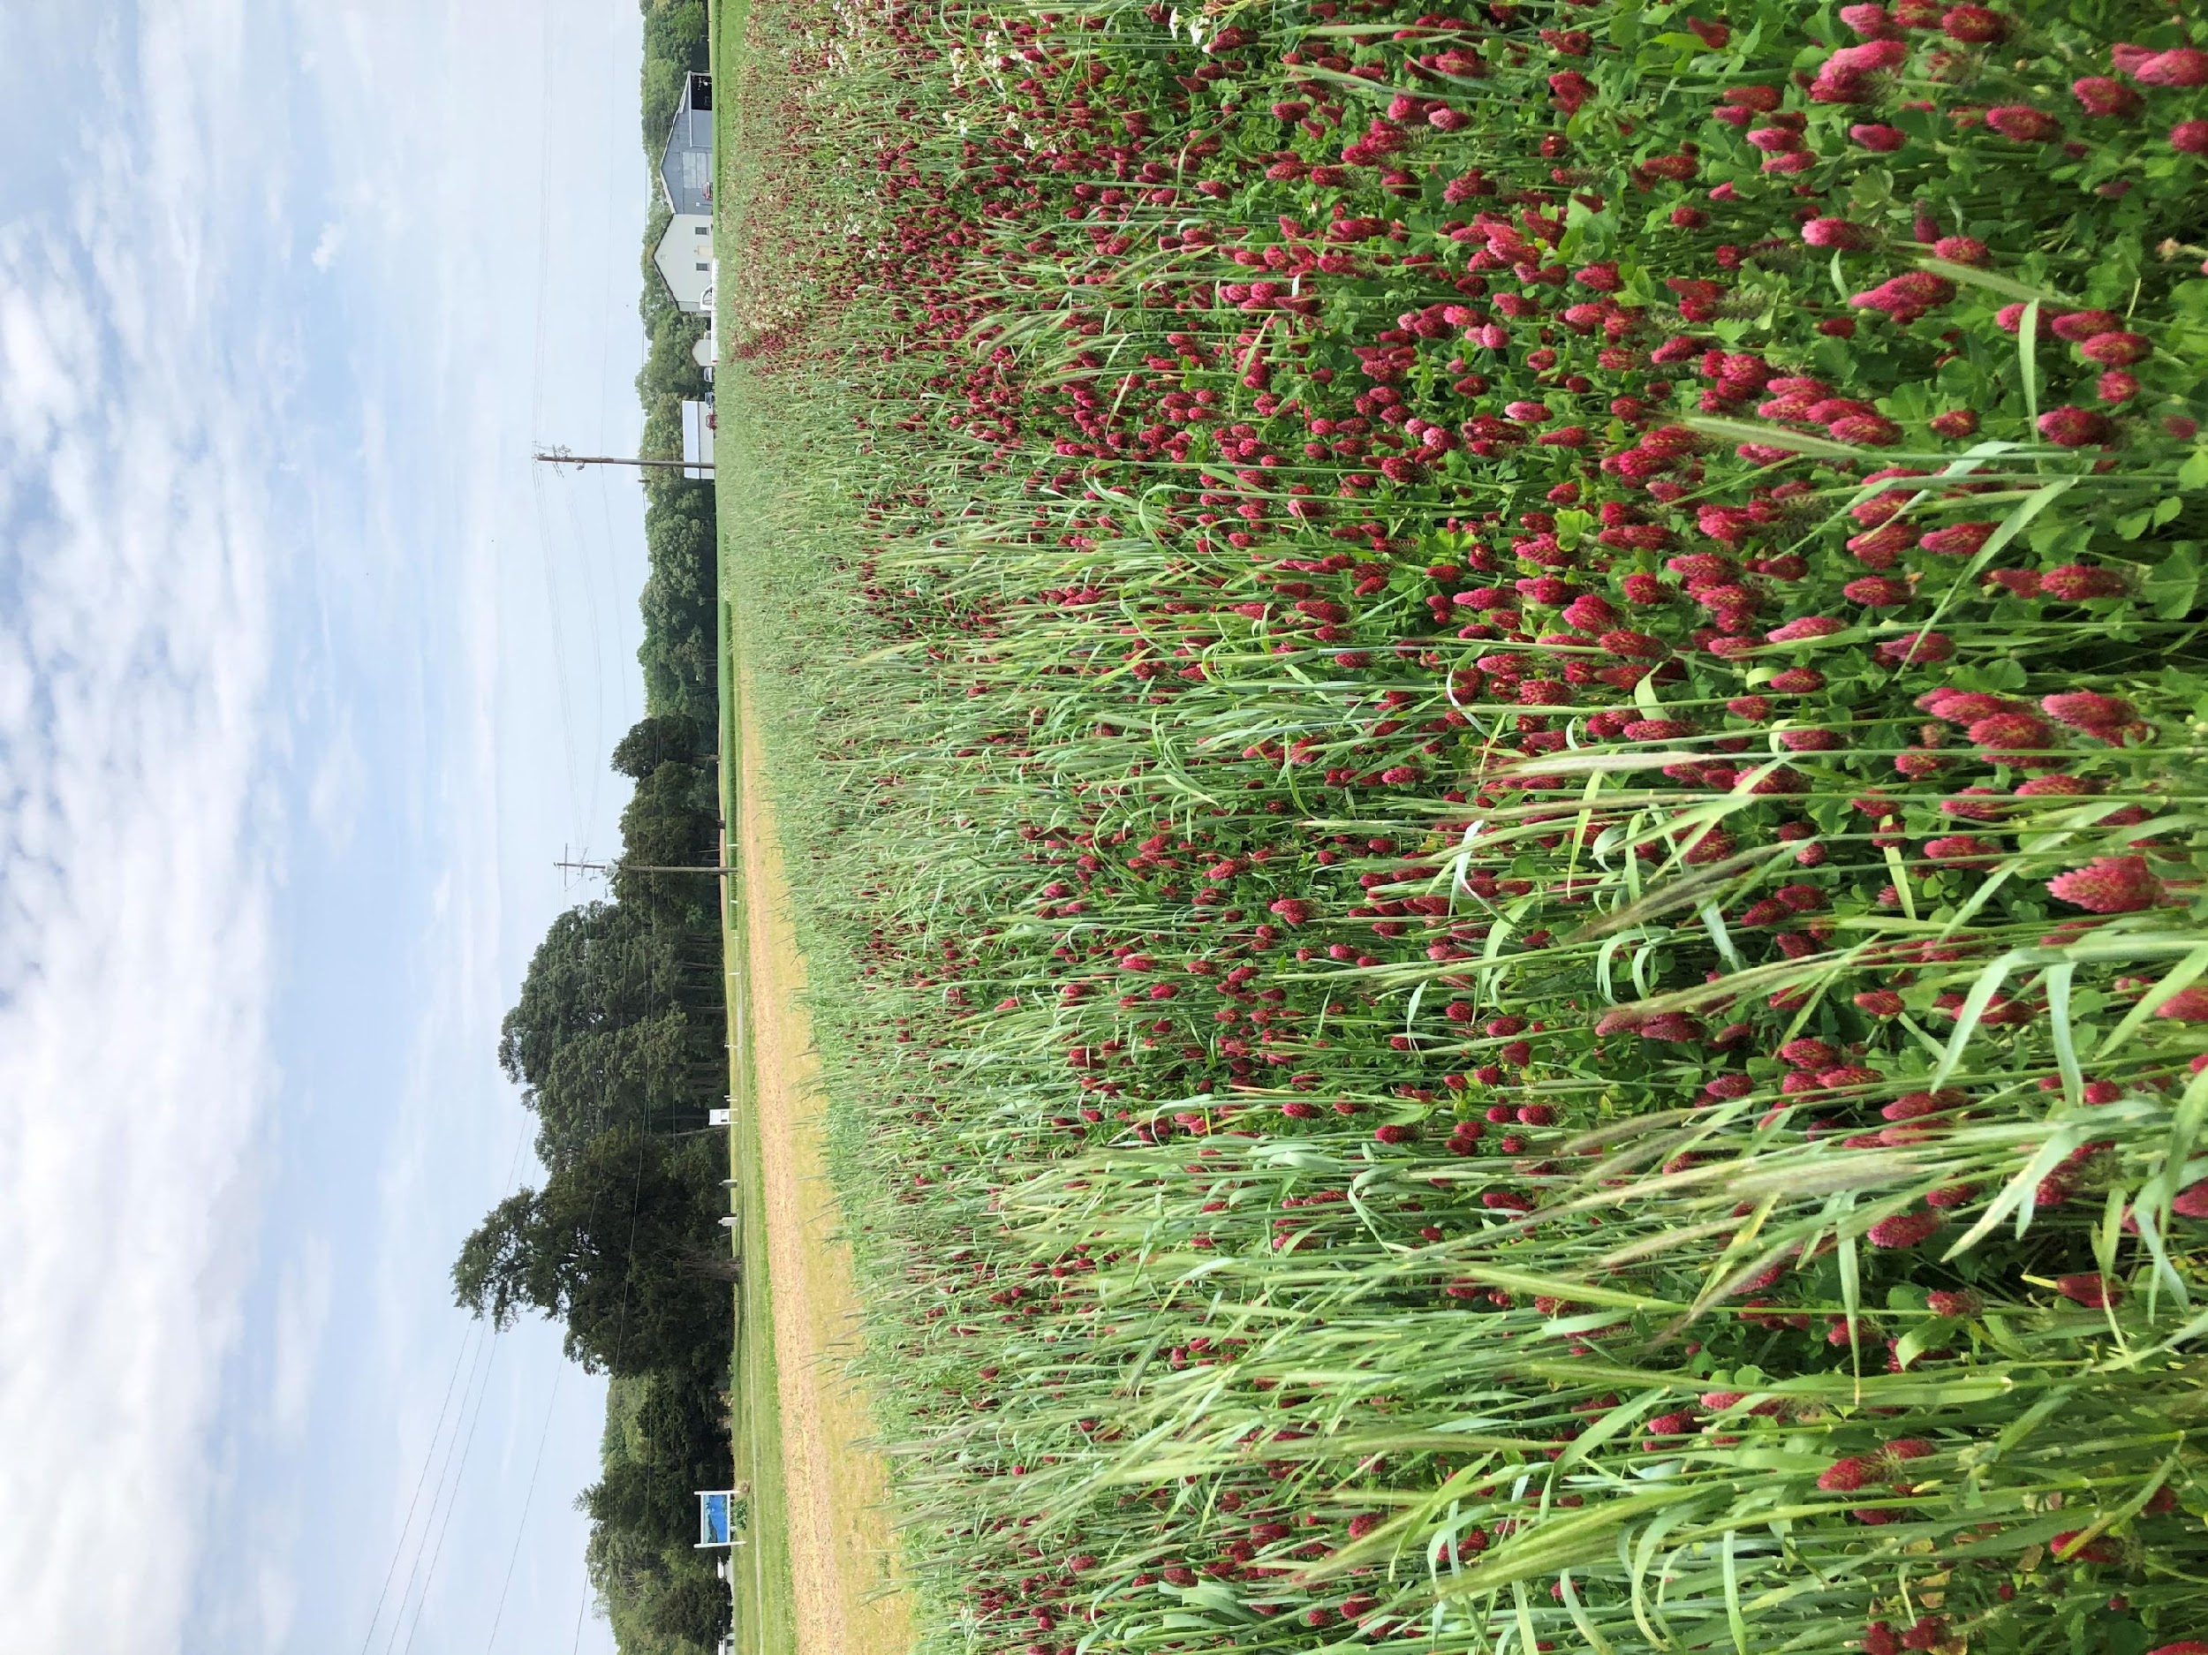
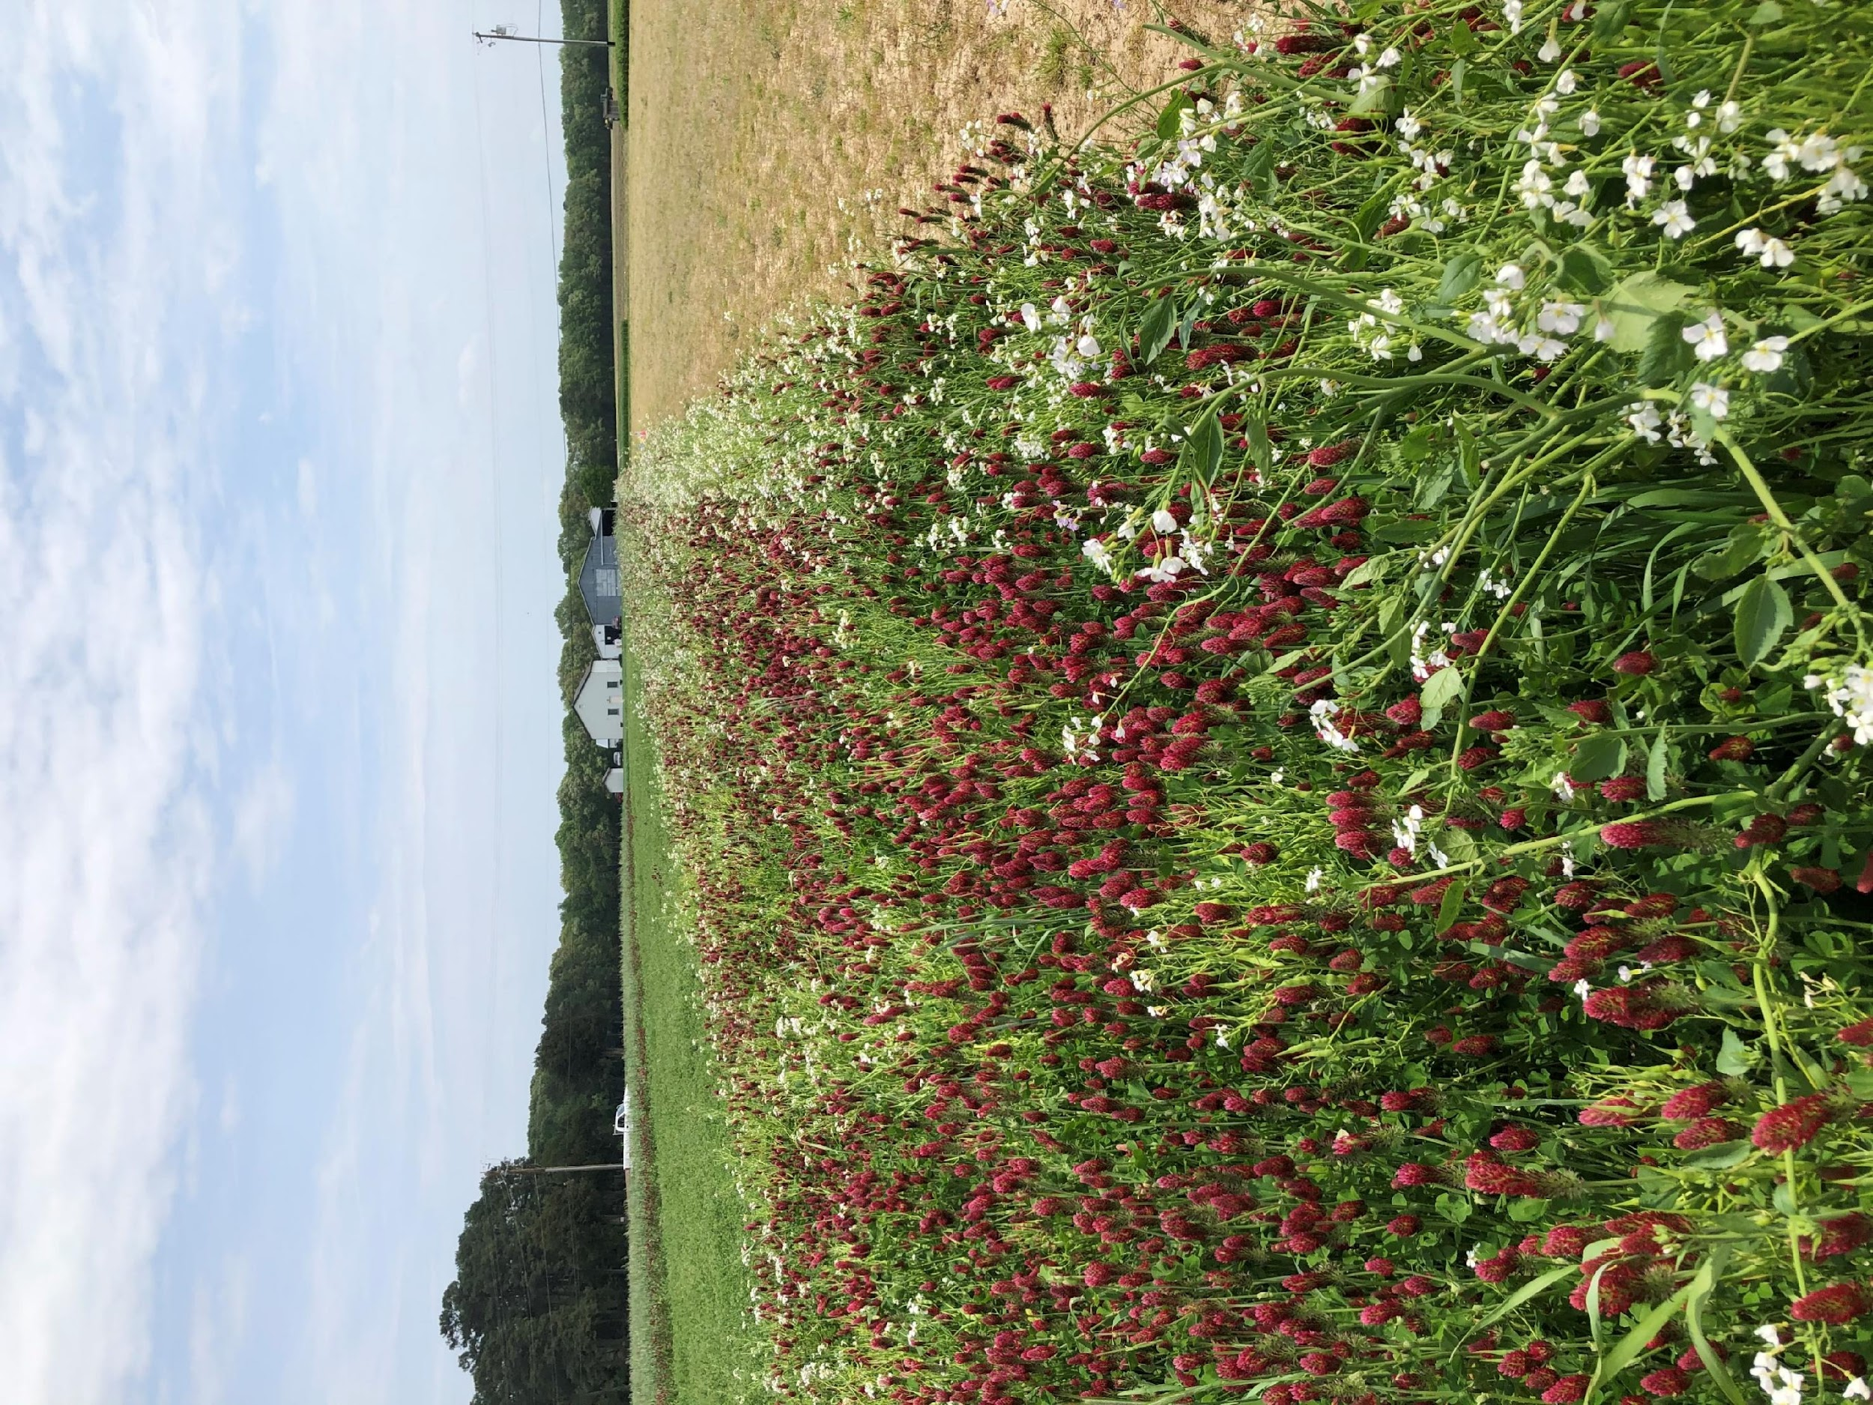
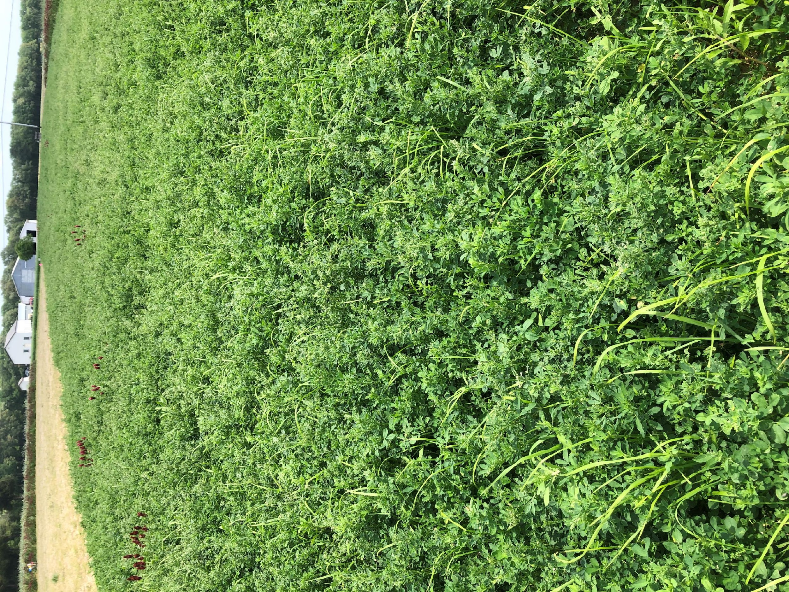
Study approach
Four transition strategies that differ in degree of soil disturbance, soil cover and input use intensity.
Soil disturbance
Treatment 1: Standard organic tillage, cultivation for weeds, maximize harvestable crops, minimal cover crops.
Treatment 2: Reduced-till
Medium disturbance. Moderate cover crop intensity and biomass.
Treatment 3: Minimum-till with precision-zoned high biomass diverse cover crops.
Treatment 4: Perennial alfalfa-grass hay, untilled
No soil disturbance after initial establishment. Multiple hay harvests per year.
Notes:
Here are the four organic transition strategies that we developed. As you go from trt 1 to trt 4, they differ along the continuum of soil disturbance, soil cover and input use intensity. Just read the descriptions.

Slide 4
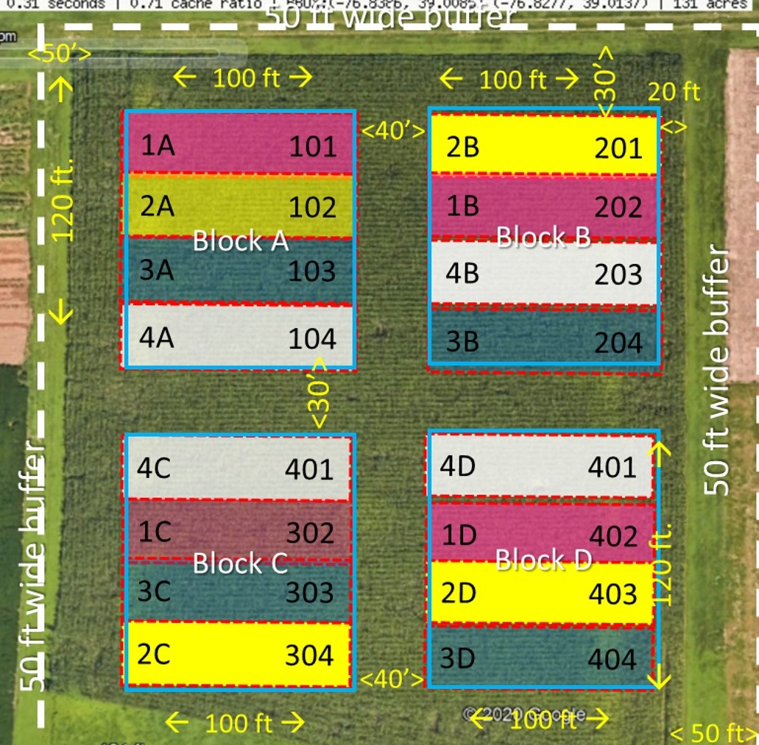
Materials and Methods
Organic transition initiated in Spring 2020 and completed in Spring 2023.
RCBD with 4 replications of each treatment at each study location.
Farm name | Soil description | Individual plot size | Treatments
CMREC (UMD research station) | Moderately well drained sandy loam | 9 m x 30 m | 1,2,3,4
LESREC (UMD research station) | Moderate-well drained silt loam | 9 m x 75 m | 1,2,3,4
Commercial farm – A | Moderate-poorly drained sandy loam | 9m ft x 90 m | 1,2,3
Commercial farm – B | Well drained silt loam | 18 m x 45 m | 1,2,3
Experimental plot design at CMREC, Beltsville, MD
Notes:
Transition phase started in spring 2020 and ended in spring 2023. Tested the four strategies in a Randomized Complete Block Design (RCBD) with four replications. Two in university research stations and two in commercial farms. Soil type-sandy loam to silt loam. Individual plot size and treatments.
Cooper: Woodstown sandy loam, Fallsington sandy loam, Typic Endoaquults, Aquic Hapludults
LESREC: Matttapex and Nassawango, Aquic Hapludults, Typic Hapludults
Cavanaugh: Penn and Croton, Ultic Hapludalfs, Typic Fragiaqualfs
CMREC: Russett Christiana complex, Aquic Hapludults

Slide 5
Research timeline
2020
2021
2022
2023
Apr | May | June | July | Aug | Sept | Oct | Nov | Dec | Jan | Feb | Mar | Apr | May | Jun | Jul | Aug | Sept | Oct | Nov | Dec | Jan | Feb | Mar | Apr | May | Jun | Jul | Aug | Sept | Oct | Nov | Dec | Jan | Feb | Mar | Apr | May | Jun | Jul | Aug | Sept | Oct
Trt 1
Trt 2
Trt 3
Trt 4
Spring oats
Winter pea
Corn
Cereal rye
Soybean (76 cm rows)
Hairy vetch + Cereal Rye
First organic corn
Disking x 3
Cultivation
Disking x 3 & Packing
Disking x 2
Cultivation x 2
Roller crimping
Spring oats
Crimson clover + Cereal rye
Corn
Cereal rye + Crimson clover
Soybean (76 cm rows)
Hairy vetch + Cereal Rye
First organic corn
Roller crimping
Roller crimping
Roller crimping
Spring oats
Crimson clover + Cereal rye + Radish (following 10 species cover crops in summer)
Corn
Cereal rye + Crimson clover + Radish
Soybean (19 cm rows)
Hairy vetch + Cereal Rye
First organic corn
Roller crimping
Roller crimping
Roller crimping
Spring oats
Alfalfa + Orchardgrass hay with multiple hay harvests per year
Hairy vetch + Cereal Rye
First organic corn
Hay harvest
Hay harvest
Disking x 4
Roller crimping
Data collection
Soil sampling (0-30cm)
Biomass sampling
PSNT soil sampling
Hand + Machine harvest
Biomass sampling
Soil sampling
Hand + Machine harvest
Biomass sampling
PSNT
Soil sampling
Hand + Machine harvest
Notes:
Busy slide, includes specific details on each treatment. Key takeaways are crop rotation: Spring oats, Corn, Soybean and after completion first organic corn. Trt 1 had winter pea, cereal rye, received a good amount of tillage for termination of cover crops and weed control. Trt 2 and 3 used multi species cover crops and roller crimping for terminating cover crops. Trt 3 had radish. Trt 4 had hay. We periodically took soil and plant samples as well. Today mostly talking about the results of soil health measurements from Fall 2022 or Summer 2023 sampling and Fall 2023 harvest.

Slide 6
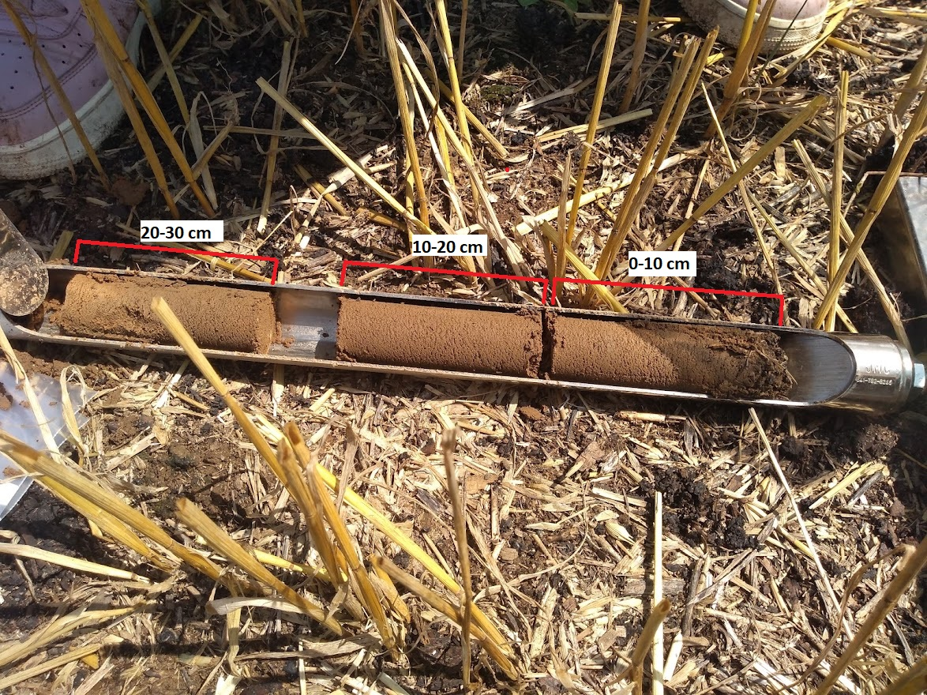
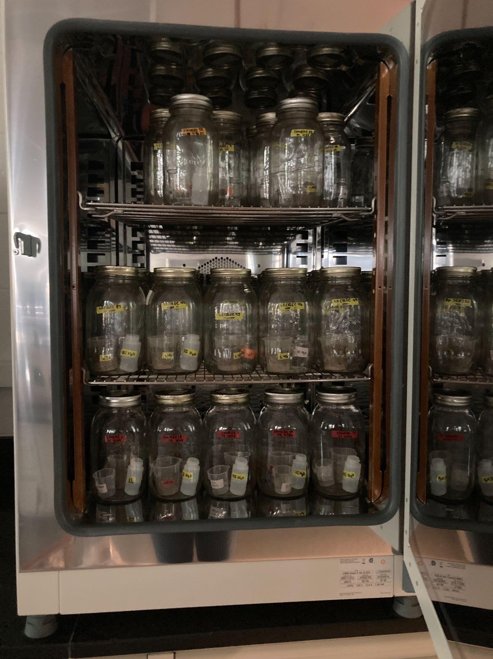
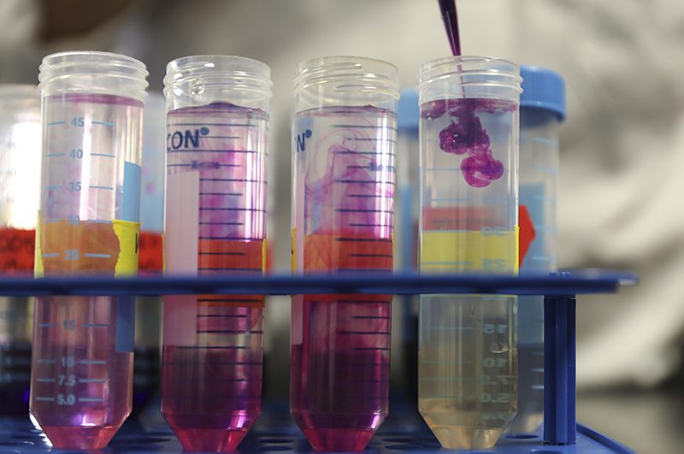
Data collection
Soil sampling schedule: Fall 2020 (Baseline), Fall 2021 (PSNT at corn V5 stage) Fall 2022 (during transition) and Fall 2023 (PSNT at Corn V5 stage)
Soil bulk density
10 to 12 cores per plot
3.1 cm diameter soil probe
Labile soil carbon
Permanganate Oxidizable Carbon (POXC) method (Weil et al., 2003)
Fall 2022 samples
Soil respiration rate
Rewetting air-dried 0-10cm soils, incubation
mgCO2-C/kg of soil
24 and 72 hours
Fall 2022 samples
Notes:
Just describe.

Slide 7
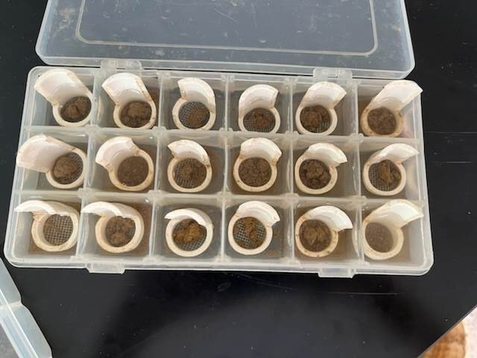
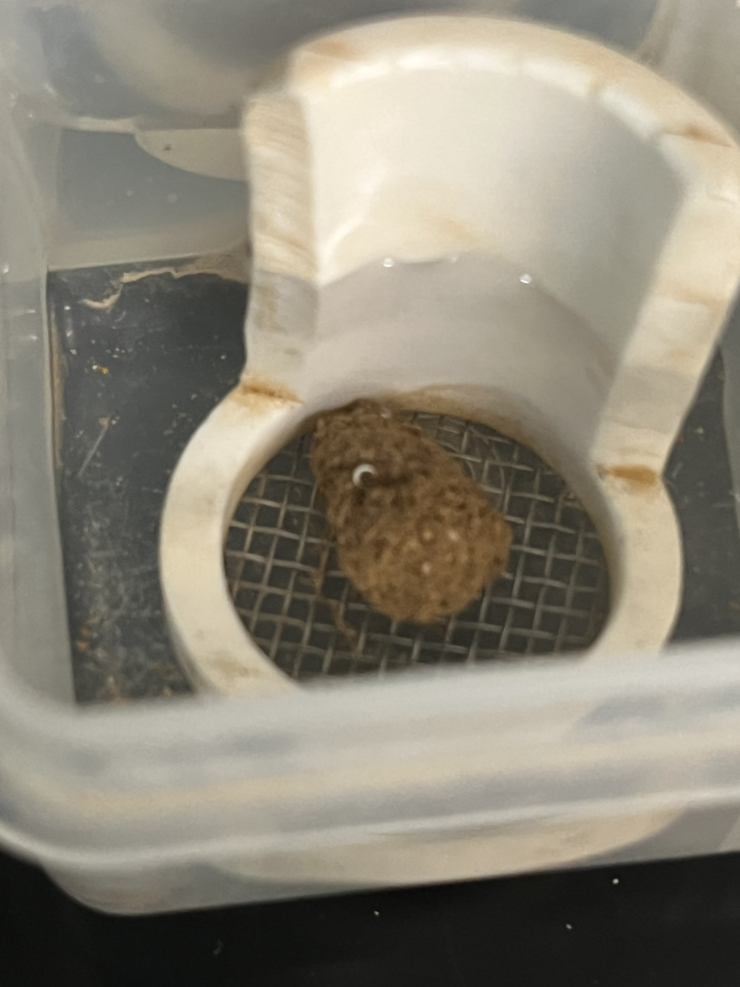
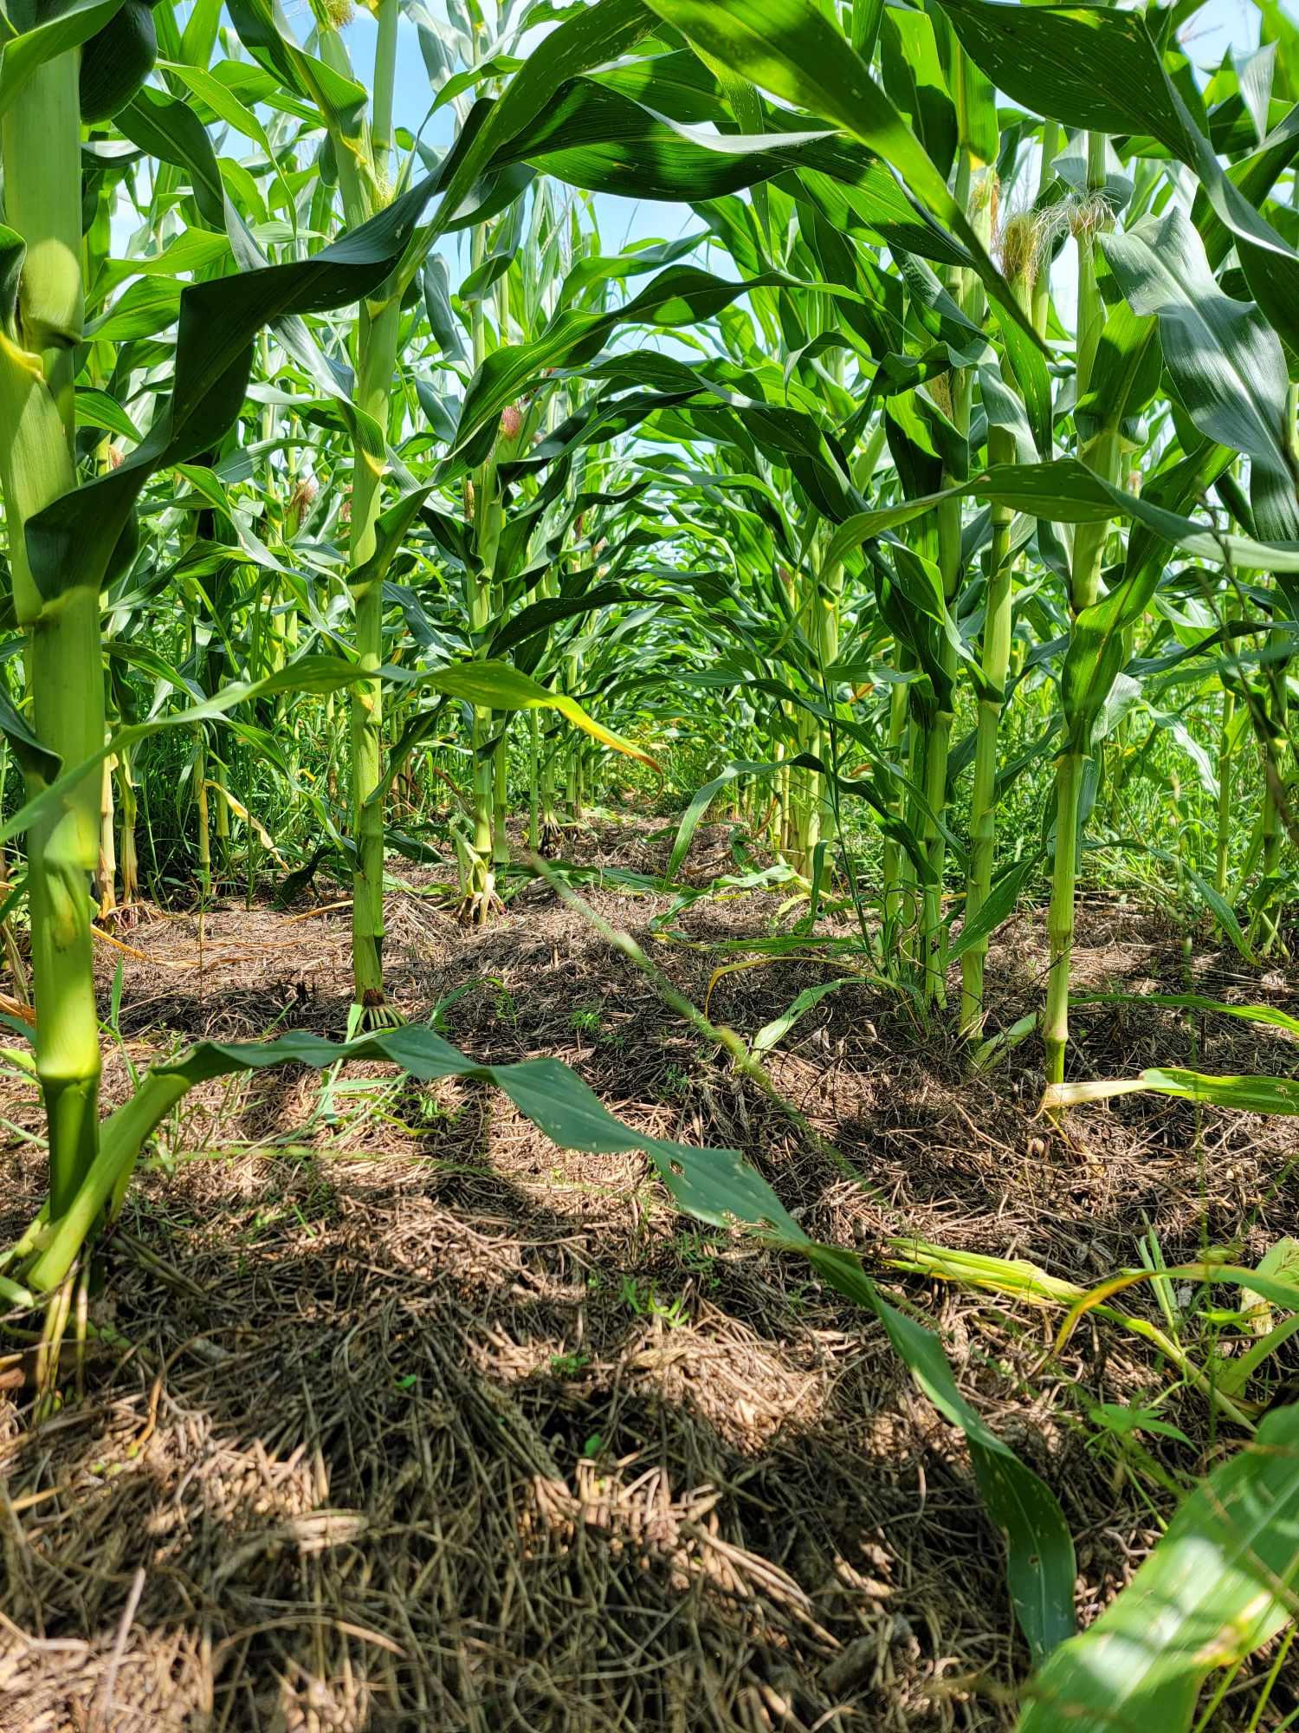
Data collection (Continued…)
Aggregate stability by slaking
Fall 2022 top 10cm samples
6 aggregates/sample (0.6-0.8 cm diameter), each on 1.5mm sieves
Immersion in water → stability class rating→ 5 dipping cycles after 5 mins → stability class rating
Field soil aggregate stability kit (Herrick et al. (2001))
Pre-sidedress nitrate test (PSNT)
- V5 stage of corn (July 2023)
- Top 30cm
Notes:
PSNT is standard practice for Maryland farmers and all Maryland farmers apply most of the nitrogen to corn at this stage.

Slide 8
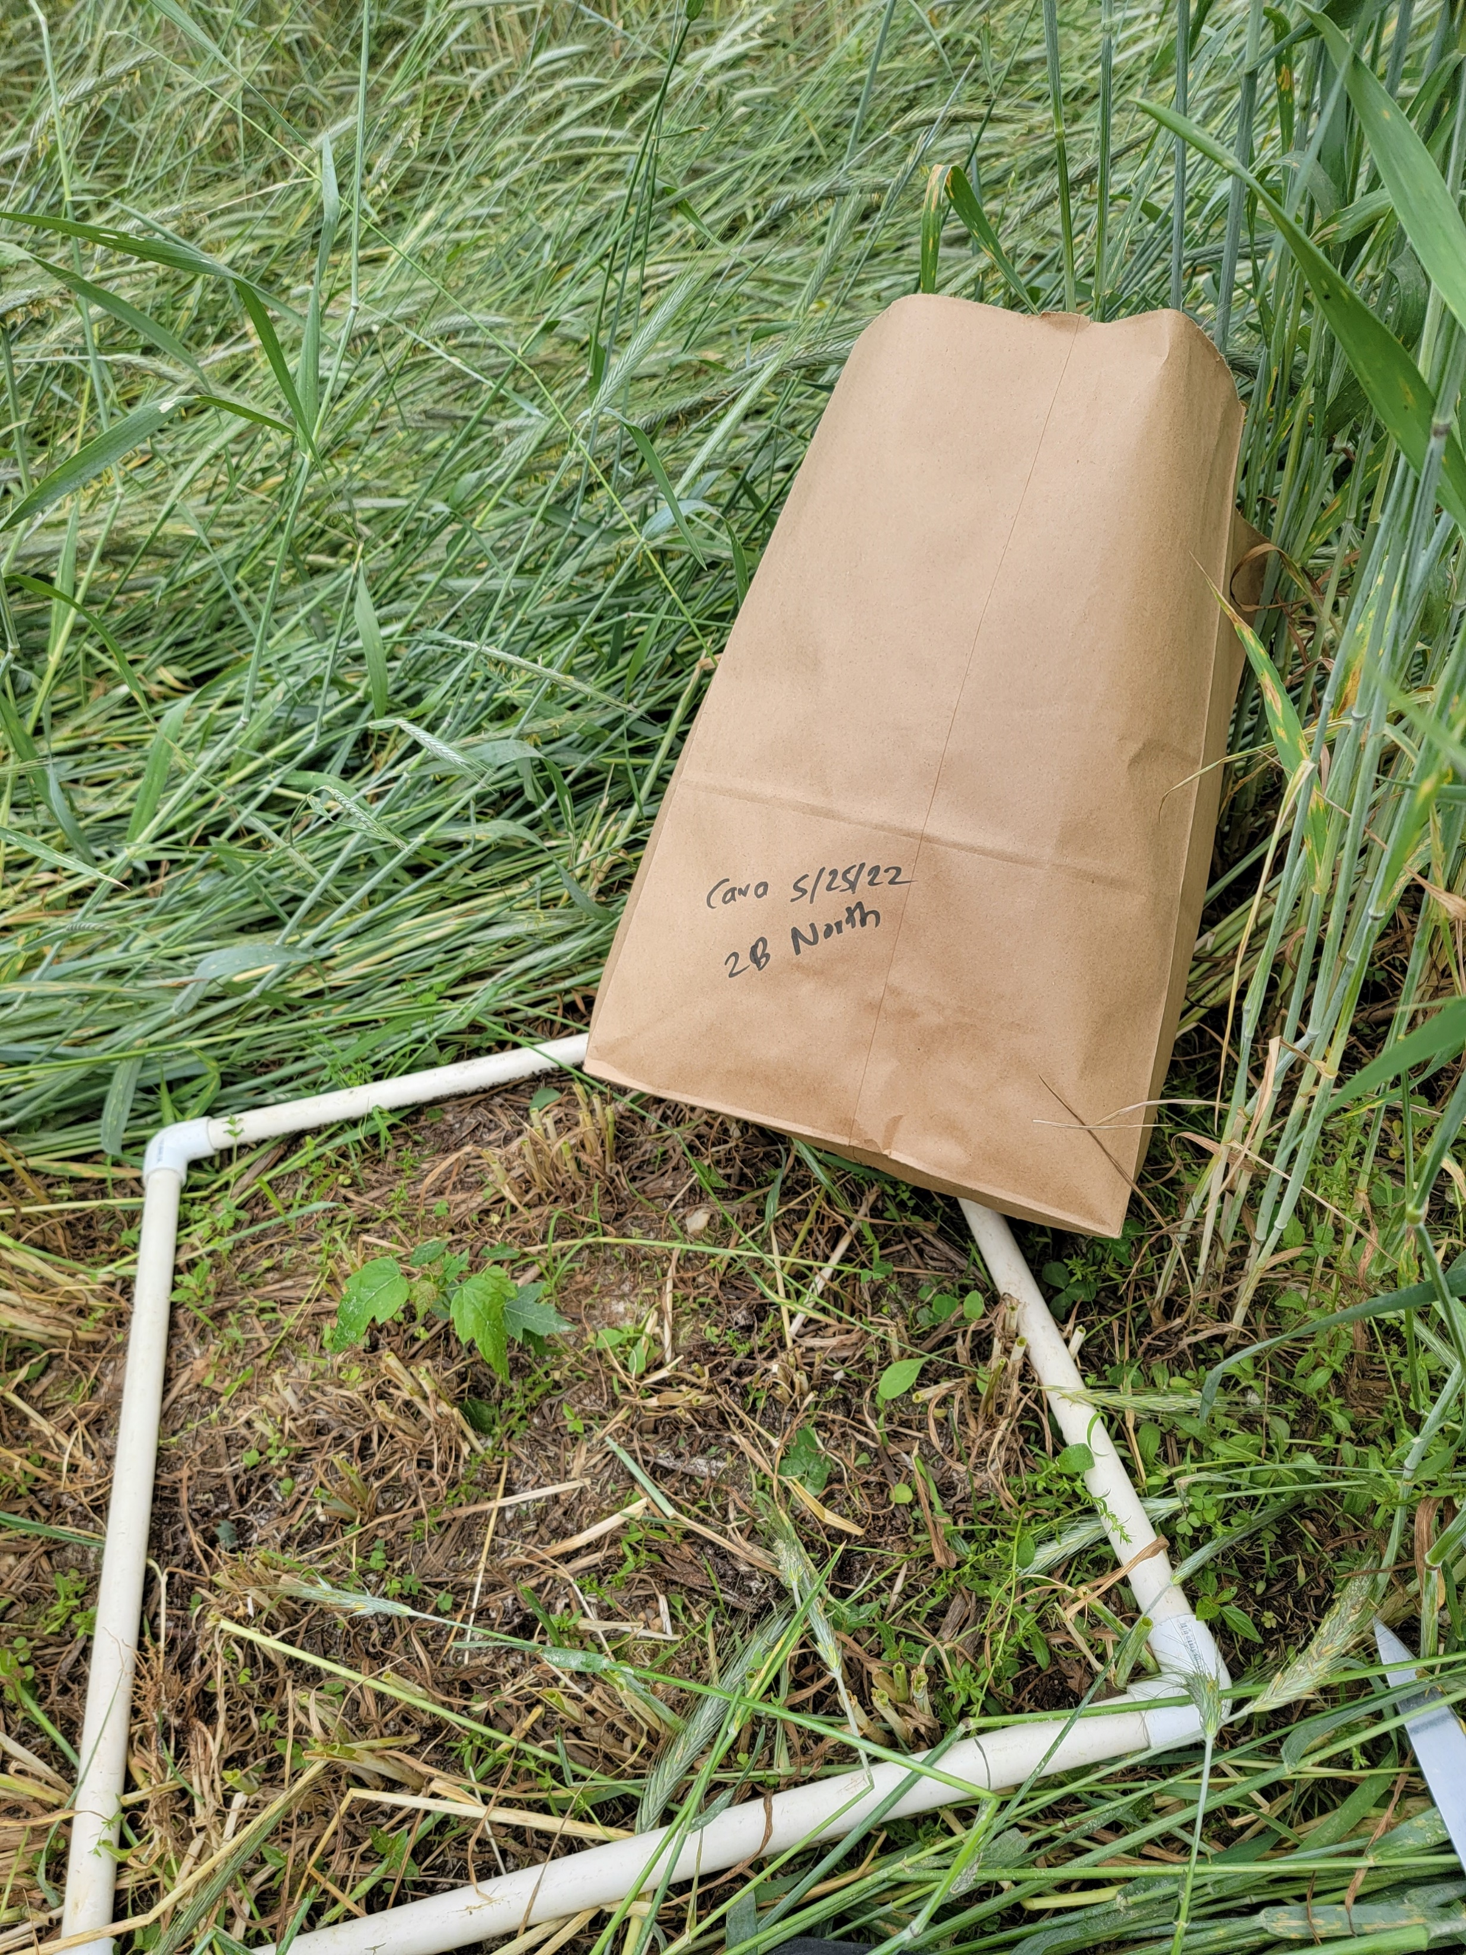
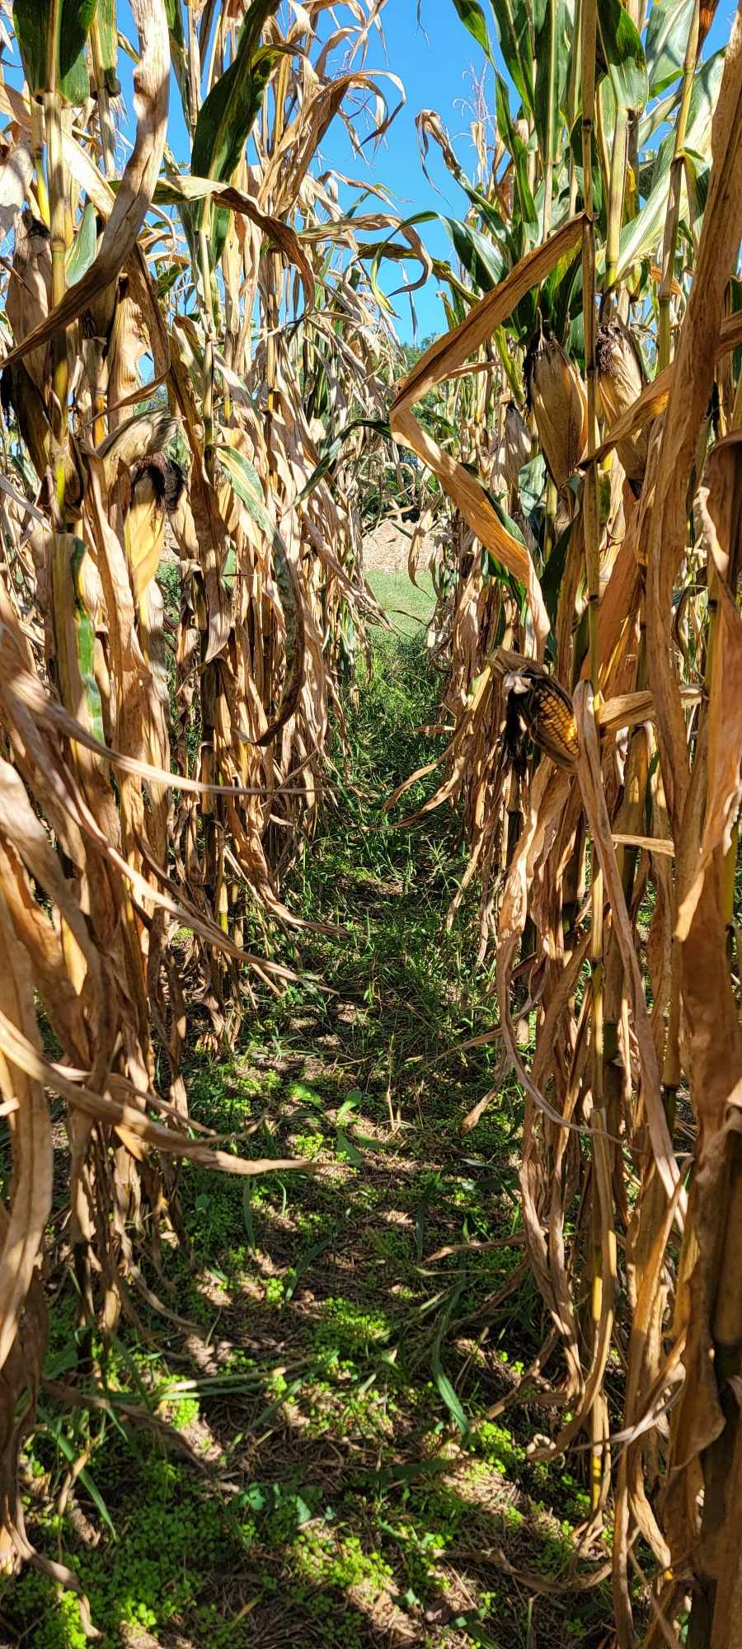
Data collection (Continued…)
Soil pH
Soil organic matter (Loss on ignition)
Soil P,K,S (Mehlich 3)
Crop yield by hand harvest
Cover crop and weed biomass
Notes:
For the PSNT samples collected, we sent the samples to a commercial lab for measurement of soil pH, soil organic matter by loss on ignition, and soil Phosphorus, Potassium, and Sulfur. We also looked at the agronomic variables that could be an indicator of the soil health, that are crop yield by hand harvest and cover crop and weed biomass.

Slide 9
Statistical analyses
Physical properties:
Soil strength, Aggregate stability, …
Biological properties: Respiration rate..
Rstudio version 2022.07.2+576
QQ-plots for normal distribution
Levene’s test for Homogeneity of Variance
Analysis of Variance (ANOVA)
Post-hoc test: Tukey’s HSD
Significance at P <= 0.05
Radar plots, principal component analysis and decision trees
Chemical properties:
pH, nutrients, CEC, Organic matter, Active C…
Notes:
So to analyze the several physical, chemical and biological properties of the soil, we used Rstudio. We checked for significant difference using ANOVA and mean separation using Tukey’s HSD at P<=0.05. We also use radar plots to visualize the data and to identify the key factors influencing the crop productivity and interaction among the soil variables, we used decision trees.

Slide 10
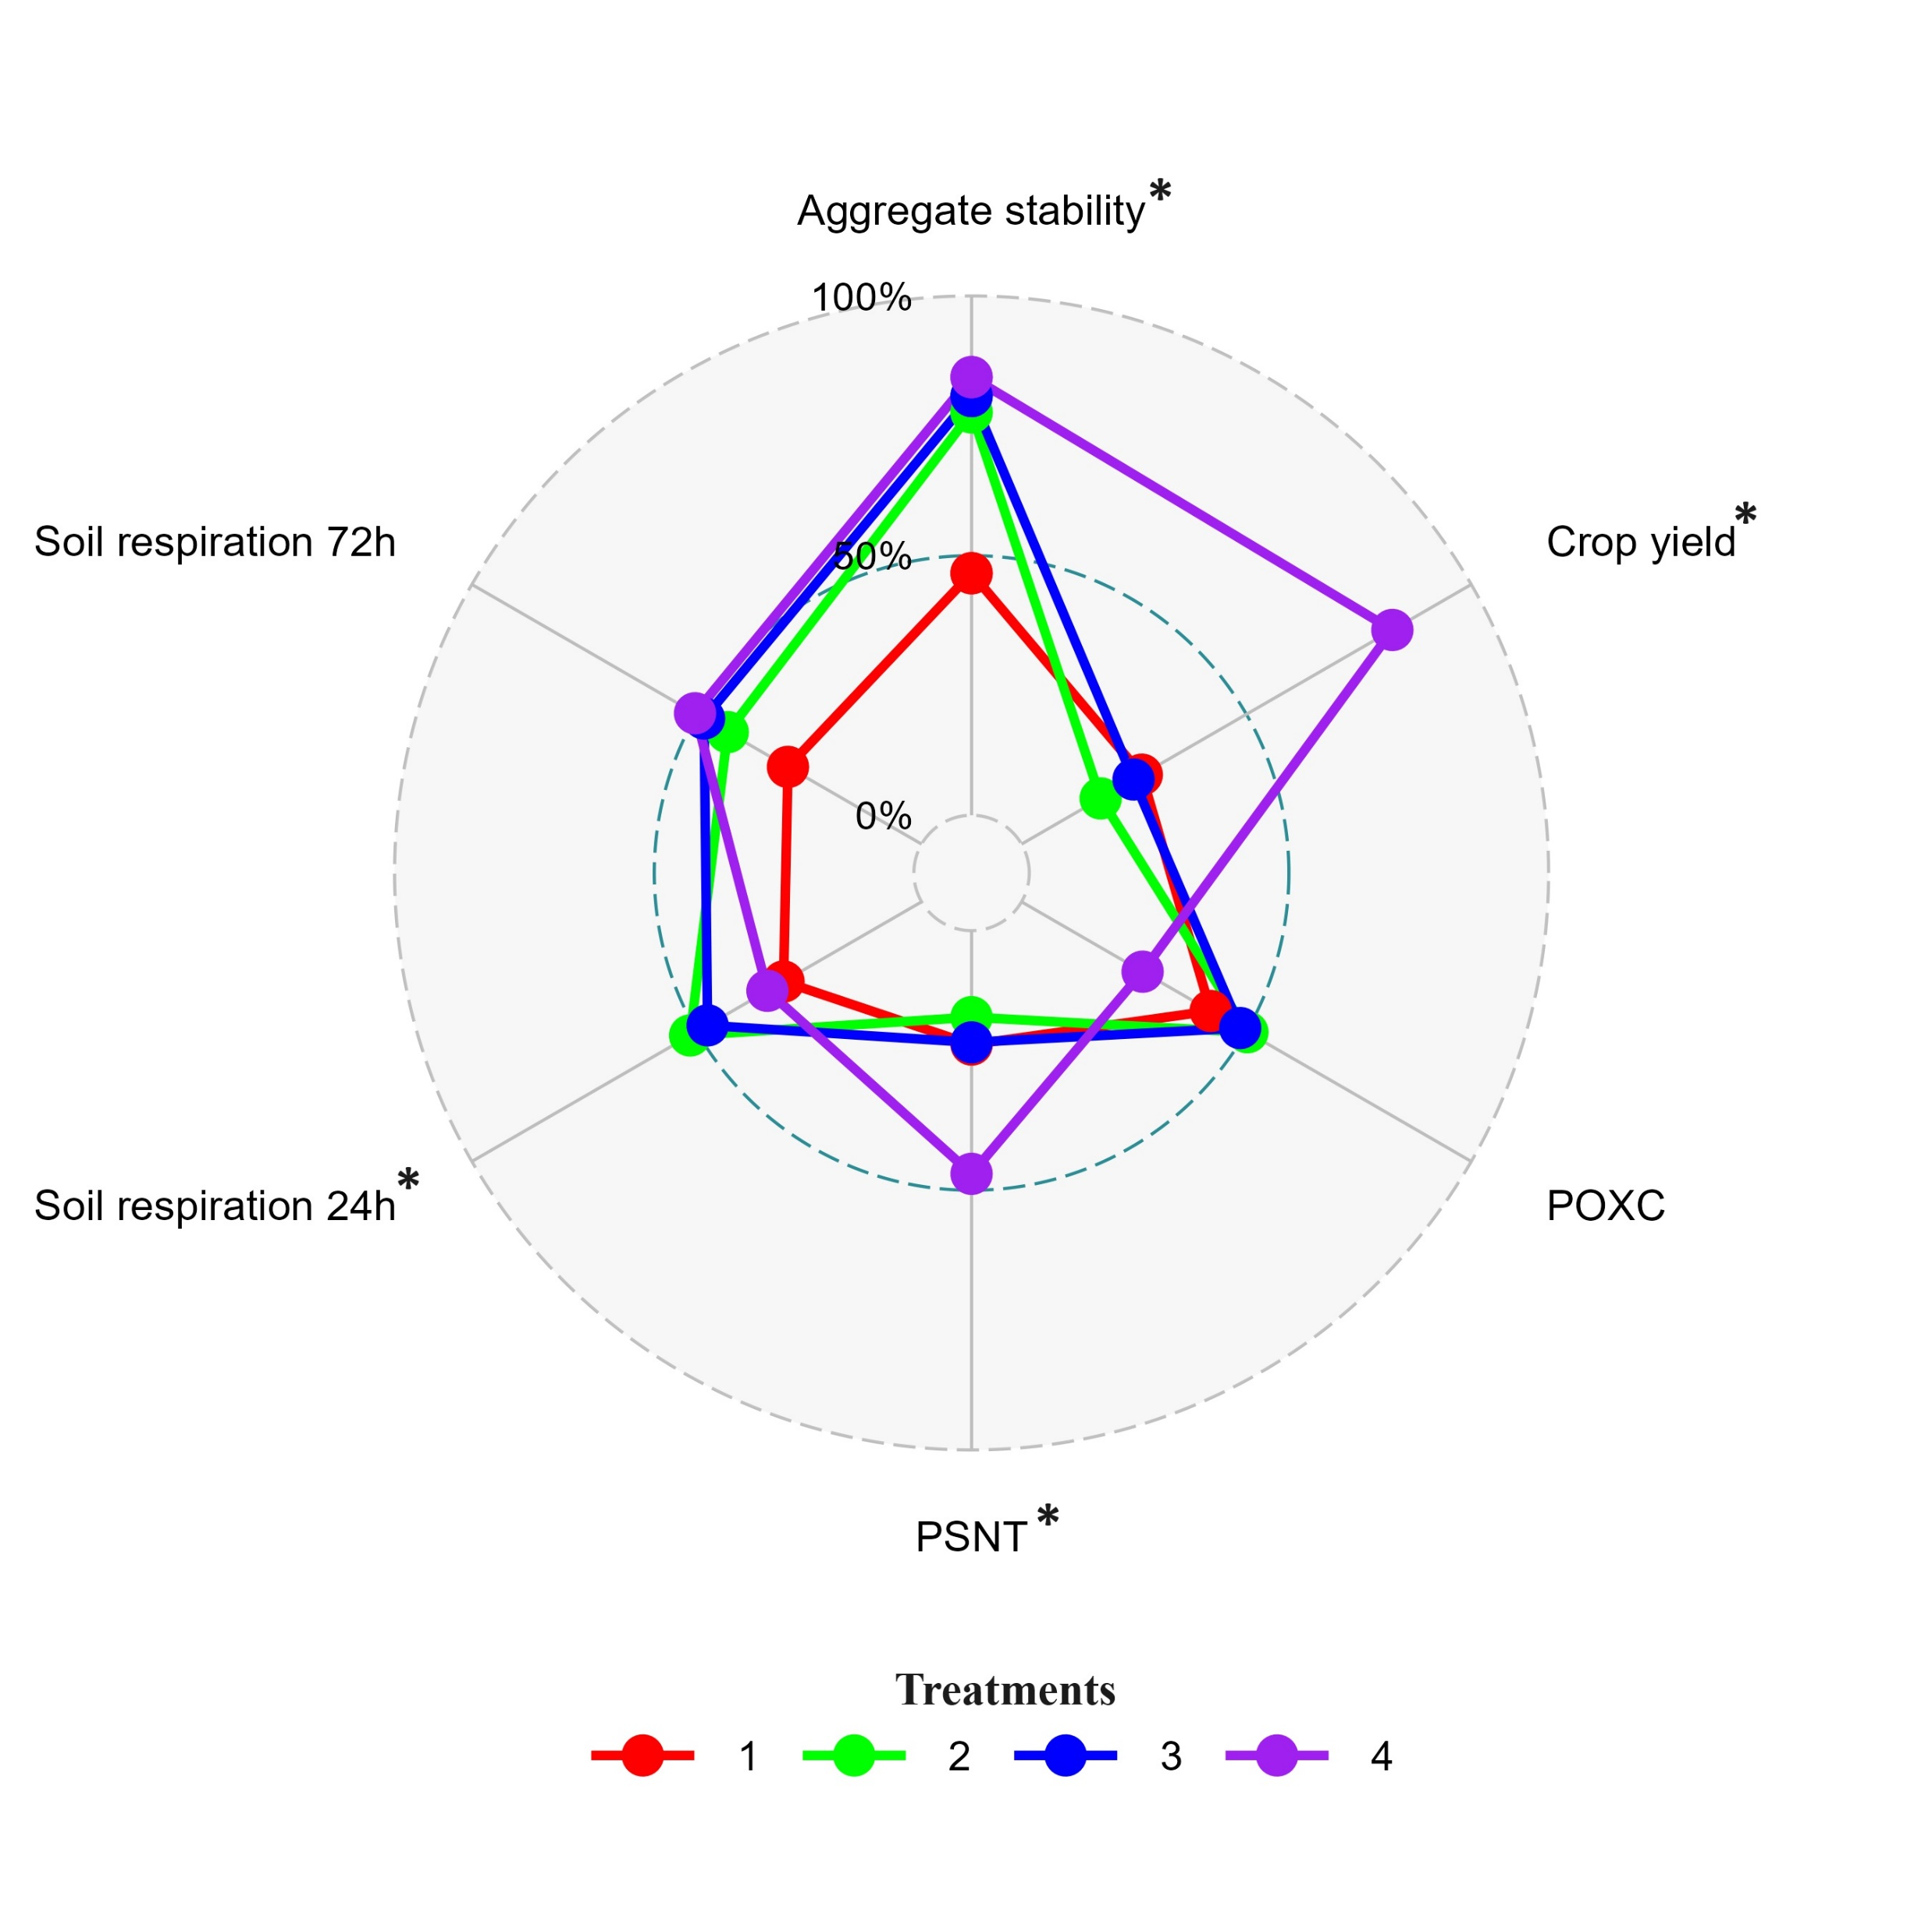
Results
*
d
a
c
b
d
b
a
b
a
b
a
b
a
b
*Significant difference between treatments in Crop yield, Aggregate stability, PSNT and Soil respiration
Figure 4. Average total CO₂-C evolved under different treatments three sites during 24 hour incubation. Treatments labeled with the same letter do not differ significantly at p<0.05.
Notes:
Here, can see a spider plot (or radar) plot showing the effects of different treatments of several soil health parameters such as aggregate stability, crop yield, POXC, PSNT, soil respiration. Values from all the variables were standardized to a similar scale of 0 to 1 before plotting the graph. The closer it gets to the outer circle, it represents higher magnitude of a given parameter. The properties with the asterisk sign differ significantly between the treatments. We saw a significant difference in the yield, aggregate stability, soil respiration and PSNT.

Slide 11
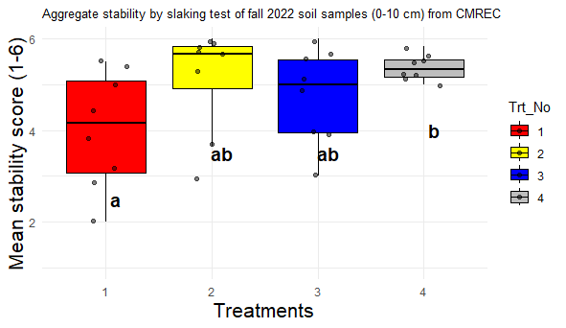
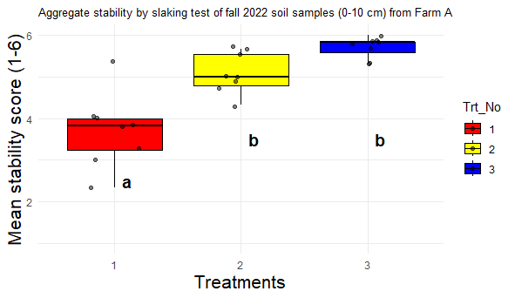
Results
Soil aggregate stability vs treatments at CMREC
Soil aggregate stability vs treatments at farm A
Treatment 1 had significantly lower stability score than treatment 4
Treatment 1 had significantly lower stability score than treatments 2,3

Slide 12
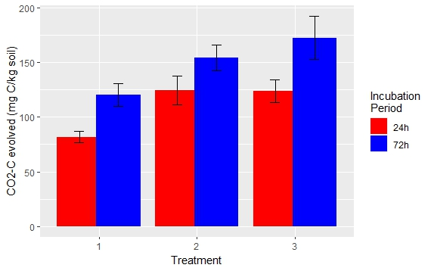
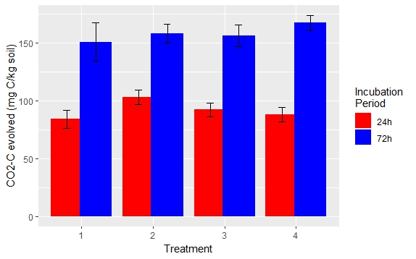
Results
Soil respiration vs treatments at Farm A
Soil respiration vs treatments at CMREC
d
a
c
b
b
d
c
b
d
a
b
a
b
a
b
a
b
a
b
d
a
b
a
b
a
b
a
b
Treatment 1 total respiration was significantly lower than other treatments at both 24- and 72-hours
No significant difference between treatments
Figure 4. Average total CO₂-C evolved under different treatments three sites during 24 hour incubation. Treatments labeled with the same letter do not differ significantly at p<0.05.
Notes:
More available carbon and microbial activity? TRT 1 numerically lower.

Slide 13
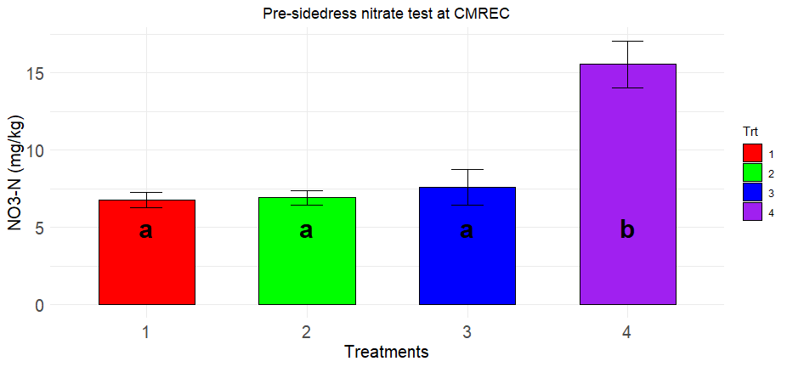
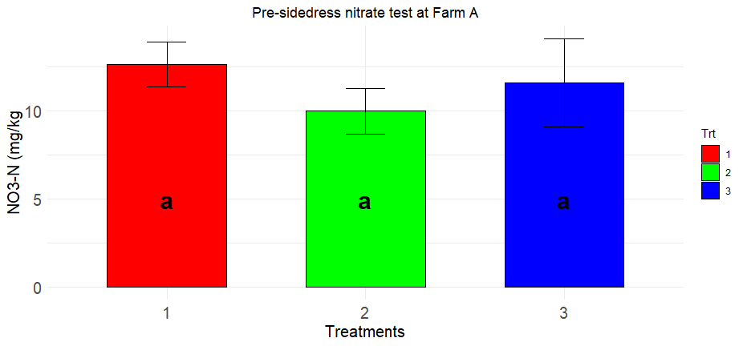
Results
Pre-sidedress nitrate nitrogen vs Treatments at CMREC
(Fall 2023)
Pre-sidedress nitrate nitrogen vs Treatments at Farm A
(Fall 2023)
PSNT NO3-N was significantly higher at trt4 (untilled-alfalfa-hay) compared to other treatments at CMREC
No significant difference between treatments at Farm A
Notes:
Still not high enough for sufficient yield.

Slide 14
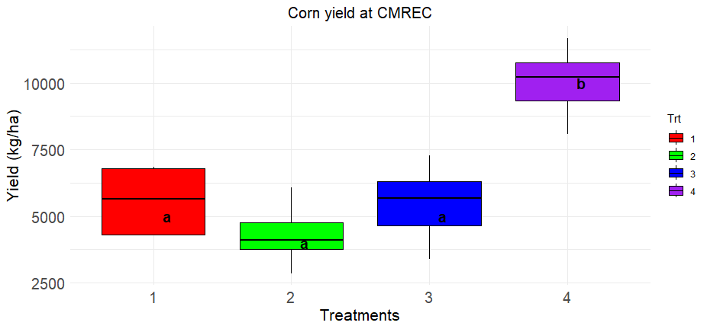
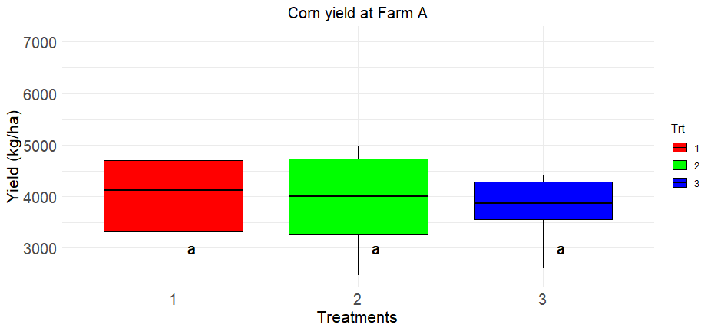
Results
Hand harvest corn yield vs Treatments at CMREC (Fall 2023)
Hand harvest corn yield vs Treatments at Farm A (Fall 2023)
Corn yield was significantly higher at trt4 (untilled-alfalfa-hay) compared to other treatments at CMREC
No significant difference between treatments
Notes:
The farm a was an experienced organic grain grower and that treatment one represented his normal practices. Levels of production in the neighborhood of four to 5,000 kg per hectare typical for organically produced corn the 10,000 kg per hectare that we achieved in treatment for at CMREC is an unusually good yield for organic corn and would even be an acceptable yield for non-organic corn production.

Slide 15
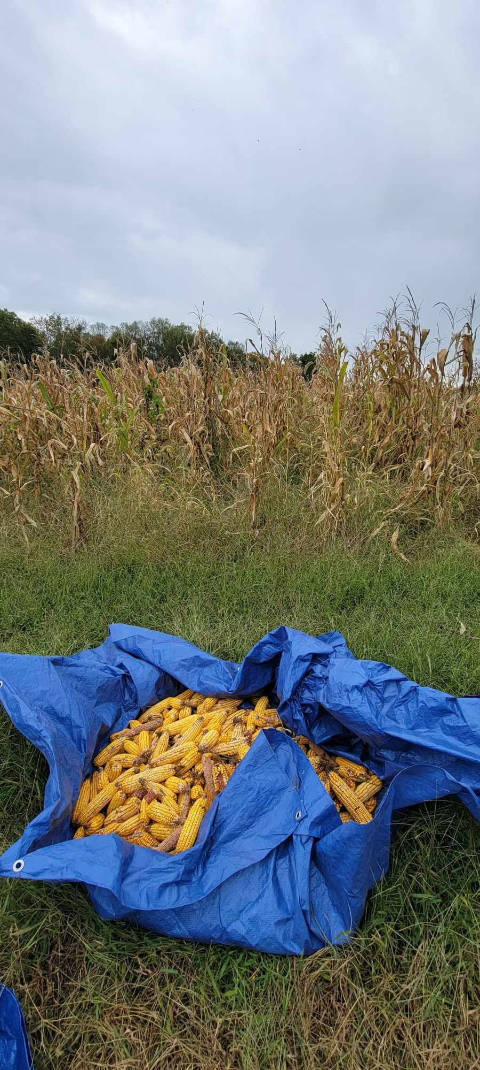
Results
Decision tree: Corn yield vs Soil Variables
Mean yield = 5,385.34
SD = 2220.72
N=28
Mehlich III Potassium < 155 mg/kg
Mean yield = 5,385.34
SD = 2220.72
N = 23
Mean yield = 7870.58
SD = 2537.01
N = 5
POXC > 242.87 mg/kg
Mean yield = 3898.58 SD = 609.43
N = 12
Mean yield = 5,877.60 SD = 2079.64
N = 11
Aggregate stability <5.25
Mean yield = 4765.47 SD = 1,235.84
N = 5
Mean yield = 6804.38 SD = 2271.67
N = 6
Potassium (K) had the highest impact to the yield, followed by POXC and aggregate stability.

Slide 16
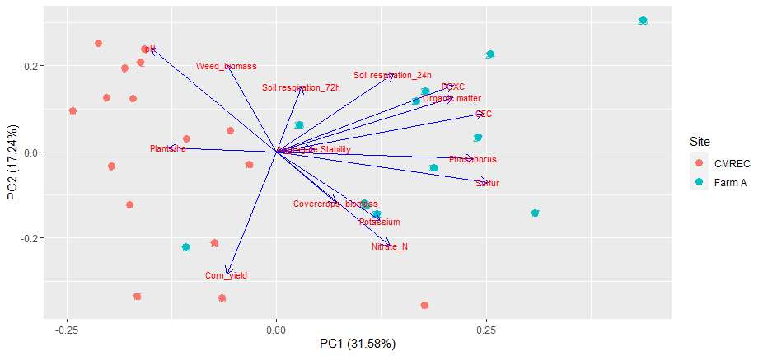
Results
PCA biplot showing crop and soil variables at CMREC and Farm A
Notes:
Red dots represent CMREC, Green dots represent Farm A, suggesting underlying difference between the farms since they are grouped differently. Soil fertility variables like POXC, soil organic matter, CEC, and P,S,K seem to be closely related and have strong loadings on the PC1. On the other hand corn yield was related to plant variables like weed biomass and plants per hectare about as much as it was to the soil fertility variables.
You can also see that the soil fertility variables potassium nitrate nitrogen sulfur and phosphorus were quite closely grouped and closely related to cover crop biomass. On the other hand corn yield was related to plant variables like weed biomass and plants per hectare about as much as it was to the soil fertility variables. You can also note that all of the soil organic matter related variables such as CEC soil organic matter poxc and soil respiration or clustered closely together.

Slide 17
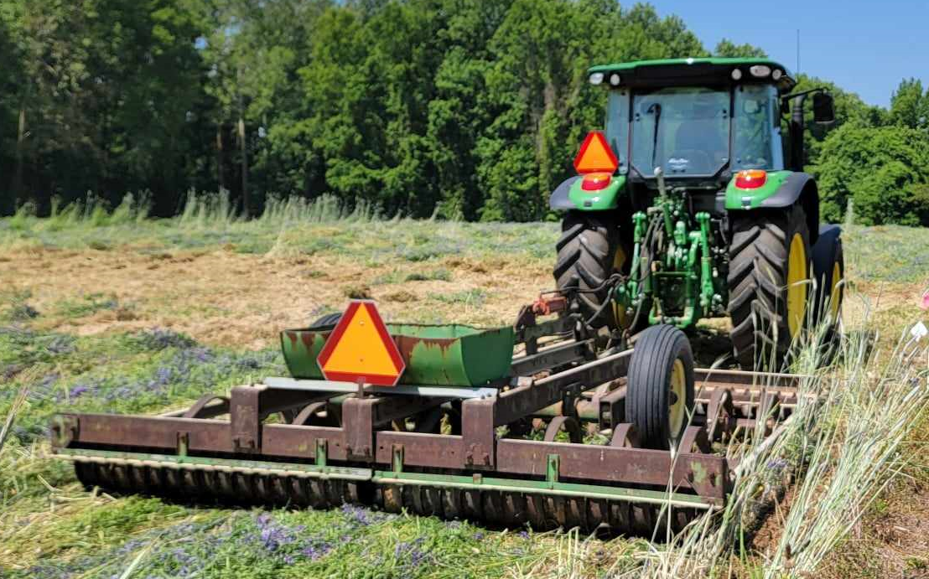
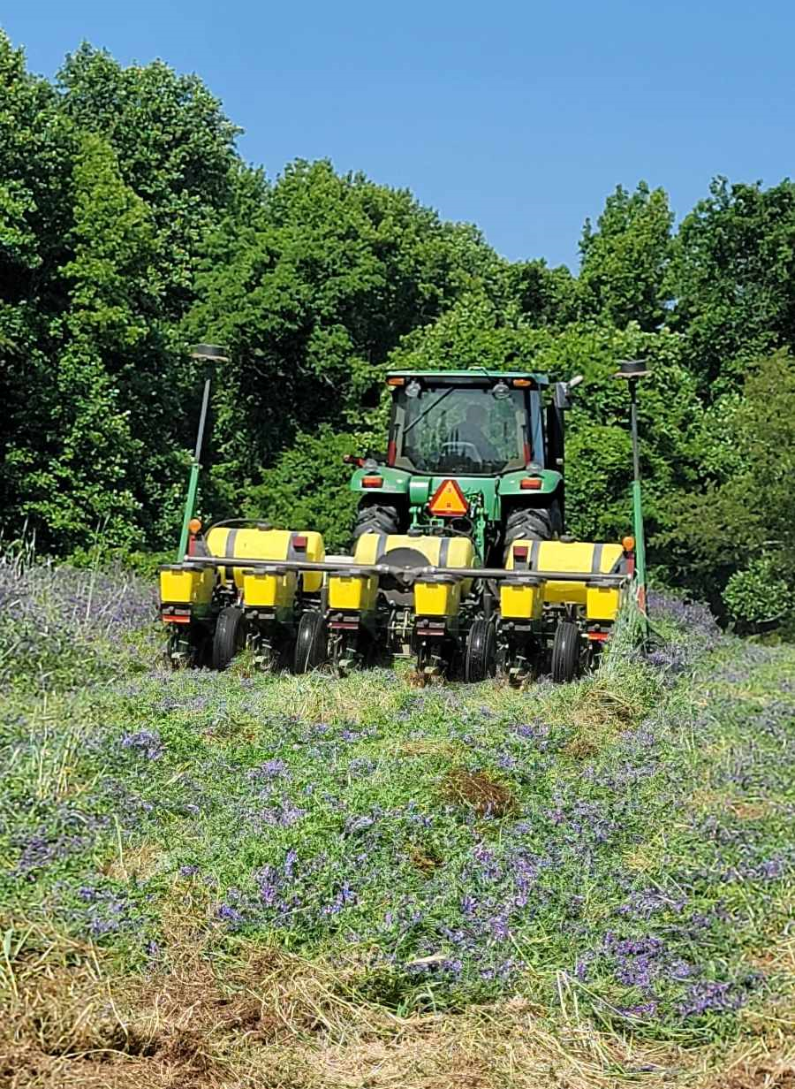
Conclusions/Lessons learned
Crop yield highest at the trt4, likely due to higher NO3-N contributed by the perennial alfalfa-hay stand during the transition and almost monoculture of legume (vetch) cover crop before planting corn
Reducing soil disturbance had positive impact on soil health metrics such as aggregate stability, respiration rate, and crop yield.
Potassium level, POXC, aggregate stability had impacts on the corn yield.
Planter down pressure, coulter, and press wheel adjustments critical to high crop yields, especially in organic grain with cover crops and without soil disturbance.
Notes:
Images of cultipacker is a very common piece of equipment on Maryland farms and not specialized for cover crops. In the past before no till it was used after tillage to smooth the soil. Below is planter.

Slide 18
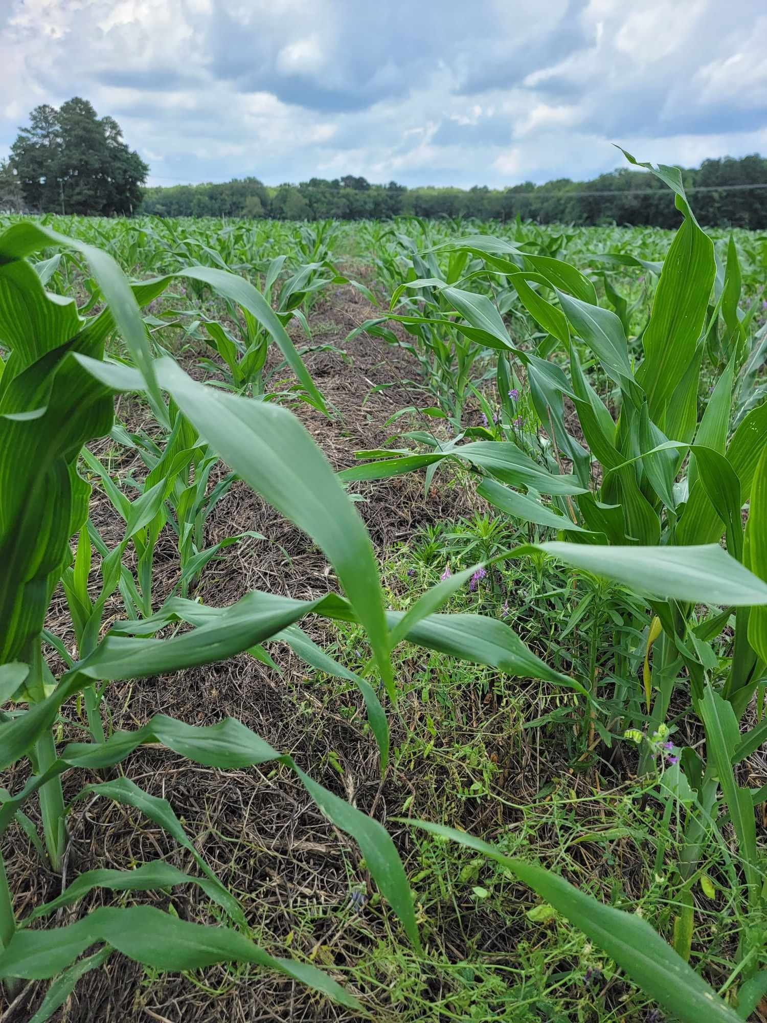
Future work
Soil biological properties, Soil Health Index
Farm profitability
Acknowledgement
USDA/NIFA Award 301326-00001
NESARE Award GNE2125535383
Soil quality lab team, ENST, University of Maryland-College Park
Future Harvest: Chesapeake Alliance for Sustainable Agriculture
UMD extension, collaborating research stations and farmers
☺ Thank You! ☺
www.enst.umd.edu

