Slide 1
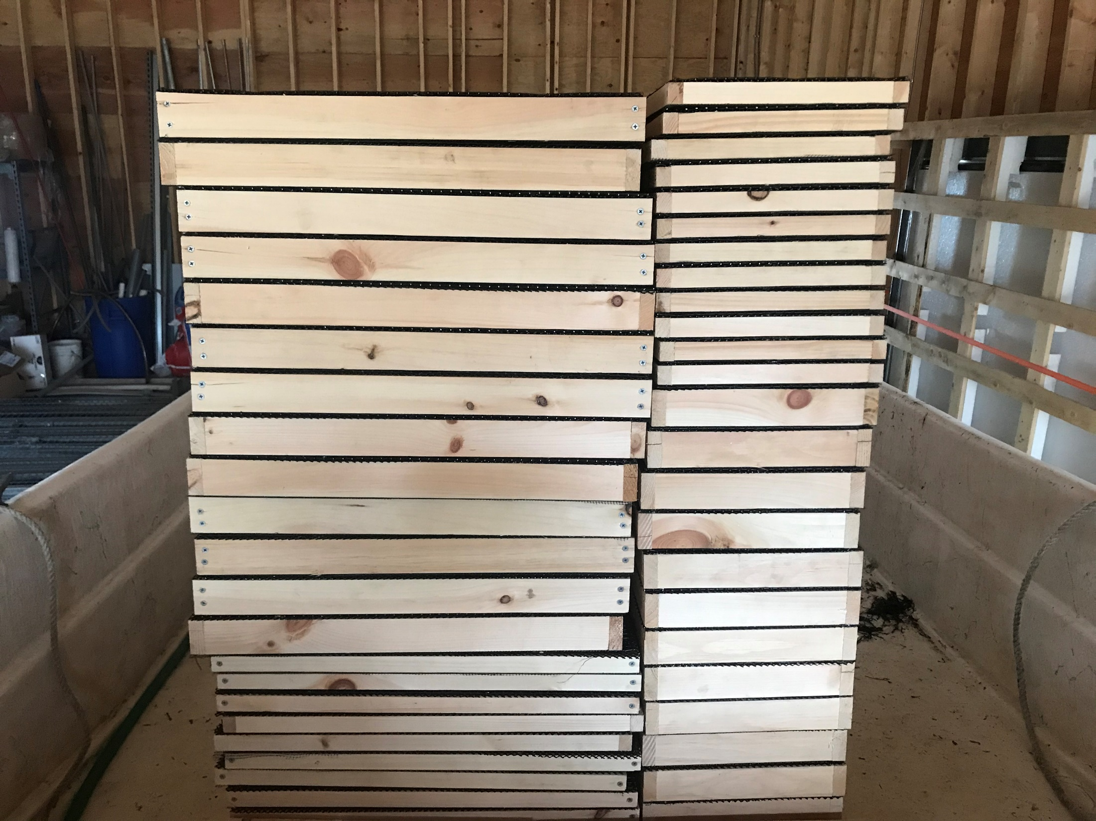
1-inch thick tops for
1-ft x 2-ft boxes
2-inch thick tops for 2-ft x 2-ft boxes
2-inch thick tops for
1-ft x 2-ft boxes
1-inch thick tops for 1-ft x 2-ft boxes

Slide 2
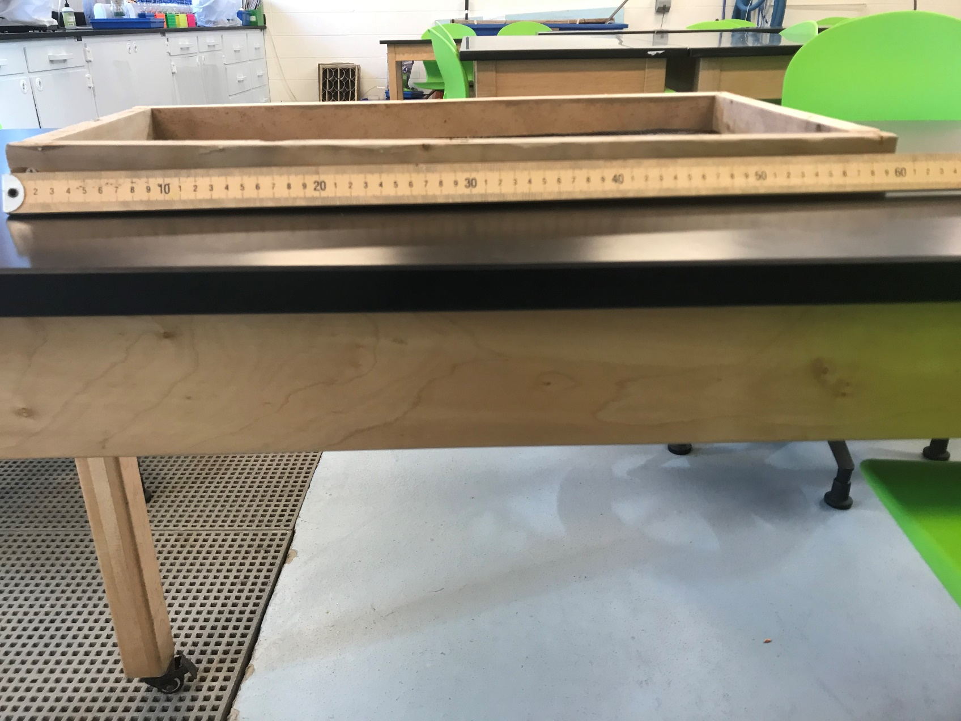
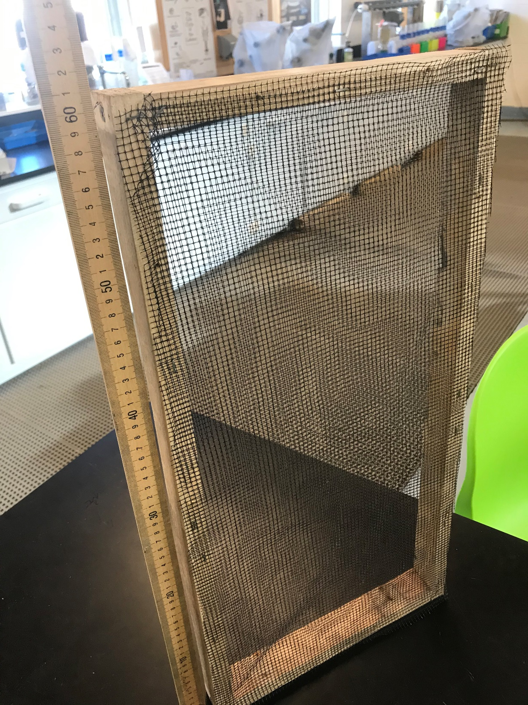
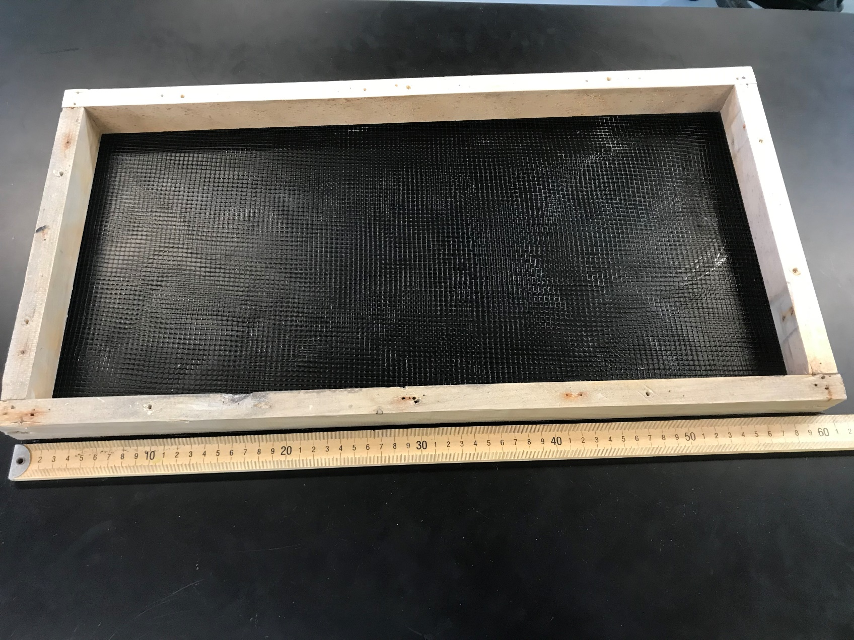
4.2 mm flexible netting

Slide 3
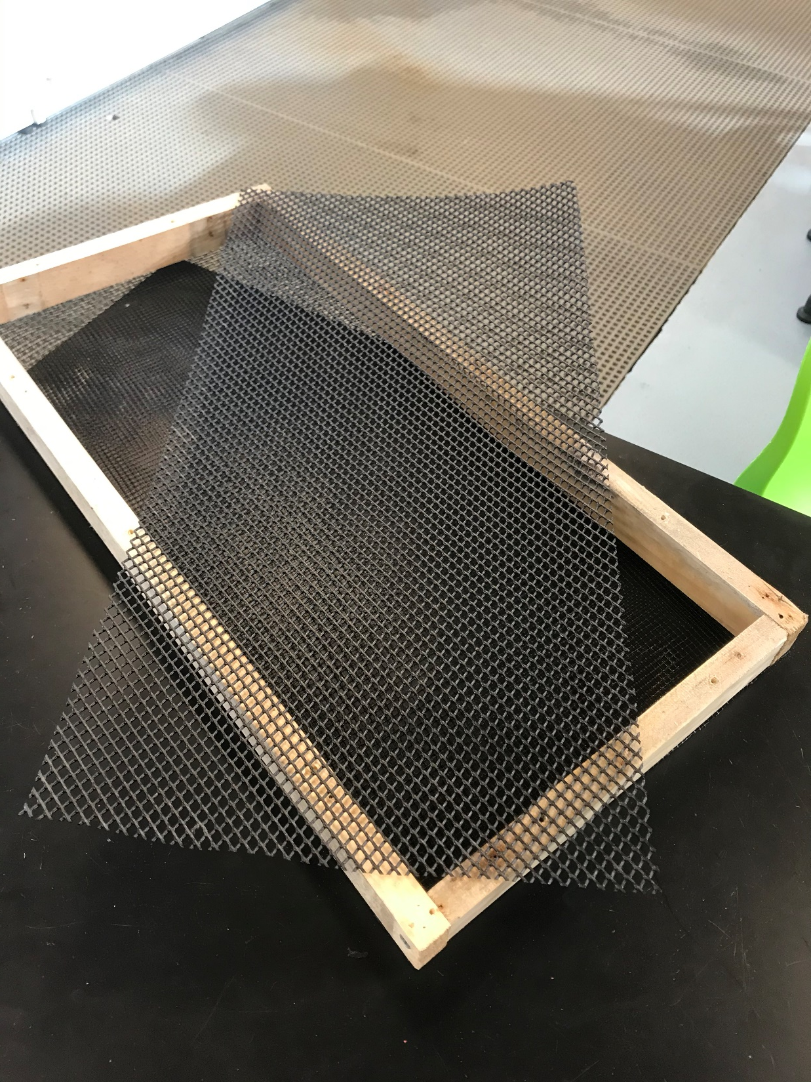
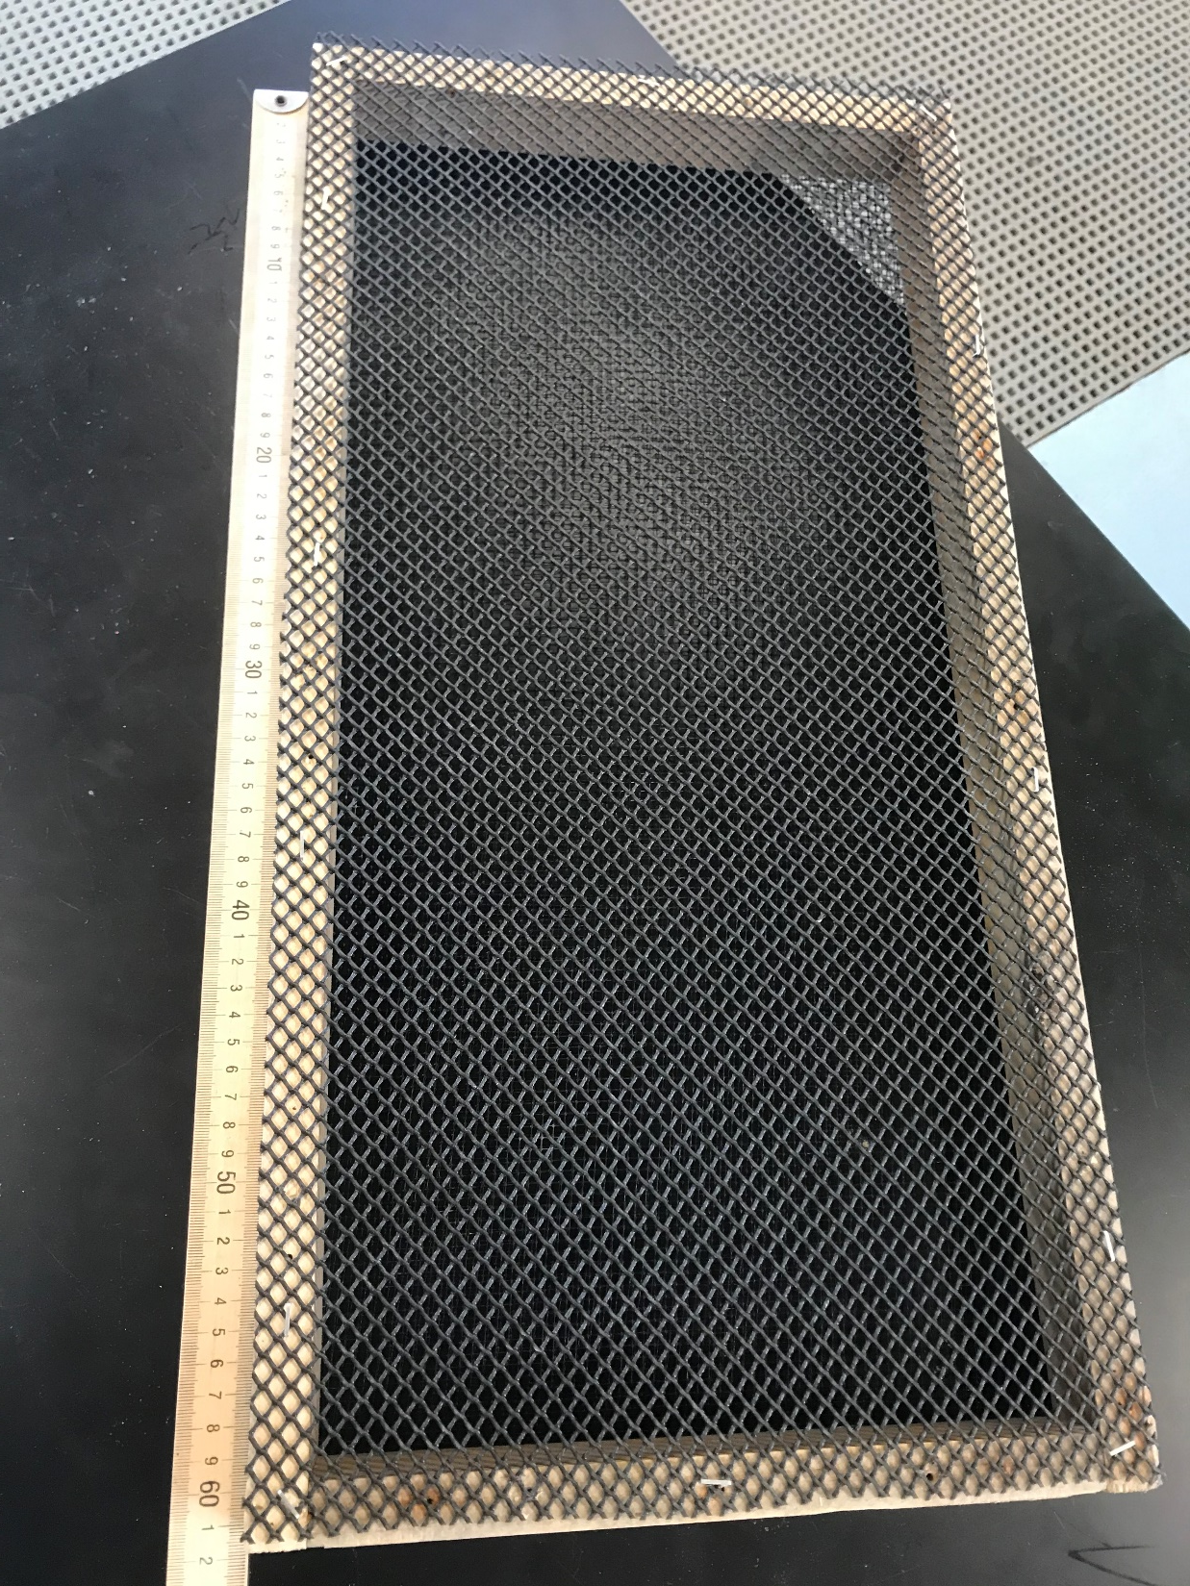
6.4 mm VEXAR

Slide 4
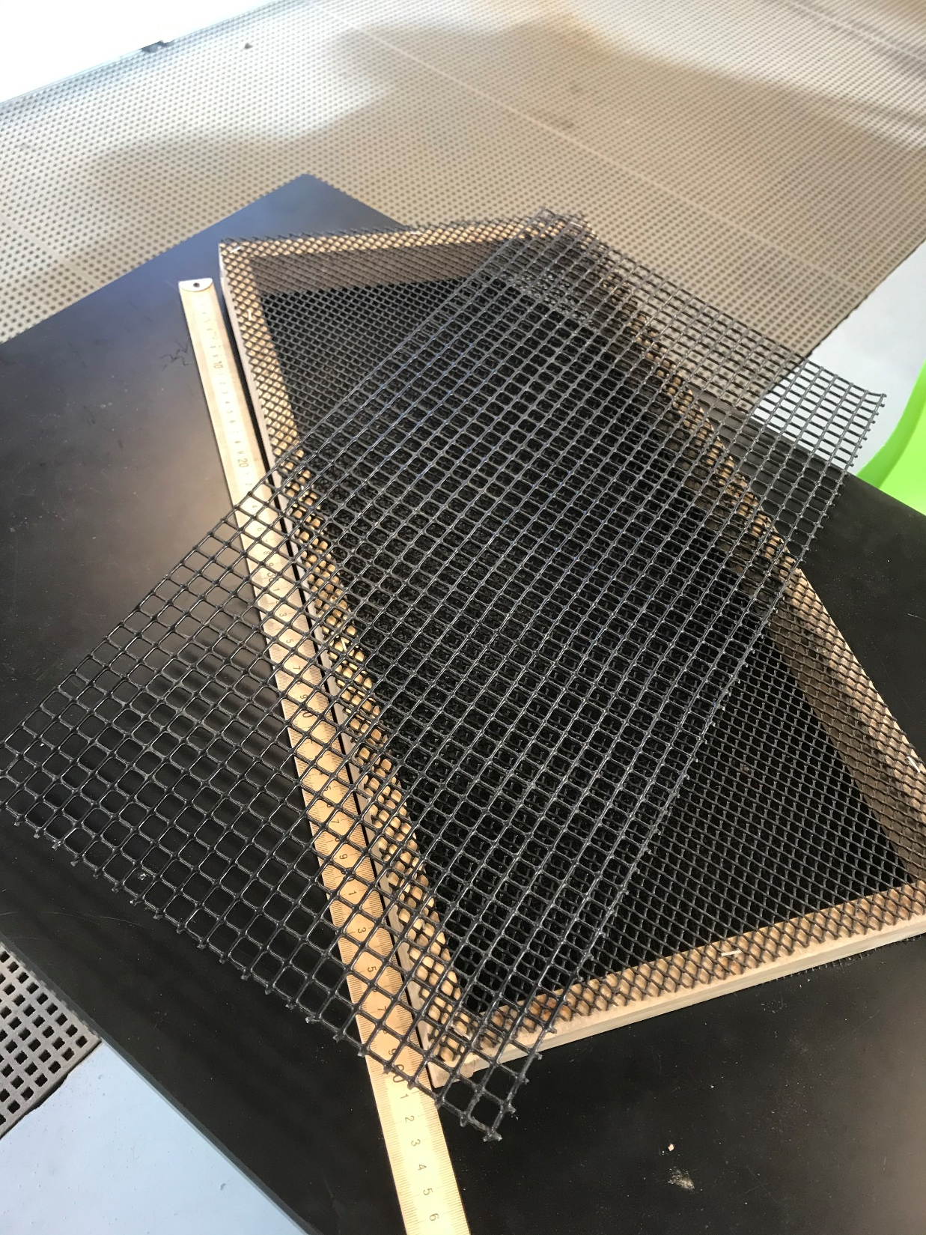
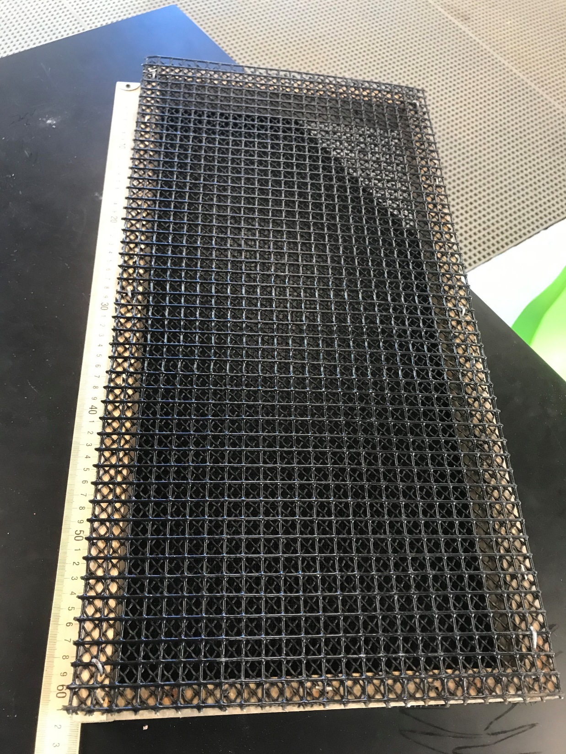
12.7 mm Vinyl-coated trap wire

Slide 5
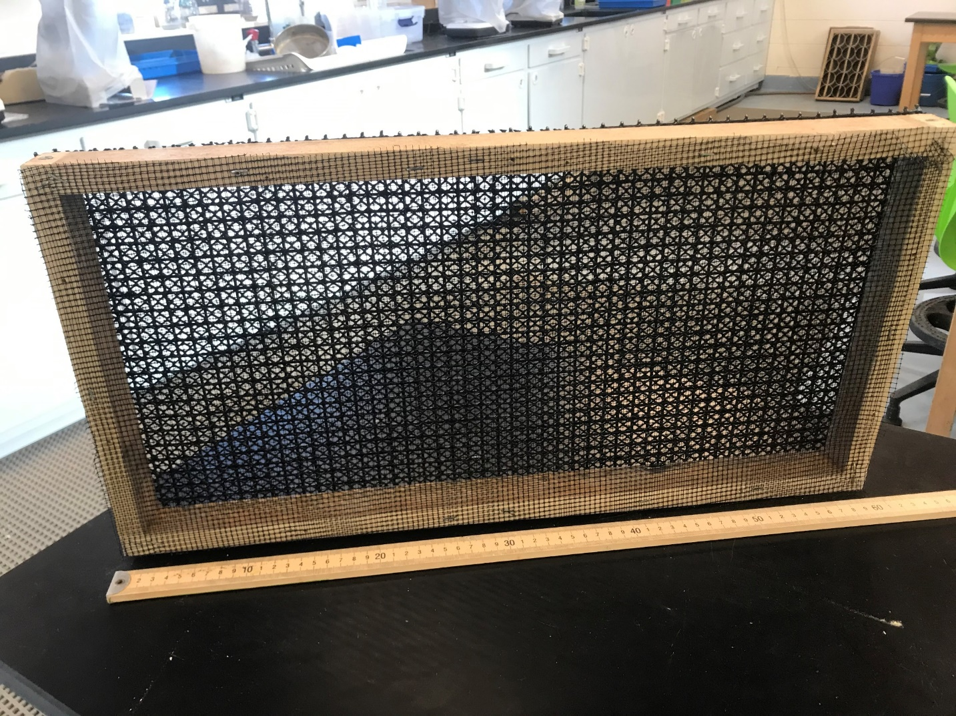
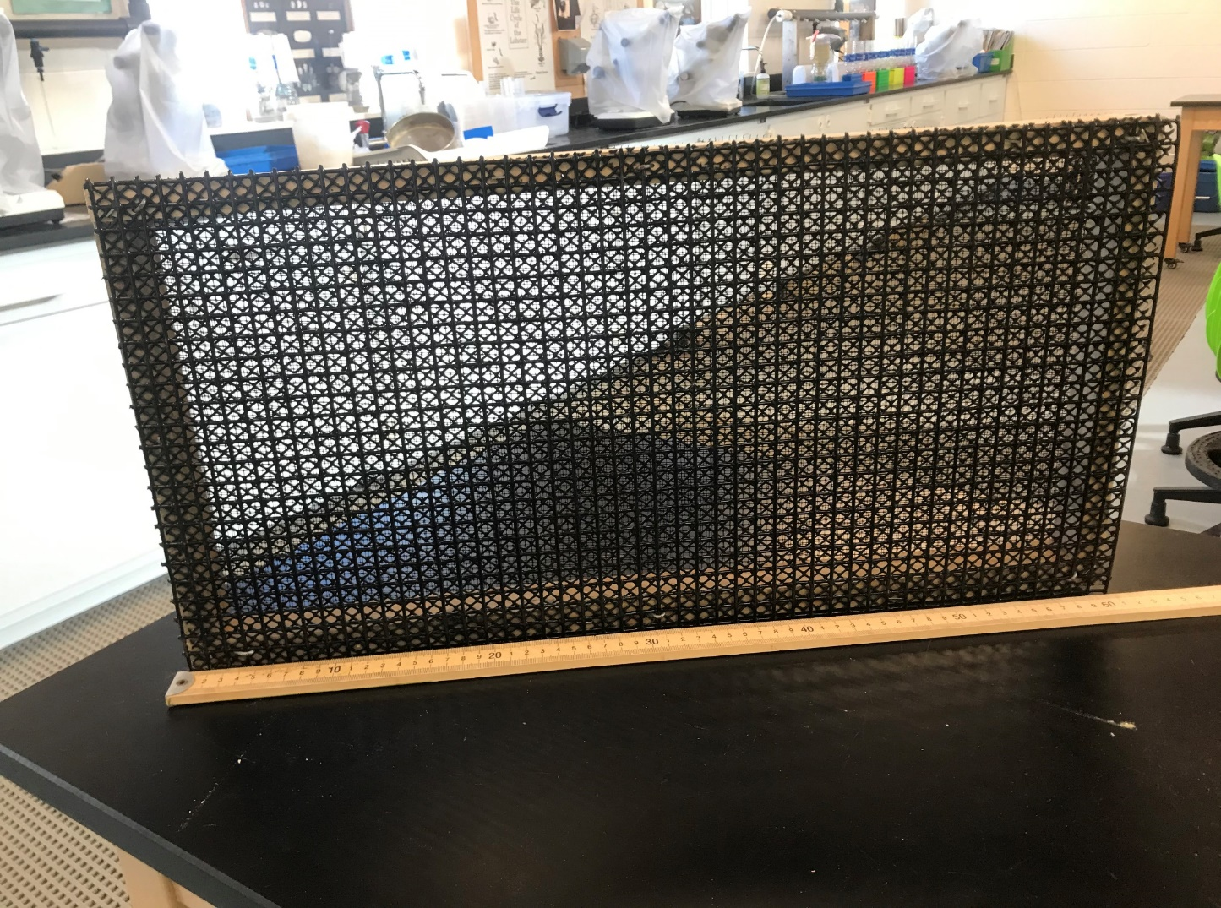
Bottom View
Top View

Slide 6
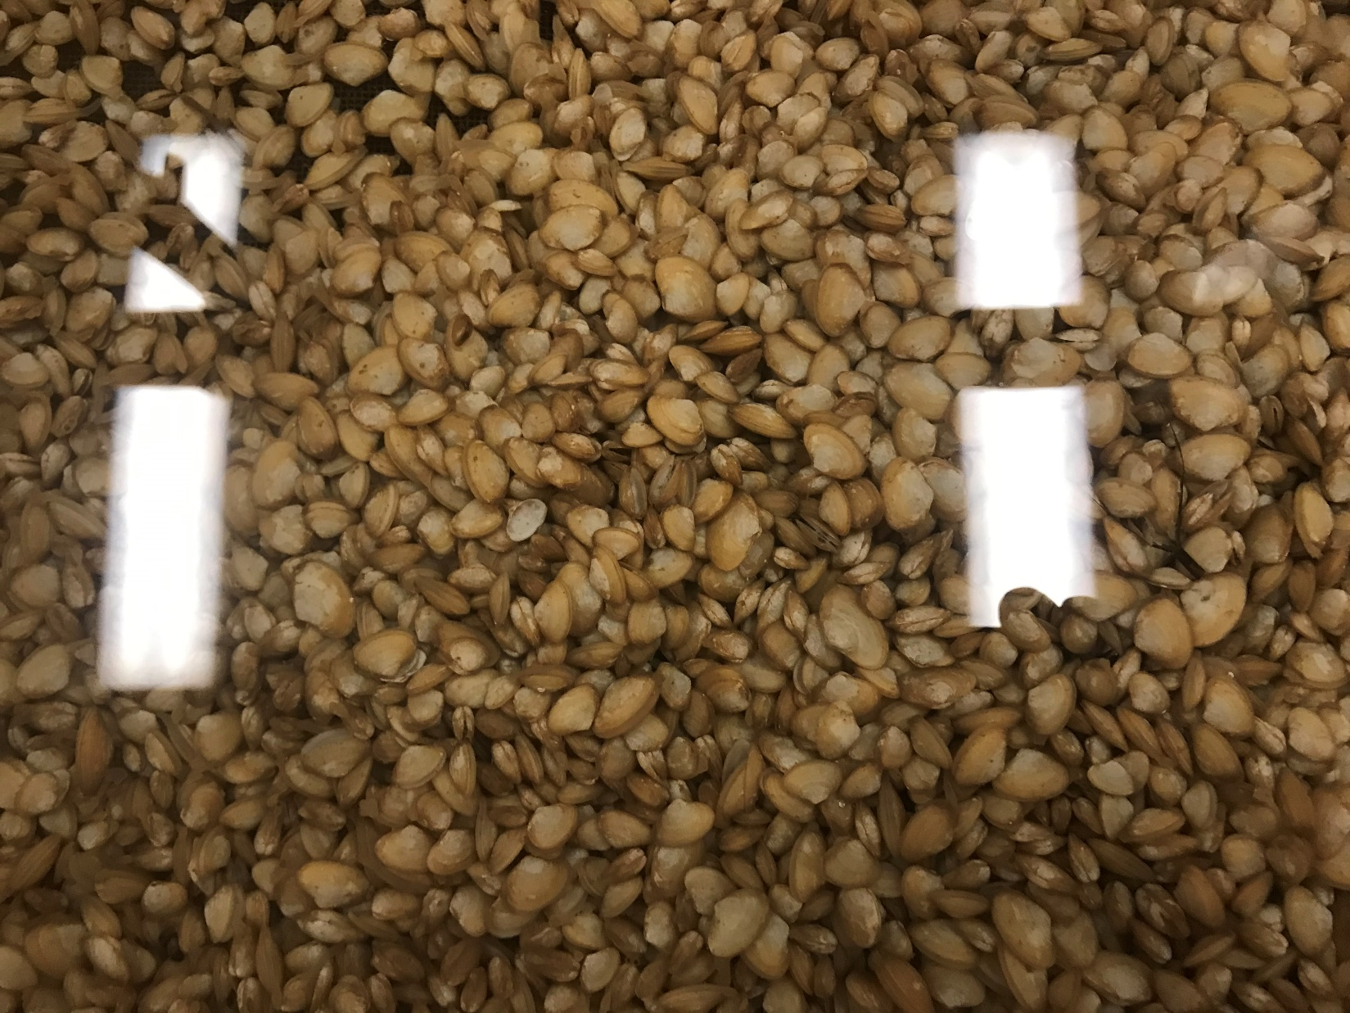

Slide 7
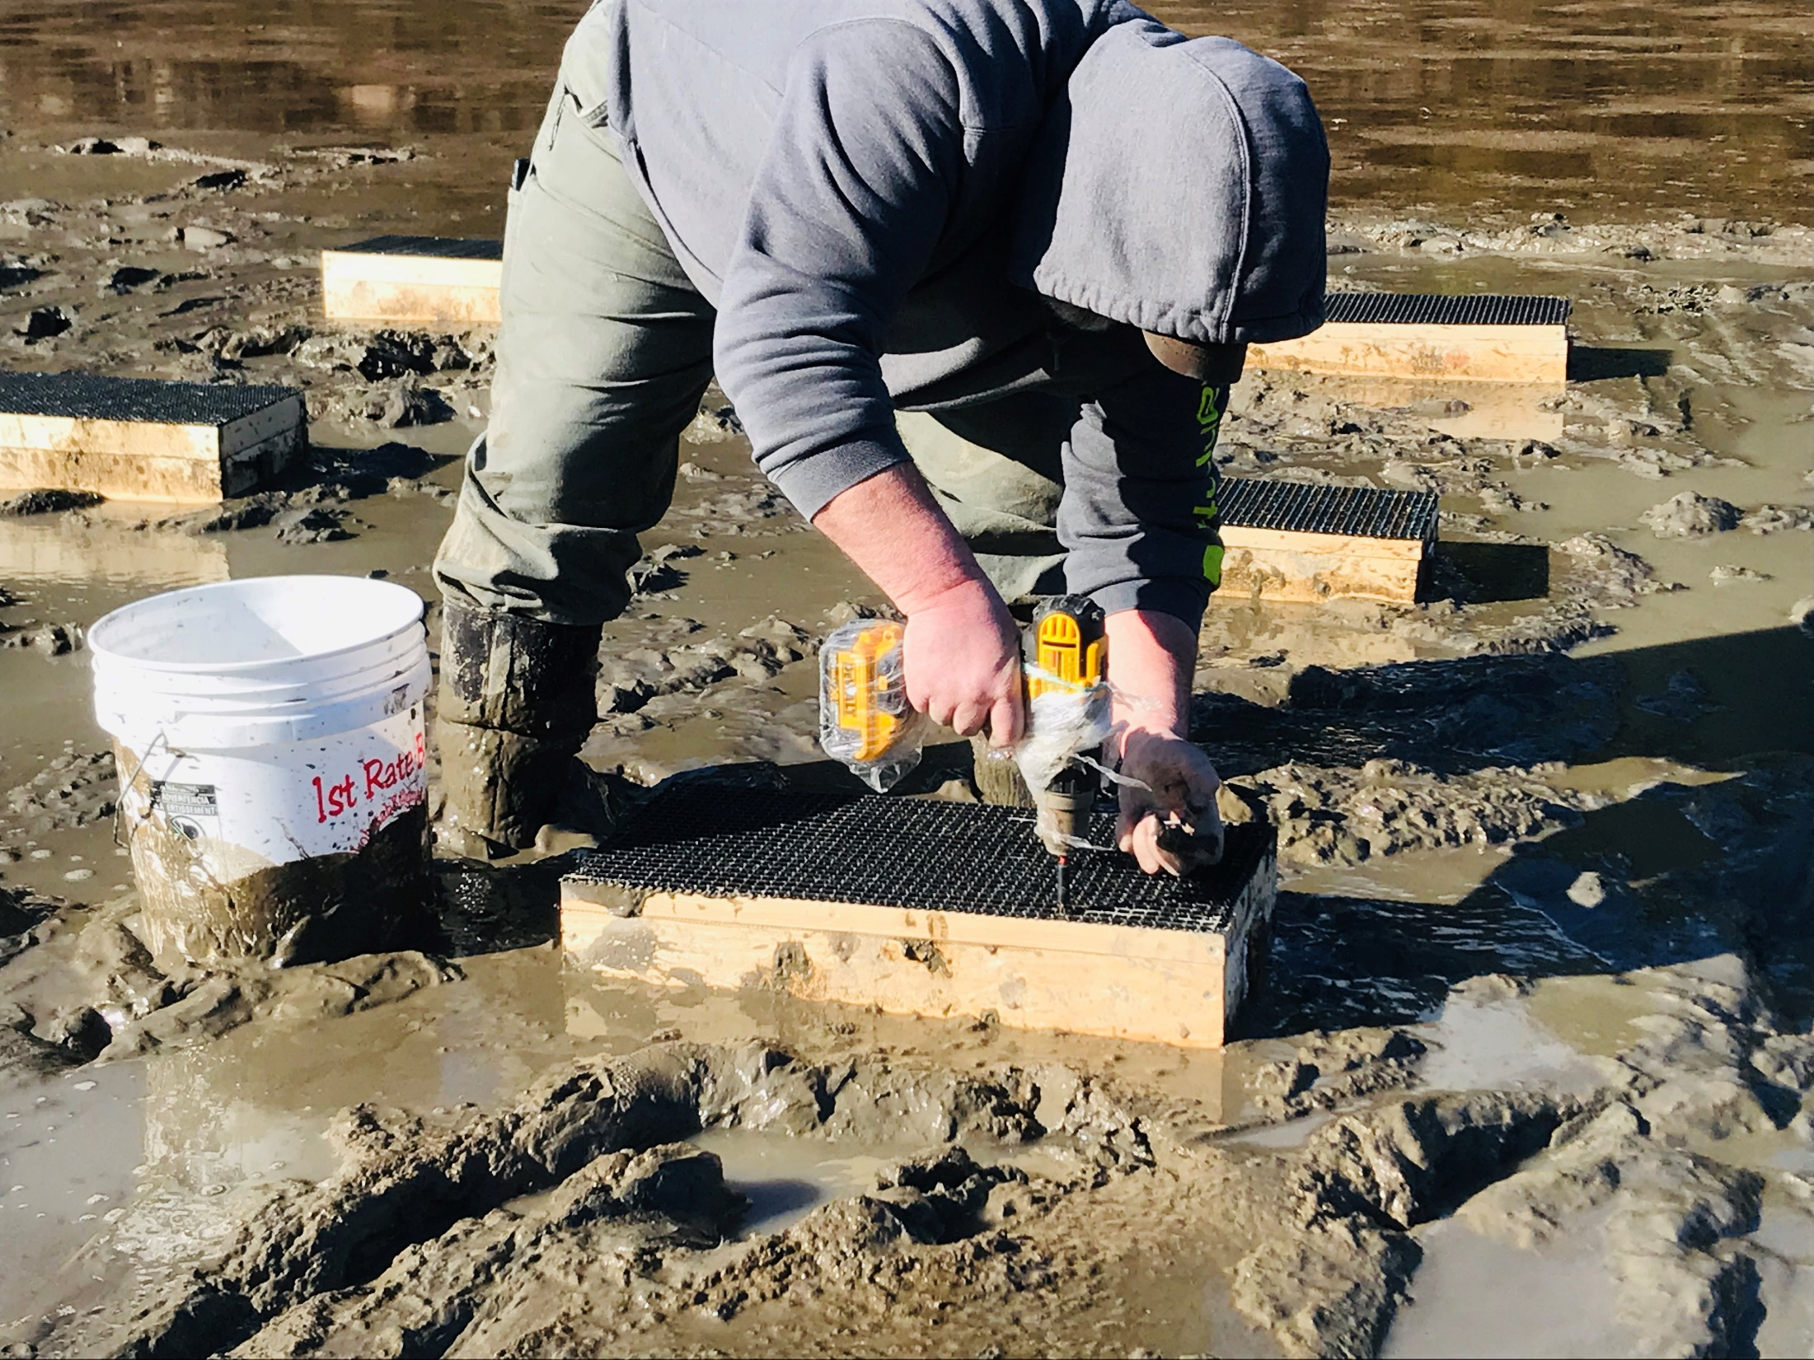

Slide 8
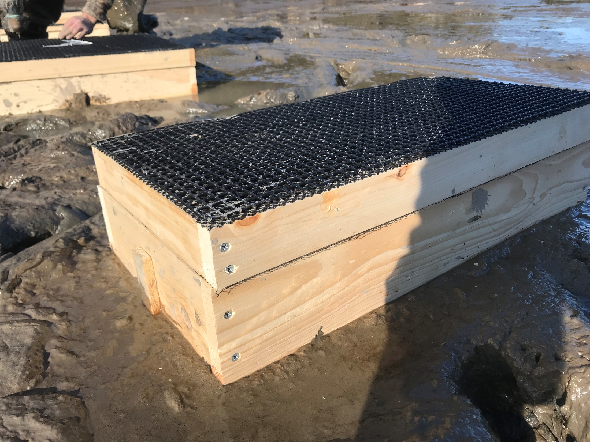
2-inch top
2ft² box

Slide 9
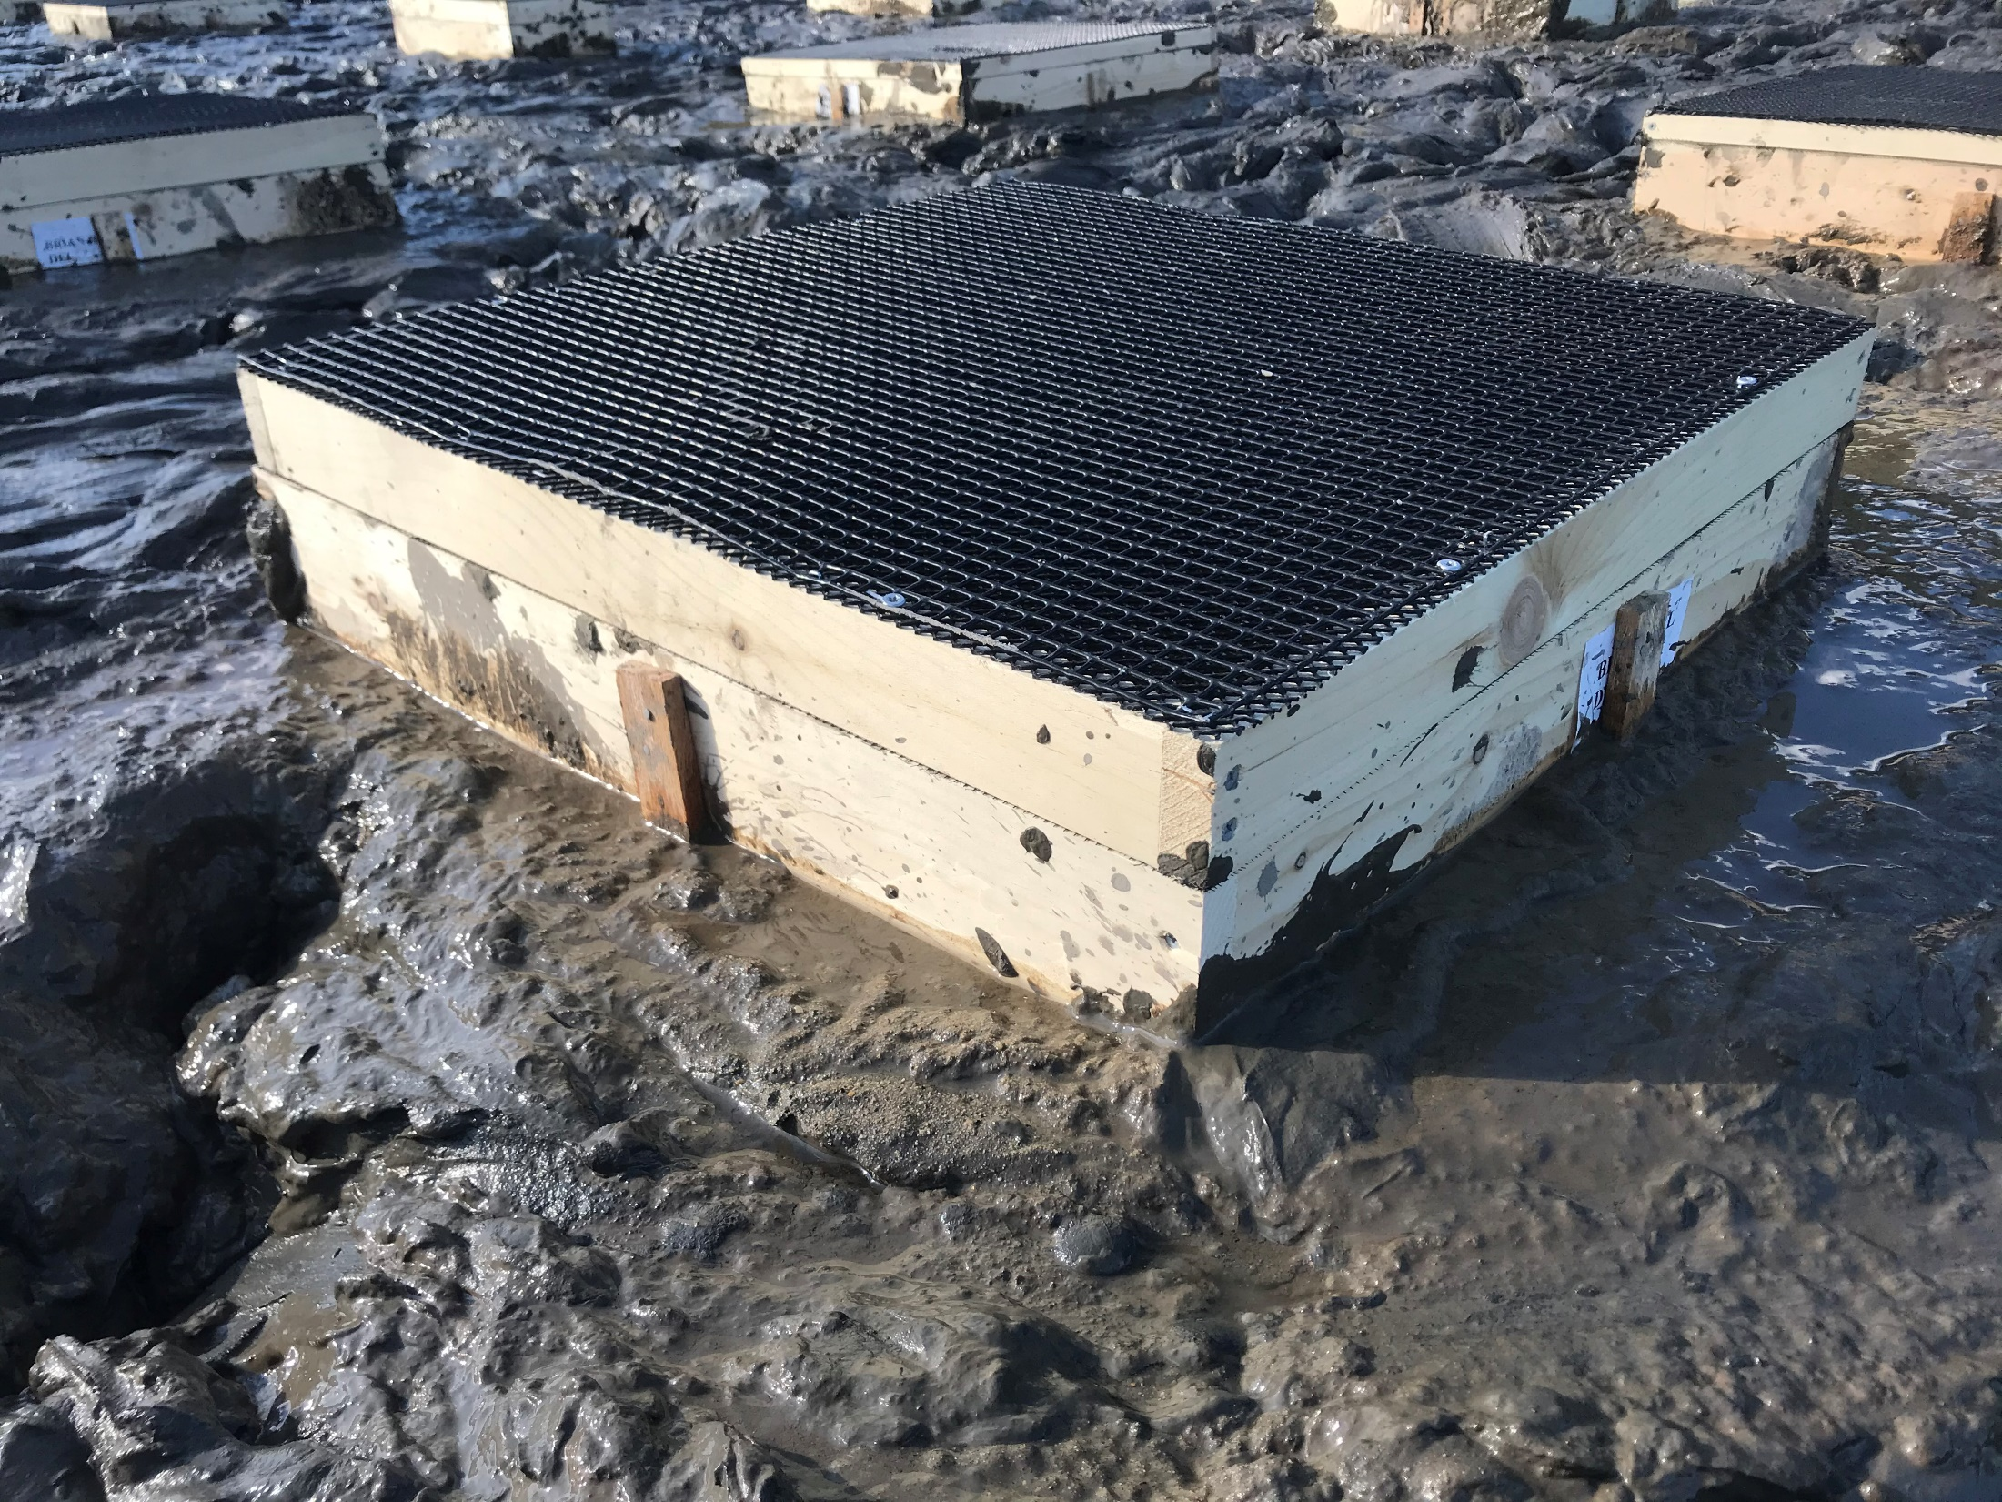
2-inch top
4ft² box

Slide 10
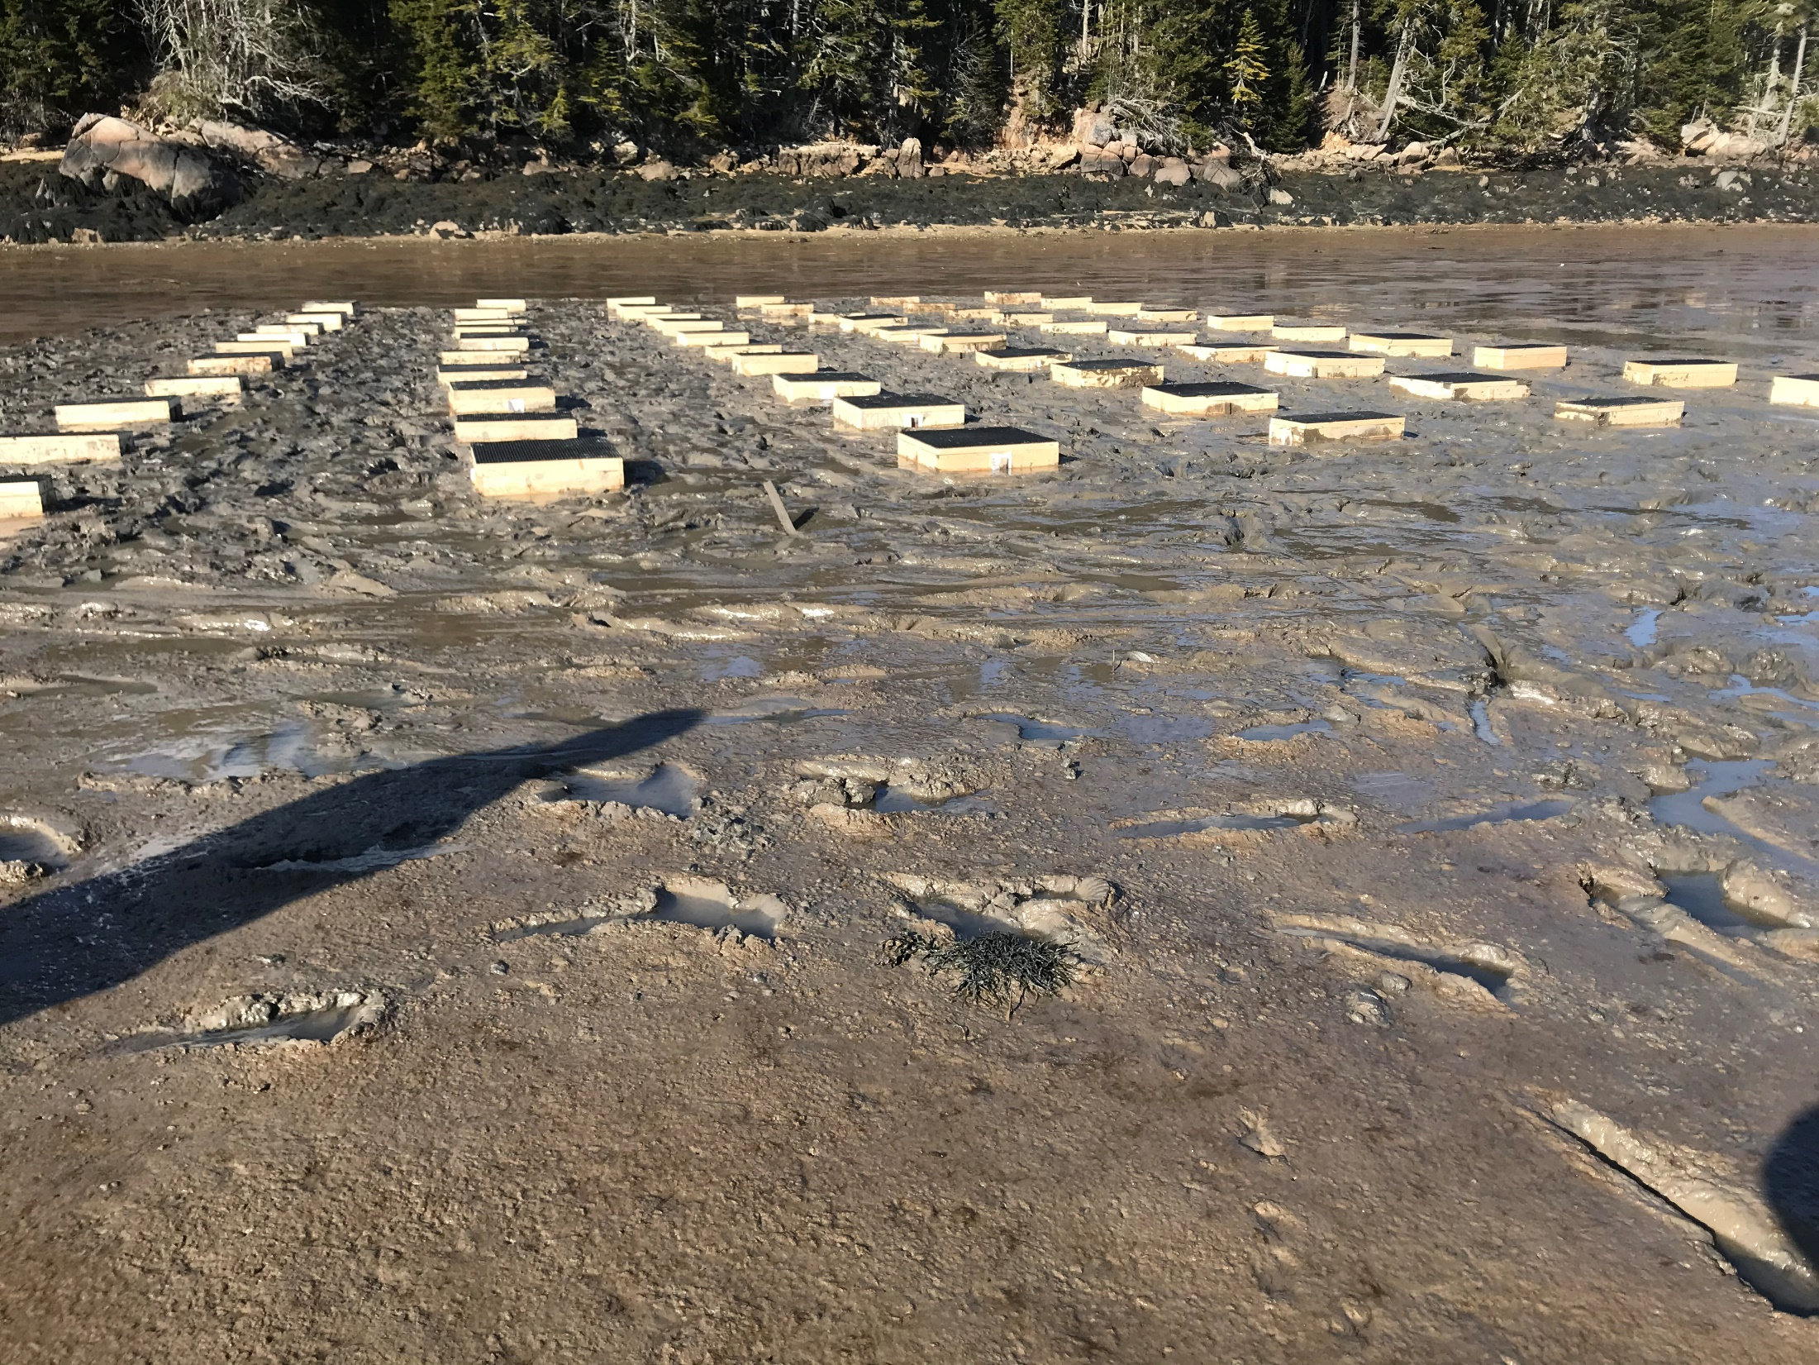
April 2, 2021

Slide 11
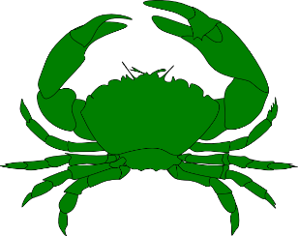
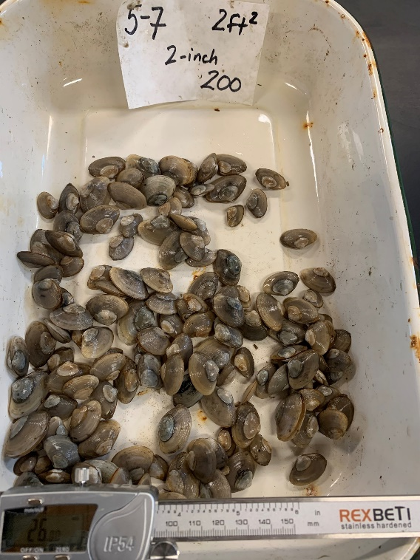
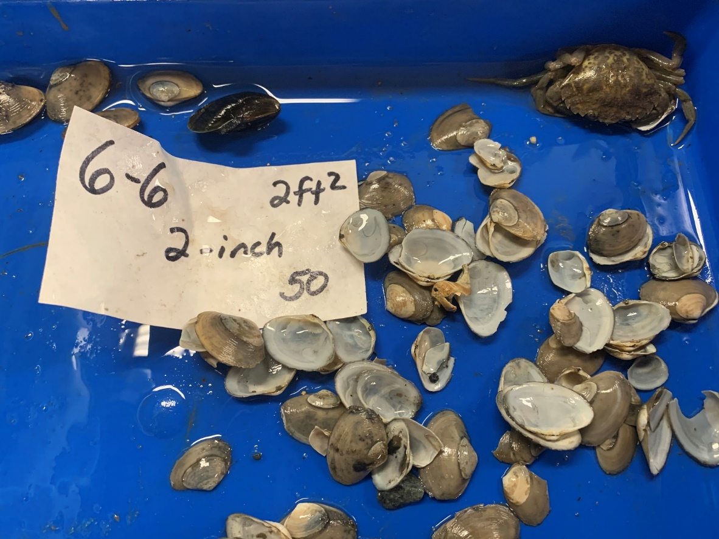
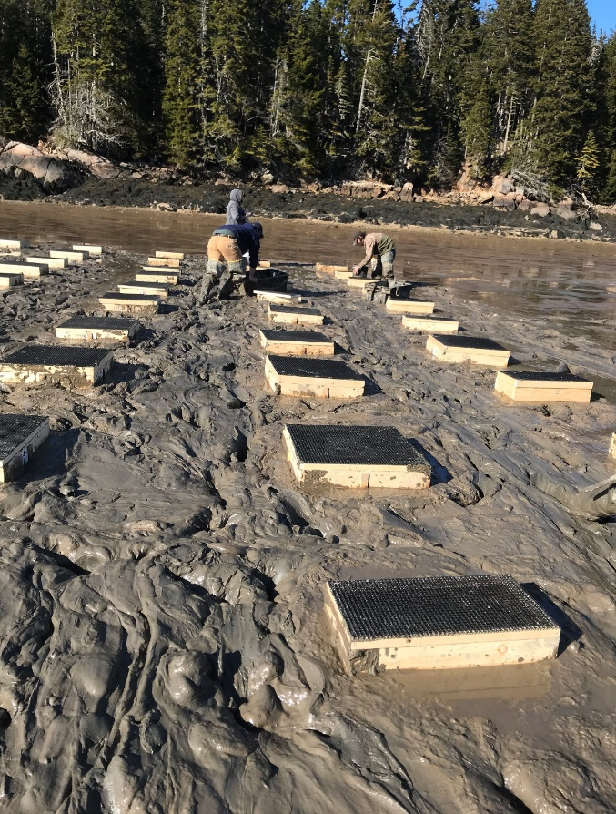
2 April to 3 December 2021
Beals
n = 20
P = 0.259
50%
N = 47
44%
33%
25
50
100
Beals
n = 30
P = 0.003
Beals
n = 30
P < 0.025
56%
57%
29%
28%

Slide 12
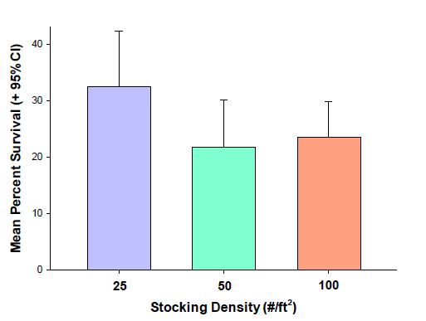
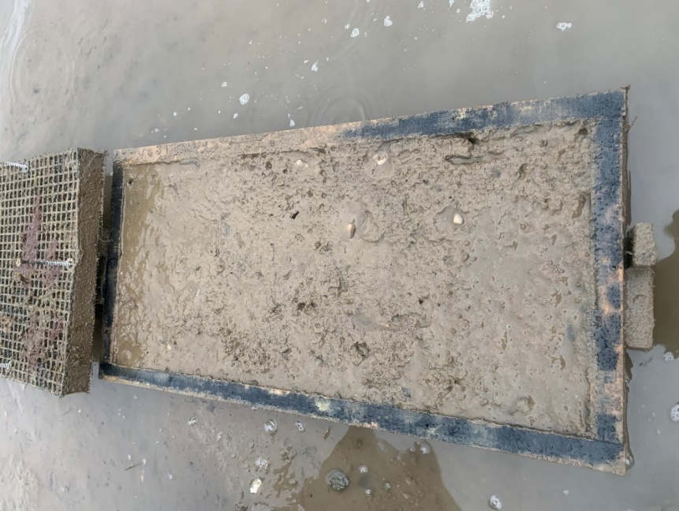
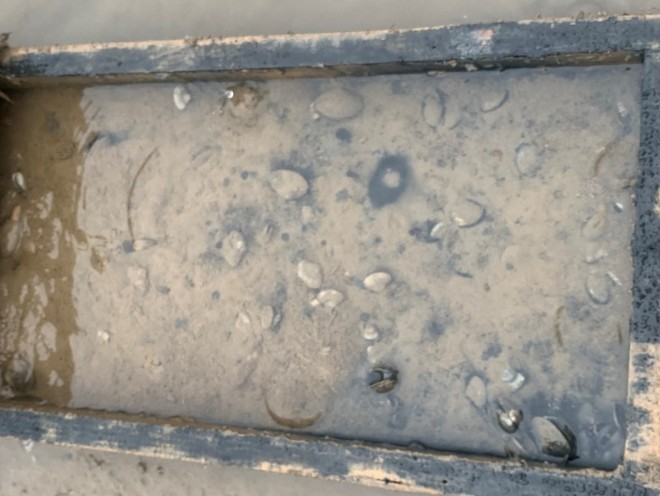
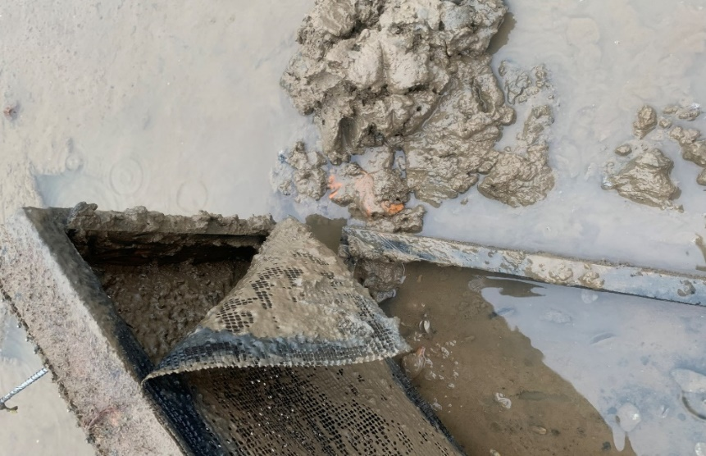
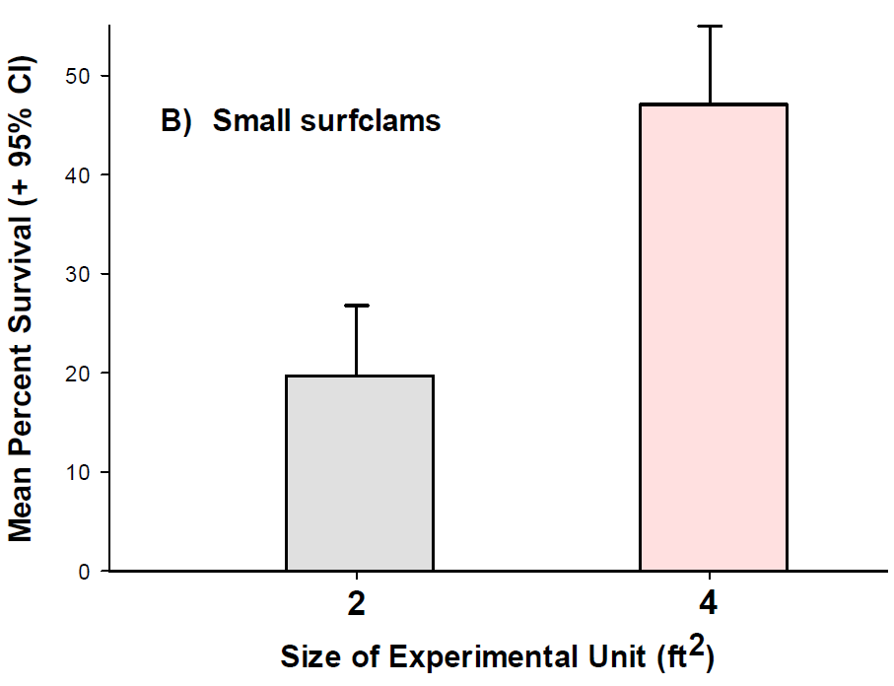
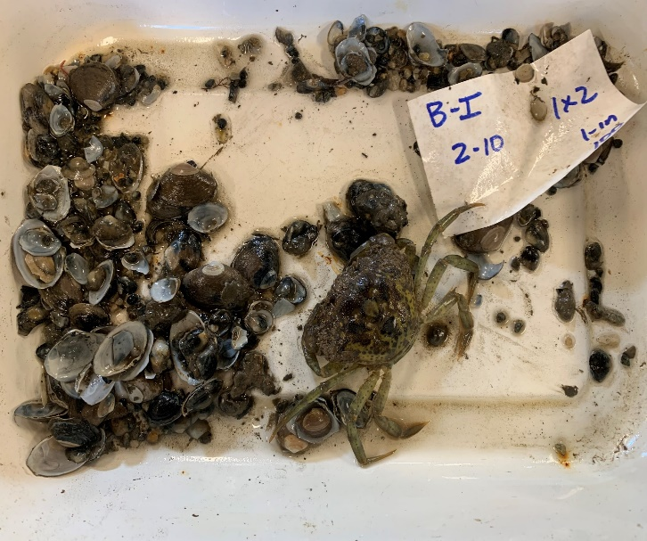
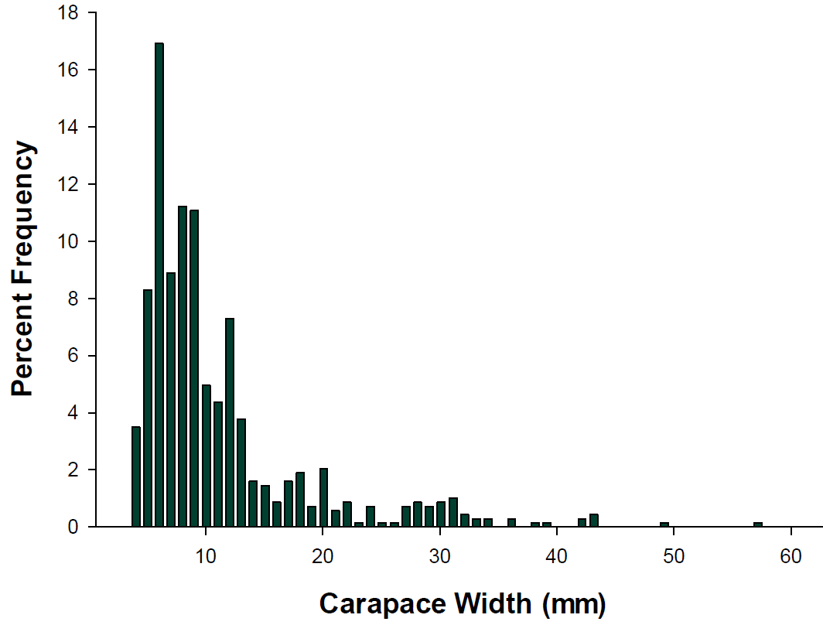
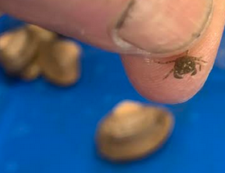
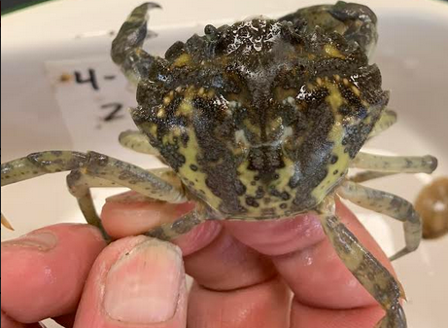
27 March to 1 December 2021
Gouldsboro
n = 20
P = 0.052
33%
24%
22%
Gouldsboro
n = 30
P < 0.001
48%
N = 686
3x more in LG v SM boxes (P < 0.01)
20%

Slide 13
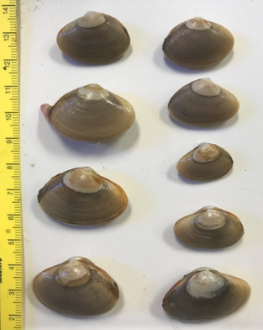
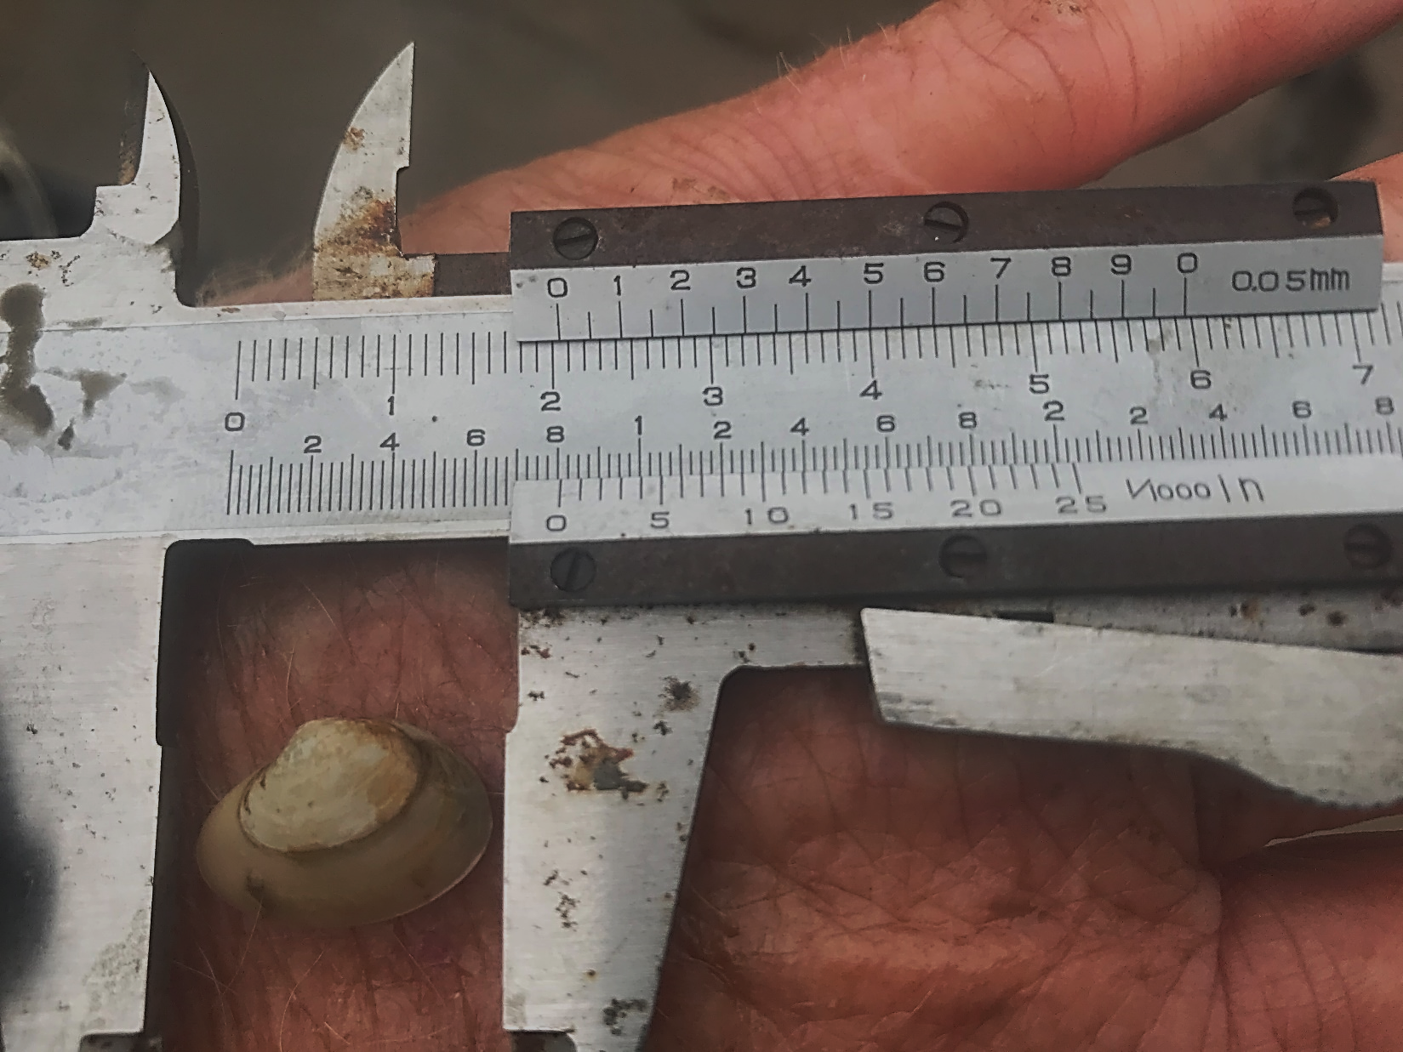
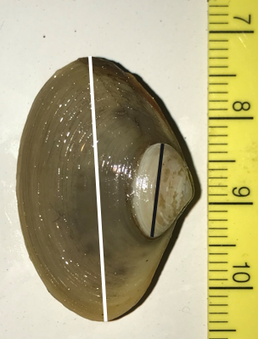

Slide 14
Beals
G = 27.7
df = 10
P = 0.002
G = 52.9
df = 10
P < 0.001
$$\overline{x}$$
$$\overline{x}$$
= 23.4 ± 0.9 mm
= 14.0 ± 0.4 mm
$$\overline{x}$$
= 10.1 ± 0.8 mm
$$\overline{x}$$
= 22.3 ± 0.9 mm
$$\overline{x}$$
= 7.8 ± 0.8 mm
$$\overline{x}$$
= 22.1 ± 0.5 mm
$$\overline{x}$$
= 20.9 ± 0.6 mm
$$\overline{x}$$
= 6.7 ± 0.6 mm

Slide 15
Gouldsboro
G = 27.7
df = 10
P = 0.002
G = 36.6
df = 10
P < 0.001
$$\overline{x}$$
$$\overline{x}$$
= 8.7 ± 0.3 mm
= 12.9 ± 0.2 mm
$$\overline{x}$$
= 21.9 ± 0.5 mm
$$\overline{x}$$
$$\overline{x}$$
= 8.5 ± 0.4 mm
= 20.9 ± 0.4 mm
$$\overline{x}$$
= 21.0 ± 0.2 mm
$$\overline{x}$$
= 20.4 ± 0.4 mm
$$\overline{x}$$
= 7.6 ± 0.3 mm

Slide 16
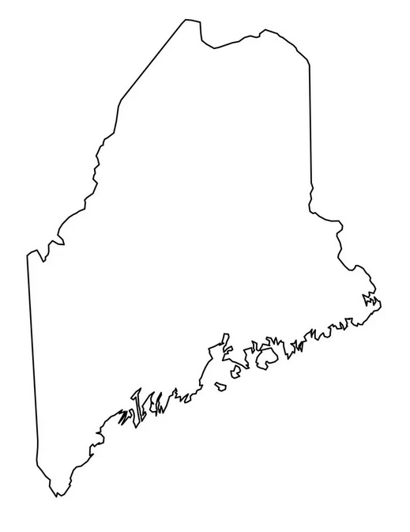
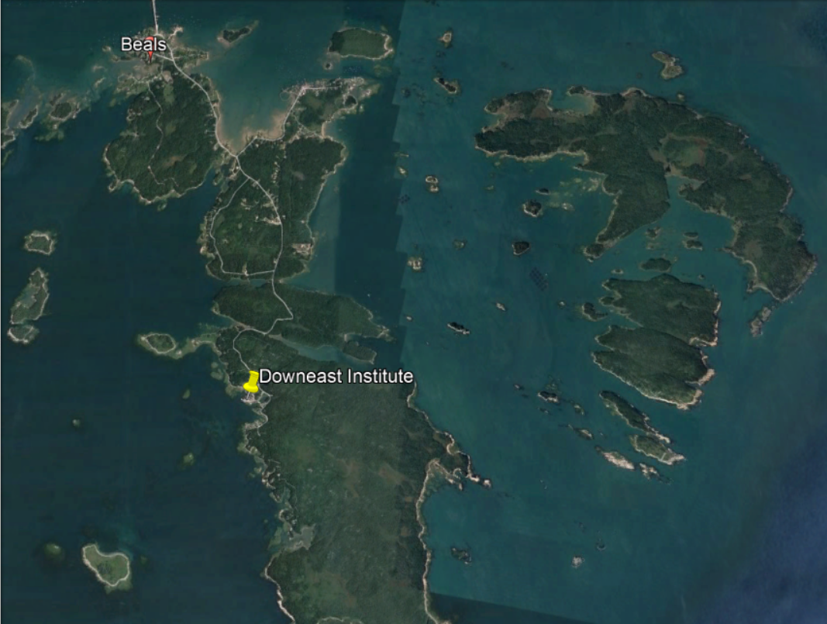
BEALS
16-17 June 2022
20 January 2023
3 Aug 2023
Mud Hole Cove

Slide 17
Three factors (n = 5)
A = Density (7.5 - 90/ft²)
B = Box Size (2 ft² vs. 4 ft²)
C = Clam Size (SM vs. LG)

Slide 18
CLAM DENSITY (#/ft²)
SMALL Clams LARGE Clams
9.6 ± 0.4 mm
4 ft²
30
45
60
7.5
30
50
Density is unique (nested within) to a given Box Size
12.9 ± 0.4 mm
30
60
90
30
50
80
2 ft²

Slide 19
Aug 8, 2022
18.8ºC
Jul 26, 2023
18.1ºC
Aug 7, 2022
15.6ºC
Jul 30, 2023
14.4ºC
Feb 4, 2023
-1.68ºC
Feb 4, 2023
-0.01ºC

Slide 20
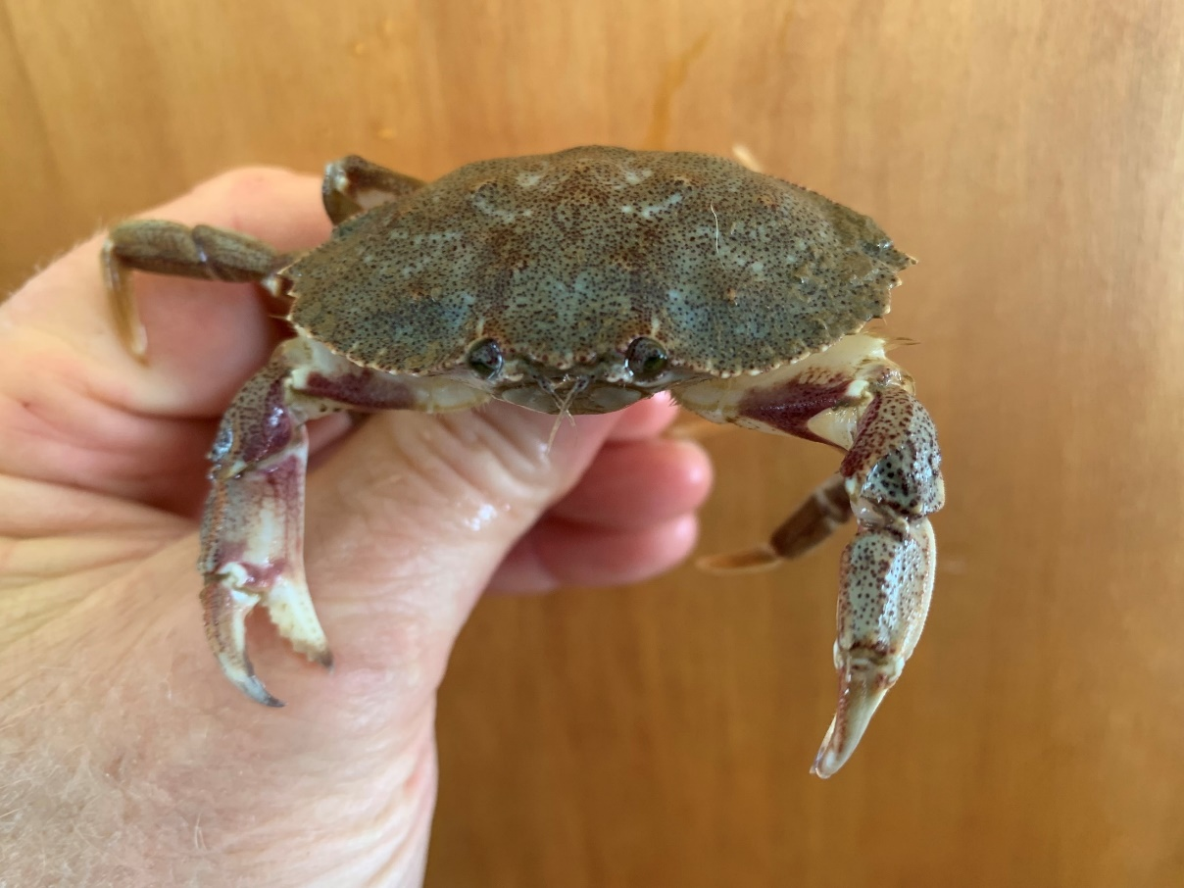
First Sampling (Beals – 16 June 2022 to 20 January 2023)
Rock crabs occurred in 3 of 60 (5%) boxes
45.7 mm
46.5 mm
11.0 mm
Green crabs occurred
in 6 of 60 (10%) boxes
Live surfclams were found in all 60 boxes (n = 2 for growth rate analysis)

Slide 21
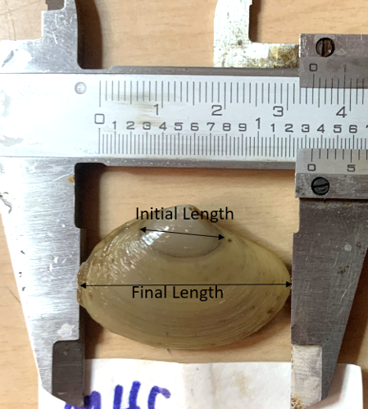
P = 0.03
16-17 June 2022
16-17 June 2022
9.6 ± 0.4 mm
12.9 ± 0.4 mm
20 January 2023
20 January 2023
28.7 ± 1.2 mm
30.4 ± 1.1 mm
Growth rates of both sizes of
surfclams were ~ 35%
greater at Beals vs. Gouldsboro

Slide 22
Second Sampling (Beals – 18 June 2022 to 3 August 2023)
S
S
SMALL BOXES (2 ft²)
LARGE BOXES (4 ft²)
4.8 ± 1.4
n = 30
8.8 ± 2.4
n = 30
52.1 ± 10.9%
29.3 ± 11.7%
Live clams occurred in 44 of 60 (73.3%) boxes

Slide 23
3 August 2023
Size-frequency distributions are
not significantly different
G = 6.25 df = 4 P = 0.18
Box Size = 2 ft²
Mean CW are
not significantly different
F = 1.54 df = 1, 45 P = 0.22
Box Size = 4 ft²

Slide 24
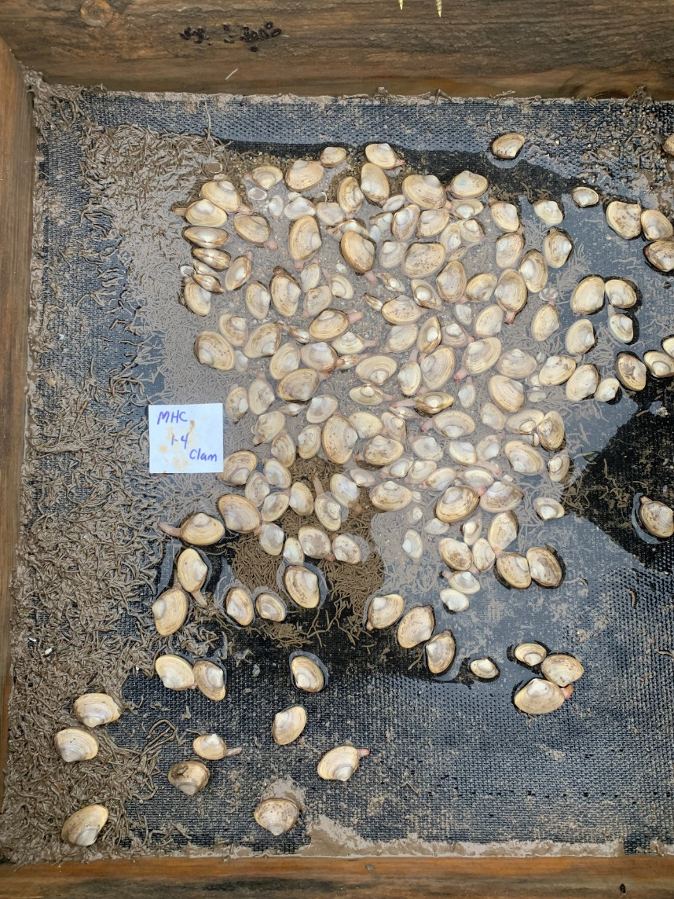
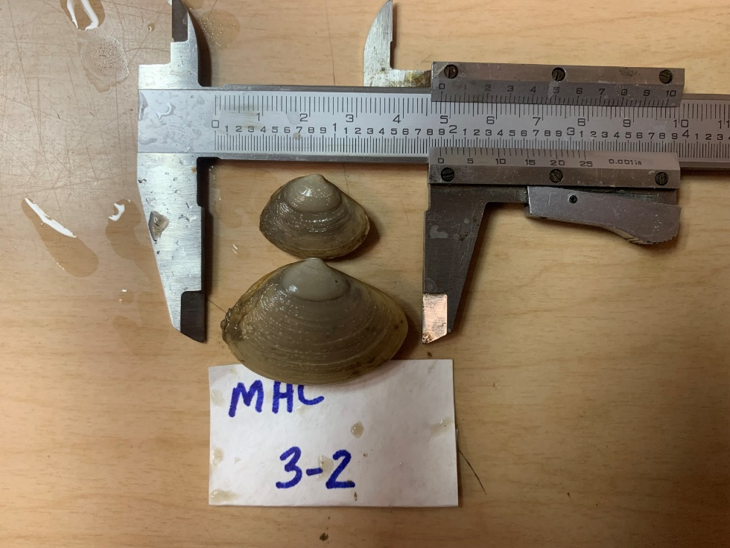
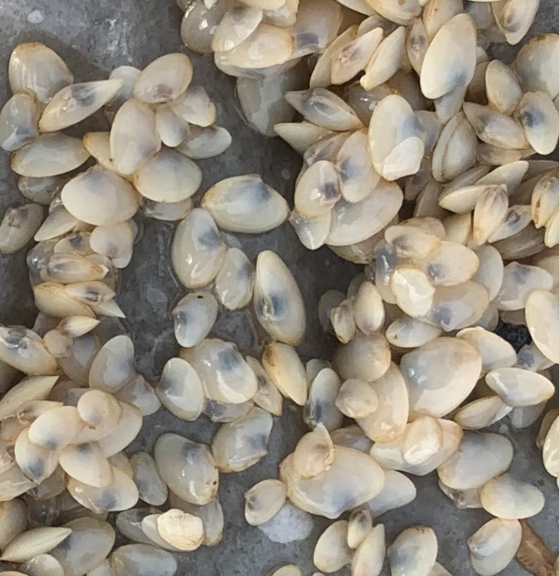
BEALS
16-17 June 2022 -
4 August 2023
$$\overline{x}$$
= 29.2 ± 0.6 mm
Small clams
$$\overline{x}$$
= 29.5 ± 0.7 mm
Large clams

Slide 25
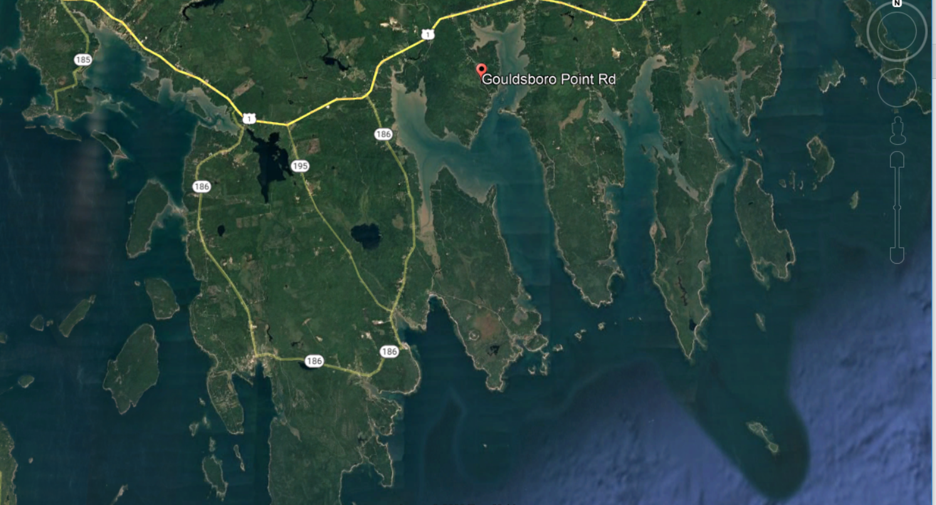
GOUDLSBORO
GOULDSBORO
18-19 June 2022
21 January 2023
4 Aug 2023
Timber Cove

Slide 26
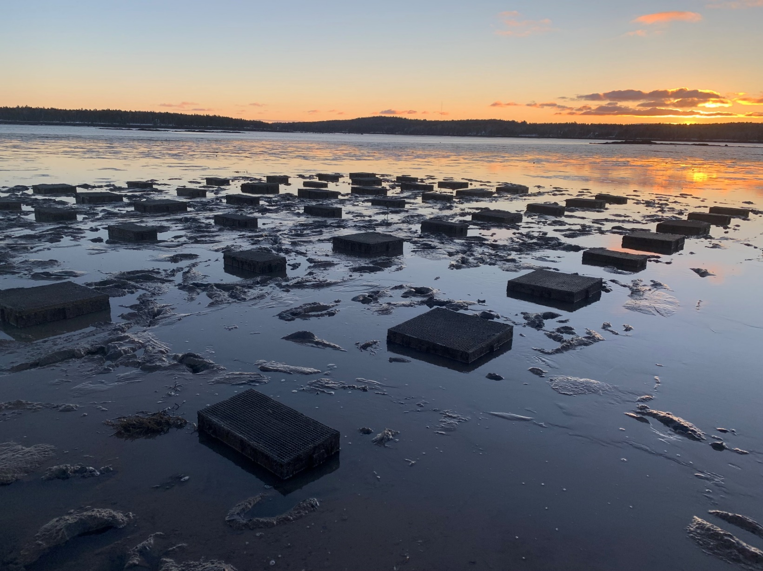
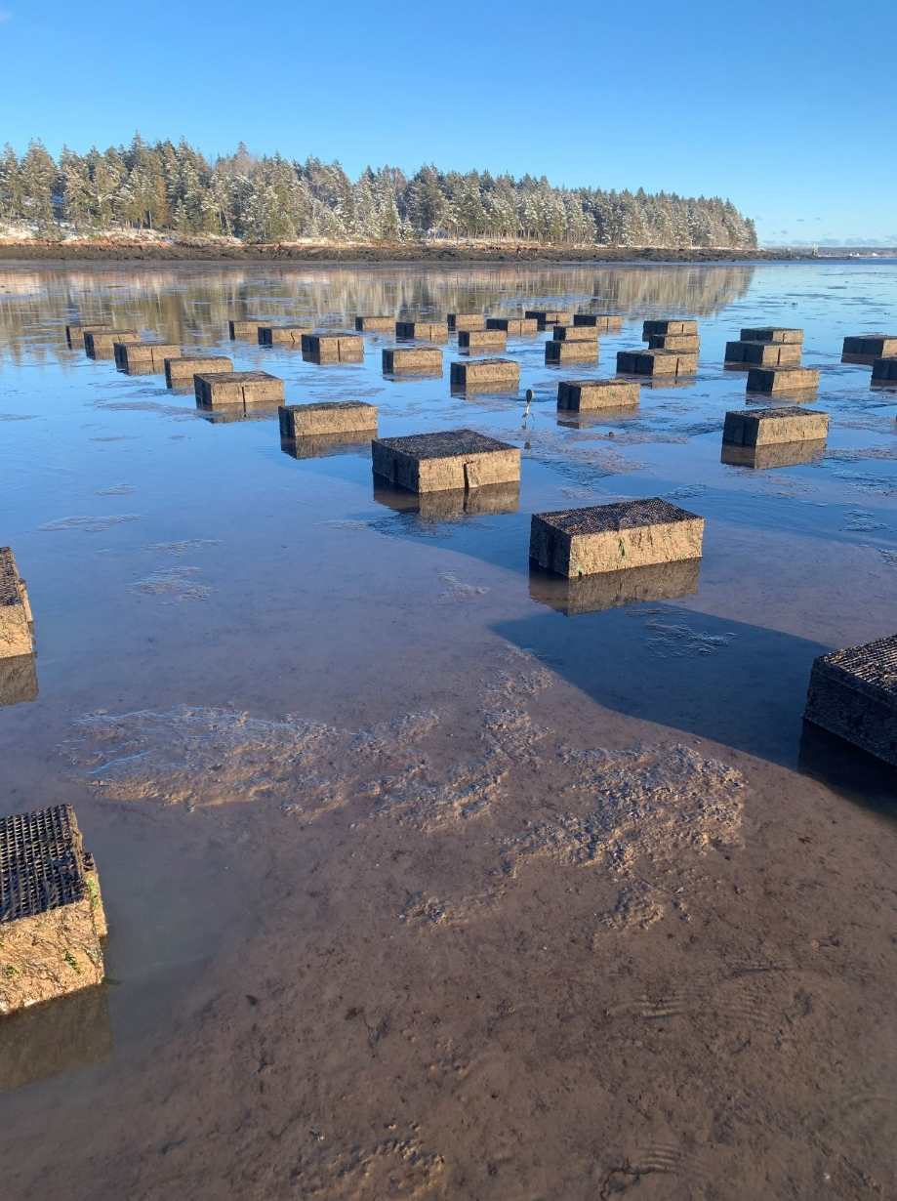
First Sampling (Gouldsboro – 19 June 2022 to 21 January 2023)

Slide 27
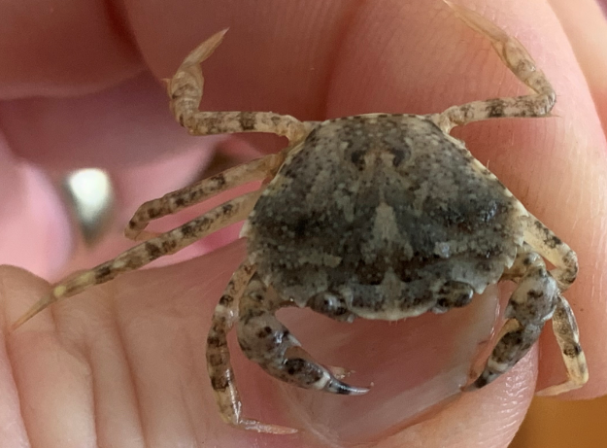
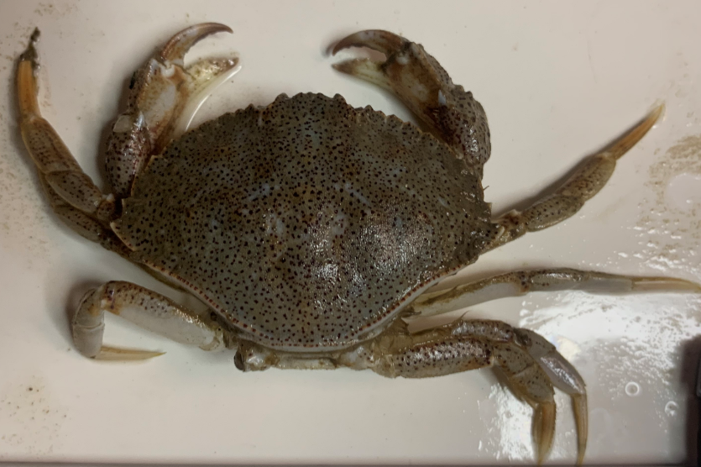
Gouldsboro – Jan 2023
6.9 ± 2.4/box
Carcinus maenas
Crabs occurred in 58
of 60 boxes.
Live clams occurred in
27 of 60 (45%) of boxes
16.4 mm
0.5 ± 0.2/box
Cancer irroratus
$\overline{x}$ = 51.5 ± 4.0 mm
N = 32
65.5 mm

Slide 28
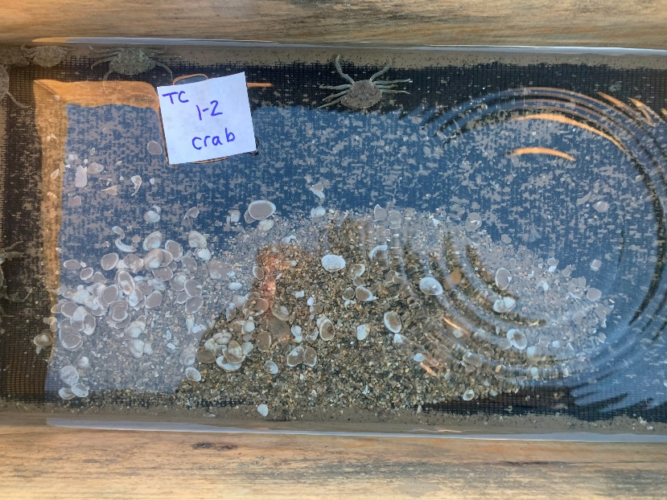
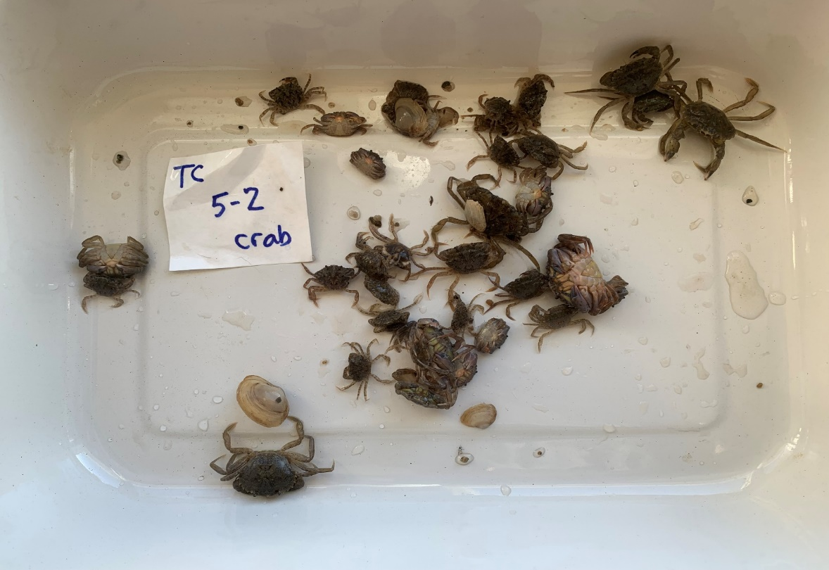
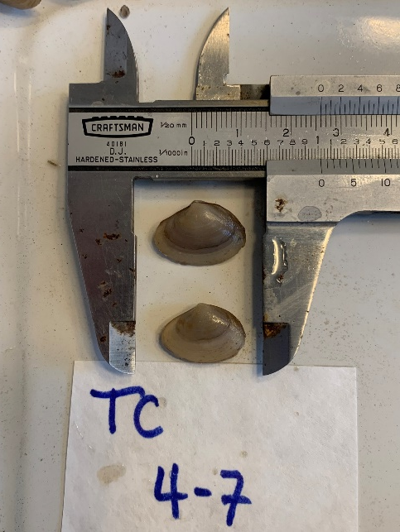
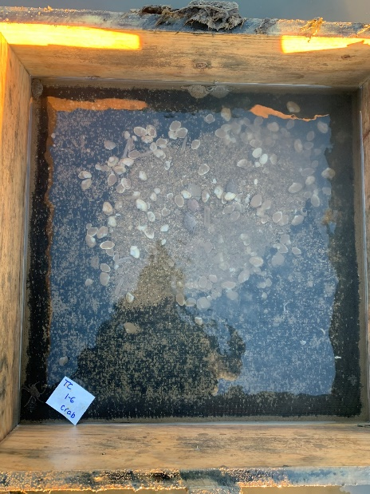
18-19 June 2022
18-19 June 2022
P < 0.01
9.6 ± 0.4 mm
12.9 ± 0.4 mm
21 January 2023
21 January 2023
20.8 ± 0.8 mm
22.4 ± 0.7 mm

Slide 29
Second Sampling (Gouldsboro – 19 June 2022 to 4 August 2023)
Live surfclams occurred in 2 of 60 boxes;
Mortality rates exceeded 99.5%
Green crabs occurred in 42 of 60 (70%) of boxes
1.7 ± 0.6 crabs/box

Slide 30
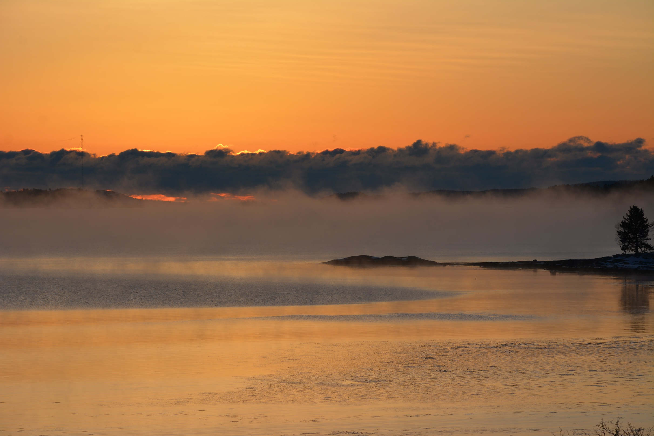
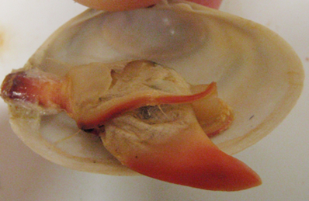
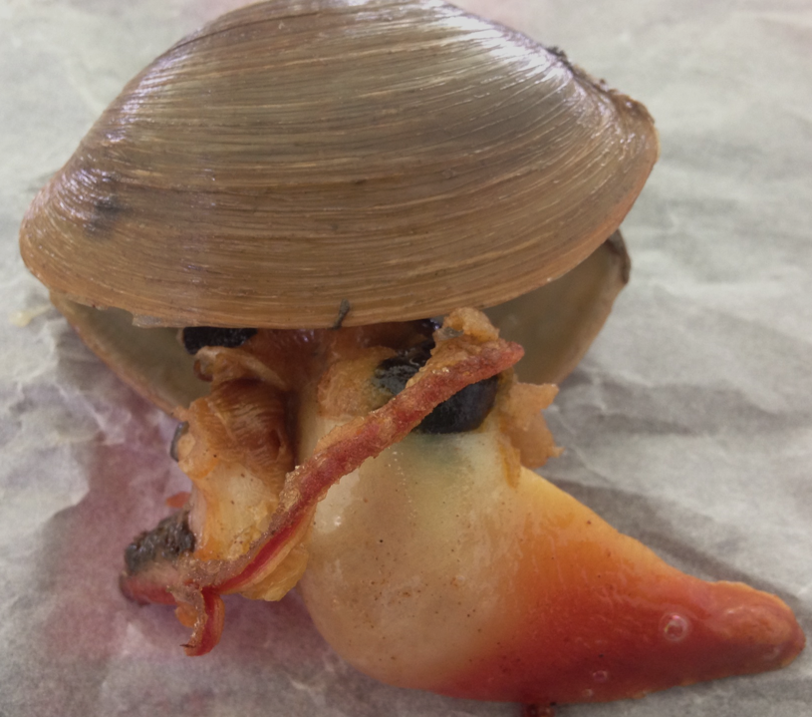
SUMMARY
Soft-shell clams and other commercially-important intertidal bivalve populations
in Maine are at/near record lows due mostly to warming ocean conditions that have
resulted in heightened predation rates by both endemic and invasive species.
Arctic surfclams are a circumboreal species that can survive and grow in the low intertidal
zone, but cannot tolerate seawater temperatures exceeding ~ 20ºC, which makes them
suitable, physiologically, for the environmental conditions that exist in eastern Maine.
Refining techniques first attempted in the mid-1990s at the Darling Center (Davis &
Shumway), the hatchery and nursery phase of Mactromeris is established.
Attempts to grow this species in the field using a variety of techniques have been frustrated
repeatedly by crustacean predators - - mainly green crabs, but also rock crabs.
Future efforts (!) to rear surfclams in the field will focus on areas in far eastern Maine and
alternate methods to exclude crabs.

Slide 31
Acknowledgments

