Slide 1
New Jersey Agricultural Service Provider Education and Networking to Improve Farmer Outreach and Services
Project Team: Stephen Komar (PI), Michelle Infante-Casella, and William Bamka
Rutgers Cooperative Extension, Agriculture and Natural Resources Department
Agricultural Agents in Sussex, Gloucester, and Burlington Counties

Slide 2
Statement of Need for this Program:
The agricultural industry in New Jersey is extremely diverse and constantly evolving. The U.S. Department of Agriculture 2017 Census of Agriculture showed the number of farms in New Jersey had risen by more than 800 since the previous census in 2012. In 2017, NJ was listed as having 9,883 farms. The amount of land in farms over this 5-year period had an increase of almost 20,000 acres standing at a total of 734,000 acres. It is anticipated the next census will once again show this trend of increased farm numbers in the State. Many farms are small-scale and are often managed as secondary businesses for landowners with abundant needs from ASPs. In addition, many ASP clients are beginning farmers with entry-level questions, needing guidance to navigate agricultural regulations, risk management issues and services for crop production and marketing. As a result, ASPs must provide multiple services for the producer and/or identify the agency that would best provide the needed service. In the past, inter-agency cooperation occurred through various professional organizations that provided both networking opportunities and the ability for agencies to promote their services and programs. As ASP’s, especially extension personnel, have focused on other issues in the state, traditional agricultural organizations have become less active or non-existent resulting in limited opportunities for information sharing and promotion of services for farmers. The diversity of operations in the state, combined with changing farmer demographics and less ASPs focusing on commercial agriculture programming makes information sharing critical for ASPs to serve farmers effectively and efficiently. ASP focus must once again be aimed at serving the agricultural industry in the State worth over $1.1 Billion annually.

Slide 3
Program Goals:
To support agricultural service providers by:
1) Discussing base services for farmers;
2) Offering yearly networking opportunities for extension, agricultural agencies, NGOs and others;
3) Provide ASPs with information to improve their knowledge and share the diverse and numerous resources available to assist farmers.

Slide 4
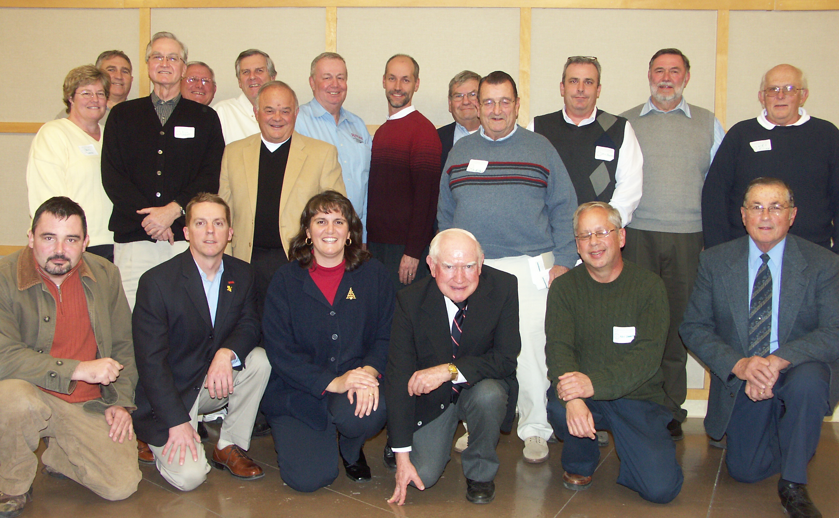
History of Ag Networking: Former NJ Agribusiness Association

Slide 5
Base Services for Agriculture:
REGULATORY
NJ DEPARTMENT OF ENVIRONMENTAL PROTECTION AGENCY, BUREAU OF WATER ALLOCATIONS – AGRICULTURAL WATER CERTIFICATION PERMITS
NJ DEPARTMENT OF ENVIRONMENTAL PROTECTION AGENCY, PESTICIDE CONTROL PROGRAM https://www.nj.gov/dep/enforcement/pcp/bpo.htm.
a. NJDEP PESTICIDE LICENSING TESTING
b. PESTICIDE APPLICATOR TRAINING MANUALS
c. RECERTIFICATION CREDIT OPPORTUNITIES
NJ DEPARTMENT OF AGRICULTURE –NJDA’s Self Certified Animal Waste Management Plans
NJ DEPARTMENT OF ENVIRONMENTAL PROTECTION AGENCY, FOREST FIRE SERVICE AGRICULTURE BURNING PERMITS https://www.state.nj.us/dep/parksandforests/fire/permits.html. Open burning and use of smudge pots to prevent cold damage of crops (mainly blossoms) during periods of severe cold weather conditions and frost (seasonally as needed).
NJ MOTOR VEHICLE COMMISSION FARMER VEHICLE CERTIFICATES - “Farmer” and “Farm Use” vehicle registrations and license plates. These certificates also verify commercial farm status for the “16-year old” Farmer Drivers Licenses, https://www.nj.gov/agriculture/divisions/md/prog/farmermotorvehicles.html

Slide 6
Base Services for Agriculture:
REGULATORY
COUNTY AGRICULTURAL DEVELOPMENT BOARD –CADBs in each county representing the local branch of the State Agricultural Development Committee. https://nj.gov/agriculture/sadc/farmpreserve/contacts/cadbs.html.
a. FARMLAND PRESERVATION PROGRAMS – https://www.nj.gov/agriculture/sadc/farmpreserve/index.html.
b. FARMLAND ASSESSMENT - https://njfb.org/wp-content/uploads/2013/07/farmlandassessmentoverview.pdf
c. RIGHT TO FARM – Right to Farm and conflict resolution cases brought before the CADB, https://www.nj.gov/agriculture/sadc/rtfprogram/conflictres/index.html
COUNTY OFFICE OF EMERGENCY MANAGEMENT –Emergency Support Function team in counties to assist in natural disasters and emergency situations where agricultural entities may be affected https://www.animalemergency.nj.gov/.

Slide 7
Base Services for Agriculture:
TECHNICAL SUPPORT
NJ DEPARTMENT OF AGRICULTURE – Many divisions of the NJDA are related to agricultural aspects within the State; the Marketing and Development Division, Plant Industry Division, Animal Division and others. https://www.nj.gov/agriculture/index.shtml.
NJ STATE AGRICULTURAL DEVELOPMENT COMMITTEE – Agricultural Management Practices rules that are used for the protection of farmers via the “Right-to-Farm” act, https://www.nj.gov/agriculture/sadc/rtfprogram/amps/.
NJ DIVISION OF FISH AND GAME – Wildlife damage for grower depredation permits and other programs, https://www.njfishandwildlife.com/farmer.htm.

Slide 8
Base Services for Agriculture:
TECHNICAL SUPPORT
RUTGERS CAMPUS-BASED PLANT AND SOIL DIAGNOSTIC SERVICES AND OTHER RESOURCES:
a. PLANT DIAGNOSTIC LABORATORY - A full-service plant health diagnostic facility of Rutgers New Jersey Agricultural Experiment Station, providing accurate and timely diagnoses of plant health problems for the residents of New Jersey, https://njaes.rutgers.edu/plant-diagnostic-lab/.
b. SOIL TESTING LABORATORY - Offers chemical and mechanical analyses of soils for the residents of New Jersey and for Rutgers University researchers, providing accurate and timely soil and water test reports to meet the unique agricultural and environmental needs of our state, https://njaes.rutgers.edu/soiltesting-lab/.
c. PUBLICATIONS - Searchable online database on thousands of topics, from animal agriculture, to natural resources and the environment, to home gardening and landscaping in the form of fact sheets, bulletins, and other media. https://njaes.rutgers.edu/pubs/.
i. COMMERCIAL GUIDES – https://njaes.rutgers.edu/pubs/category.php?cat=3.
ii. PLANT AND PEST ADVISORY - provides seasonal updates focusing on insects, diseases, and weeds of importance to NJ commercial growers,
https://plant-pest-advisory.rutgers.edu/.

Slide 9
Base Services for Agriculture:
TECHNICAL SUPPORT
COUNTY SOIL CONSERVATION DISTRICTS – SCD’s in each county to provide information related to farmland and conservation. Department of Agriculture | NJ Soil Conservation Districts
USDA FARM SERVICE AGENCY DISASTER FUNDING AND CROP INSURANCE PROGRAMS –County FSA offices to the State FSA office provide reporting the Federal USDA to designate disaster areas for crop loss funding and crop insurance payments, https://www.fsa.usda.gov/ and https://www.fsa.usda.gov/stateoffices/New-Jersey/index.
USDA NATURAL RESOURCES CONSERVATION SERVICES – NRCS has programs for farm practices related to farm infrastructure and land conservation. NRCS provides grants or cost-share opportunities to farmers for irrigation installation, land management, conservation buffer plantings, wildlife habitat plantings, and other on-farm conservation practices, https://www.nrcs.usda.gov/wps/portal/nrcs/site/national/home/ and https://www.nrcs.usda.gov/wps/portal/nrcs/site/nj/home/.

Slide 10
Base Services for Agriculture:
TECHNICAL SUPPORT
USDA SUSTAINABLE AGRICULTURE RESEARCH AND EDUCATION PROGRAM –Resources and grant programs for farmers, researchers, educators, graduate students and organizations https://www.sare.org/ and https://www.nesare.org/.
USDA NATONAL AGRICULTURAL STATISTICS SERVICES - Monitoring of conditions assists this federal agency in decision making for policies and funding for agriculture, https://www.nass.usda.gov/ and https://www.nass.usda.gov/Statistics_by_State/New_Jersey/index.php.
USDA FOOD AND AGRICULTURE COUNCILS (FAC) – The local USDA Food and Agriculture Councils are responsible for reporting the occurrence of and assessing the damage caused by potential disasters, as required to ensure that the Department's disaster programs are implemented when and where needed; to coordinate the Department's EM disaster programs with those of other Federal departments and agencies; and to provide personnel, as needed and requested by FEMA, to help staff disaster application centers in major disaster areas. https://www.nrcs.usda.gov/Internet/FSE_DOCUMENTS/nrcs142p2_001394.pdf

Slide 11
Base Services for Agriculture:
COLLABORATORATIONS:
NEW JERSEY FARM BUREAU/COUNTY BOARDS OF AGRICULTURE - NJ Farm Bureau is a non-profit, member organization representing NJ Agriculture and part of the American Farm Bureau. This organization is the main lobbying organization for agriculture locally, in the state and nationally. CBAs are also responsible for selecting county representatives on commodity boards, other state boards related to agricultural issues, and representatives to the Rutgers University NJAES Board of Managers.
COMMODITY PRODUCTION AND MARKETING GROUPS – Many ASPs serve as ex-officio and advisors to commodity-based associations – Farmers Direct Marketing, Vegetable Growers, NJ Horticultural Society, Beekeepers, NJ Landscape and Nursery, etc.

Slide 12
Base Services for Agriculture:
COLLABORATORATIONS:
ECONOMIC DEVELOPMENT DEPARTMENTS – ASPs work with the Economic Development Departments in counties when agricultural businesses, food processors, and food distributors are the topic of discussion.
HEALTH DEPARTMENTS – ASPs provide technical information for county health departments and the NJ Department of Health related to agricultural issues pertaining to farm product marketing (particularly eggs/meat/produce), water quality, agricultural housing, produce wash water, mosquito, fly, and pests of human health concern, and other topics.
PARK COMMISSIONS / WATERSHED ASSOCIATIONS / ETC. – ASPs assist when called upon for advice and assistance when identifying and planning management strategies for invasive species, forest and tree health and sustainability, wildlife damage and mitigation, water and air quality concerns, and any other topics within the agricultural production and natural resource inventory or priority areas of the county, municipality, or other clientele group requesting assistance.

Slide 13
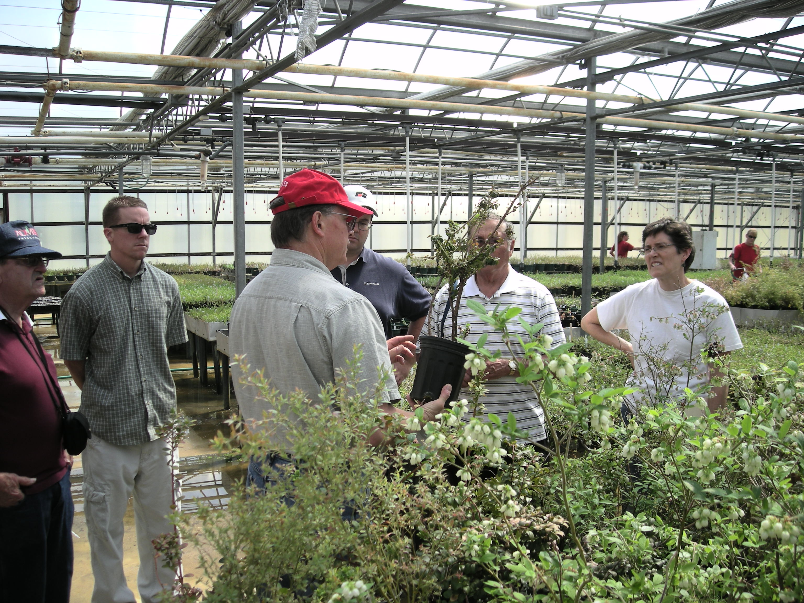
NETWORKING:
Networking and knowing where to go for answers is the key to being valuable as an ASP.
We hope to accomplish this as a result of this 3-year training program.

Slide 14
Thank you for attending this introductory webinar. Discussion…….. Questions……..

