Slide 1


Evaluating Sprouted Grains on Grazing Dairy Farms
Dr. Kathy Soder
Animal Scientist
USDA-Agricultural Research Service
Pasture Systems & Watershed Management Research Unit
University Park, PA

Slide 2
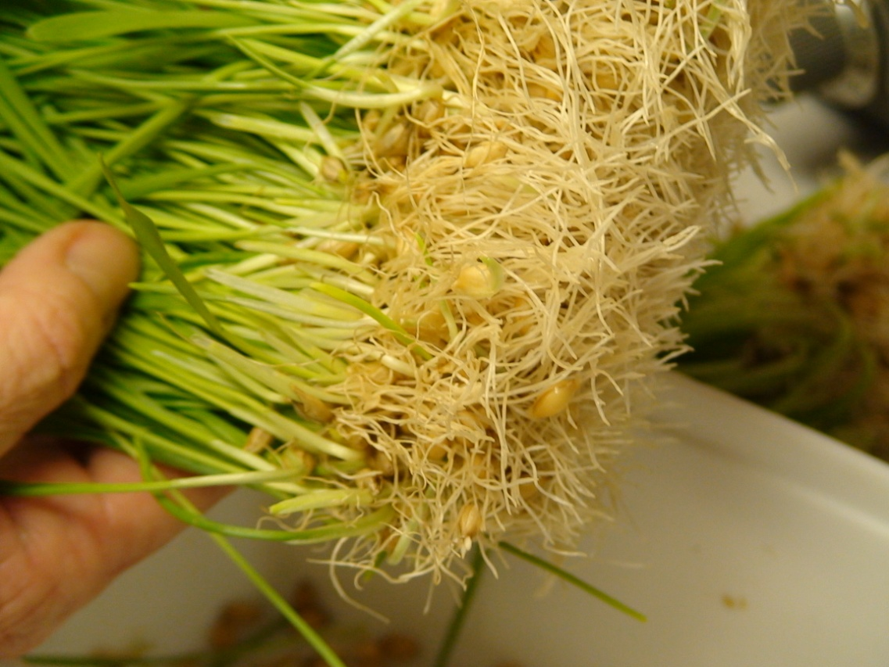
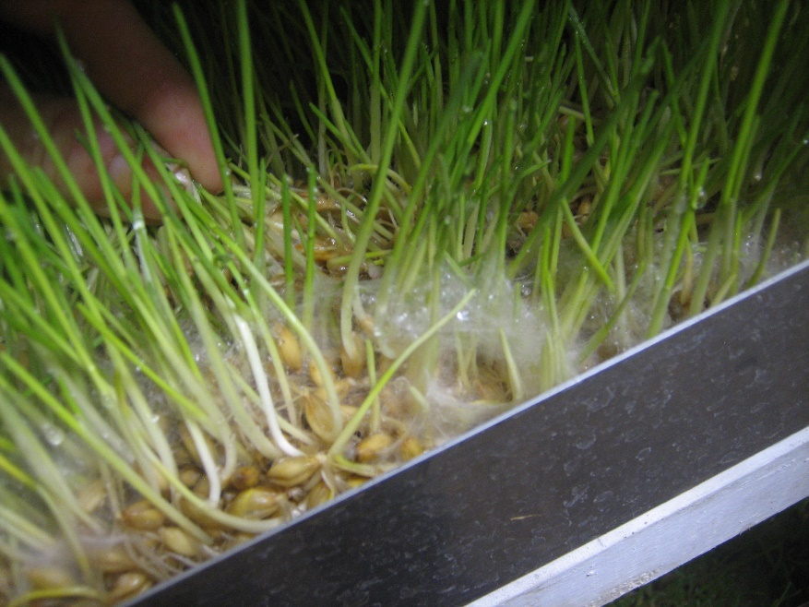
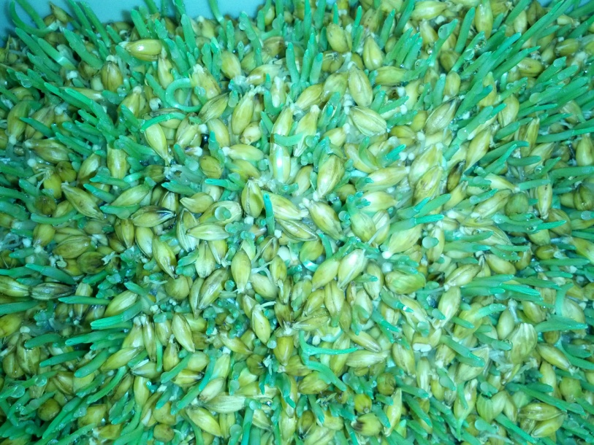
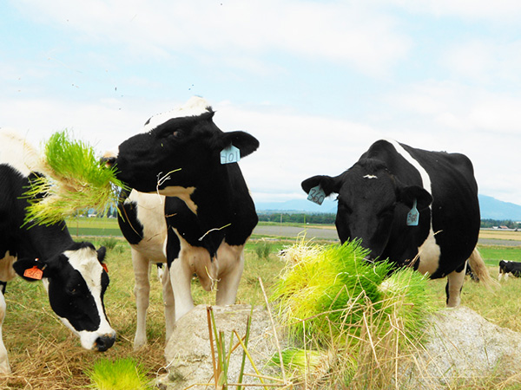
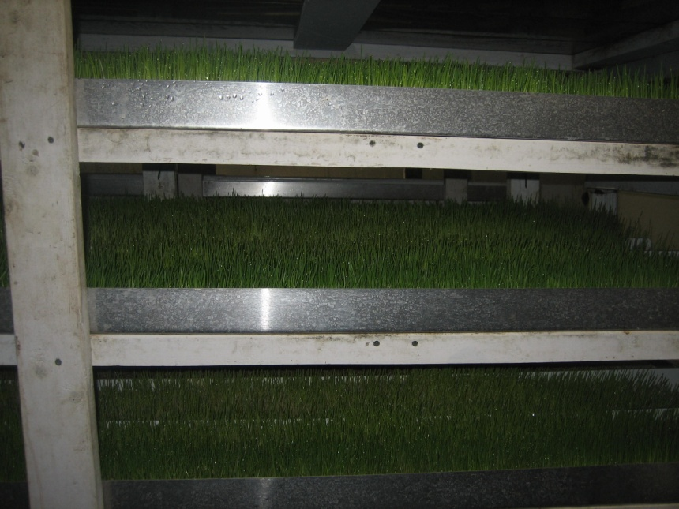
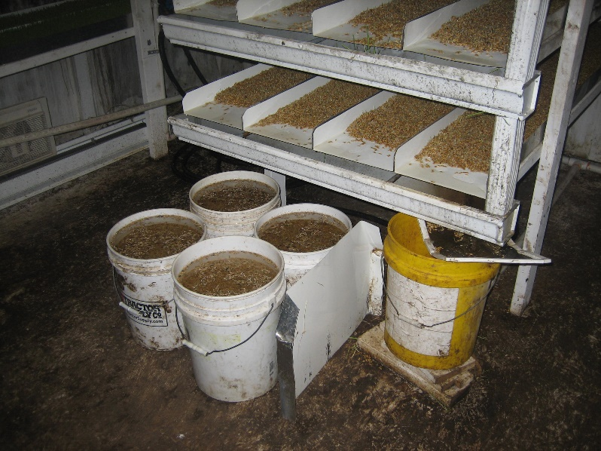
Sprouted Grain Fodder
www.nodpa.com

Slide 3
Fodder Systems
Old idea renewed- started in 1600’s
Australia and New Zealand (arid regions)
Increased interest in United States due to:
  Recent droughts/extended dry periods
  High grain prices (especially organic)
  Belief fodder is an ‘easy alternative’ to producing high-quality forage
  Hard-sell marketing by those selling the systems, with some pretty impressive (but not necessarily substantiated) animal production/economic claims
Are fodder systems feasible and economical for US grazing farms?

Slide 4
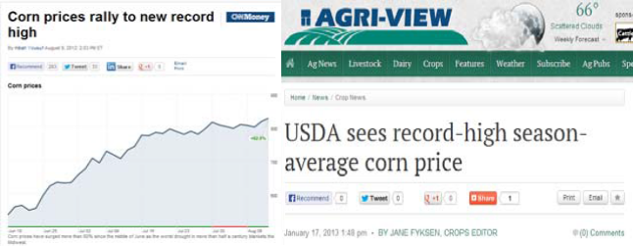
Why Interest in Fodder?

Slide 5
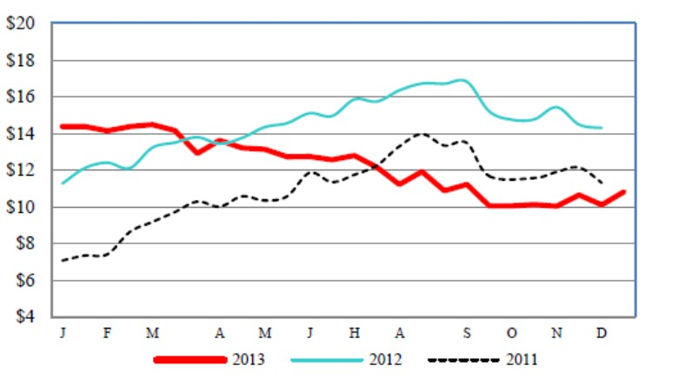
National Organic Grain Price

Slide 6
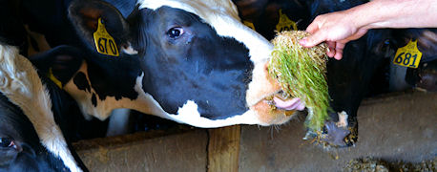
Perceived/Expected Benefits
Increased palatability
“Feel-good” feed
High forage yield in small space
No pesticides/herbicides
Little waste
Low energy/water consumption
Rapid growth
“Easy”, high-quality forage
www.farmprogress.com

Slide 7
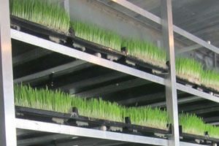
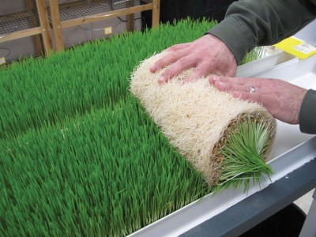
Perceived/Expected Benefits
www.thebullvine.com
Improved nutritional quality
  Increased vitamins (photosynthesis)
  Increased minerals (due to water additives)
  Improved digestibility (starch converted to sugar)
  Digestive enzymes
  Fatty acids
  Improved nutrient availability
  Reduction in anti-nutritional factors
  Antioxidant properties
Consistent feed quality
  Minimize feed changes from winter to summer
  Eliminates reliance on weather
  Molds?
1 lb grain input, 5-8+ lb output from system
www.offthegridnews.com

Slide 8
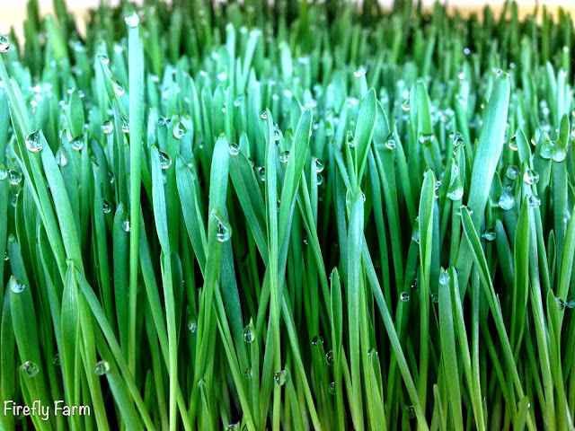
Perceived/Expected Benefits
Improved animal performance
  Better heat stress tolerance (high digestibility)
  Improves digestion/absorption with less energy required
  Greater milk production reproduction, weight gain
  More efficient waste management
  Immune response
  Lower SCC
  Greater vitality/energy
Much lower water requirements than field crops (3%)
www.fireflyadventures.blogspot.com

Slide 9
Potential Drawbacks
Mold
  Loss of feed that day- what is the backup plan?
  Ill/dead animals
Cost/lb of DM
  Fodder system distributors don’t like to talk about DM
Labor requirements
Cows will toss flakes (TMR?)
Potential for rumen acidosis (sugars)
Initial capital expense (purchased systems)
Doesn’t qualify for Organic Pasture Rule or some
grassfed labels

Slide 10
Chemical Changes
“The desirable nutritional changes that occur during sprouting are mainly due to the breakdown of complex compounds into more simple form, transformation into essential constituents, and breakdown of nutritionally undesirable constituents” Chavan and Kadam (1989)

Slide 11
Chemical Changes
Increases in Vitamins (A, E, Beta-carotene)
    Even though they may increase, are increases biologically significant? (Cuddeford, 1989; AIG, 2011).
 | Grain (mg/lb DM) | Fodder (mg/lb DM) | % Increase
Vitamin E | 3.4 | 28.4 | 735%
Beta-Carotene | 1.9 | 19.4 | 921%
Biotin | 0.08 | 0.52 | 550%
Free Folic Acid | 0.05 | 0.48 | 875%

Slide 12
Chemical Changes
Increases in Vitamins (A, E, Beta-carotene)
    Even though they may increase, are increases biologically significant? (Cuddeford, 1989; AIG, 2011).
Dairy cow requires ~1,000 IU/d (735,294 mg) Vitamin E
Is the cost of the fodder worth this small amount of vitamin?
 | Grain (mg/lb DM) | Fodder (mg/lb DM) | % Increase
Vitamin E | 3.4 | 28.4 | 735%
Beta-Carotene | 1.9 | 19.4 | 921%
Biotin | 0.08 | 0.52 | 550%
Free Folic Acid | 0.05 | 0.48 | 875%

Slide 13
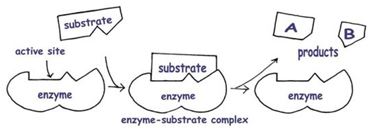
Chemical Changes
Increases in enzymes
  What is an enzyme?
    “Protein produced by a living organism that acts as a catalyst to bring about a specific biochemical reaction (i.e. digestion)”
  Enzymatic activity in the rumen is strictly done by the microbes
  Proteases, lipases, amylases, cellulases, hemicellulases, lignases
  Over 1100 enzymes in the body.
  What enzymes are present in fodder? Are they biologically active in the rumen?
    Expensive analysis

Slide 14
Nutrient Composition
 | Barley Grain | Sprouted Barley | % Change | Pasture
CP, % DM | 12.9 | 14.7 | + 14 | 25.5
NDF, % DM | 14.4 | 30.5 | + 112 | 50.0
ADF, % DM | 5.30 | 15.5 | + 193 | 31.6
Starch, % DM | 58.1 | 27.7 | 52 | 1.10
ESC, % DM | 2.0 | 15.9 | +695% | 5.8
WSC, % DM | 4.0 | 21.1 | +428% | 9.9
Ca, % DM | 0.05 | 0.05 | 0 | 0.67
P, % DM | 0.43 | 0.49 | + 14 | 0.51
Hafla et al., 2014

Slide 15
Nutrient Composition
 | Barley Grain | Sprouted Barley | % Change | Pasture
CP, % DM | 12.9 | 14.7 | + 14 | 25.5
NDF, % DM | 14.4 | 30.5 | + 112 | 50.0
ADF, % DM | 5.30 | 15.5 | + 193 | 31.6
Starch, % DM | 58.1 | 27.7 | 52 | 1.10
ESC, % DM | 2.0 | 15.9 | +695% | 5.8
WSC, % DM | 4.0 | 21.1 | +428% | 9.9
Ca, % DM | 0.05 | 0.05 | 0 | 0.67
P, % DM | 0.43 | 0.49 | + 14 | 0.51
Sprouting:
* Slightly increased CP
* Due to decreased DM
* Concentrates existing CP, does not create more
unless there is N in the water
Hafla et al., 2014

Slide 16
Nutrient Composition
 | Barley Grain | Sprouted Barley | % Change | Pasture
CP, % DM | 12.9 | 14.7 | + 14 | 25.5
NDF, % DM | 14.4 | 30.5 | + 112 | 50.0
ADF, % DM | 5.30 | 15.5 | + 193 | 31.6
Starch, % DM | 58.1 | 27.7 | 52 | 1.10
ESC, % DM | 2.0 | 15.9 | +695% | 5.8
WSC, % DM | 4.0 | 21.1 | +428% | 9.9
Ca, % DM | 0.05 | 0.05 | 0 | 0.67
P, % DM | 0.43 | 0.49 | + 14 | 0.51
Sprouting:
* Slightly increased CP
* Due to decreased DM
* Concentrates existing CP, does not create more
unless there is N in the water
* Increased fiber (NDF, ADF)
* Concentration of nutrients
Hafla et al., 2014

Slide 17
Nutrient Composition
 | Barley Grain | Sprouted Barley | % Change | Pasture
CP, % DM | 12.9 | 14.7 | + 14 | 25.5
NDF, % DM | 14.4 | 30.5 | + 112 | 50.0
ADF, % DM | 5.30 | 15.5 | + 193 | 31.6
Starch, % DM | 58.1 | 27.7 | 52 | 1.10
ESC, % DM | 2.0 | 15.9 | +695% | 5.8
WSC, % DM | 4.0 | 21.1 | +428% | 9.9
Ca, % DM | 0.05 | 0.05 | 0 | 0.67
P, % DM | 0.43 | 0.49 | + 14 | 0.51
Sprouting:
* Slightly increased CP
* Due to decreased DM
* Concentrates existing CP, does not create more
unless there is N in the water
* Increased fiber (NDF, ADF)
* Concentration of nutrients
* Decreased starch- converted to sugar
* May change feed conversion
* Increased sugar (ESC & WSC)
Hafla et al., 2014

Slide 18
Nutrient Composition
 | Barley Grain | Sprouted Barley | % Change | Pasture
CP, % DM | 12.9 | 14.7 | + 14 | 25.5
NDF, % DM | 14.4 | 30.5 | + 112 | 50.0
ADF, % DM | 5.30 | 15.5 | + 193 | 31.6
Starch, % DM | 58.1 | 27.7 | 52 | 1.10
ESC, % DM | 2.0 | 15.9 | +695% | 5.8
WSC, % DM | 4.0 | 21.1 | +428% | 9.9
Ca, % DM | 0.05 | 0.05 | 0 | 0.67
P, % DM | 0.43 | 0.49 | + 14 | 0.51
Sprouting:
* Slightly increased CP
* Due to decreased DM
* Concentrates existing CP, does not create more
unless there is N in the water
* Increased fiber (NDF, ADF)
* Concentration of nutrients
* Decreased starch- converted to sugar
* May change feed conversion
* Increased sugar (ESC & WSC)
* Minerals relatively unchanged and will depend on
additives in water
Hafla et al., 2014

Slide 19
Nutrient Composition
 | Barley Grain | Sprouted Barley | % Change | Pasture
CP, % DM | 12.9 | 14.7 | + 14 | 25.5
NDF, % DM | 14.4 | 30.5 | + 112 | 50.0
ADF, % DM | 5.30 | 15.5 | + 193 | 31.6
Starch, % DM | 58.1 | 27.7 | 52 | 1.10
ESC, % DM | 2.0 | 15.9 | +695% | 5.8
WSC, % DM | 4.0 | 21.1 | +428% | 9.9
Ca, % DM | 0.05 | 0.05 | 0 | 0.67
P, % DM | 0.43 | 0.49 | + 14 | 0.51
Sprouting:
* Slightly increased CP
* Due to decreased DM
* Concentrates existing CP, does not create more
unless there is N in the water
* Increased fiber (NDF, ADF)
* Concentration of nutrients
* Decreased starch- converted to sugar
* May change feed conversion
* Increased sugar (ESC & WSC)
* Minerals relatively unchanged and will depend on
additives in water
* Fazaeli et al. (2012)
- ↓ True protein, DM, NFC, ME, gas production
Hafla et al., 2014

Slide 20
Yield
 | Barley Grain | Sprouted Barley | % Change | Pasture
Yield
DM, % | 95 | 18 | - 81
Fresh wt, lb | 0.29 | 1.22 | + 327
DM yield, lb | 0.27 | 0.23 | 17
Total NE_{L} for 1 tray, Mcal | 0.24 | 0.19 | 21
Sprouting:
* 81% decrease in DM %
* 327 % increase in fresh weight yield
* 17% decrease in DM yield
* 21 % loss of total energy per tray
Hafla et al., 2014

Slide 21
DM vs. As Fed
9.7% DM (90.3% water!)
  2 lb. of seed (1.91 lb DM) resulted in 1.44 lb of fodder DM
  Loss of 0.46 lb, or 24.2% DM after 6 days growth
  Loss of 0.57 lb, or 30% DM after 7 days growth
  Most of the weight was in the seed/root mass (not green shoots)
How can we NOT talk in terms of DM?
Putnam et al., 2013 http://ucanr.edu/blogs/blogcore/postdetail.cfm?postnum=11721

Slide 22
Why is DM/Energy Lost?
Seeds utilize stored energy (starch) during the first week of growth to germinate
  Photosynthesis doesn’t really kick in until 2nd week of growth
  Harvesting fodder before photosynthesis really takes effect
  Net loss of energy that seed uses to germinate and get established
  Never let fodder get to the stage of growth where nutrients start to accumulate
Putnam et al., 2013 http://ucanr.edu/blogs/blogcore/postdetail.cfm?postnum=11721

Slide 23
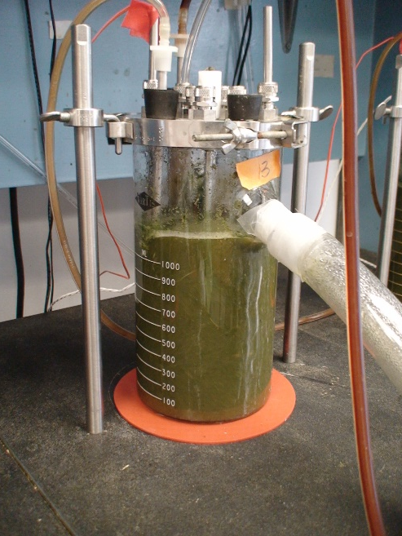
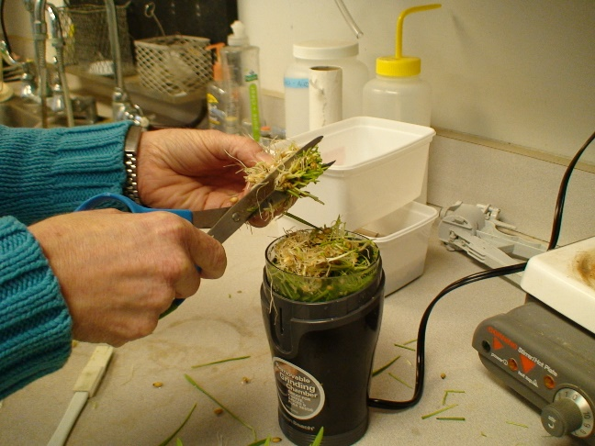
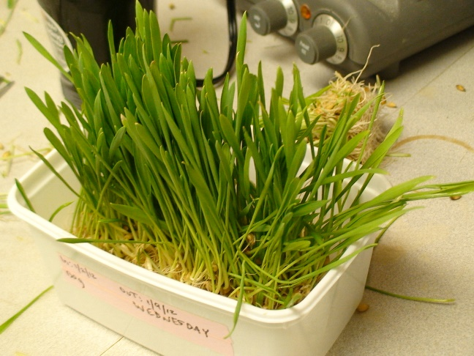
DM and Fiber (NDF) Digestibility
CCF study
* Pasture had greater NDF digestibility than haylage
* Fodder increased DM digestibility by 5%
Hafla et al., 2014

Slide 24
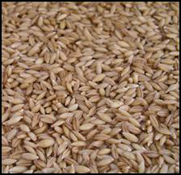
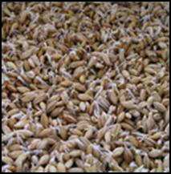
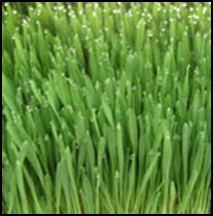
Digestibility of Barley Sprouts of Differing Ages
 | Organic Matter | Dry Matter | In Vivo
Grain | 88.8% | 89.9% | 83.9%
4-day | 91.8% | 92.2% | 85.8%
6-day | 87.9% | 88.9% | 82.1%
8-day | 88.4% | 89.0% | 82.6%
Sneath and McIntosh (2003)
Day 1 Day 2 Day 3 Day 4 Day 5 Day 6 Day 7

Slide 25
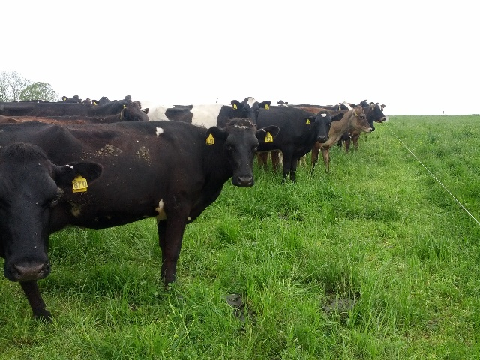
Animal Performance
“Most of the trials on livestock performance from hydroponic sprouts show no advantage to including them in the diet, especially when it replaces highly nutritious feeds such as grain. From a theoretical perspective, performance improvements occur if the supplement supplies the primary limiting nutrient(s) or improve feed use efficiency such as the situation that Tudor et al. (2003) experienced with steers on protein deficient hay”. (Sneath and McIntosh, 2003)
Notes:
In a comprehensive review, Sneath and McIntosh reported:

Slide 26
Milk Production
Heins (2015) showed no improvement in milk production or milk fat in dairy cows fed 20 lb (AF) of fodder which replaced 6 lb of corn during the grazing season.
Fodder-fed cows had a slight (0.09 lb/d) increase in milk protein.
Fodder slightly increased Omega-3 (and better O3:O6) but did not improve CLA in milk.
MUN was higher in fodder-fed cows (16.5 vs. 13.15 mg/dl).
IOFC similar between the groups.
  When organic corn price increased by 50%, fodder cows had a $0.44/cow/d advantage in IOFC.
  Fodder may pay for itself at very high organic grain prices
  ALL costs must be included.

Slide 27
Grain Replacement Study
Dr. Cynthia Daley, CSU-Chico
How many pounds of barley fodder does it take to replace a pound of grain?
Treatments (as fed amounts but based on DM energy analysis)
12 lb of parlor grain mix
6 lb of grain mix
3 lb of grain mix + 18 lb of fodder
36 lb of fodder
Daley et al., 2014 http://www.chicostateorganicdairy.com/research.html

Slide 28
Grain Replacement Study
Dr. Cynthia Daley, CSU-Chico
Grain produced more milk/d on avg (3 lb)- although NS
Fodder produced more butter fat (0.4% BF)- although NS
Daley et al., 2014 http://www.chicostateorganicdairy.com/research.html

Slide 29
Grain Replacement Study
Dr. Cynthia Daley, CSU-Chico
Income over feed costs (IOFC)
12 lb of parlor grain mix = $13.58
6 lb of parlor grain mix = $13.92
3 lb of grain mix/18 lb fodder = $14.32
36 lb of fodder = $14.29
Highest to Lowest IOFC
3 lb of grain mix/18 lb fodder
36 lb fodder
6 lb grain
12 lb grain
Daley et al., 2014 http://www.chicostateorganicdairy.com/research.html

Slide 30
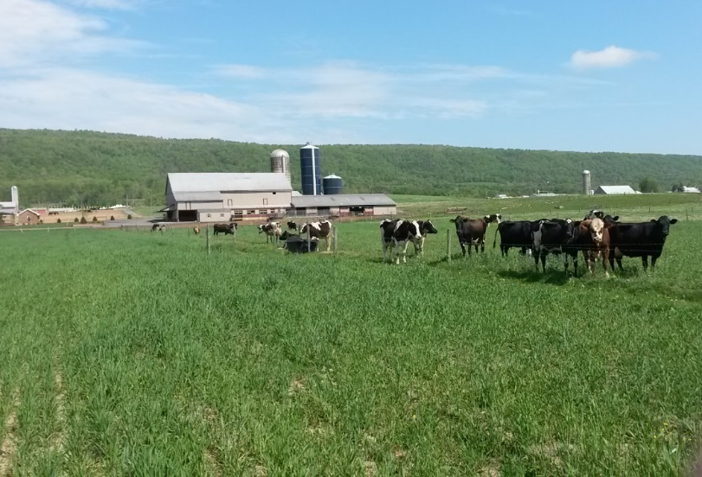
Barley Fodder On-Farm Study
Data Collection
3 Farms in Pennsylvania
1 home made system, 2 (different) purchased systems
Monitored monthly for 12 mo for fodder/feed/pasture nutrient analysis
Milk production (bulk tank receipts)
Milk composition including FA profile (our sampling)
Management, philosophy (survey)
Times of year when fodder was fed

Slide 31
Barley Fodder On-Farm Study
Data Collection
Farm 1
  Homemade system in concrete room with no supplemental light or cooling (kerosene heating)
  Certified organic dairy
  20-25 lactating cows
  Family labor
  Believes fodder is good for his animals but he can’t say why
  Very low input farm, milk sold to local creamery
    Low milk production
  Farmer did not have a good idea of his return on investment
  Pasture management could have used improvement
    Frequently overgrazed

Slide 32
Barley Fodder On-Farm Study
Data Collection
Farm 2
  Used 2 different commercial systems (not at same time)
  Certified organic dairy
  Systems were in open, garage-type building with no humidity control, heating but no cooling – some mold issues
  40-50 cows
  Hired help
  High-quality, pastures and feed
  Discontinued feeding fodder a couple months into study, perhaps due to time commitments of multiple businesses
  Didn’t see enough benefit from fodder to pay off the work involved with feeding it
    I think it was just too much bother for him- short on time

Slide 33
Barley Fodder On-Farm Study
Data Collection
Farm 3
  Large commercial system installed, including climate-controlled building (2.5-3 tons/d)
  Certified organic dairy
  150+ cows
  Large system did not seem to translate into economic benefits initially proposed
  Hired full-time person to manage fodder system
  Many issues with mold- a LOT of down time
  Fodder may have been ‘over-sold’ at the time, especially to larger farms.
  They felt this system was labor efficient, but came at too high a capital expense that couldn’t be recovered
  Farm already had well-managed, high-quality forages
    Forage quality was a high priority

Slide 34
Barley Fodder On-Farm Study
Challenges
2 farms quit feeding fodder (1 before study, 1 during study)
  While the 1 farm advocated it, he discontinued feeding it during study
  Other farm found that they couldn’t recover the significant capital expense
    Losing more money producing fodder than if they just made payments on the empty building
3rd farm only fed fodder during winter time
Obtaining monthly information from busy farmers!
Economic information

Slide 35
Labor Requirements
Varies greatly between systems
Many farmers to not put a value to their time in the fodder system
Can be cost-prohibitive for larger systems, especially if someone must be hired
“The success of a fodder system is directly correlated with the number of children in the family”- quote from a WI dairy farmer who used fodder but quit due to labor requirements

Slide 36
Are Hydroponics Profitable?
Putnam et al., 2013
Feeding choices
  Graze pasture, or grow own hay/silage
  Purchase forage
  Grow fodder
  Feed grain that would have been sprouted
One pod uses 104 lb. of seed/year, produces 60-80 lb. of fodder DM
2/3 of a 125 lb. of hay ($12-18/bale)
Including ONLY cost of production = $461/ton DM
Add infrastructure = $922/ton DM
http://ucanr.edu/blogs/blogcore/postdetail.cfm?postnum=11721

Slide 37
Economics
Companies often state that fodder can be produced for $60-200/ton
This is an AS FED price
Representatives do not like to talk about DM
  Ruminants are fed on a DM basis
How many other feeds do we purchase or balance rations on an as fed basis?
If we convert this to tons of DM (20% DM), this equates to $300 – $1,000/ton of DM.
Tranel (2013) conducted an economic analysis of fodder systems and determined a cost of $0.40/lb DM ($800/ton)
  Comparable to paying $0.107/lb DM ($214) for good quality hay that has 13% less TDN.
How does this compare to other forages that can be delivered to the farm?
  Guaranteed forage analysis
  Guaranteed quality
  No labor from the purchaser

Slide 38
Economics
Farm Example
Inputs | Cost/ Unit | Seed Qty/ day | Total/Day | AF fodder Tons/day | Cost/ Ton AF
Seed/lbs | $0.25 | 725 | $181.25 | 2.60 | $69.71
Nutrient/day | $16.00 | 0.5 | $8.00 |  | $3.08
Energy/day | $23 | 1 | $23.33 |  | $8.97
Labor/day | $48 | 1 | $47.62 |  | $18.32
Organic Barley
Seed/ton | $500.00
Totals |  |  | $260.20 |  | $100.08

Slide 39
Economics
Farm Example
Inputs | Cost/ Unit | Seed Qty/ day | Total/Day | AF fodder Tons/day | Cost/ Ton AF
Seed/lbs | $0.25 | 725 | $181.25 | 2.60 | $69.71
Nutrient/day | $16.00 | 0.5 | $8.00 |  | $3.08
Energy/day | $23 | 1 | $23.33 |  | $8.97
Labor/day | $48 | 1 | $47.62 |  | $18.32
Organic Barley
Seed/ton | $500.00
Totals |  |  | $260.20 |  | $100.08
Cost/Ton DM
AF Cost/Ton = $100.08
AF Cost/lb = $0.05
% DM = 12.00%
Cost/lb DM = $0.42
Cost/Ton DM = $833. 98
This value only includes direct costs of fodder production, not capital investment

Slide 40
Sustainability
Is a system that requires electricity and a closed in greenhouse/room (heating, lighting, humidity control) really sustainable?
If DM yield were high, answer may be yes
May need to balance out water requirements (lower for fodder/unit production) with net DM loss for different climates
  Arid vs. temperate climate
Decreasing pasture land may also negatively impact wildlife habitat, N₂ fixation, and other environmental benefits.
Putnam et al., 2013 http://ucanr.edu/blogs/blogcore/postdetail.cfm?postnum=11721

Slide 41
Where Fodder May Fit
Desire for self-sufficiency in feed production
High land prices, landlocked farms
Arid regions
No local sources of high-quality forage
Difficulty growing/buying high-quality forages
  If you can avoid molding issues!
Small producers (small cow herds, small flocks of small ruminants, rabbits, poultry, etc.)
High grain prices/low availability (especially organic)
Put pencil to paper, evaluate options, costs, farm goals

Slide 42
Summary
NOT a ‘cheap’ or ‘easy’ alternative to producing high-quality forages on your farm!
  Mold/down time
  No silver bullet
Can be a long learning curve
High maintenance/labor systems
Sprouting may have application in organic, intensive, and small-scale farms with high value outputs, high land prices, and/or high alternative feed prices.
Alternative forage source that must be thoroughly evaluated on a farm-by-farm basis

Slide 43
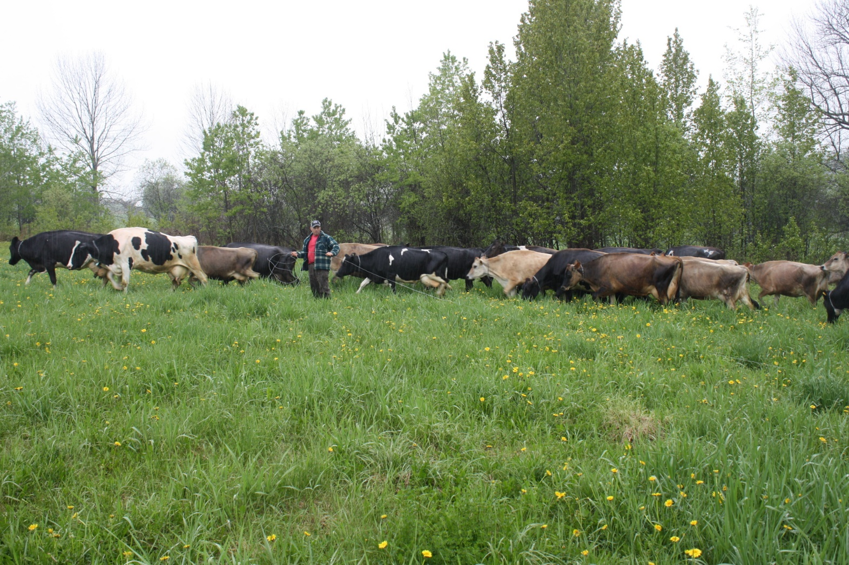
Dr. Kathy Soder
Animal Scientist
USDA- ARS, University Park, PA
Kathy.Soder@ars.usda.gov
Phone: 814-865-3158

