Slide 1
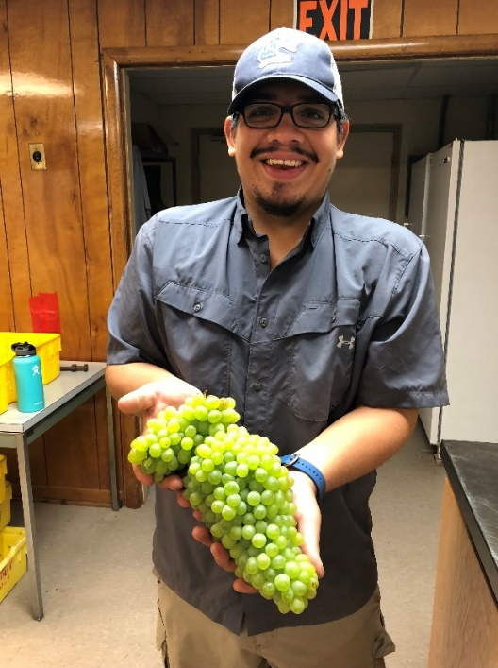
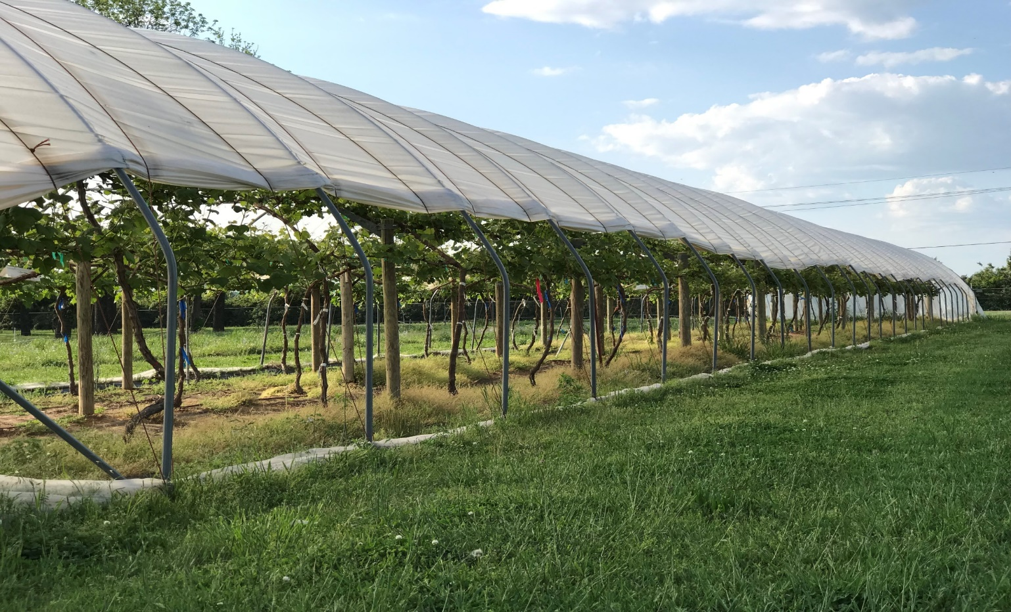
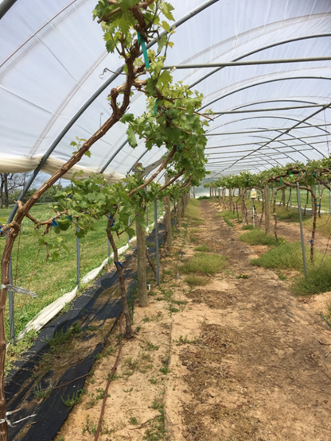
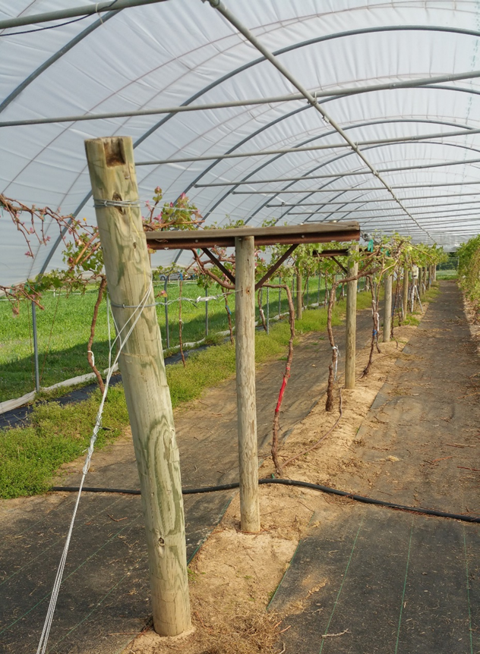
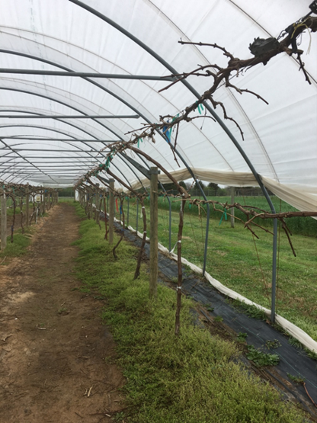
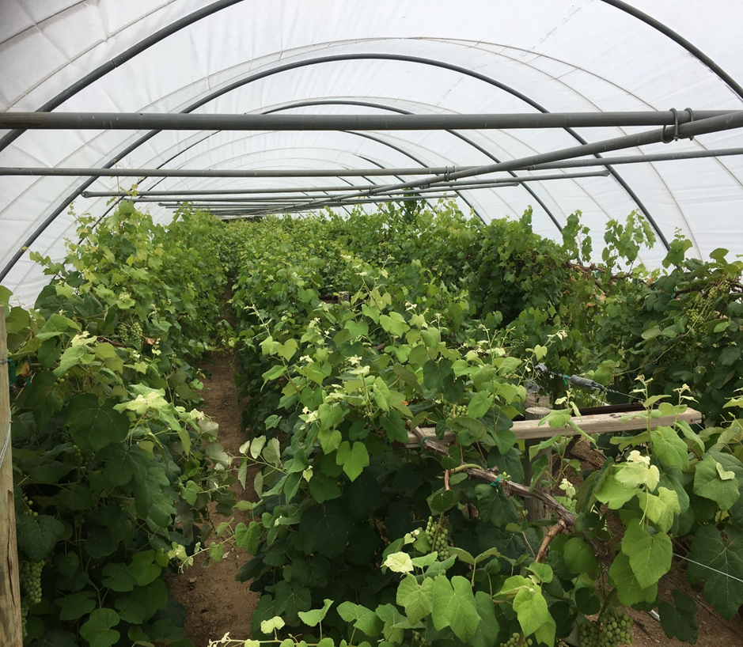
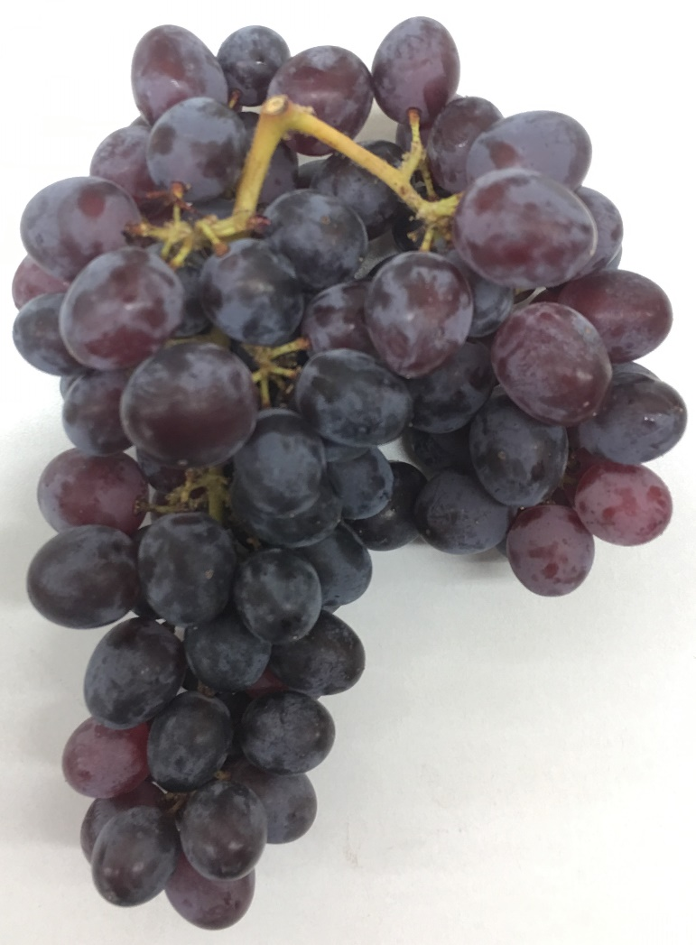
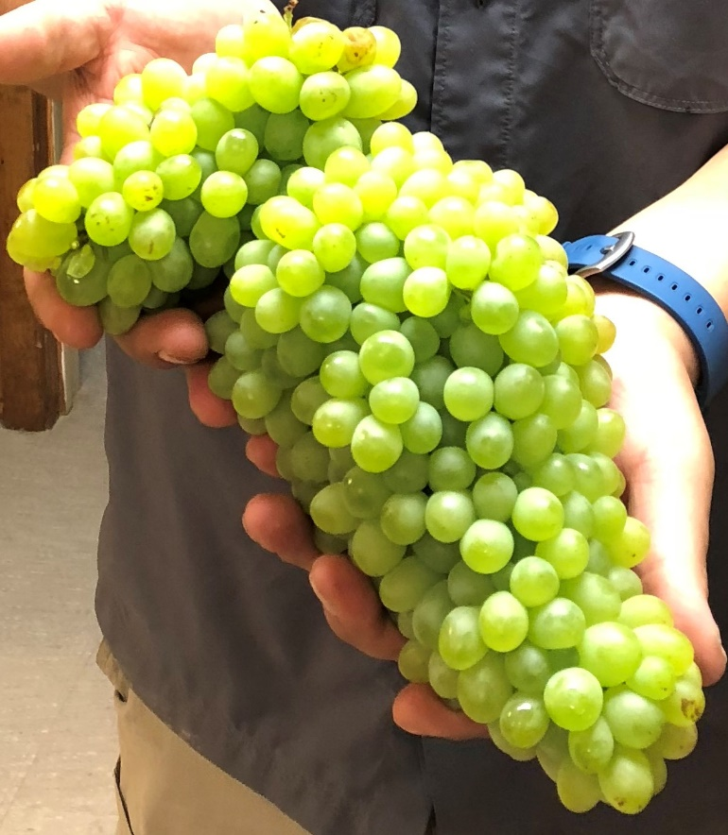
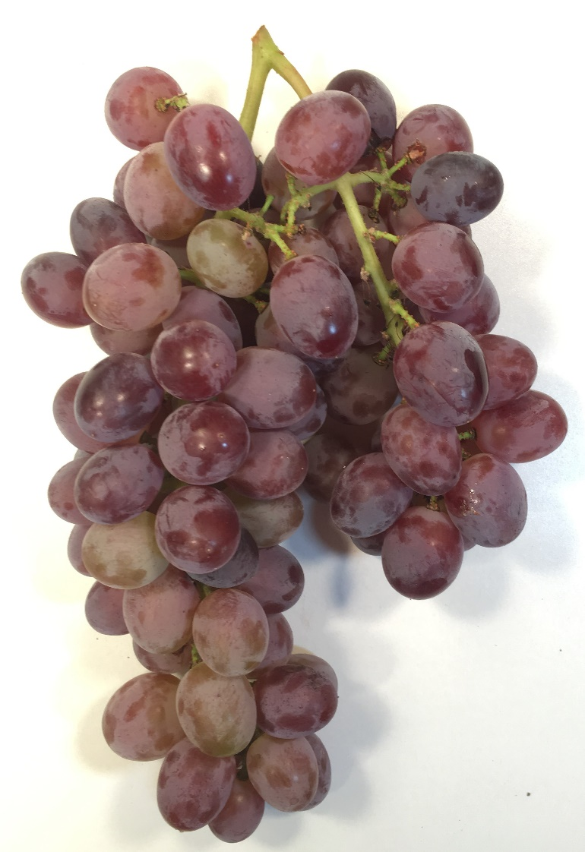
Cluster Thinning Effects on Table Grape Cultivars Grown on Three Trellises Systems Under High Tunnel
Jose Hernandez¹, Virginia Beasley¹, Karlee Pruitt¹, and Dr. Elena Garcia¹
¹Department of Horticulture, University of Arkansas Fayetteville
Introduction
Materials and Methods
Table 2. Yield and cluster number, weight, and length of three table grape cultivars grown under high tunnels at Fayetteville, AR in 2018.
Cultivar | Total yield (kg) | No. clusters per vine | Cluster weight (g)^{z} | Cluster length (cm)^{z}
Faith | 10.97b^{y} | 59.69b | 229.39b | 17.17a
Gratitude | 9.88b | 29.44c | 523.24a | 16.76a
Jupiter | 21.82a | 89.67a | 274.96b | 15.70a
Trellis system
MDHCE | 18.69a | 74.06a | 328.56a | 16.51a
GDC | 14.84a | 36.81b | 382.01a | 16.19a
MDHCW | 9.15b | 67.94a | 317.01a | 16.94a
^{z}Average of five clusters. ^{y}Means with different letter(s) for each column are significantly different (p<0.05) using Tukey's Honest Significant Difference.
Previous research at University of Arkansas (UA) has demonstrated that table grape production under high tunnels (HT) is a viable option to overcome biotic and abiotic factors that challenge production in Arkansas and the Southern region of the U.S. The hot and humid climate accompanied by high pest pressures in the region make table grape productions uneconomical requiring high pesticide inputs. High tunnels (HT) allow for moderate environmental control (i.e. frost and rain) as well as decreasing the amount of pesticide inputs required for pest management compared to field conditions. In 2014, a study was initiated to determine the feasibility and sustainability of table grape production under HT’s: The vineyard has performed exceptionally well (precocity, higher yield, improved fruit quality, and lower pesticide applications). However, during the 2017 season, despite dormant season pruning, excessive yields over 48 kg/vine were observed. This resulted in delayed ripening, reduced fruit quality, and a higher disease incidence.
Three seedless hybrid table grapes (Vitis spp.) cultivars Faith, Gratitude and Jupiter) released by the UA Fruit Breeding Program were planted in 2014 under a HT (Haygrove Super Solo - 200’ x 25’) at UA Agriculture and Research Center, Fayetteville. There three trellis systems were established within the tunnel: Modified Double High Cordon East (MDHCE) located on the east side of the tunnel; Geneva Double Curtain (GDC) located in the center of the tunnel; and Modified Double High Cordon West (MDHCW) located on the west side of the tunnel. These systems were designed to accommodate the shape of the tunnel. The experimental design is a complete block with six vines per cultivar per trellis system
Dormant pruning was conducted using a balanced pruning formula (30+10), and was applied to all vines equally. This was done while considering shoot positioning (Schaller, C.C et al., 1989).
Two cluster thinning treatments were implemented: Control (no clusters were removed) and cluster thinning (berries at pea-size). The amount of cluster thinning done was based on shoot length (White, M., 2012). However, this technique was modified to fit with our industry standards. Shoots eight inches or below had all clusters removed; shoots eight to 20 inches kept one cluster; shoots 20 inches or longer kept two clusters (citations).
Vine canopy management was conducted on a weekly basis and included: leaf thinning, shoot combing and trimming. Irrigation was performed twice per week during the growing season.
Pest management included monitoring traps and pesticide applications.
Data collection was conducted to determine vine performance and included: total yield per vine, berry weigh, and total number of clusters, weight and length.
Statistical Analysis:
Data was analyzed using JMP® (version 14.0 Pro; SAS Institute) with Tukey Honest Significant Difference for mean separation.
Results
Pruning:
Pruning weights did not significantly differ among cultivars, but trellis system did have a significant effect. The MDHCE trellis had significantly higher pruning weights than the other two training systems (GDC and MDCHW), which were not significantly different from each other (Table 1).
Thinning:
There were no significant differences by cultivar or trellis systems in the number of clusters thinned off the vines (Table 1).
Yield Performance:
‘Jupiter’ table grape cultivar had significantly higher total yield than both ‘Faith’ and ‘Gratitude’. ‘Faith’ and ‘Gratitude’ were not significantly different from each other (Table 2).
‘Jupiter’ had significantly higher number of clusters per vine at the time of harvest, ‘Faith’ had significantly higher clusters per vine than ‘Gratitude’ (Table 2).
Cultivar had an effect on cluster weight. ‘Gratitude’ had significantly higher average cluster weight than ‘Faith’ and ‘Jupiter’ which were not significantly different from each other (Table 2).
Total yield weight was not significantly different between MDHCE and GDC trellis systems but they both were significantly higher than the MDHCW (Table 2).
The MDCHE and MDHCW trellises had significantly higher number of clusters per vine than the GDC trellis (Table 2).
Objectives
One of the objectives of this study is to determine if the application of cluster thinning (amount and timing) results in a balanced crop load of the vines.
Fig. 1. Haygrove Super Solo High Tunnel located at University of Arkansas Agriculture and Research Center in Fayetteville, AR
A
B
Table 1. Pruning weights and buds left on vine based on balanced pruning formula of three table grape cultivars grown under high tunnels at Fayetteville, AR in 2018
Cultivar | Pruning weight (lb)^{z} | No. of buds left on vine after pruning^{z}
Faith | 3.87a | 62.83a
Gratitude | 4.03a | 60.06a
Jupiter | 4.29a | 58.67a
Trellis system
MDHCE | 4.72a | 67.17a
GDC | 3.98b | 59.78b
MDHCW | 3.48b | 54.61b
^{z}Means with different letter(s) for each attribute are significantly different (p<0.05) using Tukey's Honest Significant Difference.
Conclusion
C
‘Jupiter’ performed best under the high tunnel environment having the highest total yield per vine and the highest number of clusters per vine.
MDHCE supports more growth of the vines than the other trellis systems, this can be caused to several other environmental factors such as light effects.
Based on the data collected, the research showed that high tunnels are a great technologies for increasing table grape production efficiency, and improving fruit quality for the southern US regions. Cultivars used in the study showed optimal vine performance when cultivated under high tunnels, with adequate total yield per vine.
D
A
B
C
References
Fig. 2. Trellis systems in HT. MDHCW trellis located on the west side of the tunnel (A), GDC trellis located in the center of the tunnel (B), MDHCE trellis located on the east side of the tunnel (C), and an overview of the tunnel showcasing all three trellis systems (D).
Fig. 2. Pictures (Left to Right) showing clusters of different cultivars: Faith (A), Gratitude (B), and Jupiter (C),
Schaller, C.C., Morris, J., Moore, J. 1989. Grape Training and Pruning.
White, M.L. 2012. Canopy Management Concepts.
"This material is based upon work that is supported by the National Institute of Food and Agriculture, U.S. Department of Agriculture, under award number 2016-3864025382 through the Southern Sustainable Agriculture Research and Education program, under subaward number RD309-137/S001415. USDA is an equal opportunity employer and service provider. Any opinions, findings, conclusions, or recommendations expressed in this publication are those of the author(s) and do not necessarily reflect the view of the U.S. Department of Agriculture."

