Slide 1
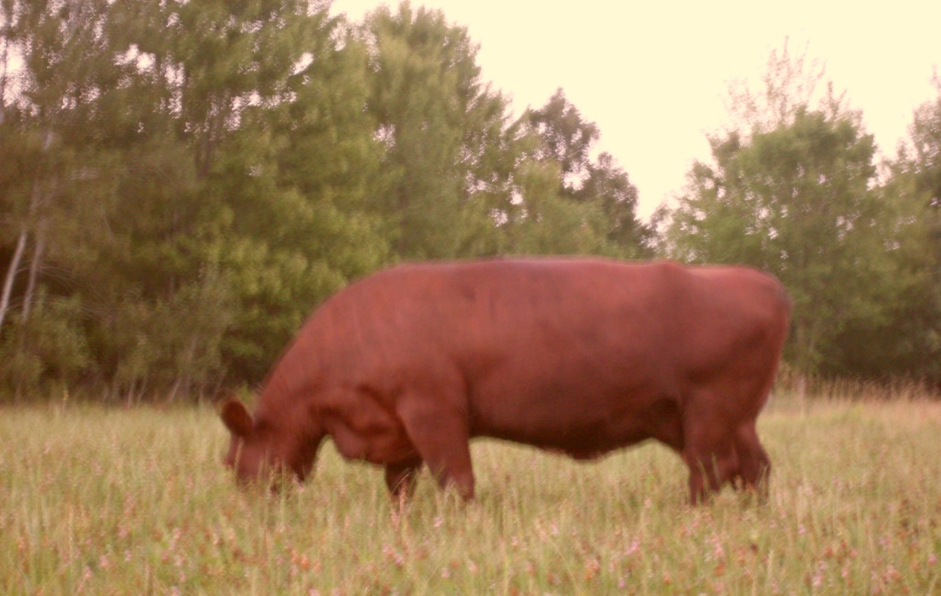
Sample Beef farm

Slide 2
Grazing Plan Components
Owner Data - goals
Land Data
Pasture info
Animal Data
Operation Data

Slide 3
Owner Data
Man hours available
Income Expectations
Type of owner
Family farm, LLC, Inc., minority,
“Vision” or goal for operation – examples:
Socially Responsible
Environmentally focused
Community oriented

Slide 4
Owner Info
Man hours
Owners have limited time 1 hour per day
Income Expectations/goals
For paying taxes and maintenance of farm and buildings
Type of Owner
Family Farm
Vision
Still working on a vision statement

Slide 5
Land Data
Zoning
Deed
Other land use restrictions
Soils
Contours
Utilities
Sensitive areas
Out-wintering or heavy use areas with pollution potential

Slide 6
Land Data
Zoning
Wetland
Shoreland Zoning
Flood Plain Zoning
Land Use – Ag, Residential, Commercial

Slide 7
Land Data
Deed
Easements
Setbacks
Right of Ways
Other land use restrictions
MFL program
Current NRCS/FSA programs

Slide 8
Current lay out

Slide 9
Zoning Maps

Slide 10
Land Data
Soils
Type with production information
Clay /Loam / Sand
Depth to ground water
AU/Ac-Day

Slide 11
Soils

Slide 12
Soils
25.8 acres
Soil Types AUD Ton/Ac
NoB Norgo Silt Loam 80 3.0
Vs Vesper Silt 80 3.5
KeA Kert Silt 130 3.5
Soil is clay silt , poorly drained, with areas of high groundwater.
Spring runs year-round – even in a drought year!

Slide 13
Land Data – contours

Slide 14
Land Data
Utilities -Location
Electrical
Telephone
Gas
Water
Propane
Barns & outbuildings
Home

Slide 15
Operation Data
Current Resources
Buildings
Equipment
Implements
Animals

Slide 16
Animal Data
Types/Breed
Number or ratio of types
Suitable grasses for each type
Comingled

Slide 17
Operation Data
Product
Cow/calf
Stockers
Horse
Sheep/swine
Poultry
Product type
Grass fed?
Organic?

Slide 18
Operation Info
Cow/calf to finish
Organic grass fed
Resources Available
Old dairy barn with pens and headlocks
Tractors, haybine, baler, wagon, brush hog
Great neighbors

Slide 19
Stocking
Carrying capacity
25.8 ac X 3 ton/year/ac X 2000 lb/t = 13 AU
1000 AU X 0.04 lb/lb X 365 X 0.8
Cow = 1600 lb, Heifer/Steer = 1000 lb, Calves= 500 lb
Land can carry 4 sets of cow/heifer/calf.
Yield is 2 steers , 1 replacement heifer, one cull cow, and one heifer for sale.

Slide 20
Income
Income
Cull cow – 1600 lb X 0.80 = $1280
2 Steers 1200 lb X 1.50 =$3600
1 heifer 1000 lb = $1800
Total $6680

Slide 21
Fence and water line layout

Slide 22
Why we graze
None economic reasons
Family bonding activities
Healthy food for ourselves
Recreation
Enjoy the family pictures

Slide 23
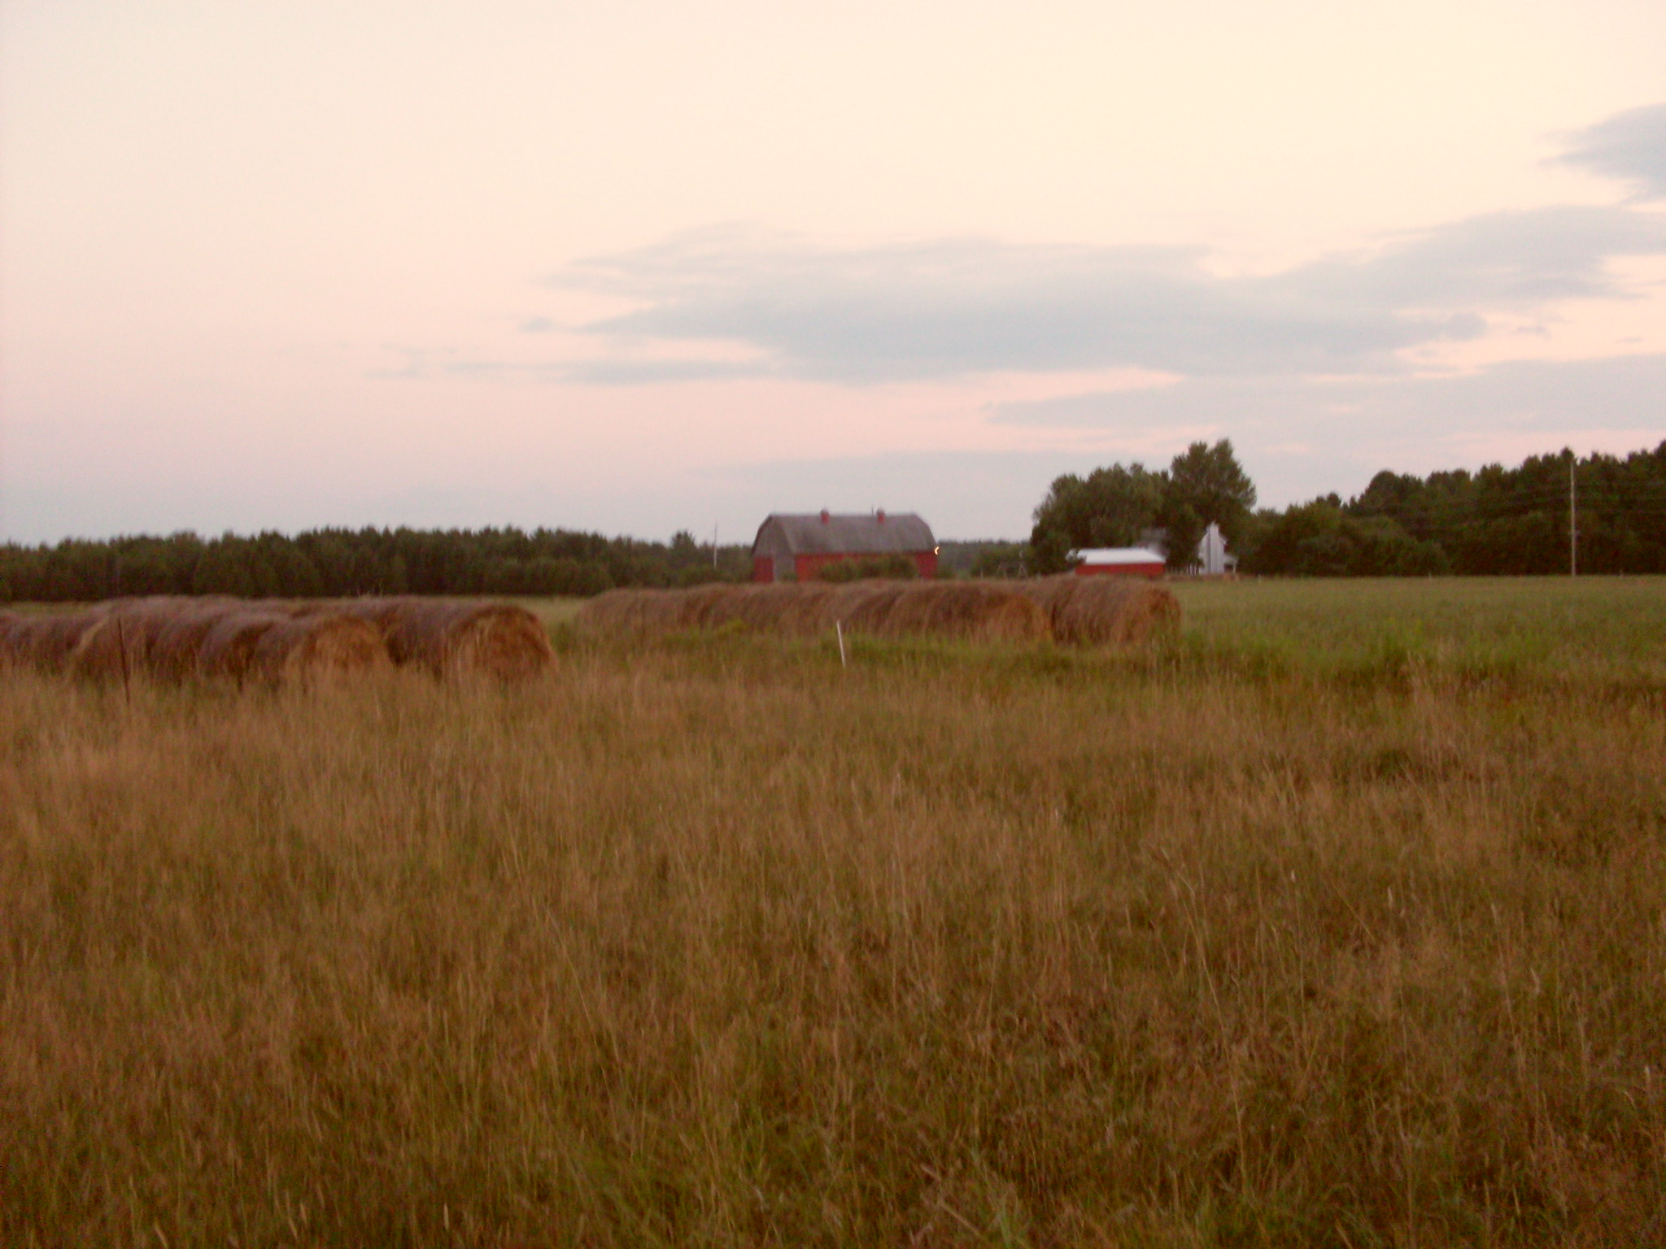

Slide 24
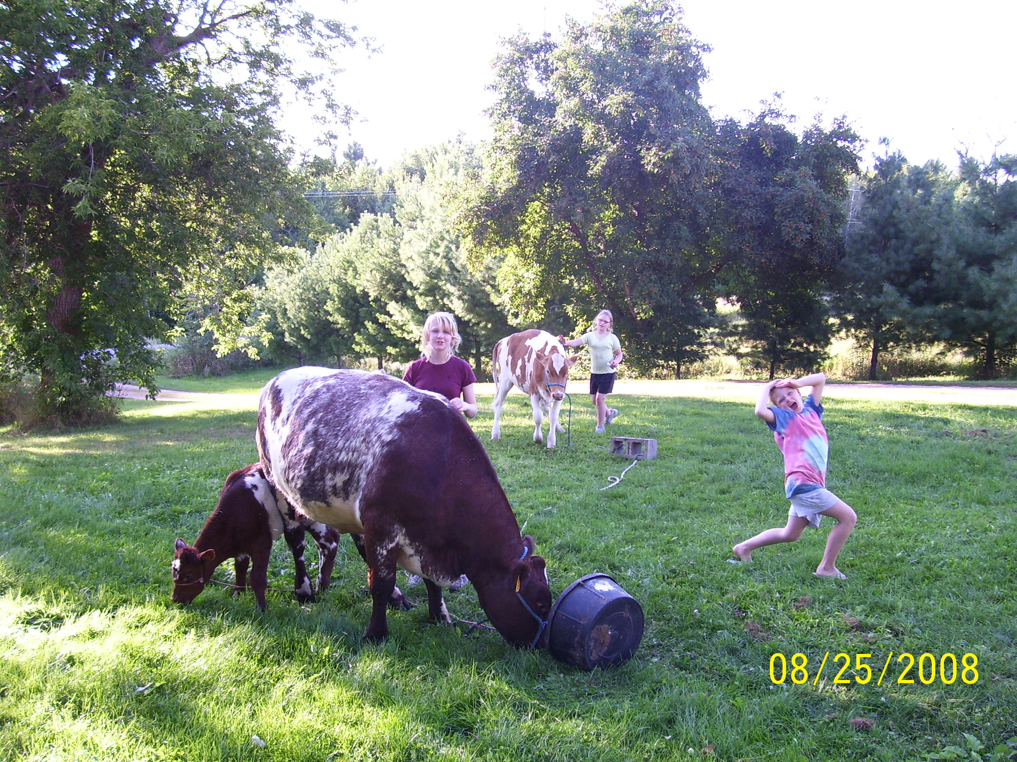

Slide 25
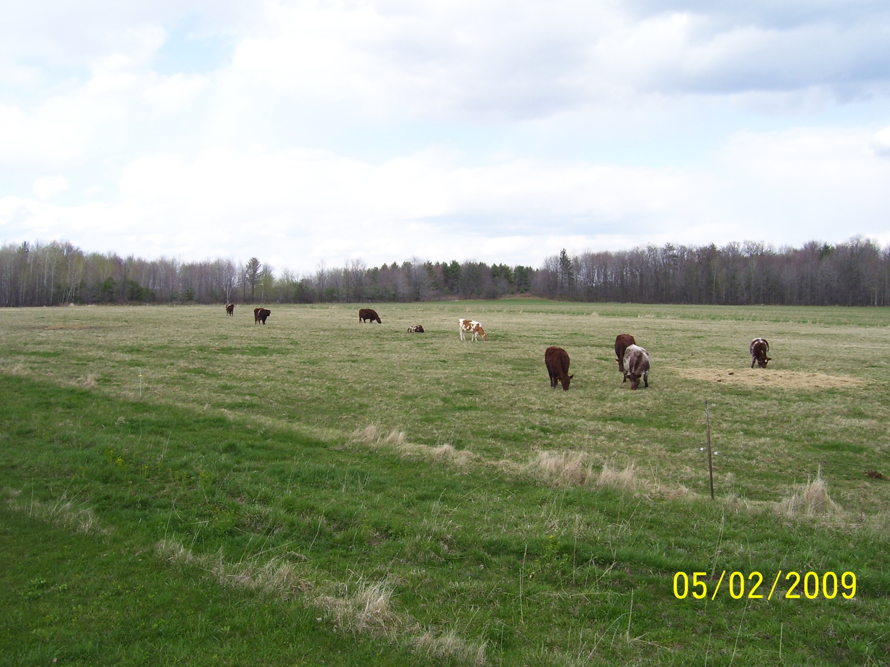

Slide 26
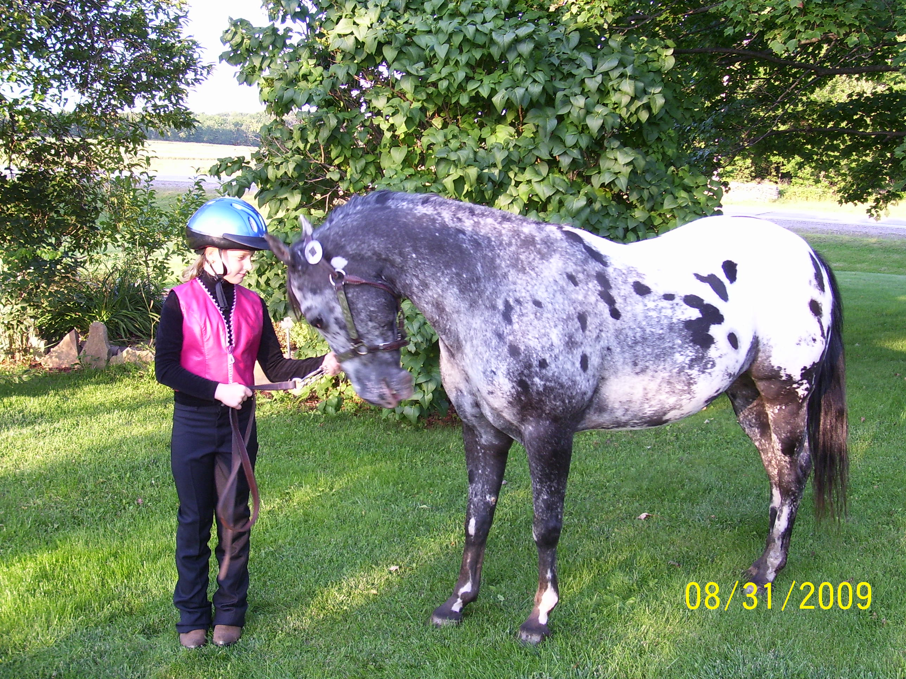

Slide 27
